Slide 1
Adiabatic Efficiency Summary

Slide 2
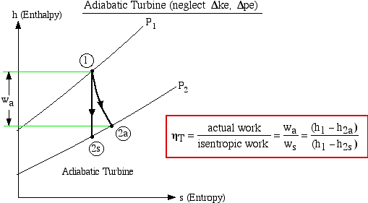

Slide 3
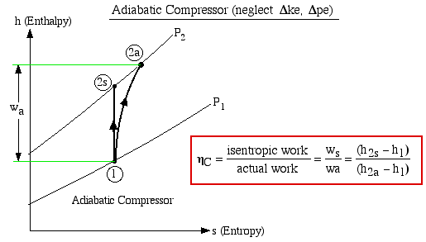

Slide 4
