Slide 1


Cogeneration and trigeneration:
prof. Mauro REINI
docente di sistemi per l’energia e l’ambiente
Università di Trieste – Polo di Pordenone

Slide 2
Introduction and basic technologies:
prof. Mauro REINI
docente di sistemi per l’energia e l’ambiente
Università di Trieste – Polo di Pordenone

Slide 3
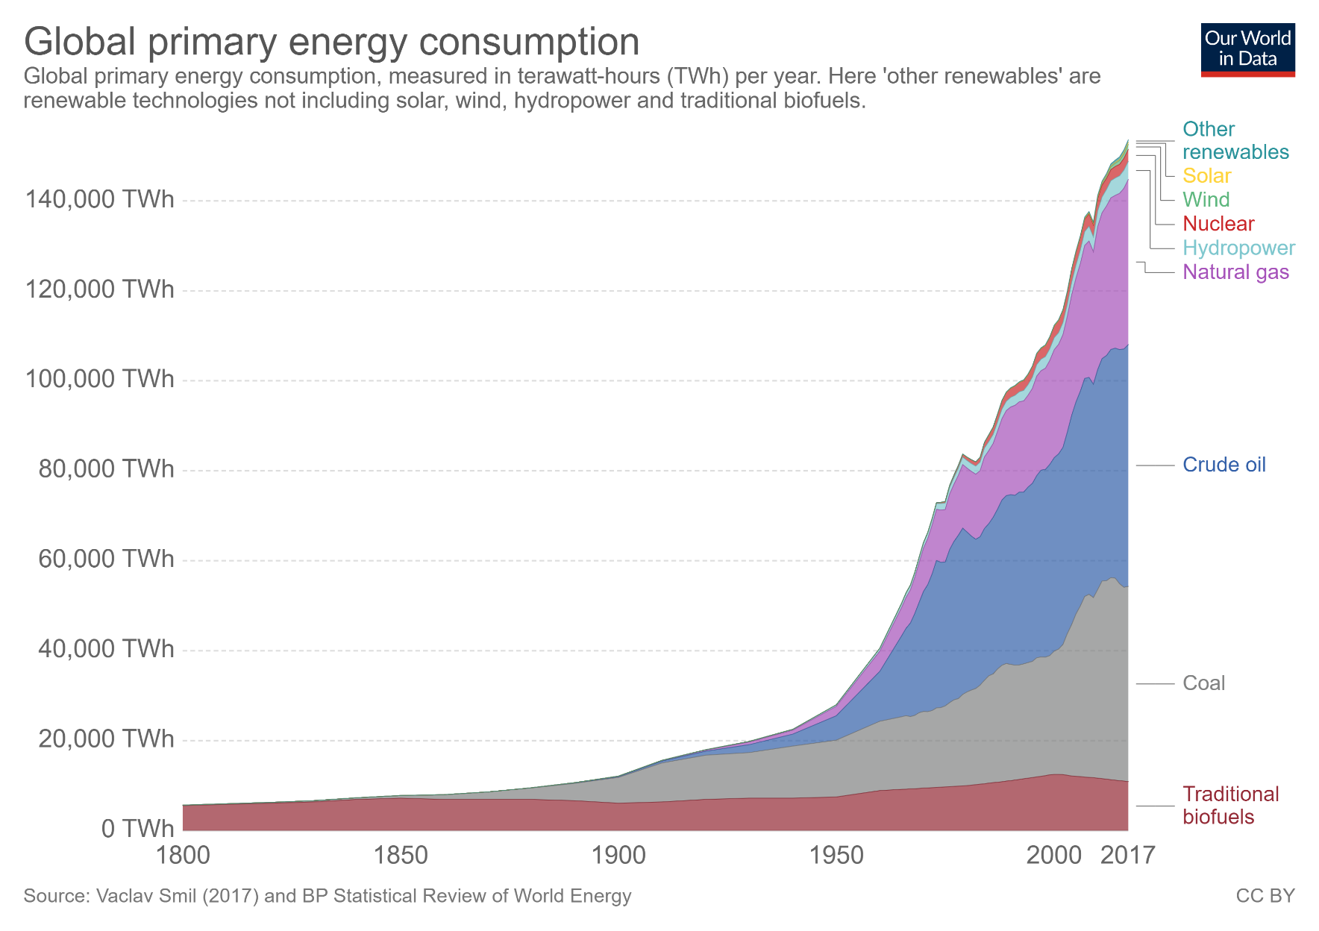
Breakdown of primary energy worldwide

Slide 4
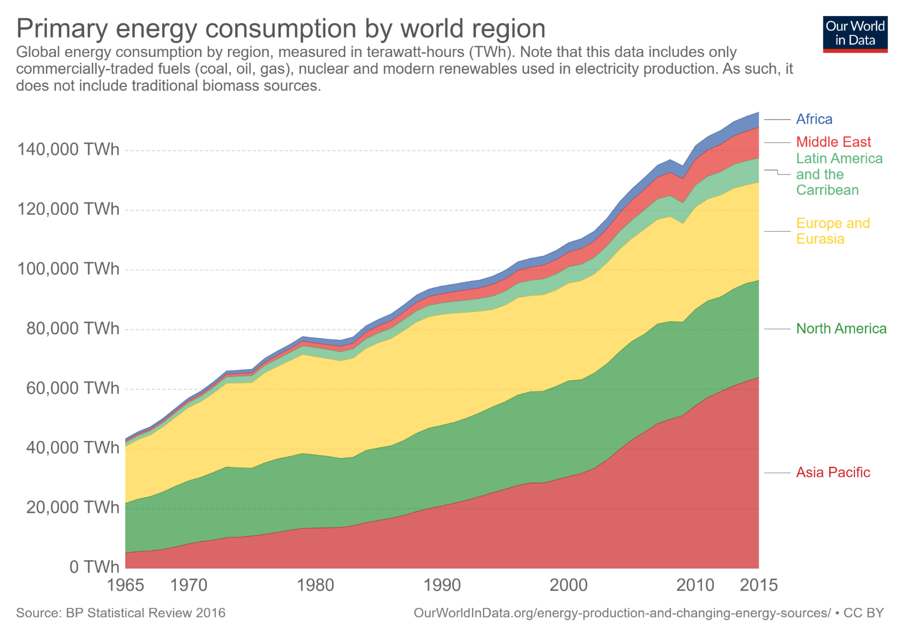
Breakdown of primary energy worldwide –By world region.

Slide 5
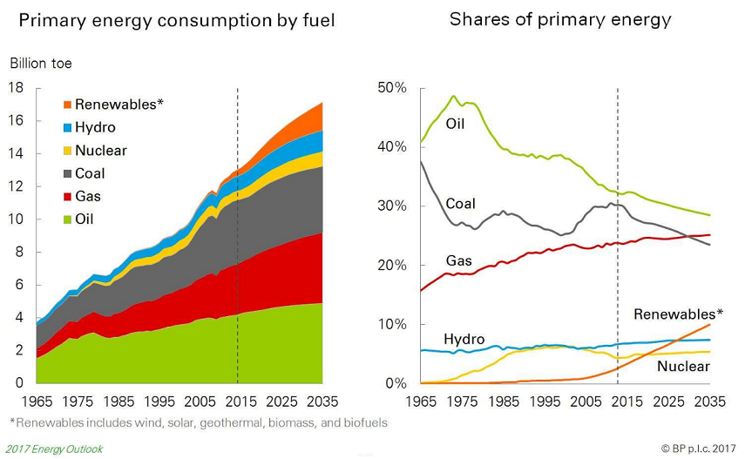
Projection of the mix of primary sources

Slide 6
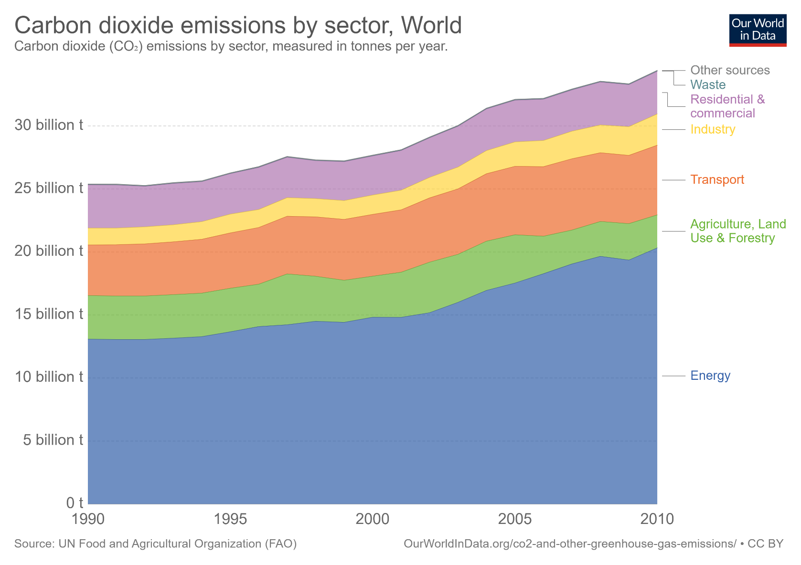
Primary energy - Co2 emissions in world by sector.

Slide 7
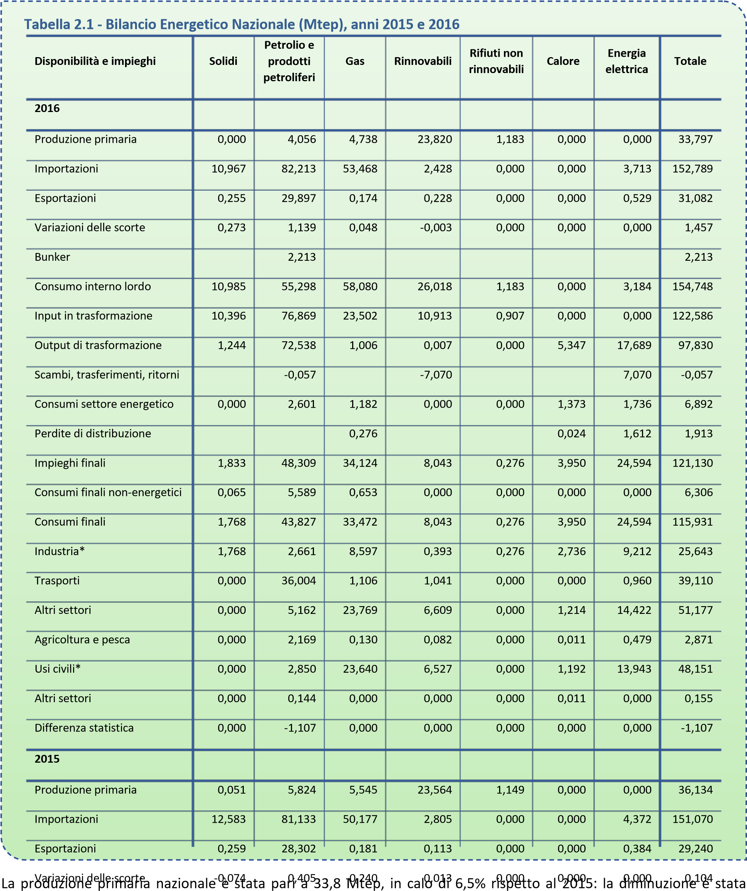
National Energy Balance –Italy 2015/2016

Slide 8
Primary energy consumpion by sectors at national level Italy(2016)

Slide 9


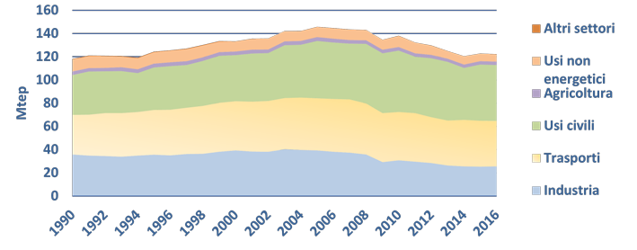
Primary energy employments consumption by sectors at national level Italy(2016)
Figura 2
.
5
–
Impieghi finali di energia per settore (Mtep), anni
1990
-
2016
Fonte: EUROSTAT
How can energy consumption be reduced?
General strategies,
Specific technologies.

Slide 10
Basic Background
I Principle
the energy CANNOT be created or destroyed
(what is the "ENERGY PROBLEM"?)
II Principle
MECHANIC ENERGY HEAT TO (USEFUL)T
(ELECTRIC ENERGY)
LOW T ° HEAT (useful?
Ex = 1-
An =

Slide 11
The energy conversion chain
II° Principle in PHYSICAL processes:
Mechanical energy (electrical, chemical ...) tends to deteriorate and "run out";
Each conversion process produces low T heat;
The heat is more easily available the lower its T (close toT°).
ENERGY SOURCE
ENERGY USEFUL
LOW TEMPERATURE HEAT

Slide 12
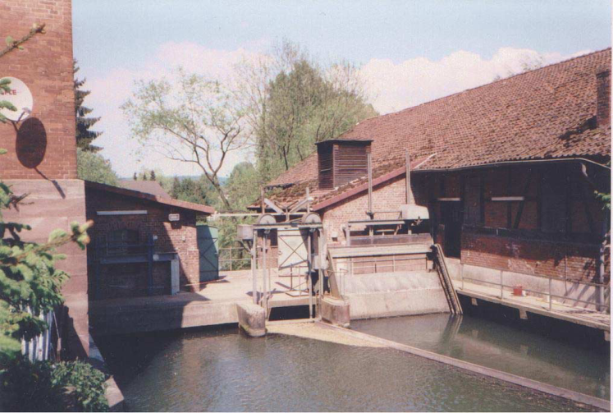
General strategies / 1
It is possible to use renewable energies that are already in "valuable" (mechanical) form:
WAVE AND TIDAL ENERGY
WIND
HYDRAULIC

Slide 13
General strategies / 2
Solar radiation is also "valuable" energy
BUT conversion yields are low!
Forward steps are expected for the innovative PV (cooled, tandem, intermediate band gap ,,,)
Concentration collectors + STIRLIG thermodynamic cycles, or Rankine (ORC).

Slide 14
General strategies/ 3: Contain heat production
Taking into account the losses in transport(5-10%) and in distribution, even a device with80% electrical efficiency has dissipatedin heat over70% of the primary energy needed to power it!

Slide 15
General strategies/ 4: combined production(CHP)
There is a response to the low yields of energy production systems:
Taking advantage of low T heat that you can NOT avoid producing COGENERATION
This is possible if:
The heat produced is that actually required Thermal production takes place NEAR the user
Therefore many small plants, adapted to the available resources and to the local thermal demand: Distributed Generation (GD).

Slide 16
Cogeneration of heat and power
Internal combustion engine
1.Electric generator
2.Air intake
3.Fuel injection
4.Motor fluid heat recovery
5.Catalyst
6.Exhaust gas thermal recovery
7.Exhaust gas exhaust
8.Exhaust air-gas mixing

Slide 17
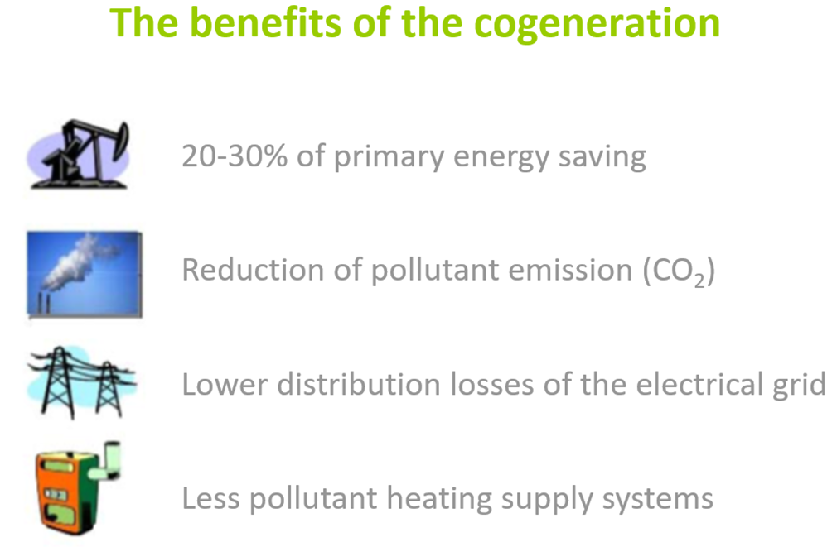
Advantages of cogeneration

Slide 18
Combined and separate energy production
IRE =0,30

Slide 19
Primary energy saving index (PES)
Definitions:
Directive 2004/8 / EC, implemented by Legislative Decree 20/07, established that, starting from 2011, the condition for which the combined production of electricity and heat can obtain the qualification of "high efficiency cogeneration" is based on PES parameter, acronym for Primary Energy Saving or Primary Energy Saving. The PES actually expresses the relative saving of primary energy achievable by a cogeneration plant compared to separate plants for the production of thermal energy and electricity and, therefore, it can be calculated as indicated below.

Slide 20

PES calculation
Firstly, from the point of view of primary energy savings in the
cogeneration plant, one can write
where, on an annual basis, Ec = mcHi is the primary energy introduced in the form of commercial fuels.
Et and Ee are, respectively, the thermal energy and the electricity produced. Consequently Et / ηt and Ee / ηe, with ηt thermal efficiency of a conventional heat generator and ηe conversion efficiency of a conventional direct cycle, can be interpreted as primary energies introduced in conventional plants for the separate production of heat and work. we arrive at the definition sought

Slide 21

PES calculation
that is to the dimensionless expression of primary
energy savings achieved with the cogeneration plant compared to separate conventional plants.
A separate problem is the evaluation of the yield values ​​ηt and ηe to be used in the formula.
In this regard, Directive 2004/8 / EC establishes to refer to the state of the technological art taking into account the type of fuel used and the prevailing climatic conditions in the locations where the plants are built.
Once the PES has been calculated, the conditions set by Directive 2004/8 / EC to obtain the qualification of "high-efficiency cogeneration" (and enjoy the incentives and benefits described below) are simple to determine:
• PES ≥ 0 for electrical powers less than 1 MW, e
• PES ≥ 0.1 for electrical powers greater than or equal to 1 MW.
PES

Slide 22
Energy and environmental benefits
- 45%
- 30%

Slide 23
Cogeneration and GD
(Distributed Generation)
The GD includes a wide range of applications but all have two main features in common:
-the electricity produced is fed into the medium or low voltage network;
-electricity is generated in the vicinity of the user.
The two most important types of GD concern:
1. The production of electricity from renewable sources (wind, solar, biomass, geothermal, ...);
2. The combined production of electricity and heat from fossil fuels (almost exclusively natural gas) in medium-small sized engines (micro-cogeneration).

Slide 24
Additional benefits of GD
increase in the efficiency of use of primary sources and consequent environmental advantages (total returns of 70 ÷ 90%);
reduction of electricity flows on the transport and distribution networks (network losses are around 7% in Italy and the distribution networks work at full load);
improvement of the reliability of the supply in terms of continuity and power quality (protection from interruptions and voltage drops);
increased stability for congested networks;
greater security in relation to "crash" of the control panel.

Slide 25
Critical parameters for the convenience of distributed microcogeneration
the demand for electricity and heat from the user (in terms of quantity and timing of withdrawals);
the cost of different energy carriers and taxes, which can vary greatly depending on the types of users, even for the same quantity;
the characteristics of the cogeneration machine (type, size, use).

Slide 26
Contraindications of distributed microcogeneration
higher installation and management costs than the conventional solution;
strong dependence on natural gas (except in the case of solutions based on renewables);
higher local emissions and more difficult to control than the centralized solution;
introduction of constraints on the end user's heat and electricity consumption (dissipation / disposal);
noise of some solutions.

Slide 27
Technologies for cogeneration
Alternative engines internal combustion
Stirling Gas microturbines
Rankine cycle groups
Fuel Cells (FC)
Gas and steam turbines
Combined cycles
ORC
, ORC

Slide 28
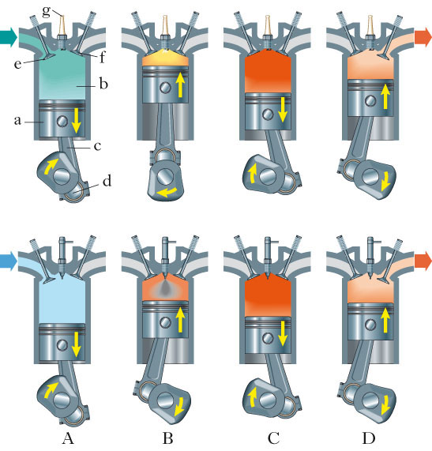
Internal combustion engine (ICE): phases of the Otto and Diesel cycles
Otto engine
(spark ignition)
Main phases:
Intake
Compression
Power
Exhaust
Diesel engine
(compression ignition)

Slide 29
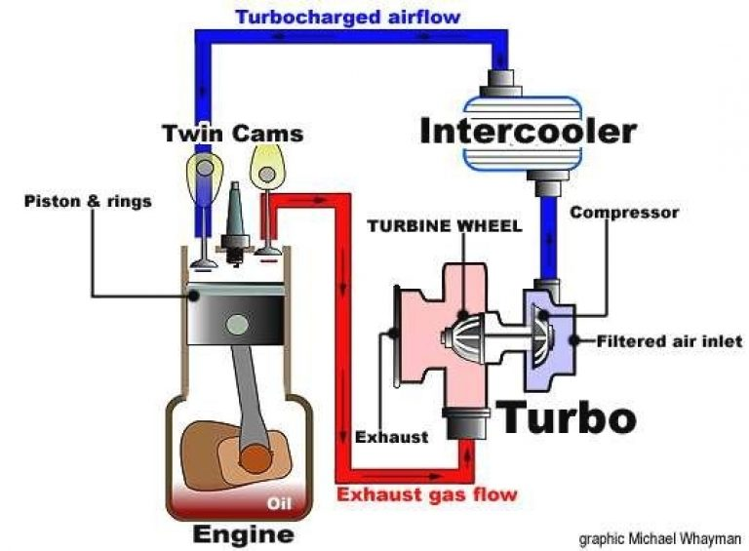
ICE: supercharging withTurbo-intercooler
Possible heat recover

Slide 30
Heat recovery sources ICE
Possible heat recovery from internal combustion engines

Slide 31
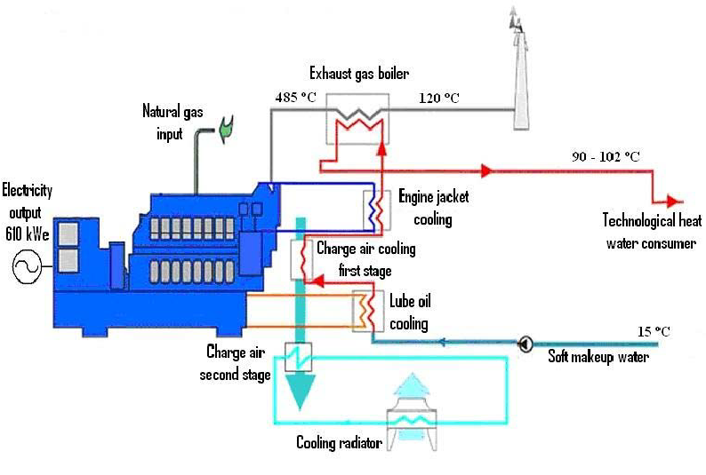
Heat recovery circuit (ICE)

Slide 32
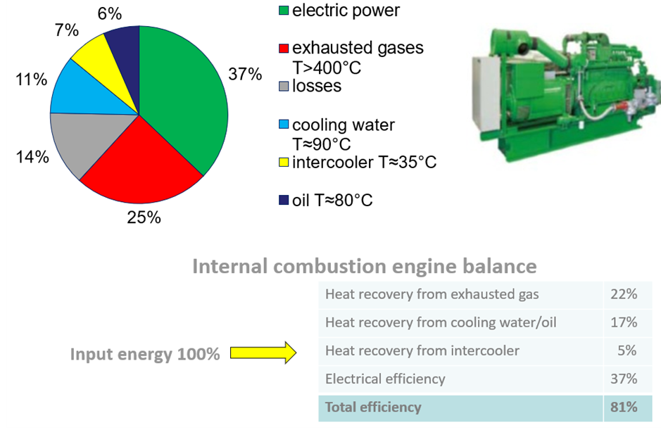
Enerby balance of ICE (1MWe)

Slide 33
Effect of the required temperature on the thermal efficiency

Slide 34
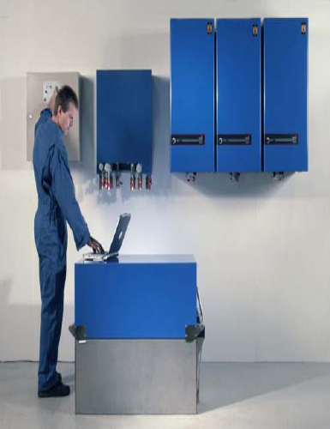
Very small (ICE)
Internal combustion micro-engines
EC Power
9kWe –17kWt
ecopower
4.7kWe;12.7kWt

Slide 35
Effect of size on electrical efficiency

Slide 36
Advantages and disadvantages of ICE
BENEFITS
-Sizes from1 kWe to about5 MWe;
-Mature technology used in different fields;
-High reliability ;
-Good conversion yields ;
-Limited investment costs ;
-High operational flexibility

Slide 37
Advantages and disadvantages of ICE
DISADVANTAGES
- High maintenance costs;
- Noise and vibrations;
- High emission values (NOx and CO).

Slide 38
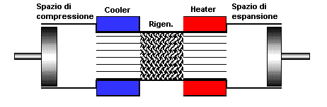
Sterling engines
Reference thermodynamic cycle

Slide 39
Sterling engines
Possible piston configurations in a Stirlig engine:
kinematics
Heat exchange

Slide 40
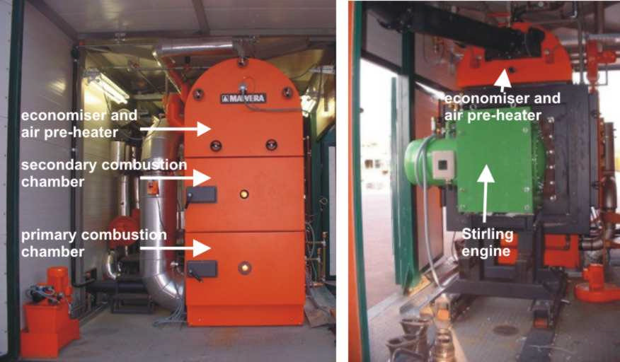
Alternative engines (Stirlig)
STIRLING engines (external combustion) in a boiler

Slide 41
Advantages and disadvantages of Stirlig engines
ADVANTAGES
- Sizes even very small;
- Possibility of using different fuels;
- Simplicity of moving parts;
- High reliability;
- Good conversion yields;
- Reduced noise and vibrations;

Slide 42
Advantages and disadvantages of Stirlig engines
DISADVANTAGES
-Technology very young commercially
-Difficulty of heat exchange with small surfaces
- High unit costs.

Slide 43
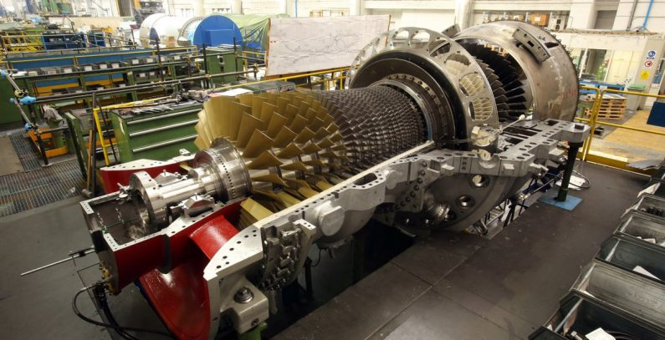
Gas Turbine for CHP

Slide 44
Gas Turbine for CHP

Slide 45
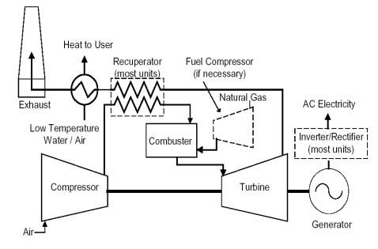
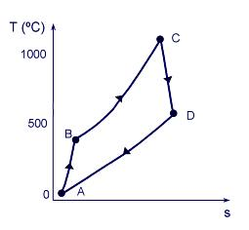
μTurbines a gas
Reference
termodynamic
cycle

Slide 46
μGas turbines- influence of the room temperature
influence of external temperature on machine performances
Efficiency , power and Texhaust

Slide 47
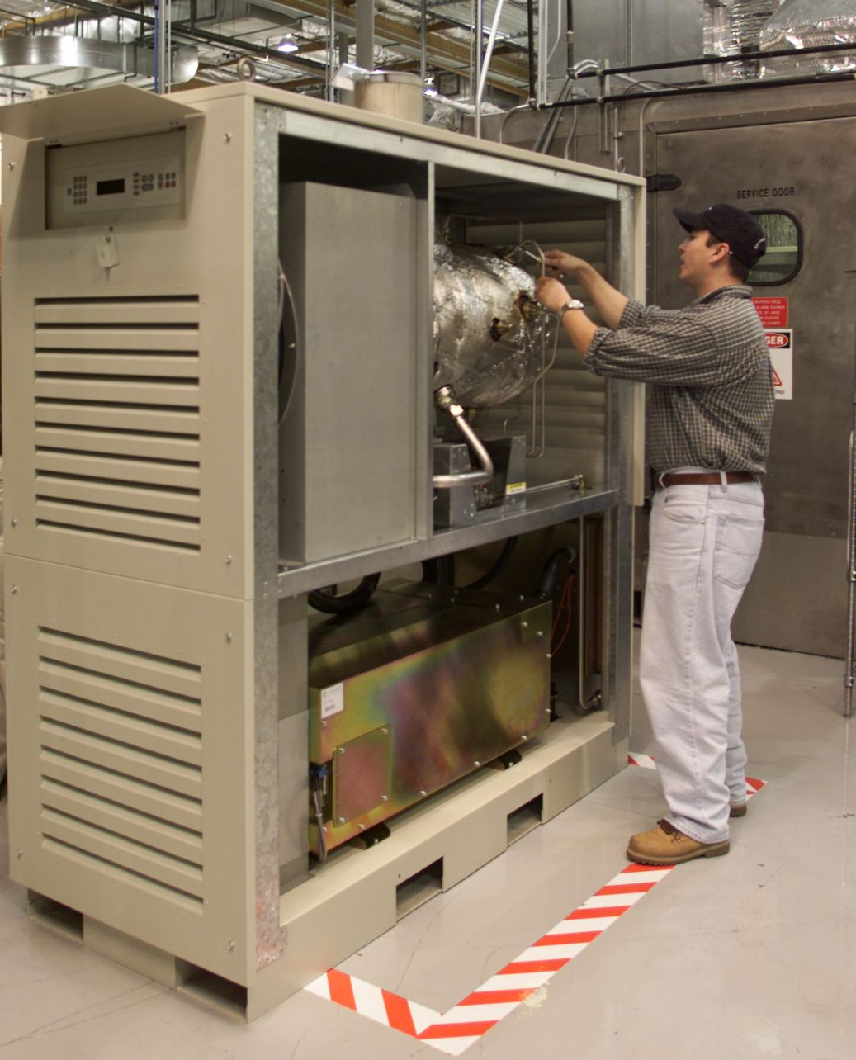
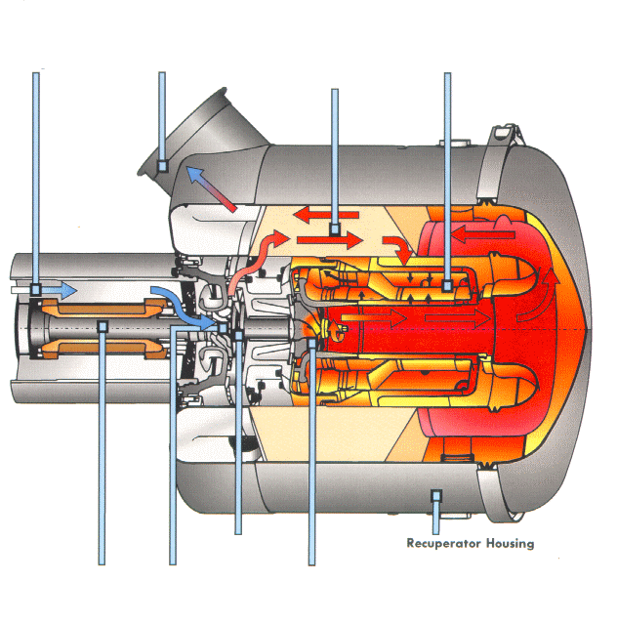


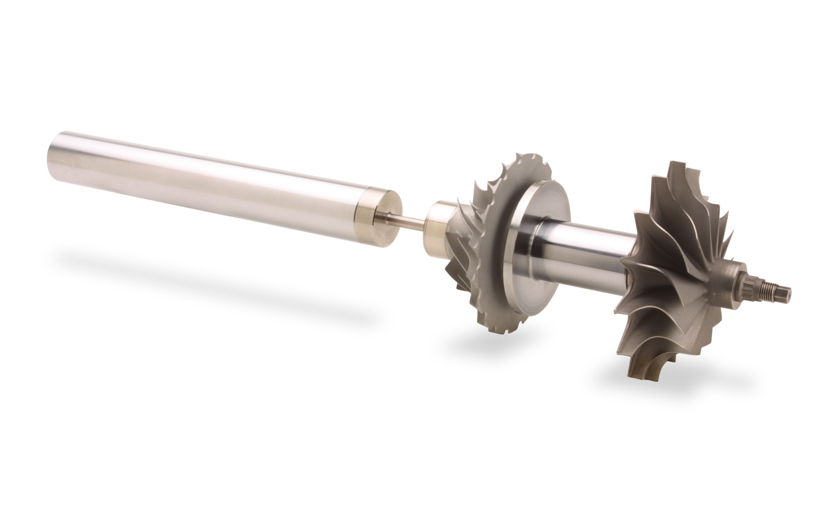
μ Gas turbine
Generator
Cooling Fins
Exhaust
Outlet
Combustion Chamber
Recuperator
Air Bearings
Generator
Compressor
Turbine

Slide 48
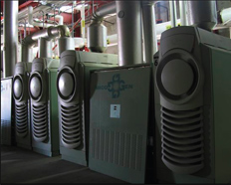
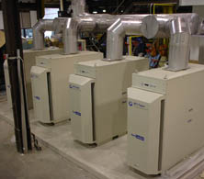
Modular units with gas microturbines

Slide 49
μGAS Turbine
They are not ascale-down of industrial gas turbines but arise froma new design:
- turbine and radial compressors (β = 4); - regeneration cycle with low compression ratio ;
- high variable rotation speed (50,000-20,000rpm);
- uncooled turbines (TIT <950°C).

Slide 50
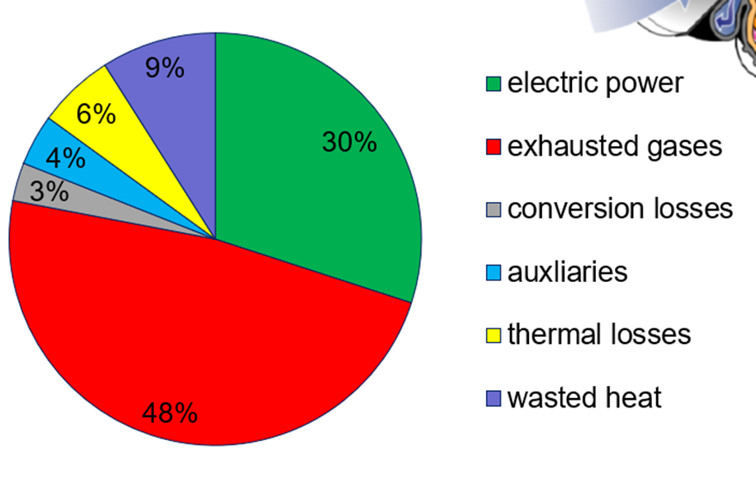
Energy balance of a 100 kWe
μ gas turbine

Slide 51
µGT vs ICE
µGT ADVANTAGES:
- ReducedNOx and CO emissions (<10ppm @ 15% O2);
- Small dimensions and weight;
- Low noise and vibration;
- Reduced maintenance(every 10,000 hours);
-High useful life(80,000 hours);

Slide 52
µGT vs ICE
µGT DISADVANTAGES:
- Relatively recent technology;
- High specific cost (€ 1,100 / kW);
- Lower electrical efficiency;
- Low smoke temperature (250 ° C).

Slide 53
Example of cogeneration for a varnishing area
Conventional situation:
Hot water is produced by boilers
Hot air for the furnace is produced by gas burners
Suggestions:
Hot Water produced by a CHP system and by two exhausted gas/water heat recoveries
Furnace hot air partially produced by the exhausted gas of two CHP systems

Slide 54
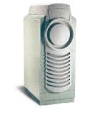
CHP for a paint process area
Hot water (70-80°C)
Exhaust gas/water recovery (50 kWth)
CHP1 250 kWel and
491 kWth
Exhaust gas/water recovery (50 kWth)
Furnace burner 1
250 kW electric power
Furnace burner 2
CHP2 100 kWel
180 kWth
Exhaust gas
Electric power
Hot water
  CHP3 100 kWel
  180 kWth
100 kW electric power
100 kW electric power

Slide 55
CHP for a paint process area - Ovens -
  Suggestions
  Conventional situation
Electric power 100 kW
Hot Air T=90°C ~2.600 kg/h
Hot water (80-90°C) for paint process process
Gas
Air
CHP
Gas
Air
Pre-Heater
Hot air T=270°C ~2.800 kg/h
Heat recovery
Exhaust gas
T=100-150°C
Exhaust gas T=100-150°C
Heat
gen.
Gas
Heat
gen.

Slide 56
Choosing a CHP plant
Installing a CHP system requires several evaluations:
A preliminary feasibility analysis in order to define the technical and economical conditions that make the investment profitable
First step:
Collecting the energy consumptions
Knowing the economic data of the actual energy supply system
Energy evaluation:
Select a CHP solution and evaluate the energy flows in the future situation
Apply the correct economic evaluation to all new/avoided flows
Preliminary investment feasibility:
Evaluate annual economic saving and total investment cost

Slide 57
Example of choosing a CHP plant
The choice of a CHP plant has to determine:
technology of the plant
  Gas Turbine, because the heat is needed as Hot Air
plant size
  Determined by the Hot Air mass flow rate, in nominal condition
operating and controlling strategies
  According to the operation of the Heat Generator
legal and feed-in tariff aspects
  Purchasing condition of the natural gas for CHP, self-consumption of the power
Electric power 100 kW
Hot water (80-90°C) for varnishing process
Gas
Air
CHP
Exhaust gas T=100-150°C
Hot air T=270°C ~2.800 kg/h
Heat recovery
Gas
Heat
gen.

Slide 58
Choosing a CHP plant
In order to achieve the goal it may be helpful to:
Develop a technical and economical model of the system
Simulate and optimize the model, or compare different CHP solutions, plant size and operation strategies.
Average costs of cogenerated electrical energy strongly depend on boundary conditions (hours of operation per year, cost of fuel, public incentives for renewable fuels, maintenance cost, required temperature of the thermal vector, actual utilization of the heat,…)
PBP faster than 3 years have to be regarded as very attractive!
About 6 years is a common situation
Innovative technologies may imply PBP even longer (up to 9)

Slide 59
Cogeneration and trigeneration
Thanks for the attention
prof. Mauro REINI
docente di sistemi per l’energia e l’ambiente
Università di Trieste – Polo di Pordenone

