Slide 1


Cogeneration and trigeneration:
prof. Mauro REINI
docente di sistemi per l’energia e l’ambiente
Università di Trieste – Polo di Pordenone

Slide 2
Rankine based Cogeneration
prof. Mauro REINI
docente di sistemi per l’energia e l’ambiente
Università di Trieste – Polo di Pordenone

Slide 3
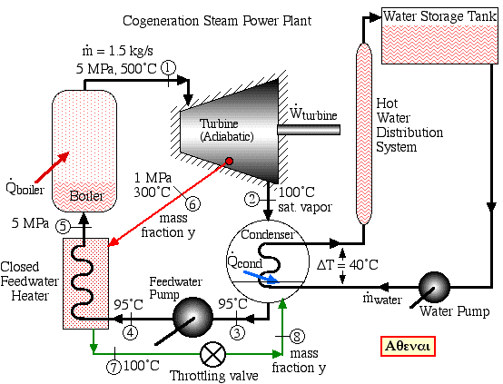
CHP with Rankine cycles
(stream power plant )

Slide 4
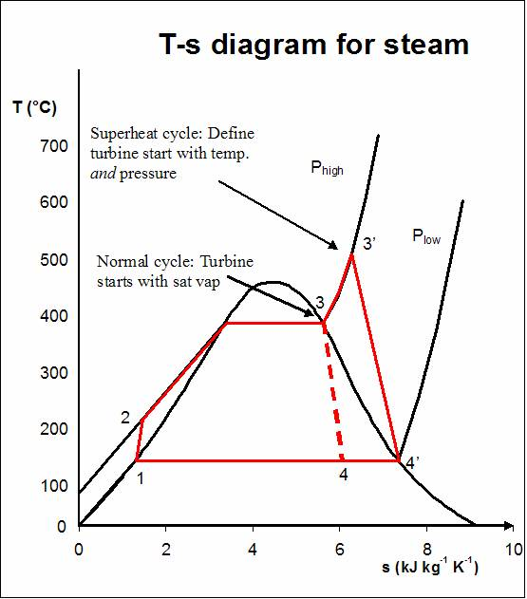
Rankine cycle groups – backpressure

Slide 5
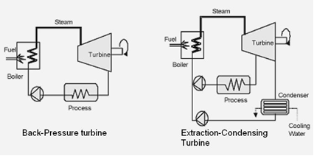
Rankine-extraction / condensation groups

Slide 6
Rankine-extraction / condensation groups

Slide 7
Rankine-extraction / condensation groups
(A) defines the operating regime at which the power is 1.6MW and the flow of extracted steam is 2.0 kg/s.
At the turbine inlet, the required steam flow is 3.28 kg/s.
The corresponding M_{ext, min} = 1.322 kg/s and e_{max} = 1.9705 MW. These values assume that M_{MV} = 3.28 kg/s = const.
When Mext = 0 (no extraction), the maximum electrical power at the generator terminals is 1.5MW.
For the purpose of generating the maximum electrical power of 2 MW, it is necessary to extract between about 1.5 and 3.4 kg/s and adequately increase the steam flow at the turbine inlet (lines 5-6).
If the extracted steam flow is below 1.5 kg/s, the electrical power will be below 2MW (lines 6-7).

Slide 8
Rankine-extraction / condensation groups
The other boundaries determine the dependence of possible electrical power on the maximum steam flow at the HP turbine inlet (line 4-5)
and the increasing steam flow and power production at full extraction (without any flow in the LP Turbine – line 2-3);
at point 3 the maximum possible extracted steam flow is reached, so that line 3-4 is at constant extraction (and increasing MMV).
The operating diagram is specific for each steam turbine and is defined by its structural design.

Slide 9
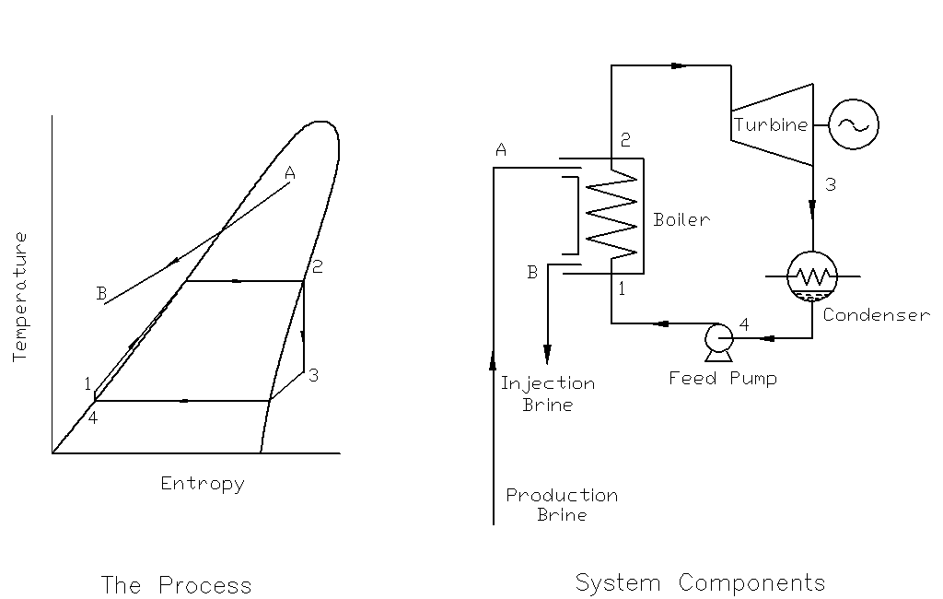
Organic Rankine Cycle - ORC

Slide 10
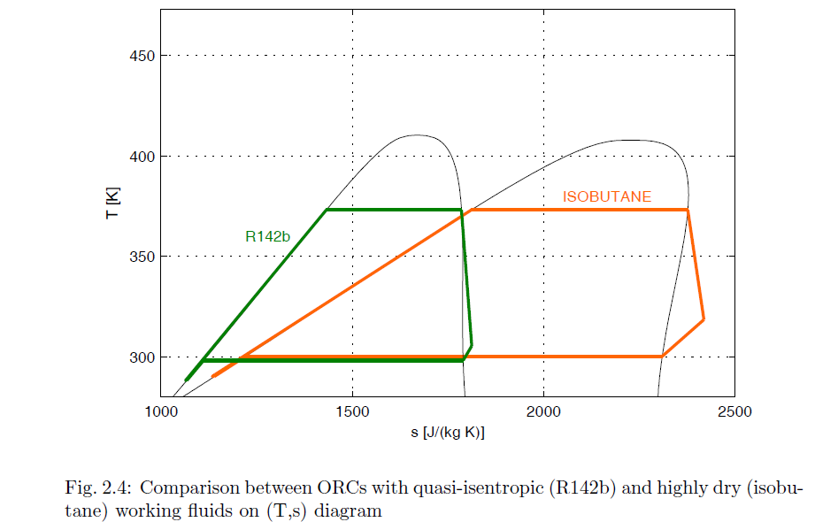
Working fluids

Slide 11
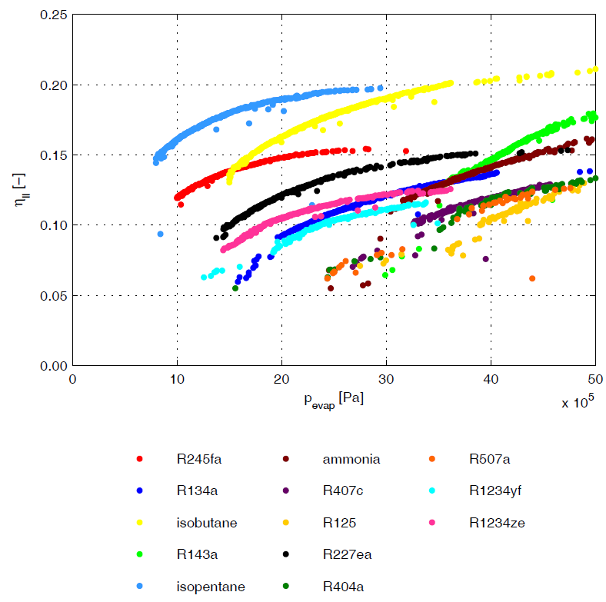
Working fluids

Slide 12
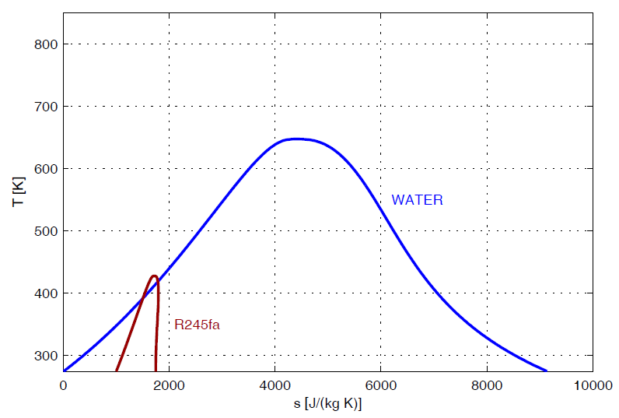
Working fluids
Heat source temperature= 215°C

Slide 13
Working fluids
Heat source temperature = 215°C
R245fa
TEMPERATRA FINALE = 150°C
TEMPERATRA FINALE = 85°C

Slide 14
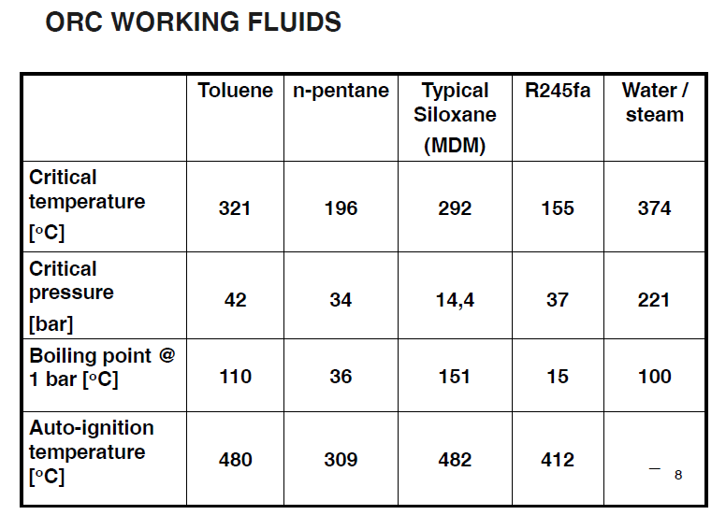
Working fluids

Slide 15
Rankine cycle groups - ORC
Exhaust gas
evaporator
turbine
Electric generator
Heat recovery
regenerator
Oil Diathermic
biomass
condensator
MDM
Water
U
.
T
.
Diathermic Oil circuit
ORC Group
Utenza termica

Slide 16
Rankine cycle groups - ORC
Using "dry" fluids you have excellent working conditions for the turbine
internal regeneration can be achieved.
Ozone Depletion Potential (ODP) null,
Relatively high flash point
T critical 250-300 ° C not too low,
cycle operating pressures not too high.
4
5
7
Forno
MDM
8
2
1

Slide 17
Benefits of ORC technology
Technical advantages of the ORC
• High efficiency of the thermodynamic cycle;
• High efficiency of the turbine (85%);
• Low mechanical stress of the turbine, due to low peripheral speed;
• Low turbine speed, so as to allow direct connection to the electric generator without
interposition of speed reducer;
• Lack of blade erosion
of the turbine, due to the absence of
moisture in the nozzles.
Operational advantages / results
• Easy to start;
• Automatic, continuous and silent operation;
• Minimum maintenance request
• Very high reliability (Admont more than 55,000 hours of operation,
reliability> 98%);
• Partial load operation up to 10% of the nominal power;
• High efficiency even at partial load;
• Request for personnel: about 3-5
hours / week;
• Long machine life.

Slide 18
Concept for Biomass CHP System

Slide 19
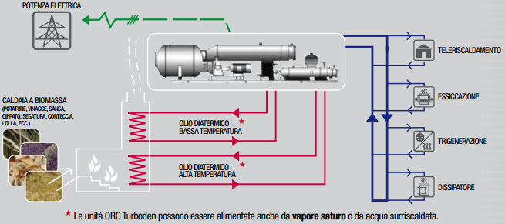
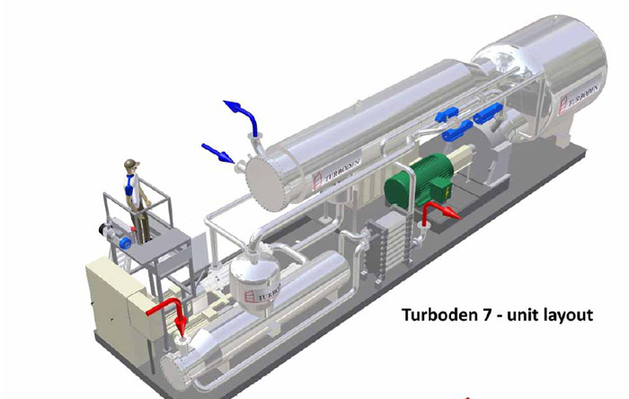
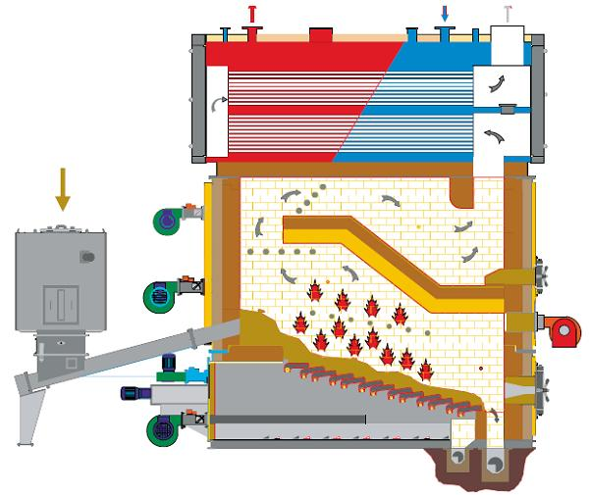

Slide 20
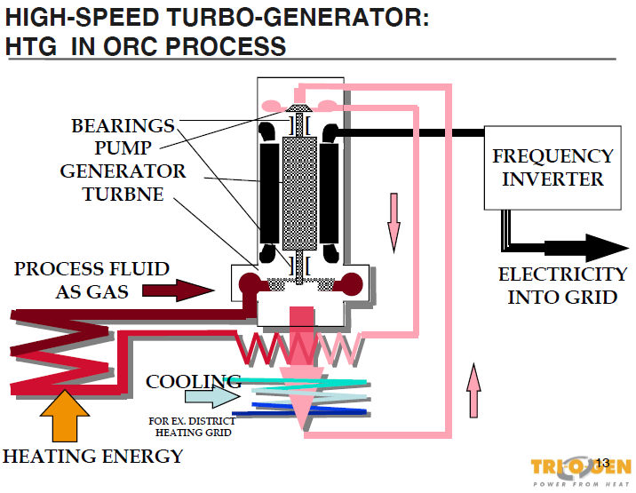

ORC Turbo-expander

Slide 21
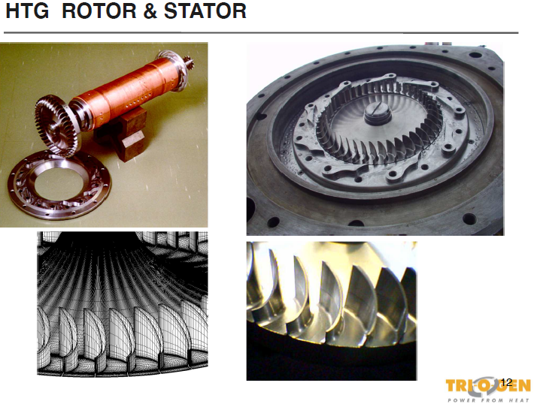
ORC Turbo-expander

Slide 22
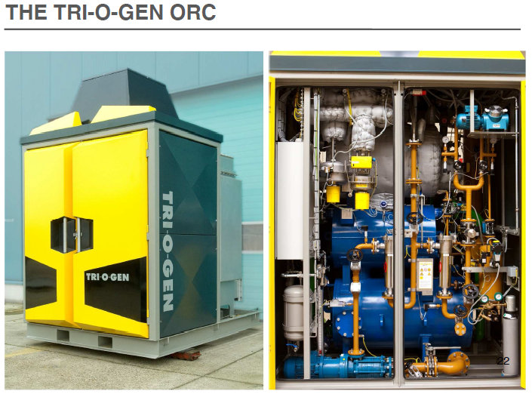
Waste Heat Recovery

Slide 23
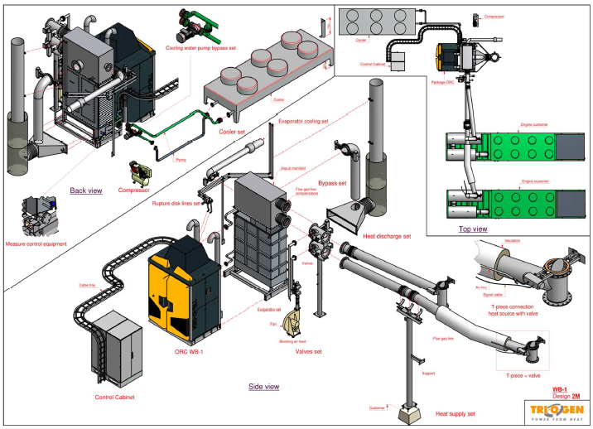
Waste Heat Recovery

Slide 24
Overview of possible applications

Slide 25
Applications
A low temperature solar thermodynamic system
total efficiency of the solar thermal collectors
efficiency of the ORC with a SCROLL expander
in the labels, the first numbers refer to the condensing temperature, the second to the maximum temperature of the cycle

Slide 26
Applications
Possibili applicazioni
Possibili applicazioni

Slide 27
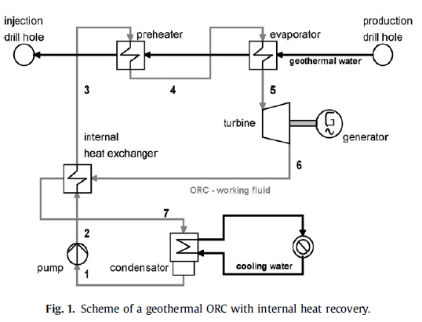
Applications

Slide 28
Applications

Slide 29
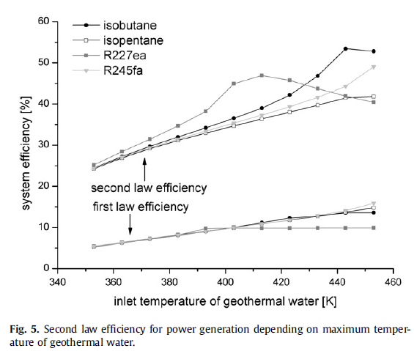
Applications

Slide 30
Applications

Slide 31
Positive Displacement Expanders: SCROLL
SCROLL CHARACTERISTICS
few moving parts
NO valves
high reliability
reduced maintenance
rotation not alternating translation
low noise
low vibrations constant torque
adoption of seals to avoid leakage | APPLICATIONS AS A COMPRESSOR
high efficiency (65-75%) | Air conditioning (automotive)
(also for small size machines) | Refrigeration
 | Pressurization

Slide 32
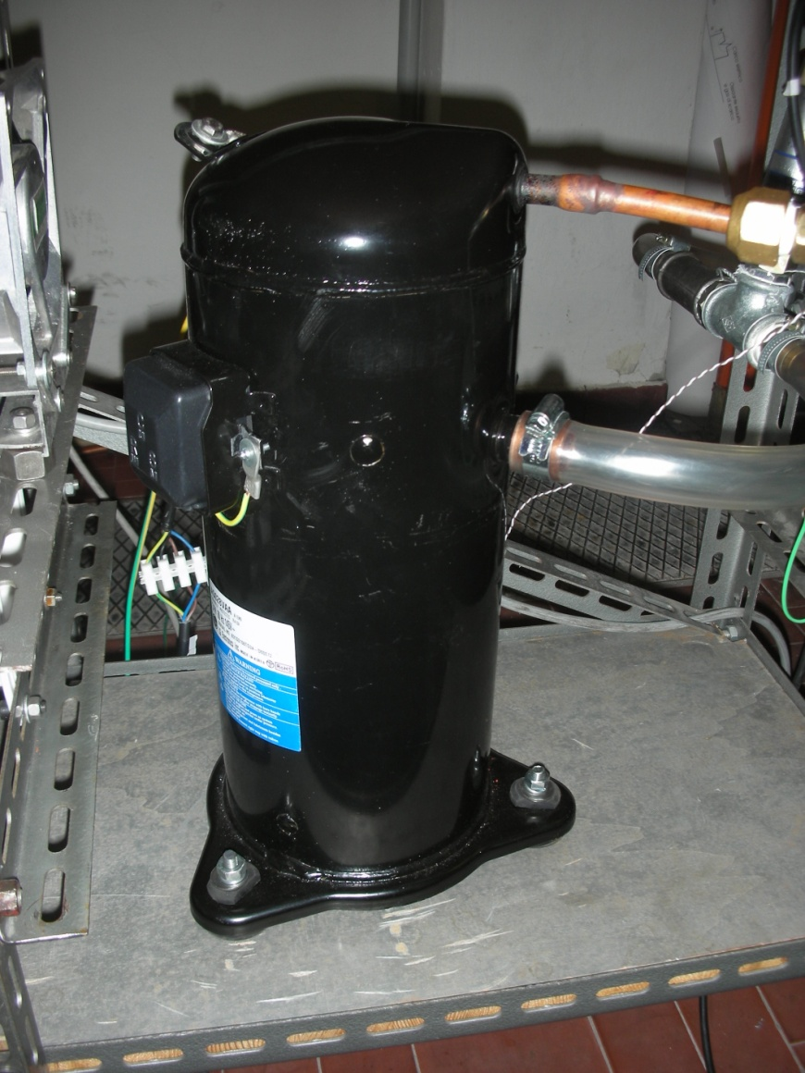
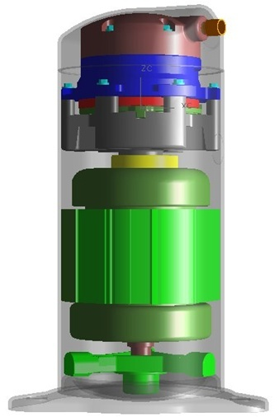
SCROLL Expanders

Slide 33
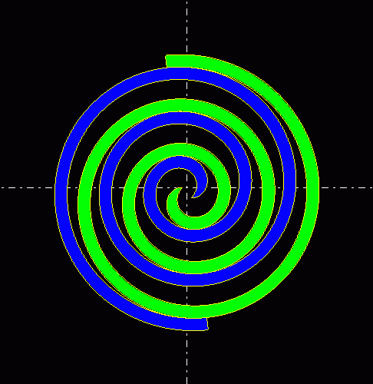
SCROLL Expanders
Espansori per R245fa derivati da compressori (3000 rpm)

Slide 34
SCROLL Expanders
actual and modified scroll losses and isentropic efficiency
(fluid: R245fa, T_{cond}=40°C, speed=3000 rpm)

Slide 35
SCROLL Expanders
actual and modified scroll net power
(fluid: R245fa, T_{cond}=40°C, speed=3000 rpm)

Slide 36
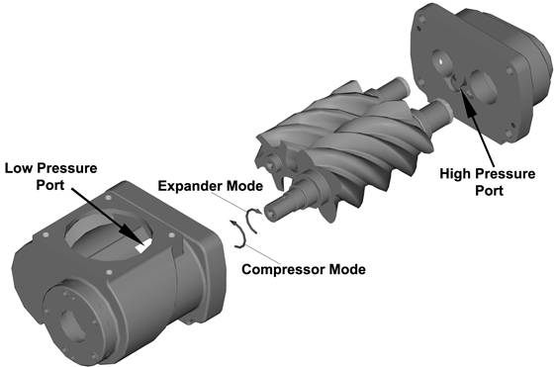
Positive Displacement Expanders: Screw

Slide 37
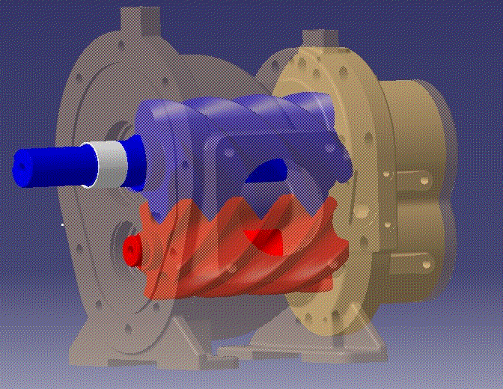
Espansori volumetrici: VITE

Slide 38
Positive Displacement Expanders: Pros
they allow the admission of wet steam. This may increase the cycle efficiency (NOT regenerative) and reduces the cost of the heat exchangers.
they allow direct coupling to the generator, thus reducing transmission losses.
On the other hand, the volumetric expander is less efficient than a turbine.
the screw expander with optimized rotors can be lubricated by the working fluid itself, with reduced traces of oil.
the volumetric expanders can be produced by slightly modifying a mass-produced compressor of the same type, with a small additional cost.
The result is that, even if small powers and low temperature differences are available, ORC systems is expected to be produced cost-effectively.

Slide 39
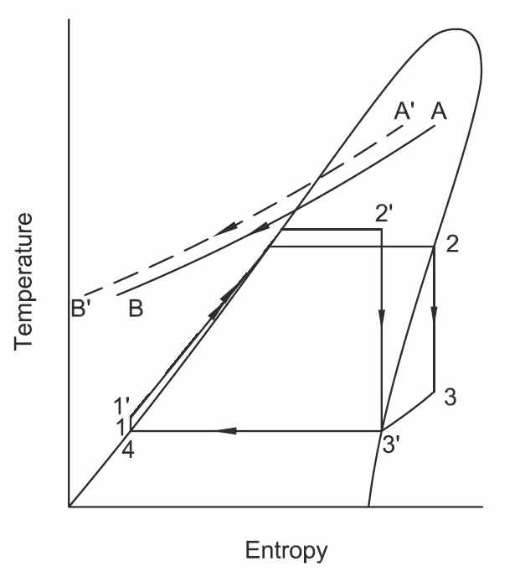
Positive Displacement Expanders: Pros

Slide 40
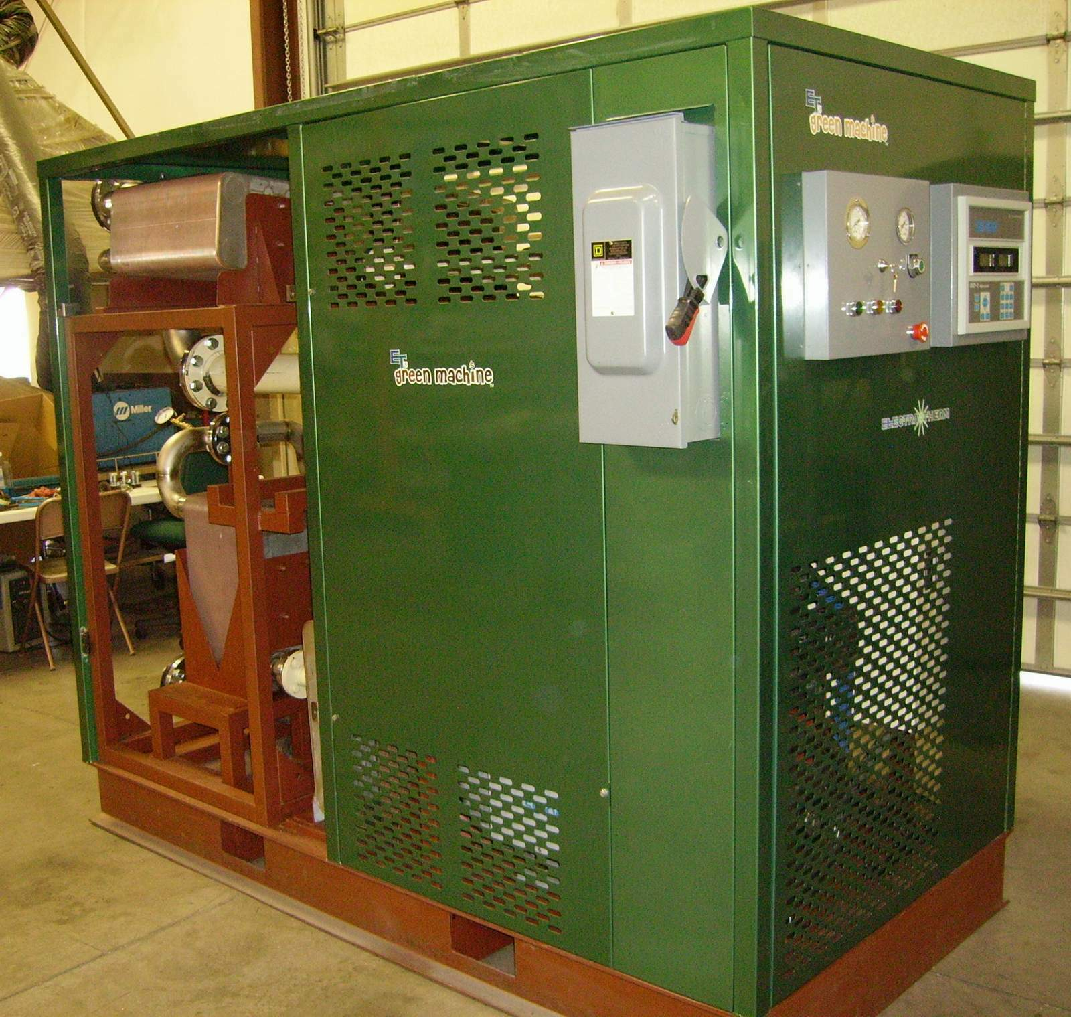
Positive Displacement Expanders: 50kW unit

Slide 41
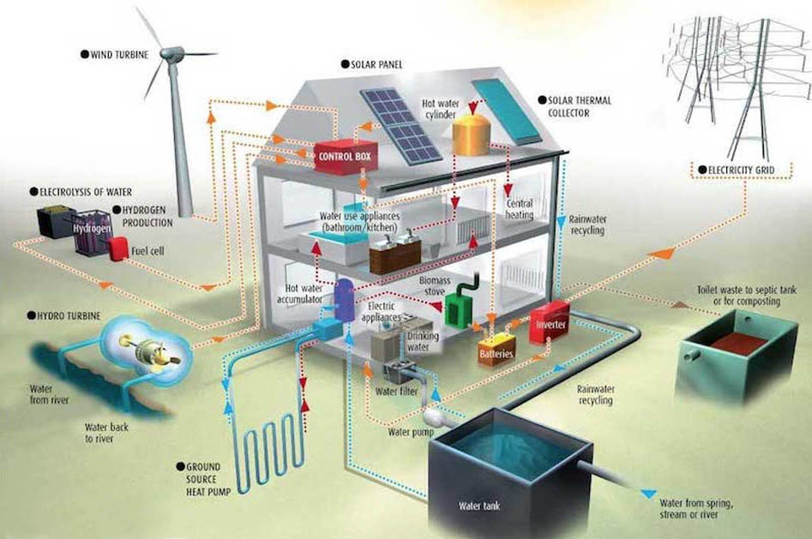
Possible integrations of domestic micro cogeneration

Slide 42
Rankine cycle micro-groups
Inergen - System
2.5 kW Electric

Slide 43
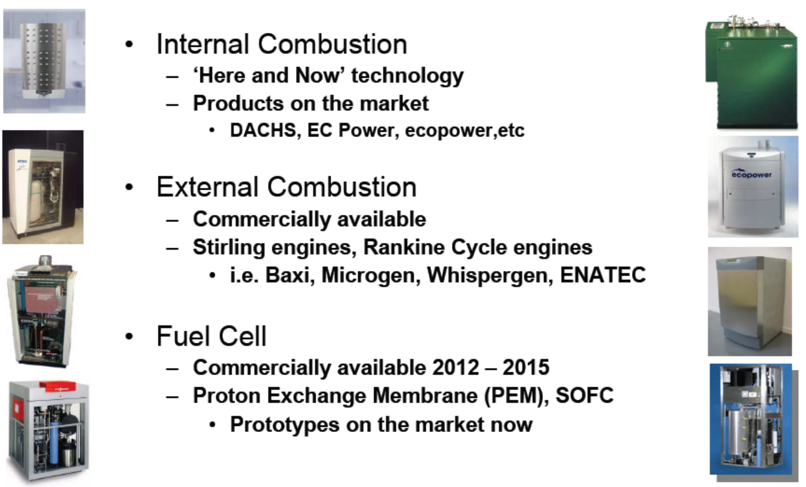
Possible domestic micro cogenerators

Slide 44
Possible domestic micro cogenerators

Slide 45
Conversion efficiency of micro cogeneration systems
Even η_{e} low allow positive PES,
If the use of heat is extensive or complete(even> 100%)!
micro-motors a
Internal combustion
η_{e}=15%
Stirling engines
& ORC Groups

Slide 46
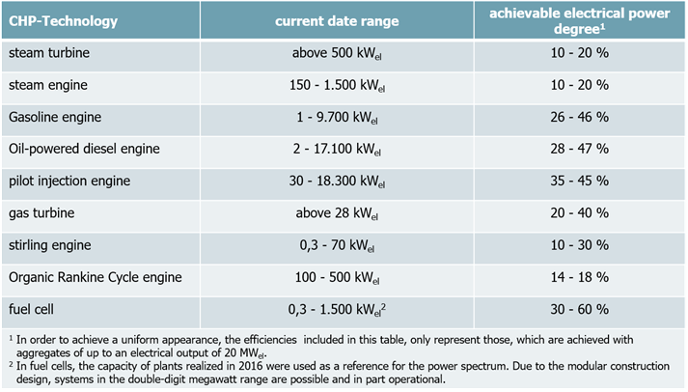
Returns of some cogeneration technologies

Slide 47
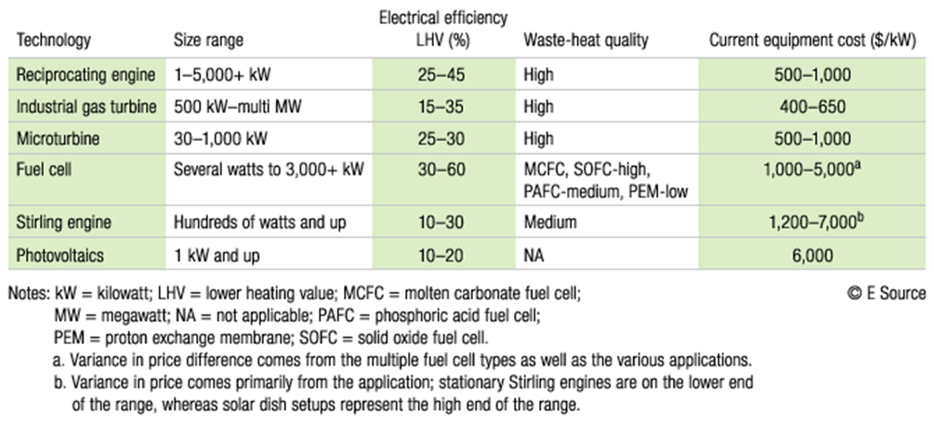
Environmental performance of some cogeneration technologies

Slide 48
Cogeneration and trigeneration
Thanks for the attention
prof. Mauro REINI
docente di sistemi per l’energia e l’ambiente
Università di Trieste – Polo di Pordenone

