Slide 1


Cogeneration and trigeneration:
prof. Mauro REINI
docente di sistemi per l’energia e l’ambiente
Università di Trieste – Polo di Pordenone

Slide 2
Cogeneration and trigeneration:
Summer production of chilled water and
integration with heat & cold district networks
prof. Mauro REINI
docente di sistemi per l’energia e l’ambiente
Università di Trieste – Polo di Pordenone

Slide 3
The choice of a cogeneration plant
It involves numerous decision-making aspects:
- A pre-feasibility analysis, to establish the technical-economic conditions that allow to obtain the desired advantages,
- Feasibility and project analysis, to define:
- Type of system;
- Size of the system;
- Management and control criteria;
- Tariff and regulatory aspects.
To do this it may be necessary:
- Develop a technical-economic model of the system;
- Pair it with simulation / optimization techniques.

Slide 4
The choice of a cogeneration plant
Starting point:
Knowledge of energy data,
Knowledge of economic data.
The choice of the cogeneration system can be supported by simulation / optimization at different levels:
Comparison between different sizes or technological solutions,
Definition of the thermal part and its components,
Choice of management strategy, in a given context,
Integration with other cogeneration plants,
Integration with heat or cold transmission networks.

Slide 5
Trend of the thermal demand
Need for extensive usege of cogenerated heat
1st management hypothesis: tracking the thermal demand
[kW] richiesti

Slide 6
Duration curve of the thermal demand
The preliminary sizing can be done based on the duration curve of the thermal demand.
Thermal peak
Maximum power of the cogenerator
[kW] richiesti
Minimum thermal ower in modulation
Full load
Partial load
Cogenerator off

Slide 7
Duration curve of the thermal demand
In general , the maximum power of the cogeneratior is decidely lowen then the maximum demand
Thermal peak with the integration boiler
Max thermal power of the cogenerator
[kW] richiesti
Min thermal power in the modulation
Full load
Potental load
Cogenerator off

Slide 8
Power segmentation
It allows to cover the therml load more extensively
It implies higher installation cost of CHP system
thermal peak with the integration boile
Max thermal power of the 2 cogenerators
Min thermal power x 1 in modulation
[kW] richiesti
Full load x2
Partial load x2 x1
Cogeneretor off

Slide 9
Tri-generative systems
All seasonal utilities are affected by reduced use of the cogenerator in summer: Extensive use of integration heat, reduction of the annual CHP efficiency, long PBPs

Slide 10
Tri-generative systems
The tri-generative systems allow the use of cogenerated heat even in summer, producing chilled water.

Slide 11
Absorption cooling machines
Conventional refrigeration cycle
2
3
8
7
9
Thermal Compression
6
10
5
4
1

Slide 12
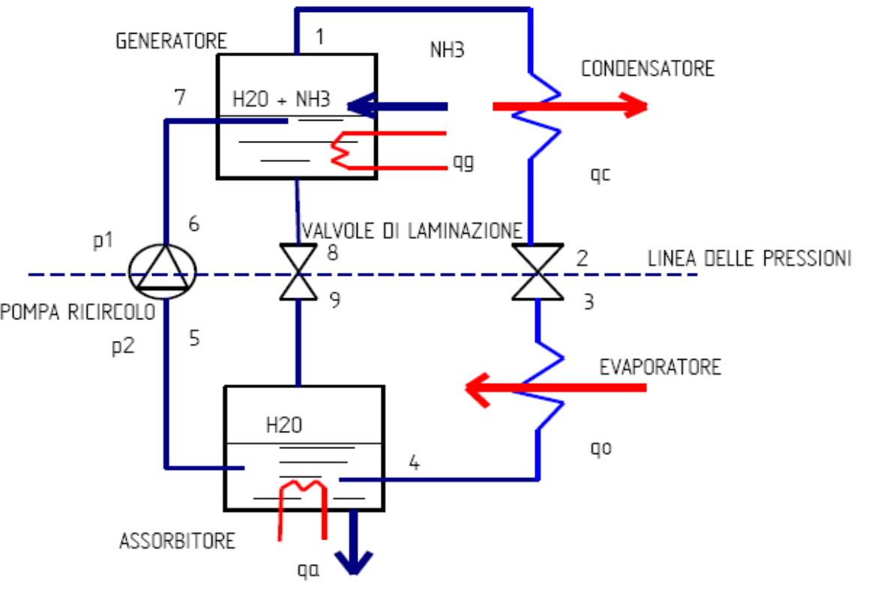
Absorption cooling machines
For water and ammonia,
the generator is 130 ° -150° C and 45 ° -55 °C in the absorber /condenser. The temperature at the evaporator (function of pv) is a few degrees below zero.
Other mixtures are also used, like water-lithium bromide or water-lithium fluoride mixtures (it is the water that acts as a refrigerant), which have the advantage of working at a lower temperature (around 80 ° C).

Slide 13
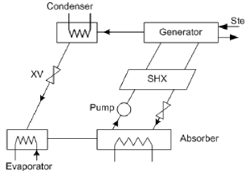
Absorption cooling machines

Slide 14
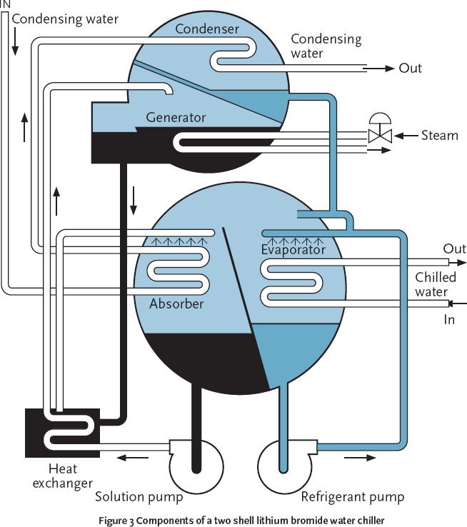
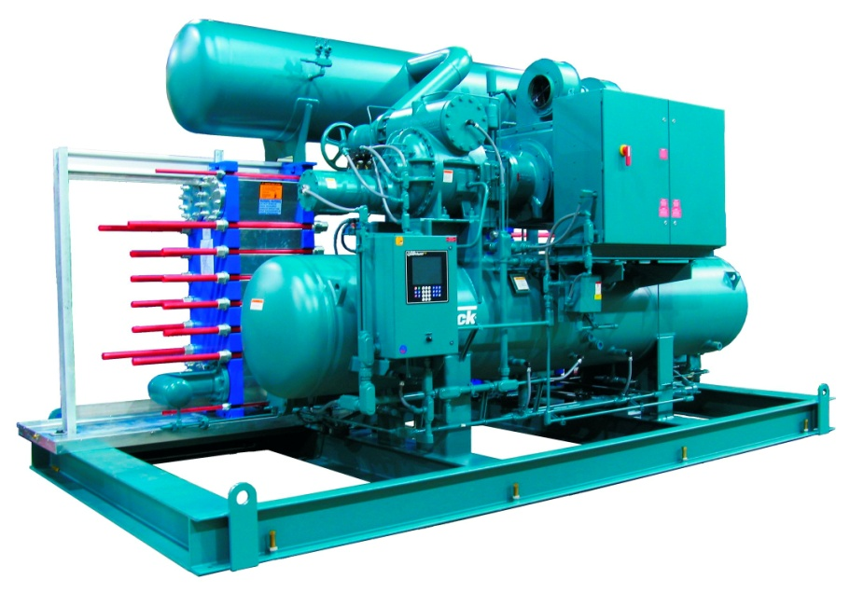
Absorbation cooling machine

Slide 15
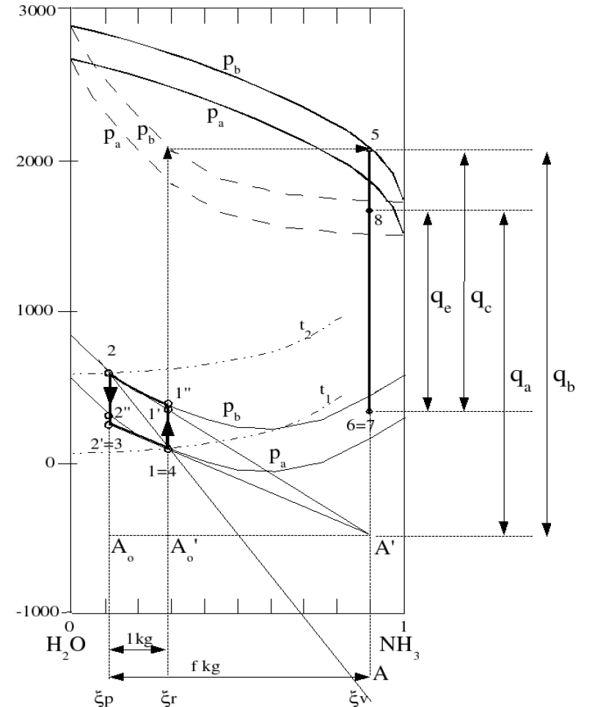
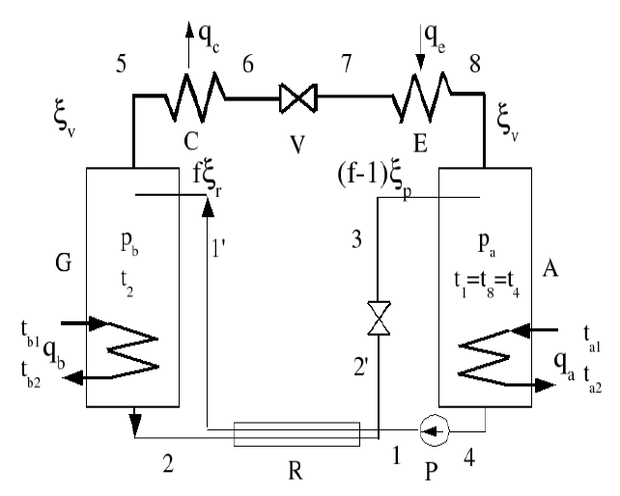
Abaco di Bosnjacovic

Slide 16
Abaco di Bosnjacovic

Slide 17
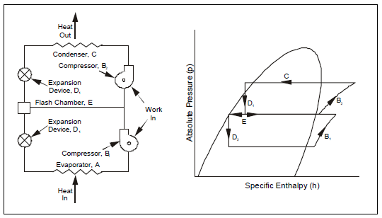
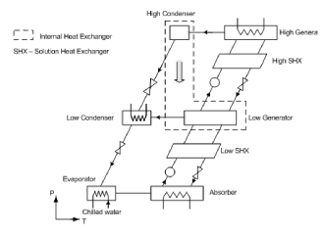
Double Effect Absorption Chillers

Slide 18
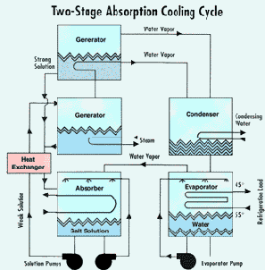
Double Effect Absorption Chillers

Slide 19
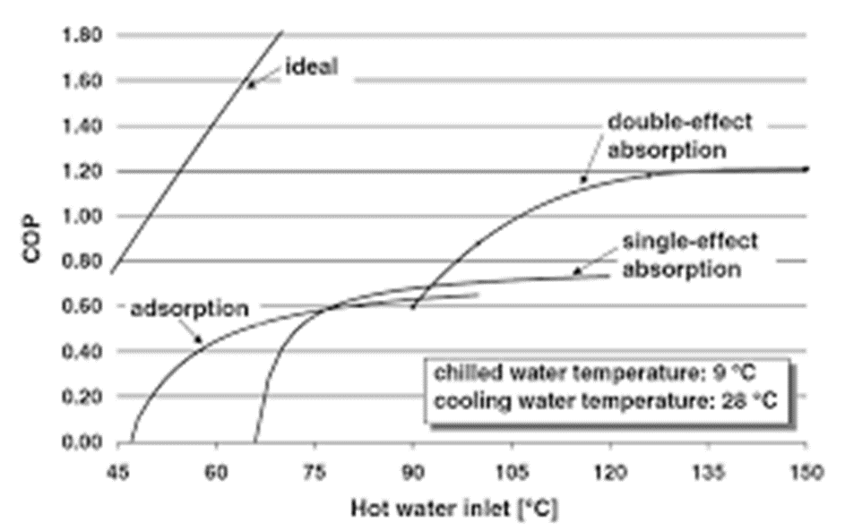
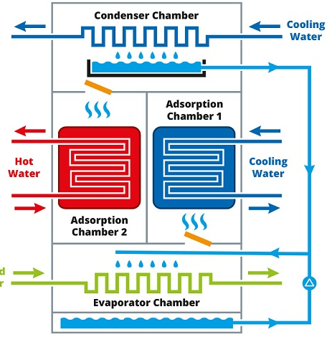
Absorption / Adsorption Chiller

Slide 20
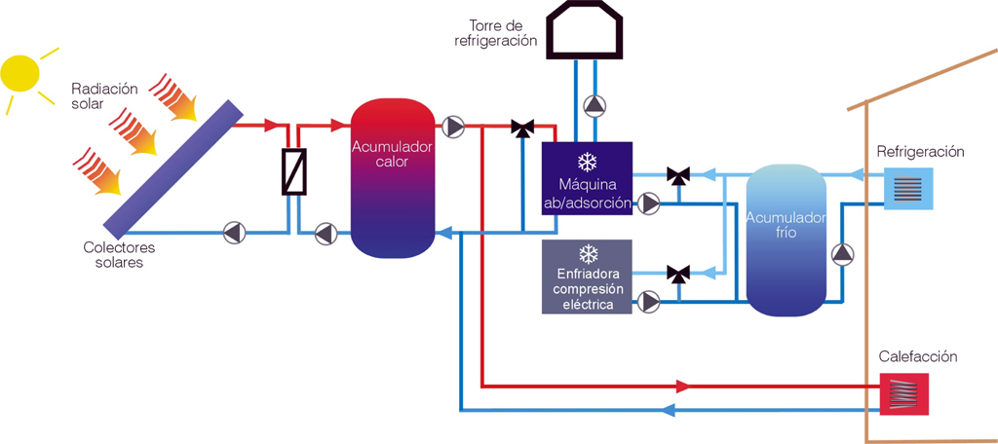
Solar cooling

Slide 21
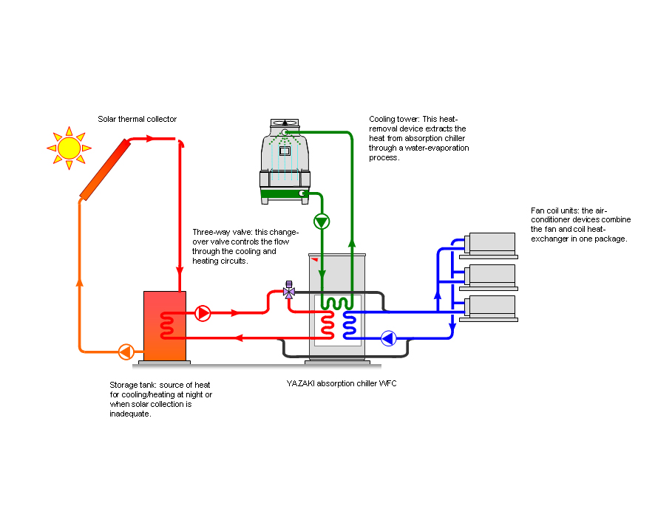
Solar cooling

Slide 22
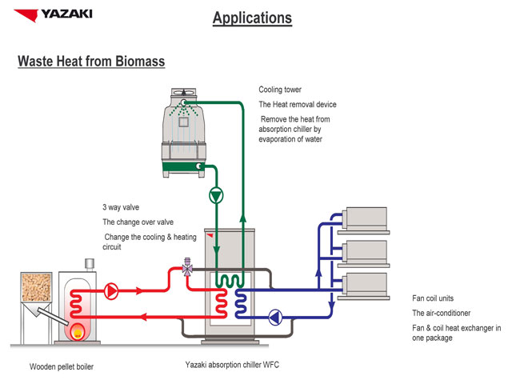
Solar cooling

Slide 23
Tri-generative systems with MTG

Slide 24

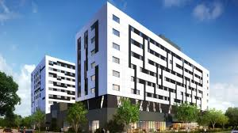
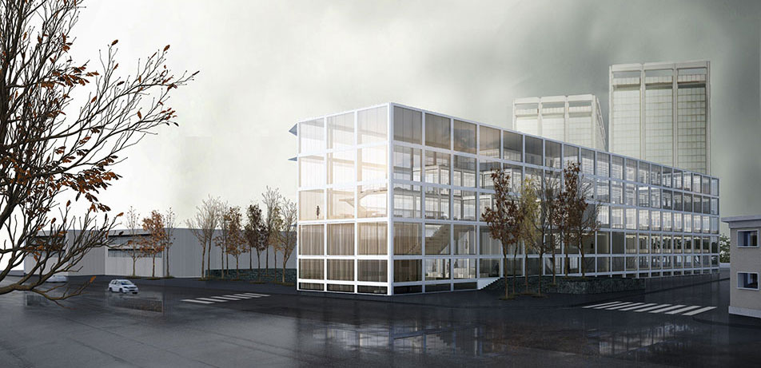
Possible uses of trigeneration
Hospistal
Public officies
Residence

Slide 25
Variability of utility loads during the typical day

Slide 26
ABSORPTION POWER CYCLE

Slide 27
ABSORPTION POWER CYCLE

Slide 28
ABSORPTION POWER CYCLE

Slide 29
ABSORPTION POWER CYCLE
Dühring diagram for a LiBr aqueous solution, highlighting a typical absorption refrigeration cycle and the power cycle presented in Novotny and Kolovratnik - Int. J. Energy Res. 2017; 41:952–975, both with a highest solution temperature of 90°C.

Slide 30
ABSORPTION POWER CYCLE
Results of thermodynamic analysis for 100 °C heat source. Novotny, Vitvarova, and Kolovratnik - Absorption Power Cycles with Various Working Fluids for Exergy-Efficient Low-Temperature Waste Heat Recovery.
u = energy utilization; gross = without considering auxiliary power for heat dissipation; c = cycle only; ex = exergy

Slide 31
Synthesis of distributed cogeneration and district heating systems
Hypothesis of cogeneration distributed with MTG, integrated with micro-district heating networks, for the historic center of Pordenone.
The developed model includes:
- a set of micro-cogeneration gas turbines, located inside 6 buildings,
- a centralized cogeneration system, (600 kWe) allowing the required thermal energy to be produced in a single site

Slide 32
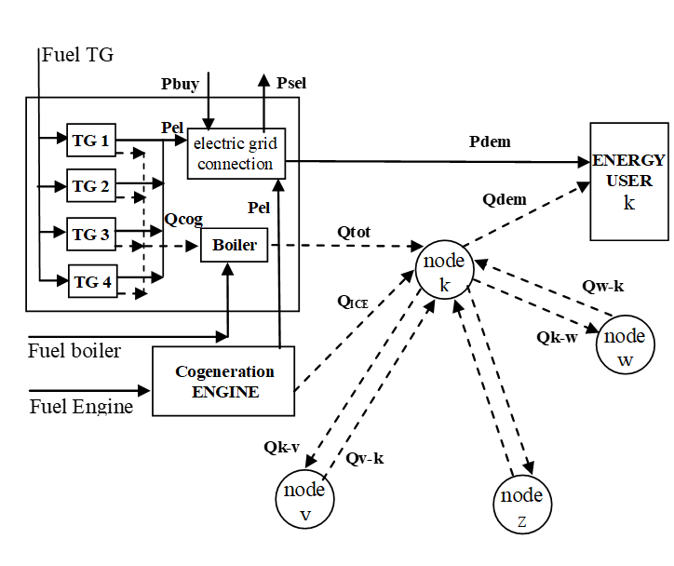
Synthesis of distributed cogeneration and district heating systems
Distributed cogeneration
scheme system

Slide 33
Synthesis of distributed cogeneration and district heating systems
ALTERNATIVES:
If you choose the centralized cogeneration system, generally based on an internal combustion engine (ICE):
cogenerated heat must be distributed to users and a district heating system must be built within a high density area of ​​historic buildings.
The investment cost of the entire system increases,
If you choose the cogeneration system distributed with mTG:
These have a higher cost per installed kWe,
They also have a lower electrical efficiency than ICE.

Slide 34
Synthesis of distributed cogeneration and district heating systems
Goals :
Choose whether the centralized engine should be adopted or not,
Define the number of micro-turbines (of fixed size) within each building,
Define the "minimum" correct connections between buildings, in order to optimize energy consumption at low thermal load,
Define the optimal strategy of system operation,
Assess the overall reduction of emissions, particularly CO2.

Slide 35
Synthesis of distributed cogeneration and district heating systems
The problems:
choosing whether the ICE has tobe adopted or not,
defining the number of micro turbines (of fixed size) inside each building,
defining“minimum” proper connections among buildings, in order to optimize energy consumption at low thermal load,
defining the operation strategy of the whole system,
to evaluate global CO2 emissions reduction

Slide 36
Synthesis of distributed cogeneration and district heating systems
Solutions:
define a Full Mixed Linear Programming program (MILP),
solve it by means of a commercial software,
OBJ: Total annual cost for acquiring, maintaining and managing the entire system,
Taking into account the economic constraints: interest rate, price of gas and electricity, cost of components and plant integration,….
taking into account the physical constraints: thermal and electrical demands of the users over time, effect of the ambient temperature on the efficiency of the turbines,….

Slide 37
Synthesis of distributed cogeneration and district heating systems
Methodology 1
defining a Mixed Integer Linear Program (MILP),
solving it by means of a commercial software,
OBJ: Total Annual Cost for owning, maintaining and operating the whole system,
taking the time dependent cost rate of gas and electricity into account to evaluate incomes and integrations from the outside,
taking account of ambient temperature effect on turbine efficiency.

Slide 38
Synthesis of distributed cogeneration and district heating systems
Energy demand:
The whole year is modeled with 3 "typical days", for energy demand, and 24 "typical days" for the value of the electricity sold to the grid.
Electric demand
Thermic demand

Slide 39
MILP models
OBJ is linear towards the variables that express the consumption of CHP systems;
Binary variables are used to express the presence / absence of mTG, ICE and network sections,
In addition to the on / off status of the machines.
In each time interval the optimization must take into account the constraints:
The performance curves of the components (variable with temperature) must be respected;
The thermal demand must be satisfied by cogenerators and auxiliary boilers;
The electricity demand must be satisfied by the cogenerators and by the integration with the network;
The thermal nodes must be balanced and all the branches have a loss proportional to their length.

Slide 40
Synthesis of distributed cogeneration and district heating systems
Optimal configurations depending on the surrounding economic conditions: a + c) estimated life of the machines and network estimated at 13/26 years; b) 4.5 / 9 years; c) of 8/16 years; Savings vary between 1 - 8%.

Slide 41
Synthesis of distributed cogeneration and district heating systems
Example of optimal management for the mTG only present in configuration b:
Thermal tracking is NOT the optimal solution (even the electrical one).

Slide 42
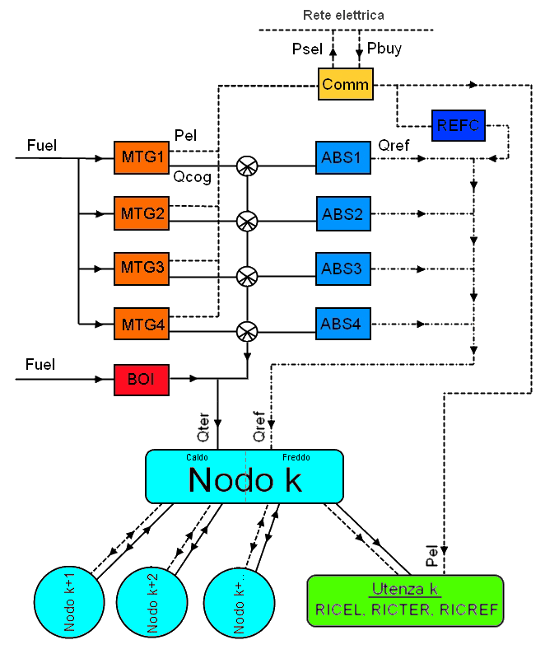
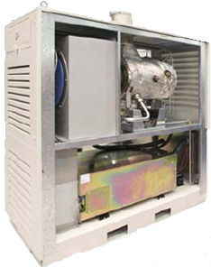
Integration of CHP with absorption machines and district-cooling networks
Cold water (tele-cooling)
Fuel (gas naturale)
Hot water (tele-heating)

Slide 43
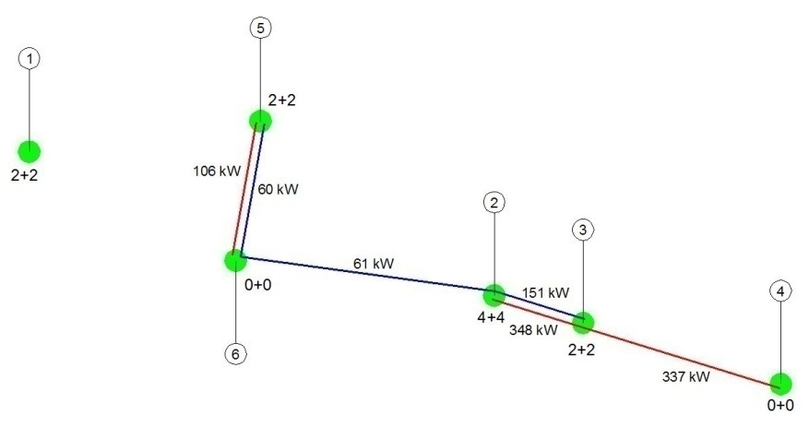
Integration of CHP with absorption machines and district-cooling networks
Ut. isolate
UT in network
Years of capital amortization:
10 for the machines, 20 for the network

Slide 44
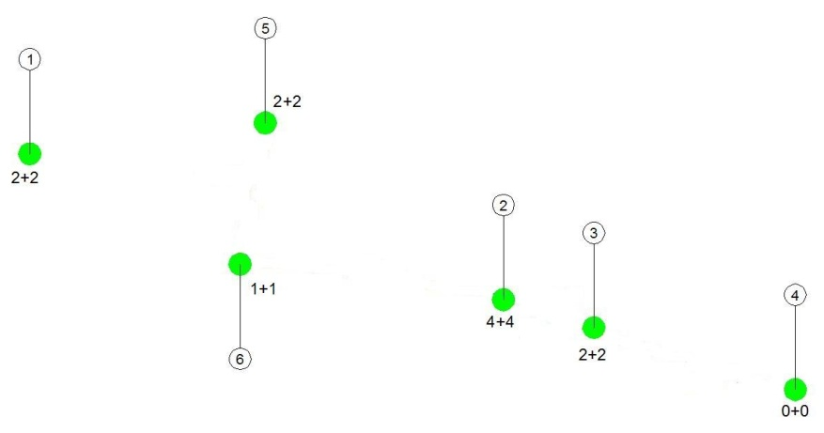
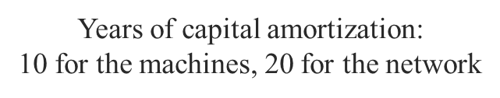
Integration of CHP with absorption machines and district-cooling networks
TRIGENERATION APPLIED TO ISOLATED UTILITIES AND TO NETWORKED UTILITIES
 | Ut insolate | Ut. In Network
n° μTG | 11 | 10
n° mAS | 11 | 10
Investment [€] | 1.368.750 | 1.482.505
Operatic cost [€/anno] | 685.332 | 632.858
Annual cost [€/anno] | 862.591 | 812.041
Saving index | 26,87% | 31,15%
IRE | 9,73% | 12,70%
TEP saves | 93 | 132
Pay Back Period [months] | 33 | 32
Ut. insolate
Ut. in network

Slide 45
Integration of CHP with absorption machines and district-cooling network
Cogeneration VS trigeneration
Economic parameters
Environmental parameters

Slide 46
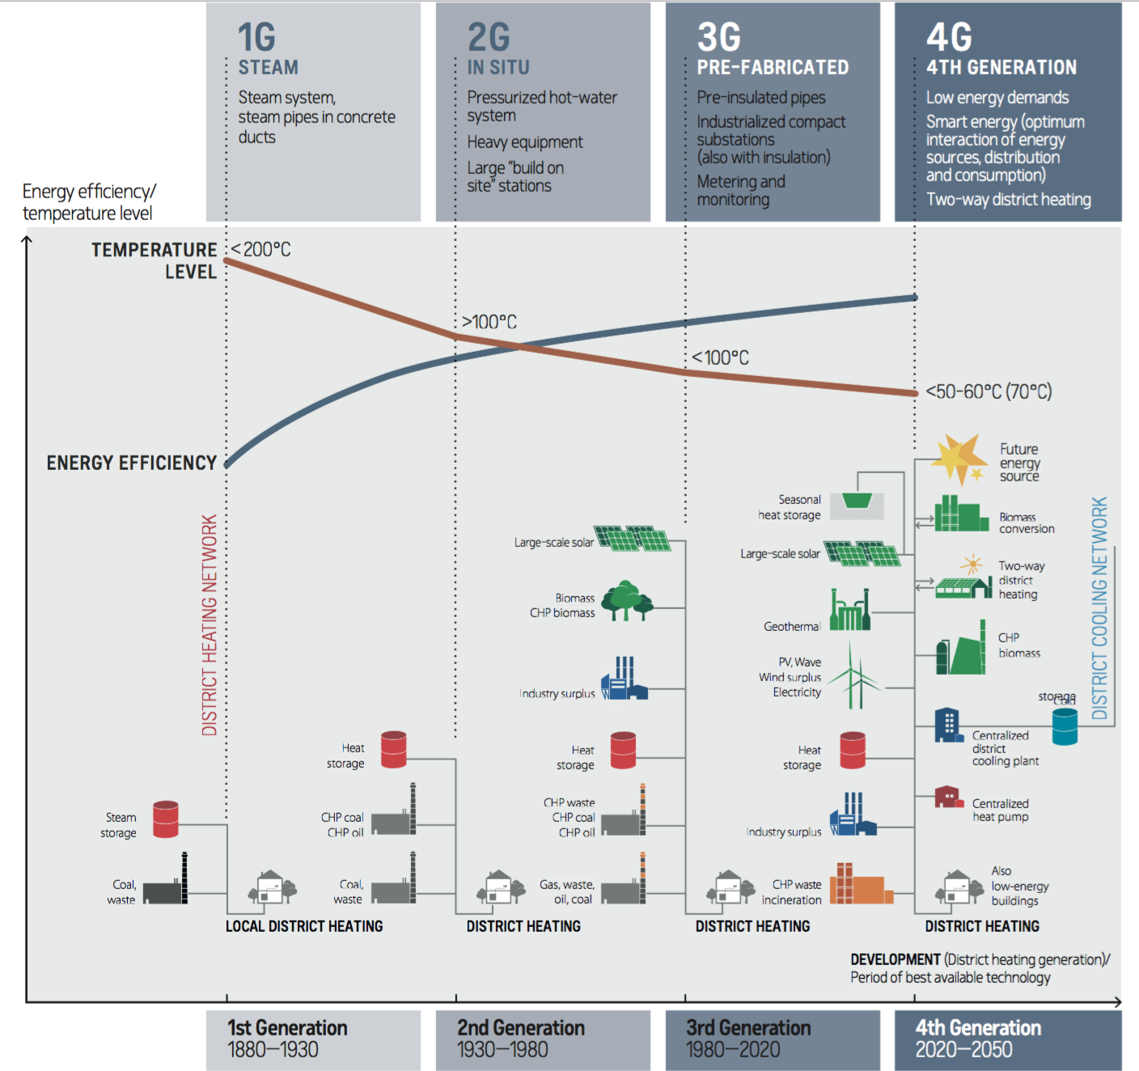
Evolution DHN systems
The integrated energy system makes it possible to use all locally available energy sources to generate heat;
a large variety of fuels can be used: natural gas, biomass, municipal solid waste, coal, fuel oil.
Heat can also be produced by industrial plants, or by natural sources (eg, geothermal phenomena) and then conveyed into the distribution network.

Slide 47
Context
CURRENT:
Large plants fueled with "valuable" fuels with yields of 40 - 50%,
Very small ONLY thermal systems, also powered by "valuable" fuels.
FUTURE (distributed generation):
Large plants fueled with different fuels ("valuable" and not) with yields of 40 - 60%,
Many medium and small COGENERATIVE systems fed with renewable or methane sources, adapted to the local thermal demand.

Slide 48
Context
Current network:
With shaft, with few productive knots.
Many simple users, civil and industrial.
Significant transmission losses.
Future network:
Knitted, with many productive knots.
Some nodes with energy storage capacity.
Great importance to the management activity to guarantee the "quality" of the energy supplied.
Reduced transmission losses

Slide 49
Conclusions
Cogeneration is a rational answer to the demand for energy efficiency;
It is possible to obtain important energy-environmental benefits also using gas-powered cogeneration systems;
The environmental benefits are even more evident by realizing cogeneration systems powered by RES (biomass, solar, ..);
An essential condition for actually obtaining the expected benefits is that as much as possible of the cogenerated heat is used usefully;
Small plants and tri-generative systems are advantageous if they result from an optimized symptesis and management

Slide 50
Cogeneration and trigeneration
Thanks for the attention
prof. Mauro REINI
docente di sistemi per l’energia e l’ambiente
Università di Trieste – Polo di Pordenone

