Slide 1


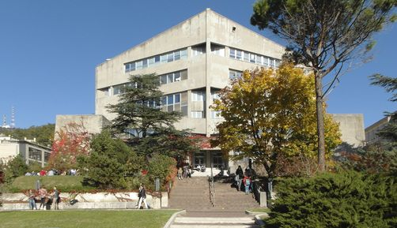
UNIVERSITÀ DEGLI STUDI DI TRIESTE
DIPARTIMENTO DI INGEGNERIA E ARCHITETTURA
Exergy Analysis and Exergy-based Cost Accounting & Optimization
Prof. M. Reini, Ph.D
Università degli Studi di Trieste
Dipartimento di Ingegneria e Architettura – Polo di Pordenone
reini@units.it

Slide 2
UNIVERSITÀ DEGLI STUDI DI TRIESTE
DIPARTIMENTO DI INGEGNERIA E ARCHITETTURA
How much energy are we actually consuming? Exergy and Emergy
Prof. M. Reini, Ph.D
Università degli Studi di Trieste
Dipartimento di Ingegneria e Architettura – Polo di Pordenone
reini@units.it

Slide 3
Outline
flow and non-flow exergy
exergy balance
chemical exergy
exergy of idrocarbons
Definition of EMergy
EMA
recycling and multi-product components
open questions

Slide 4
Introduction
Why the amount of energy actually consumed by a process, a plant or an industrial system is not immediately evident?
Because, agreeing with Second Law, different forms of energy have different quality, therefore it is better to wonder how much high quality energy are we actually consuming.
Exergy is the answer.
Because high quality energy is consumed indirectly, outside the considered control volume, for producing and operating all physical components making up processes, plants or industrial systems, or for converting energy in the proper form required.
Emergy or Exergy Cost may be the answer.

Slide 5

Exergy Reference Environment (RE)
Energy can neither be created nor destroyed: why it is missing?
The capability of producing mechanical work is the "actual" measure of energy
System
RE (Temperature, Pressure, composition)

Slide 6
Exergy Reference Environment (RE)
EXERGY is the maximum mechanical work that can be obtained from the System + Reference Environment combination:
Maximum possible production of mechanical work
System
RE (Temperature, Pressure, composition)

Slide 7
Exergy Reference Environment (RE)
EXERGY is the maximum mechanical work that can be obtained from the System + Reference Environment combination:
The RE is NOT suited to be the source of production process flows (both artificial – economic, or natural - biological), but it is the background where both the production process and its resources interact. In fact the RE:
It is homogeneous, so it does not contain any resources,
It is by definition characterized by constant Temperature, Pressure, composition, so it cannot be affected in any way by the interaction with production processes.
No additional mechanical work can be produced: EXERGY extraction is theoretically possible when there is an imbalance with the RE - thermal/chemical/mechanical
System in equilibrium with the RE
RE (Temperature, Pressure, composition)

Slide 8
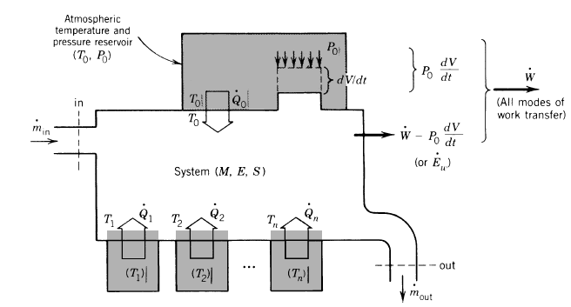
EXERGY – First and Second Law of Thermodynamics
EXERGY is the maximum mechanical work that can be obtained from the System + Reference Environment combination. Let’s consider a generic control volume:

Slide 9
EXERGY - First and Second Law of Thermodynamics
Enthalpy balance (Energy conservation)
Entropy balance (Second Law) showing entropy generation in all real/irreversible processes
Total entalpy h°

Slide 10
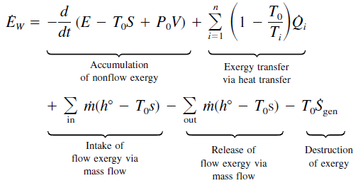
EXERGY - First and Second Law of Thermodynamics
Enthalpy balance (Energy conservation)
Entropy balance (Second Law) showing entropy generation in all real/irreversible processes
Exergy balance showing exergy destruction in all real/irreversible processes
Th. di Carnot

Slide 11
EXERGY – flow and non-flow exergy
The maximum mechanical work can be obtained from the System + Reference Environment combination if the system is brought in thermo-mechanical equilibrium with the RE at (T₀, P₀) without any exergy destruction.
non-flow exergy
        flow exergy

Slide 12
EXERGY – reversible processes
When the thermo-mechanical equilibrium with the environment is reached, it is no longer possible to obtain further mechanical work and the exergy is zero, even if the system still has a lot of energy (eg internal energy).
The value attributed to the exergy off the system depends on the thermodynamic state of the environment (T₀, P₀).
Only reversible (ideal) processes occur without exergy destruction. To achieve reversibility, all processes have to be avoided which contain:
Heat exchange with finite temperature difference ΔT,
Expansion through finite pressur difference ΔP,
Friction between surfaces in relative motion,
Fluid-wall friction and viscosity of fluids,
Mixing of different fluids,
Spontaneous chemical reactions,
Electrical resistance ,
Magnetic hysteresis.

Slide 13
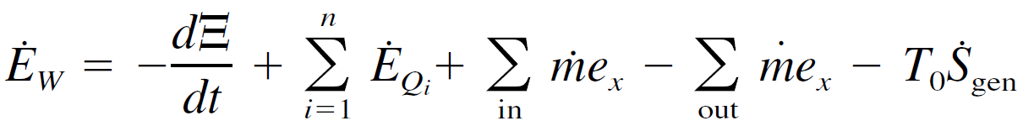
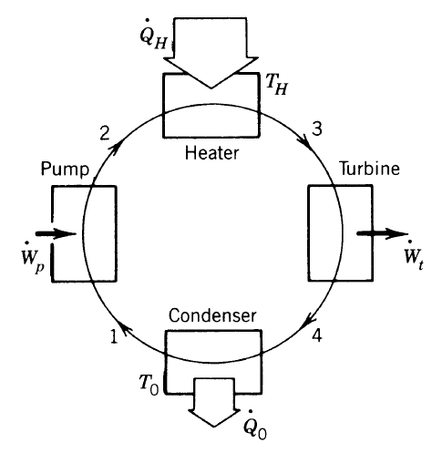
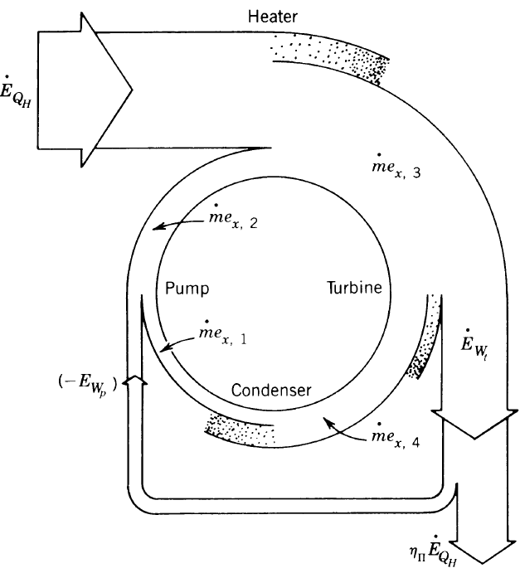
EXERGY – exergy balance
From the exergy balance of the individual processes / components and of the entire system it can be inferred where the real energy consumption originates, even if the overall performance may not be very different from that obtained by using the First Principle only!
It is possible:
Identifying the real causes of inefficiency,
Improving the efficiency of energy conversion.

Slide 14
EXERGY – exergy efficiency
NB: it is difficult to identify the flow that represents the exergy (or the energy) obtained from the condenser, therefore, its efficiency appears to be zero.
For the Turbine and the heat exchanger, on the other hand, an exergetic efficiency <100% is obtained, when the purely energetic evaluation would have expressed only the degree of adiabatic insulation of their entire control volume.

Slide 15
EXERGY – exergy efficiency
Exergy and energy characteristic curves of glazed and un-glazed solar collectors.
Entropy 2010, 12, 243-261

Slide 16
EXERGY – exergy efficiency
Exergy analysis of vapor compression refrigeration systems
Exergy, an Int. Journal 2 (2002) 266–272

Slide 17
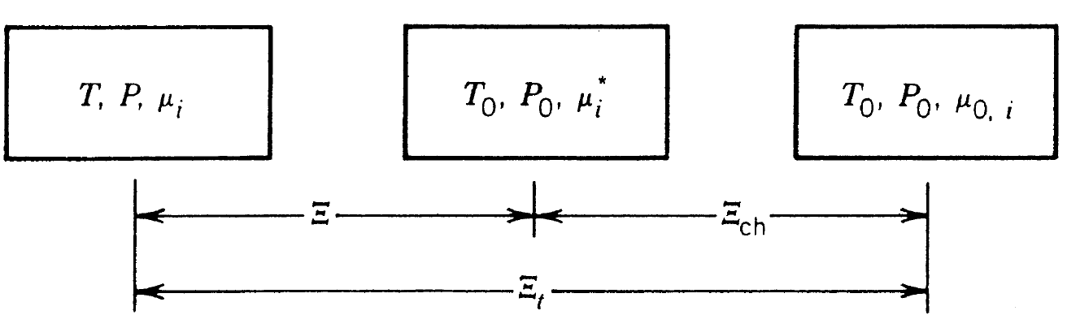
EXERGY – chemical exergy
The introduction of exergy allows to evaluate on a common basis the different flows of energy exchanged within a system, or between a system and the outside.
The central point is to recognize a potential source of work in the thermo-mechanical IMBALANCE with the environment.
The same approach can be used to obtain the evaluation of raw material flows or, in general, of all flows and reservoirs of substances in thermo-mechanical equilibrium with the environment at (T₀, P₀), BUT NOT in chemical equilibrium (Eg: reservoirs of fossil fuels, raw materials, fresh water).
Dead state: each component reacted, at constant (T₀, P₀) with environmental substances and the products have reached the chemical potential those substances have in the environment, μ_{0,i}
Reference state: each component has its own (new) chemical potential at (T₀, P₀), μ_{i}*
Current status: each component has its own chemical potential μ_{i}

Slide 18
Evaluating Chemical Exergy
The exergy reference environment (the Earth and its atmosphere)
  Environmental temperature T₀ and pressure p₀.
  Set of reference substances with their concentrations (closely corresponding to the chemical makeup of the natural environment).
Reference substances may include
  Gaseous components of the atmosphere: N₂, O₂, CO₂, H₂O(g), and other gases.
  Liquid water, in equilibrium with the Gaseous mixture.
  Solid substances from the Earth’s crust.
  Substances from the oceans.
It is worth noting that, from a rigorous thermodynamic point of view, the RE must stand alone in chemical equilibrium, otherwise the max work may depend on the final equilibrium inside the RE, not only by the final equilibrium of the system with the RE.
Nevertheless, the RE defined by Stzrgut (one of the most cited and complete) does not respect this condition, but the solid Reference substances considered are so stable that their reaction with the gas Gaseous mixture can be neglected, at the time scale of the system.

Slide 19
EXERGY – chemical exergy of substances in the RE
The exact chemical composition of the RE has to be defined:
Standard Environment for Chemical Exergy of Hydrocarbons
TemperatureT₀
Pressure,P₀
Substance in gas phase
Mole Fraction x_{i}
298.15 K
101.325 kPa
N₂
0₂
H₂0
C0₂
Other
0.7567
0.2035
0.0303
0.0003
0.0092
Q₀
For the gas substances present in the RE, the exergy corresponds to the isothermal expansion work from the pressure P₀ to the partial pressure P₀ x_{i}.
T_{o}, P_{o}
1
2
Ambiente
W_{sh}
S.P.M.
https://www.youtube.com/watch?v=AiTxIjLuoQg

Slide 20
EXERGY – chemical exergy of an hydrocarbon (CH₄)
For ALL chemical reaction at constant (T₀, P₀), the max reversible work that can be obtained (in principle) is the variation in the GIBBS function (g=h-Ts). Regarding kinetic and potential energy effects as negligible:
W_{sh}
(T₀, P₀)
(T₀, P₀)
C_{a} H_{b}
CO₂
O₂
H₂O (l)
Q₀

Slide 21
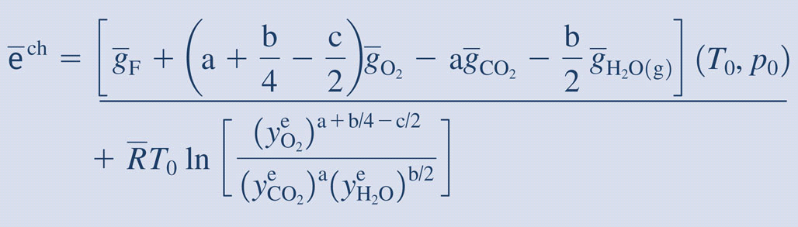
EXERGY – chemical exergy of hydrocarbons (C_{a}H_{b}O_{c})
The logarithmic term typically contributes only a few percent to the chemical exergy magnitude.
The standard chemical exergy is chemical exergy at T= 298.15 K and P=1 atm.

Slide 22
EXERGY – chemical exergy of hydrocarbons
a: Ahrendts, liquid water in equilibrium with the gas mixture as the Reference Environment. Only a small fraction evaporates and reaches the partial pressure in the gas mixture;
b: Szatgut, NO liquid water in the Reference Environment. ALL water has to evaporate and to reach the partial pressure in the gas mixture;
831,650 kJ/kmol CH₄= 51,980 kJ/kg CH₄
[kJ/kg]

Slide 23
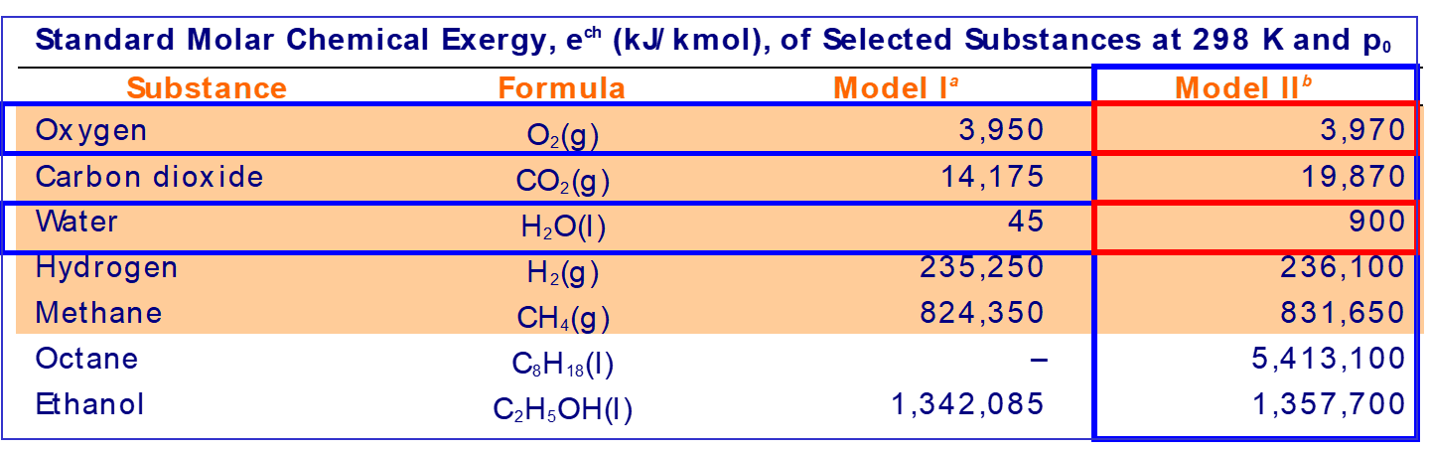
EXERGY – standard chemical exergy of other substances
a: Ahrendts, liquid water in equilibrium with the gas mixture as the Reference Environment.;
b: Szargut, NO liquid water in the Reference Environment.

Slide 24
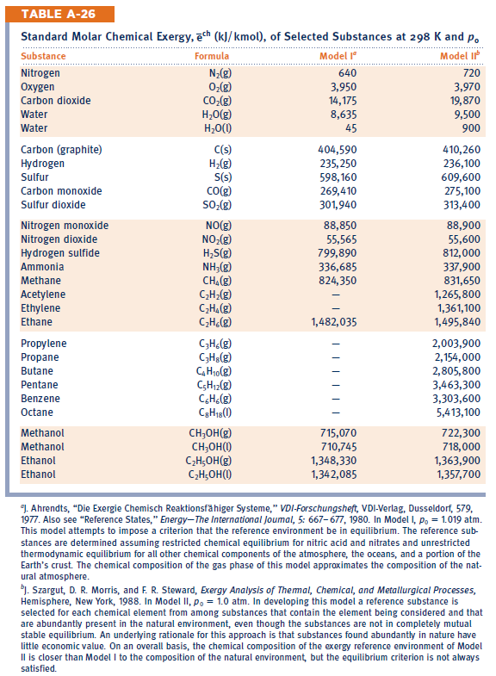
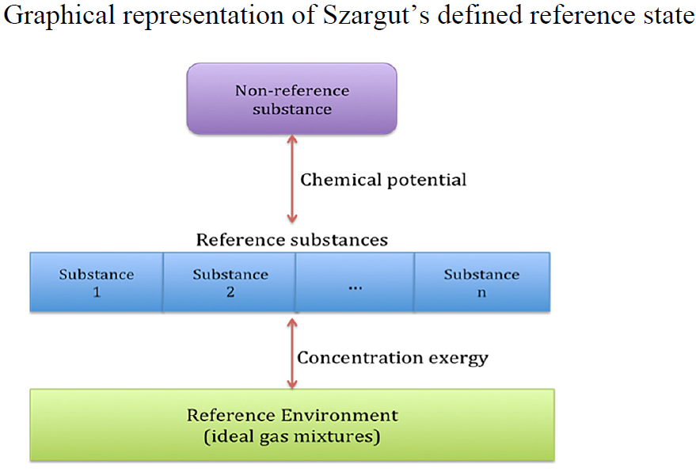
EXERGY – standard chemical exergy of other substances

Slide 25
EXERGY – standard chemical exergy of other substances

Slide 26
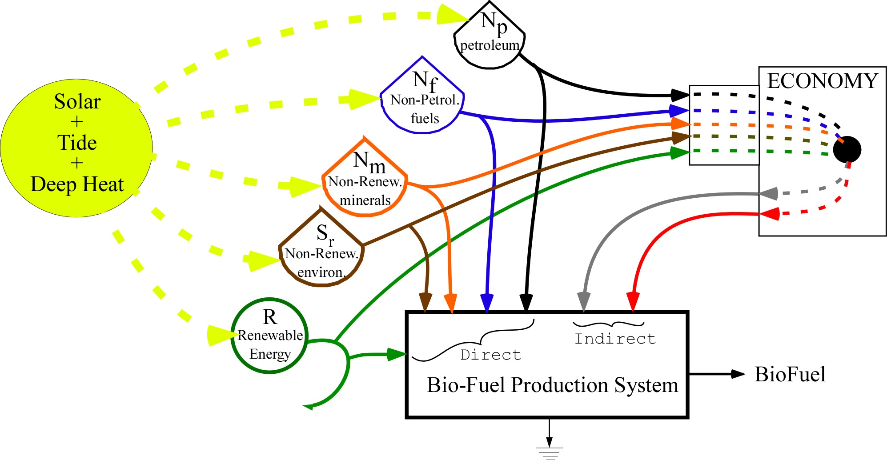
EMERGY
To answer the question: How much energy are we actually consuming?
The exergy evaluation therefore, focuses on the actual "use value" of the various energy and material flows, depending on the conditions (thermodynamic state) in which they are "here and now".
The EMERGY Analysis, on the other hand, aims to identify indirect consumption, up to a primary input, which is generally identified with the solar energy that arrived on Earth.
Goods
Services

Slide 27
EMERGY - Transformity
EMERGY is defined as the amount of available energy (exergy ??) of the same type (generally, solar) that is directly or indirectly invested to generate a given flow or amount of matter or energy. EMergy is measured in seJ (Joule of equivalent solar energy).
The TRANSFORMITY is the EMergy needed to generate an output unit. It may be regarded as the "environmental cost of production" (expressed as seJ / J, seJ / g, etc).
Goods
NB:
This approach, proposed by H.T. Odum in the 1970s, is applicable to both ecological systems (biological, geological, etc.) and production systems, in principle, of any type.
Services

Slide 28
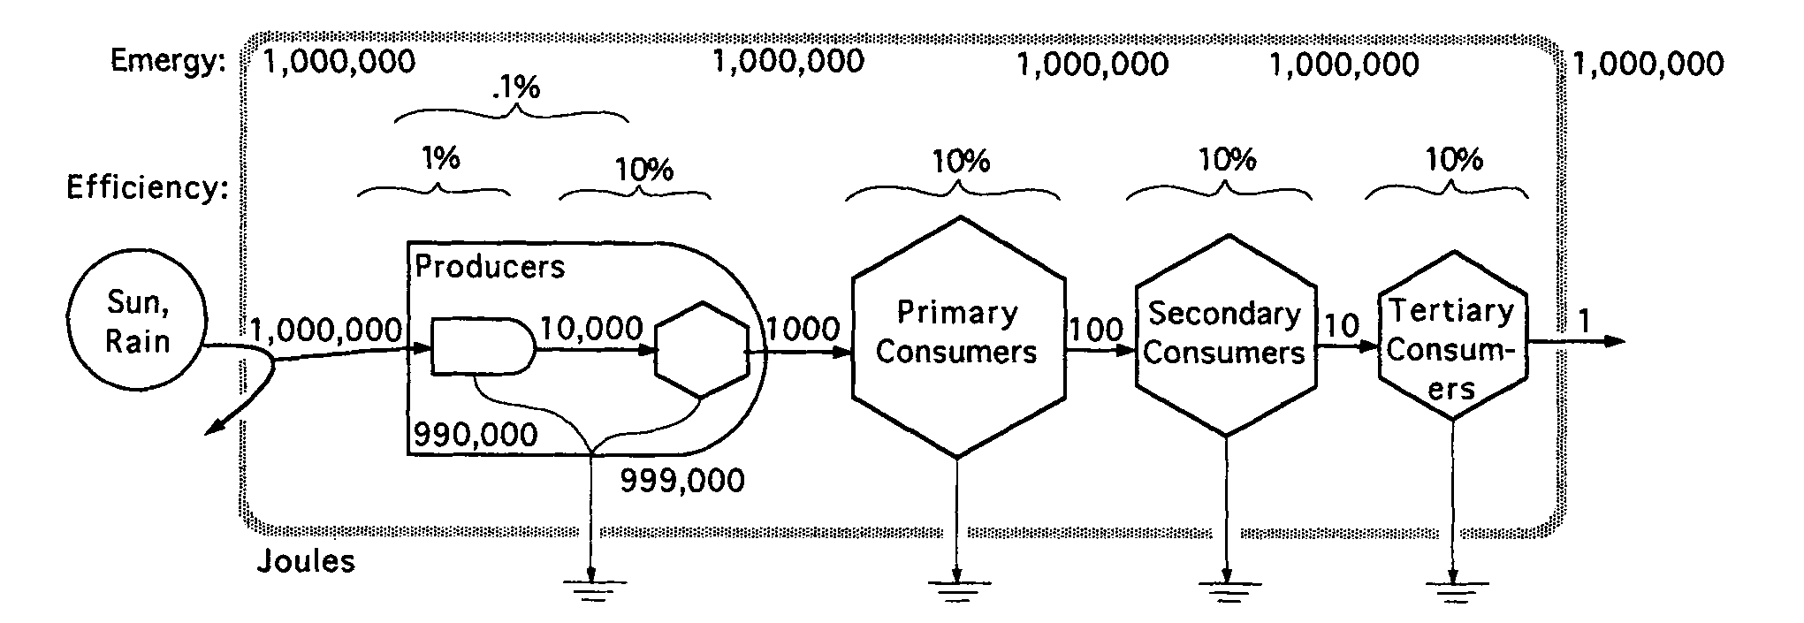
EMERGY - Transformity
From the very beginning, the eMergetic Analysis (EMA) has recognized how, in every transformation, part of the energy is degraded into low-temperature heat and only a part is transferred to the next stage of the conversion chain.
This reason, jointly with the reference to primary solar energy, which is an electromagnetic radiation i.e. in practice pure exergy, it has suggested the existence of some analogy with the Exergetic Analysis:
This analogy is senseless, as the spatial and temporal boundaries of the two approaches are different and because emergy depends on the history of the supply chains of a process, whilst exergy depends on the entropy generation inside the process and on the reference environment (an analogy exists instead with the Exergetic COST Analysis, as will be seen later).

Slide 29
EMERGY – the fundamental issue
How much primary energy has been used, directly or indirectly by the macro-system to maintain each of its internal flows at a defined value?
F
1
E
1
E
3
E
7
P
7
E
6
F
2
E
2
E
4
E
5
E
8
P
8
If the system is a linear chain operating in stationary conditions, the answer is easy to be obtained :
E₁ and E₂ correspond directly to the primary energies sources F₁ and F₂,
the flow E₃ is manteined by F₁(trasformity, or unit energy cost, k*₃ = F₁/ E₃),
the flow E₇ is manteined by a fraction of F₁ equal to E₇/ E₃; k*₇ = (E₇/ E₃) (F₁/ E₇) = k*₃,
the flow E₈ is manteined by the remainig part of F₁ by the whole flow F₂:
k*₈ = k*₃ (E₆/ E₈) + k*₅ (E₅/ E₈).

Slide 30
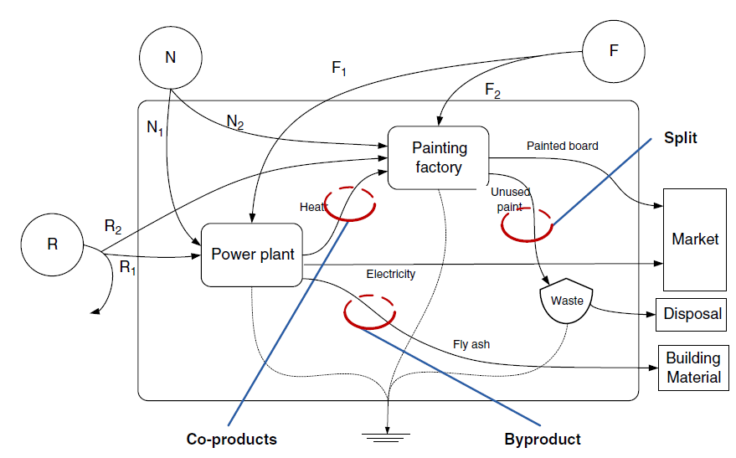
EMERGY – Recycling (feedback) and multi-products component
The EMA methodology is often presented as a set of axiomatic rules, in 4 points:
1) All the emergy input of a process is assigned to the output (or outputs) of the same process.
2) The co-products (multi-products) of a process have assigned the entire emergy input to each path.
3) When a flow splits, the two "branches" have the same transformity value.
4) The emergency cannot be counted twice: (a) the emergence of an upstream recirculating flow (feedback) cannot be accounted in the input of the component that receives it; (b) when two co-products are combined (totally or partially) their emergy cannot be summed up generating a sum greater than the source of emergy from which they were derived.
(Brown and Herendeen)

Slide 31
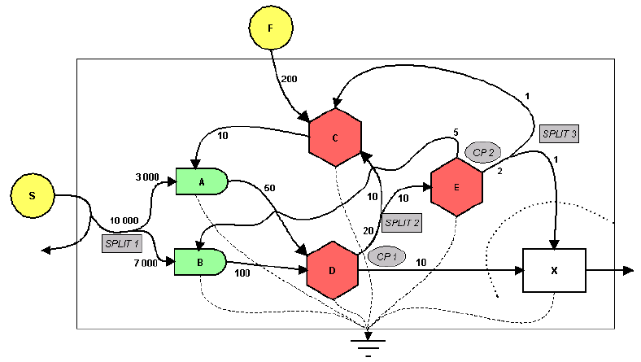
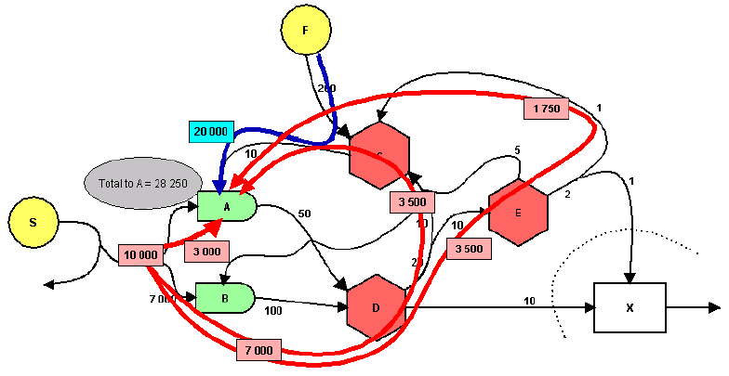
EMERGY – Recycling (feedback) and multi-products component
Paths to be consider in the evaluation of the input eMergy of process A, as a consequence of the EMA rules.
Energy is NOT a conservative quantity;
All efforts to obtain an algebraic formulation of eMergy accounting are failed;
There is a software that calculates eMergy, on the basis of the identification of the nature of co-product or split for the products obtained simultaneously.

Slide 32
EMERGY – avoiding “double counting”?
Flows of Energy (or exergy) in a system with split, recirculation and co-product.
Energy (or exergy) costs calculated without rules (2) and (4) to avoid double counting:
Budgets are conservative,
The budget of the system is consistent with those of the individual components,
An internal cost is greater than that of all the incoming input.
Emergy and Trasformity calculated without EMA rules :
Budgets are NOT conservative,
The budget of the system is NOT consistent with those of the individual components,
NO internal cost is greater than that of all the incoming input.
5
20
15
100
50
10
5 x 4=20
20 x 4=80
15 x 4=60
100 x 1=100
50 x 2,4=120
10 x 4=40
5 x 5=25
20 x 5=100
15 x 5=75
100 x 1=100
50 x 2=100
10 x 10=100

Slide 33
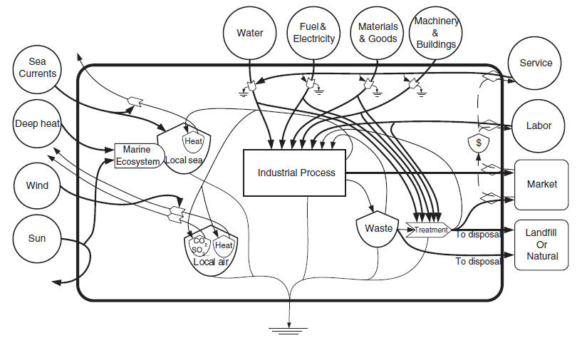
EMERGY - Exemple of eMergy model
A generic industrial process.
NB: the eMergy of all the resources considered must be known, including the eMergy equivalent of the human work and of the financial services used by the process.

Slide 34
Conclusions
The exergetic analysis allows you to evaluate on a common basis the different flows of energy and raw materials exchanged within a system, or between it and the outside;
It also allows the processes where the greatest irreversibility occurs to be identified and certainly constitutes a rational criterion for improving the efficiency of the components;
It does not take into account indirect consumption and the interactions between individual components and the whole system.
The EMergetic analysis specifically studies indirect consumption;
But it obliges us to trace-back the primary solar input also for those resources that are actually available in the environment;
It introduces its own rules of cost accounting (EMA) that make the energy non-conservative and the budgets of the components are not always consistent with those of the entire system.

Slide 35
Thank you for your attention!
Prof. Mauro Reini
reini@units.it
Suggestions:
https://www.youtube.com/watch?v=Iehgm8GyDOs
https://www.sciencedirect.com/science/article/abs/pii/S0360544218309423
http://web.mit.edu/2.813/www/readings/APPENDIX.pdf

