Slide 1



UNIVERSITÀ DEGLI STUDI DI TRIESTE
DIPARTIMENTO DI INGEGNERIA E ARCHITETTURA
Exergy Analysis and Exergy-based Cost Accounting & Optimization
Prof. M. Reini, Ph.D
Università degli Studi di Trieste
Dipartimento di Ingegneria e Architettura – Polo di Pordenone
reini@units.it

Slide 2
UNIVERSITÀ DEGLI STUDI DI TRIESTE
DIPARTIMENTO DI INGEGNERIA E ARCHITETTURA
Exergy Based Cost Accounting:
Thermoeconomics
Prof. M. Reini, Ph.D
Università degli Studi di Trieste
Dipartimento di Ingegneria e Architettura – Polo di Pordenone
reini@units.it

Slide 3
Outline
Basic ideas
The linear chain
3 illustrated problems for the linear chain
Exergy cost
Fuel Impact Formula
The production structure
Algebraic relations of thermoeconomics
Examples

Slide 4
The basic ideas of Thermoeconomics
How much primary energy has been used, directly or indirectly by the macro-system to maintain each of its internal flows at a defined value?
F
1
E
1
E
3
E
7
P
7
E
6
F
2
E
2
E
4
E
5
E
8
P
8
It is the same fundamental question that the eMergy Analysis wants to answer to, but:
All flows (energy and matter) are measured in a coherent and unambiguous way by their exergy which, once the conditions of the reference environment have been established, is a thermodynamic quantity that depends on the state of the flows.
The evaluation of the exergy cost (exergetic cost Π_{i} and exergetic unit cost k*_{i}) of all flows (internal and final products) takes place on the basis of conservative and consistent cost balances for each component and for the entire system, without worrying about the "double counting" problem.

Slide 5
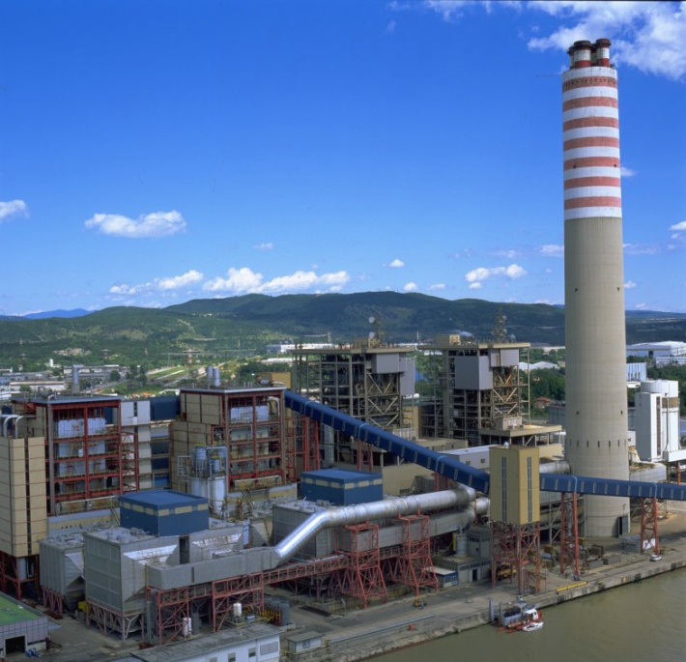
The basic ideas of Thermoeconomics
The term was introduced by Tribus and Evans, in 1962.
It was later developed by Gaggioli, El-Sayed.
In 1986 a fully algebraic version was introduced by Valero & Lozano, and then reformulated more generally in 1992.
In 1994, the “Fuel Impact Formula" was presented by Reini and Lozano (with different formalisms), which constitutes the conceptual framework for the application of the thermoeconomy to diagnostics and optimization of energy systems.
More recently, applications have also been proposed to ecological systems and to the analysis of the environmental interaction of industrial systems.
However, Thermoeconomics was born in the engineering field and therefore, the classic areas of application are energy conversion systems and the control volume of the original applications is that of a classic production plant.

Slide 6
The Linear chain in the Thermoeconomic description
Internal conbustion engine ⇒ Gearbox ⇒ Alternator
Internal conbustion engine ⇒ Gearbox ⇒ Heat Pump
SYSTEM:
Exergy Balance
Exergy efficiency
Component:
Exergy Balance
Exergy efficiency
LOSSES:

Slide 7
Thermoeconomics can face 3 kinds of problems
Costing - evaluating the (additional) consumption of resources of the global system to obtain one (more) unit of a defined flow, or as a consequence of a variation (deterioration) of the performance of one of its internal components, keeping constant the final product.
Diagnosis - having a plant in operating conditions different from the reference ones, allocate on each component the share of the greatest global consumption which it is responsible for.
Local optimization of a component - defining an optimization procedure which, while considering only the component in hand as if it were an isolated element, allows to obtain a solution that minimizes the overall consumption of system resources.
NB:
They all can be faced with the "classic" tools of energy engineering (balance equations of mass, energy, entropy, thermo-fluid dynamics relations and component characteristic curves);
BUT one is forced to consider always the entire system, and no direct correspondence, between the “local” performance of the components and the overall performance of the system, is highlighted.

Slide 8
Costing
P
F
T
E
E
E
T
E
2
3
4
1
1
2
3
F
k
=1/
η
P
=F
η
P
=F
k
=1/
η
P
1
1
1
1
2
k
=1/
2
3
3
3
3
2
2
Costing: evaluating the (additional) consumption of resources of the global system to obtain one (more) unit of a defined flow, or as a consequence of a variation (deterioration) of the performance of one of its internal components, keeping constant the final product.

Slide 9
The unit exergy cost & the non-equivalence of losses
k_{i}* is a thermodynamic magnitude, which depends on the state of the system and on the definition of exergetic flows E _{i}.
the additional global consumption corresponds exactly to the product of the additional local losses, by the unit exergetic cost, k_{i}* of the local resource, so that the problem of additional resource consumption is equivalent to that of "Costing".
"The additional global losses induced by the degradation of a component are the grater the higher the exergy cost of the flows used by the deteriorated component" (Principle of non-equivalence of losses)

Slide 10
Diagnosis
Is it correct to allocate on each component a share of the greatest global consumption equal to dF_{T} = dI_{i} ?
d
k
≠
k
≠
k
≠
1
0
d
2
0
d
3
0
d
F
= d
I
=
Σ
d
I
,
T
T
i
I
=
F
-
P
= (
k
-
1
)
P
⇒
d
I
=
[
k
P
]
[
k
1
P
]
i
i
i
i
i
i
d
i
i
+
(
i
-
) d
i
d
I
= d
k
E
+ (
k
-
1
) d
E
By eliminating:
dE₃= dk₃P_{T} ;
dE₂= dk₂E₃ + k₂dE₃
1
1
2
1
2
d
I
= d
k
E
+ (
k
-
1
) d
E
2
2
3
2
3
d
I
= d
k
E
= d
k
P
T
3
3
4
3

Slide 11
Impatto in Fuel
The modification dk₃ affects the irreversibility of all components.
Summing up the local losses, we obtain dI_{T} as a function of E_{i}, k_{i} in the reference conditions and of the modifications dk_{i}.
dF_{T}=k₁*dk₁E₂+k₂*dk₂E₃+k₃*dk₃P_{T}
Fuel Impact Relation

Slide 12
Local Optimization
In the optimization of an energy system, the costs associated with the direct consumption of external resources and the costs to have the production plant available (for making, maintaining and managing thee plant) must be taken into account simultaneously.
These costs are difficult to convert into exergetic terms, therefore, the classic approach of thermoeconomics consider to evaluate all flows on an economic basis (!) Using the monetary cost of exergy for direct resources, too.
Minimize: cost of energy consumed [$/h] + cost Z₂ associated to the component [$/h]
(Increases IF k2 increases) (Dencreases IF k2 increases)
IF (2) is the only component that has to be optimized, what is the right cost to be used for the energy consumed? It is NOT c₁, but:

Slide 13
Local Optimization
The internal Thermoeconomic costs (c_{i}) obtained by introducing the economic resources (Z_{i}), take into account of:
any further losses induced in the "upstream" conversion chain,
the different cost associated with the O&M of the "upstream" components, which have to process more energy, i.e. to change their "size".
Therefore, they allow you to locally optimize an internal component of a system even in the design phase!
An iterative procedure can be defined where, after the evaluation of the internal Thermoeconomic costs (c_{i}), the components are optimized “one by one”:
reducing the computational effort
allowing different, specific softwer to be used for each of them, without the need of the integration inside a BIG system model.

Slide 14
The Productive Structure
Energy systems cannot be always schematized as linear chains;
it is necessary to carry out a "re-aggregation" of exergetic flows;
Here the concepts of Fuel and Product has to be applied, in order of identifying the specific consumptions which transmit the effects of local irreversibility backward in the production chain,
two or more fuels per component may be considered, bacause having a different cost for each cause of irreversibility (i.e. for each Fuel) makes it possible to clearly identify the production chain involved in each modification considered in the design, or in the operation phases.
The F-P paradigm corresponds to the introduction of fictitious components (Junctions and Branches), or of introducing additional equations in the exergy cost balance of components;
the network of flows obtained in this way is the "Productive Structure"

Slide 15
The Productive Structure
In many cases it is useful to proceed with a disaggregation of the exergetic flows, separating the mechanical exergy from the thermal exergy.
Fuel and Product are defined on the basis of the concept of Exergy donor - Exergy acceptor.
Formalizing the product concept dealing with multi-product components may be much complex, whilst dissipative components (like condenser and throttling valves) have no clear products (!)
In practice, however, the analyst has ample freedom in defining the Production Structure, in particular the control volumes of the components.
8
9
11
2
3
1
4
10
5
6
7

Slide 16
The Productive Structure

Slide 17
The Productive Structure
The major problems in defining the SP concern the dissipative components, residues, by-products.
OPTIONS to properly define the condenser productive relation inside the PS of steam plant may be:
  Incorporate it into the control volume of the LP turbine (this does not allow to develop "local" considerations for the condenser alone)
  define the Fuel as the exergy lost from the condensing flow and the product as part of the exergy entering the turbine (the part in question is not uniquely defined), so that the LP turbine is able to “produce more”, thank to the contribution of the condenser.
  define the Fuel as the exergy lost by the condensing flow and the product as a new flow of the Negentropy = mT°(s_{liq}-s_{vap}), which must reach all the other components, crossed by the same mass flow (in this case, some fluxes are added in the PS of the other components which must not be accounted in the exergy balance of the individual components, but only in the calculation of the Thermoeconomic costs).

Slide 18
The Thermoeconomic relations in Matrix form
Characteristic Equation

Slide 19
The Thermoeconomic relations in Matrix form
Fuel Impact Formula
k* is the vector of the exergy costs calculated from the cost balance of all the components (real and fictitious) of the Productive Structure!

Slide 20
The Thermoeconomic relations in Matrix form
The THERMOECONOMIC MODEL
Total cost:

Slide 21
The Thermoeconomic relations in Matrix form
The THERMOECONOMIC MODEL
The costs λ (structural or marginal) are obtained from the same balance equations which supply the costs k*, by modifying only the constant term of the equation system!

Slide 22
The limits of the Thermoeconomic relations
Differential relations are used to evaluate finite variations of the state of the system.
The Impact relationships are globally exact, but each term can actually be allocated on a defined component only if the specific consumptions k_{i} are independent each other.
The thermoeconomic methods may obtain a precise allocation on the perturbed component of the losses which it is responsible for ,
Unfortunately, even components that have not experienced an actual perturbation may exhibit a non-zero impact term, because their performance parameters depend by some physical variable associated to a different component. (pressure losses downstream a turbine may affect its discharge pressure, therefor its isentropic efficiency, its exergy consumption, so that an impact term arises in the Impact Formula.(Induced malfunctions),
The "filtering" of the induced malfunction is currently the main objective in the development of thermoeconomic diagnostics. For example:
the re-allocation of the impact terms associated to the junctions (which generally have a non-zero impact, even though they are fictitious components),
the unbundling of pre-calculated impact terms:
related to the variation of T °,
related to the effect of the relationship between k_{i} and P_{i}
related to the dependence of the impact term on the effect of the system's regulation system alone.

Slide 23
EXEMPLE OF DIAGNOSIS

Slide 24
EXEMPLE OF DIAGNOSIS

Slide 25
EXEMPLE OF LOCAL OPTIMIZATION
ε η_{is}T_{c} c

Slide 26
EXEMPLE OF LOCAL OPTIMIZATION
“Locality test” on the project variables, to identify those that are actually local (those that influence a single impact term);
globally optimize the system with respect to the remaining variables (achieving a useful reduction in their number),
optimize the other variables "locally", proceeding in the iteration until convergence,
the advantage is to deal with simpler problems at each step, and to be able to use different models (in term of complexity, software, platform,….) for the different components.
Exemple
4 free variables of the thermodynamic model, resulted to be local with different degrees of approximation, relative to the condenser and the condensate extraction pump:
  the isentropic efficiency of the condensate pump,
  the neg-entropic efficiency of the condenser, (T °/ T_{condensate}),
  the efficacy (effectiveness) of the condenser,
  the speed of the cooling water in the condenser.

Slide 27
EXEMPLE OF LOCAL OPTIMIZATION
Capital cost Z_{h} have been expressed by means of equations ot the kind:
(T °/ T_{cond})
efficacy

Slide 28
CONCLUSIONS
k* is a new thermodynamic magnitude, which allows to take into account, through the Productive Structure, the global effect associated with a local modification of the components.
Energy diagnosis would be of the most promising applications, if it were possible to avoid the need to simulate the entire system and to fully identify the physical variables actually perturbed.
Unfortunately, the presence of the induced malfunction often forces the analyst to define complex filtering strategies, which do not always provide adequate results, in spite of the required effort.
Structural (marginal) costs λ are a generalization of exergy costs, BUT in monetary terms.
Through an appropriate formulation of costs Z, the structural costs take into account the effect of any local modification of a component on the overall cost of the system,
The costs λ allow the local optimization of the components inside the system, obtaining a compromise technical solution between greater efficiency and lower costs, that is very close to the optimal solution for the entire plant, in a very small number of iterations.

Slide 29
Thank you for your attention!
Prof. Mauro Reini
reini@units.it
Suggestions:
www.exergoecology.com
https://www.researchgate.net/publication/200729141_Theory_of_the_exergetic_cost
https://www.sciencedirect.com/science/article/pii/S0360544204003561

