Slide 1
Prevention and Control – passive and active immunization

Slide 2
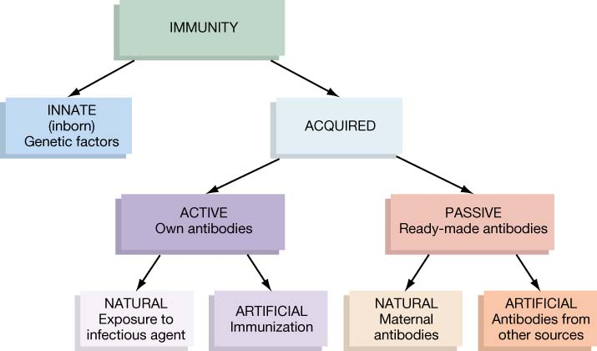
How do we acquire immunity?
Notes:
HOW LONG LASTING???
aby from other human beings - a few weeks to a few months
IgG from mom 3-6months
used for: botulism
diphtheria
hepatitis
measles
rabies
snake/spiders bites

Slide 3
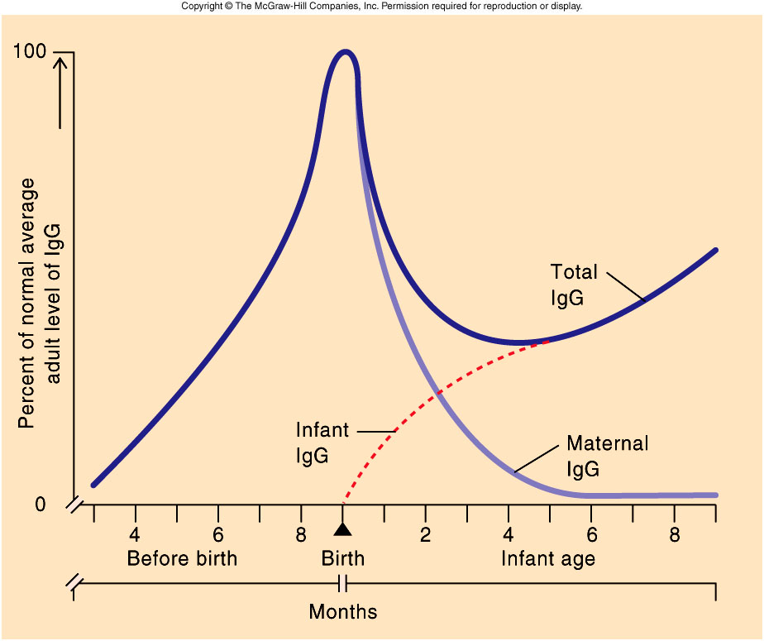
Passive Immunity in Infants

Slide 4
Artificial Passive Immunity
Gamma globulin
Ig’s from pooled blood of at least 1,000 human donors
variable content
non-specific
Specific immune globulin
higher titers of specific antibodies

Slide 5
Artificial Passive Immunity
Gamma globulin
Ig’s from pooled blood of at least 1,000 human donors
variable content
non-specific
Specific immune globulin
higher titers of specific antibodies
Antisera and antitoxins of animal origin

Slide 6
How do we acquire immunity?
Notes:
HOW LONG LASTING???
aby from other human beings - a few weeks to a few months
IgG from mom 3-6months
used for: botulism
diphtheria
hepatitis
measles
rabies
snake/spiders bites

Slide 7
Artificial Active Immunity
Vaccination (Immunization)
exposing a person to material that is an antigen but NOT pathogenic.
Notes:
Regardless of the nature of the immunizing substance, the mechanism of active immunization is the same:
When administred, the immune system recognizes it as foreign and produces antibodies or cytotoxic Tcells or both AND memory cells. The immune response is the same as the one that occurs during the course of a disease. The disease doesn’t occur because whole organisms aren’t used or (if whole orgare used) they have been weaked so that they are no longer virulent.

Slide 8
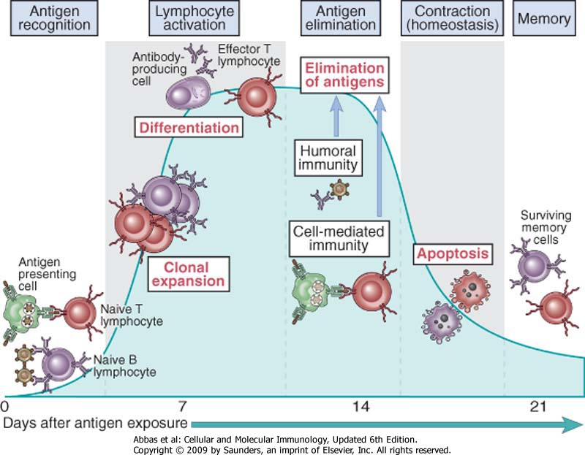
Phases of immune response

Slide 9
Designing vaccines
Important questions to consider:
1- Which part of the immune system should be activated?
2- Is immunologic memory sufficiently stimulated?
This depends on the disease..
- Influenza has a short incubation (1-2 d); effective immunity against flu depends on maintaining high levels of Ig through repeat immunizations
- Polio virus has a longer incubation (>3d) and gives memory cells time to produce serum Ig and activate immune cell effectors

Slide 10
Childhood vaccines
7 major vaccines:
HepB
DTaP (Diphtheria, Tetanus, Pertussis)
IPV (smallpox /vaiolo)
MMR (measles, mumps, and rubella / morbillo, parotite, rosolia)
Hib (Haemophilus influenzae type B)
Var (Varicella)
PCV (Pneumococcal Conjugate Vaccine)
*children require booster shots for most…
(American Academy of Pediatrics, 2002)

Slide 11
Adult vaccines (dependent on risk group)
For those living in close quarters
Meningitis (Hib)
Pneumonia (PCV)
Influenza
For travelers to endemic areas:
Cholera Meningits
Typhus Yellow fever
Typhoid Polio
Hepatitis

Slide 12
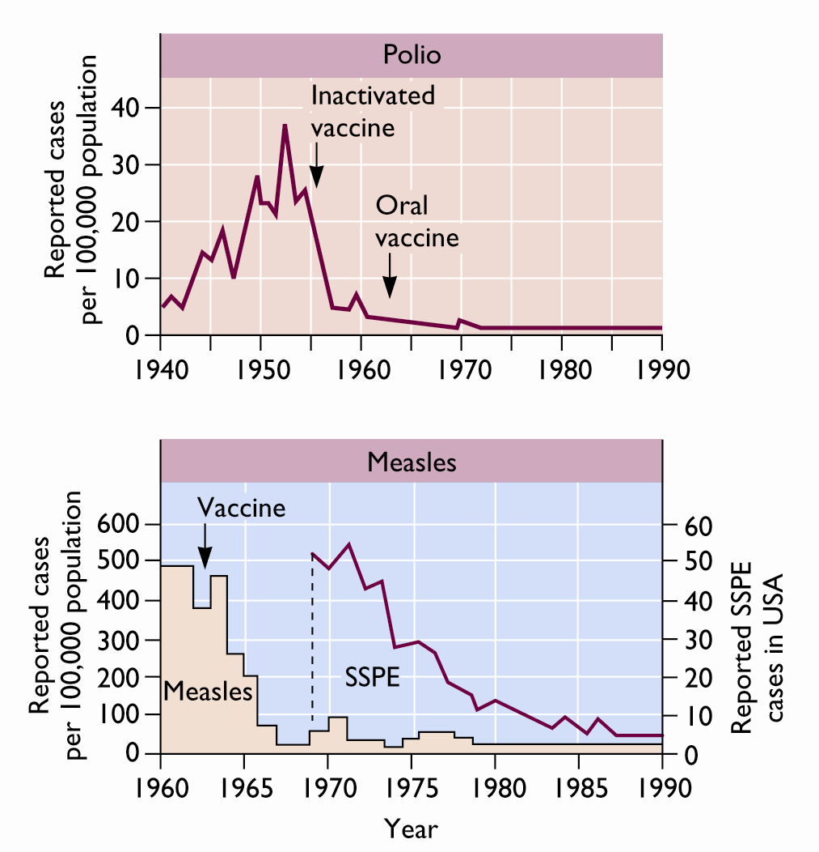
Large scale vaccination programs
Dramatic improvements in public health.
Nobody in this room has had…
Smallpox, Polio, Measles, Chickenpox
Mumps, Rubella
…Because of vaccination
Smallpox is the only human disease to ever be eradicated

Slide 13
Characteristics of a good vaccine
Safe / Few side effects
Give long lasting, appropriate protection
Low in cost
Stable with long shelf life (no special storage requirements)
Easy to administer
Public must see more benefit than risk

Slide 14
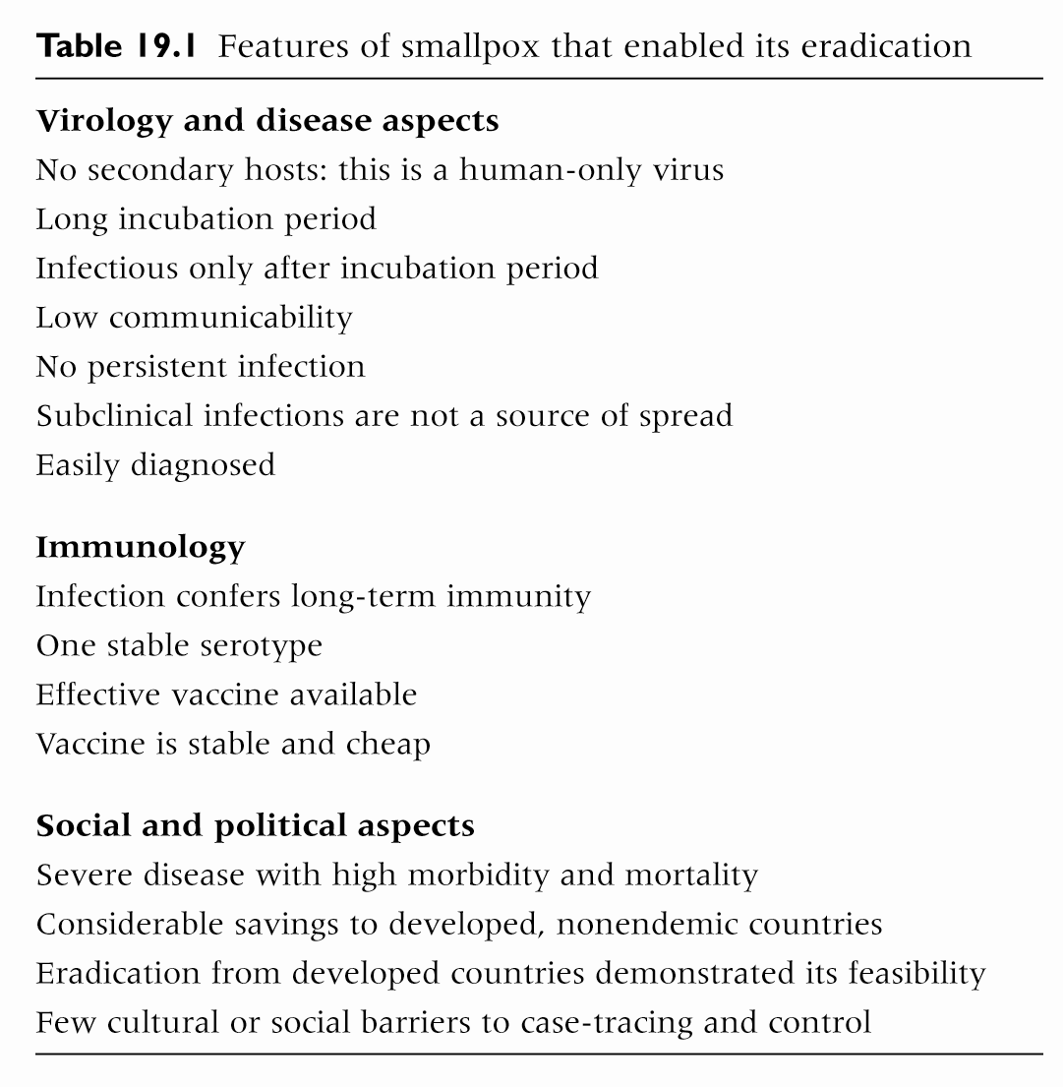

Slide 15
Types of vaccines
whole agent
subunit of the agent
recombinant
individual parts alone

Slide 16
Whole agent vaccines Killed using heat or formaldehyde
Live virus
Killed virus
epitopes
epitopes
Inactivated polio vaccine (Salk)
Influenza (Classic)
Notes:
Problem: These microbes are dead! Living organisms, b/c they replicate in the body, usually elicit a more robust immune response and are more likely than killed organisms to cause production of memory cells. Living organism provide longer stimulation of the immune system. Despite this limitation, there have been a number of effective killed microbe vaccines

Slide 17
Whole agent vaccines Attenuated
attenuated - a process that lessens the virulence of a microbe
oral polio vaccine (Sabin),
MMR (measles, mumps, rubella)
Influenza -- Flumist
Notes:
Attenuation is usually achieved by modfying the growth conditions or manipulating microbial genes in a way that eliminates virulence factors.
Attenuation methods include long-term cultivation, selection of mutant strains that grow at lower (or higher) temperatures, passage of the microbe through unnatural hosts or tissue culture
TB vaccine was obtained after 13 years of subculturing an agent of bovine TB

Slide 18
Attenuation of viruses by passage through non-human cells
Pathogenic virus isolated from patient, grown in human cells
Infect monkey cells with cultured virus
Virus acquires many mutations that allow it to grow well in monkey cells
Mutations make the virus unable to grow well in human cells
→ Vaccine candidate
1
2
3
4

Slide 19
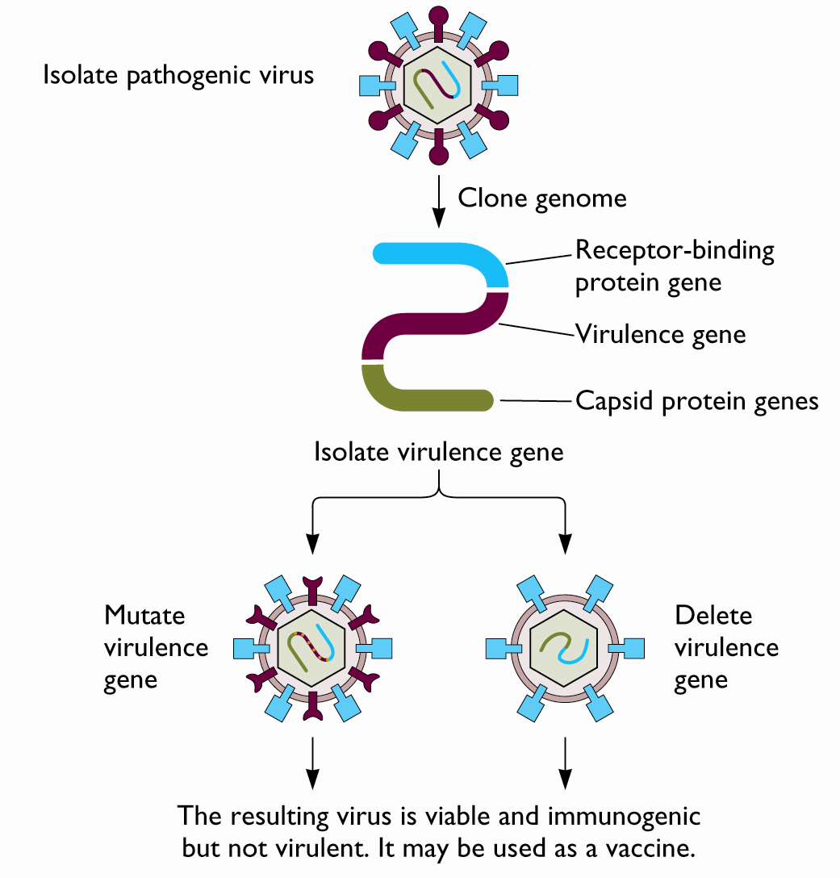
Construction of recombinant attenuated virus
Isolate virus
Clone genome
Isolate virulence gene
Mutate or delete virulence gene
Resulting virus is
Viable
Immunogenic
Not virulent
Can be used as a vaccine

Slide 20
Vaccines stimulate immune memory
Killed virus vaccine requires multiple doses (booster shots) to adequately stimulate a protective immune response
Live virus vaccines replicate in the host.
No requirement for boosters.

Slide 21
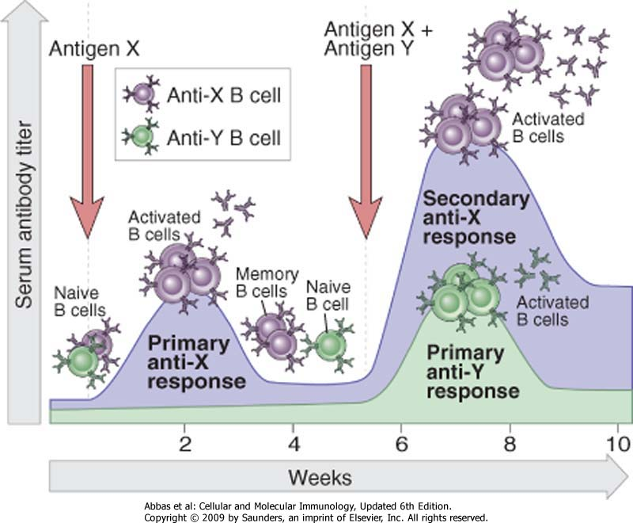

Slide 22
Vaccines stimulate immune memory
Killed virus vaccine requires multiple doses (booster shots) to adequately stimulate a protective immune response
Live virus vaccines replicate in the host.
No requirement for boosters.

Slide 23
Advantages for live vaccines
multiply like natural organism
require fewer doses and boosters
long-lasting
Disadvantages for live vaccines
special storage
back mutation
side effects
Notes:
side effects - both live and dead whole cell vaccines

Slide 24
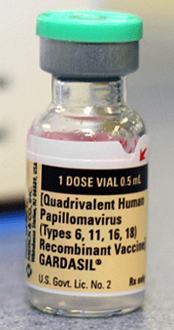
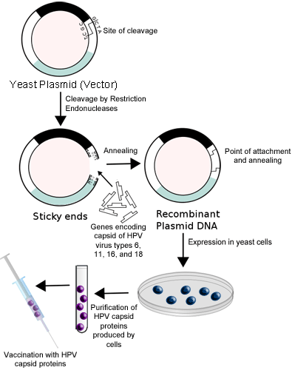
Subunit vaccines
Single antigen or mixture of antigens
Safer (cannot reproduce)
However, often less effective than whole agent vaccines
Can be costly
Always require boosters
Notes:
Provide an alternative to whole microbes vaccines in cases where the Whole microbes are toxic. Subunit vaccines have two drawbacks.
COST: it is much more expensive to extract and purify isolated antigens than to use intact microbes.
BOOSTERS: must be administered more than once to mimic the repeated stimulation of the immune system by a living organism.
Their safety has made them very popular.

Slide 25
Overcoming Subunit vaccine problems
Multiple doses
Use adjuvants
prolongs stimulation of immune response
works by trapping the antigens in a chemical complex and releases them slowly
Notes:
DTp - p was killed bacteria for whooping cough (Bordetella pertussis)
aP - acellular pertussis is now a toxoid - as effective as killed whole cells
Usually require a series of injections (boosters) b/c cannot replicate - THIS IS A PROBLEM!!

Slide 26
Types of vaccines
Live vaccines | Live Attenuated vaccines | Killed Inactivated vaccines | Toxoids | Cellular fraction vaccines | Recombinant vaccines
Small pox variola vaccine | BCG Typhoid oral Plague Oral polio Yellow fever Measles Mumps Rubella Intranasal Influenza Typhus | Typhoid Cholera Pertussis Plague Rabies Salk polio Intra-muscular influenza Japanise encephalitis | Diphtheria Tetanus | Meningococcal polysaccharide vaccine Pneumococcal polysaccharide vaccine Hepatitis B polypeptide vaccine | Hepatitis B vaccine

Slide 27
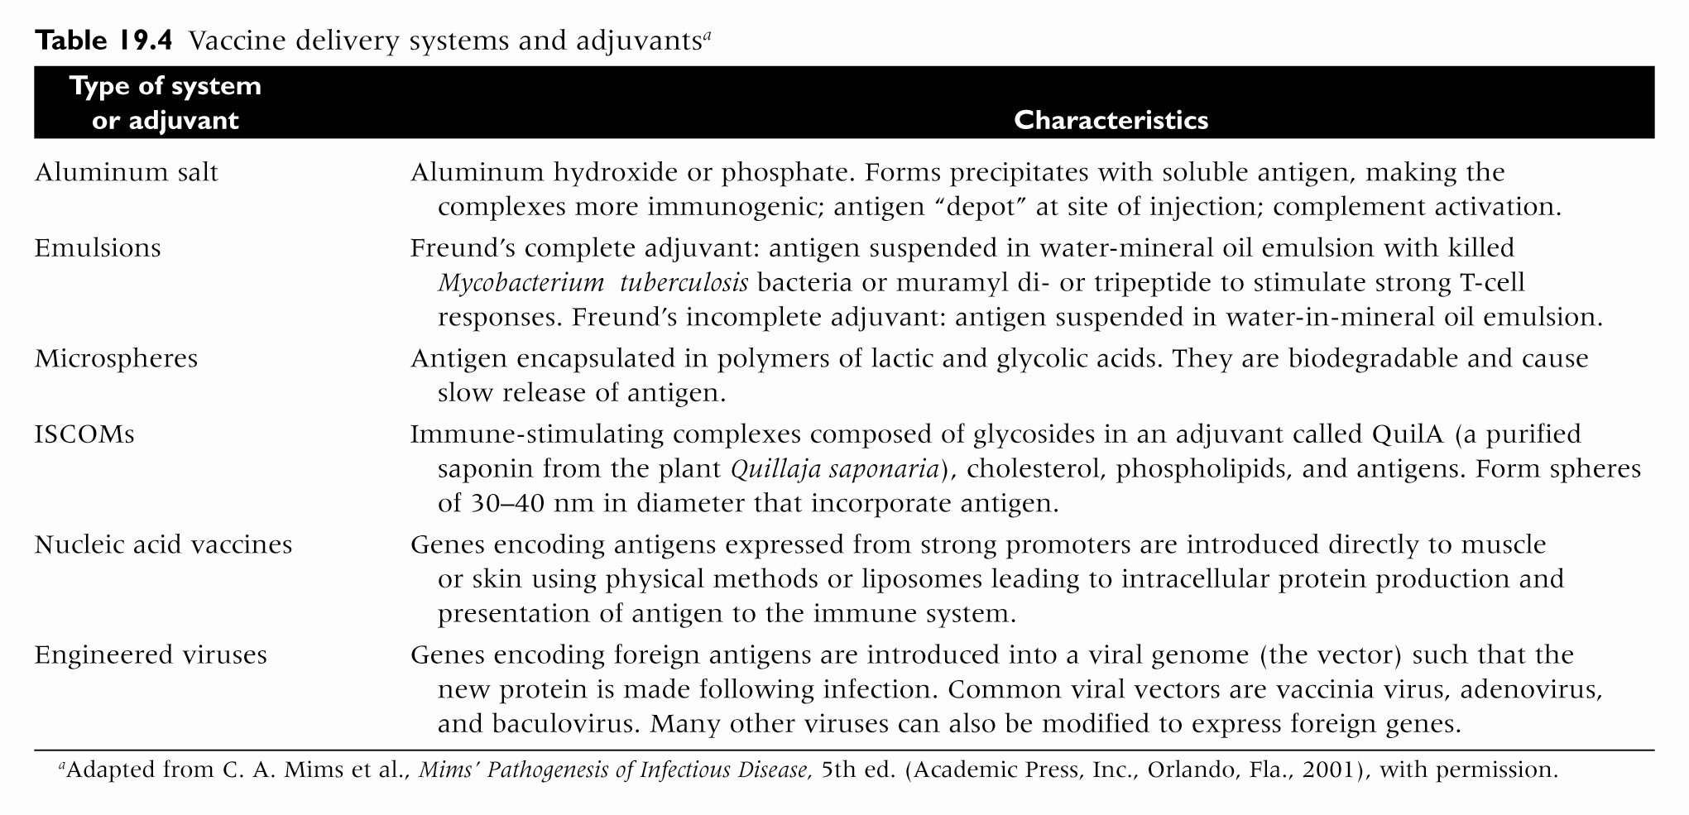
Vaccine delivery systems and adjuvants

Slide 28
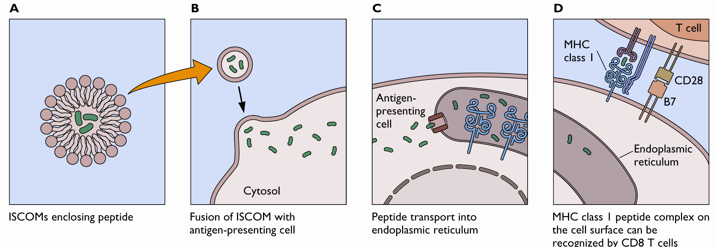
Vaccine delivery systems and adjuvants
ISCOMS as peptide delivery systems

Slide 29
Vaccine delivery systems and adjuvants

Slide 30
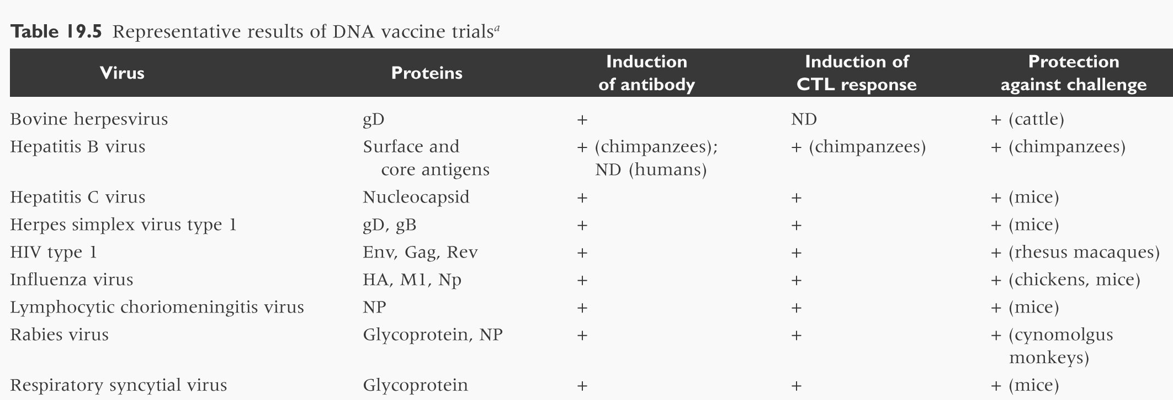
Representative results of DNA vaccine trials

Slide 31
DNA vaccines Vs Traditional vaccines
DNA vaccines
Traditional vaccines
Uses only the DNA from infectious organisms.
Avoid the risk of using actual infectious organism.
Provide both Humoral & Cell mediated immunity
Refrigeration is not required
Uses weakened or killed form of infectious organism.
Create possible risk of the vaccine being fatal.
Provide primarily Humoral immunity
Usually requires Refrigeration.

Slide 32
DISADVANTAGES
Limited to protein immunogen only
Extended immunostimulation leads to chronic inflammation
Some antigen require processing which sometime does not occur

Slide 33
Vaccine delivery systems and adjuvants

Slide 34
Routes of administration
Deep subcutaneous or intramuscular route (most vaccines)
Oral route (sabine vaccine, oral BCG vaccine)
Intradermal route (BCG vaccine)
Scarification (small pox vaccine)
Intranasal route (live attenuated influenza vaccine)

Slide 35
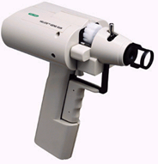
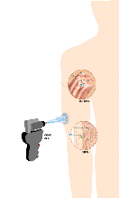
Routes of administration
Gene gun delivery:-
Adsorbed plasmid DNA into gold particles
Ballistically accelerated into body with gene gun.

Slide 36
HOW DNA VACCINE WORKS
BY TWO PATHWAYS
ENDOGENOUS :- Antigenic Protein is presented by
cell in which it is produced
EXOGENOUS :- Antigenic Protein is formed in
one cell but presented by different cell

Slide 37
Scheme of immunization
Primary vaccination
One dose vaccines (BCG, variola, measles, mumps, rubella, yellow fever)
Multiple dose vaccines (polio, DPT, hepatitis B)
Booster vaccination
To maintain immunity level after it declines after some time has elapsed (DT, MMR).

Slide 38
Periods of maintained immunity due to vaccines
Short period (months): cholera vaccine
Two years: TAB vaccine
Three to five years: DPT vaccine
Five or more years: BCG vaccine
Ten years: yellow fever vaccine
Solid immunity: measles, mumps, and rubella vaccines.

Slide 39
Levels of effectiveness
Absolutely protective(100%): yellow fever vaccine
Almost absolutely protective (99%): Variola, measles, mumps, rubella vaccines, and diphtheria and tetanus toxoids.
Highly protective (80-95%): polio, BCG, Hepatitis B, and pertussis vaccines.
Moderately protective (40-60%) TAB, cholera vaccine, and influenza killed vaccine.

Slide 40
Vaccination Coverage
Vaccination coverage is the percent of at risk or susceptible individuals, or population who have been fully immunized against particular diseases by vaccines or toxoids. To be significantly effective in prevention of disease on mass or community level at least a satisfactory proportion (75% or more) of the “at risk” population must be immunized.

Slide 41
New approaches
Cancer
HIV/AIDS
Malaria
Vaccines against bioterrorism
Anthrax
Small pox
plague

Slide 42
