Slide 1
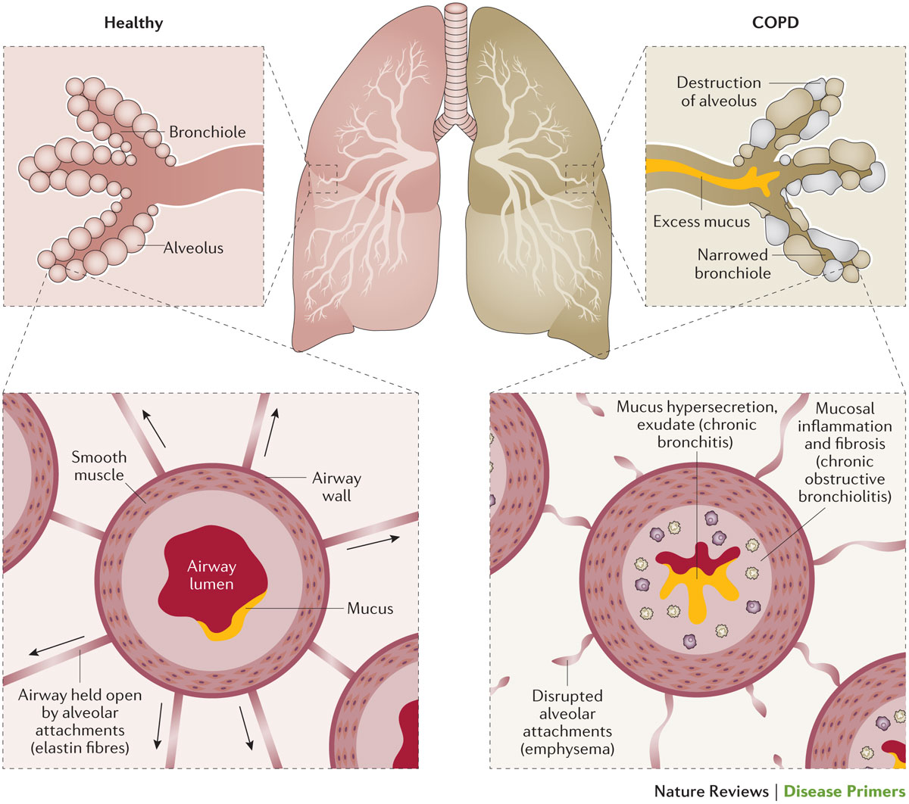
Airway obstruction in COPD
La BPCO è una malattia con aspetti anche di infiammazione delle vie aeree che può essere di vari tipi.
Comunemente nella fase di bronchite cronica (es. da fumo) si tratta di flogosi neutrofila (con linfociti CD8)
Vi può essere anche eosinofilia se la componente di asma è prioritaria e durante le riacutizzazioni
Barnes, P. J. et al. (2015) Chronic obstructive pulmonary disease
Nat. Rev. Dis. Primers doi:10.1038/nrdp.2015.76

Slide 2
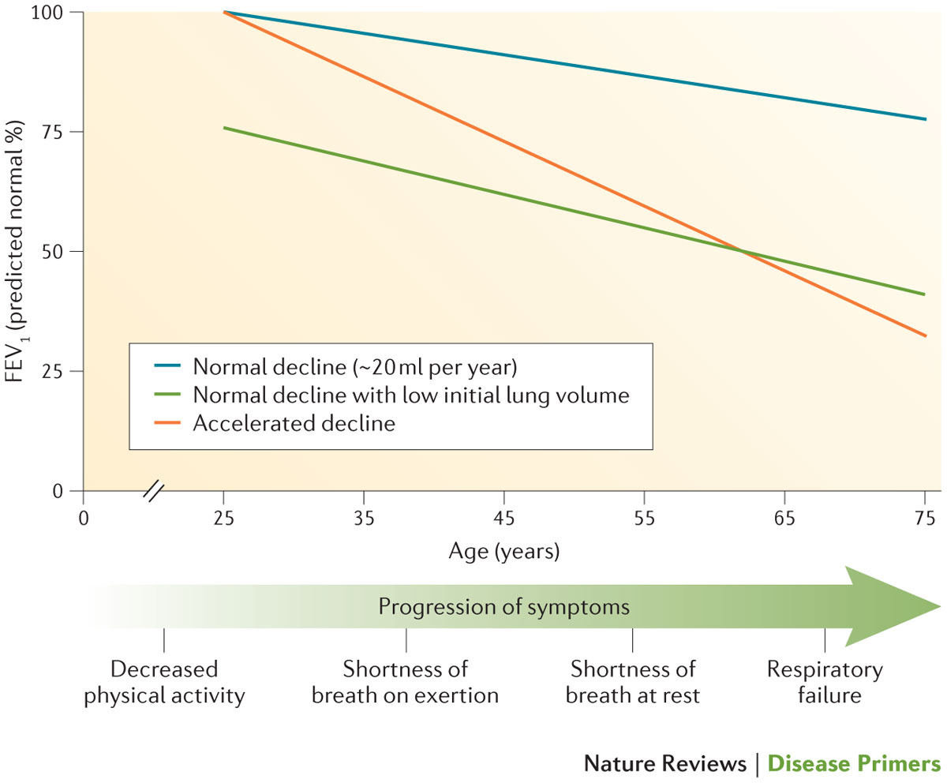
Disease progression in COPD
Barnes, P. J. et al. (2015) Chronic obstructive pulmonary disease
Nat. Rev. Dis. Primers doi:10.1038/nrdp.2015.76

Slide 3
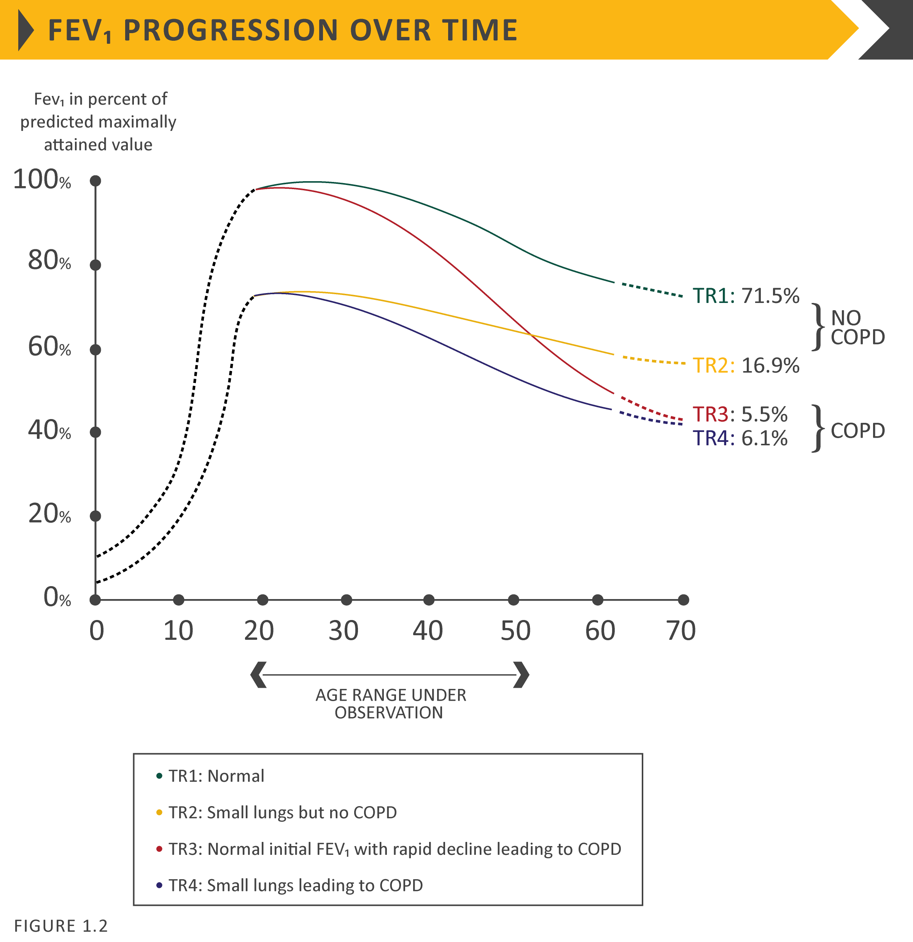
FEV₁ progression over time
© 2019 Global Initiative for Chronic Obstructive Lung Disease

Slide 4
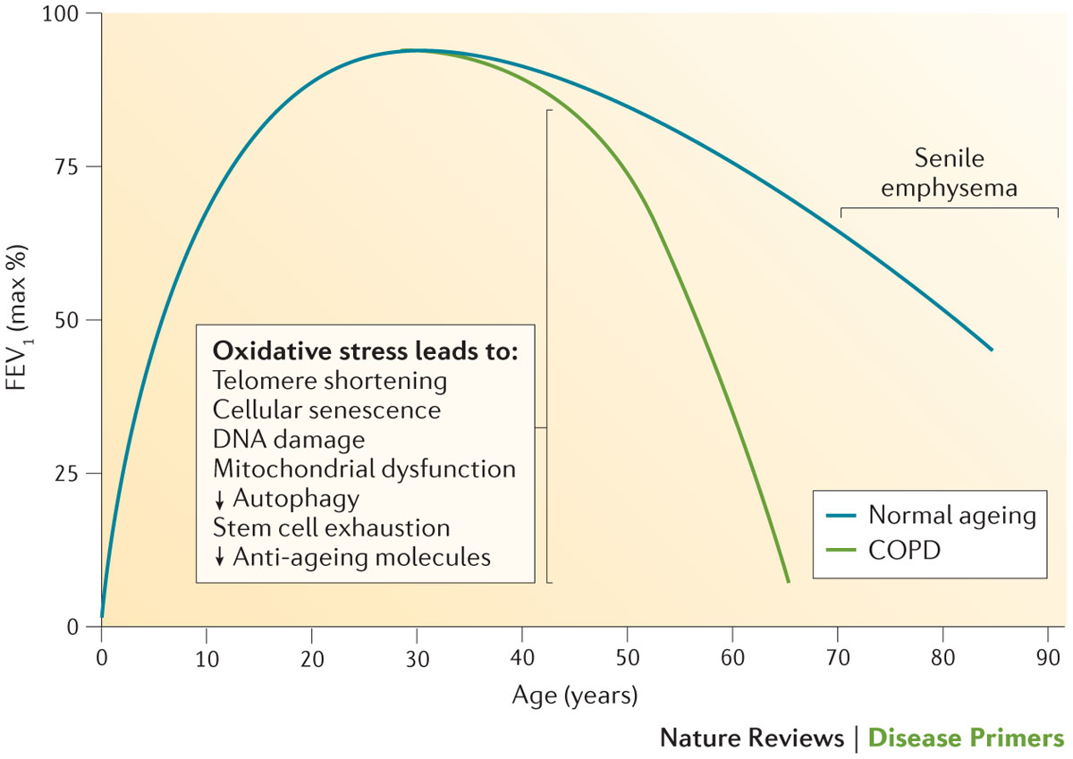
Accelerated ageing in COPD
Barnes, P. J. et al. (2015) Chronic obstructive pulmonary disease
Nat. Rev. Dis. Primers doi:10.1038/nrdp.2015.76

Slide 5
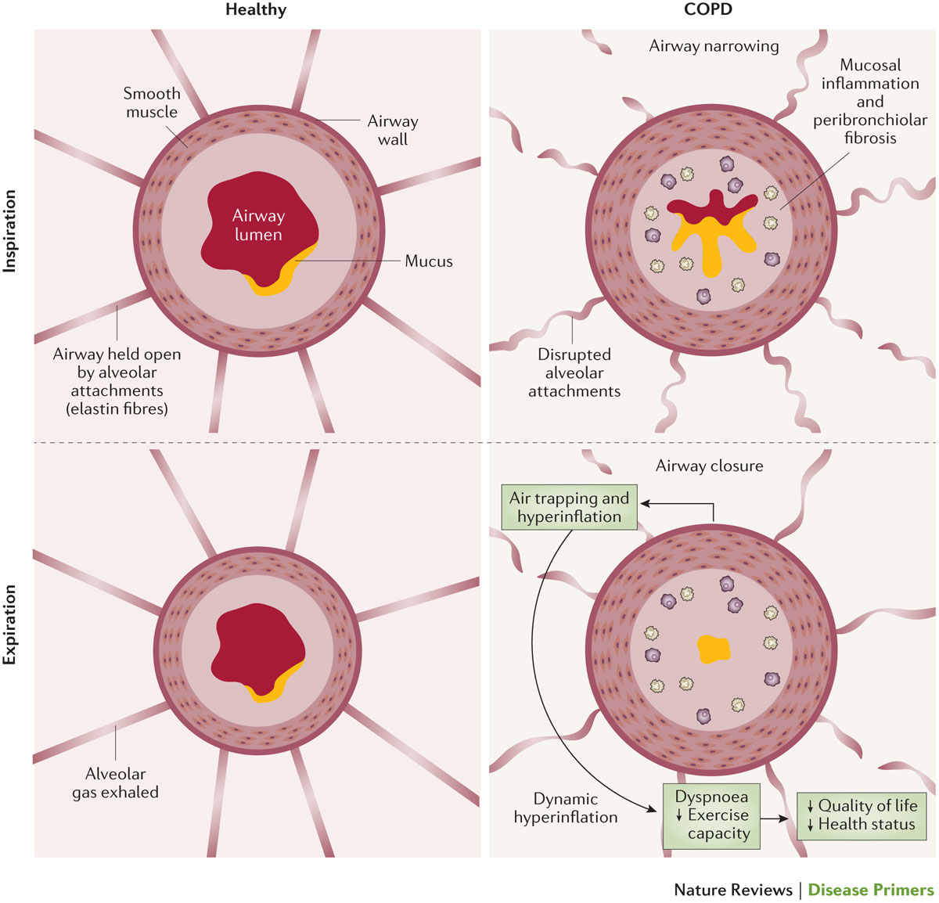
Air trapping in COPD
Barnes, P. J. et al. (2015) Chronic obstructive pulmonary disease
Nat. Rev. Dis. Primers doi:10.1038/nrdp.2015.76

Slide 6
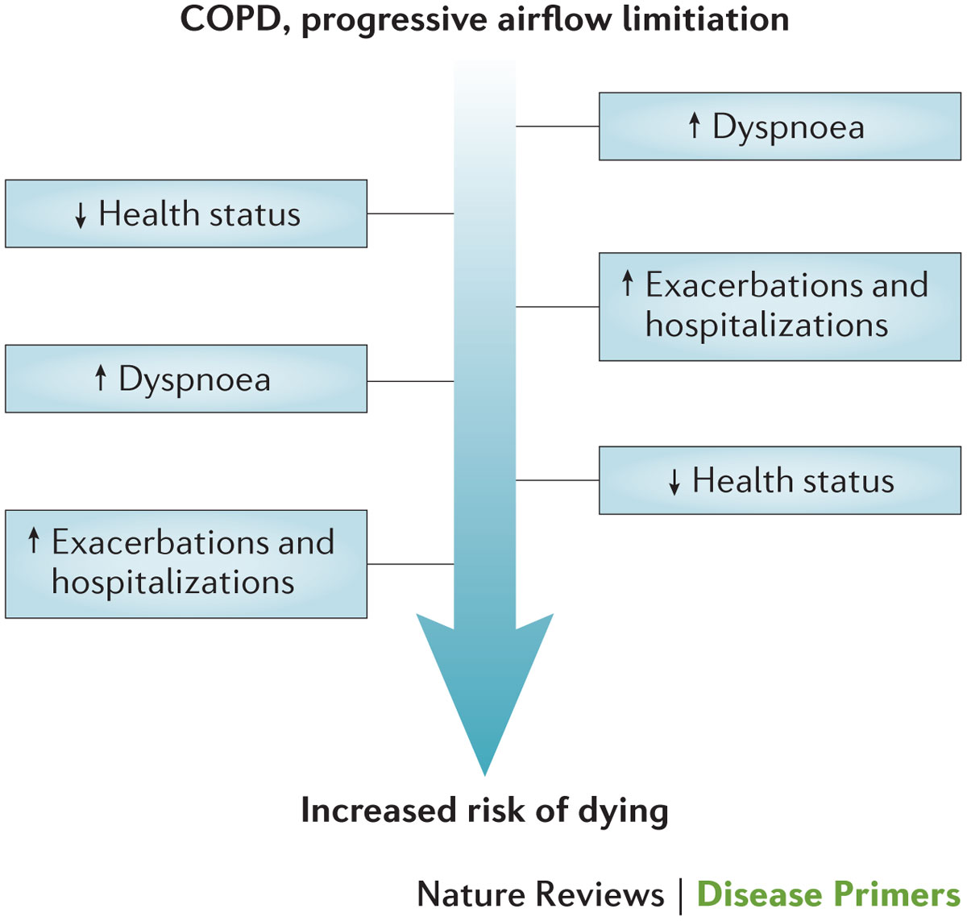
Downward spiral of health-related quality of life in COPD
Barnes, P. J. et al. (2015) Chronic obstructive pulmonary disease
Nat. Rev. Dis. Primers doi:10.1038/nrdp.2015.76

Slide 7
Factors that influence disease progression
Genetic factors
Age and gender
Lung growth and development
Exposure to particles
Socioeconomic status
Asthma & airway hyper-reactivity
Chronic bronchitis
Infections
© 2019 Global Initiative for Chronic Obstructive Lung Disease

Slide 8
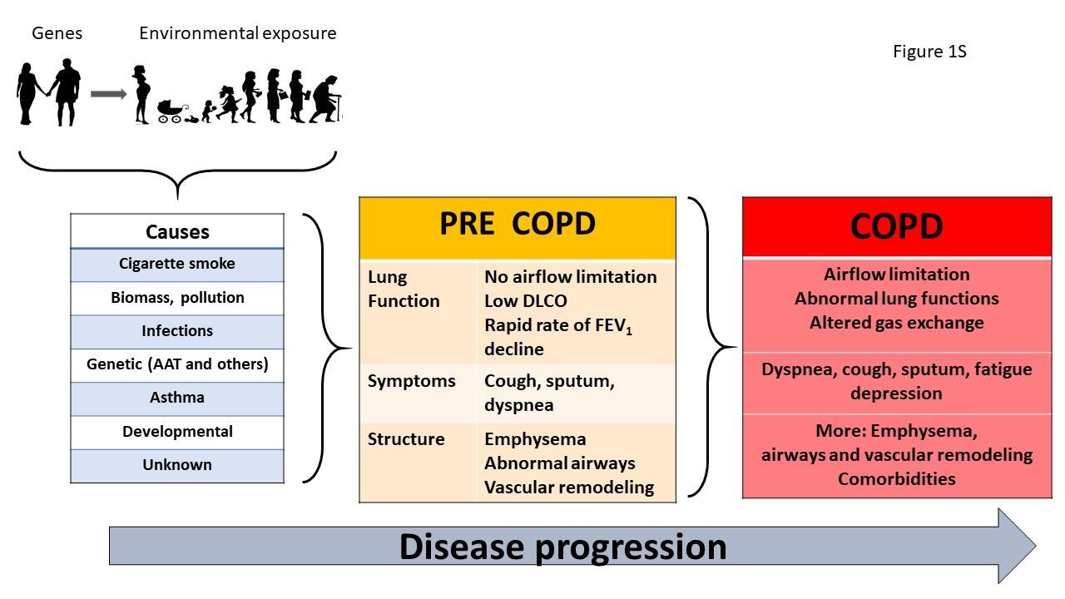

Slide 9
Prevention & Maintenance Therapy
Inhaler technique needs to be assessed regularly.
Influenza vaccination decreases the incidence of lower respiratory tract infections.
Pneumococcal vaccination decreases lower respiratory tract infections.
Pulmonary rehabilitation improves symptoms, quality of life, and physical and emotional participation in everyday activities.
In patients with severe resting chronic hypoxemia, long-term oxygen therapy improves survival.
© 2017 Global Initiative for Chronic Obstructive Lung Disease
© 2019 Global Initiative for Chronic Obstructive Lung Disease

Slide 10
Prevention & Maintenance Therapy
In patients with stable COPD and resting or exercise-induced moderate desaturation, long-term oxygen treatment should not be prescribed routinely. However, individual patient factors must be considered when evaluating the patient’s need for supplemental oxygen.
In patients with severe chronic hypercapnia and a history of hospitalization for acute respiratory failure, long-term non-invasive ventilation may decrease mortality and prevent re-hospitalization.
In select patients with advanced emphysema refractory to optimized medical care, surgical or bronchoscopic interventional treatments may be beneficial.
Palliative approaches are effective in controlling symptoms in advanced COPD.
© 2017 Global Initiative for Chronic Obstructive Lung Disease
© 2019 Global Initiative for Chronic Obstructive Lung Disease

Slide 11
Smoking Cessation
Smoking cessation has the greatest capacity to influence the natural history of COPD.
If effective resources and time are dedicated to smoking cessation, long-term quit success rates of up to 25% can be achieved.
© 2017 Global Initiative for Chronic Obstructive Lung Disease
© 2019 Global Initiative for Chronic Obstructive Lung Disease

Slide 12
Vaccination
Influenza vaccination can reduce serious illness (such as lower respiratory tract infections requiring hospitalization) and death in COPD patients.
Pneumococcal vaccinations, PCV13 and PPSV23, are recommended for all patients ≥ 65 years of age.

Slide 13
Pharmacological therapy
Overview of the medications
Pharmacological therapy for COPD is used to reduce symptoms, reduce the frequency and severity of exacerbations, and improve exercise tolerance and health status.
To date, there is no conclusive clinical trial evidence that any existing medications for COPD modify the long-term decline in lung function.
The choice within each class depends on the availability and cost of medication and favorable clinical response balanced against side effects.
Each treatment regimen needs to be individualized as the relationship between severity of symptoms, airflow limitation, and severity of exacerbations can differ between patients.
© 2019 Global Initiative for Chronic Obstructive Lung Disease

Slide 14
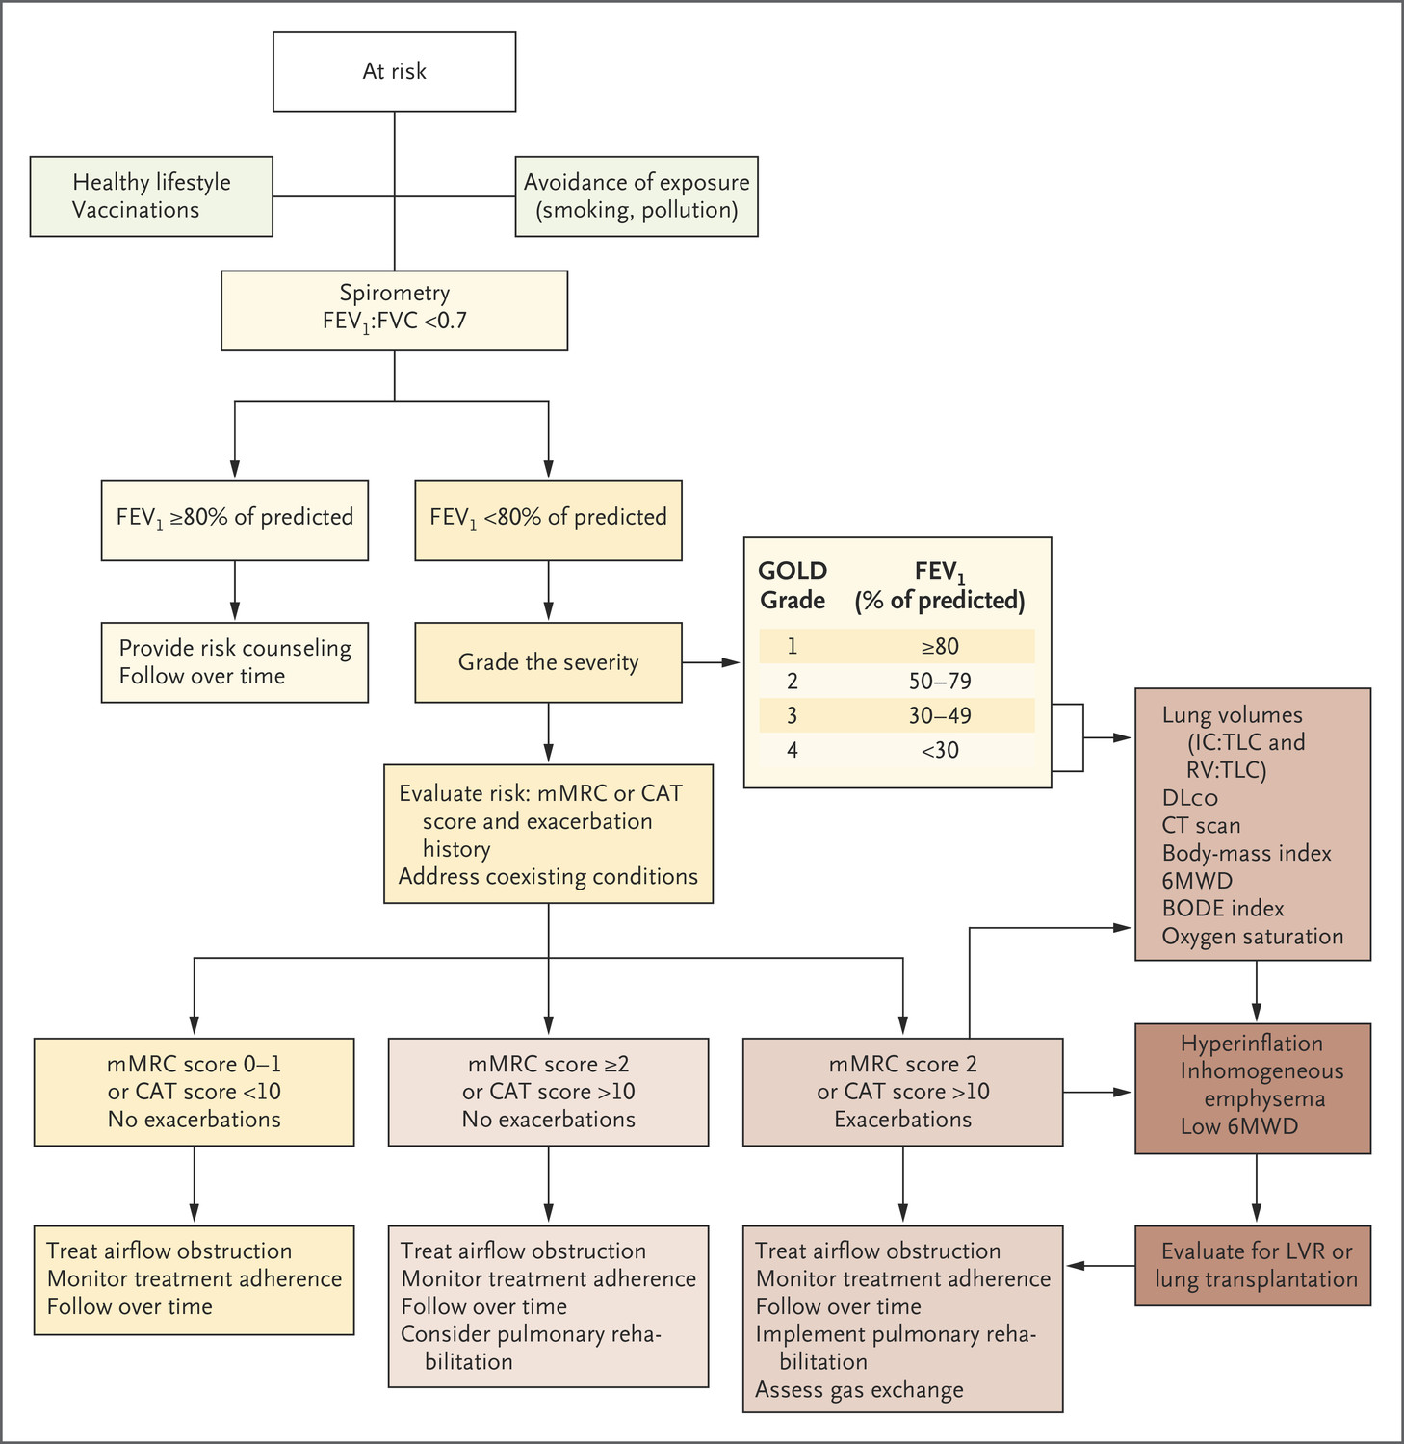
BR Celli, JA Wedzicha. N Engl J Med 2019;381:1257-1266.
Evaluation and Treatment of Persons with COPD or at Risk for COPD.
Primary care
Pulmonologist
Notes:
Figure 2. Algorithm for the Evaluation and Treatment of Persons with COPD or at Risk for COPD. Most patients with mild symptoms (green) and no exacerbations per year do well with exposure control, increased physical activity, vaccinations, and use of long-acting bronchodilators. The green and yellow pathways are usually the domain of primary care practitioners. The brown pathways are best managed by health care professionals with experience in COPD management. The darker shades of yellow and brown indicate more severe disease or more complex therapy than the lighter shades. Global Initiative for Chronic Obstructive Lung Disease (GOLD) grade 1 indicates mild disease, and GOLD grade 4 very severe disease. The BODE index consists of the integration of body-mass index, the degree of airflow obstruction, the severity of dyspnea, and exercise capacity (6-minute walking distance [6MWD]). CAT denotes COPD Assessment Test, DLCO diffusing capacity of the lung for carbon dioxide, FEV₁ forced expiratory volume in 1 second, FVC forced vital capacity, IC inspiratory capacity, LVR lung-volume reduction, mMRC modified Medical Research Council dyspnea scale, RV residual volume, and TLC total lung capacity.

Slide 15
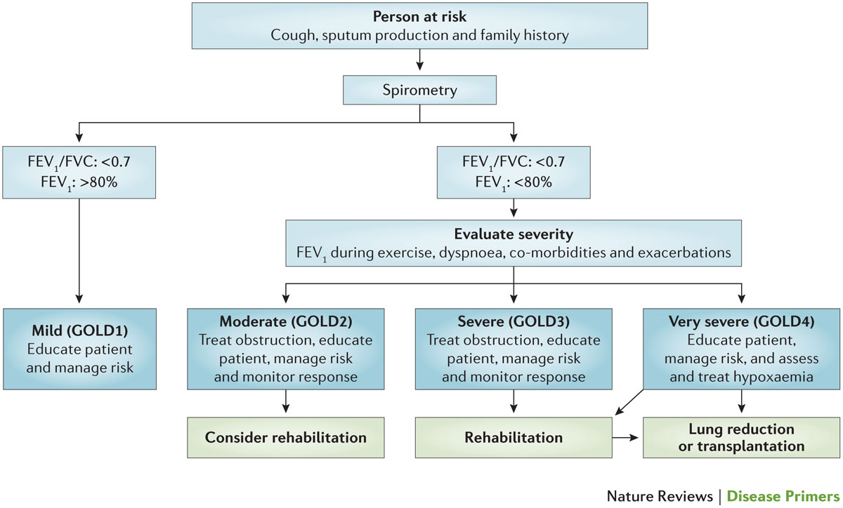
Algorithm for the diagnosis, staging and management programme for COPD
Barnes, P. J. et al. (2015) Chronic obstructive pulmonary disease
Nat. Rev. Dis. Primers doi:10.1038/nrdp.2015.76

