Slide 1
La cytokine release syndrome – istologia
A-B:
Danno alveolare diffuso con essudato
Desquamazione di pneumociti e formazione di membrane jaline (ARDS)
Edema polmonare
Infiltrato mononucleare interstiziale
Pneumociti modificati (macrofagi) con modifiche citopatiche a «tipo virale»
C-D:
Steatosi epatica
Infiltrato mononucleare cardiaco
Xu Z. et al. Lancet Respir Med 2020

Slide 2
Caratteristiche cliniche Complicanze
Neurological
Febbre: 83 – 98%
Cefalea: 6 – 16%
Confusion: 0 – 9%
Systemic
Septic shock: 4 – 8%
Muscular
Myalgia or fatigue: 11 – 41%
Cardiac
Arrhytmia: 17% circa
Acute cardiac injury: 7 – 12%
Respiratory:
Cough (usually dry): 47 – 82%
Expectoration: 26 – 28%
Dyspnea: 14 – 59%
Sore throat: 5 – 17%
Runny nose: 3 – 4%
Chest pain: 2 – 14%
Respiratory
ARDS: 17 – 29%
Renal
AKI: 3 – 7%
Gastrointestinal:
Diarrhea: 2 – 14%
Nausea/Vomiting 1 – 6%
Zhu Y. et al. J infect 2020; Lake MA. Clin Med 2020; Xiong Y et al. Invest Radiol 2020; Xia W et al. Pediatr Pulmonol 2020; Huang C et al. Lancet 2020;
Wang Y et al. J Med Virol 2020; Young BE et al. JAMA 2020; Li K et al. Invest Radiol 2020; Tian S et al. J infect 2020; Chen N et al. Lancet 2020

Slide 3
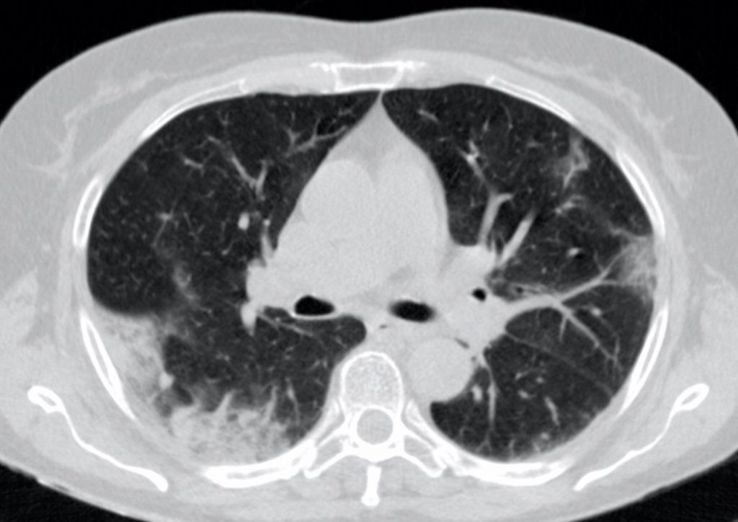
Caratteristiche radiografiche iniziali
Polmonite bilaterale con addensamenti «ad alveare» e area di «ground glass» a pattern periferico. Evidente ispessimento bronchiale infiammatorio.
Caso numero 22. Dalla repository gratuita della Società Italiana di Radiologia Medica e Interventistica. Accesso 11.03.2020

Slide 4
Caratteristiche radiografiche malattia avanzata

Slide 5
Sintomi clinici
Febbre 58%
Tosse 54%
Malessere 29%
Espettorazione 25%
Mialgie-artralgie 45%
Manifestazioni cutanee 10%
Anoosmia 22%
Anaugesia 20%
Iperestesia cutanea 18%
Dispnea 30%
Astenia 28%
Diarrea 16%
Inappetenza, nausea 38%

Slide 6
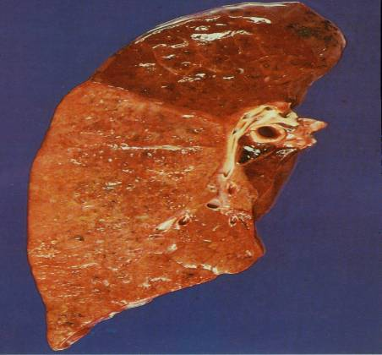
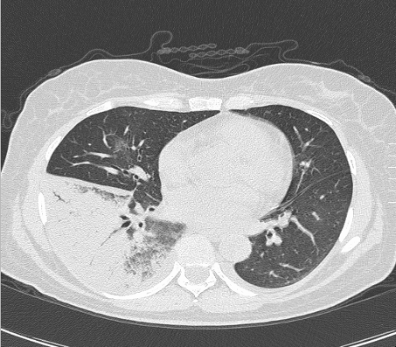
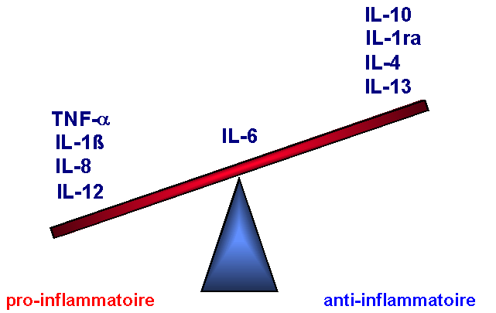
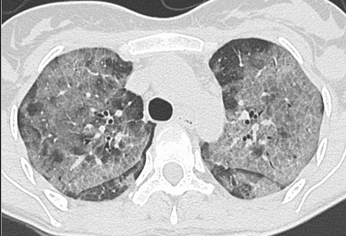
Lobar Pneumonia
Compartimentalized (localized) and self-limiting inflammatory response
Spill over
Diffuse and uncontrolled persistently inflammatory response
ALI-ARDS
379726

Slide 7
Il ruolo regolatore centrale del recettore alfa dei glucocorticoidi (GR𝞪)

Slide 8
Regulation of Inflammation by GRα
TNFα and IL-1β
Activation HPA-axis
Ischemia/Reperfusion
Glucocorticoid
Systemic Inflammation
Physical stress
Cell Membrane
NF-κB-GR
IL-10
I-κB
Kinases
TNF−α
IL-1β
IL-6
Kinases
GRα
GRα
p
p
p65
p65
I-κB
I-κB
p50
p50
Glucocorticoid
receptor
mRNA
NF-κB
mRNA
Nucleus
X
GRE binding site
TATA
IκB gene
p65
p50
κB binding site
TATA
Notes:
The body needs mechanisms to keep acute inflammation in check,²⁵ and the GC-activated glucocorticoid receptor a (GRa) complex (GC-GRa) is the most important physiologic inhibitor of inflammation²⁶ affecting thousands of genes involved in stress-related homeostasis with more transactivation than transrepression.^{45,46}
It is now appreciated that the ubiquitously present cytoplasmic transcription factors nuclear factor-kB (NF-kB) – activated by inflammatory signals – and glucocorticoid receptor a – activated by endogenous or exogenous glucocorticoids – have diametrically opposed functions that counteract each other in regulating transcription of inflammatory genes
NF-kB is recognized as the principal driver of the inflammatory response, responsible for the transcription of greater than 100 genes, including TNF-a, IL-1β, and IL-6.⁴⁹
NF-kB is a heterodimeric protein composed of the DNA-binding proteins p65 and p50 constitutively present in the cytoplasm in an inactive form stabilized by the binding to the inhibitory protein IkBa.(4). Cellular activation by a multitude of adverse stimuli leads to phosphorylation and proteolytic degradation of IkBa.(4) The liberated NF-kB then translocates into the nucleus and binds to promoter regions of target genes to initiate the transcription of multiple cytokines including tumor necrosis factor-a (TNF-a), and the interleukins (IL) IL-1b, IL-2, IL-6, chemokines such as IL-8, cell adhesion molecules, and inflammation-associated enzymes(4)

Slide 11
