Slide 1
Static and dynamic balancing of rigid rotors

Slide 2
When a rotor can be assumed rigid?
The answerer depends on the rotor speed.

Slide 3
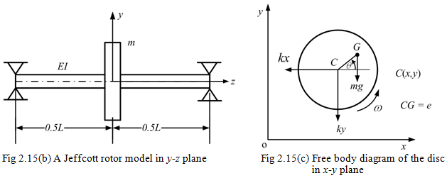
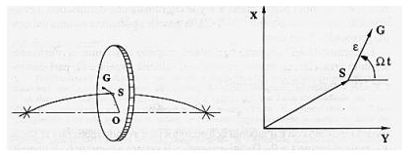
Jeffcott rotor: critical speed problem
single mass Jeffcott rotor with rigid bearings
The disk has an eccentricity of its centre of gravity.
The shaft deflects elastically.

Slide 4
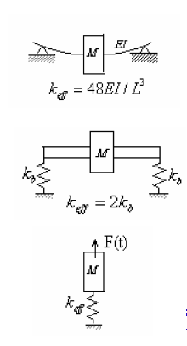
The simplest model of the rotor system
can be a 1 DOF mechanism.
Two types of rotor model are shown here
In top Figure the bearing (support) is
assumed to be rigid (simply supported)
and the shaft as flexible.
The mass of the rotor is considered rigid
In the Figure in the middle, the bearing is
assumed to be flexible and the rotor and the shaft as rigid.
Both the cases can be idealized as a single DOF as shown in down Figure.
L

Slide 5

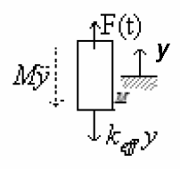

The rotor imbalance gives a sinusoidal force at the rotor rotational frequency. Thus, the imbalance force is modeled as sinusoidal force
Newton’s law on the free body of the rotor mass as shown in Figure, i.e. equating sum of external forces to the mass of the rotor multiplied by the acceleration of the center of gravity of the rotor mass, we have

Slide 6



For the free vibration, when the external imbalance force is absent, the rotor mass will be having oscillation and that will be given by
where omega_n is the frequency of oscillation during the free vibration and that is called the natural frequency of the system.
Replacing, one obtains
For the non-trivial solution of equation

Slide 7
Steady-state response
When the spin speed tends to be equal to the natural frequency of the system, the undamped steady state forced response amplitude tends to infinity.
This is a resonance condition and the spin speed corresponding to the resonance is defined as critical speed.

Slide 8
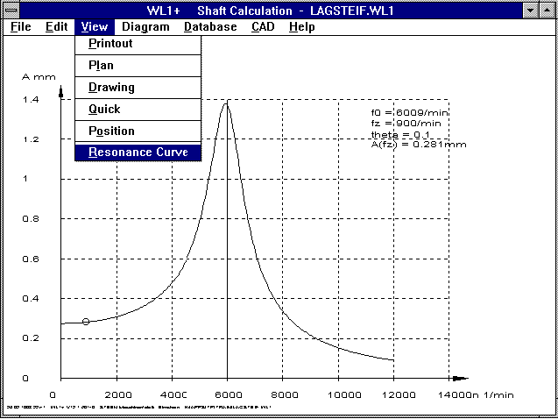
A rotor is assumed rigid when its speed is half of its critical speed
RIGID

Slide 9
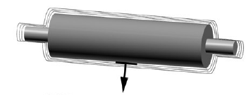
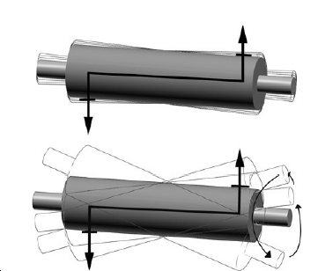
Static and dynamic unbalancing (rigid rotor)
Rotors are classified as being either rigid or flexible.
A rigid rotor is one whose service speed is less than 50% of its first critical speed.
Above this speed, therotor is said to be flexible.

Slide 10
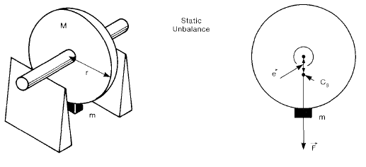



Static unbalance (definitions)
Centrifugal force
Unbalance
Specific unbalance

Slide 11
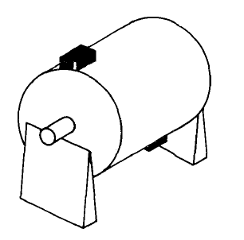
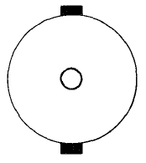
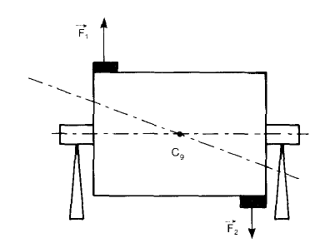
Couple unbalance
The center of gravity belongs to the rotational axis
Example

Slide 12
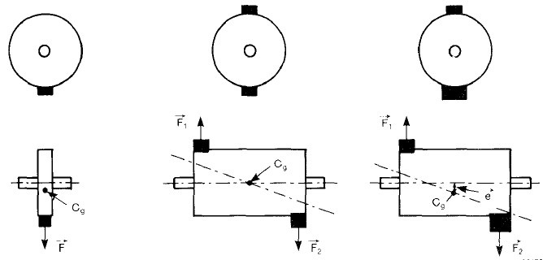
Static unbalance + coupled unbalance = dynamic unbalance

Slide 13
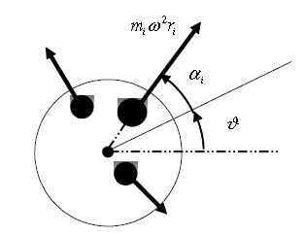

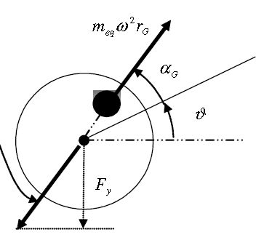



Static balancing
Geometric errors and variation in density of material causes a series of unknown centrifugal forces
A single unknown unbalancing force account for all the contributions
In complex notation

Slide 14

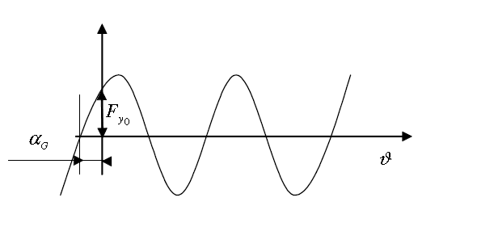
The vertical component of the reaction force is measured by means of a load cell
The signal (in N) is a plot similar to that on the right.
This may it is possible to know F_{ymax}, F_{yo} and α_{G}
Force generated by the bearing to support the rotor

Slide 15
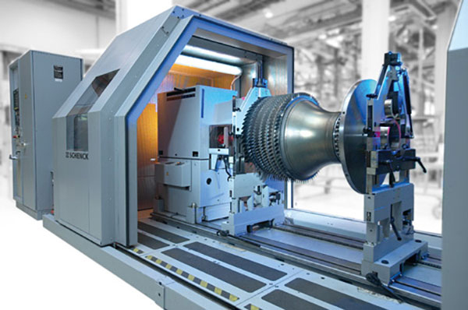
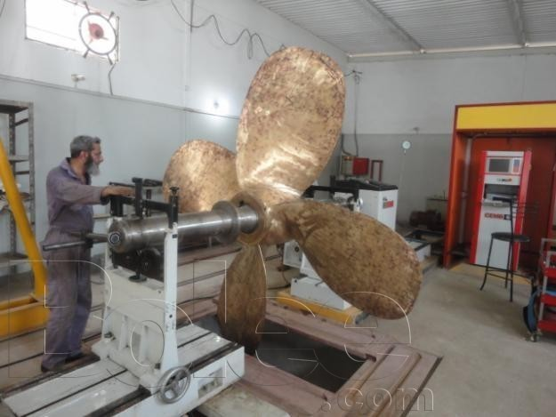
Example of balancing machines

Slide 16
Instruments needed
An instrument to measure the angular speed
One (for the static balancing) or two (for the dynamic balancing) load cells to measure the vertical components of the reaction forces generated by the supports
A sensor (or a procedure) to calculate the instant when the a mark (or a reference) on the rotor pass through a mark (or a reference) fixed to the inertial frame
(see the video Dynamic Balancing.mp4)

Slide 17



From the previous eq.s it yields
Therefore the unbalance is (angular speed is known)
The position of the unbalance mass is

Slide 18



If we decide to fix the value of the balancing mass (m), its distance from the center has to be
And its position with respect to the reference, has to be
Alternatively, tf we decide to fix the distance of the mass from the center (r), the value of the mass has to be

Slide 19
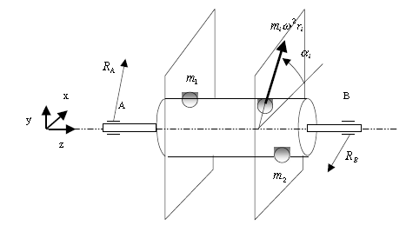
Dynamic balancing
The problem consists in calculating the positions and the values of the two balancing masses m1 and m2
Masses are located on two planes
Reaction forces on the supports

Slide 20
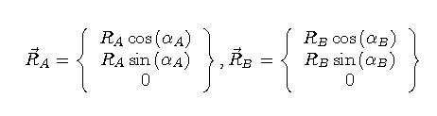
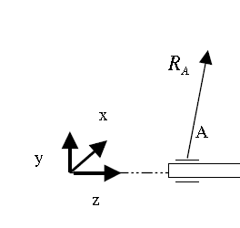


Reaction forces
The reaction forces are measured when the rotor passes for its initial position, therefore when $θ=0+2 k π$ . They are
In complex notation, according to the figure, they are
Im
Re

Slide 21

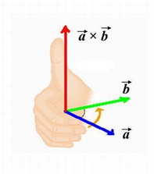
Moments of the reaction forces with respect to the pole on the origin “O”
Right-hand rule for the cross product
Note that the moment doesn’t have a component along the
Z axis

Slide 22
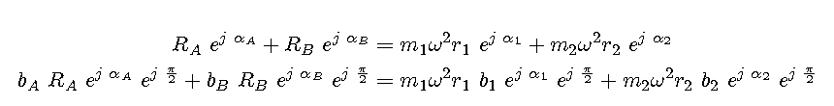
Dynamic equilibrium of the forces acting on the rotor
r1 and r2 are fixed
m1, m2, α1 and α2 are variables to be calculated

Slide 23
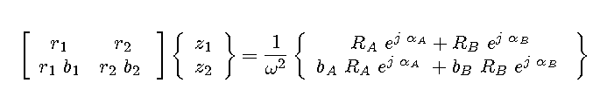
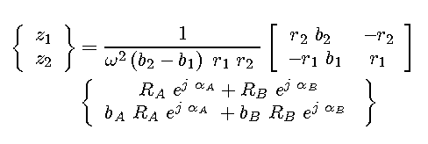
Introducing the variables
The system in matrix notation becomes
The solution of the system is

Slide 24

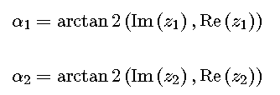
… in conclusion
Since
Moreover, since
It yields

Slide 25
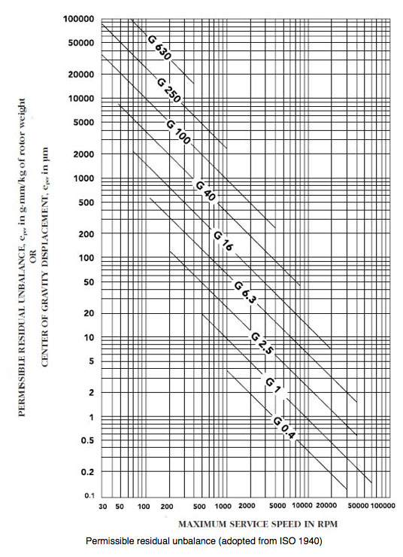
Balance quality grade
Balance Quality Grade | Type of Rotor
G 630 | Crankshaft drives of rigidly mounted large four-cycle engines; crankshaft drives of elastically mounted marine diesel engines.
G 250 | Crankshaft drives of rigidly mounted fast four-cylinder diesel engines.
G 100 | Crankshaft drives of fast diesel engines with six or more cylinders; complete engines (gasoline or diesel) for cars and trucks.
G 40 | Car wheels, wheel rims, wheel sets, driveshafts; crankshaft drives of elastically mounted fast four-cycle engine (gasoline or diesel) with six or more cylinders; crankshaft drives for engines of cars and trucks.
G 16 | Parts of agricultural machinery; individual components of engines (gasoline or diesel) for cars and trucks.
G 6.3 | Parts or process plant machines; marine main-turbine gears; centrifuge drums; fans; assembled aircraft gas-turbine rotors; fly wheels; pump impellers; machine-tool and general machinery parts; electrical armatures; paper machine rolls.
G 2.5 | Gas and steam turbines; rigid turbo-generator rotors; rotors; turbo-compressors; machine-tool drives; small electrical armatures; turbine-driven pumps.
G 1 | Tape recorder and phonograph drives; grinding-machine drives
G 0.4 | Spindles; disks; armatures of precision grinders; gyroscopes.

Slide 26
Multi-plane balancing considerations
Equilibrium of forces along x and y axes
Equilibrium of momentum along x and y axes
4 equations
For each balancing mass there are two parameters to calculate.
Number of balancing masses > 2
Use of the pseudoinverse to solve the problem
This is not the only possibility (optimization of the non linear problem)

Slide 27
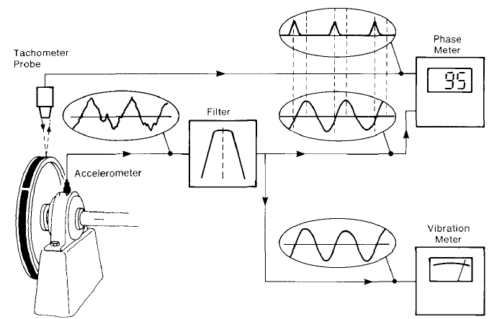
Measurement chain in case of balancing with accelerometers

Slide 28
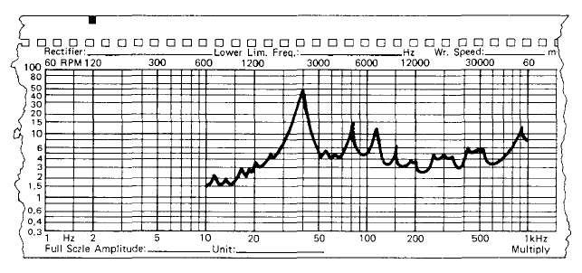
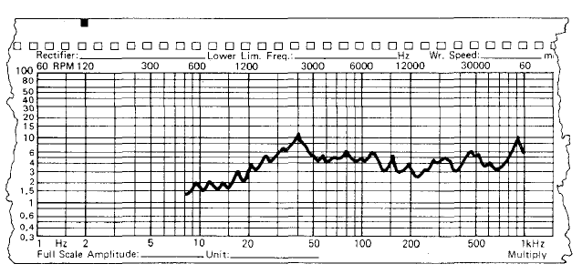
Before and after the balancing
Frequency spectrums

Slide 29
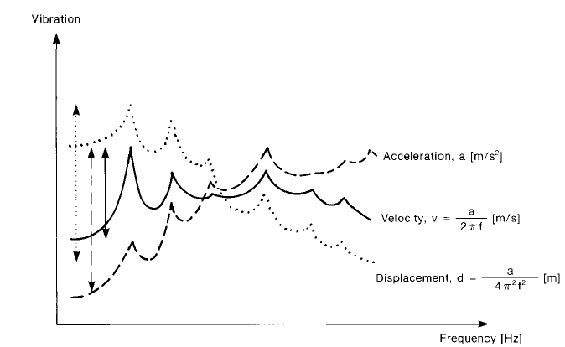
The vibration can be measured
in terms of acceleration, velocity, or
displacement.
Experience has shown that velocity usually has the flattest curve, so it is the parameter most often selected.
Use of acceleration levels tends to emphasize higher frequency components

