Slide 1
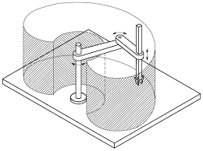
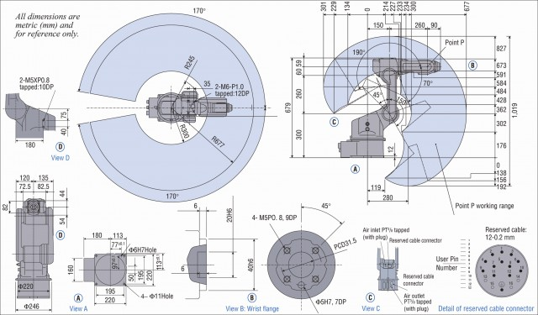
Workspace
the region described by the origin of the end-effector frame when all the manipulator joints execute all possible motions
Joint limits

Slide 2
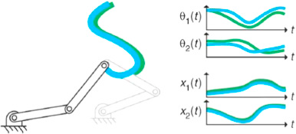
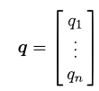
Joint space and working space
Joint space
Working space
The problem of describing end-effector orientation can be done by means of minimal representations.
There is this link
operational space
joint space

Slide 3
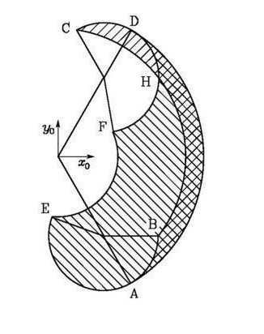
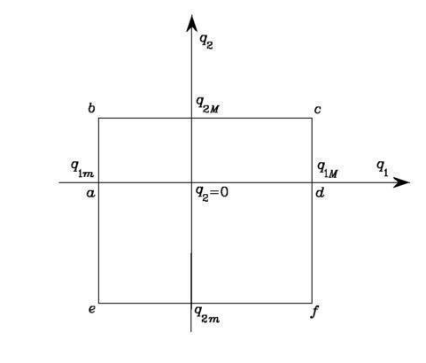
Dexterous workspace
The region that the origin of the end-effector frame can describe while attaining different orientations
Consider the simple two-link planar arm.

