Slide 1
Kinematics
Paolo Gallina
pgallina@units.it
040 5583829
Office: Buolding. C5, first floor, room 27

Slide 2
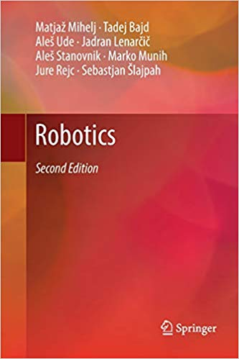
Robotics
Authors: Mihelj, M., Bajd, T., Ude, A., Lenarčič, J., Stanovnik, A., Munih, M., Rejc, J., Šlajpah, S.

Slide 3
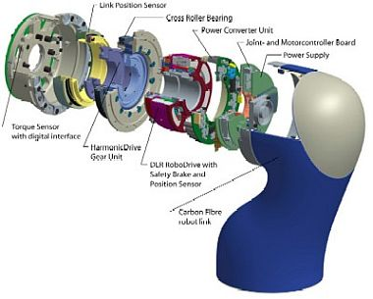
Revolute joints

Slide 4
JOINTS
Prismatic joint
Revolute joint
https://www.youtube.com/watch?v=kl6qNn9-nkk
https://www.youtube.com/watch?v=cknXa0U2M6I

Slide 5
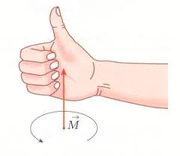
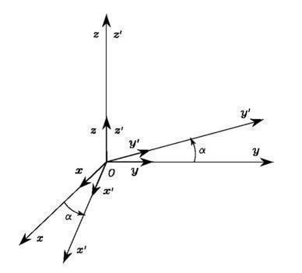
Elementary Rotations
elementary rotations of the reference frame about one of the coordinate axes.
rotations are positive if they are made counter-clockwise about the relative axis.
rotated by an angle
α about axis z
The unit vectors of the new frame can be described in terms of their components with respect to the reference frame

Slide 6
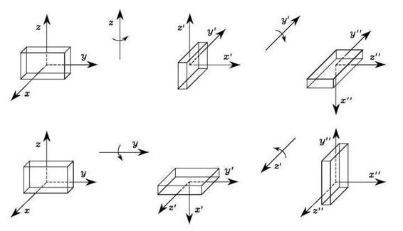
If rotation matrix are commuted (current frame), it is evident that the final object orientation is different in the two cases (POST MULTIPLICATION)

Slide 7
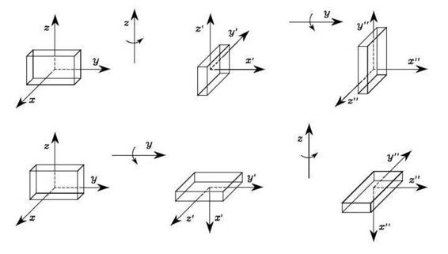
Rotation with respect to the fixed frame (commutated) PRE-MULTIPLICATION

Slide 8
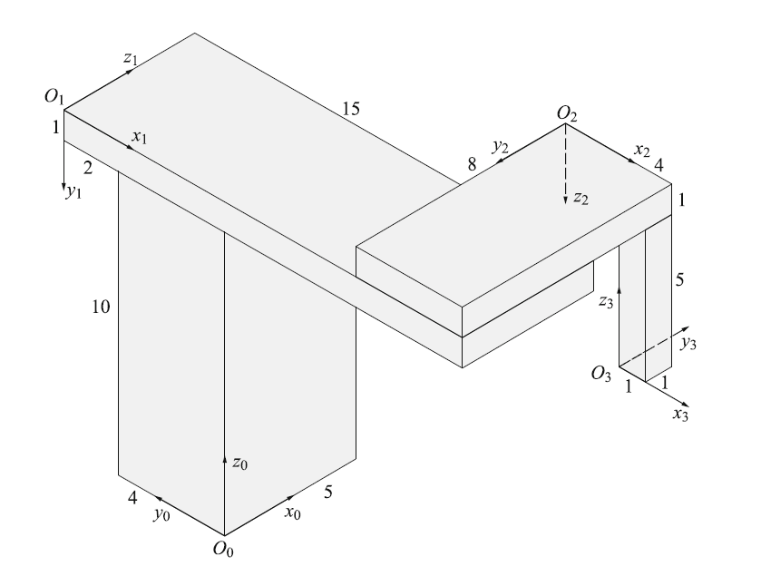
Fig. 2.8

Slide 9
Structures
Cartesian
SCARA

Slide 10
SCARA Robot

Slide 11
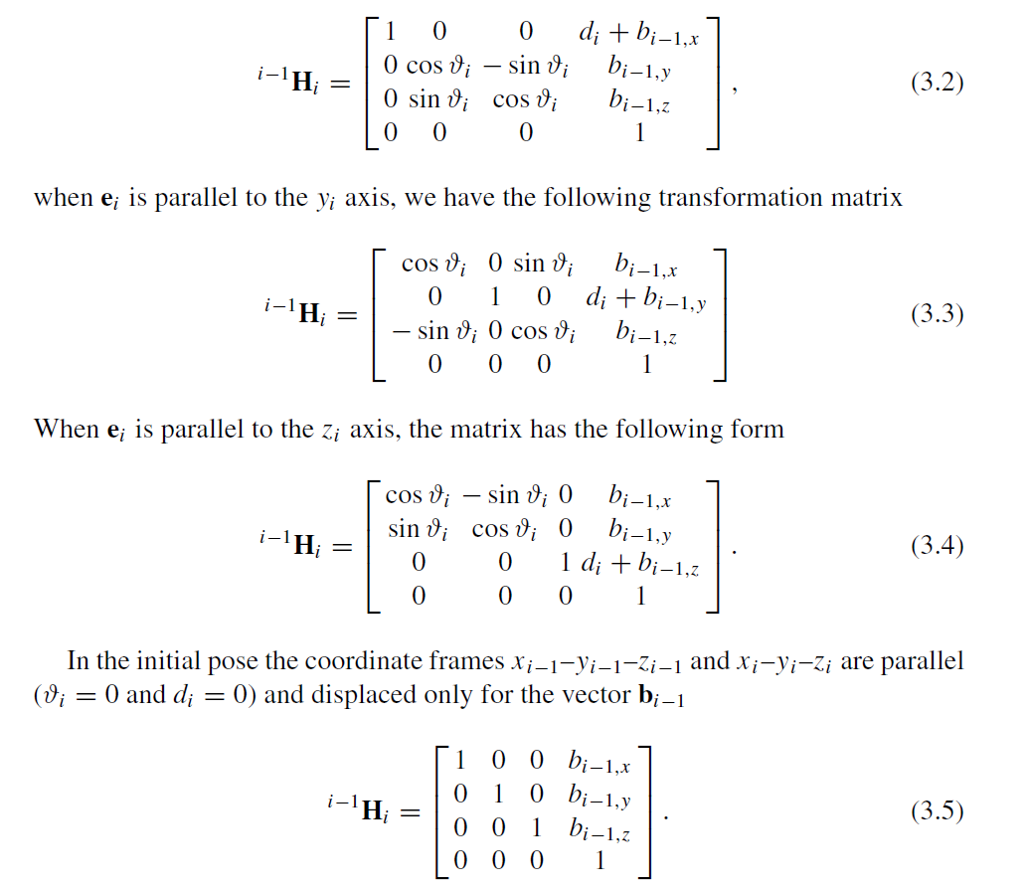
Cap 3 vector parameters

Slide 12
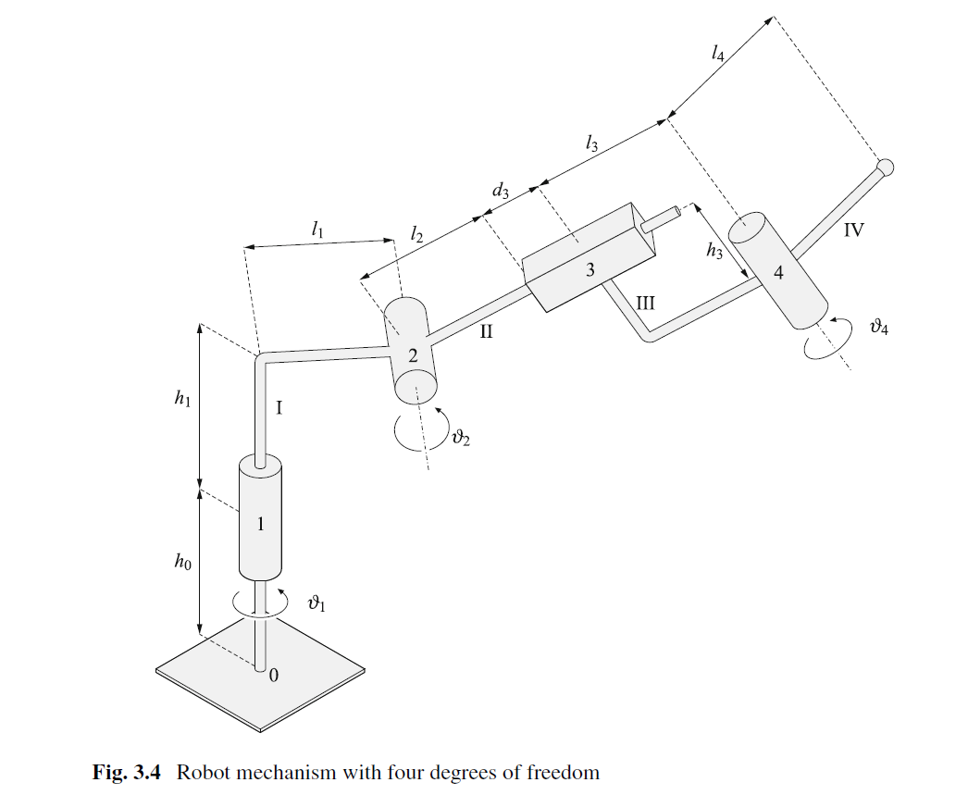
Es. Robot - vector parameters

Slide 13
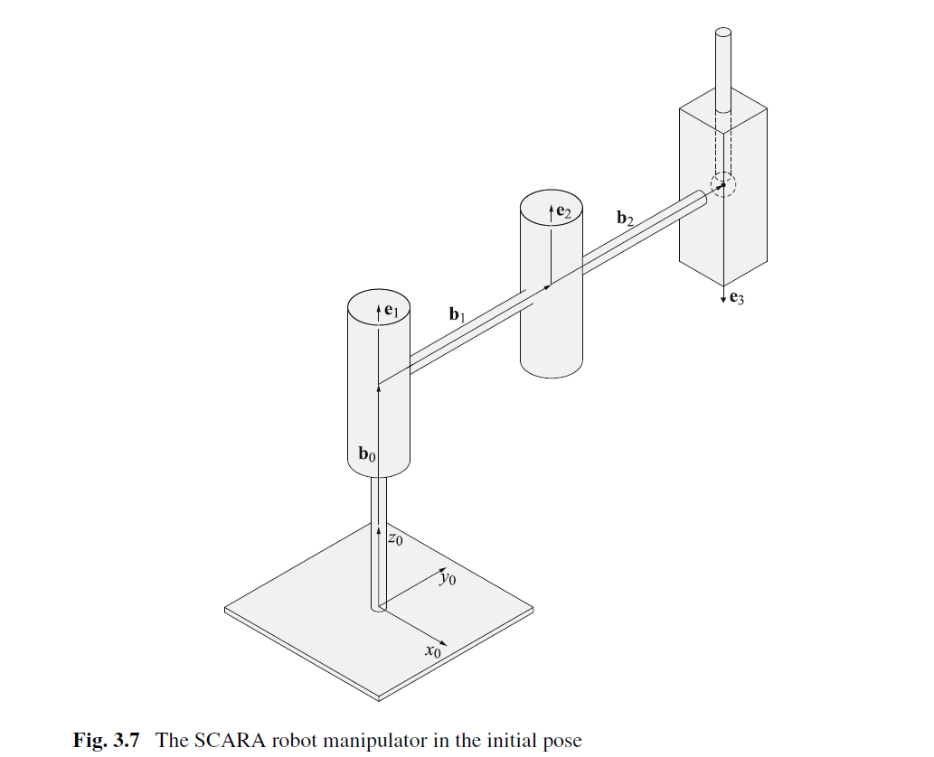
Es. SCARA - vector parameters

Slide 14
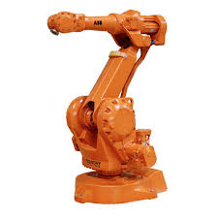
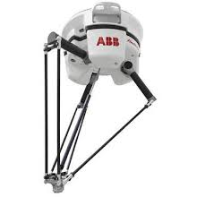
Strutture cinematiche
Open kinematic chain
Closed kinematic chain

Slide 15
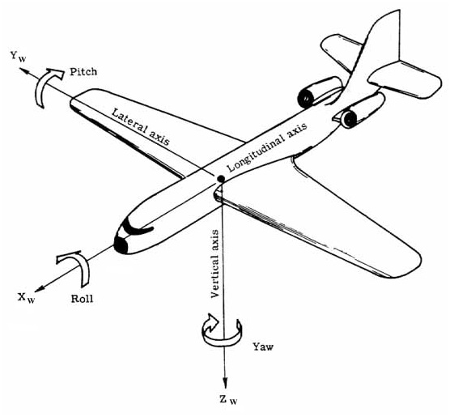
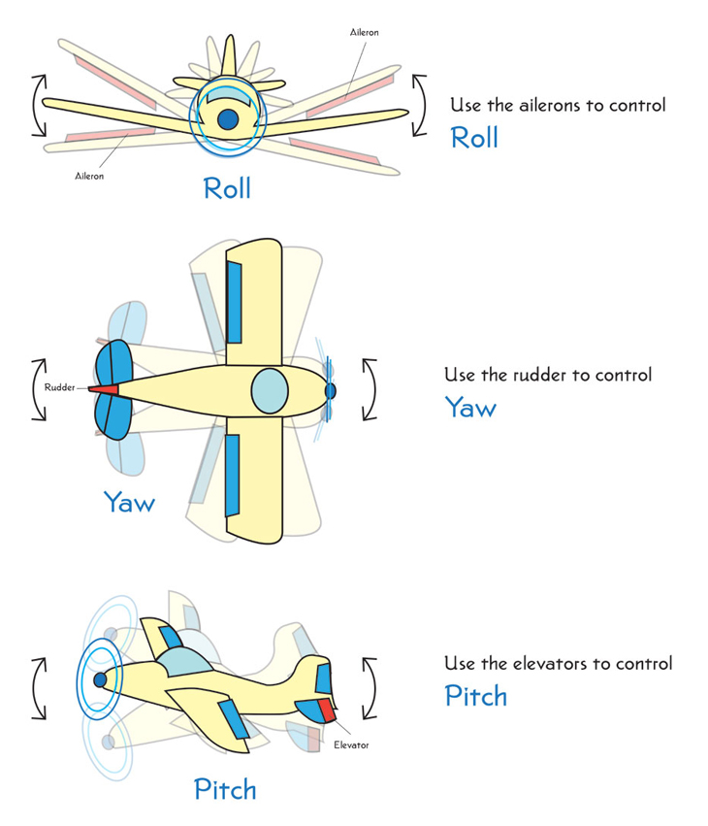
Roll-PitchYaw angles (ZYX)
https://www.youtube.com/watch?v=UpSMNYTVqQI

Slide 16
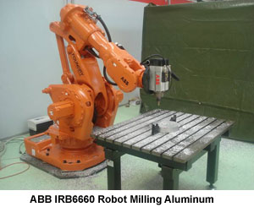
If we consider also the presence of a tool (with its frame) and the base
n (end-effector)
e (tool)
b (base)
0 (base of the robot)

Slide 17
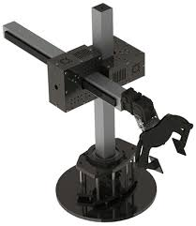
Exercise: rototranslation matrices
Kinematics of a cylindrical robot
Identify the rototranslation matrix
from the end-effector to the base
See main1.m

Slide 18
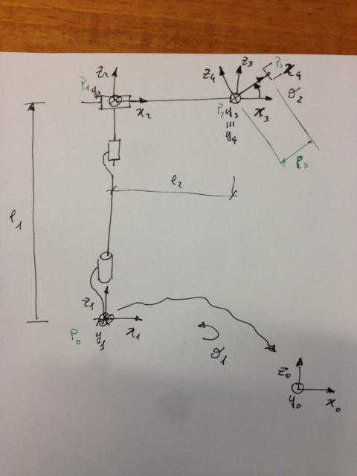
Possible solution

Slide 19
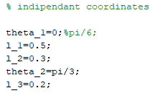
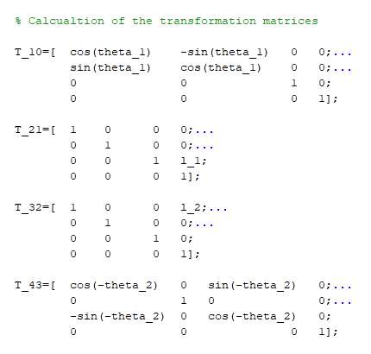

Slide 20
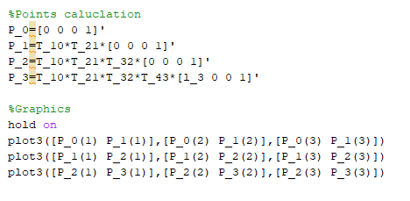
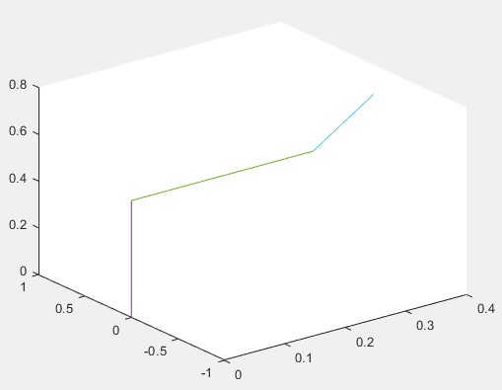

Slide 21
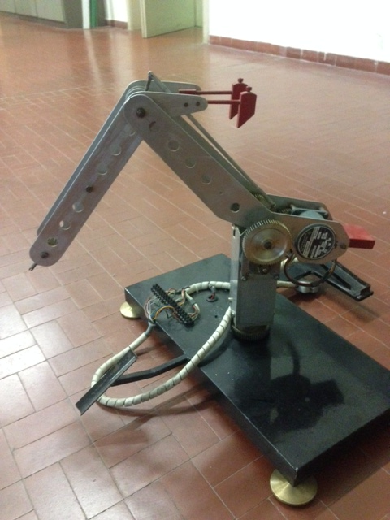
Exercise: rototranslation matrices
Kinematics of a 3 DoF robot
Identify the rototranslation matrix
from the end-effector to the base

