Slide 1
Denavit-Hartenberg
In general, the frames can be arbitrarily chosen as long as they are attached to the link they are referred to
D-H define the relative position and orientation of two consecutive links: uniquoness

Slide 2
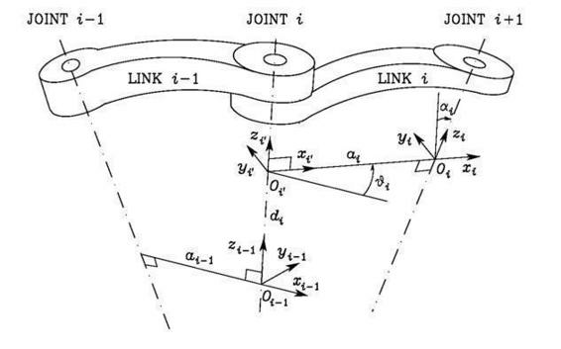
Denavit-Hartenberg
Numerate the links
Numerate the joints
Choose axis z_i along the axis of Joint i+1 (verse is arbitrary)
Minimum distance line or common normal (red lines)
(it is perpenduclar to both the z axis)
Locate the origin Oi at the intersection of axis z_i with
the common normal to axes
Choose axis xi along the common normal
with direction from Joint i to Joint i + 1
Choose axis yi and zi so as to complete a right-handed frame

Slide 3
Denavit-Hartenberg

Slide 4
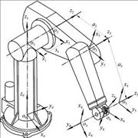
Case in which the DH doesn’t provide a unique definition of the link frame
For Frame 0, only the direction of axis z0 is specified; then x0 can be arbitrarily chosen.
DH introduces a constraint:
z_{i-1} ┴ x_{i}
To identify the frame it is necessary a previous kinematic joint (which is not present on the base)

Slide 5
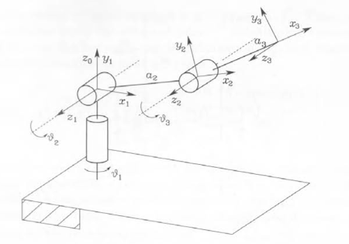
For Frame n, since there is no Joint n+ 1, zn is not uniquely defined while x_{n} has to be normal to axis z_{n-1}.
Typically, Joint n is revolute, and thus z_{n} is to be aligned with the direction of z_{n_1}.

Slide 6
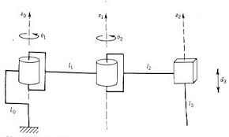
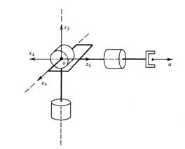
When two consecutive axes are parallel, the common normal between them is not uniquely defined.
When two consecutive axes intersect, the direction of x_{i} is arbitrary
x₄
6
5
4
x₄

Slide 7
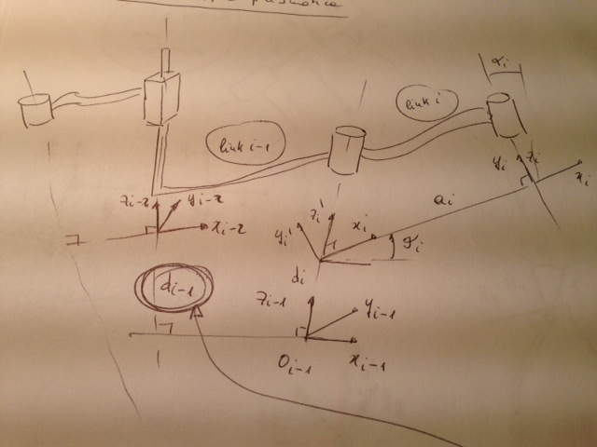
Case with prismatic joint

Slide 8
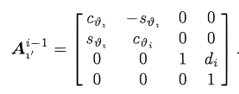
D-H parameters (4 parameters)
Coordinate transformation between Frame i and Frame i - 1
Translate the chosen frame by di along axis zi-1
and
rotate it by θi about axis zi_1

Slide 9
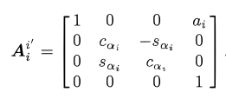
Translate the chosen frame by ai along axis xi
and
rotate it by αi about axis xi

Slide 10
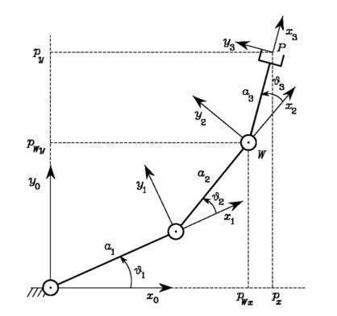
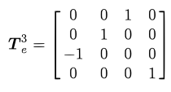
Three-link planar arm
z
y
If an end-effetor is required

Slide 11
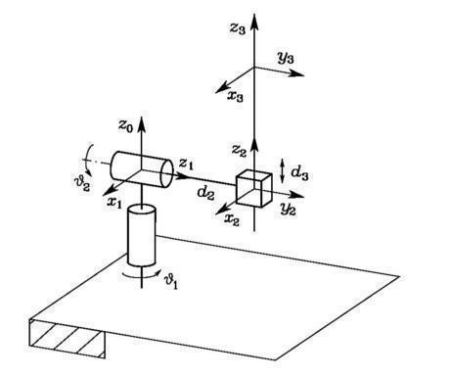
Spherical Arm

Slide 12
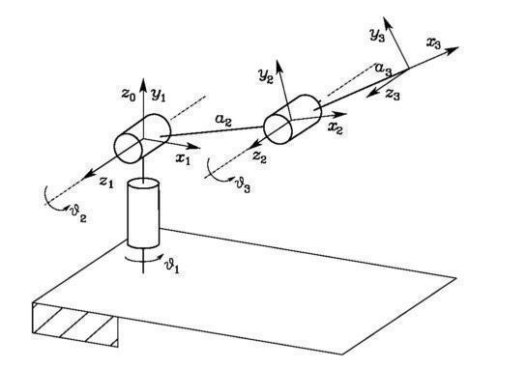
Anthropomorphic Arm

Slide 13
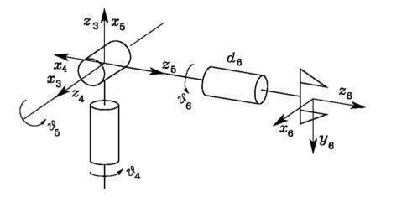
Spherical wrist

Slide 14
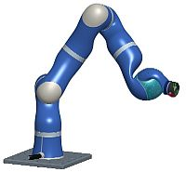
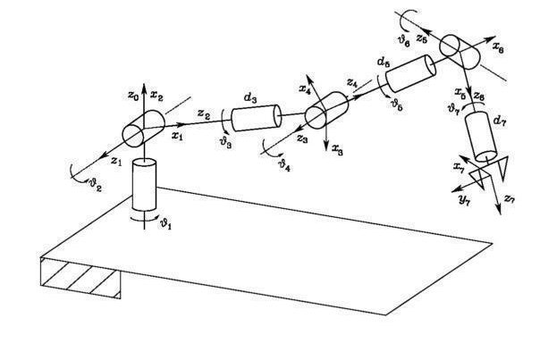
DLR robot (Kuka)

Slide 16
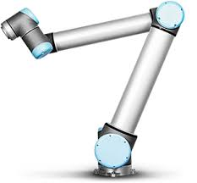
Example: D-H applied to UR10

