Slide 1

Inverse Kinematics Problem
Equations of the Inverse Kinematics
The inverse kinematics problem consists of the determination of the joint variables corresponding to a given end-effector position and orientation.
The equations to solve are in general nonlinear
It is not always possible to find a closed-form solution
Multiple solutions may exist
The existence of solutions is guaranteed only if the given end-effector position and orientation belong to the manipulator dexterous workspace
Infinite solutions may exist, e.g., in the case of a kinematically redundant manipulator

Slide 2
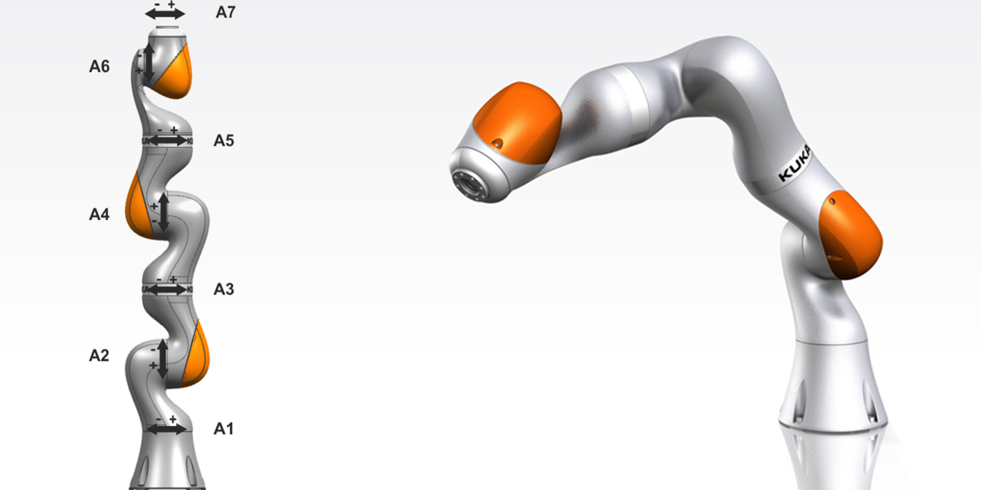
7 DoF (redundant manipulator)

Slide 3
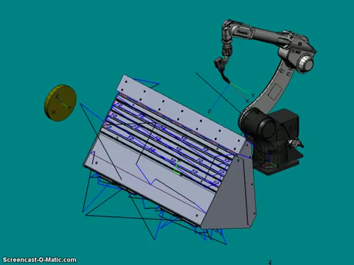

Why is useful the inverse kinematic?
Off-line programming
Show video “self-programming” or “self-teaching”
CMA (https://www.youtube.com/watch?v=V4k4IOVJGaA)
disengaged clutch to manually operate the robot

Slide 4
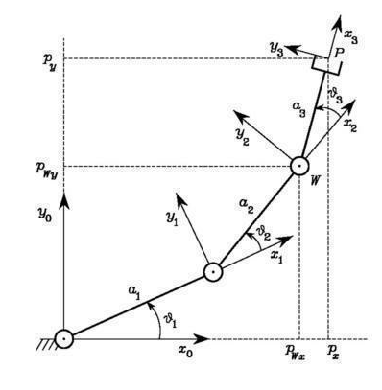
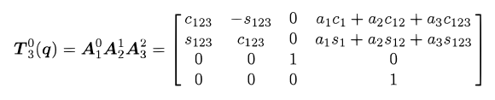


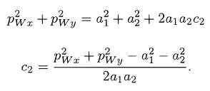
Example: Solution of Three-link Planar Arm
INPUT: px,py,φ
Squaring and summing
The existence of a solution obviously imposes that -1 < c2 < 1
[…]

Slide 5
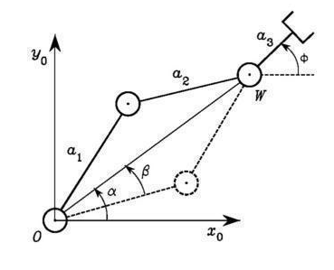


An alternative geometric solution
cosine theorem
[…]

Slide 6
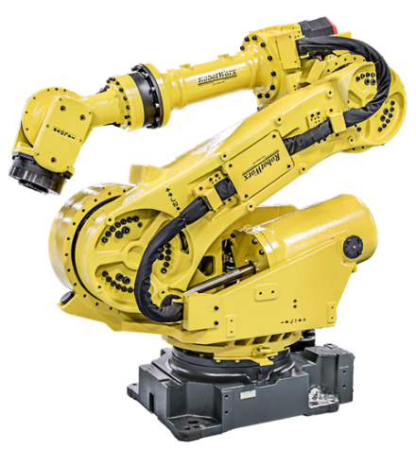
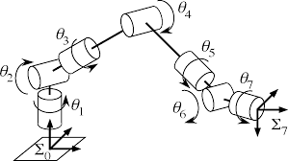
Solution of Manipulators with Spherical Wrist
three consecutive revolute joint axes intersect at a common point

Slide 7
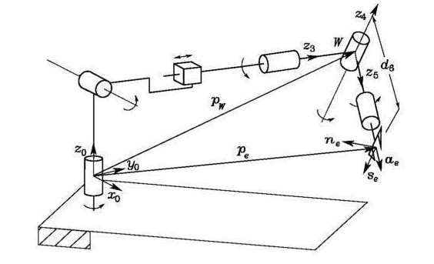

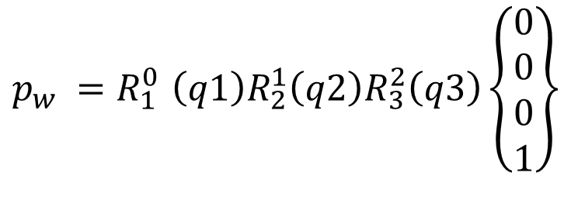
point W at the intersection of the three terminal revolute axes
the wrist position can be found as
$$p_{w} {=R}_{1}^{0}\left(q1\right)R_{2}^{1}\left(q2\right)R_{3}^{2}\left(q3\right)\left\{\begin{matrix}0 \\ 0 \\ 0 \\ 1\end{matrix}\right\}$$
It possible to calculate
q1,q2,q3

Slide 8


$$R_{e}^{0} is known$$
$${R_{e}^{0}=R_{3}^{0}R}_{4}^{3}\left(q4\right)R_{5}^{4}\left(q5\right)R_{e}^{5}\left(q6\right)$$
It is possible to calculate
q4,q5,q6

Slide 9
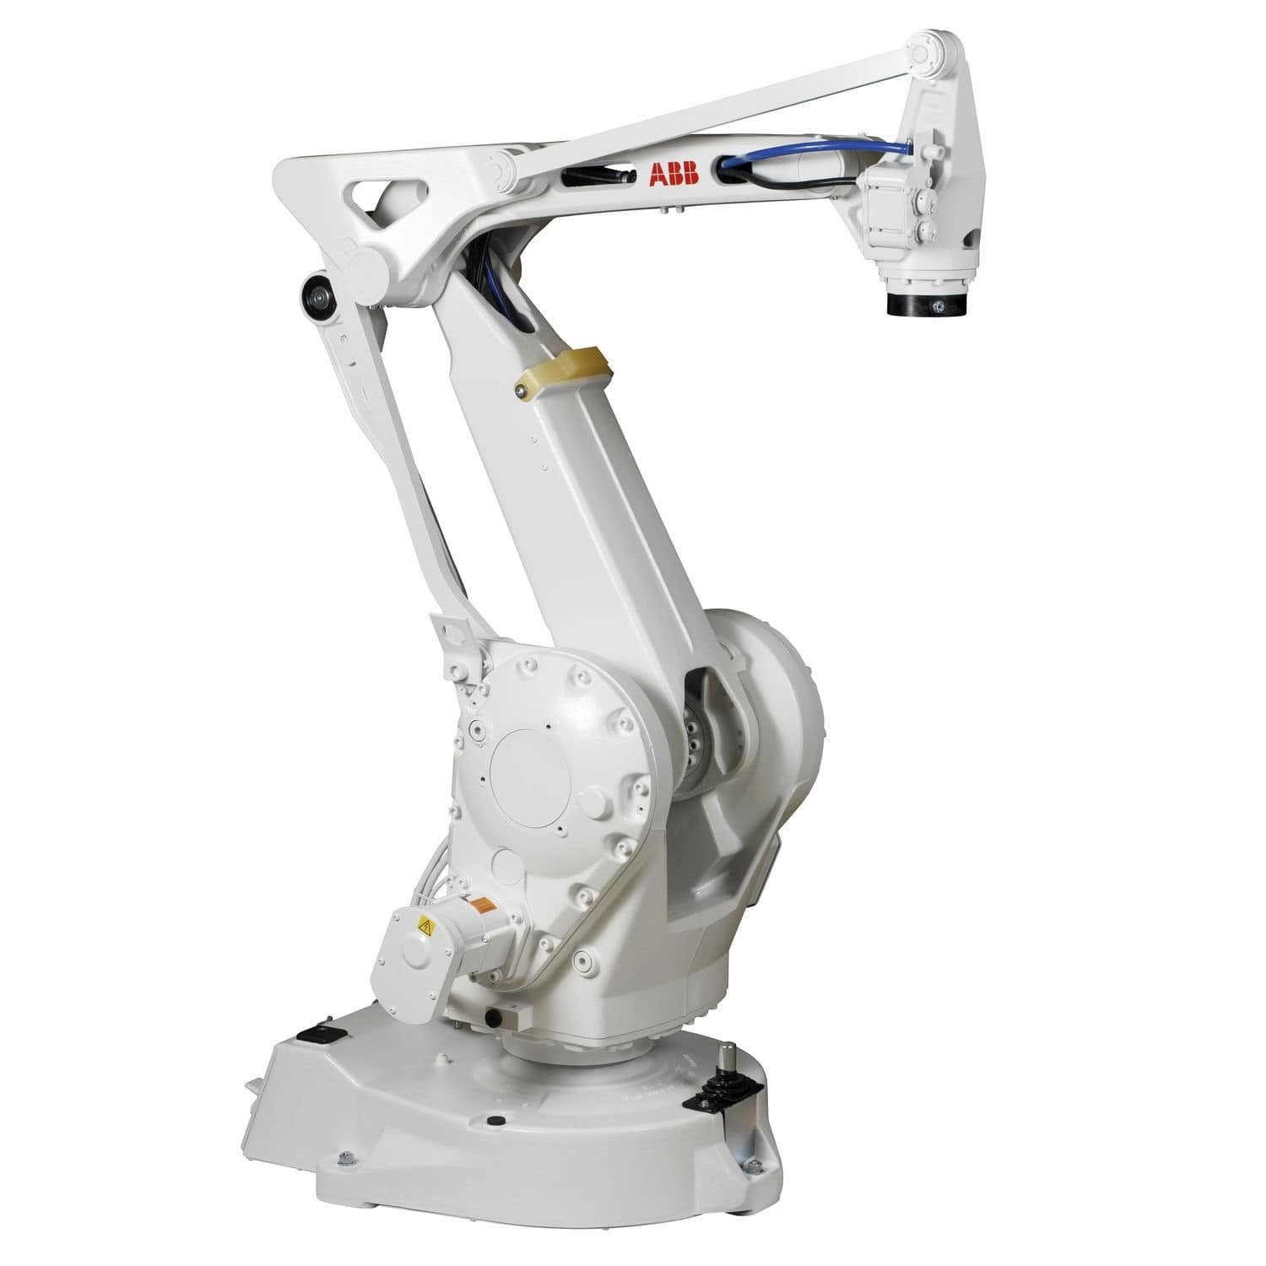
three consecutive revolute joint axes are parallel facilitate the solution

Slide 10
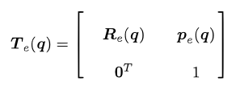
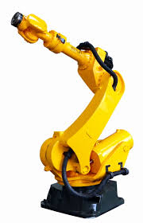
Differential kinematics
Consider an n-DOF manipulator. The direct kinematics equation can be written in the form
e-frame
where q = is the vector of joint variables.
Both end-effector position and orientation vary as q varies
The goal of the differential kinematics is to find the relationship between the joint velocities and the end-effector linear and angular velocities

Slide 11



relations are both linear in the joint velocities
= Geometric Jacobian
Geometric Jacobian is a function of q

Slide 12
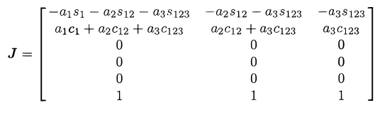
Jacobian of Typical Manipulator Structures
Three-link Planar Arm

Slide 13
Jacobian of Typical Manipulator Structures
Three-link Planar Arm

Slide 14

Kinematic Singularities
those configurations (q) at which J is rank-deficient are termed kinematic singularities.
Therefore, when det(J)=0
Singularities represent configurations at which mobility of the structure is reduced, i.e., it is not possible to impose an arbitrary motion to the end-effector
infinite solutions to the inverse kinematics problem may exist
small velocities in the operational space may cause large velocities in the joint space

Slide 15
Video di configurazione di singolarità
https://www.youtube.com/watch?v=6Wmw4lUHlX8

Slide 16
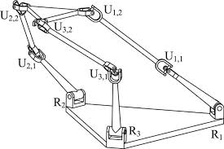
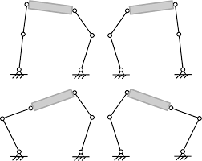
Boundary singularities that occur when the manipulator is either outstretched or retracted
Internal singularities that occur inside the reachable workspace and are generally caused by the alignment of two or more axes of motion

Slide 17
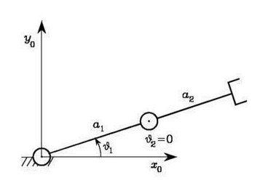



two-link planar arm
singularity

