Slide 1




Inverse Differential Kinematics
inverse kinematics problem admits closed form solutions only for manipulators having a simple kinematic structure.
the differential kinematics equation represents a linear mapping between the joint velocity space and the operational velocity space
PROBLEM
Suppose that a motion trajectory is assigned to the end-effector in terms of v_{e}(t) and the initial conditions on position and orientation
determine a feasible joint trajectory (q(t), $\dot{q}$(t))
it is necessary that the Jacobian be square and of full rank

Slide 2
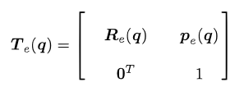
Problem in invertion
It follows that the computed joint variables q do not coincide with those satisfying
  the
Therefore, reconstruction of joint variables q is numerical integration involves drift phenomena of the solution; as a consequence, the end-effector pose corresponding to the computed joint variables differs from the desired one.

Slide 3







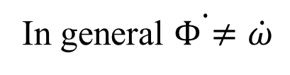
Analytical Jacobian
minimal representation (Euler angles)
It is possible to compute the Jacobian via differentiation of the direct kinematics function with respect to the joint variables
Analytical Jacobian
In general $\dot{Φ≠}\dot{ω}$

Slide 4




Inverse Kinematics Algorithms
space error between the desired and the actual end-effector position and orientation
Consider the time derivative
It is necessary to choose a relationship between q and e that ensures convergence of the error to zero.
If K is a positive definite (usually diagonal) matrix, the system is asymptotically stable.
The error tends to zero along the trajectory with a convergence rate that depends on the eigenvalues of matrix K

Slide 5

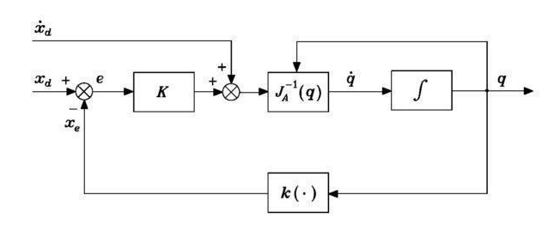
Replacing and inverting
If the values of k are too high, there could be instability

