Slide 1
Convolutional Networks
A few examples

Slide 2
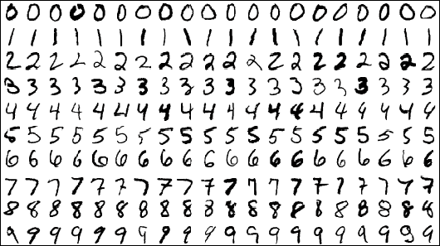
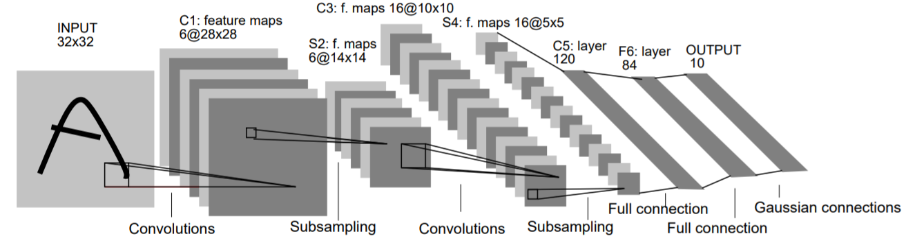
LeNet (1998)
n.of parameters: 60K (same order of data points)
non-linearity: tanh
filters size: 5
no padding

Slide 3
ConvNetJS CIFAR-10 demo

Slide 4
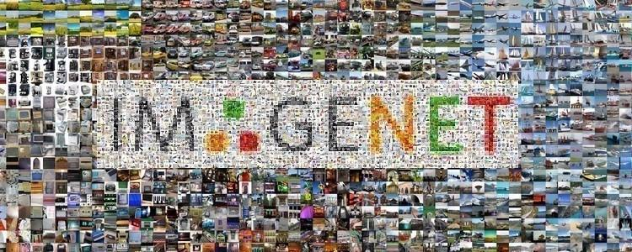
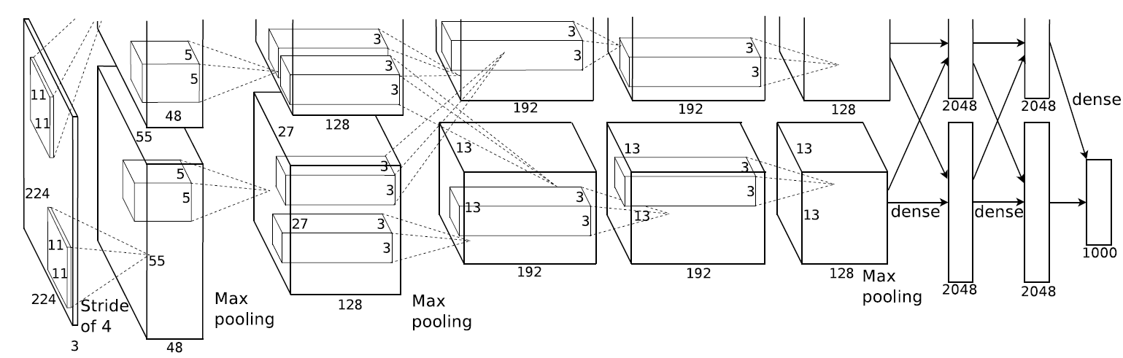
AlexNet (2012)
n.of parameters: 60M (three orders of magnitude more than LeNet)
non-linearity: ReLU
filters sizes: 11 (with stride 4) 227->55, 5, 3
Dropout

Slide 5
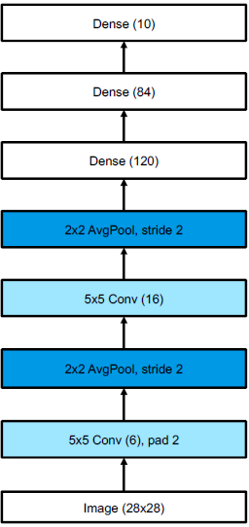
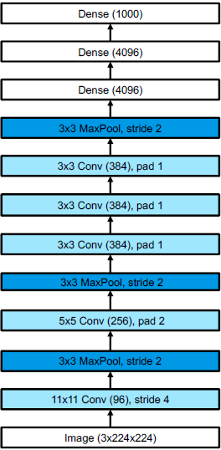
Similar schemas
LeNet
AlexNet
Basic schema (“classic”):
Feature extraction
sequence of CONV (or blocks of CONVs) followed by POOL
Classifier
Stack of FC
SOFTMAX

Slide 6
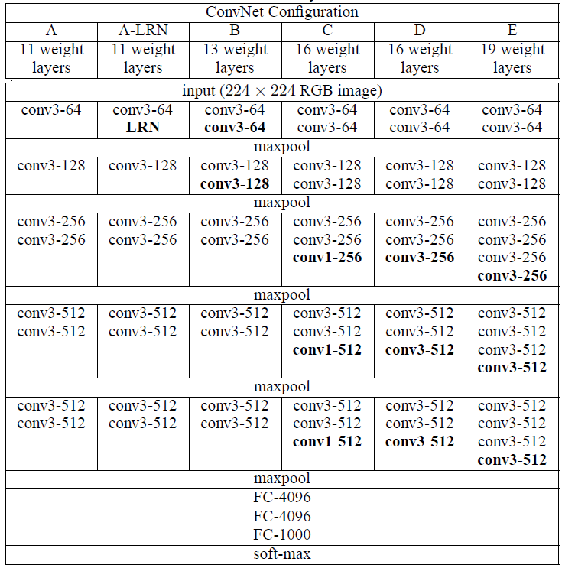
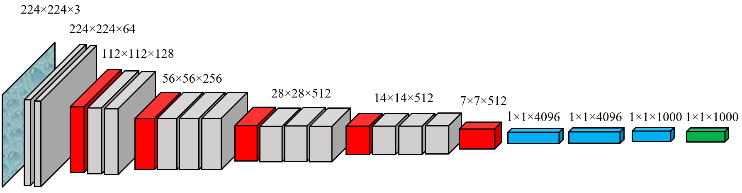
VGG (2014)
Still a “classic”, very regular schema
Small CONV filters (3*3)
Stacks of CONVs
Bulky stack of FC

Slide 7
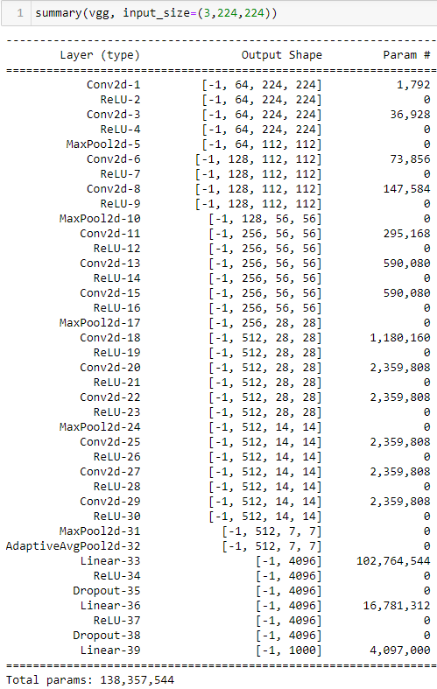
VGGs (2014)
Number of parameters
most parameters in last FC layers
most memory in early CONV layers
Size of the representations
(activation volumes)
Input 150528
CONV1 3211264
CONV2 1605632
CONV3 802816
….
….
….
….
LAST POOL 100352
FC1 4096
FC2 4096
OUTPUT 1000

Slide 8

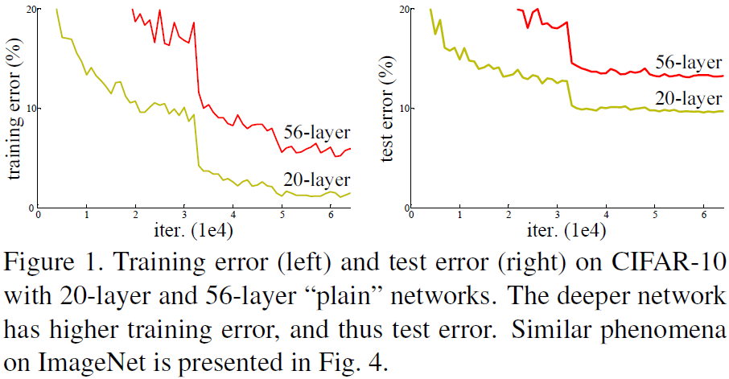
Limitations of “plain” architectures
Diagnose which is the problem!

Slide 9
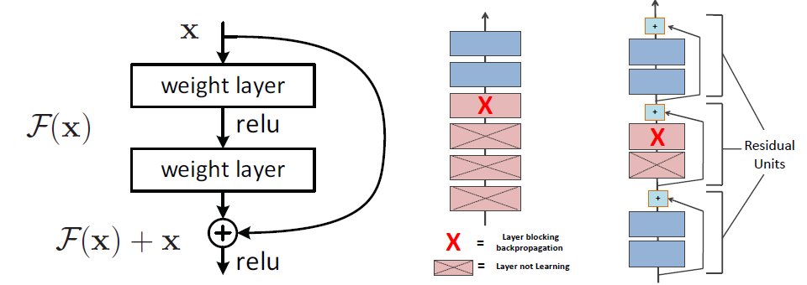
ResNets (2015)
Residual learning building block
Information flow

Slide 10
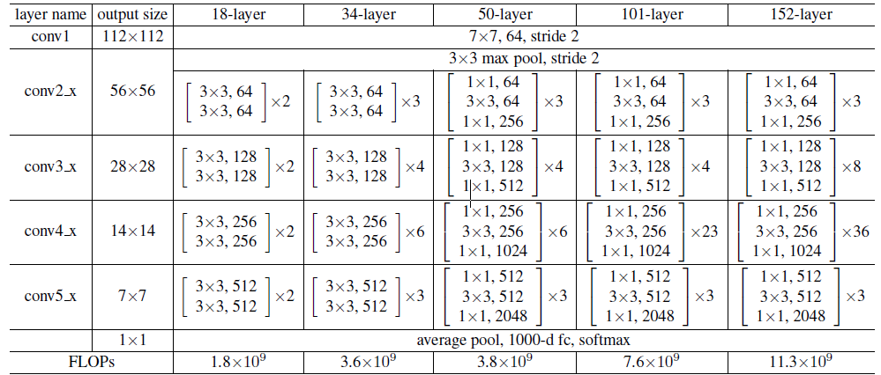
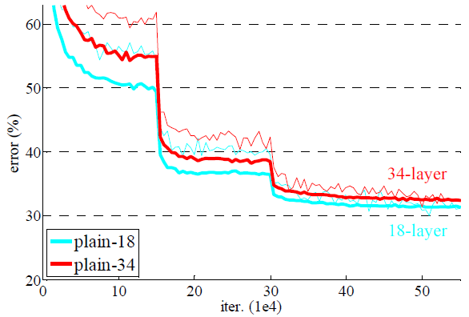
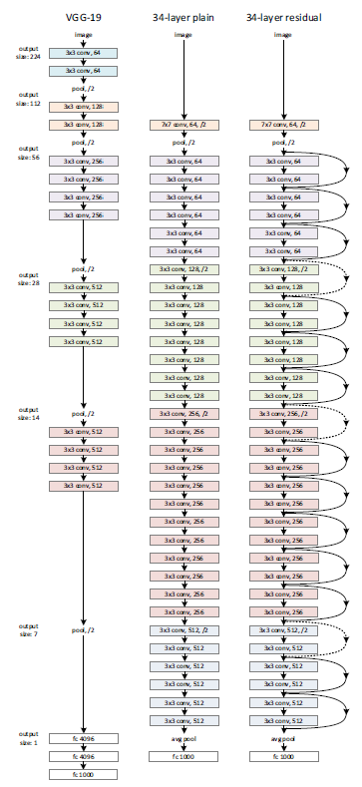
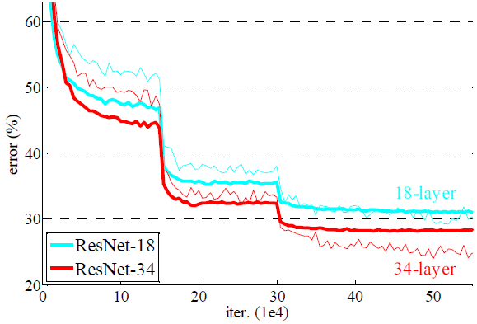
ResNets (2015)
Plain
ResNet

Slide 11
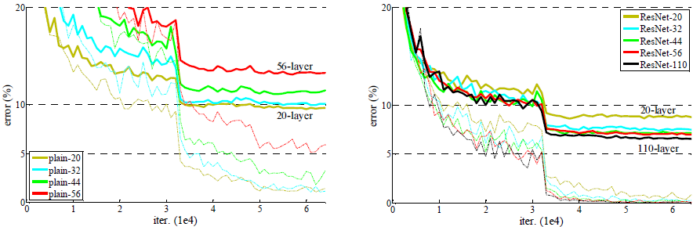
ResNets (2015)
Optimization becomes possible for very deep architectures

Slide 12
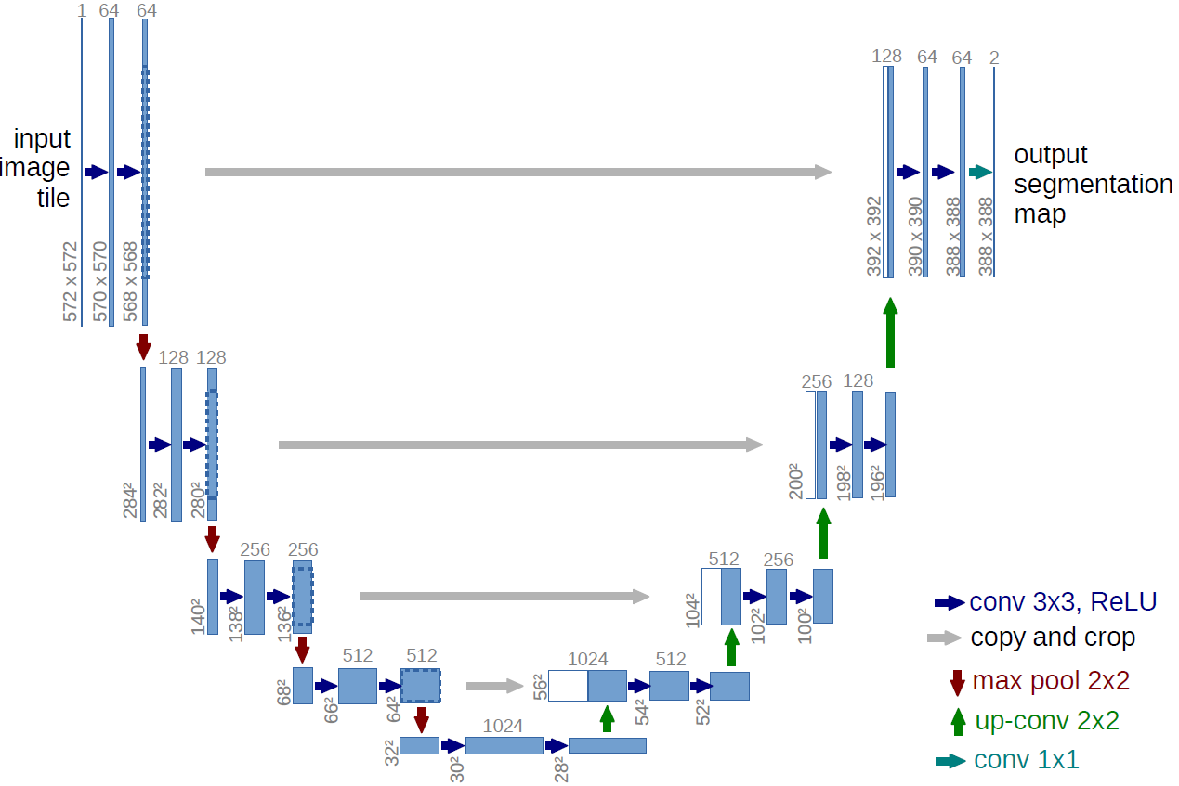
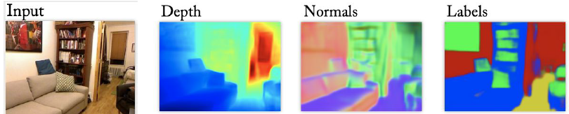
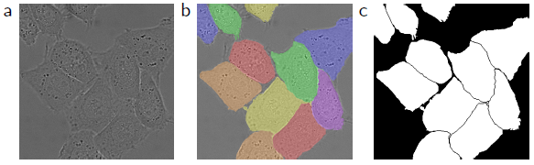
“Dense” predictions
Semantic Segmentation
Original image
Ground truth
Segmentation map

Slide 13
U-Net (2015)
U-Net: Convolutional Networks for Biomedical Image Segmentation

Slide 14
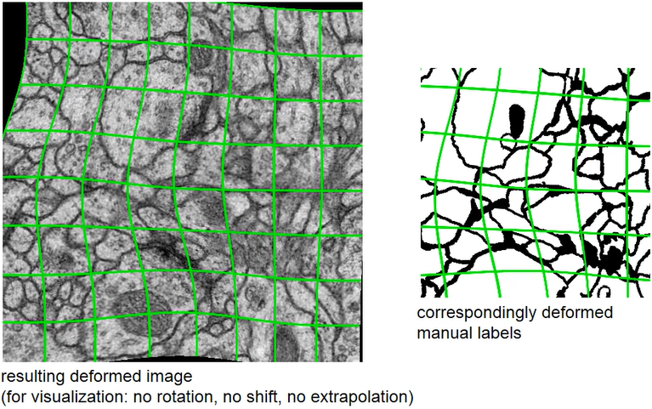
U-Net (2015)
Data augmentation

Slide 15
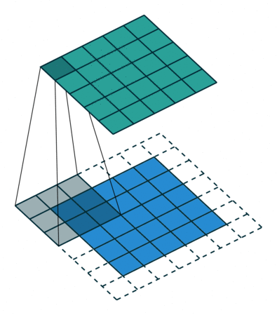
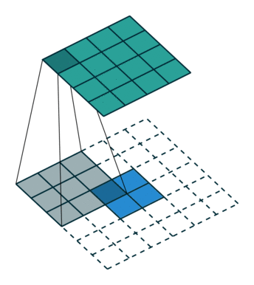
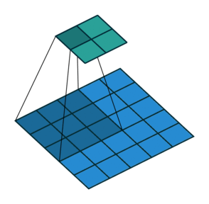
Transposed convolutions
“Same” Convolution
Convolution with stride S > 1:
downsampling
Transposed convolution:
upsampling

Slide 16
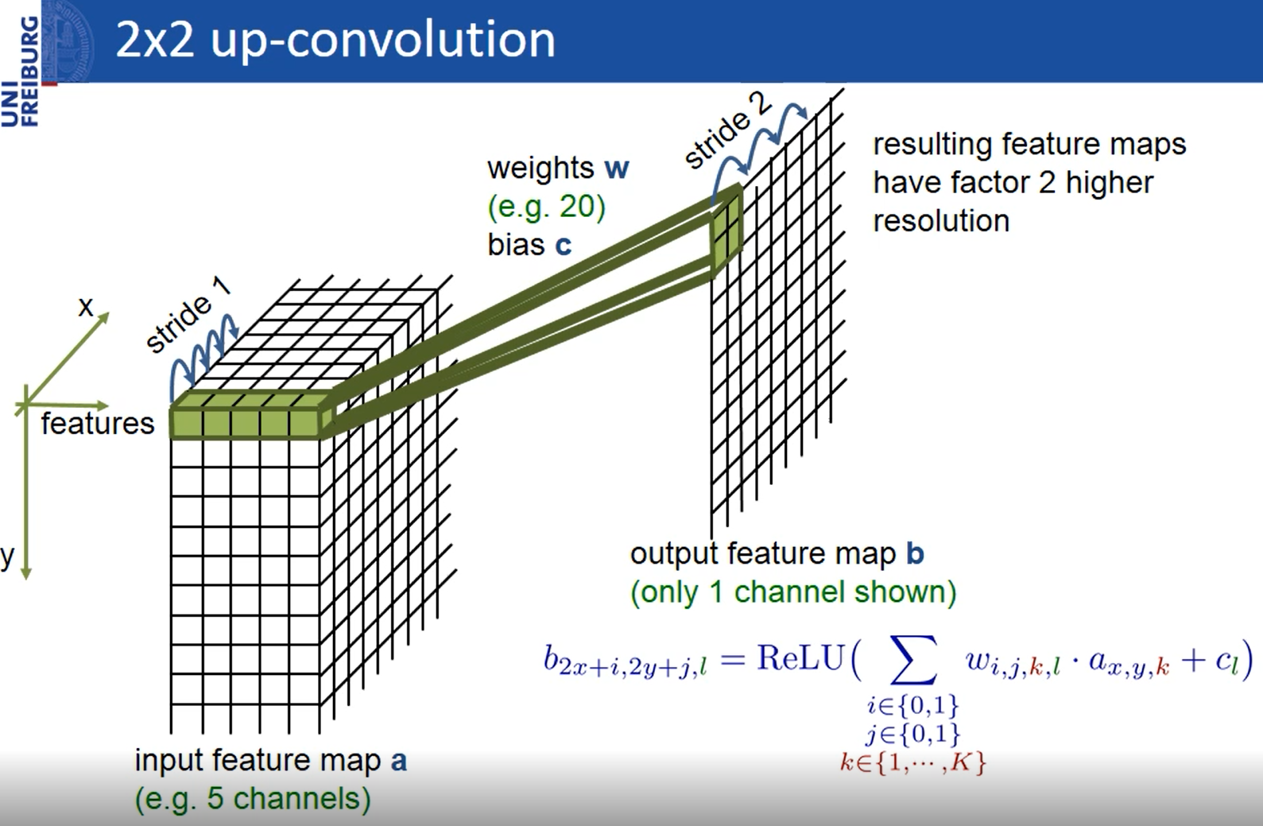
Transposed convolutions for U-Net

