Slide 1
The manifold hypothesis and
intrinsic dimensionality

Slide 2
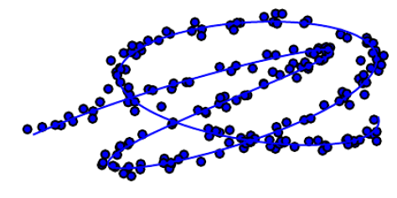
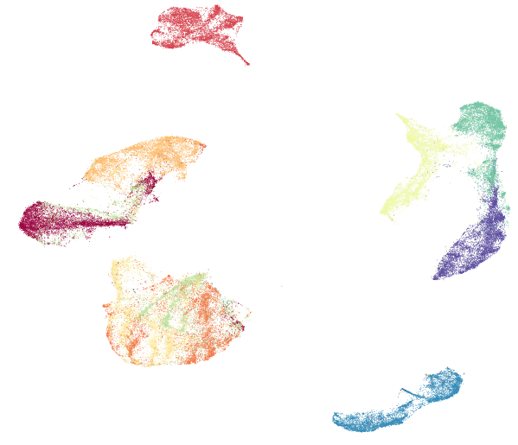
The manifold hypothesis
Embedding dimension = 2
True (intrinsic) dimension = 1
Interesting (valid) inputs only in the neighborhoods
of a “low” dimensional manifold
Interesting variations of the learned function along the manifold (or across manifolds, if there are more than one)
https://umap-learn.readthedocs.io/en/latest/

Slide 3
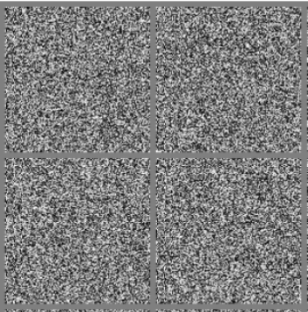
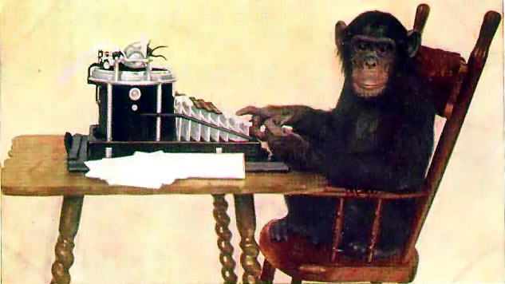
Empirical evidences
Natural dataset have “zero” measure in a uniform distribution
Random images
Monkey typewriting

Slide 4
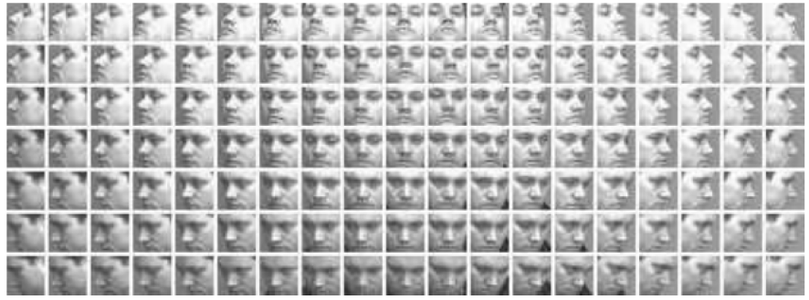
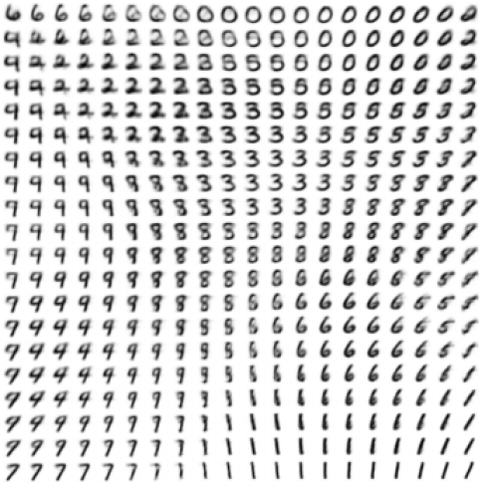
Traversing the manifold
Elevation
Azimuth rotation
The coordinates can be discovered with particular models (e.g. VAEs)

Slide 5
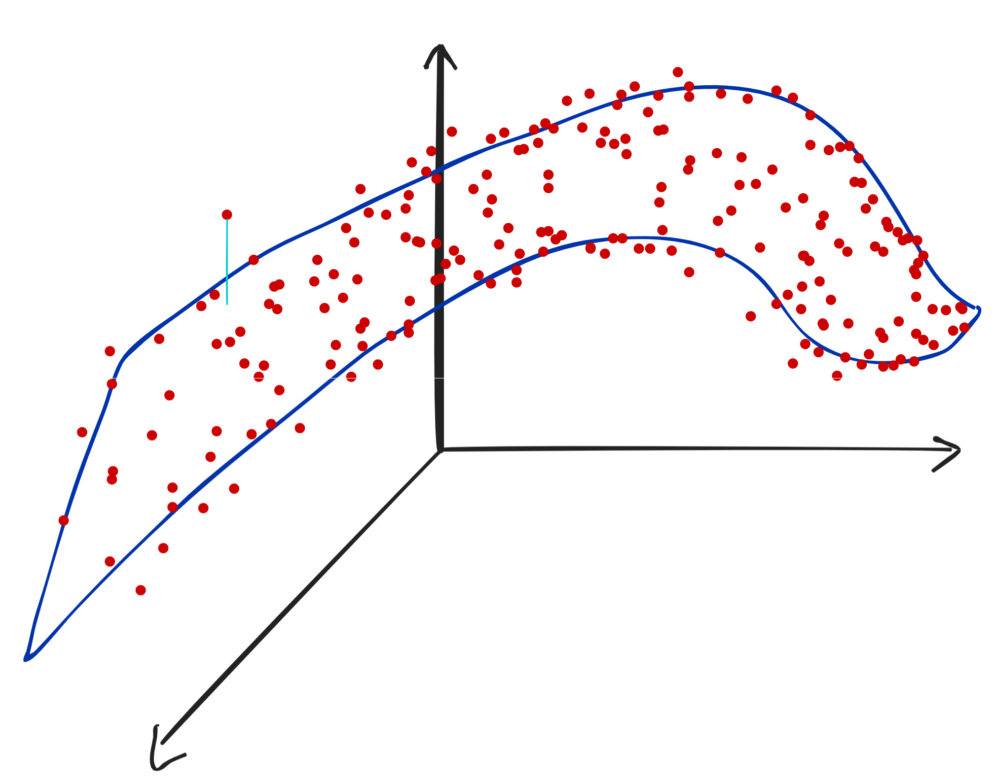
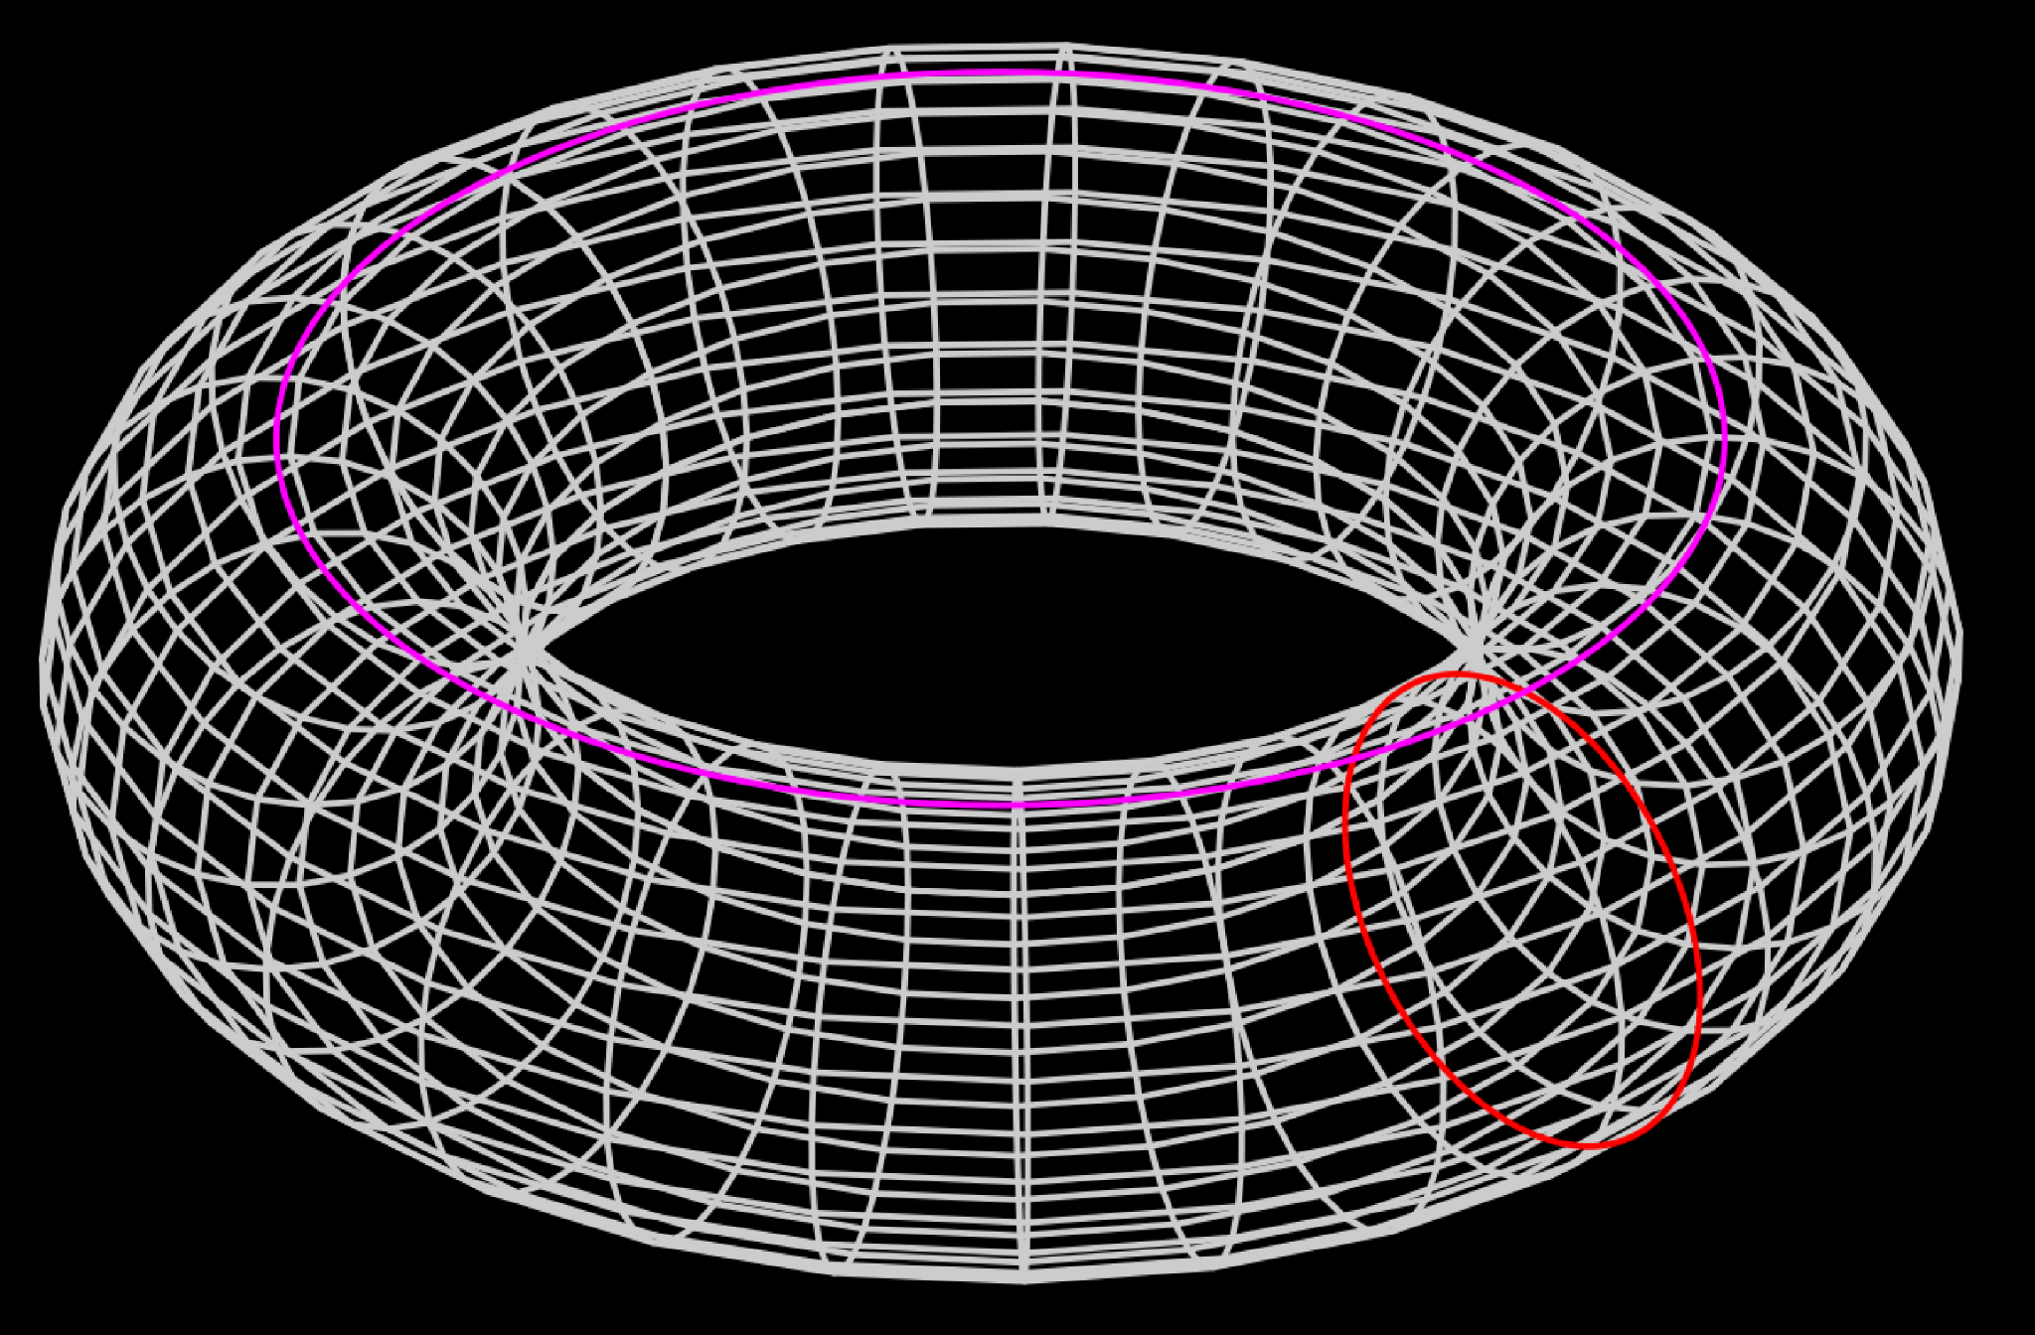
Intrinsic dimension (ID)
The ID is the smallest number of variables that allow to individuate a data point with “minimal information loss”
Three dimensions, two angles : ID = 2

Slide 6
Methods to estimate the ID

Slide 7
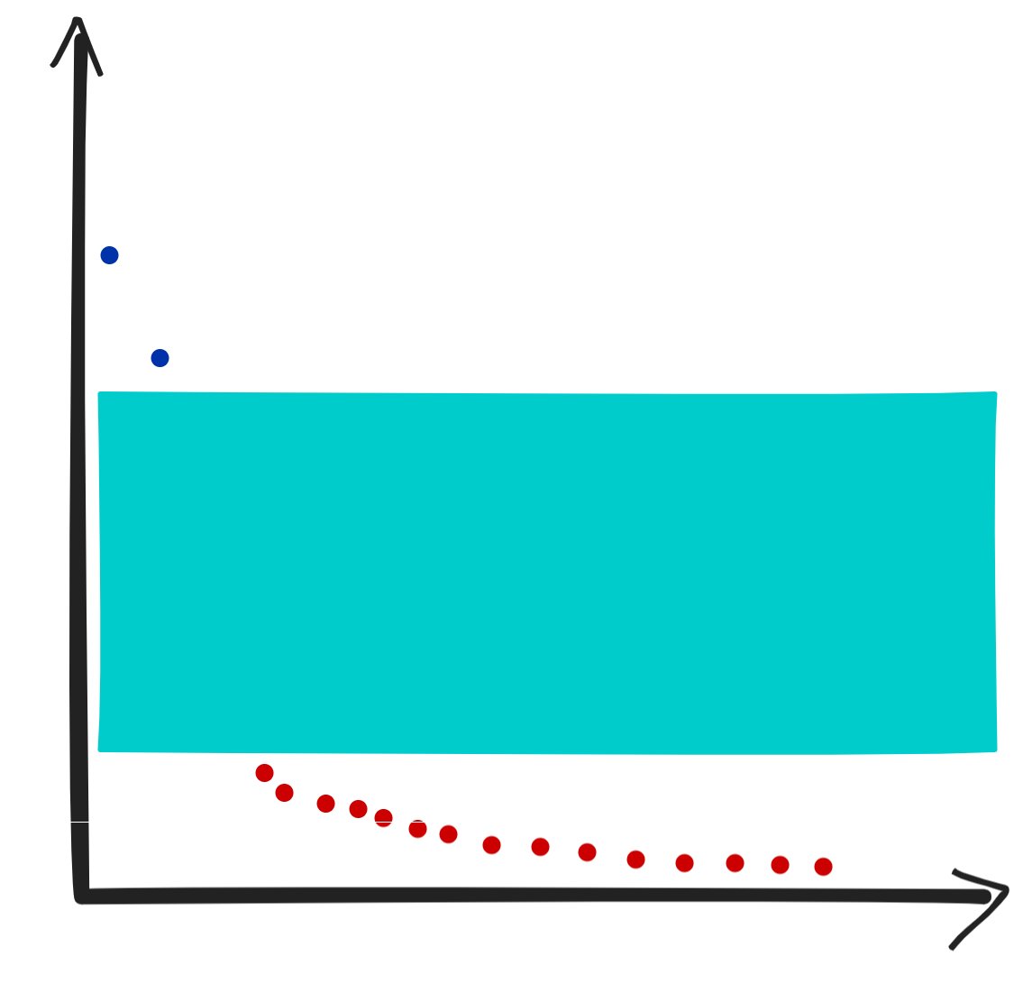
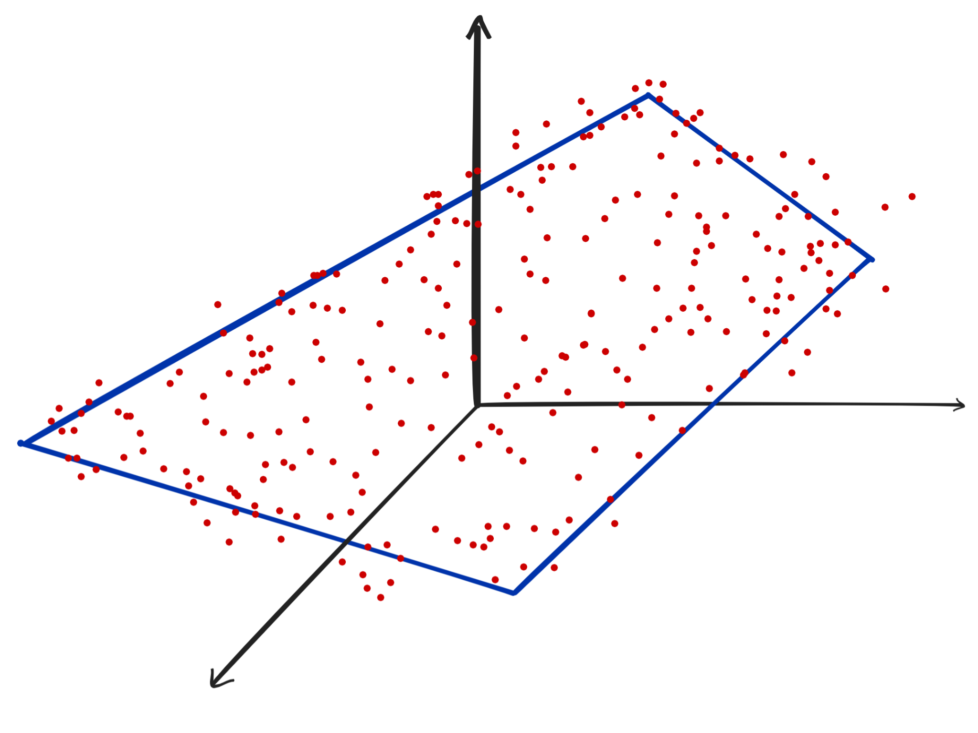
PCA (linear method)
Data on a linear manifold (hyperplane)
Gap in PCA eigenvalues

Slide 8
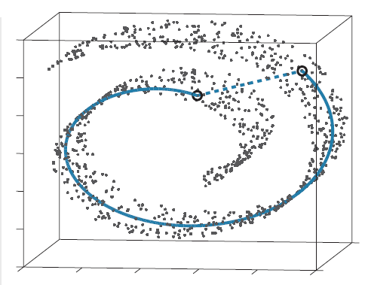
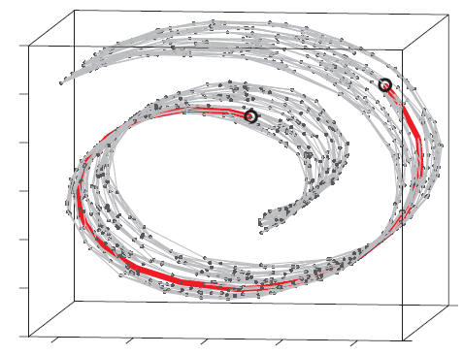
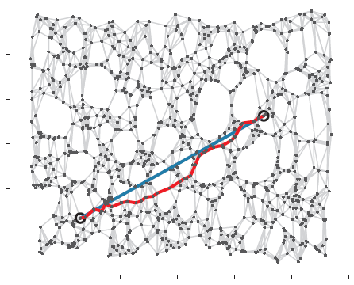
IsoMap
Near in space, distant in the manifold
Geodesic distance
Paths on neighbours graph
Essence of IsoMap:
Replace euclidean distances with (approximation of) geodesic distances
Apply multidimensional scaling (MDS)
A Global Geometric Framework for Nonlinear Dimensionality Reduction

Slide 9
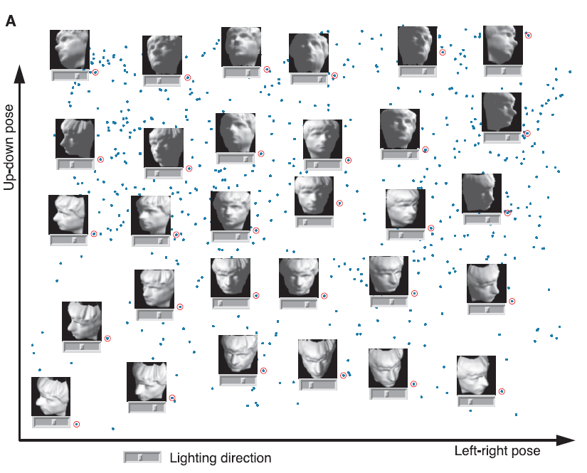
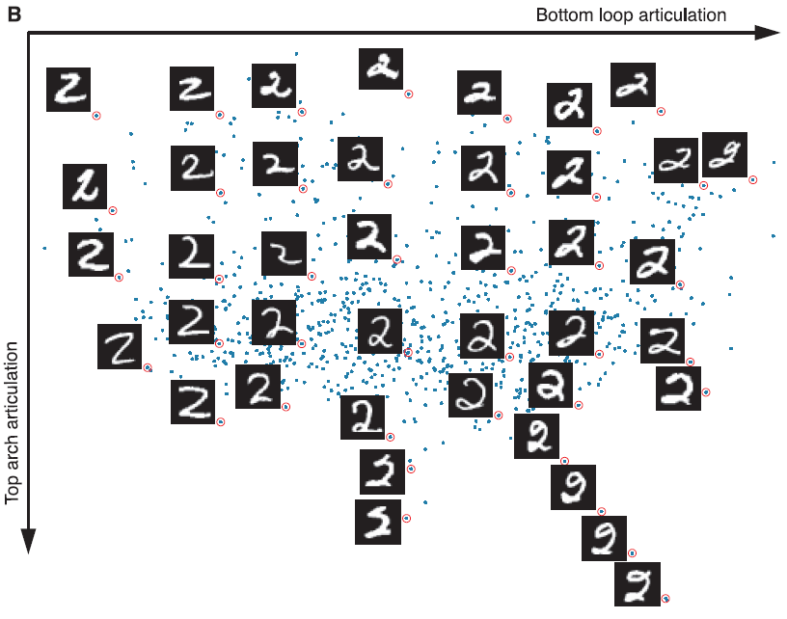
Transversing the manifold with IsoMap

Slide 10
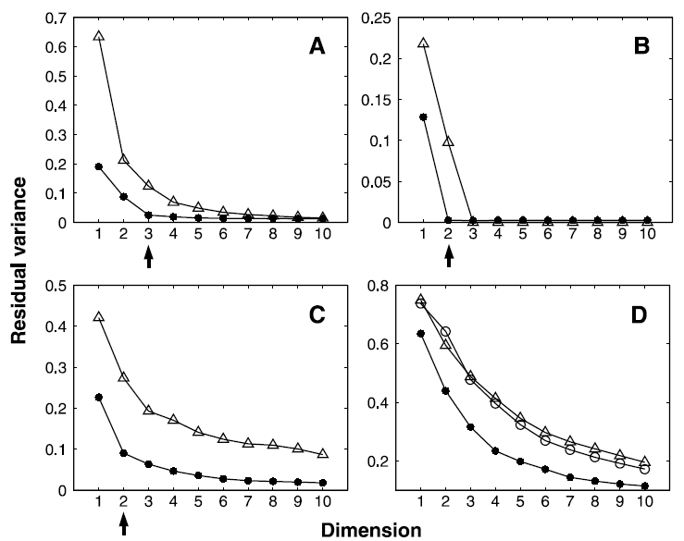
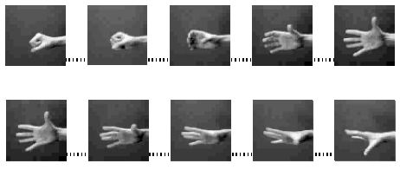
ID with IsoMap

Slide 11
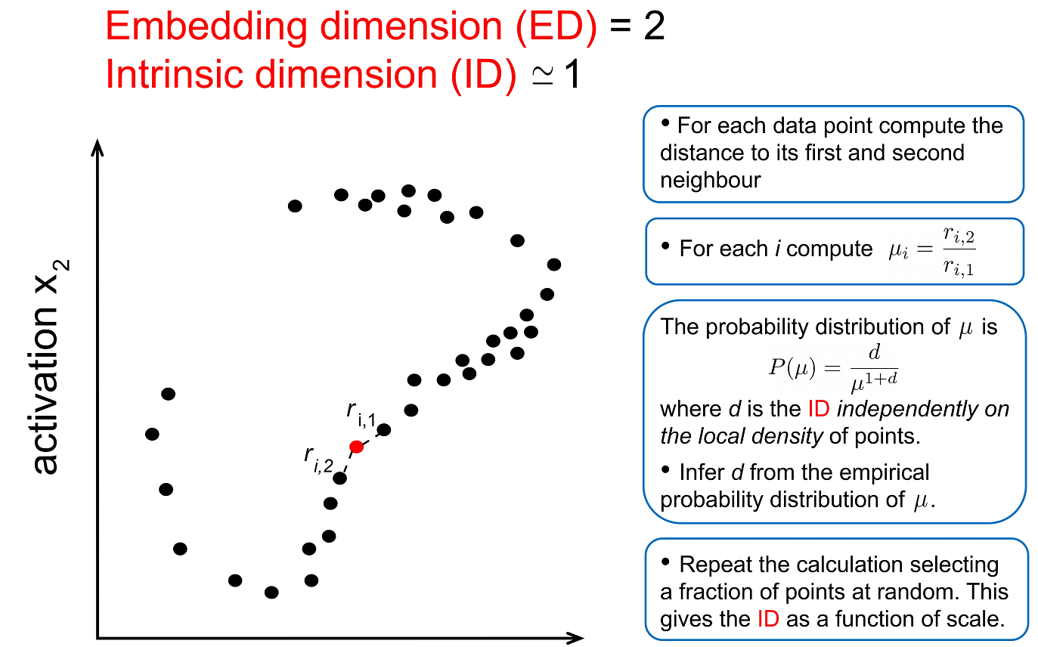
ID with the TWO-NN method
Estimating the intrinsic dimension of datasets by a minimal neighborhood information

Slide 12
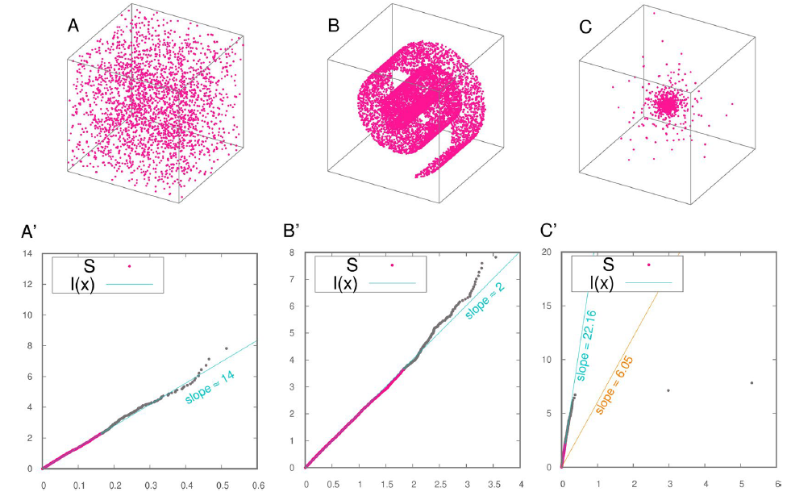
TWO-NN examples

Slide 13
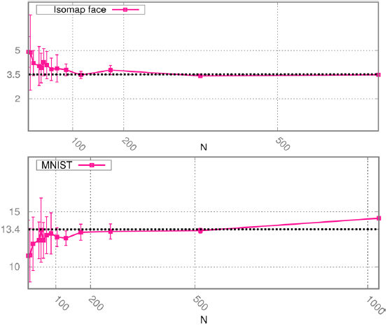
TWO-NN examples

Slide 14
Sketch of the proof

Slide 15
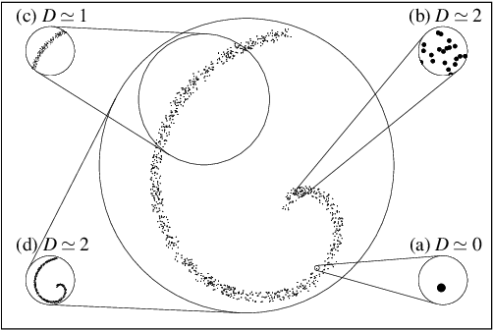
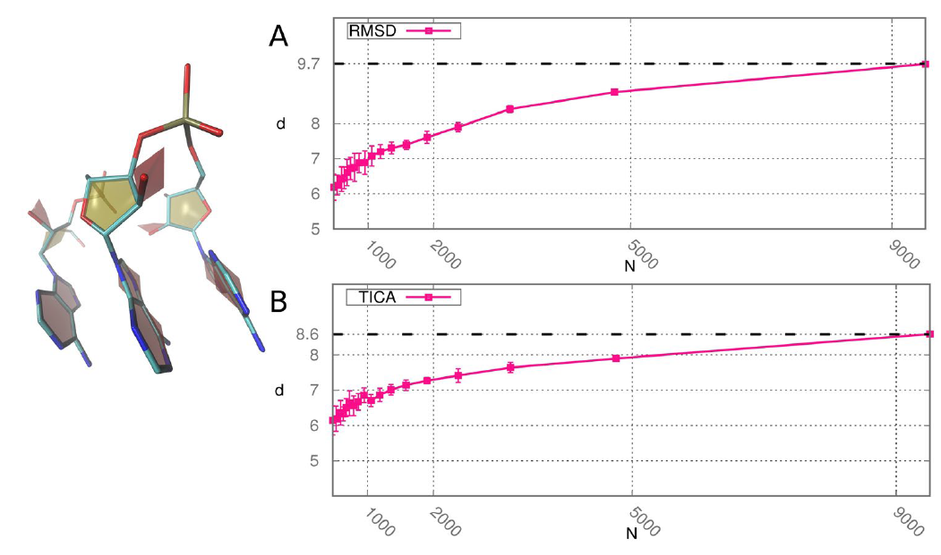
The ID depends on the scale
ID appears different at different scales
Estimate of the ID at multiple scales

Slide 16
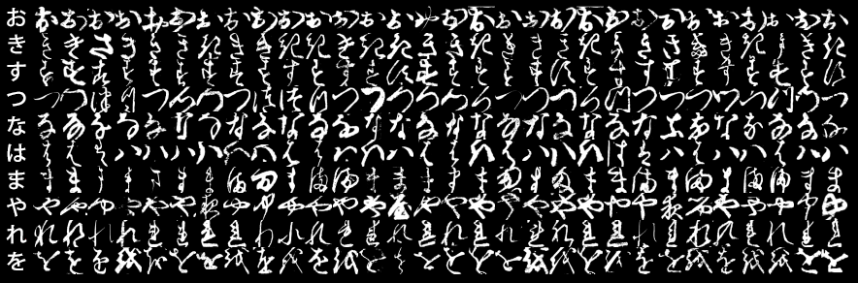
Experiment on the KMNIST dataset
Guess what is the ID of this dataset!
Hint:for MNIST is about 13
Notes:
Go to the notebook

Slide 17
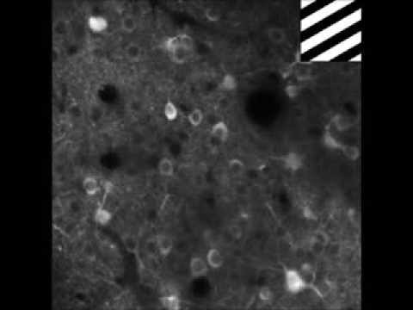
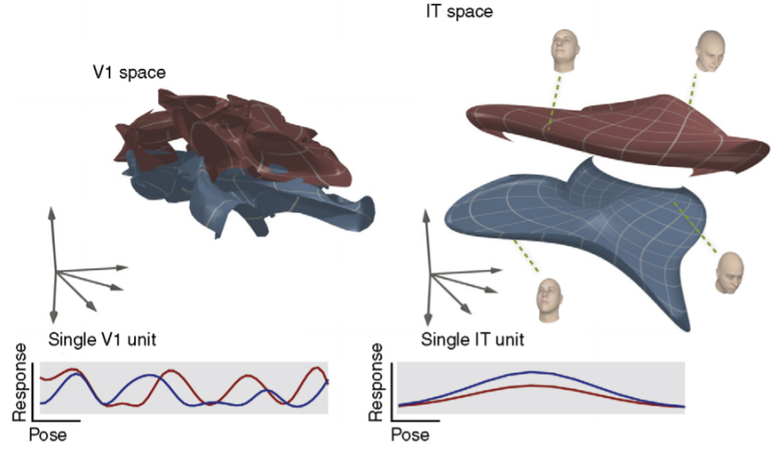
Inspiration from biology
Neural responses to stimuli are vectors of activity
Manifold disentanglement hypothesis

Slide 18
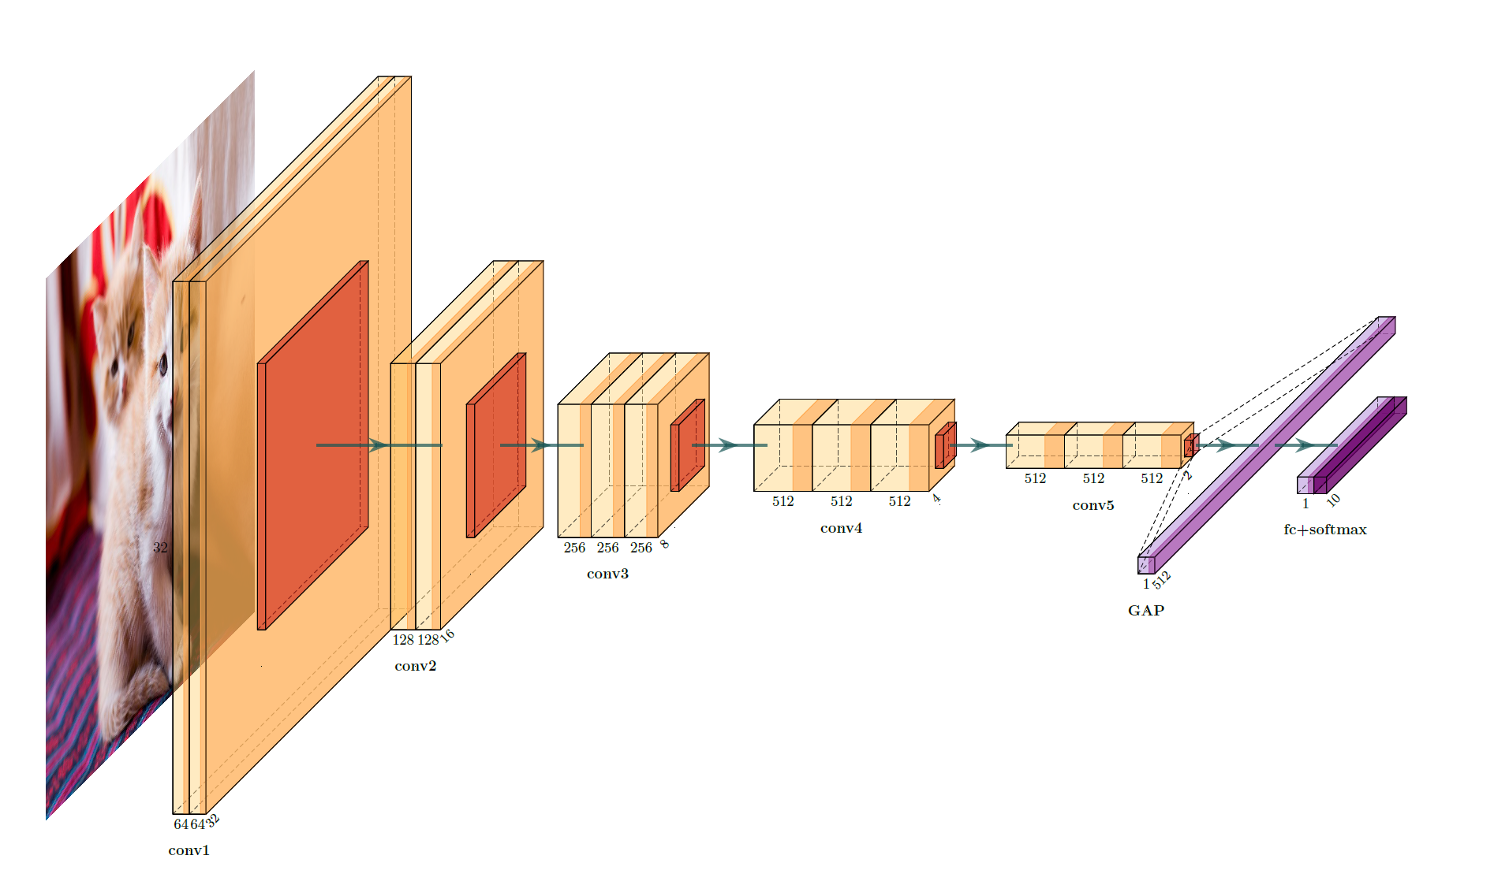
TWO-NN applied on convnets

Slide 19
Exercise: VGG-16 on CIFAR-10
Idea for an optional exercise, feel free to change it at your will:
Implement the ID point estimate following the pseudocode in Estimating the intrinsic dimension of datasets by a minimal neighborhood information (page 3).
Check the correctness of the result computing the ID of MNIST dataset (choose a subsample of 1000 data points to start). Do the same for the dataset Kuzushiji-MNNIST rois-codh/kmnist: Repository for Kuzushiji-MNIST, Kuzushiji-49, and Kuzushiji-Kanji. Do the results that you obtained make sense?
Train a VGG-16-like convnet on cifar-10 for n epochs: you can decide when to stop. Save a checkpoint of the model before training (epoch 0) and after each epoch.
At each epoch, including epoch 0 before training, extract and unroll the representations from one checkpoint layer (decide which one, we suggest e.g. the last hidden layer or the second to last). In doing this choose 1000 images at random either from one specific class or from a mixture of classes. The result should be a rectangular matrix whose dimension is (1000*size of the representation).
Estimate the ID at each epoch and store it in a list.
For each epoch compute a similarity measure of the representation with its final state at epoch n and store it in a list; choose one from those introduced in Keynote 1.
Make a scatter plot of the ID vs the similarity values you obtained and comment the result.
Notes:
Self explanatory

Slide 20
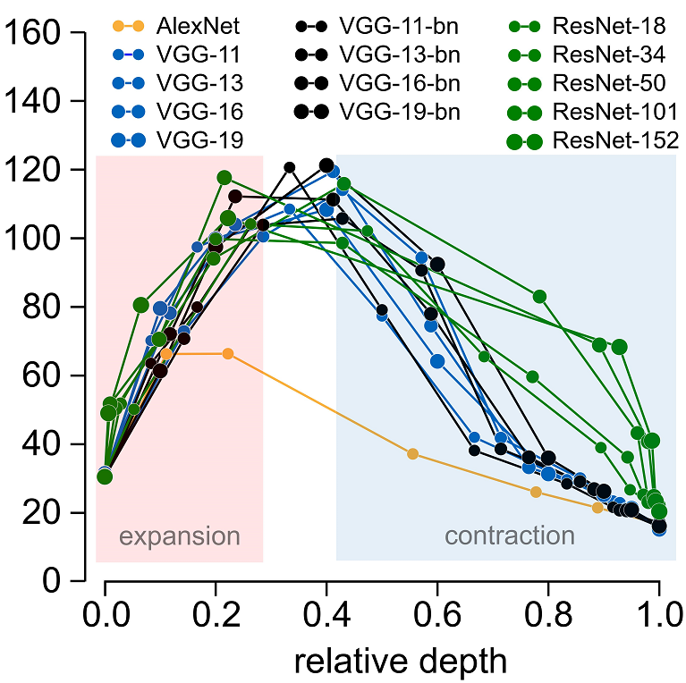
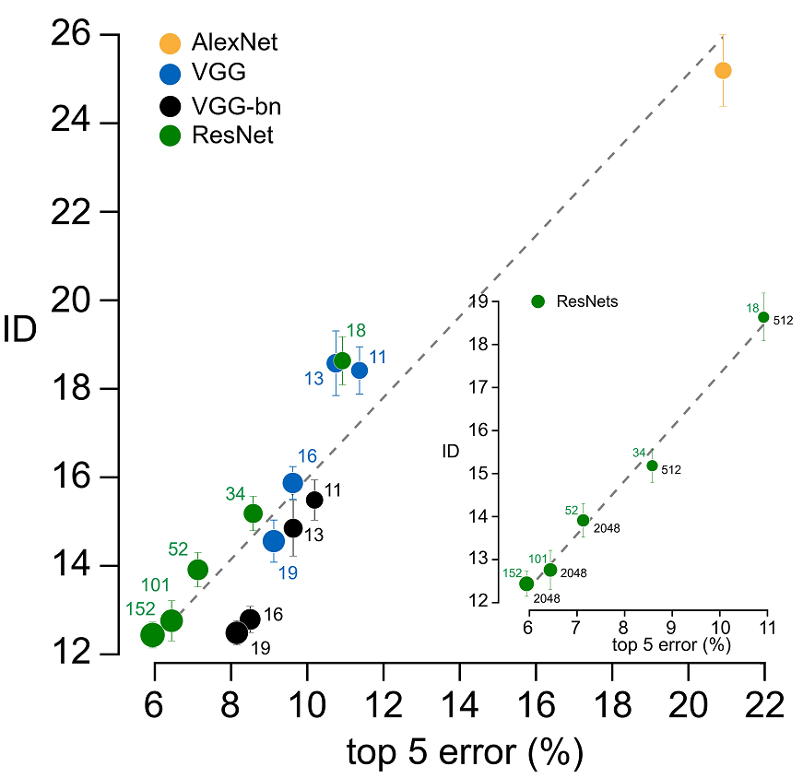
“Static” aspects of ID
A shared profile of the ID across architectures
The ID in the last hidden layer predicts performance
Intrinsic dimension of data representations in deep neural networks

Slide 21
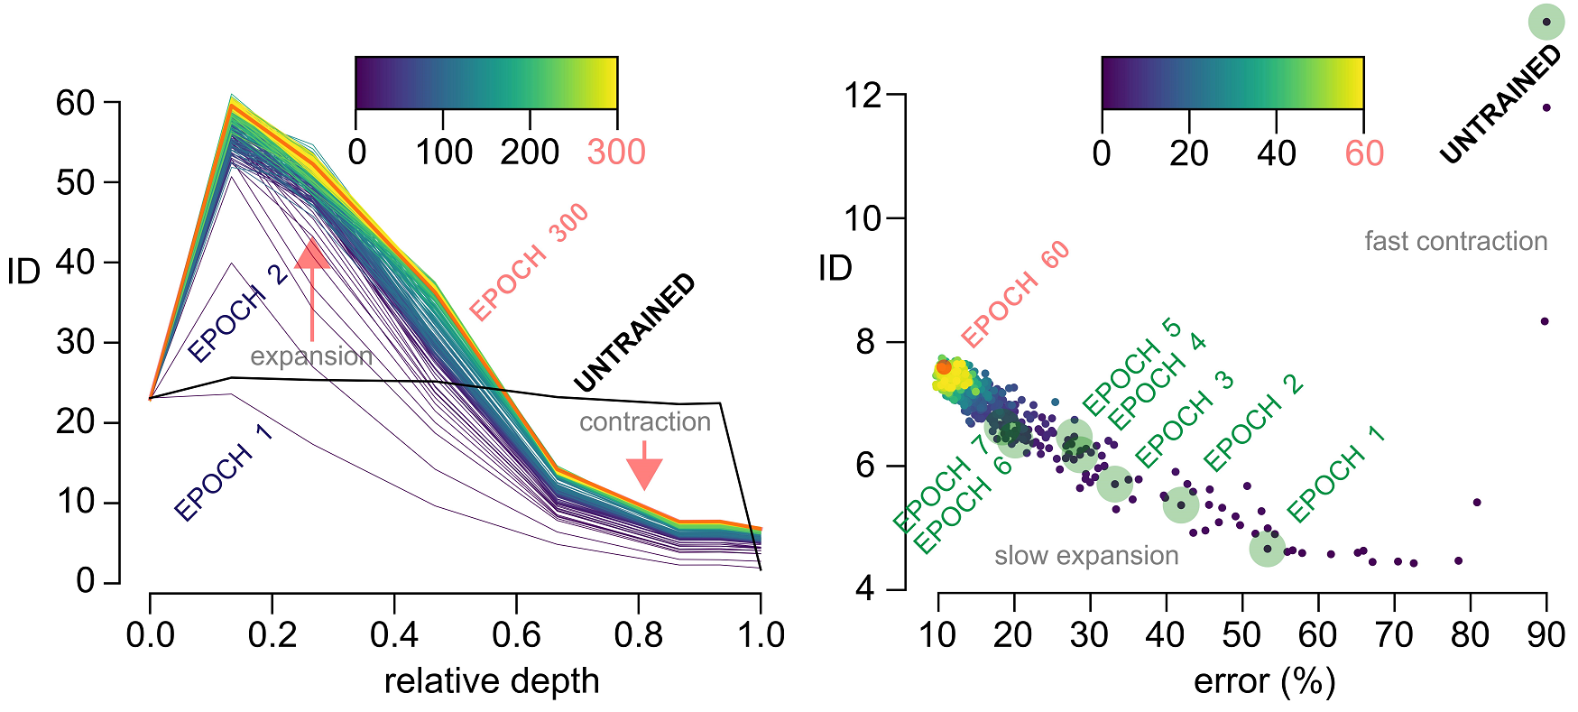
Dynamical aspects of ID
Early layers expand, deeper layers contracts
Dynamics in the last hidden layer

Slide 22
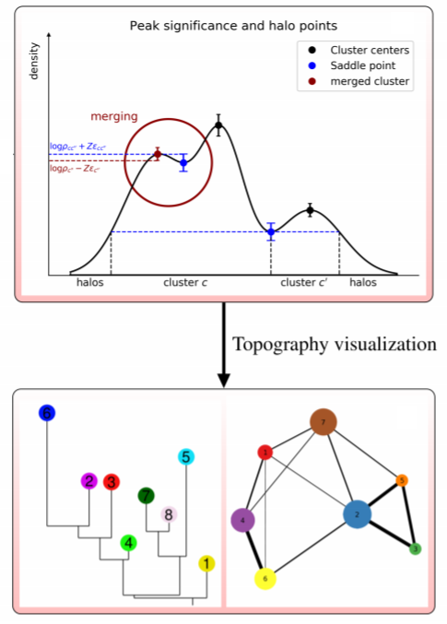
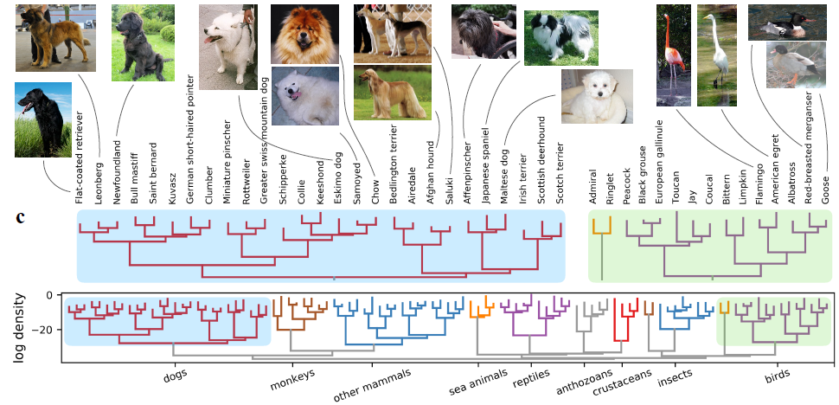
Further developments
Next 27 April Keynote Lecture 2, by Diego Doimo and Aldo Glielmo (SISSA)
https://paperswithcode.com/paper/hierarchical-nucleation-in-deep-neural

