Slide 1
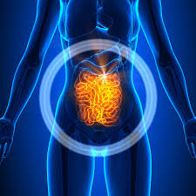
RUOLO DEL MICROBIOMA INTESTINALE NELLA SALUTE E NELLE PATOLOGIE CRONICHE GASTROINTESTINALI

Slide 2
MICROBIOME
The concept of the human microbiome was first suggested by Joshua Lederberg, who coined the term “microbiome, to signify the ecological community of commensal, symbiotic, and pathogenic microorganisms that literally share our body space” (Lederberg and McCray, 2001)
Microbes in a healthy human adult outnumber human cells by a ratio of ten to one, and the total number of genes in the microbiome is 200 fold major than the number of genes in the human genome

Slide 3
THE COMMUNITY OF MICROBES IN AN INDIVIDUAL MAY INFLUENCE:
susceptibility to certain infectious diseases
obesity and diabetes
response to a particular drug treatment
produce certain vitamins
regulate immune system
protect against disease-causing bacteria

Slide 4
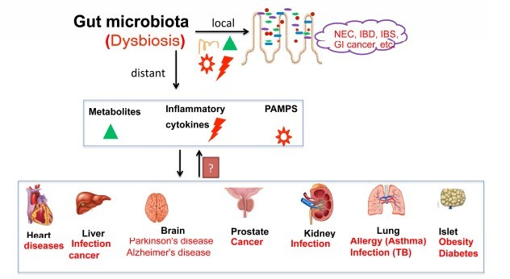

Slide 5
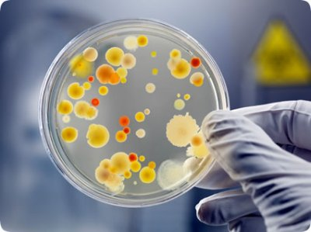
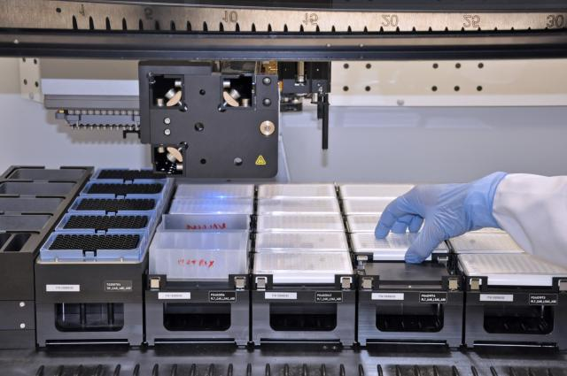
TOOLS FOR STUDYING THE GUT MICROBIOME
Culture-based techniques
High throughout sequencing technologies

Slide 6
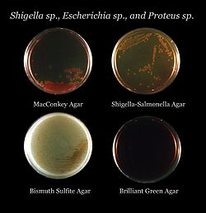
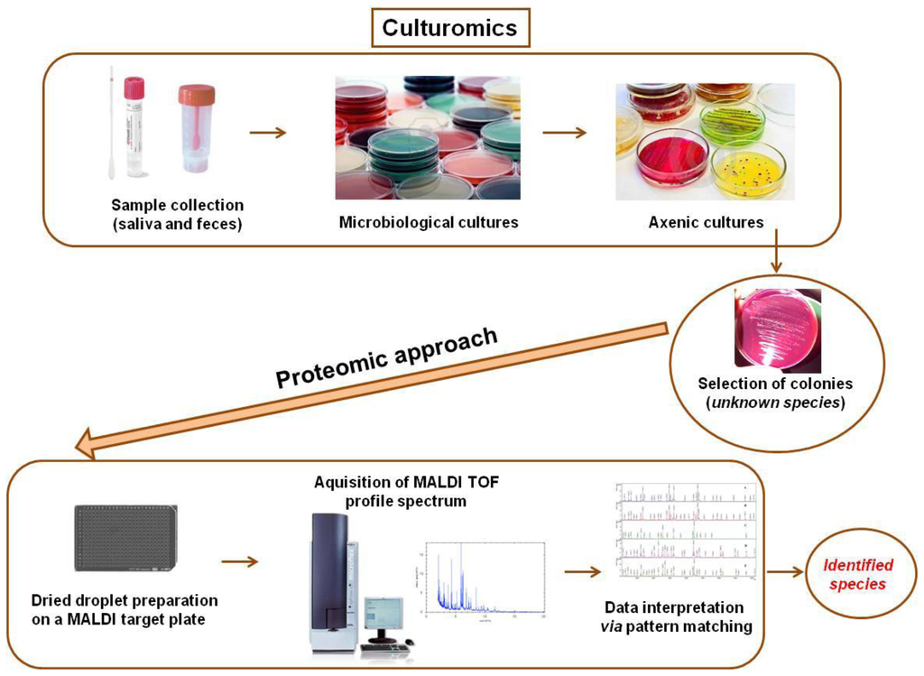
CULTURE-BASED TECHNIQUES
Selective and specialized media
Microbial culturomics

Slide 7
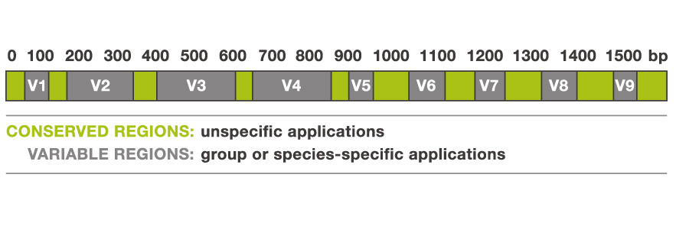
HIGH THROUGHOUT SEQUENCING TECHNOLOGIES
16S rRNA gene sequencing
Method | Max Read Length
454 (Roche, 2007) [discontinued in 2014] | 700 bp
Illumina (Solexa, 2005) | 600 bp
AB SOLID System (Life Technologies, 2006) | 2X60 bp
Ion Torrent (Life Technologies, 2010) | 100- 400 bp
A common approach is to survey all copies of a single gene (16S rRNA gene mostly) in a polymicrobial specimen

Slide 8
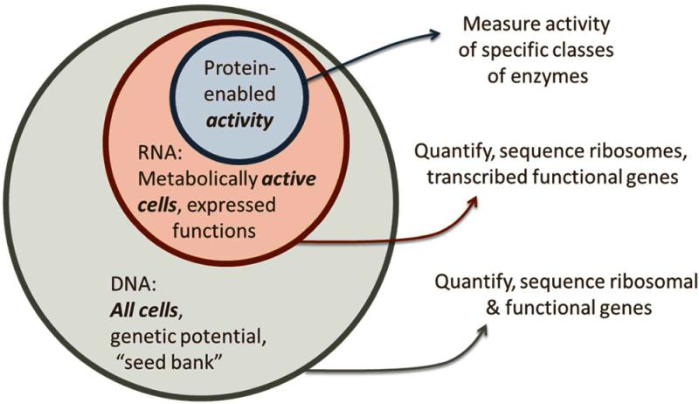
OTHER TOOLS:
Metagenomics
Metatranscriptomics
Metaproteomics
Metabolomics

Slide 9
FUNDING INITIATIVES
European Metagenomics of the human intestinal tract (MetaHIT) (2008)
US Human Microbiome Project (HMP Consortium) (2008)

Slide 11
ADULT GUT MICROBIOME
PHYLUM
Firmicutes
Bacteroidetes
Actinobacteria
Proteobacteria
Verrucomicrobia
Fusobacteria
SPECIES
Faecalibacterium prausnitzii
Roseburia intestinalis
Bacteroides uniformis

Slide 12
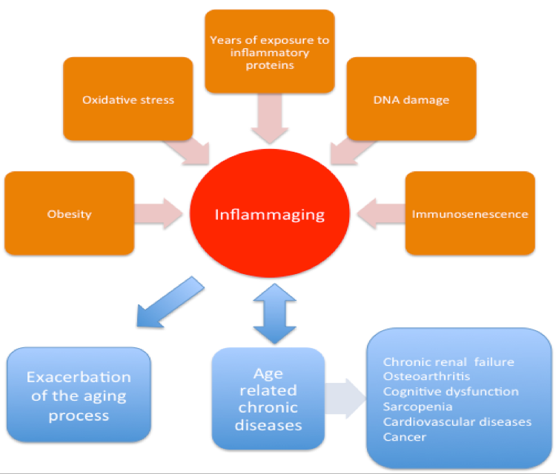
Bacteroidetes
Firmicutes

Slide 13
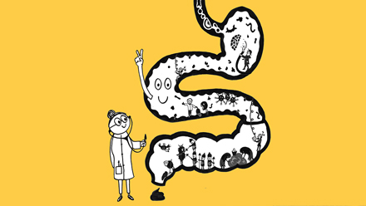
GUT MICROBIOTA AND CHRONIC GASTROINTESTINAL (GI) DISEASE:
Irritable Bowel Syndrome (IBS)
Inflammatory Bowel Disease (IBD)
Type 2 Diabetes (T2D) and Obesity
Colorectal Cancer (CRC)

Slide 14
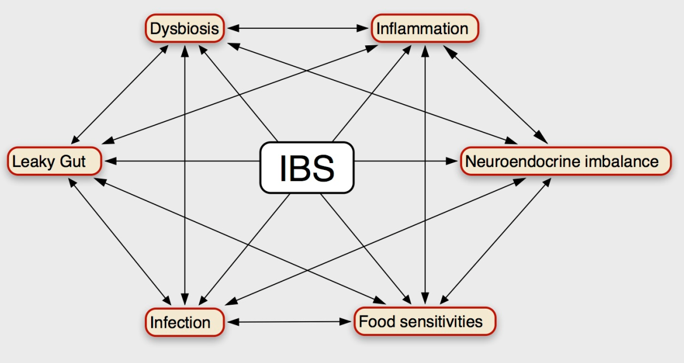
IRRITABLE BOWEL SYNDROME
Increased
Firmicutes:Bacteroidetes ratio
Ruminococcus
Dorea
Clostridium
Haemophilus influenzae (pIBS)
Proteobacteria (pIBS)
Alistipes (pIBS)
Decreased
Bifidobacterium
Faecalibacterium
Bacteroides (pIBS)

Slide 15
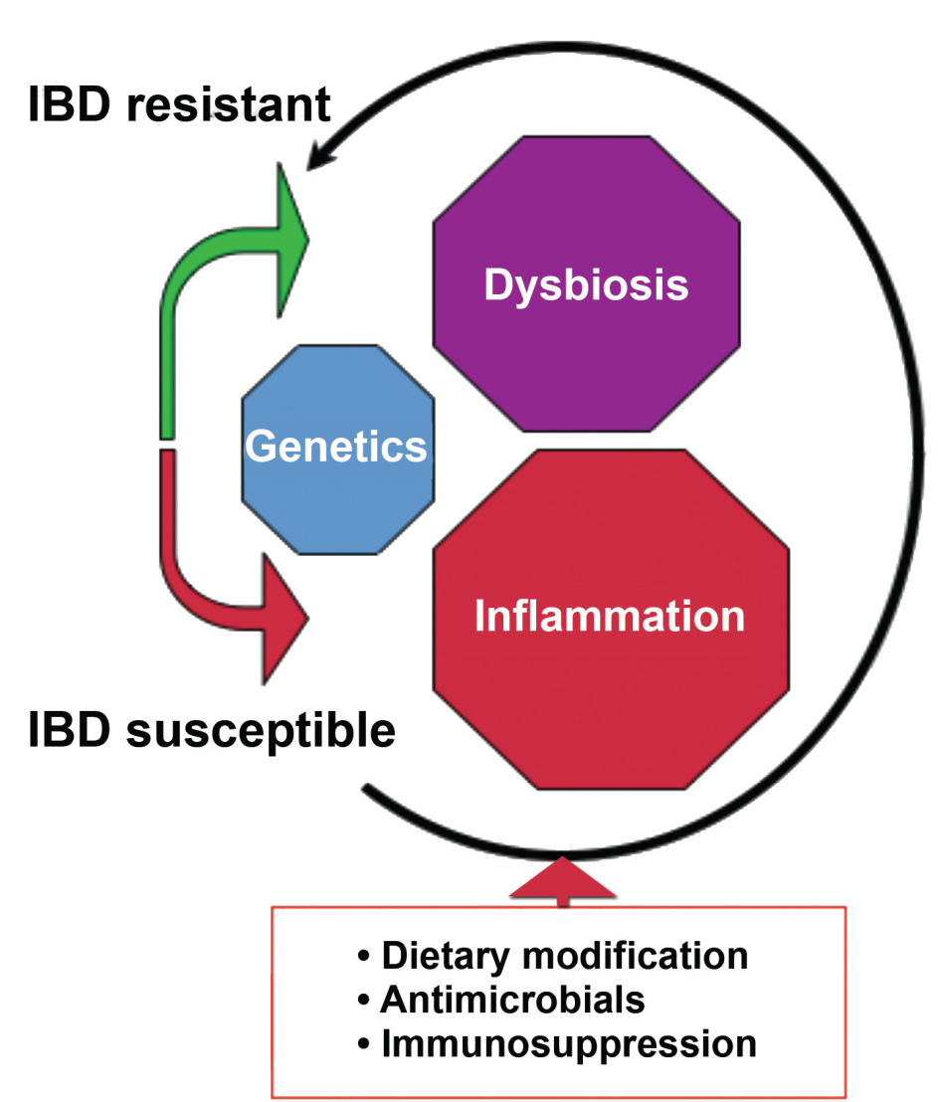
INFLAMMATORY BOWEL DISEASE:
ULCERATIVE COLITIS (UC) AND CHRON’S DISEASE (CD)
Increased
Bacterial numbers in mucosa (CD)
Adherent invasive E. coli (CD)
Gammaproteobacteria (CD)
Enterobacteriaceae (UC)
Clostridium spp.
Decreased
Bacterial diversity
Bacteroidetes
Firmicutes
Clostridium leptum and coccoides group
F. prausnitzii
Roseburia
Phascolarctobacterium

Slide 16
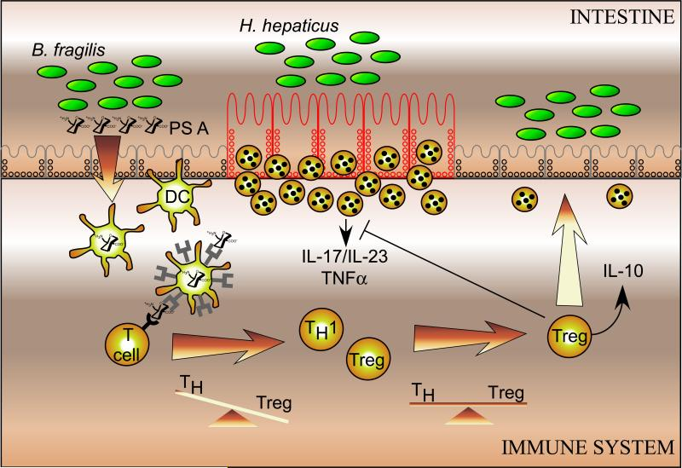
Round JL, Mazmanian SK. The gut microbiome shapes intestinal immune responses during health and disease. Nature reviews Immunology. 2009;9(5):313-323. doi:10.1038/nri2515.

Slide 17
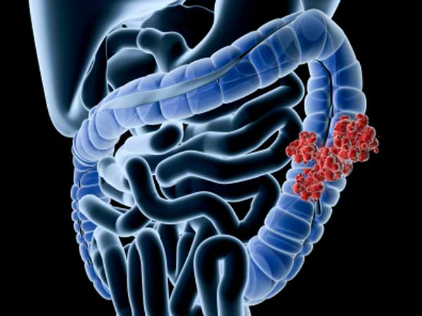
COLORECTAL CANCER
Increased
Fusobacterium spp. (F. nucleatum, F. mortiferum, F. necrophorum)
Proteobacteria
E. Coli (pks+)
Decreased
Firmicutes
Bacteroidetes

Slide 18
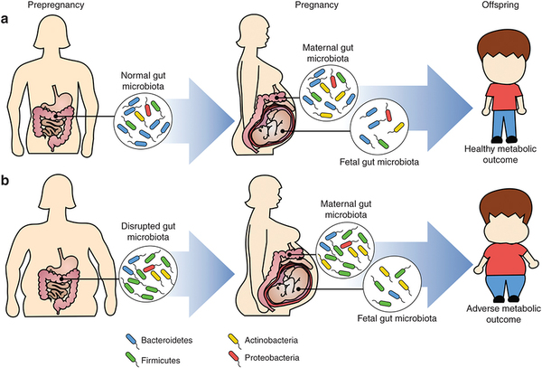
OBESITY
Increased
Firmicutes:Bacteroidetes ratio
Actinobacteria
Prevotellaceae
Decreased
Bacterial diversity
C. Leptum group
Bifidobacterium

Slide 19
TYPE 2 DIABETES
Increased
Opportunistic pathogens
(Clostridium spp., E. coli, Eggerthella lenta)
Akkermansia municiphilia
Betaproteobacteria
Bacteroides spp.
Decreased
Butyrate-producing organisms
(Roseburia spp., Faecalibacterium spp., Eubacterium spp.)
Firmicutes

Slide 20
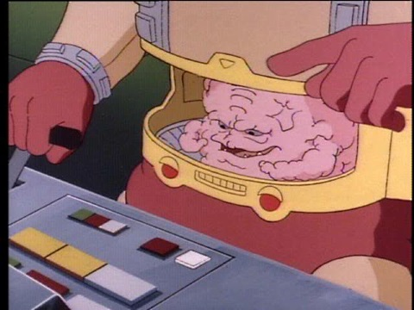
STRATEGIES TO MANIPULATE GUT MICROBIOME
Prebiotics/Probiotics
Faecal microbial transplantation
Antimicrobial compounds

Slide 21
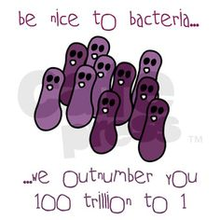
CONCLUDING REMARKS
Our gut microbiota has a pivotal role in human health and disease
Microbiota influence host metabolism, physiology and immune system
The targeting of specific components of gut microbiome will allow the removal of harmful organisms and enrich the beneficial microbes that contribute to our health

