Slide 1
THE VAGINAL MICROBIOME (VMB)
IN HEALTH AND DISEASE
Eubiosis vs Dysbiosis
Notes:
Il microbiota vaginale
Drug metabolism
Functions of vmb
Microbiota transpantation

Slide 2
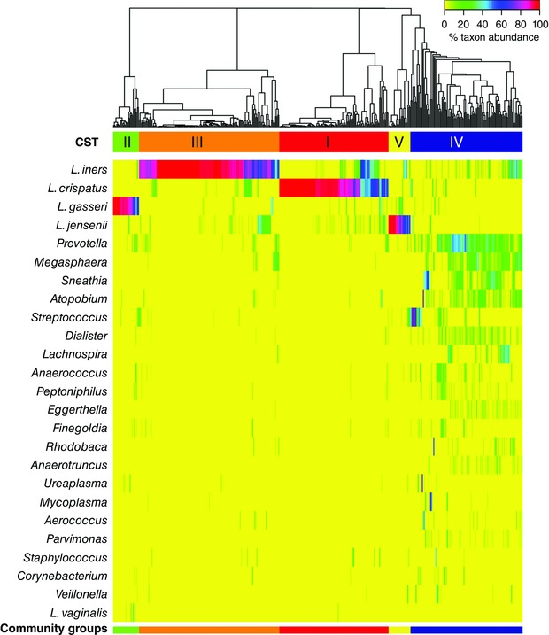
THE VAGINAL COMMUNITY STATE TYPES (CSTs) or VAGITYPES
CST IV-A:
modest proportions of Lactobacillus spp., together with low proportions of various species of strictly anaerobic bacteria such as Anaerococcus, Corynebacterium,
Finegoldia,
or Streptococcus.
CST IV-B:
higher proportions of the genus Atopobium, in addition to Prevotella, Parvimonas, Sneathia, Gardnerella, Mobiluncus, or Peptoniphilus and several other taxa.
DOI: 10.1113/JP271694
Notes:
A e B
Il primo è caratterizzato da una notevole riduzione di Lattobacilli che, in proporzioni modeste, sono ancora presenti insieme a basse quantità di varie specie di batteri strettamente anaerobici come Anaerococcus, Corynebacterium, Finegoldia o Streptococcus. Al contrario, nel IV-b I LATTOBACILLI SONO QUASI DEL TUTTO Assenti ed a predominare è il genere Atopobium, oltre a Prevotella, Parvimonas, Sneathia, Gardnerella, Mobiluncus o Peptoniphilus e numerosi altri taxa.
Il CST IV normalemtne è quelo hce si osserva in condizioni si disbiosi.
In euebiosi, i MO predominatni sono LCT spp. che possono coesistere con altri MO. E’ importnate sottolineare come nell’arco della propria vita e in base al ciclo mestreuale, i VMB può subire delle variazioni.

Slide 3
The frequency of CSTs in different ethnic backgrounds
doi/10.1073/pnas.1002611107

Slide 4
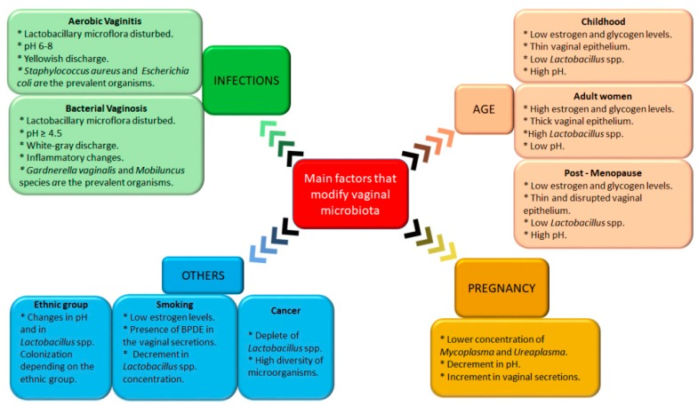
Factors that modify the vaginal microbiota
doi:10.3390/pharmaceutics11050217

Slide 5
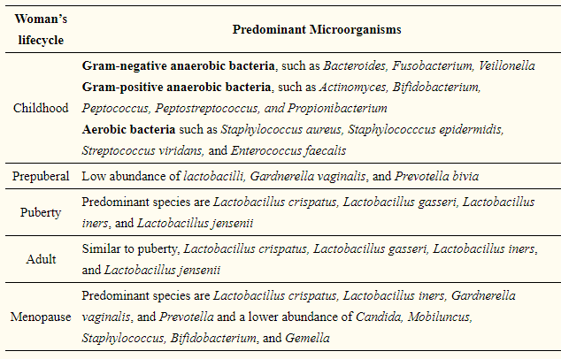
Factors that modify the vaginal microbiota:
age
doi:10.3390/pharmaceutics11050217

Slide 6
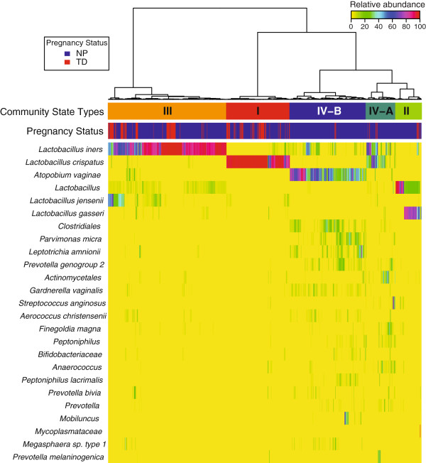
doi: 10.1186/2049-2618-2-4
Factors that modify the vaginal microbiota:
pregnancy
Not pregnant
Term Delivery

Slide 7
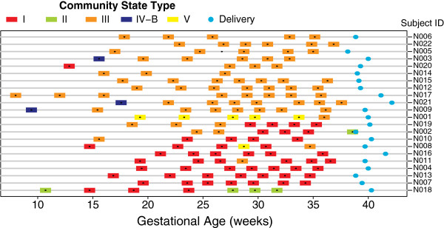
Factors that modify the vaginal microbiota:
pregnancy
doi: 10.1186/2049-2618-2-4

Slide 8
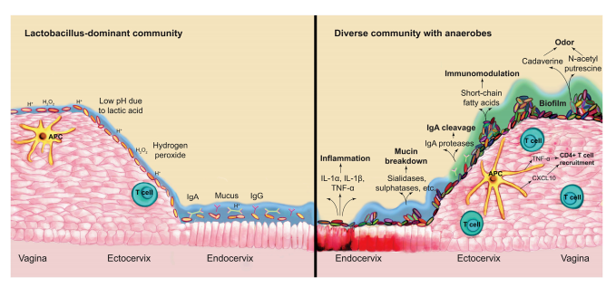
Factors that modify the vaginal microbiota:
bacterial vaginosis (BV)
BV= Bacterial vaginosis (BV) can described as a disturbance in the vaginal microbiome in which the Lactobacilli are replaced by an overgrowth of vaginal commensal organisms. It may be transient or become persistent.
doi: 10.1016/j.chom.2018.01.013

Slide 9
Factors that modify the vaginal microbiota:
aerobic vaginitis (AV)
doi:10.1016/j.resmic.2017.04.004

Slide 10
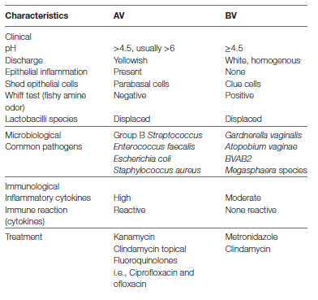
BV vs AV
doi: 10.3389/fpubh.2018.00078

Slide 11
Factors that modify the vaginal microbiota:
other factors
Smoking
smokers show decreased amount of Lactobacilli spp. and
increased amount of benzo[a]pyrene diol epoxide (BPDE)
in vaginal secretions.
Presence of cervical cancer

Slide 12
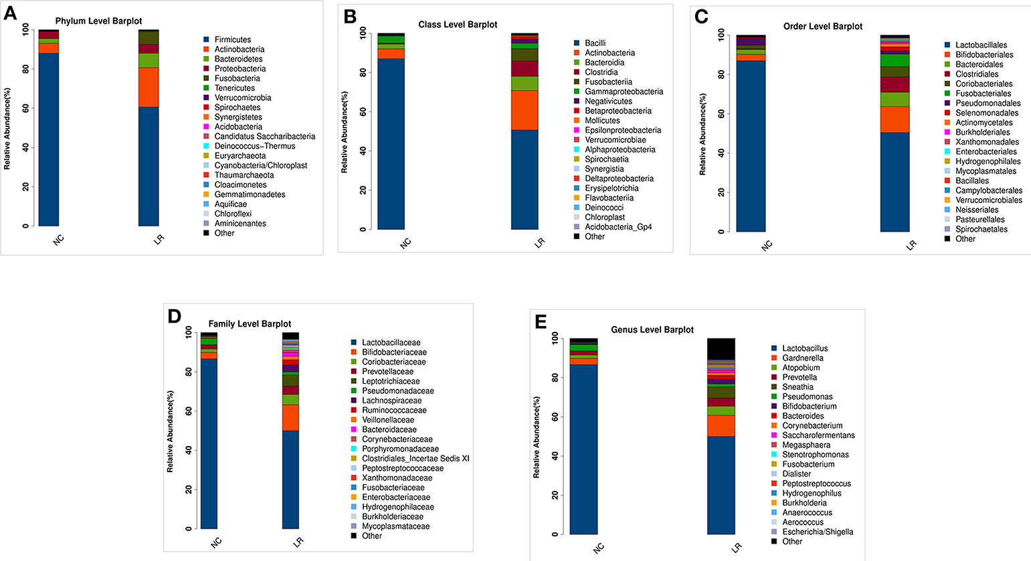
Factors that modify the vaginal microbiota:
cervical cancer
doi.org/10.3389/fcimb.2019.00294

Slide 13
Factors that modify the vaginal microbiota:
oncogenic virome
doi:10.3390/microorganisms7100414

Slide 14
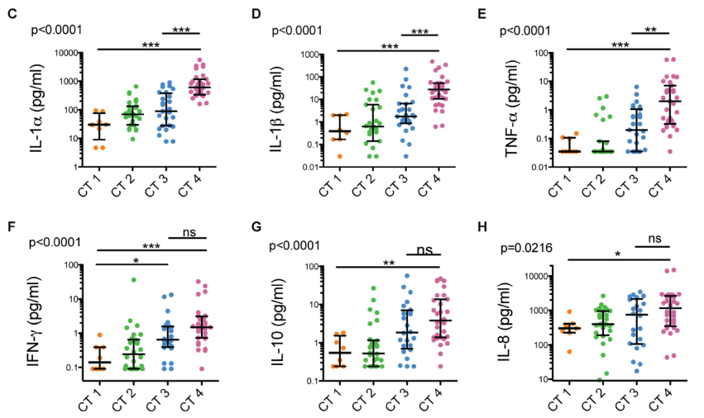
The effects of vaginal microbiota on host physiology:
host defence
doi: 10.1016/j.immuni.2015.04.019

Slide 15
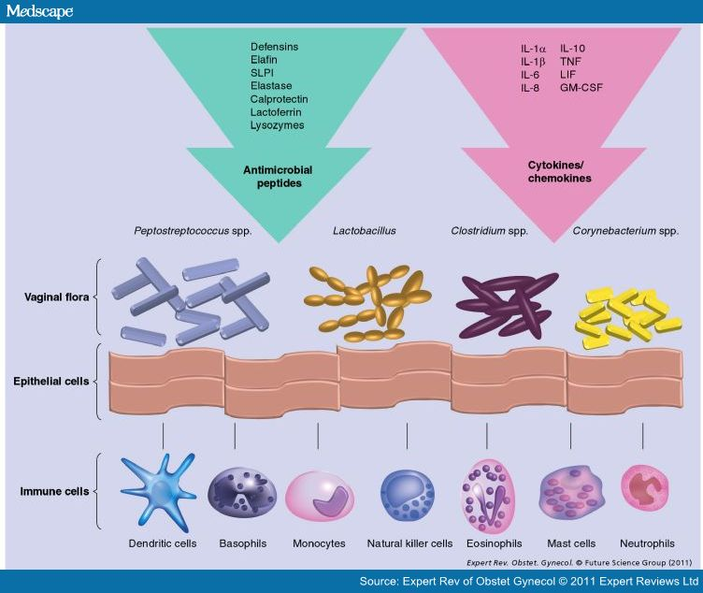
The effects of vaginal microbiota on host physiology:
lactic acid production and vaginal mucosa
L-lactate and D-lactate
HIV

Slide 16
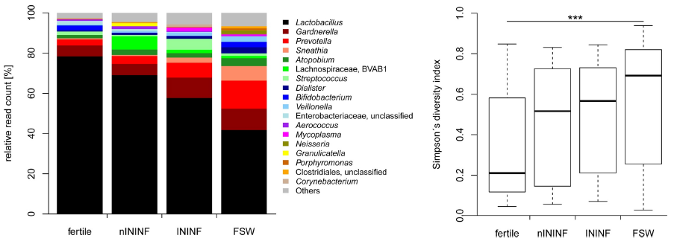
The effects of vaginal microbiota on host physiology:
reproductive function
nININF: Non-infectious infertility; ININF: Infectious infertility; FSW: Female sex workers.
*tubal factor infertilty
doi: 10.1371/journal.pone.0191047

Slide 17
doi:10.1002/jcp.25806

Slide 18
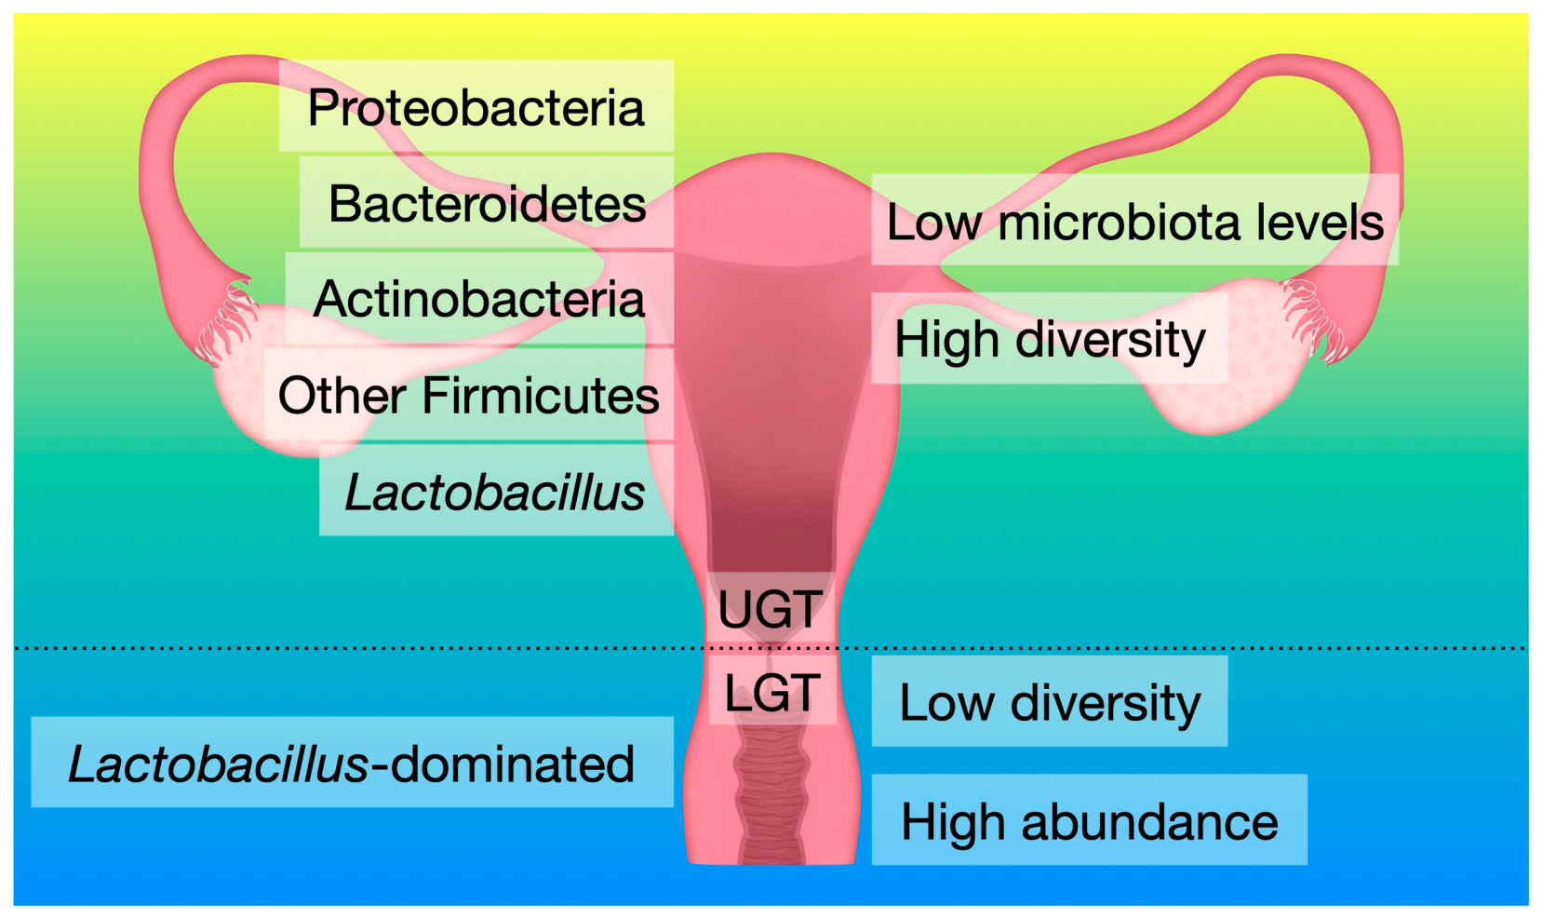
The effects of vaginal microbiota on host physiology:
reproductive function
doi.org/10.3390/ijms20143405

Slide 19
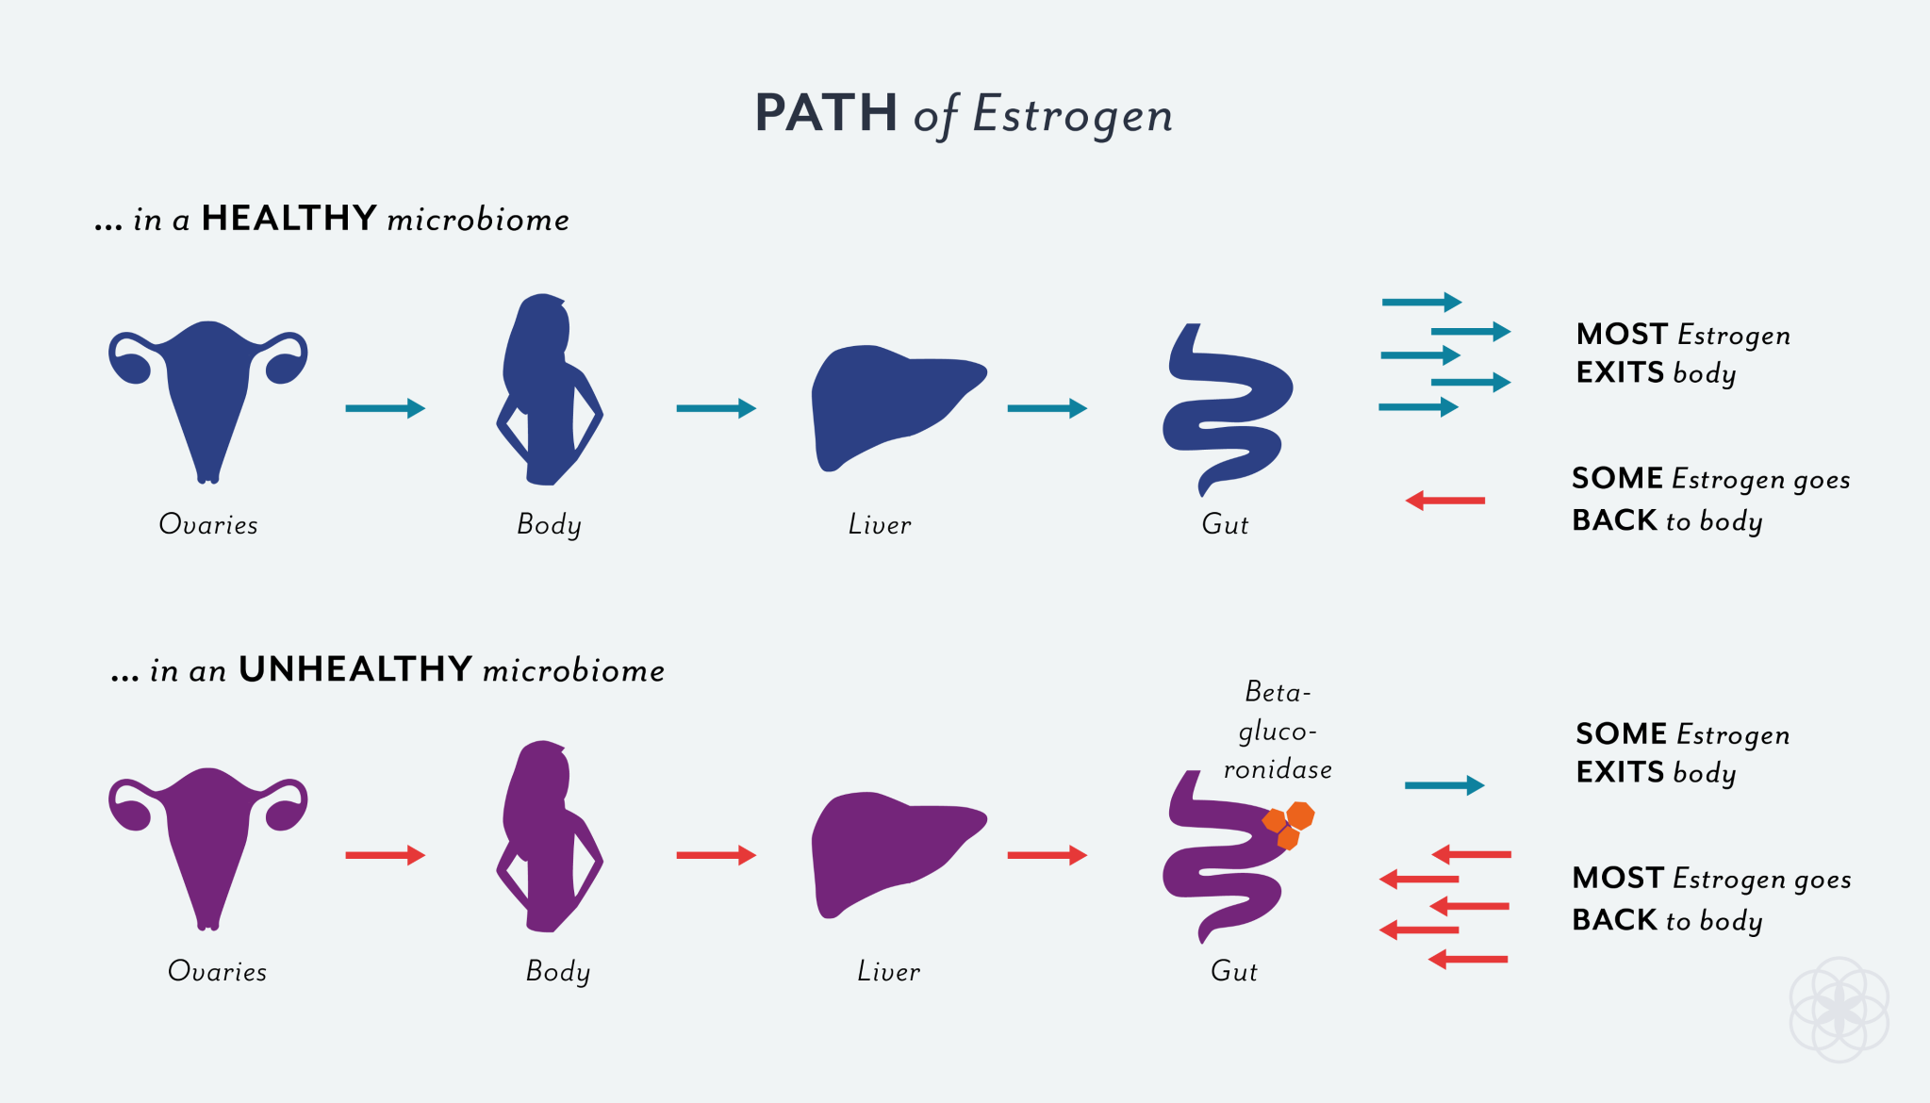
The estrobolome

Slide 20
The effects of vaginal microbiota on host physiology:
endometriosis
Control
Endometriosis
doi.org/10.1038/s41598-019-39700-6
Control
Endometriosis

Slide 21
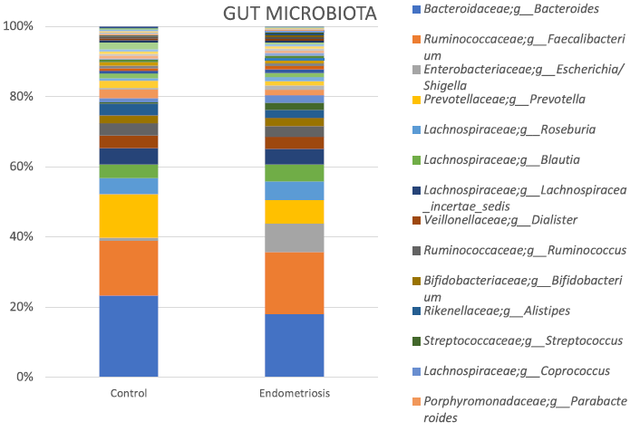
The effects of vaginal microbiota on host physiology:
endometriosis
Control
Endometriosis
doi.org/10.1038/s41598-019-39700-6

Slide 22
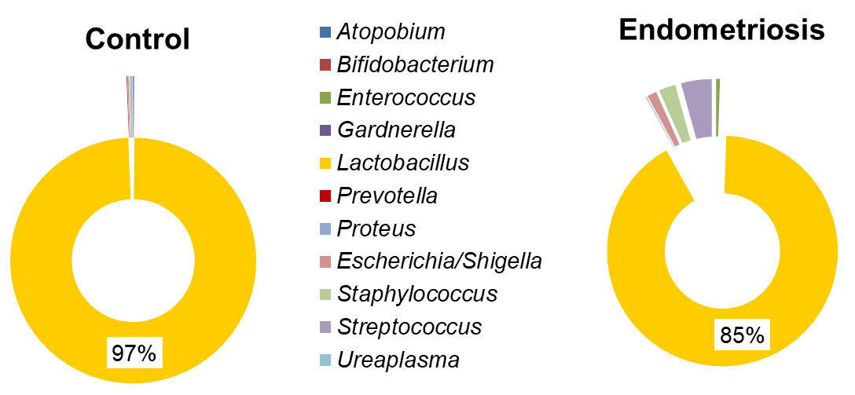
The effects of vaginal microbiota on host physiology:
Endometriosis
Our preliminary results
Cervico-Vaginal µBiota

Slide 23
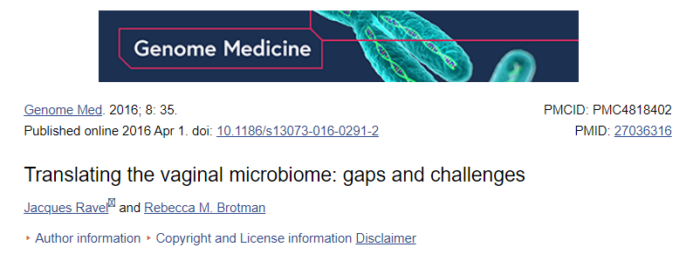

Slide 24
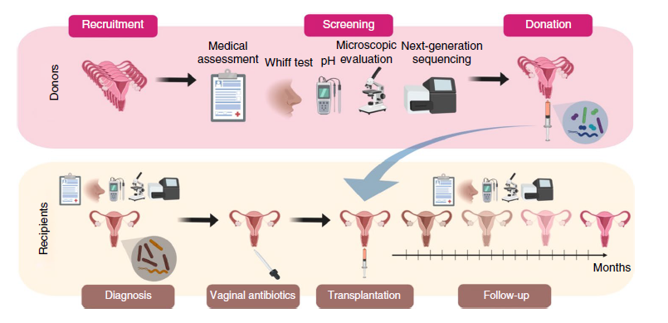
How can we modulate the VMB
Vaginal Microbiome Transplantion (VMT)
doi: 10.1038/s41591-019-0600-6

