Slide 1
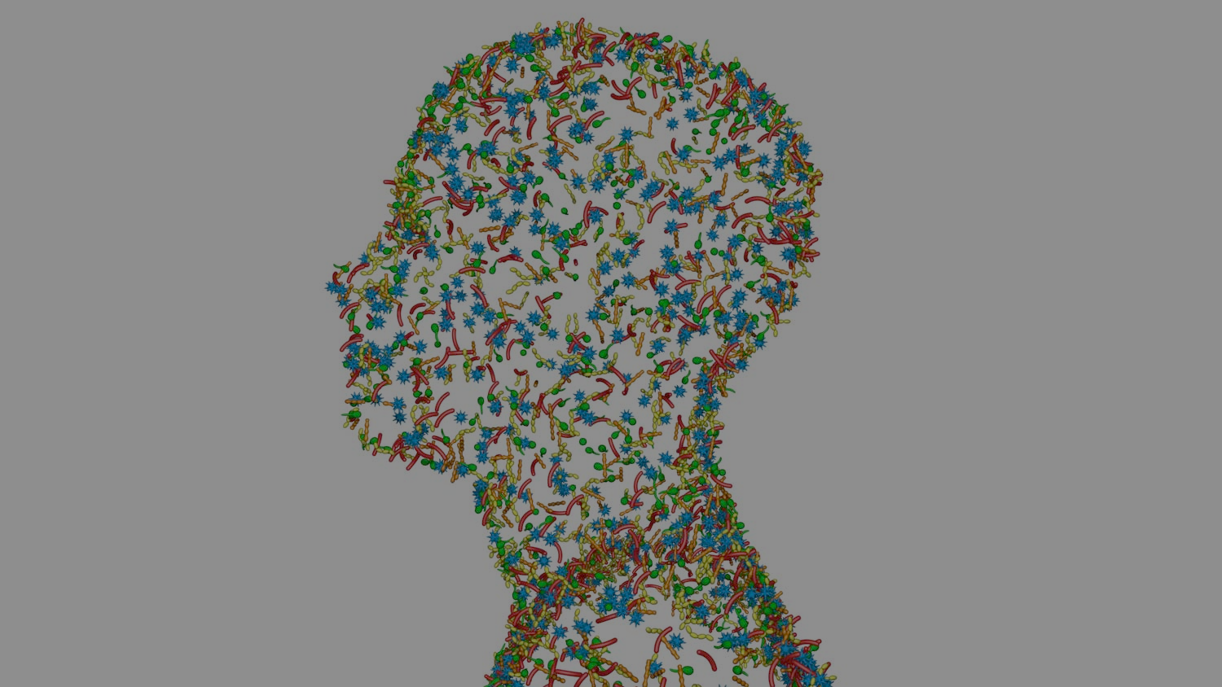
SKIN MICROBIOME

Slide 2
SKIN MICROBIOME:
The establishment
Breastfeeding
Mode
of delivery
Environment
10.1073/pnas.1002601107

Slide 3
SKIN MICROBIOME:
The establishment
10.1073/pnas.1002601107

Slide 4
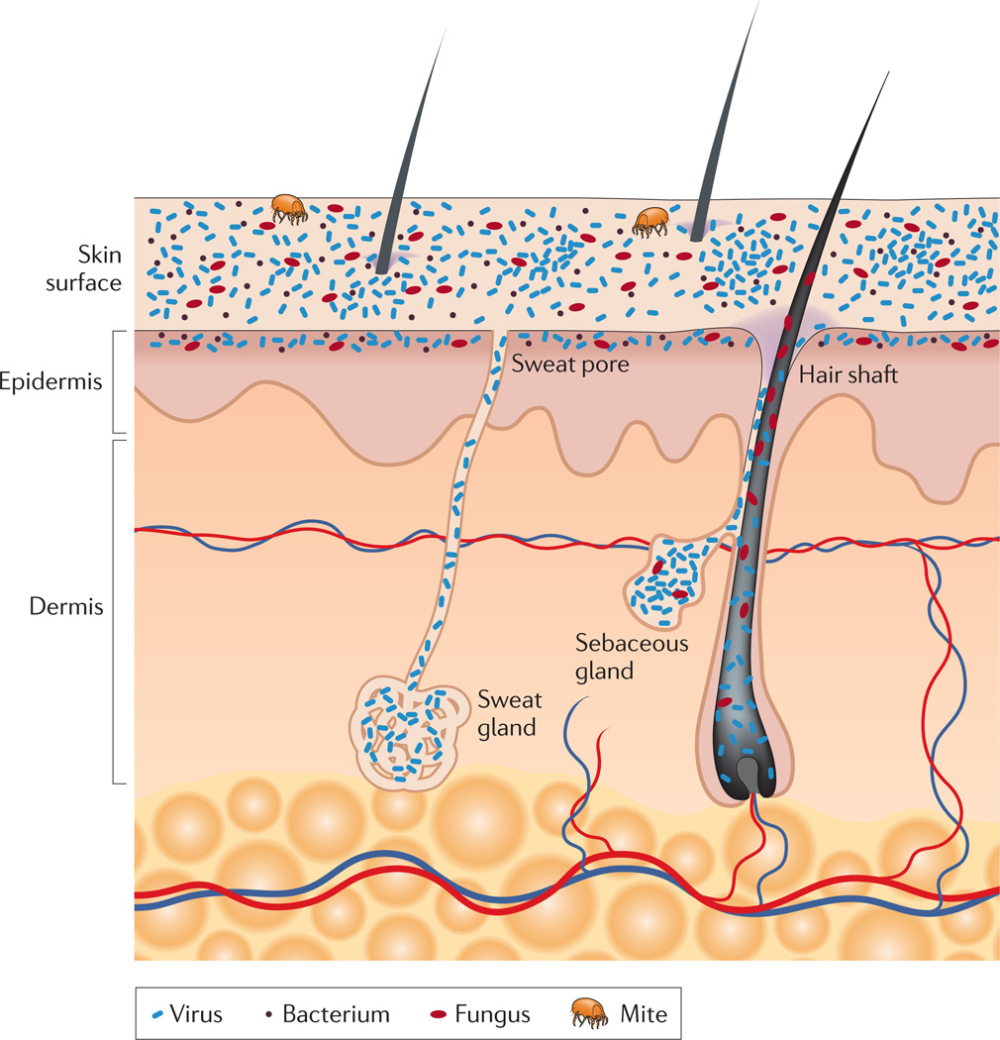
Healthy SKIN MICROBIOME
Resident Microorganisms (Core microbiome)
+ Transient microorgamisms (Tourists) = skin microbiome
The most abundant phyla:
Actinobacteria,
Firmicutes,
Proteobacteria,
Bacteroidetes
The three most common bacterial genera:
Corynebacteria,
Propionibacteria,
Staphylococci
Yeast:
Malassezia spp.
Parasitic arthropod:
Demodex spp.
doi: 10.1038/nrmicro2537

Slide 5
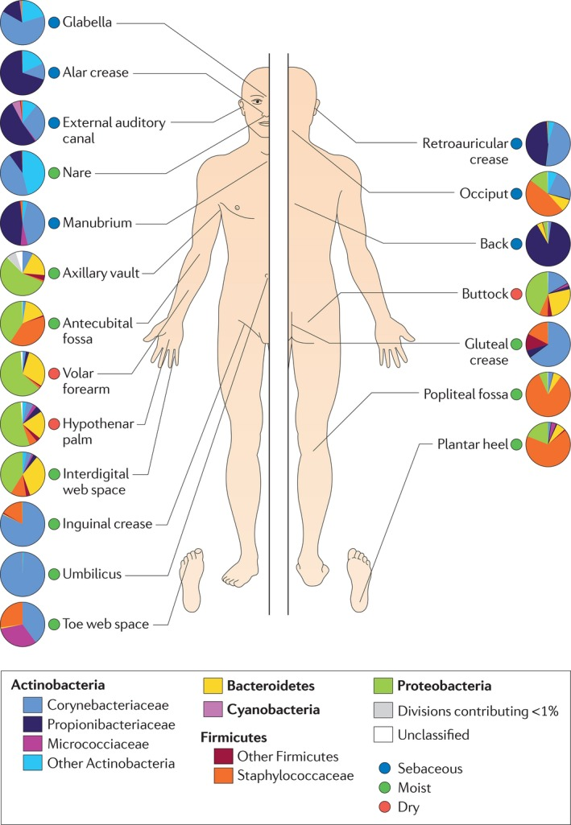
The topographical distribution of SKIN MICROBIOME
doi: 10.1038/nrmicro2537

Slide 6
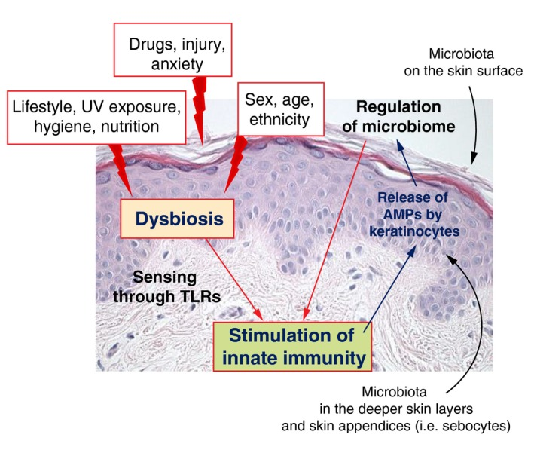
The importance of the SKIN MICROBIOME
PRRs= pattern recognition receptor
TLRs= Toll-like receptors
AMPs= Anti-Microbial Peptides
S. epidermidis and S. aureus =
opportunistic pathogen
S. aureus, S. pyogenes
P. acnes
S. epidermidis, Corynebacteria
doi: 10.1111/jdv.13965

Slide 7
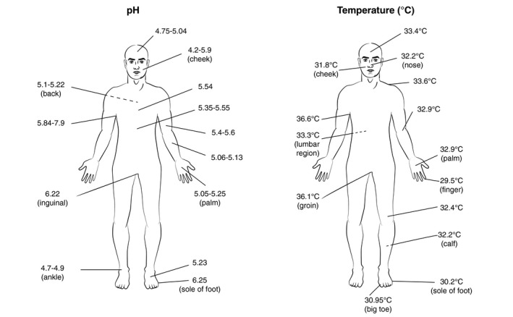
What affects the SKIN MICROBIOME
DA RIFARE
Extrinsic factors
-UVB and UVC
-alcohol
-vitamin deficiency
Intrinsic factors
-pH
-body temperature
-sebum overproduction
Other factors
-anti-inflammatory therapies
-frequent washing
-cosmetics products
-antibiotics
-radiotherapy and chemotherapy
doi: 10.1111/jdv.13965

Slide 8
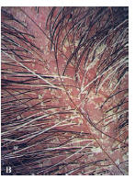
Dysbiotic SKIN MICROBIOME
Skin disorders with a correlation to microbiota
Seborrheic dermatitis
Malassezia spp.
doi:10.1016/j.jaad.2003.12.034

Slide 9
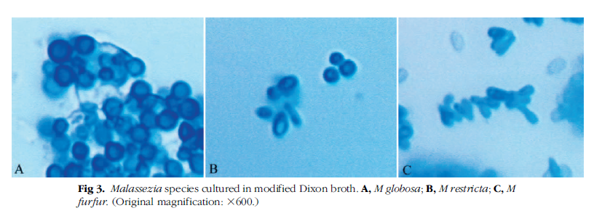
Dysbiotic SKIN MICROBIOME
Skin disorders with a correlation to microbiota
Pityriasis Versicolor
Malassezia spp.
doi:10.1016/j.jaad.2003.12.034

Slide 10
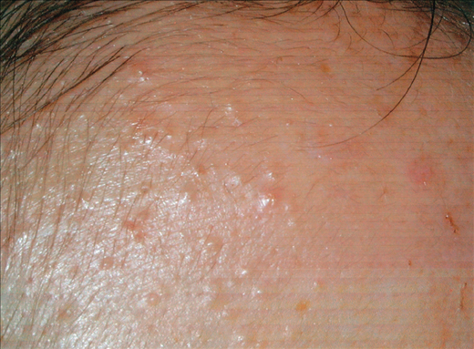
Dysbiotic SKIN MICROBIOME
Skin disorders with a correlation to microbiota
Malassezia (Pityrosporum) Folliculitis
Malassezia spp.
doi:10.1016/j.jaad.2003.12.034

Slide 11
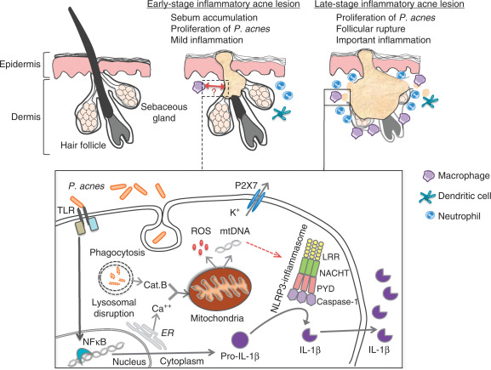
Dysbiotic SKIN MICROBIOME
Skin disorders with a correlation to microbiota
Acne
P. acnes
doi.org/10.1038/jid.2013.505

Slide 12
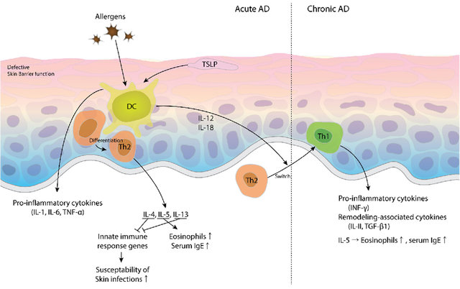
Dysbiotic SKIN MICROBIOME
Skin disorders with a correlation to microbiota
Atopic dermatitits
S. aureus
DOI: 10.3390/toxins9010003

Slide 13
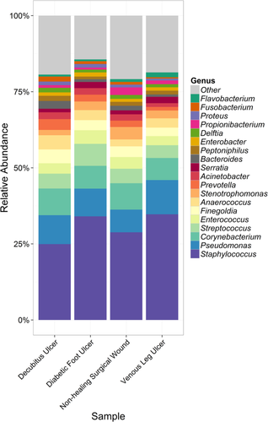
Dysbiotic SKIN MICROBIOME
Disorder with an unidentified microbial component
doi.org/10.1111/wrr.12370

Slide 14
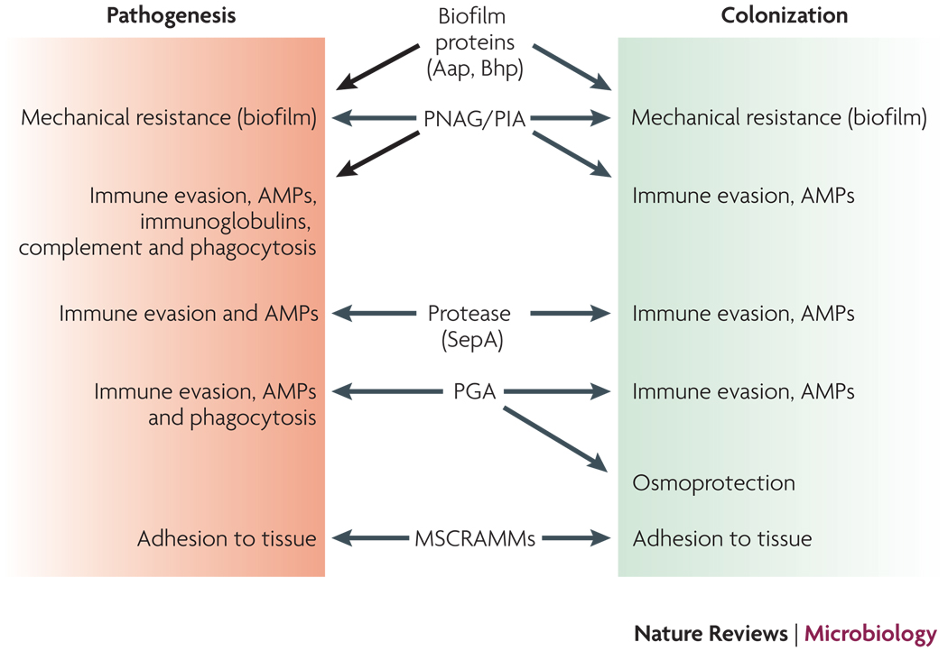
S. epidermidis: an invasive skin commensal that causes infection
doi: 10.1038/nrmicro2182

Slide 15
Future perspectives
Gut-Skin axis
Probiotics
Emollients and moisturizers enriched with bacterial lysates
and much more…

