Slide 1
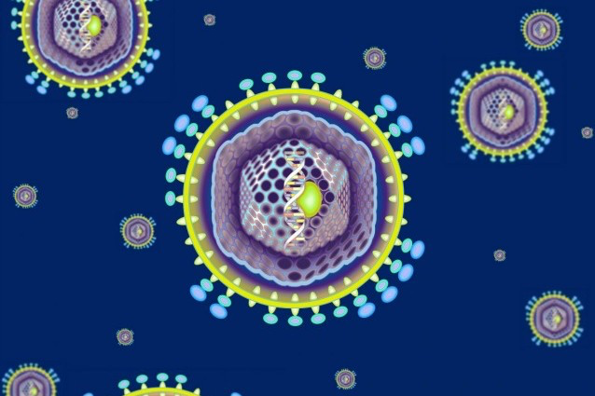
” i virus sono il creatore nascosto che ha contribuito a renderci umani”
Luis Villarreal
Parte delle nostre vite in un senso piu’ letterale di quanto immaginiamo e almeno il 30% degli adattamenti evolutivi a livello molecolare è servito a difenderci dai virus.
M. Comar
Dip. Scienze Mediche, Chirurgiche e della Salute
Universita’ degli Studi di Trieste
IRCCS-Burlo Garofalo, Trieste
Notes:
Bacteria are the most populous cellular microbes inhabiting body surface and their viruses are significantly more prevalent in human than their eukaryotic counterparts.
Thanks to ngs and improved our capabilities in the fold of metagenomica recorgnizing the complexity and diversity within these dynamic viral communities has given new perspective on human body as an ECOSYSTEM restablishing the role of microbes in human health and diseases at the start of the 21° centuary. I virus hanno cooperato alla storia e la cultura umana ( aids e rapporto occidente con la sessualita’).
1

Slide 2
THE VIROME
The virome can be described as the set of all viruses that are found in a particular enviroment.
It forms part of the microbiome
In humans different virome exists since different bacteria communities or microbiome harbor human body

Slide 3
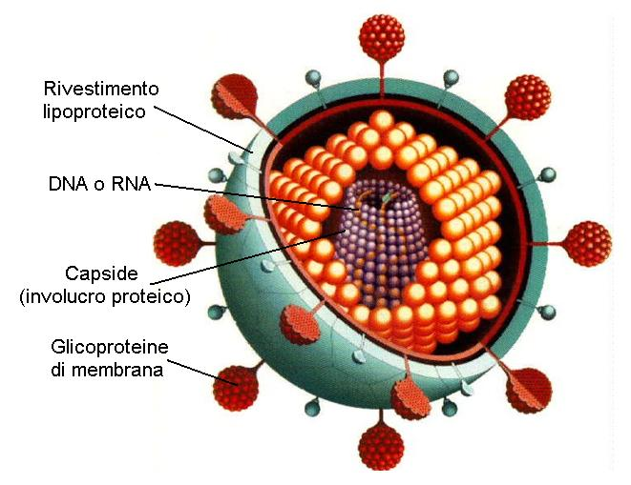
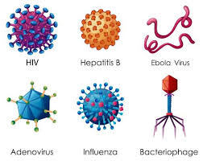
Viruses are parasitic biologic entities that require host cells for replication
Notes:
They are made up od single or doulble-stranded DNA or RNA and a protein capsid forming VIRION.
Some have a lipid envelope modified from their host cell membrane.
They are considered UBIQUITOUS in that they infect every type of cells and found in every ecosystem
3

Slide 4

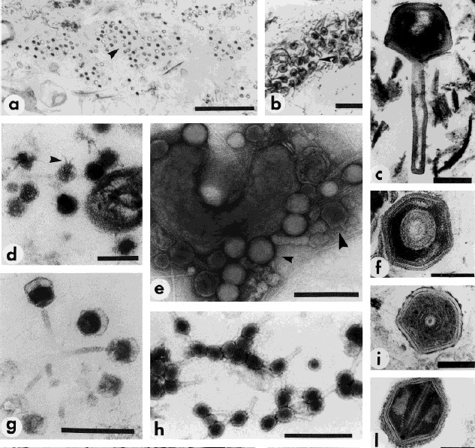
The global virome
10⁷ viruses per ml in sea water
Viruses outnumber hosts by ~10-fold in sea water
10³¹ viral particles on Earth
Numerically most successful biological entities
Data from Lita Proctor, Forrest Rohwer, Curtis Suttle and others
Proctor, 1997

Slide 5
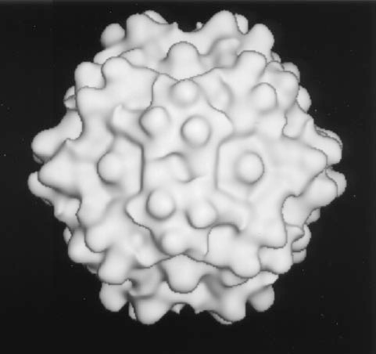

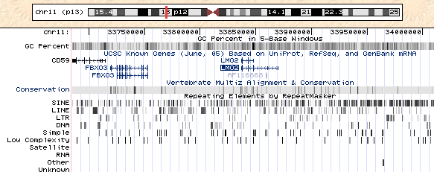
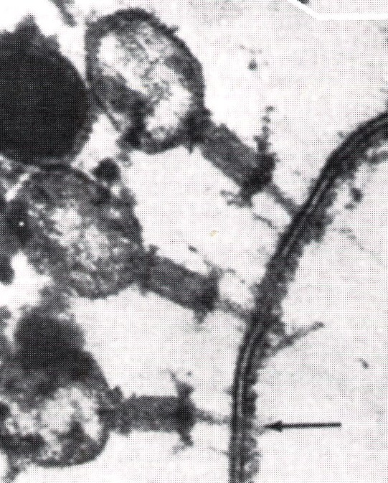
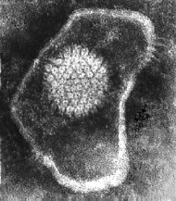
The Human Virome
Transient
Persistent/latent infections
infections with animal cell viruses
 |  | Bacteriophage predators of bacteria
Virus
seropositive
EBV
VZV
Herpes
HSV1
HPV
CMV
HSV2
HIV
HCV
100%
95%
80%
68%
60%
59%
22%
1%
1%
Endogenous retroviruses
8% of human DNA
10¹⁰-10¹¹
per gram of stool
Notes:
Tutti questi virus sono da considerarsi parte del VIROMA dei mammiferi in quanto in alcune circostanze possono produrre un effetto patogenetico o essere impegnati nella traduzione di proteine nella replicazione virale o evolute in esse.. Nel 2001 fu dimostrato che il nostro patrimonio genetico è per quasi la meta’ costituito da sequenze ripetute. L’8% è composto da decine di migliaia di sequenze che chiamiamo HERV:human endogenous retrovirus e il 40% del genoma è costituito da versioni degenerate e semplificate di questi virus dette TRASPOSOMI
The human virome is composed by the set of all viruses, eukaryotic and prokaryotic, present in the human body,
each body compartment constitutes a different microenvironment, the virome varies with the body part,
Additionally, other factors influence the virome composition, such as age, diet, and the presence of other components of the microbiome (METABOLITIES)

Slide 6
Eukaryotic are relevant as pathogen causing acute or persistent infections hestablishING a long term relationship with the host and influence the inflammatory status of the body.
Other are found in healthy individuals without apparent disease.
Many sequences are integrated in human genome reffered as endogenous viral elements ( EVEs) including retroviral (8%).
Some remains as complete ORFs and seem to be functional
Gammaretroviruses HERV-T envelope sequences remains functional in primate for milions of years.
EUKARYOTIC

Slide 7
BACTERIOPHAGE
Role as modulators of bacteriome
Direct impact on inflammation as in Crohn’s disease.
They can use 2 different cycles to infect and regulate bacterial communities lytic and lysogenic:
In the lityc cycle the infection results in the distruction of infected cells and release progeny
In the lysogenic cycle , they integrate their genome in host genome as prophage.

Slide 8
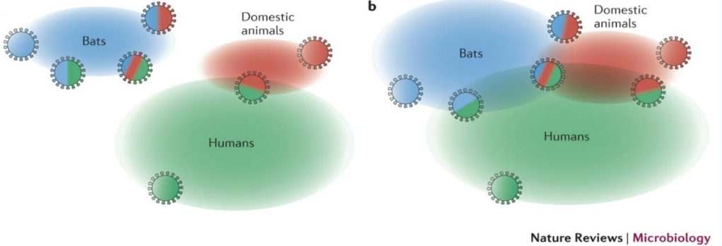
Trans-species transfer of viruses: a moving target
Graham et al. Nat Rev Microbiol 2013
▪ >80 Mio pet cats worldwide
▪ Feline Co-infections common (40% of cats shed >5 viruses in feces)
▪ Novel viruses in asymptomatic cats (Sakobuvirus, Bocavirus, Astroviren, Picobirnavirus)
Ng et al. Veterinary Microbiol 2013; Benedictis et al. Infection, Genetics, Evolution 2011
Notes:
The human virome is a moving target due to zoonoses although the rate at which such animal viruses adapt to human-human transmission is unclear.The constituent species of the human virome will also vary over time due to ongoing zoonotic transmission from animal whose own viromes will also be changing. Analysis of humans with extensive contact with wild or domesticated animals or those exposed to insetct bites in regions of high biodiversity will increase the odds of detecting new human viruses.
Alphacoronaviruses and betacoronaviruses have historically been shown to have the capacity to utilize orthologous receptors and carbohydrates for entry in different species. Thus, in host pools (bats, blue; domestic animals, red; and humans, green), viruses that are capable of cross-species transmission might exist or be generated by the intrinsic error rate of the RNA-dependent RNA polymerase. Bat populations that are largely separated from human and domestic animal populations result in limited viral emergence into new populations (part a). However, the expansion of human populations into previously unsettled areas, intensive domestic animal farm management practices that result in increased herd and flock sizes in small areas and in closer proximity to their human caretakers ( persone che lavorano a stretto contatto con gli animali) and the encroachment of bats into human-populated regions contribute to the increased incidence of pathogenic human viruses from zoonotic pools (part b).
GENI ORTOLOGHI: geni omologhi presenti in specie diverse ma correlate che codificano per proteine con strutture e funzioni simili. Originano da un gene ancestrale e si sono separati a seguito di separazione della specie ( speciazione) avvenuta nel corso dell’evoluzione.

Slide 9
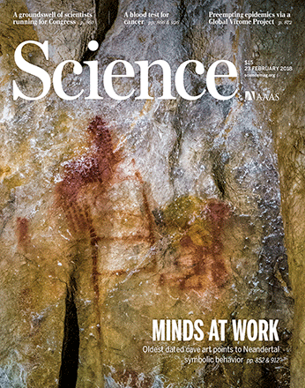
The HUMAN VIROME project
GVP paper published in Science
"Outbreaks of novel and deadly viruses highlight global vulnerability to emerging diseases, with many having massive health and economic impacts...
Our ability to mitigate disease emergence is undermined by our poor understanding of the diversity and ecology of viral threats, and of the drivers of their emergence.
We describe a Global Virome Project (GVP) aimed to launch in 2018 that will help identify the bulk of this viralthreat and provide timely data for public health interventions against future pandemics."
Notes:
Ngs matagenomica

Slide 10
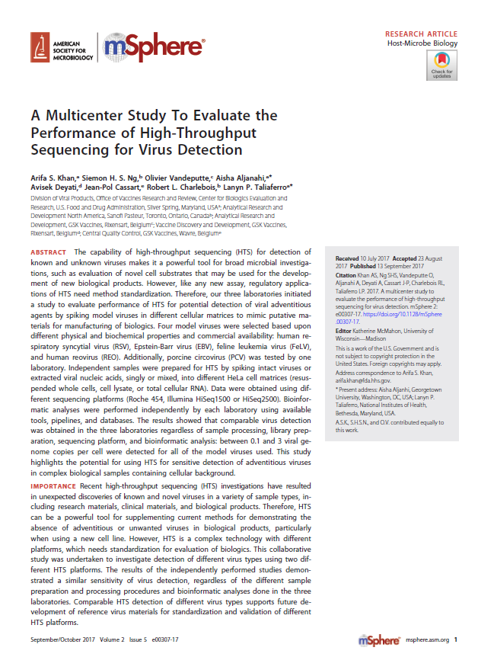
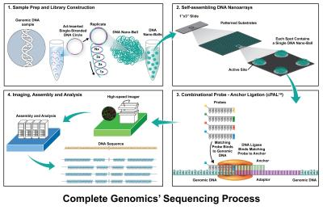
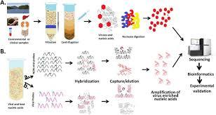
Notes:
The viruses currently described using deep sequencing methods have not been described before and not have homolougous sequences in current virus sequences database

Slide 11
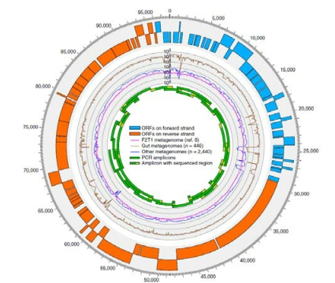
Cross Assembly phage (2014)
the first organism named after metagenomic analysis
▪ 6x more abundant in feces than all other known phages together
▪ 90% of all reads in virus-like particle (VLP)-derived metagenomes
▪ 22% of total community metagenomes
▪ 1.68% sequences in the database →
of all human fecal metagenomic sequencing reads in the public databases
▪ Year of discovery: 2014
▪ Majority of crAssphage-encoded
proteins match no known
discarded as data junk
Dutilh et al. Nat Comm 2014
Notes:
Cross assembly phage is a bacteriophage discovered in 2014. It is a circular genome 97 kbp with 80 predicted open reading frame and the sequences is commonly found in human feacal samples. The virus is predicted to infecte the Phylum Bacteroidetes that are common in intestinal tract. Based on metagenomics data it has been identified in about half of all sampled humans.
Cr ASSphage is possibly the first organism to be named after comput program.It may be part on an expensive bacteriophage family ( Podoviridae, order CAUDOVIRALES) found in a rage of enviroments.- marker of human faecal contamination.
11

Slide 12
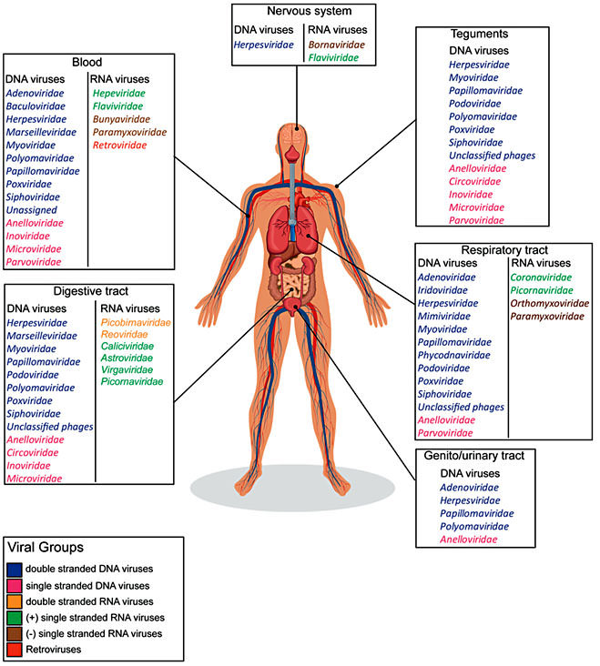
Eukaryotes virus in symptomatic and asymptomatic individuals

Slide 13
VIRUS in HUMAN BLOOD

Slide 14
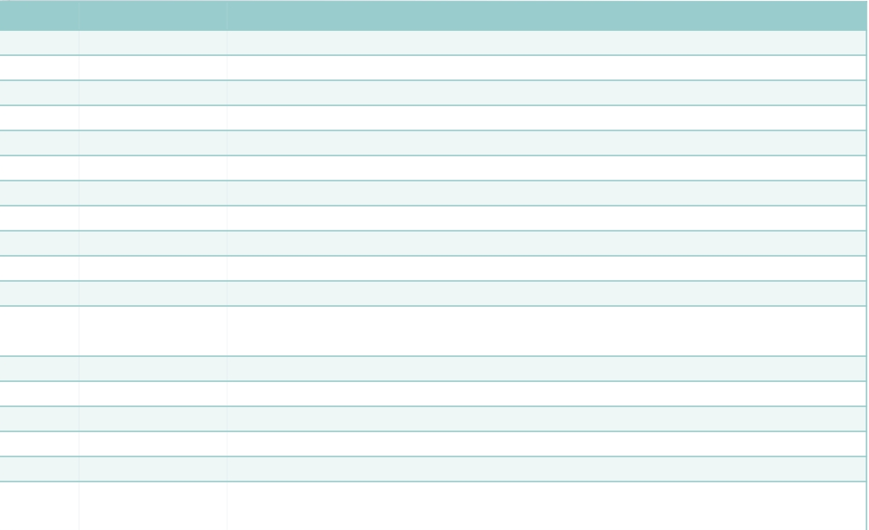
The „silent“ human virome
Group Family Species
dsDNA Adenoviridae Enteric adenovirus 40, 41
Iridoviridae Lymphocystis disease virus
Myoviridae phiBCD7, Bacillus phage G, phiP-SSM4
Podoviridae Enterobacteria phage P22, phage T3
Siphoviridae Listeria phage A118, phiE125 Lactococcus phage bIL285, phiCP39-O, Clostridium
Phages Halophage eHP-10
Papillomaviridae Human papillomavirus 6, 18, 66
Polyomaviridae BK virus, JC virus, SV40 virus, Human polyomavirus 9, 12, Merkel cell polyomavirus
Herpesviridae Epstein-Barr virus, Human cytomegalovirus
ssDNA Anelloviridae TTV
Circoviridae Chicken anemia virus, TN9, PK5034, PK5222, NG12
Microviridae
Chlamydia phage 1,3,4, Bdellovibrio phage phiMH2K, Chlamydia phage CPG1, Spiroplasma phage 4, Chlamydia phage CPAR39
dsRNA Picobirnaviridae Human picobirnavirus
Reoviridae Human rotavirus
(+) ssRNA Caliciviridae Norwalk virus
Astroviridae Human astrovirus
Virgaviridae Pepper mild mottle virus, Tobacco mosaic virus
Picornaviridae
Cosavirus, Klassevirus/salivirus, Aichi virus, Enterovirus, Parechovirus, Saffold
cardiovirus, Echovirus, Coxsackievirus, Poliovirus
Popgeorgiev et al. Intervirology 2013; Wylie et al. BMC Biology 2014; Foulongne et al. PlosOne 2012

Slide 15
VIRUS and HUMAN CANCER

Slide 16
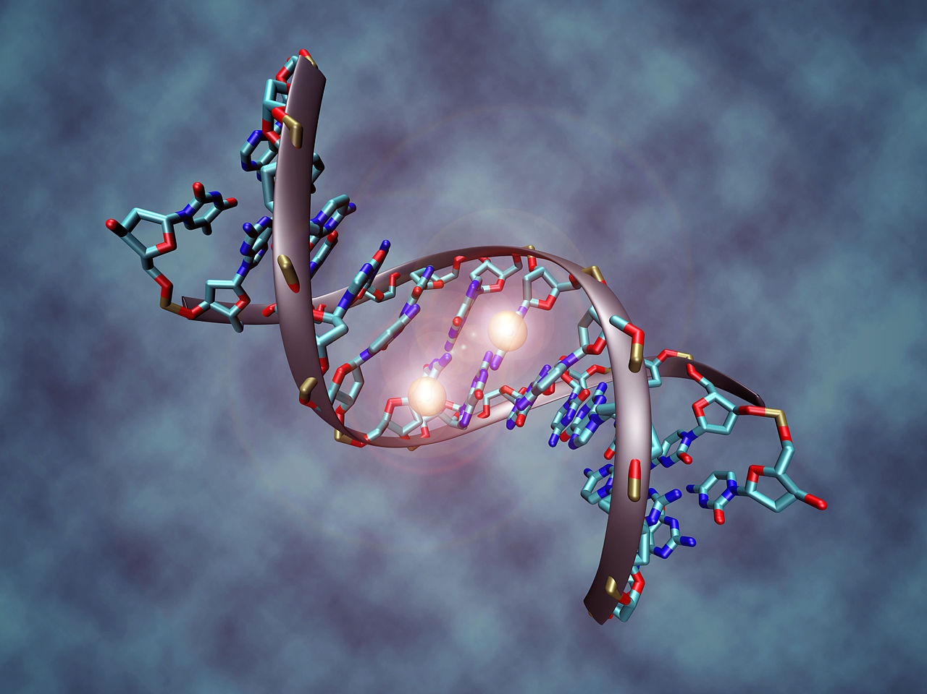
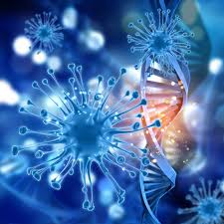
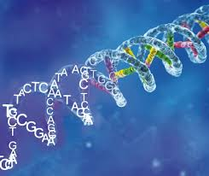
VIRUS Integration in Human DNA

Slide 17
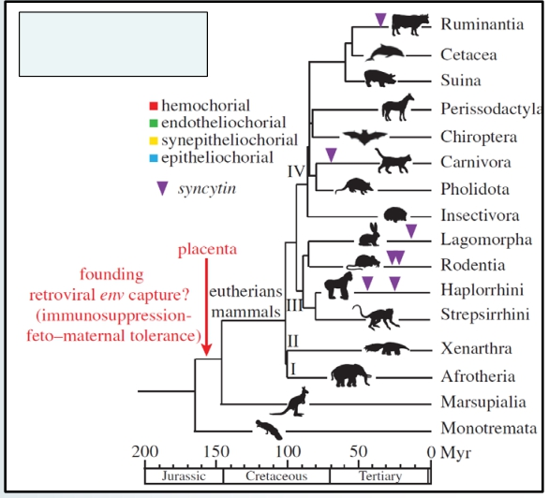
HERV-W env (syncytin-1)
Physiologic functions of syncytins
▪ Inserted in human-prehominoids chromosome 7q21, 40-45 millions years ago
▪ Absolute requirement for placenta development and embryo survival
▪ Positive selective advantage – switch from egg to uterus
▪ Induction of maternal immune tolerance to fetus?
▪ Cellular resistance against infection by retroviruses of family spleen necrosis virus
Syncytin gene capture events
Lavialle et al. Phil. Trans. R. Soc. B 2013; Blesa et al. Cancer Therapy 2008
Notes:
E’ un gene di un retrovirus, noto come syncytin, a permettere la formazione della placenta umana..Originalmente il gene serviva al virus per fondersi con la cellula ospite: ora permette ad alcune cellule di fondersi creando uno stato impermeabile al sistema immunitario della madre. Nell’embrione HERV-K viene attivato. Le proteine prodotte sembrano difendere l’embrione da altre infezioni virali.L’8% è composto da decine di migliaia di sequenze che chiamiamo HERV:human endogenous retrovirus e il 40% del genoma è costituito da versioni degenerate e semplificate di questi virus dette TRASPOSOMI. E’ un gene di un retrovirus, noto come syncytin, a permettere la formazione della placenta umana..Originalmente il gene serviva al virus per fondersi con la cellula ospite: ora permette ad alcune cellule di fondersi creando uno stato impermeabile al sistema immunitario della madre. Nell’embrione HERV-K viene attivato. Le proteine prodotte sembrano difendere l’embrione da altre infezioni virali

Slide 18
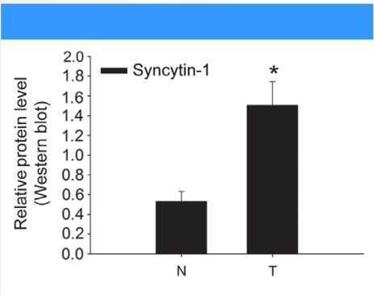
Role of HERV-W env (syncytin-1) in human cancer
▪ Overexpressed in 76% of urothelial cell carcinoma tissues (controls, 6%)
▪ Overexpression increases proliferation and viability of immortalized human uroepithelial cells
▪ Involved in mediating cancer-endothelial cell fusions in vitro
▪ Syncytin-1 expression = positive prognostic factor in breast cancer
▪ Syncytin-1 expression in 38% of all breast cancer samples
▪ Upregulated in endometrial carcinoma
Urogenital cancer tissue
Yu et al. Oncogene 2014; Blesa et al. Cancer Therapy 2008; Larsson et al. Placenta 2002
Notes:
Protein found in human that is encoded by the ervw-1 gene (endogenous retrovirus group W envelope member 1). It is a a cell-cell fusion protein whose function is best characterized in placental development. The placenta in turn aids in embryo attachment to the uterus and establishment of a nutrient supply. Human Gene location is chromosome 7q21.2.the gene is a endogenous retroviral element that is remnant of an ancient retroviral infection integrated into the primate germ line. ( 25 milon years ago)
Syncytin-1 is also implicated in neurological pathologies such as multiple sclerosis , as an immunogen. PRECLAMPsya due to reduction expression of syncytin.
18

Slide 19

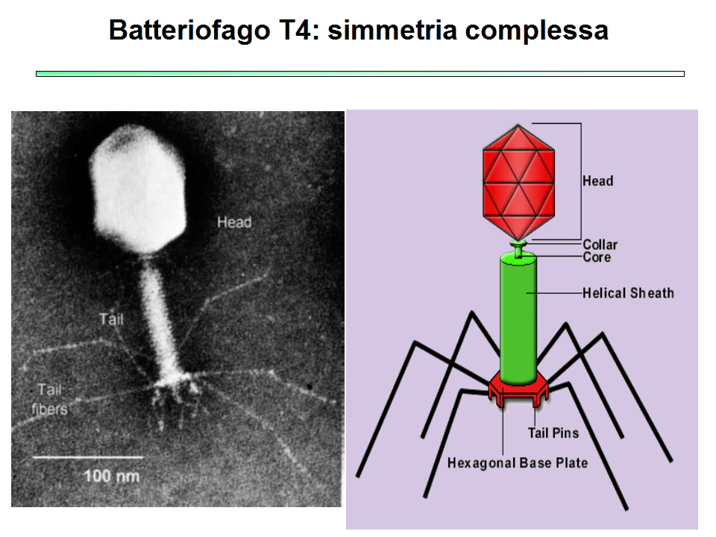
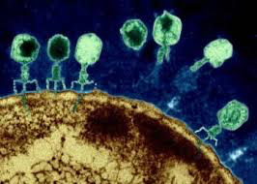

10³¹ phage on earth
10 phage for bacteria
10²²-10²⁴ stars in entire universe
Notes:
Dove c’è vita ci sono i virus e infettano tutte le forme viventi. Sono coevoluti con i batteri sono responsabili di una grande pressione evoluzionistica sui batteri stimolando mutazioni e cambiando il pool di geni. Shift microbiologico. I Fagi sono la maggiore sorgente di trasferimento genico orizzontale tra i vari batteri, specie e generi. Tossina di Stafiloccocco aureo trasferita a stafiloccocchi coagulasi negativi, quindi conferimento di caratteri di patogenicita’ e aumento di virulenza.
Conferiscono protezione ai batteri dall’infezione con altri fagi

Slide 20
Phage- bacteria predation dynamics or Kill-the winner
Phage kill only the dominant bacterial strains to reestablish a microbiological equilibrium.
In humans different niche contain stable communities of phage and bacteria as consequence of a predominant phage lysogenic cycle. Es: of role of lytic phage into the development of disease ( periodontitis)
Phage-induced bacterial genome modification
They offer evolutionary advantage to bacteria by stimulating mutations, adaptations and antibiotic resistance, by horizontal gene transfer. Es: profhage of enterococcus feacalis adhesion to human platelets , first step of infective endocarditis
Phage –human immune system dynamics
Pahge and microbiota colonize mucosal surface and are considered as part of innate immune system as they provide physical and biochemical antimicrobial defence.
Notes:
They can interact with Immune system directly by inducing a humoral antibody response ( which may obstruct phage action) or indirectly through nonspecific immunomodulatory effects on the immune response.

Slide 21
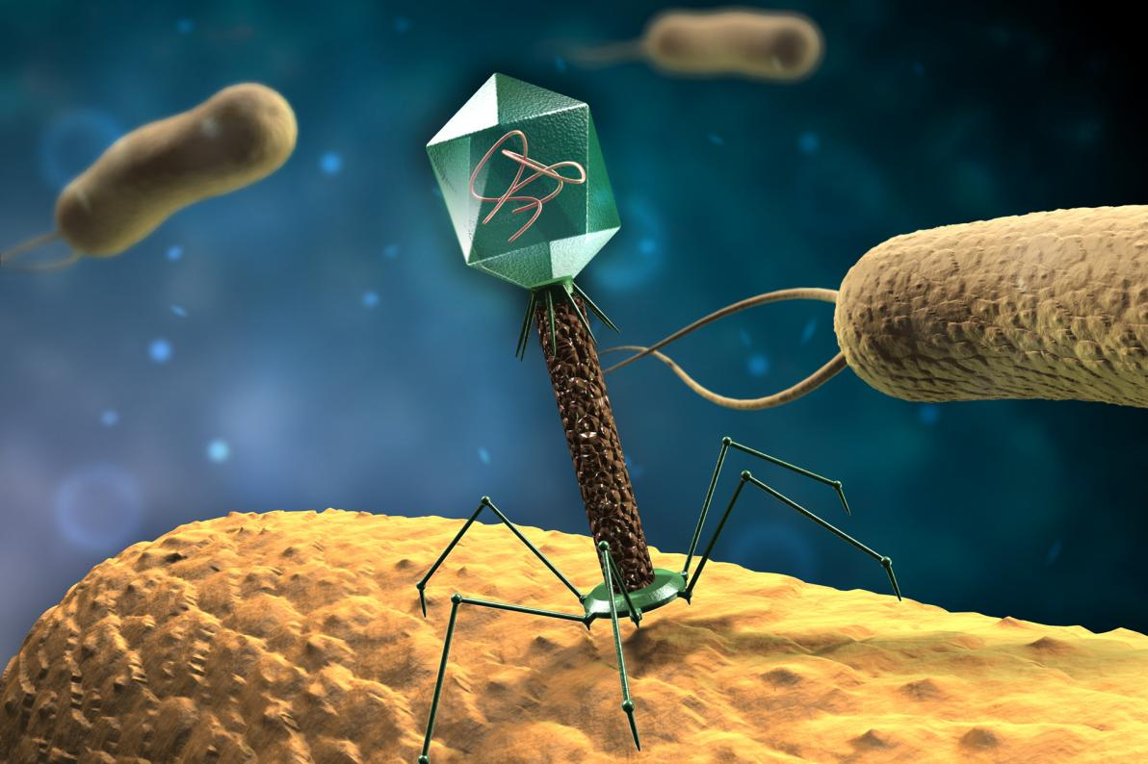
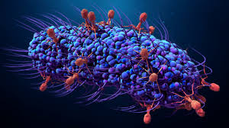
Bacteriophages shape the microbiota of all metazoans
Notes:
Phage- bacteria predation dynamics or Kill-the winner
Phage kill only the dominant bacterial strains to reestablish a microbiological equilibrium.
In humans different niche contain stable communities of phage and bacteria as consequence of a predominant phage lysogenic cycle. Es: of role of lytic phage into the development of disease ( periodontitis)
Phage-induced bacterial genome modification
They offer evolutionary advantage to bacteria by stimulating mutations, adaptations and antibiotic resistance, by horizontal gene transfer. Es: profhage of enterococcus feacalis adhesion to human platelets , first step of infective endocarditis
Phage –human immune system dynamics
Pahge and microbiota colonize mucosal surface and are considered as part of innate immune system as they provide physical and biochemical antimicrobial defence.

Slide 22
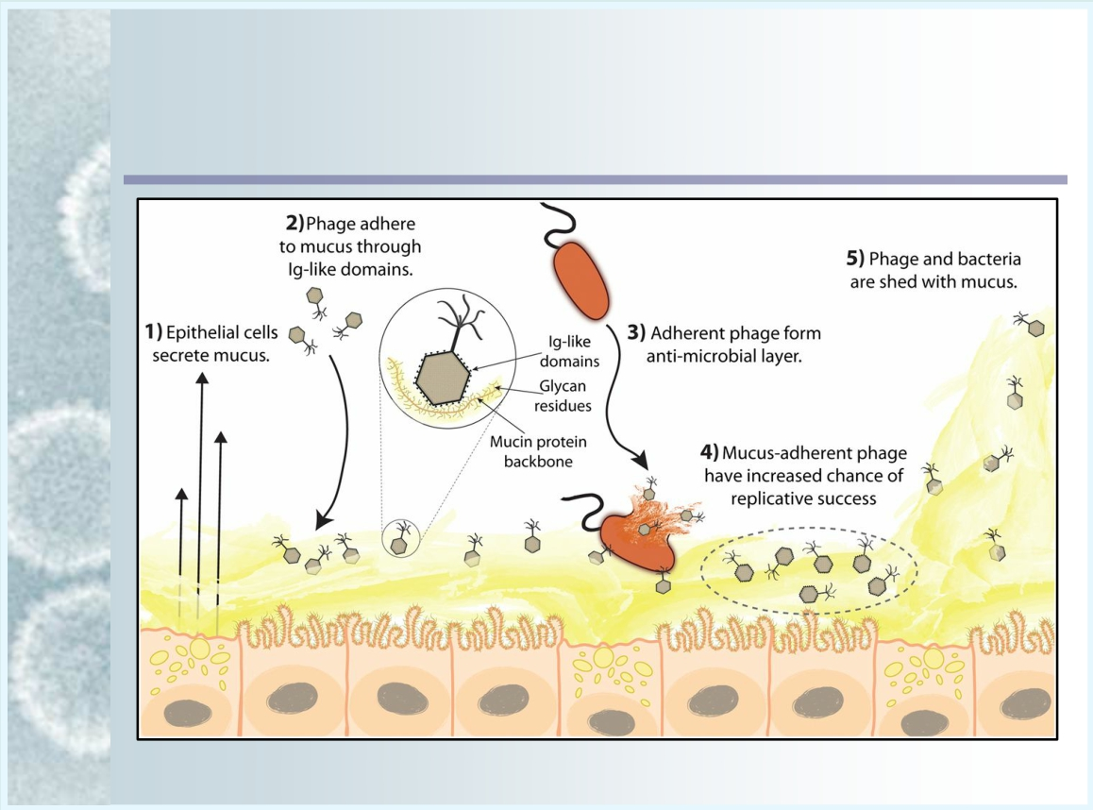
Intestinal Bacteriophages
Phages protect from pathogenic Bacteria: co-evolution with metazoan
Barr et al. PNAS 2013
Notes:
Bacteriophage communities have recently been shown to have a unique role in immunity as a prominent defender of the mucosa barrier from invading bacteria.
Mucosal surfaces are a main entry point for pathogens and the principal sites of defense against infection. Both bacteria and phage are associated with this mucus. Here we show that phage-to-bacteria ratios were increased, relative to the adjacent environment, on all mucosal surfaces sampled, ranging from cnidarians to humans. In vitro studies of tissue culture cells with and without surface mucus demonstrated that this increase in phage abundance is mucus dependent and protects the underlying epithelium from bacterial infection. Enrichment of phage in mucus occurs via binding interactions between mucin glycoproteins and Ig-like protein domains exposed on phage capsids. In particular, phage Ig-like domains bind variable glycan residues that coat the mucin glycoprotein component of mucus. Metagenomic analysis found these Ig-like proteins present in the phages sampled from many environments, particularly from locations adjacent to mucosal surfaces. Based on these observations, we present the bacteriophage adherence to mucus model that provides a ubiquitous, but non–host-derived, immunity applicable to mucosal surfaces. The model suggests that metazoan mucosal surfaces and phage coevolve to maintain phage adherence. This benefits the metazoan host by limiting mucosal bacteria, and benefits the phage through more frequent interactions with bacterial hosts. The relationships shown here suggest a symbiotic relationship between phage and metazoan hosts that provides a previously unrecognized antimicrobial defense that actively protects mucosal surfaces.
Metazoan animals are multicellular, mitochondrial eukaryotes. Today Metazoa encompasses all animals with differentiated tissues, including nerves and muscles.

Slide 23
The VIROME is more than a source of pathogens
THE EMERGING PARADIGM
The virome can influence the host in a profound way independent of classical viral disease
A systemic virus is inherited from parents very early in life.
The virome may be properly seen as a significant part of our individual genetic identity, whether or not the virus is integrated into our chromosome
Notes:
. L’evoluzione della nostra visione dei virus come comprensione del concetto di simbiosi e talvolta di rapporto mutualistico con l’ospite, ha il potenziale di impattare significativamente con la comprensione della nostra genetica , salute e malattia.

Slide 24
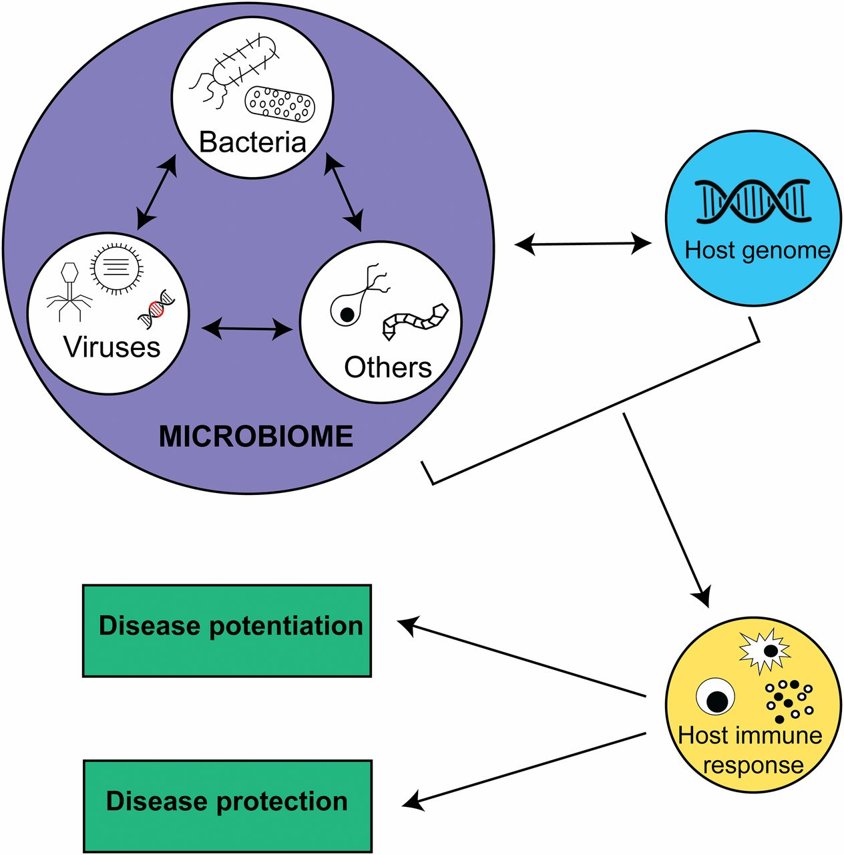
Virome
stimulates low level of immune response in asymptomatic host.
Notes:
Siamo costantemente reinfettati da virus a bassa virulenza che continuamente stimulano la risposta immunitaria mucosale con la potenziale conseguenza della resistenza ad altre infezioni e la suscettibilita’ a patologie quali asma e diabete tipo 1. questi virus “ acuti” sono presente in alcuni portatori come per i batteri stafilococco e pneumococco. Anche le infezioni croniche sistemiche stimolano il sistema immune

Slide 25
Notes:
dynamic relationship between viral infections/clearance, bacterial communities and host

Slide 26
birth mode results in distinctly different viral communities, with Spontaneous Vaginal Delivery infants having greater viral and bacteriophage diversity
Notes:
however, few studies have examined the infant gut virome/phageome during this developmental period. 20 infant faecal viromes at one year of age to determine whether spontaneous vaginal delivery (SVD) or caesarean section (CS) influenced viral composition.
We demonstrate that CrAssphage is acquired early in life, both in this cohort and two others, although no difference in birth mode is detected.
Therefore, our results indicate that vertical transmission of viral communities from mother to child may play a role in shaping the early life microbiome, and that birth mode should be considered when studying the early life gut virome.
suggesting that underlying physiology of pregnancy may regulate both bacterial and viral communities.

Slide 27
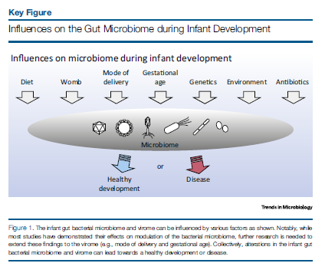
Bacterial and virus cooperation…
Notes:
Establishing a diverse gut microbiota after birth is being increasingly recognised as important for preventing illnesses later in life. . It is well established that bacterial diversity rapidly increases post-partum

Slide 31
the vaginal virome was clearly linked with bacterial community structure and BV
Notes:
acterial vaginosis (BV) is characterized by a reduction in Lactobacillus (L.) spp. abundance
and increased abundance of facultative anaerobes, such as Gardnerella spp. BV aetiology is not fully understood; however, bacteriophages could play a pivotal role in the perturbation of the vaginal bacterial community. We investigated the vaginal viral community, including bacteriophages and the association to the bacterial community and BV-status. Vaginal samples from 48 patients undergoing IVF treatment for non-female factor infertility were subjected to metagenomic sequencing of purified virus-like particles. The vaginal viral community was characterized and correlated with the BV-status by Nugent score, bacterial community, structure, and the presence of key vaginal bacterial species. The majority of identified vaginal viruses belonged to the class of double-stranded DNA bacteriophages, with eukaryotic viruses constituting 4% of the total reads. Clear links between the viral community composition and BV (q = 0.006, R = 0.26) as well as the presence of L. crispatus (q = 0.001, R = 0.43), L. iners, Gardnerella spp., and Atopobium vaginae were found (q < 0.002, R > 0.15). The eukaryotic viral community also correlated with BV-status (q = 0.018, R = 0.20). In conclusion,

Slide 32
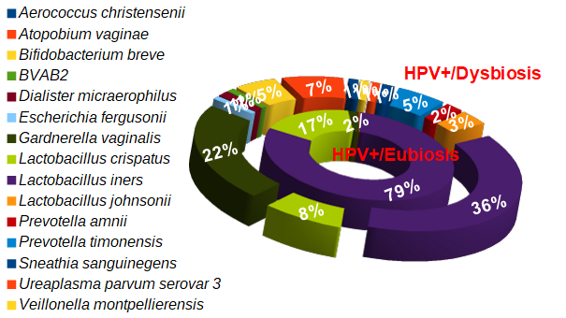
Notes:
Tra le donne HPV +, le donne con disbiosi mostrano un’alta diversità microbica e un aumento di Gardnerella.
La presenza della Gardnerella potrebbe correlare con un maggior stato infiammatorio nelle HPV+/disbiosi. E’ accertato infatti che la Gardnerella induce una cascata infiammatoria e, inoltre, favorisce l’ascesa dei patogeni verso il tratto genitale femminile superiore. HPV potrebbe dunque approfittare dello stato flogistico cronico per attecchire con più facilità.
Le donne con eubiosi presentano ridotta eterogeneità batterica e una predominanza di Lactobacilli di cui però il più abbondante è il L. iners.
Studi hanno dimostrato che L. iners ha un genoma più piccolo rispetto a quello degli altri Lactobacilli, per cui manca di molte funzioni benefiche caratteristiche di questo genere batterico. Inoltre, L. iners codifica per una tossina in grado di danneggiare le membrane cellulari che è simile al fattore di virulenza vaginolisa di G. vaginalis. (Rampersaud et al., 2011). Dunque, nelle donne HPV+/eubiosi, l’assenza di predominanza di lactobacilli fortemente protettivi come il L. crispatus potrebbe garantire un vantaggio riproduttivo dell’HPV.
32

Slide 33
The objective of this study was to examine the vaginal eukaryotic DNA virome in a cohort of pregnant women and examine associations between vaginal community characteristics and preterm birth.

Slide 34
virome composition

Slide 35
Having both high bacterial diversity and high viral diversity in the first trimester was associated with the highest risk for preterm birth.
Notes:
Conclusions—Higher vaginal viral diversity is associated with preterm birth. Changes in vaginal virome diversity appear similar to changes in the vaginal bacterial microbiome over pregnancy, suggesting that underlying physiology of pregnancy may regulate both bacterial and viral communities.
women who had both high bacterial diversity and high viral diversity early in pregnancy had the highest risk for preterm birth suggesting that consideration of both bacterial and viral communities is critical for interpretation of associations between the microbiome and preterm birth.

Slide 36
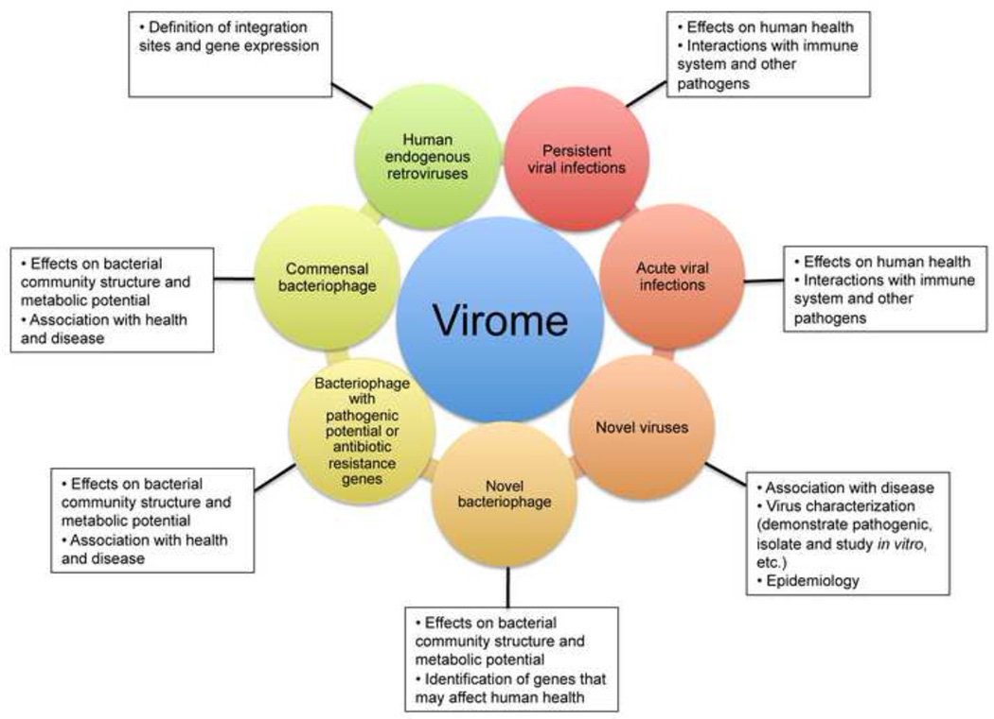

Slide 37
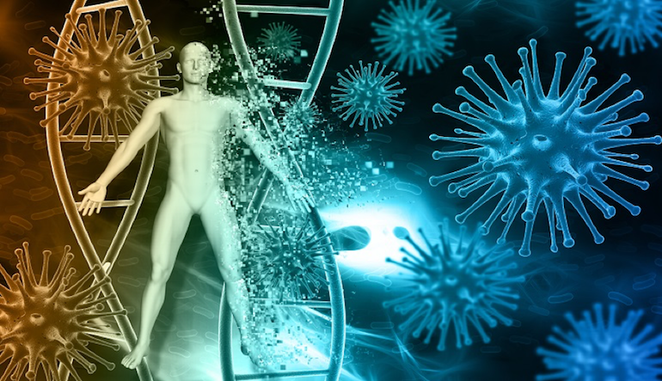
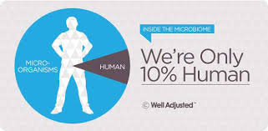
..
Thank you !!!

