Slide 1
Robotics and Mechatronics
3 March 2020
Furniture technology

Slide 2
3 March 2020
Due to the COVID-19 “Coronavirus” emergency, this lecture series will be given remotely

Slide 3
3 March 2020
For info/questions, please contact me at:
  sseriani@units.it
  +39 040 558 2540

Slide 4
Something about me
Stefano Seriani, born in Trieste (Italy) in 1986.
I received my B.E. in 2010 from the University of Trieste with a thesis on the development of a synchrotron light microtomography device.
I received my M.Sc. in mechanical engineering (2012) from the same university with a thesis on bolted assemblies for space structures, developed at ICAM Toulouse, for the CNES (Centre national d'études spatiales).
I received my Ph.D. in 2016 at the University of Trieste, for my research on Large Workspace Robots.
In 2016 I was Research Fellow at the Institute of Robotics and Mechatronics of the german space agency (DLR), working on the development of hybrid locomotion solutions for planetary exploration rovers.
I am now Research Fellow and Assistant Professor at the University of Trieste, studying mobile robots, space robotics and industrial robotics.

Slide 5
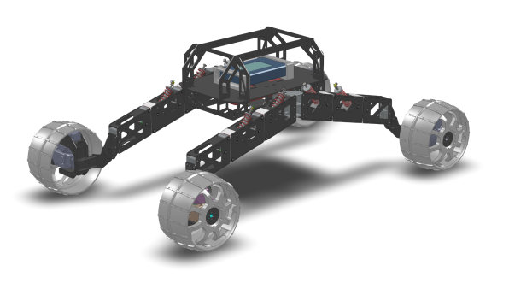
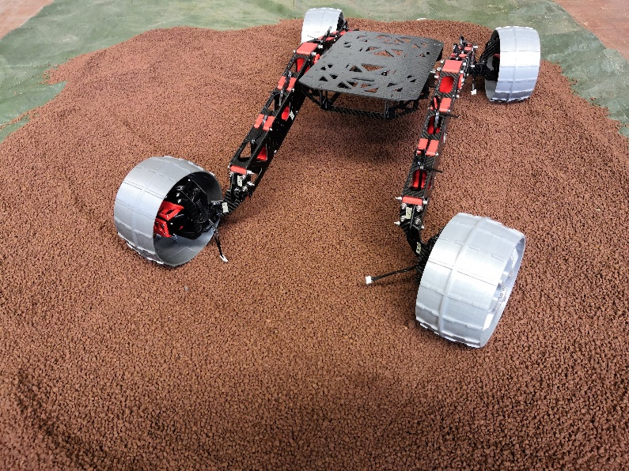
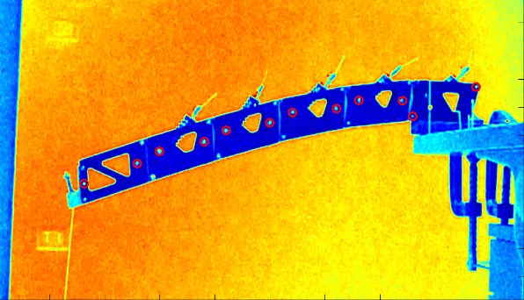
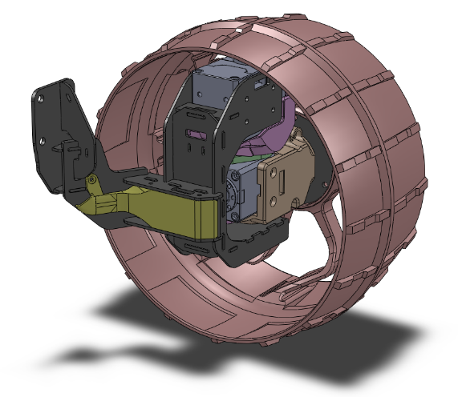
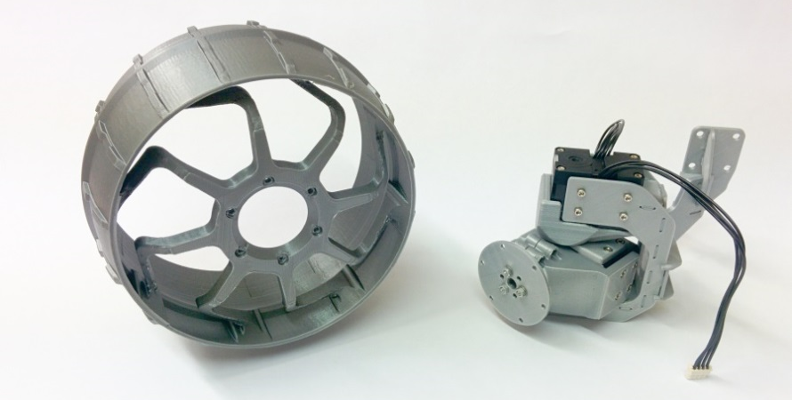
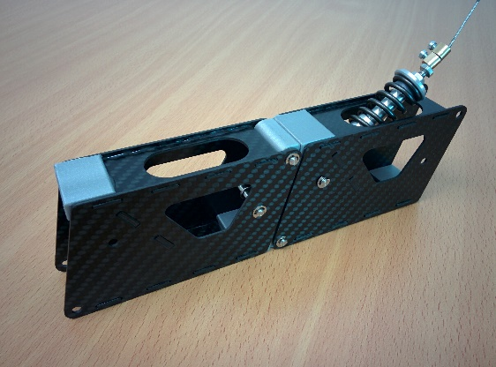
Research
My research interests include:
  Space robotics
  Mobile robotics
  Applied mechanics
  Computer-vision

Slide 6
Course
Contact information
  Seriani Stefano
  E-mail: sseriani@units.it
  Phone: +39 040 558.2540
  Consultation
    Appointment required (via email)
    Monday 13:00-15:00

Slide 7
Main topics
Industrial robotics (50%)
Mobile robotics (30%)
Sensing in robotics (15%)
Machine vision (5%)

Slide 8
Programme
Industrial robots
Teaching and robotized painting
Pick&place systems
Robots and safety
Cobots: collaborative robots
Mobile robots
Sensing
ROS – Robotic Operative System
Machine vision

Slide 9
Exam
Two possibilities:
Oral exam
Hybrid: report + oral exam
Details
Report
  In-depth analysis on one of the topics covered in the course (there is a certain flexibility of course)
  The report topic needs to be discussed with the professor, and approved
  The report needs to be handed over at least 7 days before the exam
Evaluation
  Oral exam:
    3 questions
    Final mark (0-30) = oral exam mark (0-30)
  Hybrid:
    Oral exam consists of 2 questions
    Final mark (0-30) = report mark (0-10) + oral exam mark (0-20)
    30/30 with honours (lode) require honours in the oral exam

Slide 10
Suggested reads
Robotica - Modellistica, pianificazione e controllo, B. Siciliano, L. Sciavicco, L. Villani, G. Oriolo
Robotics - Modelling, Planning and Control, Bruno Siciliano, Lorenzo Sciavicco (english version)
Introduction to Autonomous Mobile Robots, R. Siegwart, I.R. Nourbakhsh
Lecture presentation in power point (Seriani)

