Slide 1
Mobile Robots
Part I.1
a.a. 2020-2021
Robotics and Mechatronics

Slide 2
Suggested reads
Introduction to Autonomous Mobile Robots, R. Siegwart, I.R. Nourbakhsh
Robotics - Modelling, Planning and Control, Bruno Siciliano, Lorenzo Sciavicco (english version)
Lecture presentation in power point (Seriani)

Slide 3
Info!
Mobile Robotics – Siegwart
  http://home.deib.polimi.it/gini/robot/docs/siegwart.pdf

Slide 4
Introduction to mobile robotics
Mobile Robotics

Slide 5
Mobile robots
... also called Automated Guided Vehicles, or Autonomous Ground Vehicles (AGV)
... or Rovers when used on rough terrain
Features
  Base is not fixed
  Autonomy
  Most useful when
    Work has to be done on large spaces
    Environment does not allow large fixed structures

Slide 6
Mobile robots vs. AGV
Automated Guided Vehicles
  Autonomous but simple programming,
  Dependent on “fixed guides” (points of reference): magnetic, optical, etc.,
  Limited flexibility.
Mobile robots
  Full autonomy, complex programming,
  Less dependent on fixed points of reference,
  Flexible.
This distinction is not always clear

Slide 7
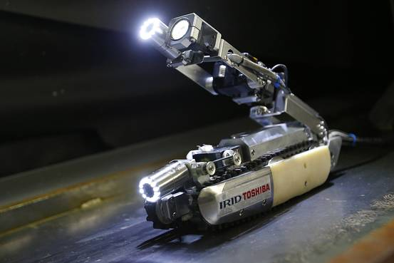
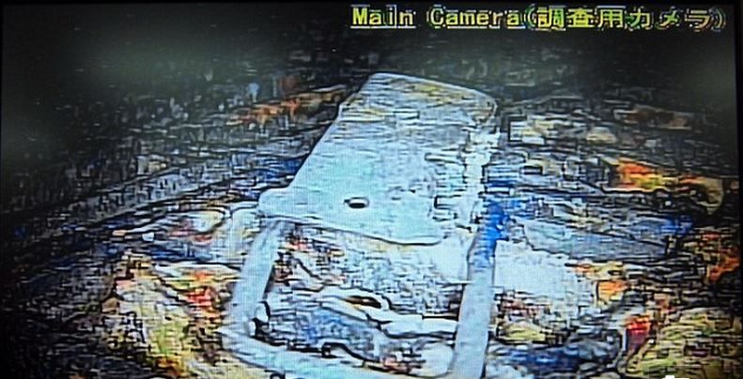
Application example
Fukushima nuclear plant 2011 disaster
  Hazarduous environment
  No infrastructure can be built
  Large space needs to be explored
Mobile robot

Slide 8
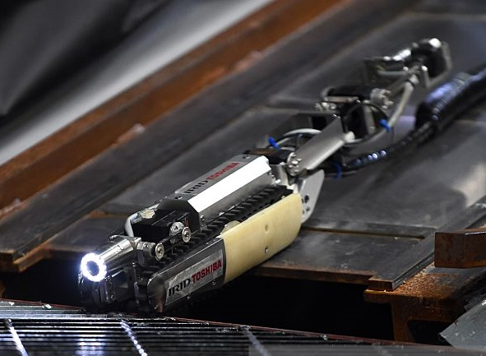
Rugged skid-steer robot
Differential steering (skid steering)
Good performance against uneven terrain
Bad accuracy
Low autonomy
Video skidSteer

Slide 9
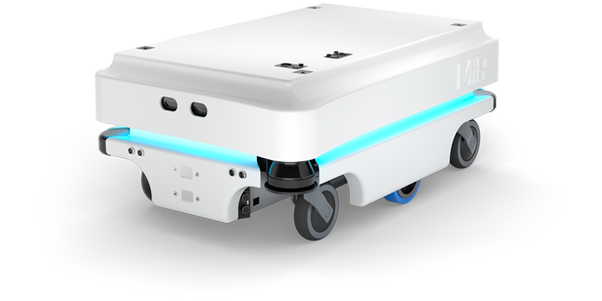
Differential drive robot
Differential steering
Good performance against uneven terrain
Video differentialDrive

Slide 10
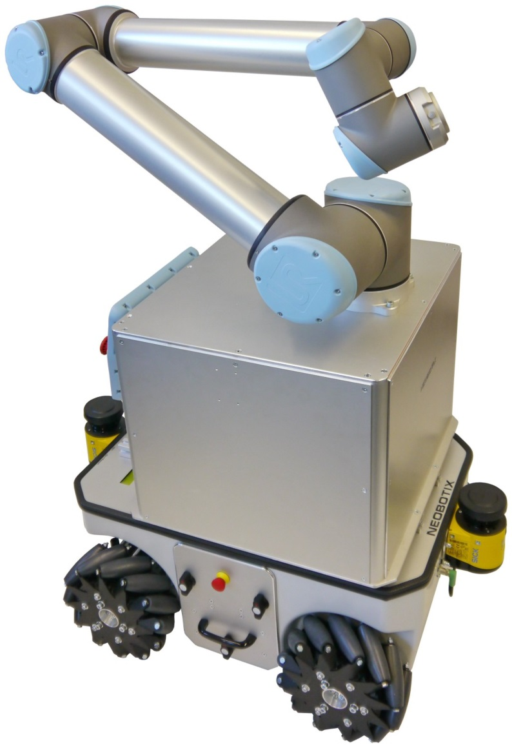
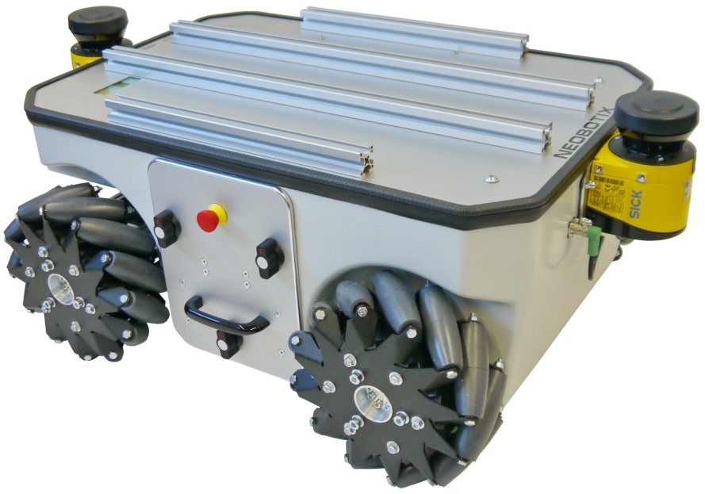
Omnidirectional platform
Can move in all directions
High loads
High positional accuracy
Is used mainly in the industry:
  In warehouse
  Transport and Handling
Bad with uneven terrain
Video orientableWheels
Video mecanumWheels

Slide 11
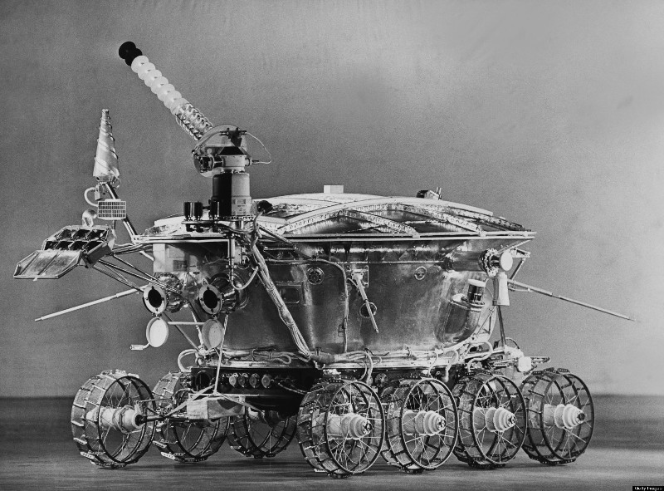
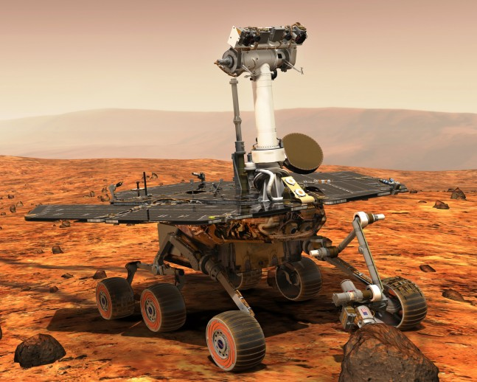
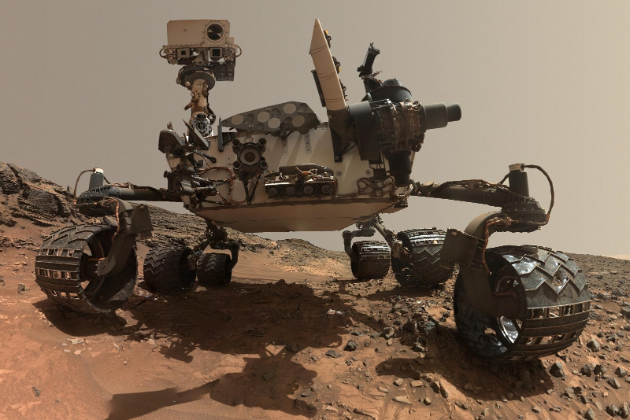
Space exploration rovers
Lunokhod (1970)
Steerable wheels
Exploration of extreme environments
High degree of autonomy
Good on rough terrain
Very expensive
MER A/B (2003)
MSL (2011)

Slide 12
The problem
Go from point A to point B
Obstacles
  Static/dynamic
  Obstacle avoidance
Uneven terrain
  Requires mapping
  Yield
  Traction loss, slopes, etc...
Contamination, etc.
B
A

Slide 13
Issue 1: obstacles
Static obstacles
  Position is fixed in time
Dynamical obstacles
  Position varies with time
  Not always predictable
B
A
?
B
A

Slide 14
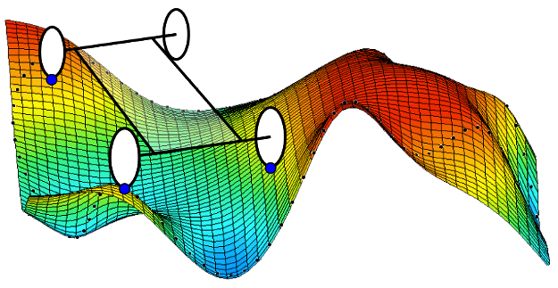
Issue 2: uneven terrain
Risks:
  Loss of contact with the ground
  Terrain yield and traction loss
  Slopes

Slide 15

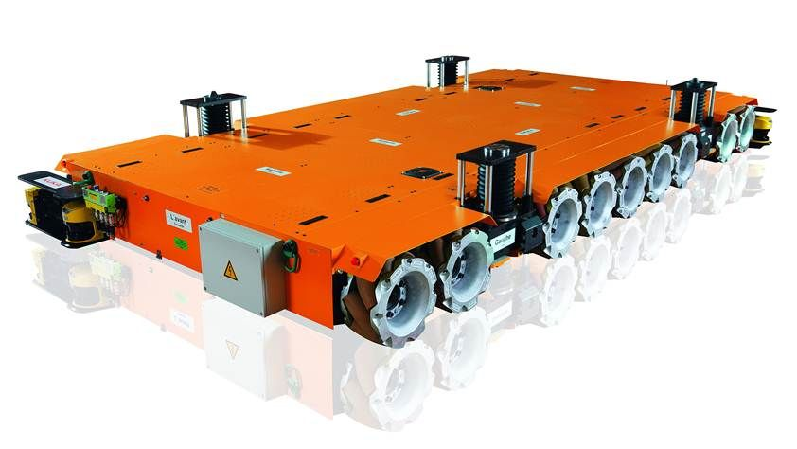
Purpose
Why go from A to B?
  Exploration
  Executing task at B
  Transporting something from A to B
This way we can define the robot’s accessories: solar panels, arms etc.

Slide 16
Features of mobile robots
Mobile Robotics

Slide 17
Elementary motions
Motion = combination of:
  Point-to-point motion
  Path following
  Trajectory tracking
  Reactive motion

Slide 18
Elementary motions
Point-to-point motion:
Path following:
Trajectory tracking:
B
A
x
The parameter is $x∈path$
$$t=4s$$
$$t=3s$$
The parameters are
$$t∈\left[0,T\right]$$
$$x∈path$$
$$t=1s$$
$$t=2s$$

Slide 19
Reactive motion
Online obstacle avoidance
Line/wall following
Target tracking
A
Original path
B
Alternative path

Slide 20
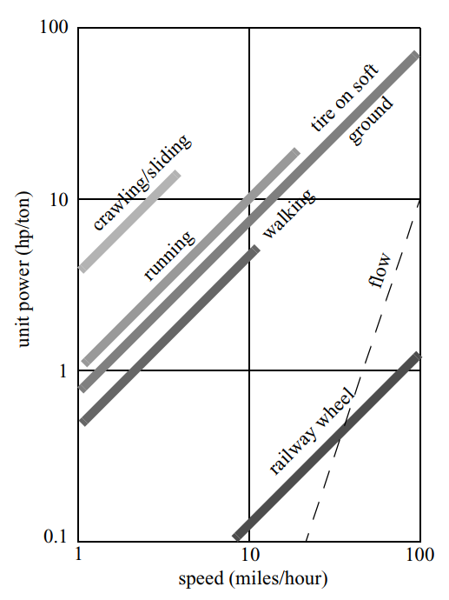
Wheel systems
Why use wheels?
  Legged systems are much more complicated
    Wheel: 2 DoF
    Leg: 6 DoF
  Wheels are efficient on hard terrains
  Legged systems on soft

Slide 21
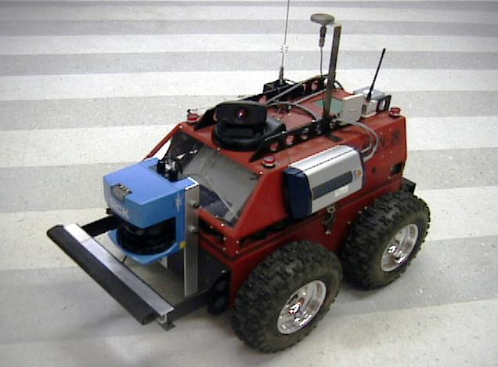
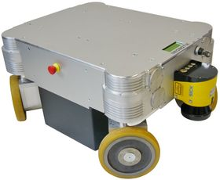

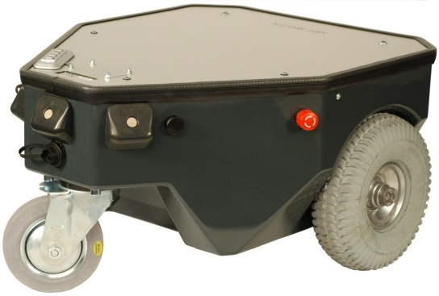
Wheel systems
Simple
Simple wheel
Orientable wheel
Omnidirectional wheel
  Omniwheel
  Mecanum wheel
Passive wheels
  Not actuated, generally used for stability
Omnidirectional
Orientable
Passive
Video differentialDrive

Slide 22
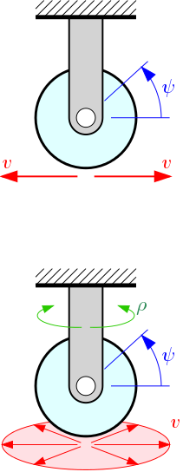
Wheel systems
Simple wheel
Orientable wheel
1 d.o.f. (rotation $ψ$)
Admissible speed vector$v$direction is unique
2 d.o.f.
  Rotation $ψ$
  Orientation $ρ$
Admissible $v∈plane$
No slip on the point of contact!

Slide 23
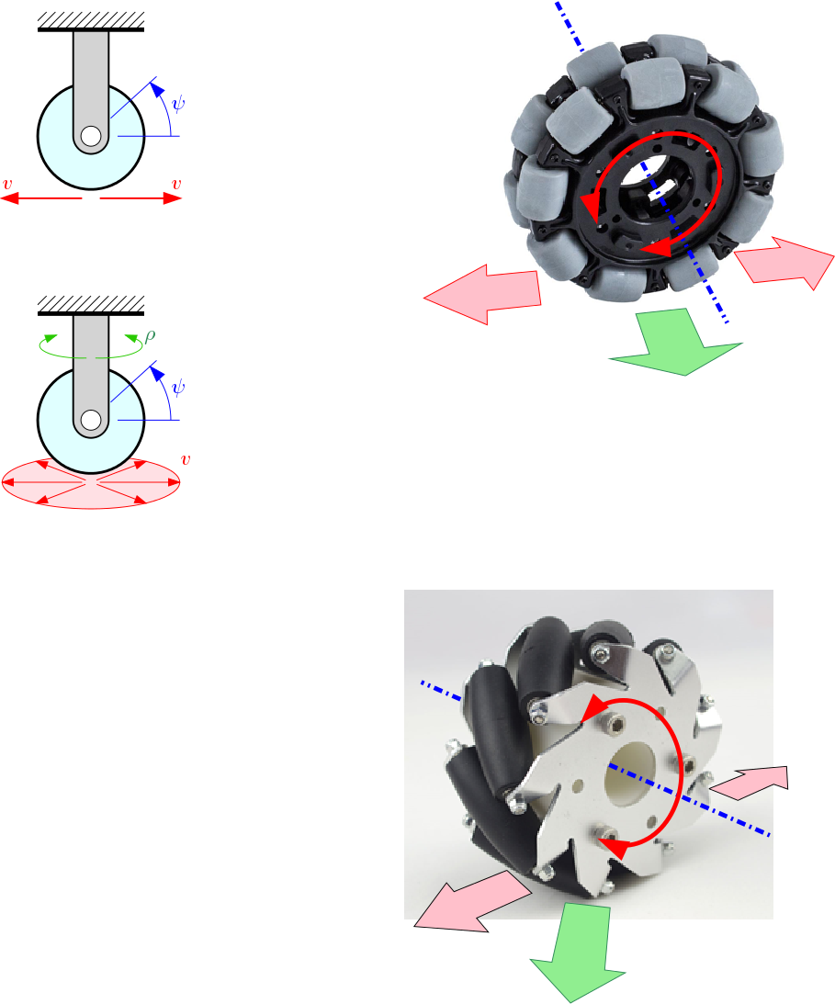
Wheel systems
Omnidirectional wheels (swedish wheels)
Omniwheel
Hint: Combining rotation $\dot{φ}$
of the wheels, the admissible velocity vector $v$ can be omnidirectional
$$\dot{φ}$$
$$v$$
Controlled motion
Lability
Video

Slide 24
Wheel systems
Omnidirectional wheels (swedish wheels)
  Mecanum wheel or Ilon wheel
Hint: Combining rotation $\dot{φ}$ of the wheels, the admissible velocity vector $v$ can be omnidirectional
$$\dot{φ}$$
$$γ$$
$$v$$
Video mecanum wheels

Slide 25
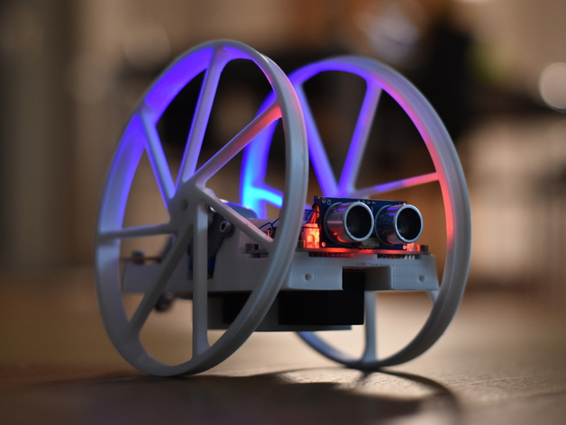
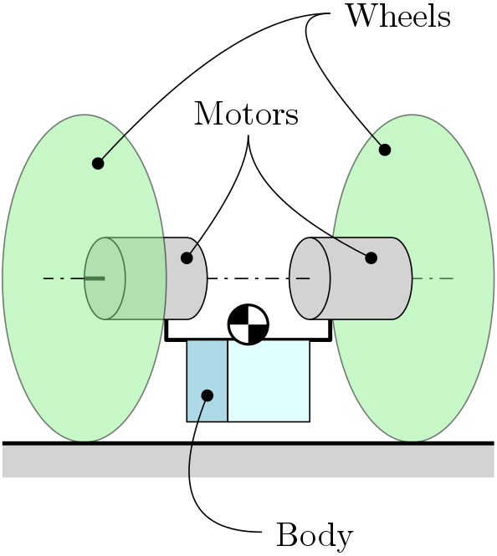
Stability
What is the minimum number of wheels for a stable system?

Slide 26
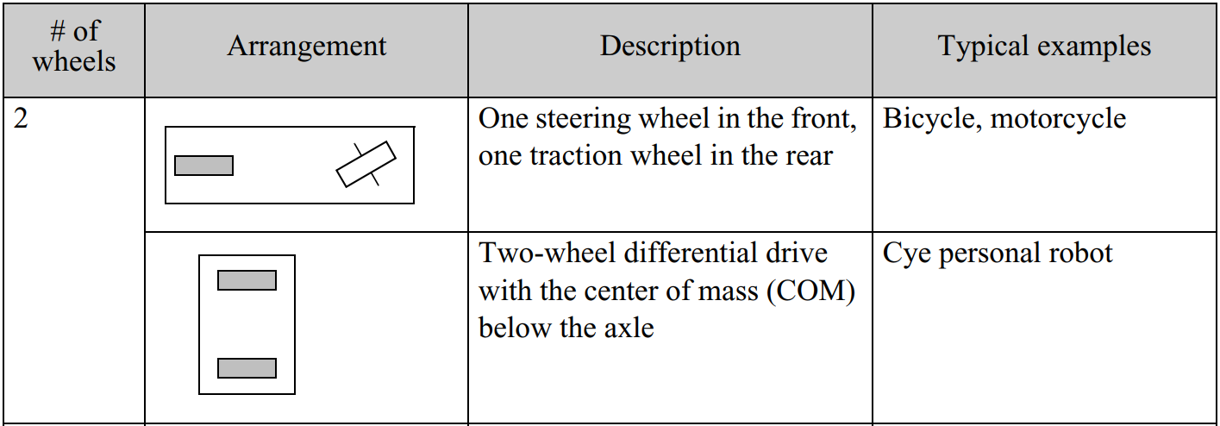
Wheel configurations
2 wheels

Slide 27
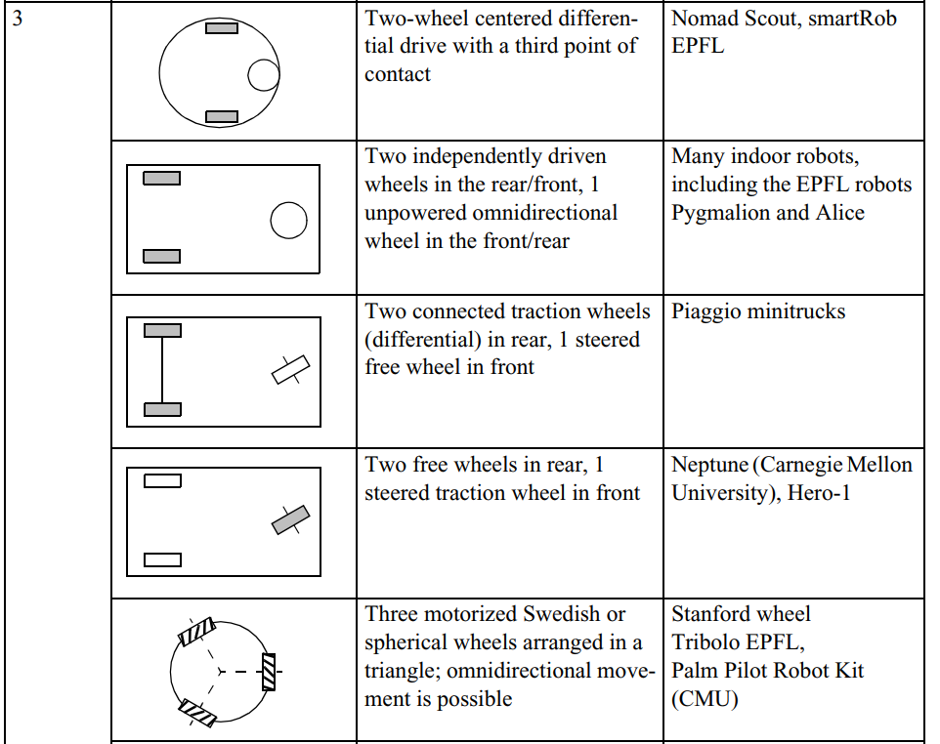
Wheel configurations
3 wheels

Slide 28
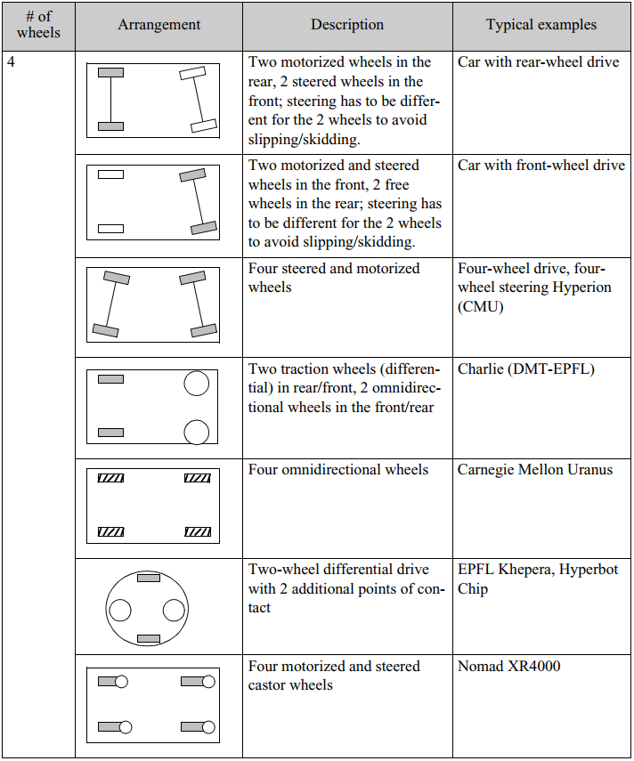
Wheel configurations
4 wheels

Slide 29
Introduction to the Theory
Mobile Robotics

Slide 30
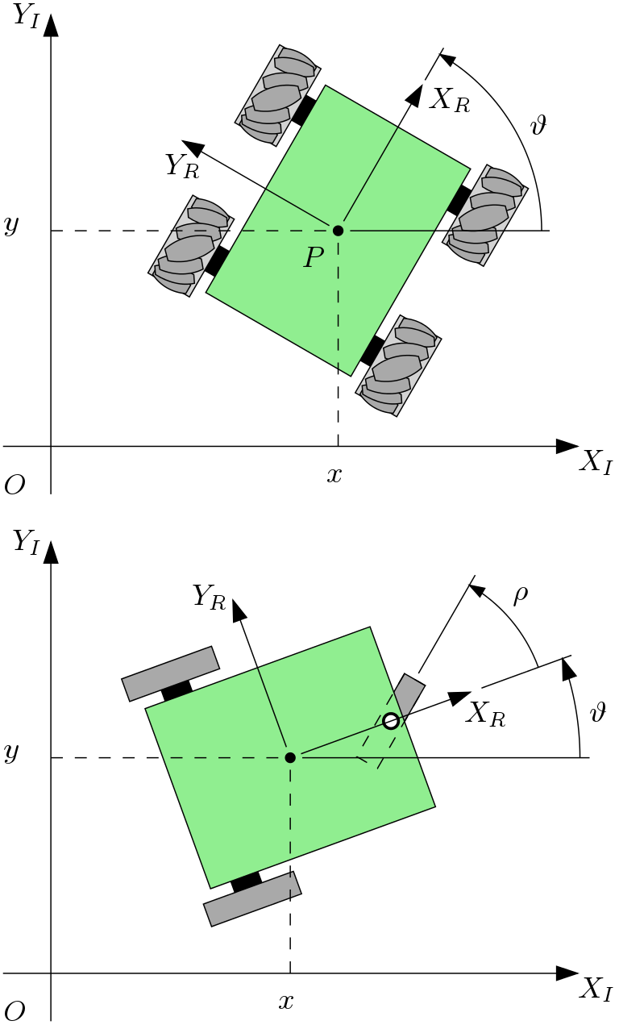
Frames of reference
Global inertial frame of reference:
  $$\left\langle X_{I},Y_{I}\right\rangle$$
Local frame of reference:
  $$\left\langle X_{R},Y_{R}\right\rangle$$

Slide 31
Pose and configuration space
Pose of the robot
  Determined by a set of independent variables
Pose: $\left(x,y,θ\right)$
  Configuration space $C$:
  $${\left\{x,y,θ \right\}}^{T}∈C$$
  $$\dim\left(C\right)≥3$$
Wheels
  Determined by a set of internal variables:
    Front wheel angle $ρ$
    Wheel rotation $ψ$

Slide 32
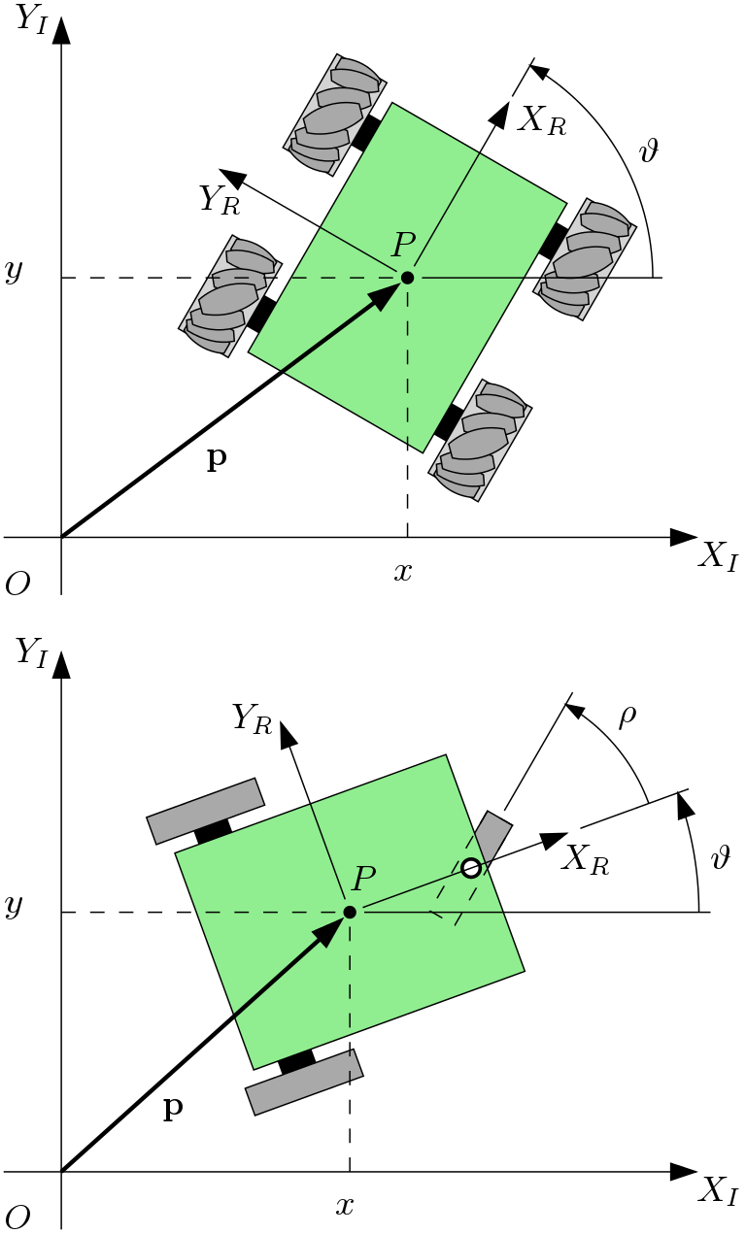
Velocity transformation: global $→$ local
Pose: $ξ_{I}=\left[\begin{matrix}x \\ y \\ θ\end{matrix}\right]$
Rotation matrix:
$$R\left(θ\right)=\left[\begin{matrix}\cos{θ} & \sin{θ} & 0 \\ −\sin{θ} & \cos{θ} & 0 \\ 0 & 0 & 1\end{matrix}\right]$$
Transformation:
$${\dot{ξ}}_{R}=R\left(θ\right){\dot{ξ}}_{I}$$

Slide 33
Velocity transformation: local $→$ global
Rotation matrix:
$$R\left(θ\right)=\left[\begin{matrix}\cos{θ} & \sin{θ} & 0 \\ −\sin{θ} & \cos{θ} & 0 \\ 0 & 0 & 1\end{matrix}\right]$$
Inverse transformation:
$${\dot{ξ}}_{R}=R\left(θ\right){\dot{ξ}}_{I}$$
$$⇓$$
$${\dot{ξ}}_{I}=R^{−1}\left(θ\right){\dot{ξ}}_{R}$$

Slide 34
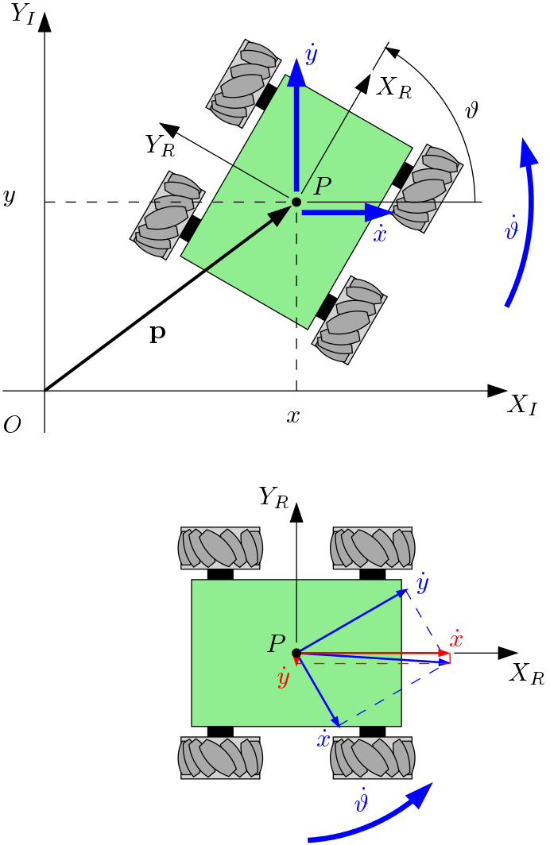
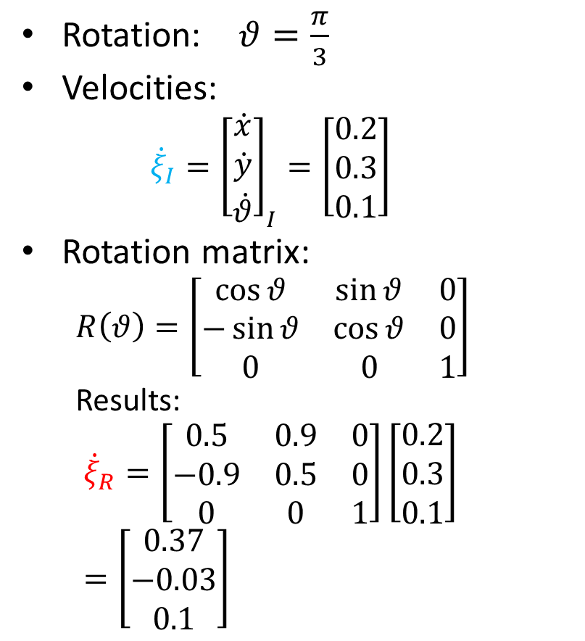
Example
$$\dot{y}$$
$$\dot{θ}$$
Rotation: $θ=\frac{π}{3}$
Velocities:
  $${\dot{ξ}}_{I}={\left[\begin{matrix}\dot{x} \\ \dot{y} \\ \dot{θ}\end{matrix}\right]}_{I}=\left[\begin{matrix}0.2 \\ 0.3 \\ 0.1\end{matrix}\right]$$
Rotation matrix:
  $$R\left(θ\right)=\left[\begin{matrix}\cos{θ} & \sin{θ} & 0 \\ −\sin{θ} & \cos{θ} & 0 \\ 0 & 0 & 1\end{matrix}\right]$$
  Results:
  $${\dot{ξ}}_{R}=\left[\begin{matrix}0.5 & 0.9 & 0 \\ −0.9 & 0.5 & 0 \\ 0 & 0 & 1\end{matrix}\right]\left[\begin{matrix}0.2 \\ 0.3 \\ 0.1\end{matrix}\right]=\left[\begin{aligned}0.37 \\ −0.03 \\ 0.1\end{aligned}\right]$$
$$\dot{x}$$

Slide 35
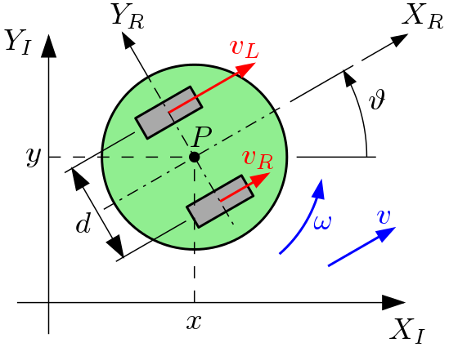
Forward kinematics
$$\dot{y}$$
$$\dot{θ}$$
Local $→$ global
Transformation:
$${\dot{ξ}}_{I}=R^{−1}\left(θ\right){\dot{ξ}}_{R}$$
$${\dot{ξ}}_{R}={\left[\begin{matrix}\dot{x} \\ \dot{y} \\ \dot{θ}\end{matrix}\right]}_{R}=\left[\begin{aligned}v \\ 0 \\ ω\end{aligned}\right]=\left[\begin{aligned}\frac{v_{R}}{2}+\frac{v_{L}}{2} \\ 0 \\ \frac{v_{R}}{+d}+\frac{v_{L}}{−d}\end{aligned}\right]$$
$$R^{−1}\left(θ\right)=\left[\begin{matrix}\cos{θ} & −\sin{θ} & 0 \\ \sin{θ} & \cos{θ} & 0 \\ 0 & 0 & 1\end{matrix}\right]$$
$$\dot{x}$$
Note:
The calculation is done separately for each wheel, considering the other wheel as stationary, followed by addition.

Slide 36
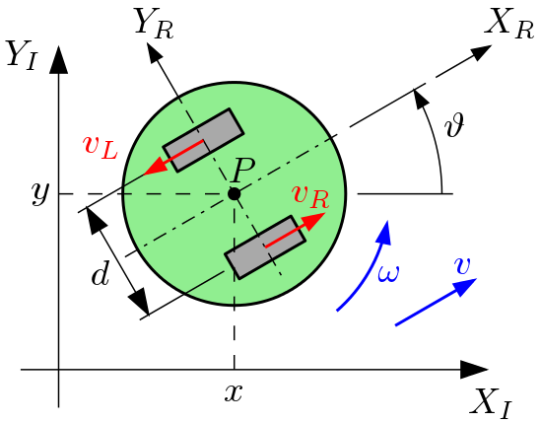
Example
$${\dot{ξ}}_{R}=\left[\begin{aligned}\dot{x} \\ \dot{y} \\ \dot{θ}\end{aligned}\right]=\left[\begin{aligned}\frac{v_{R}}{2}+\frac{v_{L}}{2} \\ 0 \\ \frac{v_{R}}{+d}+\frac{v_{L}}{−d}\end{aligned}\right]=\left[\begin{aligned}\frac{1}{2}−\frac{1}{2} \\ 0 \\ \frac{1}{3.3 }+\frac{−1}{−3.3}\end{aligned}\right]=\left[\begin{aligned}0 \\ 0 \\ 0.3+0.3\end{aligned}\right]=\left[\begin{aligned}0 \\ 0 \\ 0.6\end{aligned}\right]$$
Then:
$${\dot{ξ}}_{I}=R^{−1}\left(θ\right)\left[\begin{aligned}0 \\ 0 \\ 0.6\end{aligned}\right]$$
Parameters:
  $$v_{R}=1$$
  $$v_{L}=−1$$
  $$d=0.3$$
  $$θ=π/3$$

Slide 37
Example
$${\dot{ξ}}_{R}=\left[\begin{aligned}\dot{x} \\ \dot{y} \\ \dot{θ}\end{aligned}\right]=\left[\begin{aligned}\frac{v_{R}}{2}+\frac{v_{L}}{2} \\ 0 \\ \frac{v_{R}}{+d}+\frac{v_{L}}{−d}\end{aligned}\right]=\left[\begin{aligned}\frac{0.8}{2}+\frac{1}{2} \\ 0 \\ \frac{0.8}{0.3}+\frac{1}{−0.3}\end{aligned}\right]=\left[\begin{aligned}0.9 \\ 0 \\ 2.67−3.3\end{aligned}\right]=\left[\begin{aligned}0.9 \\ 0 \\ −0.67\end{aligned}\right]$$
Then:
$${\dot{ξ}}_{I}=R^{−1}\left(\frac{π}{3}\right){\dot{ξ}}_{R}=\left[\begin{aligned}0.45 \\ 0.78 \\ −0.67\end{aligned}\right]$$
Parameters:
  $$v_{R}=0.8$$
  $$v_{L}=1$$
  $$d=0.3$$
  $$θ=π/3$$
Time integration
$$x_{i}=x_{i−1}+\dot{x}dt$$
$$y_{i}=y_{i−1}+\dot{y}dt$$
$$θ_{i}=θ_{i−1}+\dot{θ}dt$$

Slide 38
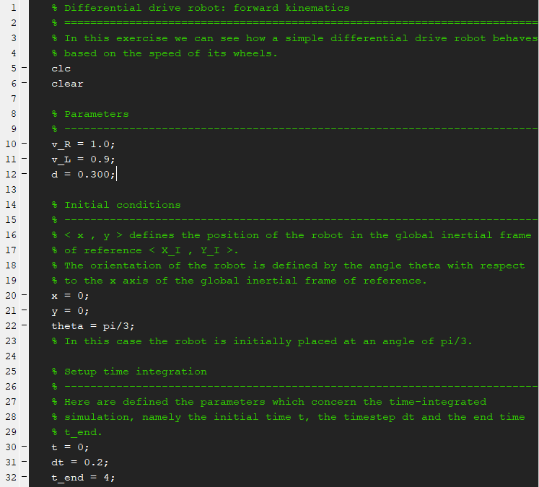
Exercise
Parameters
Initial conditions
Differential drive robot
Time integration parameters for the simulation

Slide 39
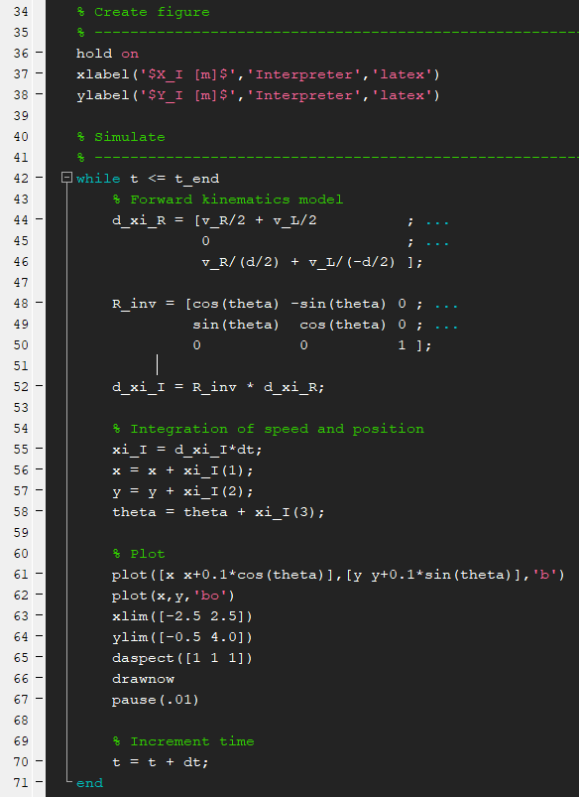
Exercise
$${\dot{ξ}}_{R}=\left[\begin{aligned}\dot{x} \\ \dot{y} \\ \dot{θ}\end{aligned}\right]=\left[\begin{aligned}\frac{v_{R}}{2}+\frac{v_{L}}{2} \\ 0 \\ \frac{v_{R}}{+d}+\frac{v_{L}}{−d}\end{aligned}\right]$$
Kinematic model
$$R^{−1}\left(θ\right)=\left[\begin{matrix}\cos{θ} & −\sin{θ} & 0 \\ \sin{θ} & \cos{θ} & 0 \\ 0 & 0 & 1\end{matrix}\right]$$
Time integration
$${\dot{ξ}}_{I}=R^{−1}\left(θ\right){\dot{ξ}}_{R}$$
Plot
Differential drive robot
Time increment

Slide 40
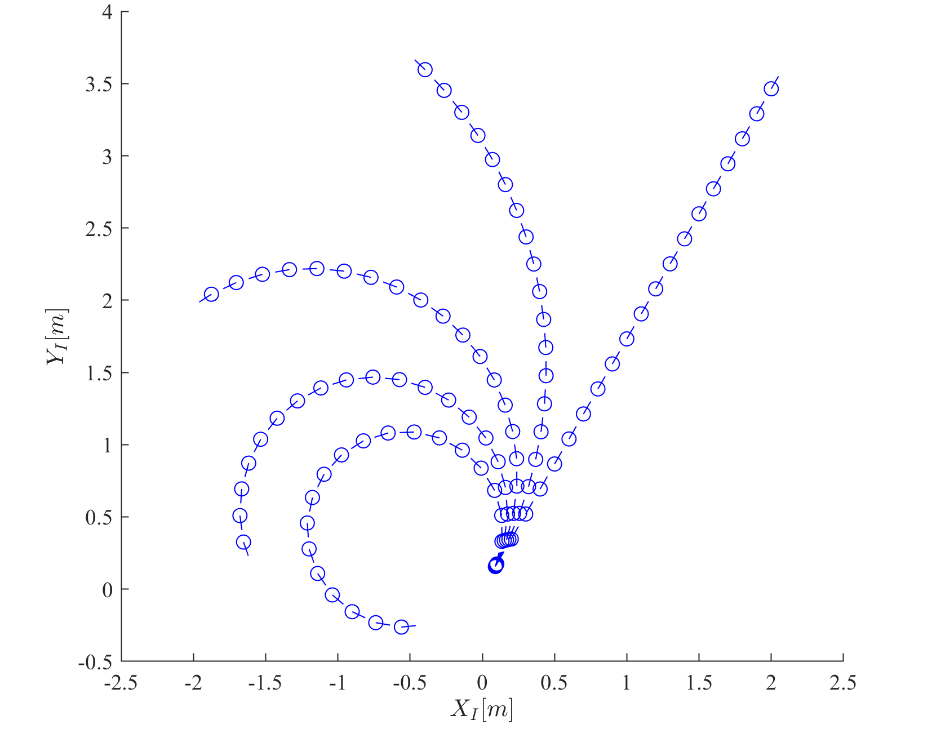
Results
$$v_{R}=1$$
$$v_{L}=0.95$$
$$v_{R}=1$$
$$v_{L}=1$$
$$v_{R}=1$$
$$v_{L}=0.90$$
$$v_{R}=1$$
$$v_{L}=0.85$$
$$v_{R}=1$$
$v_{L}=0.8$0

Slide 41
Wheel models
Mobile Robotics

Slide 42
Constraints
No-slip constraint causes:
  Two constraints for each wheel:
    Rolling constraint
    Sliding constraint
$$v_{t}$$
$$\dot{φ}$$
$$v$$

Slide 43
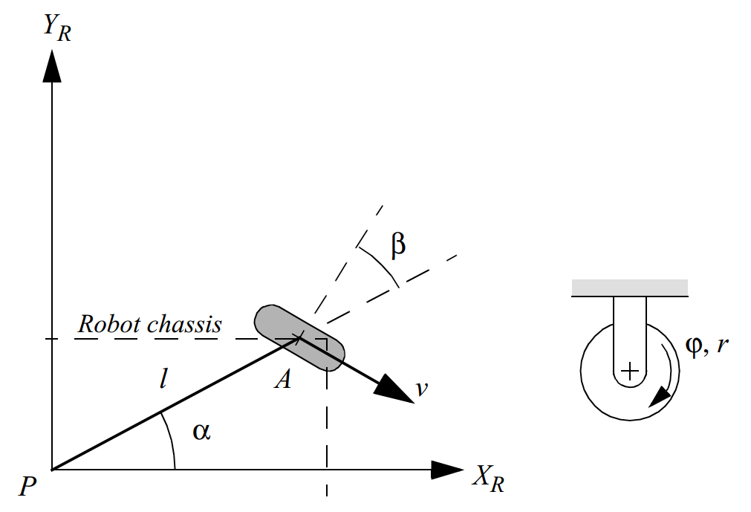
Fixed/steered wheel model
Wheel spin:
  $$v=\dot{φ}r$$
The motion of the wheel in local frame:
$$v=\dot{x}\sin\left(α+β\right)−\dot{y}\cos\left(α+β\right)−\dot{θ}l\cos{β}−r\dot{φ}=0$$
Thus the rolling constraint:
$${\left[\begin{matrix}\sin\left(α+β\right) \\ −\cos\left(α+β\right) \\ −l\cos\left(β\right)\end{matrix}\right]}^{T}R\left(θ\right){\dot{ξ}}_{I}−r\dot{φ}=0$$
Local reference frame
$${\dot{ξ}}_{R}$$
$$v$$

Slide 44
Rolling constraint
Local reference frame
$$l\dot{θ}$$
$$\dot{y}$$
$$\dot{x}$$
$$\dot{x}$$
$$α+β$$
$$l\dot{θ}$$
$$β$$
$$\dot{y}$$
$$v$$
$$α+β$$
$$v=\dot{x}\sin\left(α+β\right)−\dot{y}\cos\left(α+β\right)−\dot{θ}l\cos{β}−r\dot{φ}=0$$

Slide 45
Fixed/steered wheel model
The constraint of the wheel in local frame:
$$v_{t}=\dot{x}\cos\left(α+β\right)+\dot{y}\sin\left(α+β\right)+\dot{θ}l\sin{β}=0$$
Thus the sliding constraint:
$${\left[\begin{matrix}\cos\left(α+β\right) \\ \sin\left(α+β\right) \\ l\sin\left(β\right)\end{matrix}\right]}^{T}R\left(θ\right){\dot{ξ}}_{I}=0$$
Local reference frame
Steering angle
$$v_{t}$$

Slide 46
Sliding constraint
$$v_{t}=\dot{x}\cos\left(α+β\right)+\dot{y}\sin\left(α+β\right)+\dot{θ}l\sin{β}=0$$
Local reference frame
$$\dot{y}$$
$$v_{t}$$
$$l\dot{θ}$$
$$v_{t}$$
$$\dot{x}$$
$$l\dot{θ}$$
$$β$$
$$α+β$$
$$α+β$$
$$\dot{y}$$
$$\dot{x}$$

Slide 47
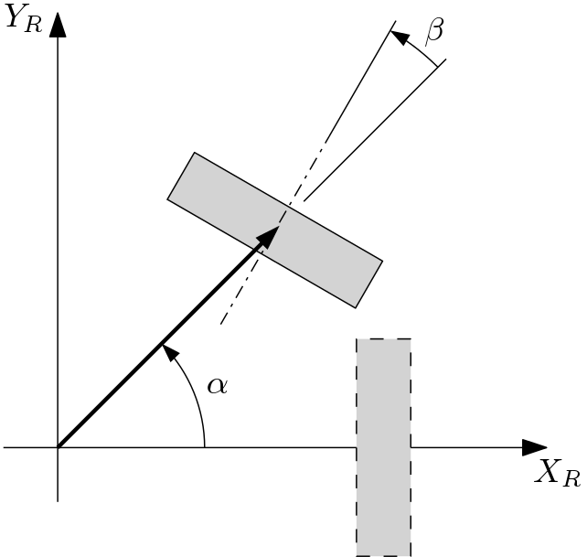
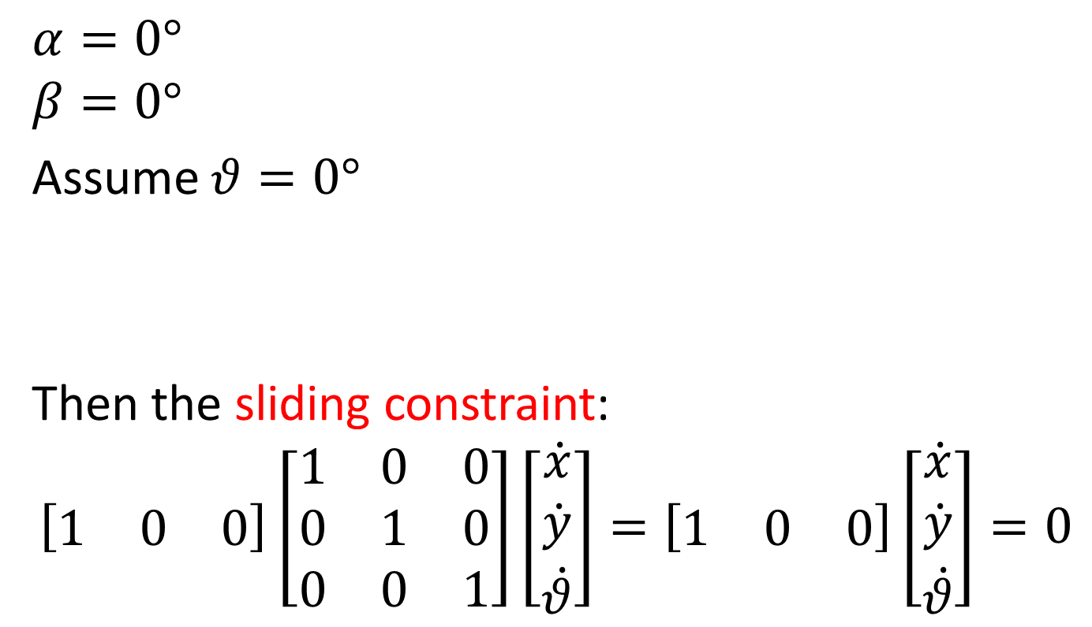
Example
$$α=0°$$
$$β=0°$$
Assume $θ=0°$
Then the sliding constraint:
$$\left[\begin{matrix}1 & 0 & 0\end{matrix}\right]\left[\begin{matrix}1 & 0 & 0 \\ 0 & 1 & 0 \\ 0 & 0 & 1\end{matrix}\right]\left[\begin{aligned}\dot{x} \\ \dot{y} \\ \dot{θ}\end{aligned}\right]=\left[\begin{matrix}1 & 0 & 0\end{matrix}\right]\left[\begin{aligned}\dot{x} \\ \dot{y} \\ \dot{θ}\end{aligned}\right]=0$$

Slide 48
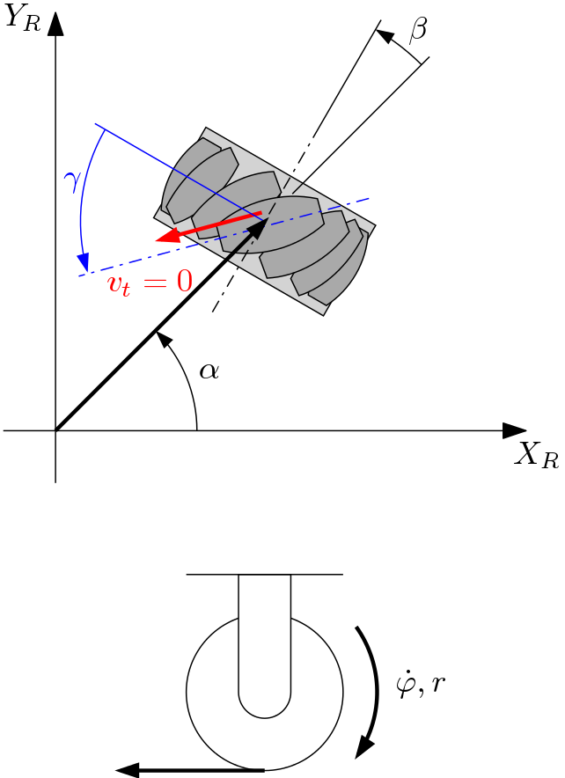
Mecanum wheel model
The rolling constraint:
$${\left[\begin{matrix}\sin\left(α+β+γ\right) \\ −\cos\left(α+β+γ\right) \\ −l\cos\left(β+γ\right)\end{matrix}\right]}^{T}R\left(θ\right){\dot{ξ}}_{I}−r\dot{φ}\cos{γ}=0$$
The sliding constraint:
$${\left[\begin{matrix}\cos\left(α+β+γ\right) \\ \sin\left(α+β+γ\right) \\ l\sin\left(β+γ\right)\end{matrix}\right]}^{T}R\left(θ\right){\dot{ξ}}_{I}−r\dot{φ}\sin{γ}−r_{rl}{\dot{φ}}_{rl}=0$$
$$v$$
$$v$$
Rollers

Slide 49
Example
Consider $γ=0$
The rolling constraint:
$${\left[\begin{matrix}\sin\left(α+β+γ\right) \\ −\cos\left(α+β+γ\right) \\ −l\cos\left(β+γ\right)\end{matrix}\right]}^{T}R\left(θ\right){\dot{ξ}}_{I}−r\dot{φ}\cos{γ}=0$$
The sliding constraint:
$${\left[\begin{matrix}\cos\left(α+β+γ\right) \\ \sin\left(α+β+γ\right) \\ l\sin\left(β+γ\right)\end{matrix}\right]}^{T}R\left(θ\right){\dot{ξ}}_{I}−r\dot{φ}\sin{γ}−r_{rl}{\dot{φ}}_{rl}=0$$
Equivalent to fixed wheel
The rolling constraint of the rollers!

Slide 50
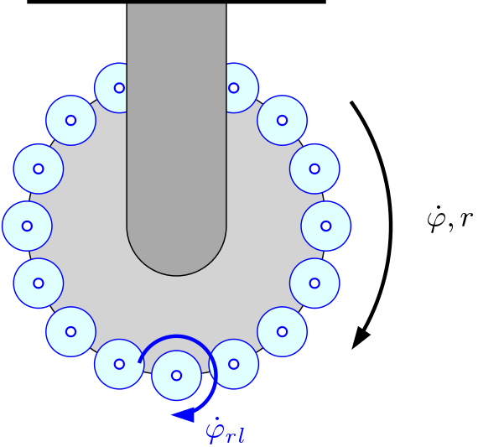
Example
Consider $γ=\frac{π}{2}$
The rolling constraint:
$${\left[\begin{matrix}\sin\left(α+β+γ\right) \\ −\cos\left(α+β+γ\right) \\ −l\cos\left(β+γ\right)\end{matrix}\right]}^{T}R\left(θ\right){\dot{ξ}}_{I}−r\dot{φ}\cos{γ}=0$$
The sliding constraint:
$${\left[\begin{matrix}\cos\left(α+β+γ\right) \\ \sin\left(α+β+γ\right) \\ l\sin\left(β+γ\right)\end{matrix}\right]}^{T}R\left(θ\right){\dot{ξ}}_{I}−r\dot{φ}\sin{γ}−r_{rl}{\dot{φ}}_{rl}=0$$
Not related to $\dot{φ}$!
Degenerate form

