Slide 1
Mobile Robots
Part I.2
a.a. 2020-2021
Robotics and Mechatronics

Slide 2
Mobile robot kinematics
Mobile Robotics

Slide 3
Robot kinematics
We need to go from single-wheel models to a model for a N-wheel robot:
  Let’s assume $N$ standard wheels:
    $N_{f}$ fixed
    $N_{s}$ steerable
We need to combine the rolling and sliding constraints equations for each wheel.
Let’s consider:
$$φ\left(t\right)=\left[\begin{matrix} \\ \\ \end{matrix}\begin{aligned}φ_{f} \\ φ_{s}\end{aligned}\begin{matrix} \\ \\ \end{matrix}\right]$$
Fixed wheels
Steerable wheels

Slide 4
Rolling constraints
Combine the rolling constraints:
$$J_{1}\left(β_{s}\right)R\left(θ\right){\dot{ξ}}_{I}−J_{2}\dot{φ}=0$$
$$\left[\begin{matrix}r_{1} & 0 & … & 0 \\ 0 & r_{2} & & ⋮ \\ ⋮ & & ⋱ & 0 \\ 0 & … & 0 & r_{M}\end{matrix}\right]$$
$$J_{1f}=\left[N_{f}×3\right]=\left[\begin{matrix}\sin\left(α_{1}+β_{1}\right) & −\cos\left(α_{1}+β_{1}\right) & −l\cos\left(β_{1}\right) \\ ⋮ & ⋮ & ⋮ \\ \sin\left(α_{N_{f}}+β_{N_{f}}\right) & −\cos\left(α_{N_{f}}+β_{N_{f}}\right) & −l\cos\left(β_{N_{f}}\right)\end{matrix}\right]$$
$$\left[\begin{aligned}J_{1f} \\ J_{1s}\left(β_{s}\right)\end{aligned}\right]$$
$$J_{1f}=\left[N_{f}×3\right]=\left[\begin{matrix}\cos\left(α_{N_{f}+1}+β_{N_{f}+1}\right) & \sin\left(α_{N_{f}+1}+β_{N_{f}+1}\right) & l\sin\left(β_{N_{f}+1}\right) \\ ⋮ & ⋮ & ⋮ \\ \cos\left(α_{N_{f}+N_{s}}+β_{{N_{f}+N}_{s}}\right) & \sin\left(α_{{N_{f}+N}_{s}}+β_{N_{f}+N_{s}}\right) & l\sin\left(β_{{N_{f}+N}_{s}}\right)\end{matrix}\right]$$

Slide 5
Sliding constraints
Combine the sliding constraints:
$$C_{1}\left(β_{s}\right)R\left(θ\right){\dot{ξ}}_{I}=0$$
where,
$$C_{1}\left(β_{s}\right)=\left[\begin{aligned}C_{1f} \\ C_{1s}\left(β_{s}\right)\end{aligned}\right]=\left[\begin{aligned}\left[N_{f}×3\right] \\ \left[N_{s}×3\right]\end{aligned}\right]$$

Slide 6
Model
We can finally join the equations:
$\left[\begin{matrix} \\ \\ \end{matrix}\begin{aligned}J_{1}\left(β_{s}\right) \\ C_{1}\left(β_{s}\right)\end{aligned}\begin{matrix} \\ \\ \end{matrix}\right]R\left(θ\right){\dot{ξ}}_{I}=\left[\begin{matrix} \\ \\ \end{matrix}\begin{aligned}J_{2}\dot{φ} \\ 0\end{aligned}\begin{matrix} \\ \\ \end{matrix}\right]$
thus
$${\dot{ξ}}_{I}=R^{−1}\left(θ\right){\left[\begin{matrix} \\ \\ \end{matrix}\begin{aligned}J_{1}\left(β_{s}\right) \\ C_{1}\left(β_{s}\right)\end{aligned}\begin{matrix} \\ \\ \end{matrix}\right]}^{−1}\left[\begin{matrix} \\ \\ \end{matrix}\begin{aligned}J_{2}\dot{φ} \\ 0\end{aligned}\begin{matrix} \\ \\ \end{matrix}\right]$$
Rolling constraints
Sliding constraints

Slide 7
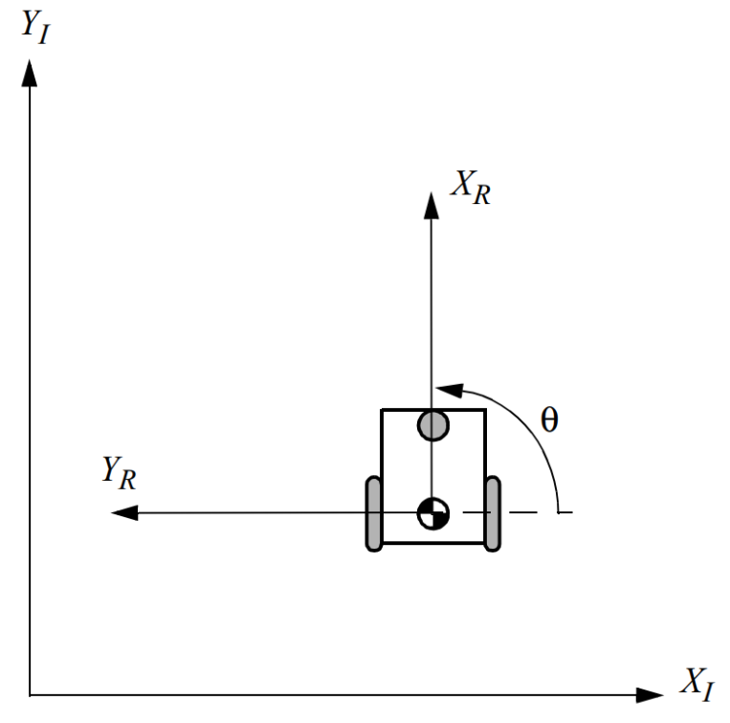
$${\dot{ξ}}_{I}=R^{−1}\left(θ\right){\left[\begin{matrix} \\ \\ \end{matrix}\begin{aligned}J_{1}\left(β_{s}\right) \\ C_{1}\left(β_{s}\right)\end{aligned}\begin{matrix} \\ \\ \end{matrix}\right]}^{−1}\left[\begin{matrix} \\ \\ \end{matrix}\begin{aligned}J_{2}\dot{φ} \\ 0\end{aligned}\begin{matrix} \\ \\ \end{matrix}\right]$$
$${\dot{ξ}}_{I}=R^{−1}\left(θ\right)\left[\begin{aligned}\frac{v_{R}}{2}+\frac{v_{L}}{2} \\ 0 \\ \frac{v_{R}}{+d}+\frac{v_{L}}{−d}\end{aligned}\right]$$
Time integration
$$ξ_{I}\left(t+δt\right)=ξ_{I}\left(t\right)+{\dot{ξ}}_{I}δt$$

Slide 8
Example: differential drive
Right wheel: $α=−\frac{π}{2}$, $β=π$
Left wheel: $α=\frac{π}{2}$, $β=0$
$$\left[\begin{matrix} \\ \\ \end{matrix}\begin{aligned}J_{1}\left(β_{s}\right) \\ C_{1}\left(β_{s}\right)\end{aligned}\begin{matrix} \\ \\ \end{matrix}\right]=\left[\begin{matrix}J_{1f} \\ C_{1f}\end{matrix}\right]=\left[\begin{aligned}\left[\begin{matrix}1 & 0 & l \\ 1 & 0 & −l\end{matrix}\right] \\ \left[\begin{matrix}0 & 1 & 0\end{matrix}\right]\end{aligned}\right]$$
And,
$${\dot{ξ}}_{I}=R^{−1}\left(θ\right){\left[\begin{matrix} \\ \\ \end{matrix}\begin{aligned}J_{1}\left(β_{s}\right) \\ C_{1}\left(β_{s}\right)\end{aligned}\begin{matrix} \\ \\ \end{matrix}\right]}^{−1}\left[\begin{aligned}J_{2}\dot{φ} \\ 0\end{aligned}\right]=R^{−1}\left(θ\right)\left[\begin{matrix}\frac{1}{2} & \frac{1}{2} & 0 \\ 0 & 0 & 1 \\ \frac{1}{2l} & −\frac{1}{2l} & 0\end{matrix}\right]\left[\begin{aligned}J_{2}\dot{φ} \\ 0\end{aligned}\right]$$
Remember that $\dot{φ}={\left[\begin{matrix}{\dot{φ}}_{1} & {\dot{φ}}_{2}\end{matrix}\right]}^{T}$ and that $J_{2}$ is the matrix or the radii of the wheels, thus,
$$\left[\begin{aligned}J_{2}\dot{φ} \\ 0\end{aligned}\right]=\left[\begin{aligned}\left[\begin{matrix}r_{1} & 0 \\ 0 & r_{2}\end{matrix}\right]\left[\begin{aligned}{\dot{φ}}_{1} \\ {\dot{φ}}_{2}\end{aligned}\right] \\ 0\end{aligned}\right]=\left[\begin{aligned}{r_{1}\dot{φ}}_{1} \\ r_{2}{\dot{φ}}_{2} \\ 0\end{aligned}\right]$$
$${\left[\begin{matrix}\sin\left(α+β\right) \\ −\cos\left(α+β\right) \\ −l\cos\left(β\right)\end{matrix}\right]}^{T}R\left(θ\right){\dot{ξ}}_{I}−r\dot{φ}=0$$
$${\left[\begin{matrix}\cos\left(α+β\right) \\ \sin\left(α+β\right) \\ l\sin\left(β\right)\end{matrix}\right]}^{T}R\left(θ\right){\dot{ξ}}_{I}=0$$
Same sliding constraint!
$${\dot{ξ}}_{I}=R^{−1}\left(θ\right)\left[\begin{matrix}\frac{1}{2} & \frac{1}{2} & 0 \\ 0 & 0 & 1 \\ \frac{1}{2l} & −\frac{1}{2l} & 0\end{matrix}\right]\left[\begin{aligned}{r_{1}\dot{φ}}_{1} \\ r_{2}{\dot{φ}}_{2} \\ 0\end{aligned}\right]=R^{−1}\left(θ\right)\left[\begin{aligned}\frac{r_{1}{\dot{φ}}_{1}}{2}+\frac{r_{2}{\dot{φ}}_{2}}{2} \\ 0 \\ \frac{r_{1}{\dot{φ}}_{1}}{2l}−\frac{r_{2}{\dot{φ}}_{2}}{2l}\end{aligned}\right]$$

Slide 9
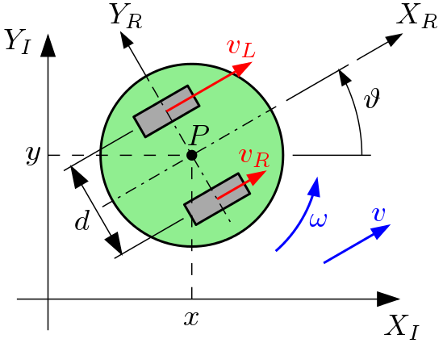
Example: differential drive
$v_{i}=r_{i}{\dot{φ}}_{i}$ !
$${\dot{ξ}}_{I}=R^{−1}\left(θ\right)\left[\begin{aligned}\frac{v_{R}}{2}+\frac{v_{L}}{2} \\ 0 \\ \frac{v_{R}}{+d}+\frac{v_{L}}{−d}\end{aligned}\right]$$
$${\dot{ξ}}_{I}=R^{−1}\left(θ\right)\left[\begin{aligned}\frac{r_{1}{\dot{φ}}_{1}}{2}+\frac{r_{2}{\dot{φ}}_{2}}{2} \\ 0 \\ \frac{r_{1}{\dot{φ}}_{1}}{2l}−\frac{r_{2}{\dot{φ}}_{2}}{2l}\end{aligned}\right]$$
$d=2l$ !

Slide 10
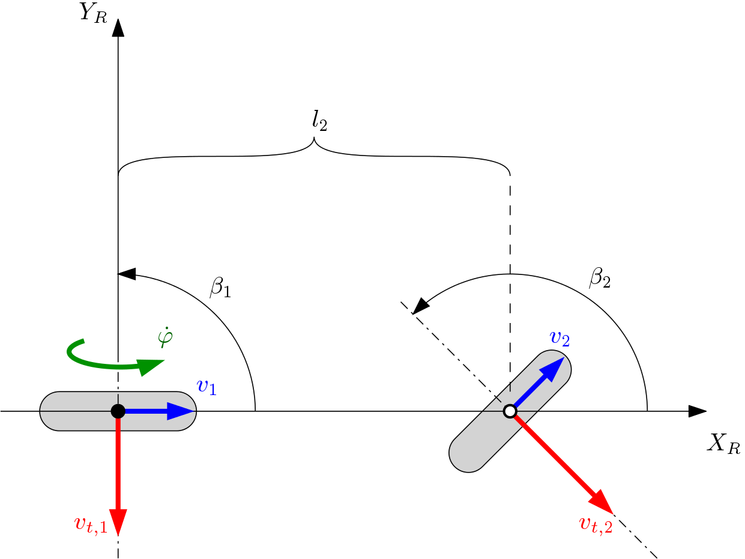
Example: bicycle

Slide 11
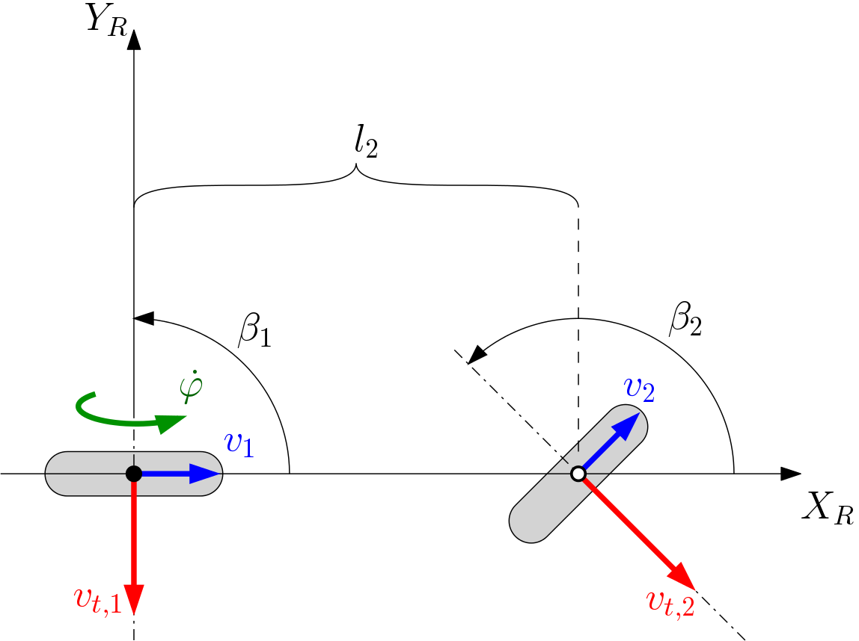
Example: bicycle
Wheel 1
  Sliding constraint
  $$\dot{x}\cos\left(α_{1}+β_{1}\right)+\dot{y}\sin\left(α_{1}+β_{1}\right)+l_{1}\dot{θ}\sin{β_{1}}=0$$
  Rolling constraint
  $$\dot{x}\sin\left(α_{1}+β_{1}\right)−\dot{y}\cos\left(α_{1}+β_{1}\right)−l_{1}\dot{θ}\cos{β_{1}}−{\dot{φ}}_{1}r_{1}=0$$
Wheel 2
  The same applies for the other wheel, with parameters $α_{2}, β_{2}, l_{2}, θ_{2}$ and ${\dot{φ}}_{2}$
  Since the motor wheel is on the rear-wheel, we can discard the rolling constraint equation for wheel 2!
  However, the sliding constraint on wheel 2 must still be enforced!
Wheel 1
Wheel 2
$$\left[\begin{matrix}\cos\left(α_{1}+β_{1}\right) & \sin\left(α_{1}+β_{1}\right) & l_{1}\sin{β_{1}} \\ \sin\left(α_{1}+β_{1}\right) & −\cos\left(α_{1}+β_{1}\right) & −l_{1}\cos{β_{1}} \\ \cos\left(α_{2}+β_{2}\right) & \sin\left(α_{2}+β_{2}\right) & l_{2}\sin{β_{2}}\end{matrix}\right]\left\{\begin{matrix}\dot{x} \\ \dot{y} \\ \dot{θ}\end{matrix}\right\}−\left\{\begin{matrix}0 \\ −r_{1}{\dot{φ}}_{1} \\ 0\end{matrix}\right\}=0$$

Slide 12
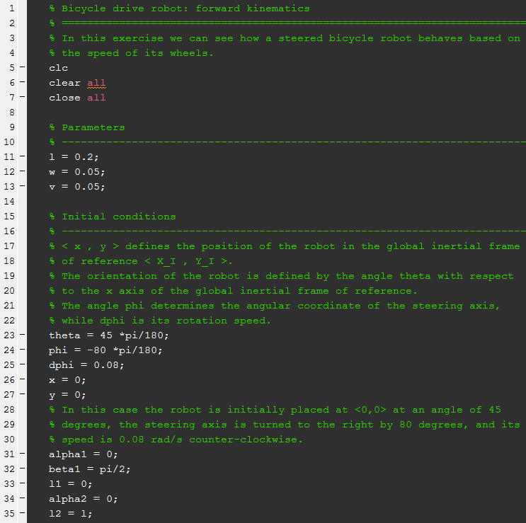

Exercise
$l$ – Distance between wheels
$w$ – Radius of the wheel (only graphical)
$v$ – Linear speed of the robot
$θ$ – Angle of the robot in global frame
$φ$ – Steering angle
$\dot{φ}$ – Steering angle
$\left\langle x,y\right\rangle$ – Position of the robot in global frame
Bicycle

Slide 13
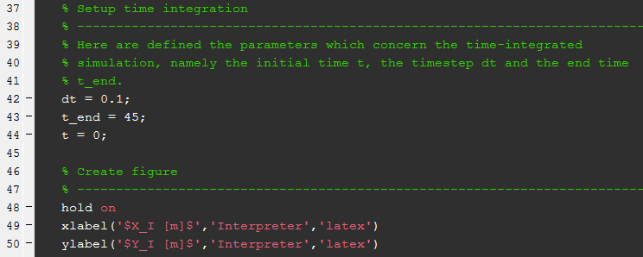
Exercise
$dt$ – Timestep
$t_{end}$ – Time at which the simulation ends
$t$ – Initial time
Bicycle

Slide 14
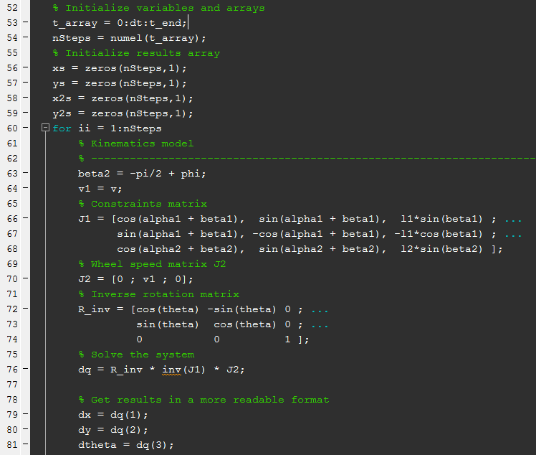
Exercise
Initialization
$$\left[\begin{matrix}\cos\left(α_{1}+β_{1}\right) & \sin\left(α_{1}+β_{1}\right) & l_{1}\sin{β_{1}} \\ \sin\left(α_{1}+β_{1}\right) & −\cos\left(α_{1}+β_{1}\right) & −l_{1}\cos{β_{1}} \\ \cos\left(α_{2}+β_{2}\right) & \sin\left(α_{2}+β_{2}\right) & l_{2}\sin{β_{2}}\end{matrix}\right]$$
Get $β_{2}$ from the steering angle
Set the motor to the rear-wheel
$$J_{2}=\left[\begin{matrix}0 \\ {r_{1}\dot{φ}}_{1} \\ 0\end{matrix}\right]$$
$$R^{−1}\left(θ\right)=\left[\begin{matrix}\cos{θ} & −\sin{θ} & 0 \\ \sin{θ} & \cos{θ} & 0 \\ 0 & 0 & 1\end{matrix}\right]$$
Bicycle
$${\dot{ξ}}_{I}=R^{−1}\left(θ\right){\dot{ξ}}_{R}$$

Slide 15
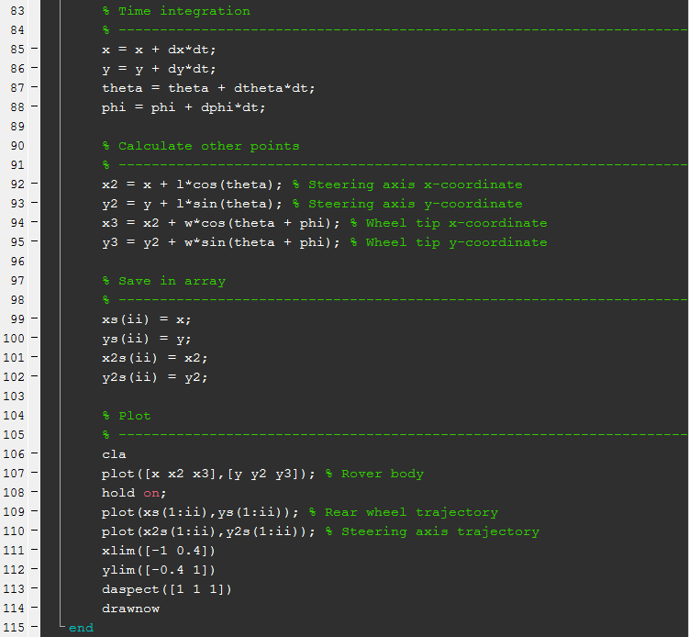
Exercise
Time integration
$$x\left(t+δt\right)=x\left(t\right)+\dot{x}δt$$
Mainly for graphic purpose
Save trajectories of the robot origin $\left\langle x,y\right\rangle$ and of the steering axis
Bicycle
Plot

Slide 16
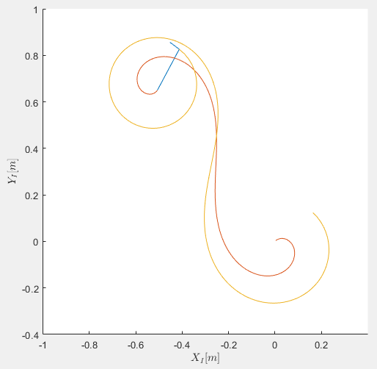
Results!

Slide 17
Exercises
Mobile robot kinematics

Slide 18
Differential drive robot: forward kinematics

Slide 19
Bicycle drive robot: forward kinematics

Slide 20
Mobility
Mobile Robotics

Slide 21
Kinematics: recap
Kinematics for mobile robots:
$\left[\begin{matrix} \\ \\ \end{matrix}\begin{aligned}J_{1}\left(β_{s}\right) \\ C_{1}\left(β_{s}\right)\end{aligned}\begin{matrix} \\ \\ \end{matrix}\right]R\left(θ\right){\dot{ξ}}_{I}=\left[\begin{matrix} \\ \\ \end{matrix}\begin{aligned}J_{2}\dot{φ} \\ 0\end{aligned}\begin{matrix} \\ \\ \end{matrix}\right]$
thus
$${\dot{ξ}}_{I}=R^{−1}\left(θ\right){\left[\begin{matrix} \\ \\ \end{matrix}\begin{aligned}J_{1}\left(β_{s}\right) \\ C_{1}\left(β_{s}\right)\end{aligned}\begin{matrix} \\ \\ \end{matrix}\right]}^{−1}\left[\begin{matrix} \\ \\ \end{matrix}\begin{aligned}J_{2}\dot{φ} \\ 0\end{aligned}\begin{matrix} \\ \\ \end{matrix}\right]$$
Rolling constraints
Sliding constraints

Slide 22
Mobility
Rolling constraints
$$\left[\begin{matrix} \\ \\ \end{matrix}\begin{aligned}J_{1}\left(β_{s}\right) \\ C_{1}\left(β_{s}\right)\end{aligned}\begin{matrix} \\ \\ \end{matrix}\right]R\left(θ\right){\dot{ξ}}_{I}=\left[\begin{matrix} \\ \\ \end{matrix}\begin{aligned}J_{2}\dot{φ} \\ 0\end{aligned}\begin{matrix} \\ \\ \end{matrix}\right]$$
Sliding constraints
We have a lateral zero-slip constraint
  This is valid for each wheel
  It can be specified separately for fixed and steerable wheels:
  $C_{1f}R\left(θ\right){\dot{ξ}}_{I}=0$
  and,
  $C_{1s}\left(β_{s}\right)R\left(θ\right){\dot{ξ}}_{I}=0$
$$C_{1}\left(β_{s}\right)$$
Motion vector
$$⇔$$
$$R\left(θ\right){\dot{ξ}}_{I}∈\ker\left(C_{1}\left(β_{s}\right)\right)$$
Motion vector
$$\dot{ξ_{R}}$$
Projection matrix
Sliding constraints

Slide 23
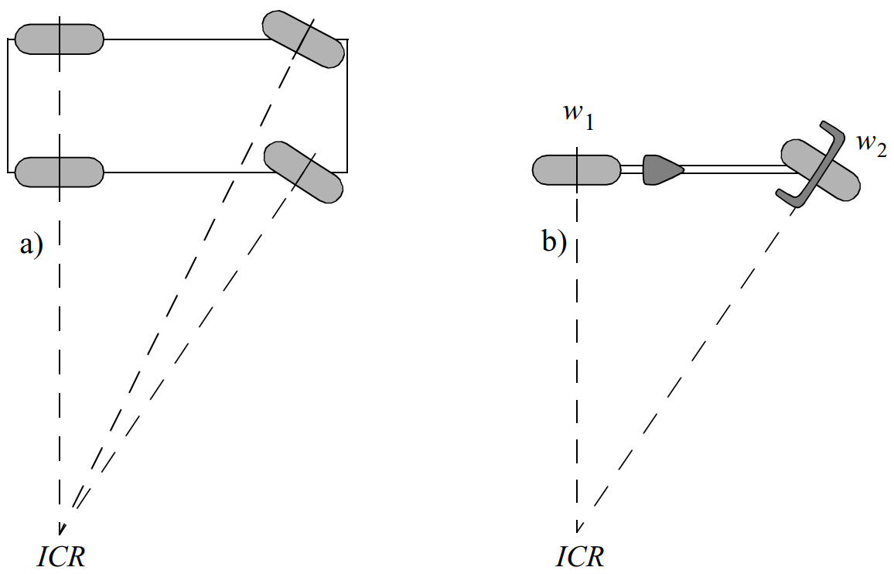
Mobility
Geometrical proof
Solutions
Instantaneous Centre of Rotation
It is the single solution that allows mobility
Zero motion lines

Slide 24
Mobility
Examples

Slide 25
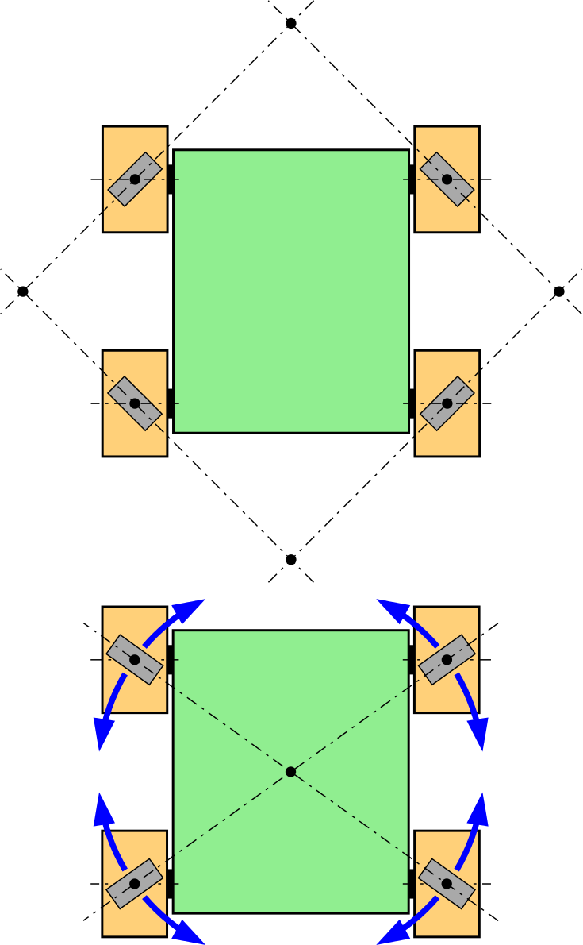
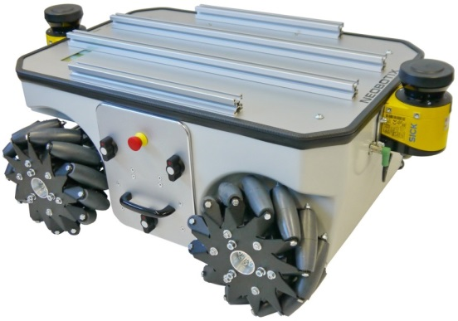
Kinematics:
Omnidirectional robot
Necessary conditions:
  No single point should exist where all the axes of the rollers intersect
  Same with parallel axes
  If not, then the system is labile.

Slide 26
Mobility
In general, the degree of mobility $δ_{m}$ is a function of the set of independent constraints.
  $⇒$ related to the $rank$ of a matrix:
  $$δ_{m}=3−rank\left(C_{1}\left(β_{s}\right)\begin{matrix} \\ \\ \end{matrix}\right)$$
It should be: $rank\left(C_{1}\right)∈[0, 3]$
Number of
independent
constraints
Unrestrained motion
Unmovable

Slide 27
Steerability
Degree of steerability
  $$δ_{s}=rank\left(C_{1s}\left(β_{s}\right)\begin{matrix} \\ \\ \end{matrix}\right)$$
  $$δ_{s}∈[ 0 , 2 ]$$
Examples:
  Differential drive robot:
    $rank\left( \right)=0$, $δ_{s}=0$
  Bicycle:
    $rank\left( \right)=1$, $δ_{s}=1$
  Omni wheel robot:
    $rank\left( \right)=0$, $δ_{s}=0$
Rolling constraints
$$\left[\begin{matrix} \\ \\ \end{matrix}\begin{aligned}J_{1}\left(β_{s}\right) \\ \left[\begin{matrix}C_{1f} \\ C_{1s}\left(β_{s}\right)\end{matrix}\right]\end{aligned}\begin{matrix} \\ \\ \end{matrix}\right]R\left(θ\right){\dot{ξ}}_{I}=\left[\begin{matrix} \\ \\ \end{matrix}\begin{aligned}J_{2}\dot{φ} \\ 0\end{aligned}\begin{matrix} \\ \\ \end{matrix}\right]$$
Sliding constraints

Slide 28
Example
$$N_{f}=2$$
$$N_{s}=2$$
Fixed wheels
Steered wheels
However:
  Rear wheel:
    Common axle $⇒$ same sliding constraint $⇒rank\left(C_{1f}\right)=1$
  Front wheel:
    Both wheels must have the same ICR
    $⇒$ inter-dependent rolling/sliding constraint
    $$⇒rank\left(C_{1s}\right)=1$$
Thus:
  $$δ_{m}=1$$
  $$δ_{s}=1$$

Slide 29
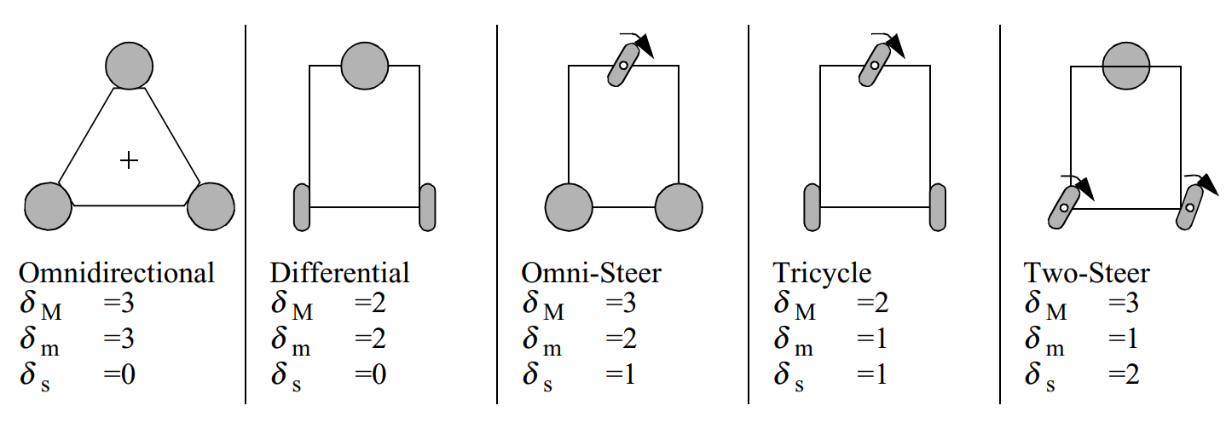
Maneuverability
Degree of maneuverability:
  $$δ_{M}=δ_{m}+δ_{s}$$
Includes both the direct d.o.f. (wheel spin $φ$) and indirect d.o.f. ($β_{s}$)
Some examples:

Slide 30
Mobile robot workspace
This part not clear: C-space is the equiv of joint-space. WS is the space of poses so they are made of different stuff.
The point is that for a n-hol system we can have that every point in WS can be connected to a point in the C-space.
Thus, even if dim(C-space) = 2, dim(W) can be = 3.
Workspace:
  Possible configurations $W$ in the configuration space $C$:
$$W∈C$$
However, the following is possible:
  $$δ_{M}<\dim\left(W\right)$$
  Which means that the robot can have $δ_{M}=2$ and a workspace of $dim\left(W\right){=3}$!

Slide 31
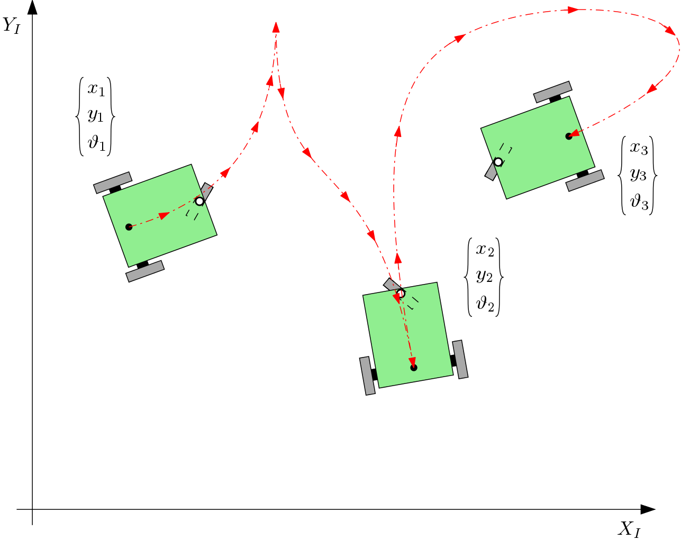
Example
$\dim{W}=3$ !
Indeed, the robot can reach every possible triplet ${\left\{x,y,θ\right\}}^{T}∈C$
$$δ_{M}=1+1=2$$

Slide 32
DDOF
Differentiable Degrees of Freedom
  Given by the kinematic constraints
  (admissible velocity space)
  Example:
  Always:
    $$n\left(DDOF\right)=δ_{m}$$
    $$n\left(DDOF\right)≤δ_{m}≤n\left(DOF\right)$$

Slide 33
Mobile Robots
Part I.07
a.a. 2020-2021
Robotics

Slide 34
Non-Holonomic constraints
Mobile Robotics

Slide 35
Non-holonomic Constraints
Holonomic constraints
  Must have the following form:
  $$h\left(x_{1},…,x_{N},t\right)=0$$
  OR integrated in the same form.
  Constraint on positional coordinates
Non-holonomic constraints
  Constraints acting on velocities $\left({\dot{x}}_{1},…,{\dot{x}}_{N}\right)$
  Only if not integrable $⇒$ Not expressible in the previous form

Slide 36
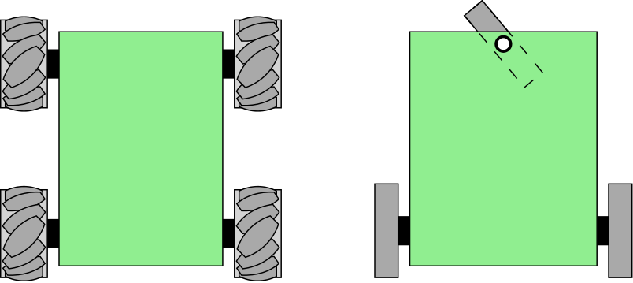
Non-holonomic Constraints
Any wheeled vehicle is subject to kinematic constraints that reduce in general its local mobility, while leaving intact the possibility of reaching arbitrary configurations by appropriate maneuvers.
Example:
  It is impossible to move a car instantaneously in the direction orthogonal to the forward direction.
  The same car can perform a S-manoeuver: the result is a displacement in the orthogonal direction!

Slide 37
Holonomic/Non-holonomic constraints
P
Pure rolling, no slip
  $x=x_{P}$ is holonomic
    Constraint on a coordinate ($x$)
    In form: $x−x_{p}=h\left(x\right)=0$
  $v_{t}=0$ is non-holonomic
    Constraint on velocity
    Not ascribable to the
    form: $h\left(x_{i}\right)=0$
  $⇒$ The system is non-holonomic
$$P$$
$$\hat{z}$$
$$\hat{x}$$
$$\hat{y}$$
$$x_{P}$$
$$\dot{ψ }$$
$$v_{t}=0$$
$$v$$

Slide 38
Holonomic Constraints
Given configuration $q$
Holonomic constraints
  (Positional constraints)
  $$h_{i}\left(q\right)=0, i=1,…,k<n$$
  reduce the configuration space $C$ to $n−k$
  $k$ is the number of constraints
  $n$ is the number of coordinates
Example: Point in space vs. point in plane

Slide 39
Non-holonomic Constraints
Dependent both on position and velocity!
Kinematic constraints $a_{i}\left(q,\dot{q}\right)=0$
  In Pfaffian form (linear on velocity):
  $a_{i}^{T}\left(q\right)\dot{q}=0$ or $A^{T}\left(q\right)\dot{q}=0$
$∃ k$ holonomous constr. $⇒ ∃ k$ kinematic constr.
  $$\frac{dh_{i}\left(q\right)}{dt}=\frac{∂h_{i}\left(q\right)}{∂q}\dot{q}=0$$
$∃ k$ kinematic constr
$⇏$ $∃ k$ holonomous constr.
$k$ holonomic constraints!
$k$ non-holonomic constraints!

Slide 40
Non-holonomic Constraints
  Consider a Pfaffian constraint: $a_{i}^{T}\left(q\right)\dot{q}=0$
  If holonomous, integration is possible:
    $$\frac{∂h\left(q\right)}{∂q}=γ\left(q\right)a^{T}\left(q\right), γ\left(q\right)≠0$$
    $$\int{\frac{∂h\left(q\right)}{∂q}dq}=\int{γ\left(q\right)a^{T}\left(q\right)dq}=h\left(q\right)−c=0 ⇒ h^{′}\left(q\right)=0$$
    $⇒$ There is loss of accessibility of $C$. Motion is confined in a tangent surface $T_{Q}$ of $C$ of value $c:$
    $$\dim\left(T_{Q}\right)=n−k$$
Linear!
Note: the proof of this is a little too involved for us: it revolves around the Frobenius Theorem and Lie brackets theory.

Slide 41
Non-holonomic Constraints
To summarize:
Non-holonomic constraints are representable only as constraints on velocities and not on positions.
Whatever kinematic constraint that is representable as a positional constraint is holonomic.

Slide 42
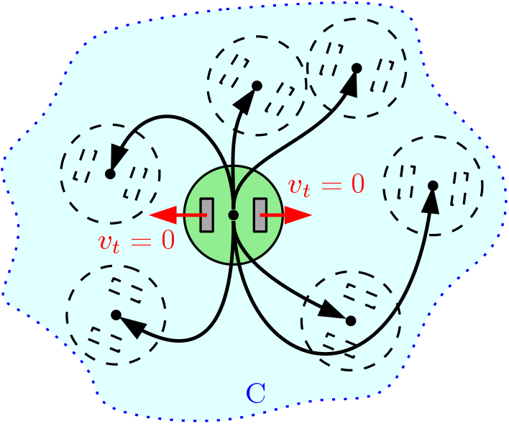
Non-holonomic Constraints
If non-holonomous
  Velocities $\dot{q}$ are constrained in a vector subspace of $C$
  Since $a_{i}^{T}\left(q\right)\dot{q}=0$ is non-integrable, there is no limitation for $q$ (position) in $C$.
Non-holonomic systems always
have complete accessibility of the
entire configuration space $C$.

Slide 43
Model derivation
The Pfaffian constraint $a_{i}^{T}\left(q\right)\dot{q}=0$defines $∀q∈C$
  $$\dot{q}∈\ker{A^{T}\left(q\right)}≡\left\{{\dot{q}}^{∗}:A^{T}\left(q^{∗}\right)\dot{q}=0\right\}$$
If $\left\{g_{1}\left(q\right),…,g_{m}\left(q\right)\right\}$ is a base of$A^{T}\left(q\right)$, then the possible instantaneous trajectories (admissible velocities) are solutions of:
  $$\dot{q}=\sum_{j=1 }^{m}{g_{j}\left(q\right)u_{j}}=G\left(q\right)u, m=n−k$$
  where $q∈ℝ^{n}$ configuration or state vector, $u∈ℝ^{n}$ input vector
The base $g_{1},…,g_{m}$ is arbitrary, usually such as that $u_{j}$ are physical quantities (which are controllable!!)
  Since $g$ is a base, $\dot{q}$ can be whatever linear combination using $\left\{u_{j}\right\}$ as coefficients
  That is:
  $$\dot{q}=G\left(q\right)u=g_{1}\left(q\right)u_{1}+…+g_{m}\left(q\right)u_{m}$$

Slide 44
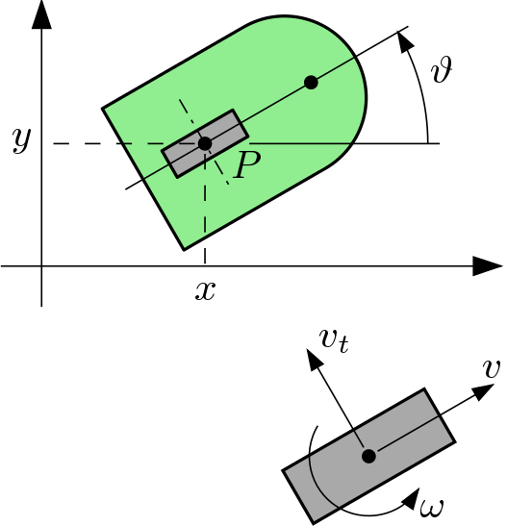

Kinematics: unicycle
The wheel can roll and rotate along the vertical axis
Configuration:
  $$q={\left[ x y θ \right]}^{T}$$
Pure roll constraint:
  $v_{t}=0$
  $$=\dot{x}\cos{θ}−\dot{y}\sin{θ}−\dot{θ}l\cos{β}$$
  $$=\left[\cos{θ},−\sin{θ, 0}\right]\dot{q}=0$$
If $g_{1}$ and $g_{2}$ are bases of $\ker{A^{T}\left(q\right)}$
  $G\left(q\right)=\left[{ g}_{1}\left(q\right){ g}_{2}\left(q\right)\right]=\left[\begin{matrix}\cos{θ} & 0 \\ −\sin{θ} & 0 \\ 0 & 1\end{matrix}\right]$
Model:
  $$\dot{q}=\left\{\begin{aligned}\dot{x} \\ \dot{y} \\ \dot{θ}\end{aligned}\right\}=G\left(q\right)u=\left[\begin{matrix}\cos{θ} & 0 \\ −\sin{θ} & 0 \\ 0 & 1\end{matrix}\right]\left\{\begin{aligned}u_{1} \\ u_{2}\end{aligned}\right\}==\left[\begin{matrix}\cos{θ} & 0 \\ −\sin{θ} & 0 \\ 0 & 1\end{matrix}\right]\left\{\begin{aligned}v \\ ω\end{aligned}\right\}$$
$$X_{R}$$
$$Y_{R}$$
${\dot{ξ}}_{R}=R\left(θ\right){\dot{ξ}}_{I}$ !
$l=0$ !

Slide 45
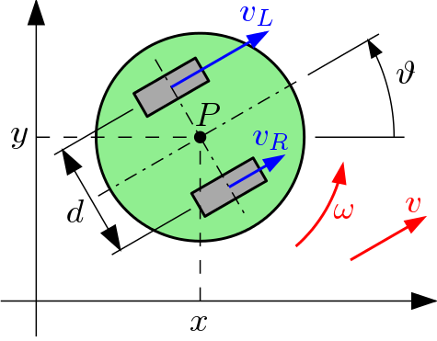
Kinematics: differential steering
$$X_{R}$$
$$Y_{R}$$
Similar model to the unicycle
  $$\left\{\begin{aligned}v_{Lt}=0 \\ v_{Rt}=0\end{aligned}\right.⟹\dot{q}=\left[\begin{matrix}\cos{θ} & 0 \\ \sin{θ} & 0 \\ 0 & 1\end{matrix}\right]\left\{\begin{aligned}v \\ \\ ω\end{aligned}\right\}$$
Special case:
  Input vector: ${u=\left[v_{L} v_{R}\right]}^{T}$
  Relation to ${\left[v,ω\right]}^{T}$: $\begin{matrix}v=\frac{v_{L}+v_{R}}{2} & , & ω=\frac{v_{R}−v_{L}}{d}\end{matrix}$
  Model: $\dot{q}=\left\{\begin{aligned}\dot{x} \\ \dot{y} \\ \dot{θ}\end{aligned}\right\}=\left[\begin{matrix}1/2cos{θ} & 1/2cos{θ} \\ 1/2{\sin{θ}} & 1/2sin{θ} \\ 1/d & −1/d\end{matrix}\right]\left\{\begin{aligned}v_{R} \\ \\ v_{L}\end{aligned}\right\}$

Slide 46
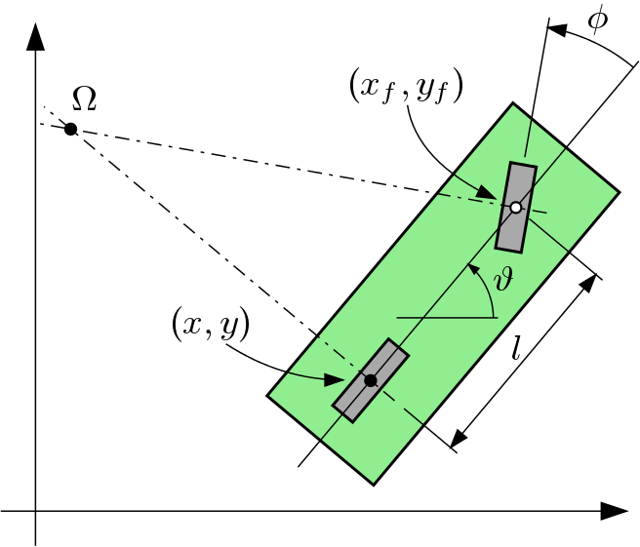
Kinematics: bicycle Part 1
$q={\left[x y θ φ\right]}^{T}$
Two constraints:
  Rear: $\dot{x}\sin{θ}−\dot{y}\cos{θ}=0$
  Front: $\dot{x_{f}}\sin\left(θ+φ\right)$
  $−\dot{y_{f}}\cos\left(θ+φ\right)=0$
Rigid body constraint:
  $$\begin{matrix}x_{f}=x+l\cos{θ} \\ y_{f}=y+l\sin{θ}\end{matrix}$$
Pfaffian constraint matrix:
  $$A^{T}\left(q\right)=\left[\begin{matrix}\sin{θ} & −\cos{θ} & 0 & 0 \\ \sin\left(θ+φ\right) & −\cos\left(θ+φ\right) & −l\cos\left(φ\right) & 0\end{matrix}\right]$$

Slide 47
Kinematics: bicycle Part 2
  $$A^{T}\left(q\right)=\left[\begin{matrix}\sin{θ} & −\cos{θ} & 0 & 0 \\ \sin\left(θ+φ\right) & −\cos\left(θ+φ\right) & −l\cos\left(φ\right) & 0\end{matrix}\right]$$
Since $dim\left(\ker\left(A^{T}\left(q\right)\right)\right)=n−k=2$ we can define 2 inputs $u_{1}$ and $u_{2}$
  $$\dot{q}=\left[\begin{aligned}\dot{x} \\ \dot{y} \\ \dot{θ} \\ \dot{φ}\end{aligned}\right]=\left[\begin{aligned}\cos{θ}cos⁡φ \\ \sin{θ}cosφ \\ \left(\sin{φ}\right)/l \\ 0\end{aligned}\right]u_{1}+\left[\begin{aligned}0 \\ 0 \\ 0 \\ 1\end{aligned}\right]u_{2}$$
We can choose $u_{2}=ω$ steering speed
What about $u_{1}$?
  Front wheel drive:$u_{1}=v$
  Rear wheel drive:$u_{1}=\frac{v}{\cos{φ}}$
  $⇒$ $\dot{q}=\left[\begin{aligned}\dot{x} \\ \dot{y} \\ \dot{θ} \\ \dot{φ}\end{aligned}\right]=\left[\begin{aligned}\cos{θ} \\ \sin{θ} \\ \left(\tan{φ}\right)/l \\ 0\end{aligned}\right]v+\left[\begin{aligned}0 \\ 0 \\ 0 \\ 1\end{aligned}\right]ω$

Slide 48
Control
Mobile Robotics

Slide 49
Control problem
Our kinematics model gives us:
$${\dot{ξ}}_{I}=R^{−1}\left(θ\right){\left[\begin{matrix} \\ \\ \end{matrix}\begin{aligned}J_{1}\left(β_{s}\right) \\ C_{1}\left(β_{s}\right)\end{aligned}\begin{matrix} \\ \\ \end{matrix}\right]}^{−1}\left[\begin{matrix} \\ \\ \end{matrix}\begin{aligned}J_{2}\dot{φ} \\ 0\end{aligned}\begin{matrix} \\ \\ \end{matrix}\right]$$
We need to control $\dot{φ}$ in order to produce a motion vector ${\dot{ξ}}_{I}$ in the global frame.

Slide 50
Control problem
Controlling $\dot{φ}$ means controlling for example:
  The rotational speed of the wheels $v_{L}$ and $v_{R}$
$$X_{R}$$
$$Y_{R}$$

Slide 51
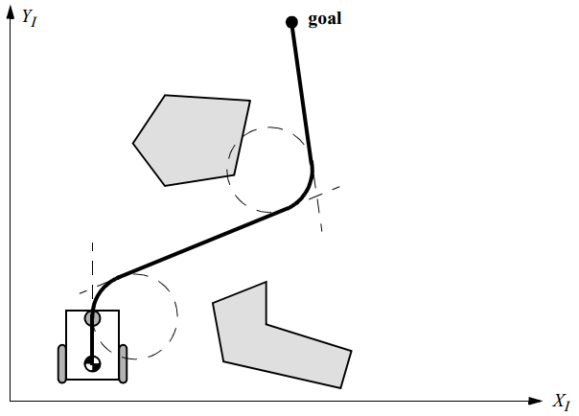
Precomputed trajectory tracking
Division of the trajectory in segments of precise nature:
  Lines,
  Arcs, etc.
Advantages
  Easy to control, because we know the type of trajectory and how to apply the vector $\dot{φ}$
Disadvantages
  Unknown environment,
  Transitions between segments not smooth
  No adaptability to dynamic change

Slide 52
Heading control
Strictly bound to the kinematics

Slide 53

Control basics
In general, to define a control system for a mobile robot we need:
  For $δ_{m}=1,2$
    Control of heading
    Control of linear forward speed
  For $δ_{m}=3$
    Control of rate of rotation
    Control of linear motion

Slide 54
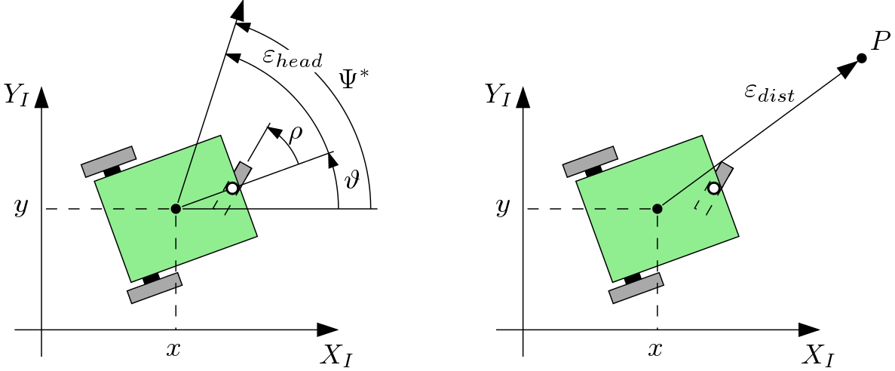
Control basics

Slide 55
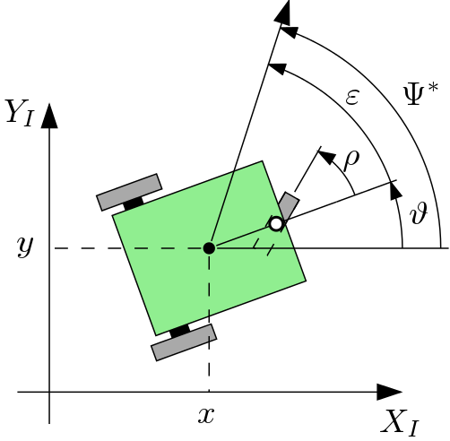
Heading control: bicycle Part 1
Variables
  Current heading: $θ$
  Desired heading: $Ψ^{∗}$
  Error: $ε=Ψ^{∗}−θ$
  Controlled variable: $\dot{ρ}$
Linear Proportional-Derivative controller
  $\dot{ρ}=k_{p}\left(ε\right)+k_{d}\left(\frac{dε}{dt}\right)$
  Where $k_{p}$ is the proportional gain and $k_{d}$ is the derivative gain.

Slide 56
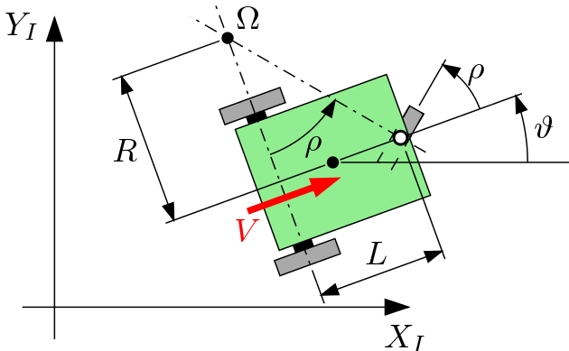
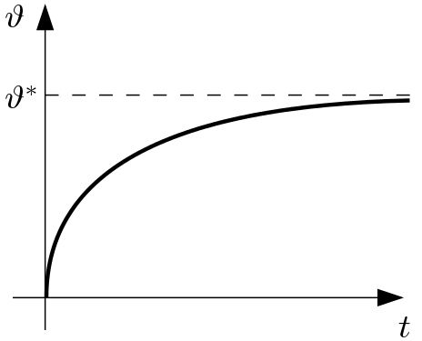
Heading control: bicycle Part 2
Basic geometry
  Note that: $\frac{L}{R}=\tan{ρ}$
  and: $V=R\dot{θ}$
  Thus: $\dot{θ}=\frac{V}{L}\tan{ρ}$
If we assume that: $\tan{ρ}≈ρ$
  $$\dot{θ}=\frac{V}{L}ρ ⇒ \dot{θ}=\frac{V}{L}k\left(ε\right)$$
Exponential heading correction $→$
Speed of convergence is determined by a time constant
  $$T_{c}=\frac{L}{kV}$$
Linear control

Slide 57
Forward speed controller
We can define the PID forward speed controller:
$$v=K_{p}\left(ε_{dist}\right)+K_{d}\left(\frac{δε_{dist}}{δt}\right)+K_{i}\int_{o}^{t}{ε_{dist}}dt$$
With the coefficients $K_{p}$, $K_{d}$ and $K_{i}$ for proportional, derivative and integral gains.

Slide 58
Heading controller
We can define the PID heading controller:
$$v=K_{p}\left(ε_{head}\right)+K_{d}\left(\frac{δε_{head}}{δt}\right)+K_{i}\int_{o}^{t}{ε_{head}}dt$$
With the coefficients $K_{p}$, $K_{d}$ and $K_{i}$ for proportional, derivative and integral gains.

Slide 59
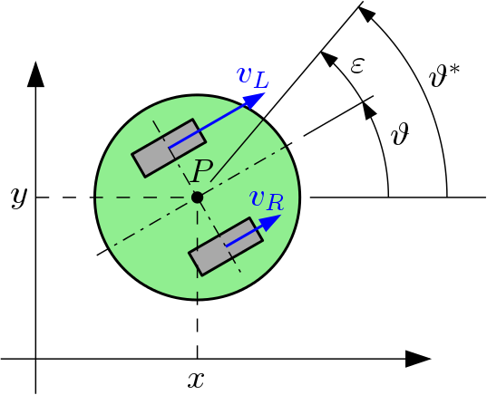
Heading control: differential steering Part 1
Turn-then-travel
  Step 1: rotation
    $$\dot{θ}=\frac{v_{L}−v_{R}}{d}$$
  Step 2: forward motion
    $$\left[\begin{aligned}\dot{x} \\ \\ \dot{y}\end{aligned}\right]=\left[\begin{matrix}\frac{1}{2}cos{θ^{∗}} & \frac{1}{2}cos{θ^{∗}} \\ \frac{1}{2}{\sin{θ^{∗}}} & \frac{1}{2}sin{θ^{∗}}\end{matrix}\right]\left\{\begin{aligned}v_{R} \\ \\ v_{L}\end{aligned}\right\}$$
Turn-while-traveling
  continues...

Slide 60
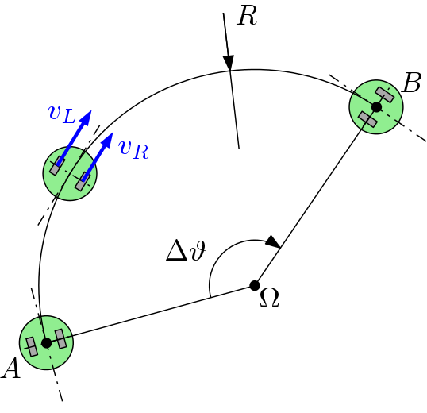
Heading control: differential steering Part 2
Turn-while-traveling
    $$\left\{\begin{aligned}ω=\frac{v_{L}−v_{R}}{d} \\ v=\frac{v_{L}+v_{R}}{2}\end{aligned}\right.$$
  Since $v=Rω$ and assuming that $v_{L}>v_{R}$ (Right turn)
    $$v_{R}=v_{L}\frac{2R−d}{2R+d}$$
  Maximize overall speed by imposing $v_{L}=v_{max}$ (saturation)
Desired direction
$$ω$$

Slide 61
Exercises
Mobile robot control

Slide 62
Bicycle robot model: heading control (Proportional-Derivative controller)

Slide 63
Differential drive model: heading control (Proportional-Derivative controller)

Slide 64
Bicycle model: heading control (Proportional-Derivative controller)

