Slide 1
Mobile Robots
Part II.1
a.a. 2020-2021
Robotics and Mechatronics

Slide 2
Sensing
Mobile Robotics

Slide 3
Sensors
Sensors allow measurements of physical quantities
Two kinds:
  Proprioceptive
    Measurement of quantities pertaining to the “self”, i.e. the robot,
    Example: joint positions, wheel speed/angular position, …
  Exteroceptive
    Measurement of quantities related to the environment where the robot lives.
    Example: position of the rover, position of obstacles, temperature, illumination, …

Slide 4
Proprioceptive sensors
Perception of the internal state of the robot
  Position of components
    Pose of the links
    Angular position of the wheels
  Speed
  Acceleration

Slide 5
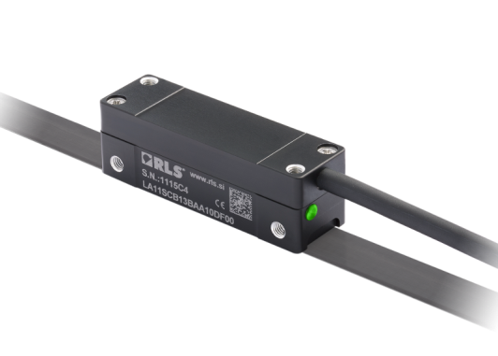
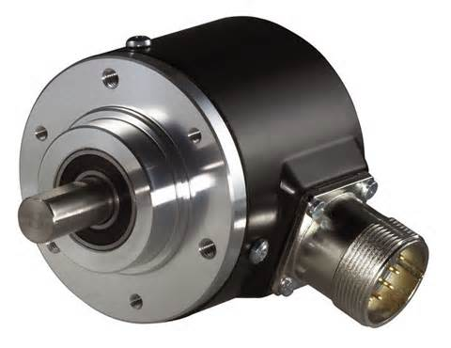
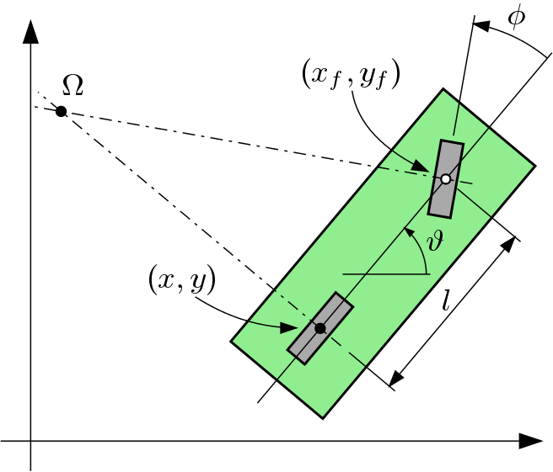
Proprioceptive sensors
Position sensors
  They provide a signal proportional to the displacement measured between a part and a reference position
  Linear
    Linear potentiometers, linear encoders
  Angular
    Potentiometers, rotary encoders, resolvers
Example of measurements:
  Steering angle ($φ$ in the figure $→$)
  Wheel rotation speed

Slide 6
Proprioceptive sensors
Speed sensors
  Generally derived from position sensors’ readings
Acceleration sensors
  Measure of linear acceleration using inertial forces
  Micro Electro-Mechanical Systems (MEMS)
    Principle:
Measurable strain
$$\ddot{z}$$
Strain-gauge
$$m\ddot{z}$$
Test Mass
Cantilever

Slide 7
Proprioceptive sensors
Speed sensors
  Generally derived from position sensors’ readings
Acceleration sensors
  Measure of linear acceleration using inertial forces
  Micro Electro-Mechanical Systems (MEMS)
    Principle:
Measurable strain
$$\ddot{z}$$
Strain-gauge
$$m\ddot{z}$$
Test Mass
Cantilever

Slide 8
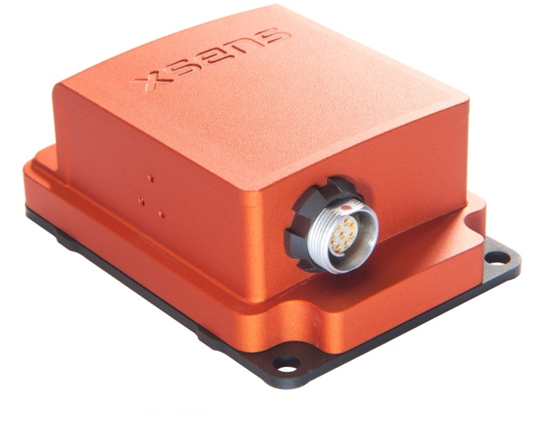
Proprioceptive sensors
Inertial Measurement Unit (IMU)
  Array of accelerometers used to measure the complete inertial configuration of a system
    3 accelerometers for accelerations $\left(\ddot{x},\ddot{y},\ddot{z}\right)$
    3 gyroscopes for rotation speed around the axes $\left(x,y,z\right)$
  NOTE: If used for measuring the gravity vector, it’s considered an exteroceptive sensor.

Slide 9
Exteroceptive sensors
Proximity sensors
  Detection of obstacles/hazards
  Examples:
    Contact/collision sensors
    Infrared reflection sensor
    Magnetic sensor
Distance sensors
  Examples:
    Ultrasound
    Laser scanner (2D or 3D)
    Rotating laser scanner (LiDAR)
    Vision systems
Force sensors
  Load sensing, overload detection
  Examples: load cell, strain gauge
Environmental sensors
  Temperature, humidity, illumination, radiation, …

Slide 10
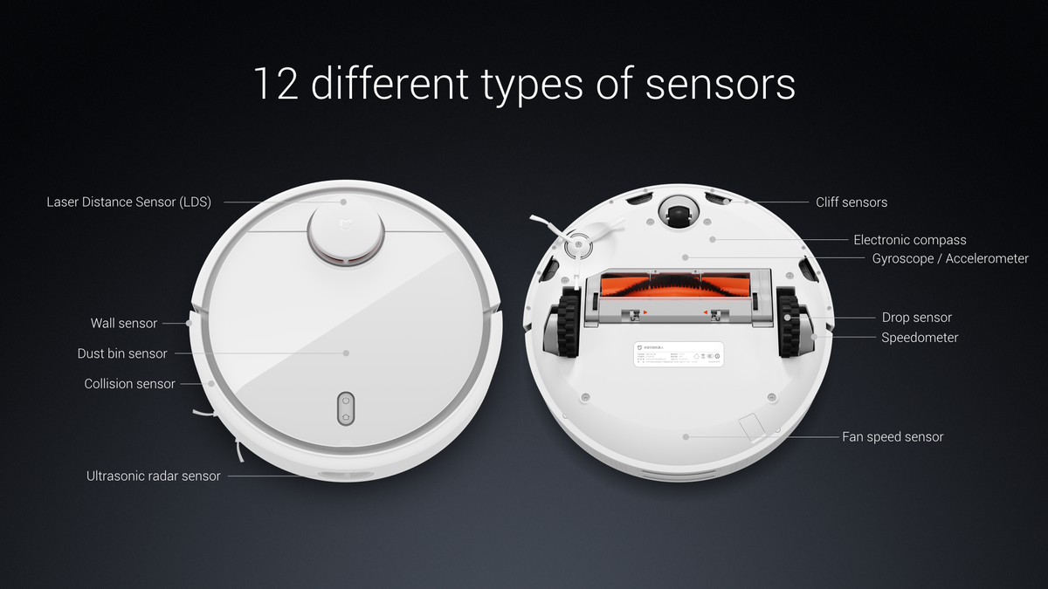
Proximity sensors
Contact/collision sensor
  Bumper in simple mobile robots

Slide 11
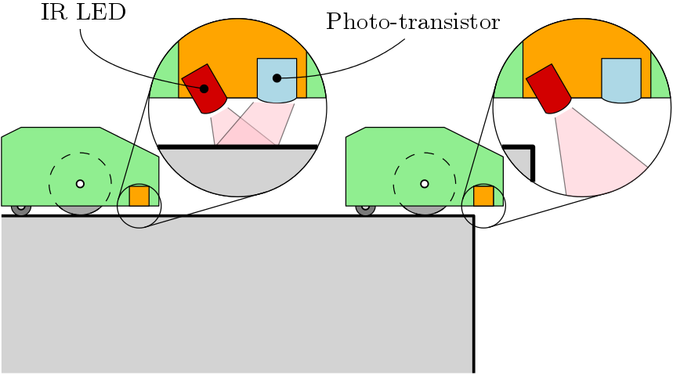
Proximity sensors
Infrared reflection sensor
  Contact-less
  Fail-safe
  Very limited range (4-40 cm or 20-150 cm)
  Reflection is impaired for some materials

❒

Slide 12
Distance sensors
Most widely used in modern mobile robotics
Crucial for mapping and navigation
  Much larger range (100s of meters or more)
  Enables position determination techniques
  Motion and path planning can be done earlier
  Better hazard and obstacle avoidance

Slide 13
Distance sensors
Operating principles:
  Range-finding
    Evaluation of distance through emission-reflection and collection of a signal (sound, light, radar, ...)
    Time of flight (TOF)
    Interferometry
  Scanning
    Multidirectional range-finding
    2D or 3D mapping of objects/environment
  Vision systems
    Image processing/analysis
    Stereoscopy

Slide 14
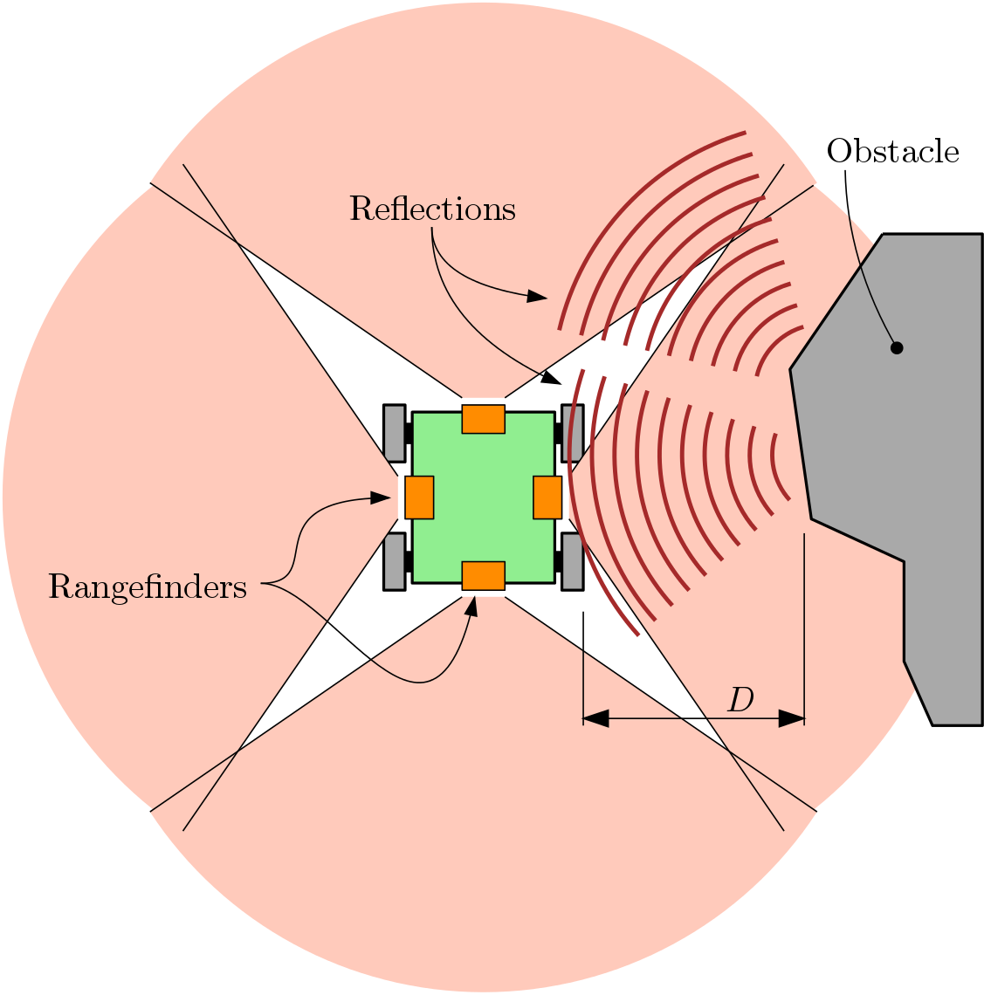
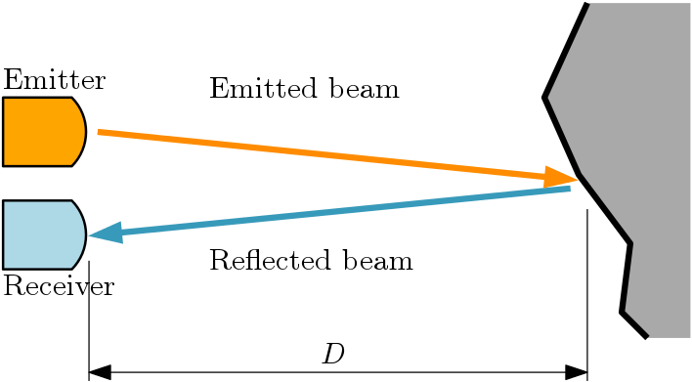
Distance sensing
Range finding
  Using the Time-Of-Flight:
    $$D=\frac{1}{2}t_{TOF}v_{signal}$$

Slide 15
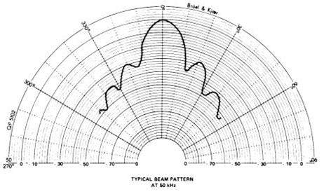
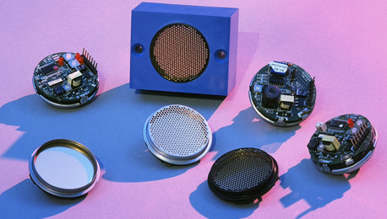
Distance sensing
Ultrasound
  Use of wave propagation and reflection (20-50Hz)
  Distance is proportional to Time-of-flight (TOF) along the measurement path
    $$D=\frac{1}{2}t_{TOF}v_{sound}$$
    Example:
      $$D=1 m$$
      $$v_{sound}=344 m/s$$
      $$t_{TOF}≈5.82 ms$$
  Range is limited
    $>0.5 m$ (echo)
    $<6.5 m$ (angular dispersion $f\left(D^{2}\right)$)
  Low accuracy because of beam
  pattern spread
Beam pattern
Emitter

Slide 16
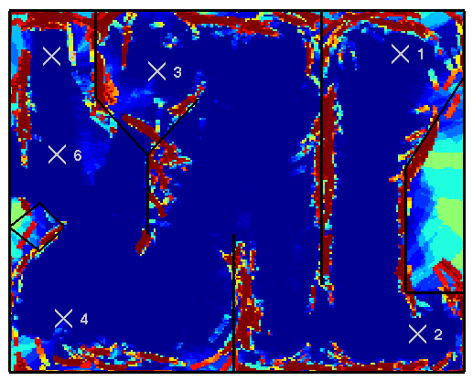
Distance sensing
Mapping with ultrasound sensor

Slide 17
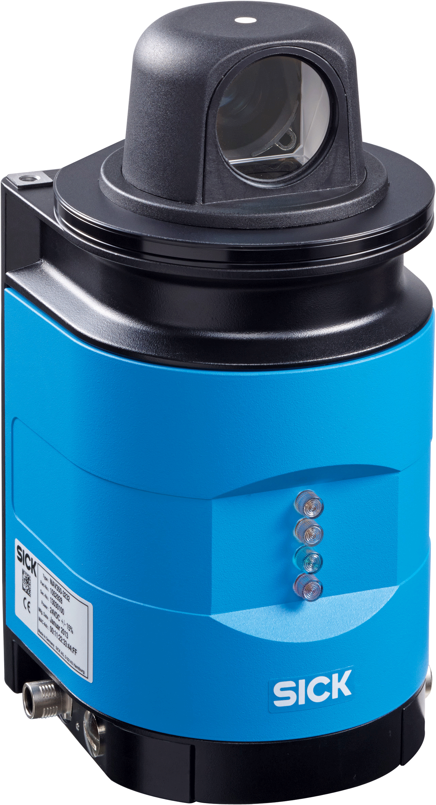
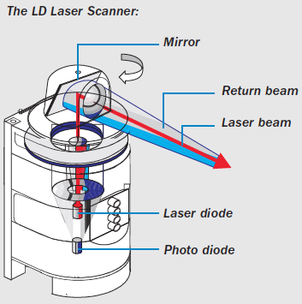
Distance sensing
Laser scanner
  Fixed or rotating (LiDAR - Light radar)
  Scanning:
    Set of successive range measurements of the environment
    Range-finding with a narrow beam of light
    The result is a map of the environment
  2D or 3D
  Resolution $10 mm$, range $100 m$ approximately
Sick S300
2D laser scanner

Slide 18
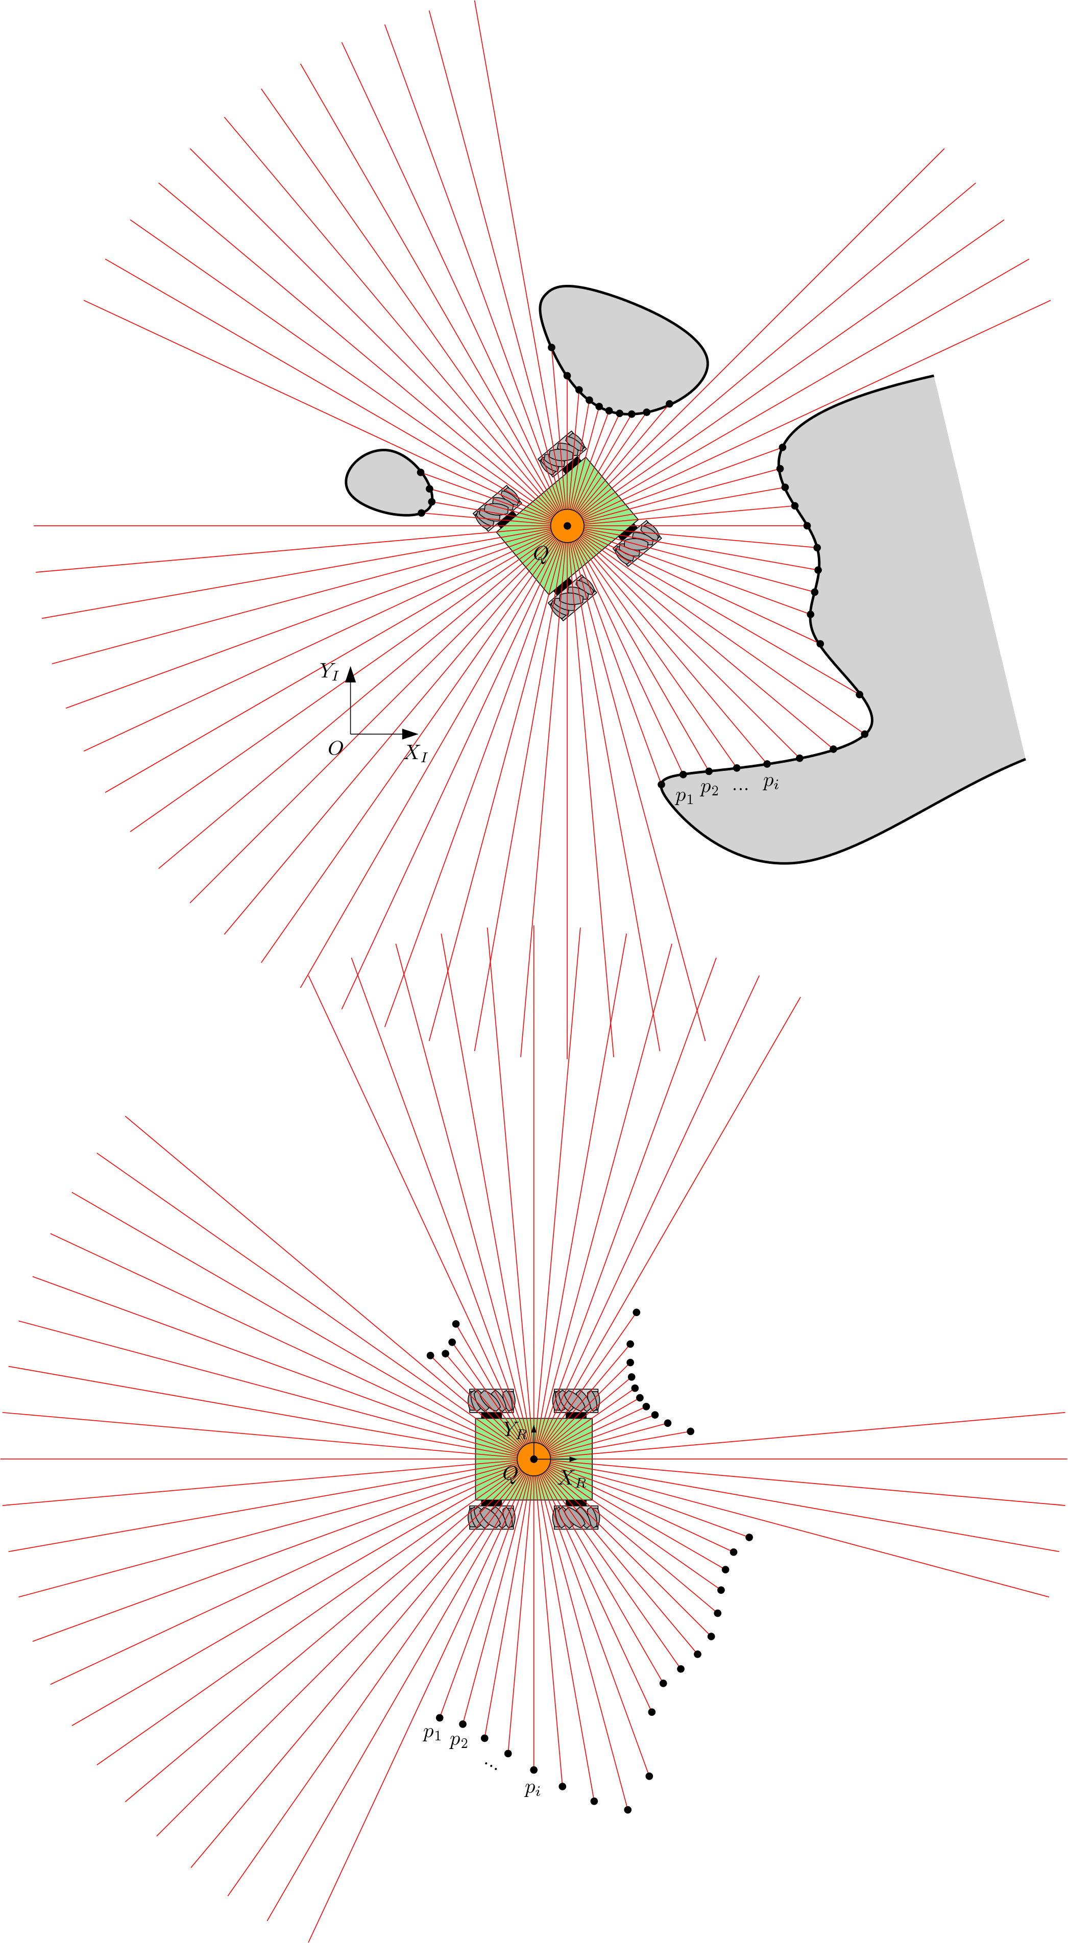
Scanning: mapping principle

Slide 19
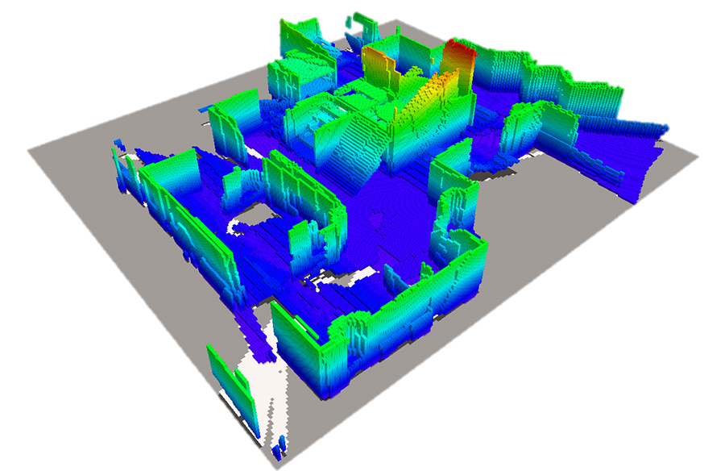
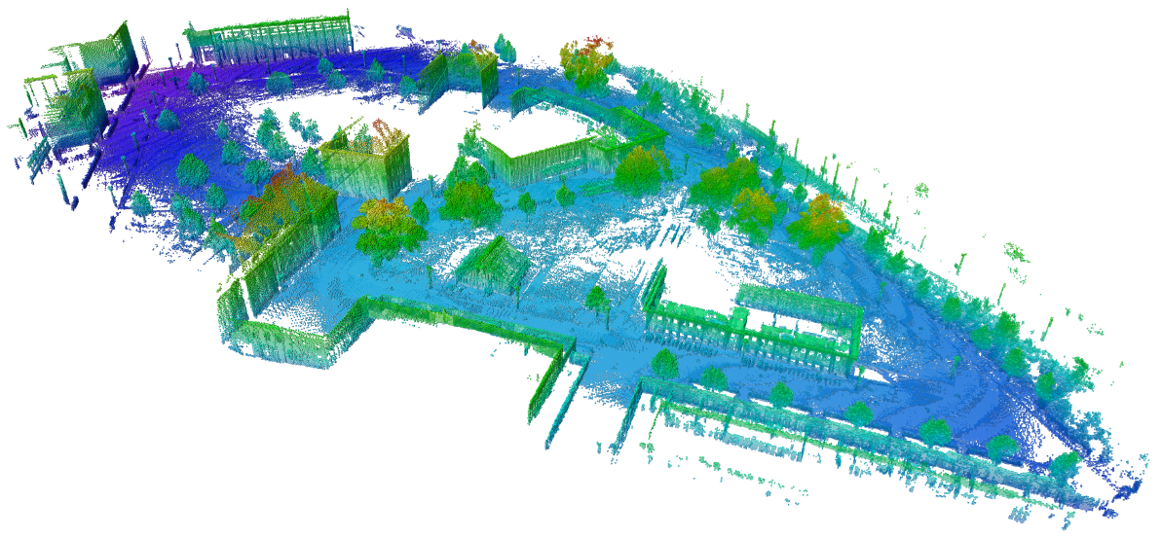
Distance sensing
Mapping with LiDAR
Credits: http://rrt.fh-wels.at/sites/robocup/mapping.html
Credits: http://octomap.github.io/

Slide 20
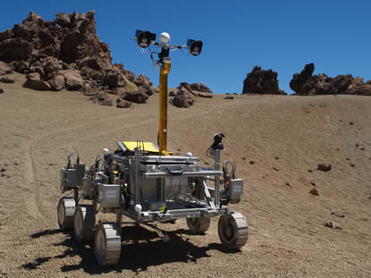
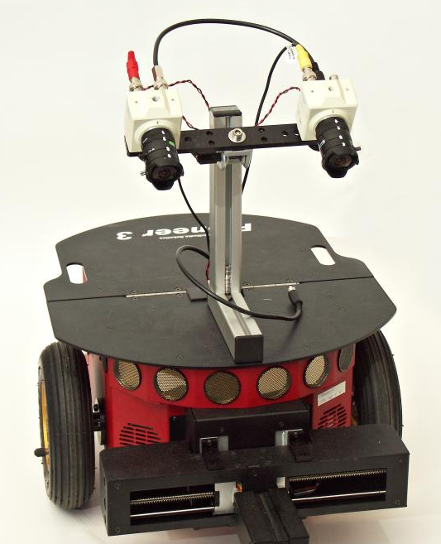
Distance sensing
Vision systems
  Stereo vision
    Depth perception using 2 or more cameras
    Allows 3D mapping of the environment
    Sturdy compared to LiDAR
    Drawbacks:
      Computationally intensive
      Less accurate than LiDAR

Slide 21
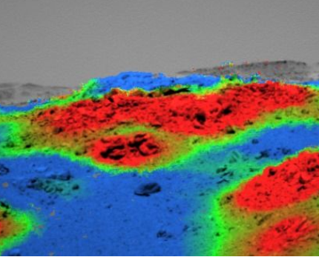
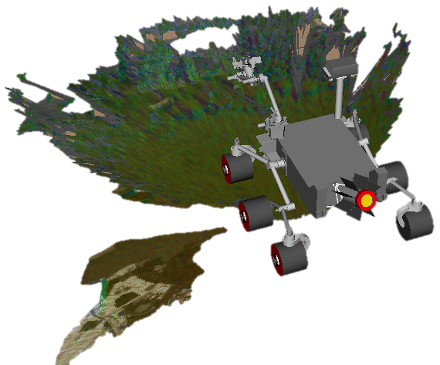
Distance sensing
Mapping with vision systems
C. Laeger et al., Remote image analysis for Mars Exploration
Rover mobility and manipulation operations

