Slide 1
The Science of Macroeconomics
Macroeconomics
N. Gregory Mankiw
© 2019 Worth Publishers, all rights reserved
Notes:
TO THE INSTRUCTOR:
Many slides contain “notes” in this area of your screen. They are visible only to you and will not display during your classroom presentations. I use these notes to provide additional information you may find helpful.
Depending on the slide, this information may include data sources and teaching suggestions.
Many slides contain data. These notes usually provide the source—often the exact URL—in case you wish to visit the source and update the data to the latest available before teaching.

Slide 2
Important issues in macroeconomics Part 1
Macroeconomics—the study of the economy as a whole—addresses many topical issues, such as:
What causes recessions? What is “government stimulus,” and why might it help?
How can problems in the housing market spread to the rest of the economy?
What is the government budget deficit? How does it affect workers, consumers, businesses, and taxpayers?
Notes:
1
This slide and the next contain a list of some topical issues that macroeconomics can help students understand. Feel free to substitute others as new issues emerge.

Slide 3
Important issues in macroeconomics Part 2
Macroeconomics—the study of the economy as a whole—addresses many topical issues, such as:
Why does the cost of living keep rising?
Why are so many countries poor? What policies might help them grow out of poverty?
What is the trade deficit? How does it affect a country’s well-being?
Notes:
2

Slide 4
U.S. real GDP per capita (2009 dollars)
Notes:
Two main features of these data:
Over the long run, there has been a clear upward trend in living standards.
In the short run, there have been fluctuations.
Source: Same as the textbook.

Slide 5
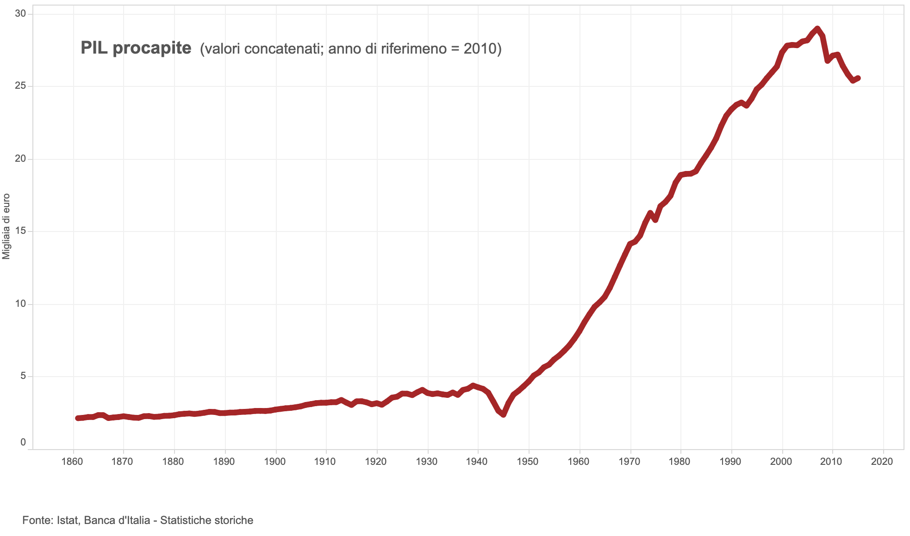
ITALY real GDP per capita (2010 Euro)
Notes:
Two main features of these data:
Over the long run, there has been a clear upward trend in living standards.
In the short run, there have been fluctuations.
Source: Same as the textbook.

Slide 6
U.S. Inflation Rate
Notes:
Source: Same as the textbook.

Slide 7
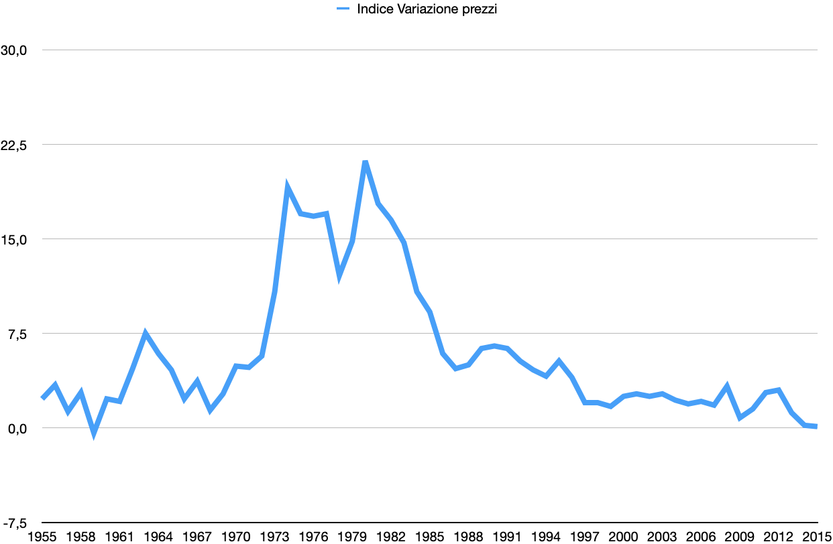
Tasso Inflazione, Italia - 1955-2015
Fonte: ISTAT

Slide 8
U.S. unemployment rate (% of labor force)
Notes:
Interesting features:
The unemployment rate is never zero.
The most obvious feature is the 25% unemployment rate during the Great Depression.
Also quite impressive is the huge drop coinciding with World War II.
Unemployment often responds to shocks with a lag. For example, after each of the oil shocks (1973, 1979), it took 1 or 2 years for unemployment to shoot up.
Although the most recent recession officially ended in June 2009, the unemployment rate remained abnormally high through the end of 2011.
Source: Same as the textbook.

Slide 9
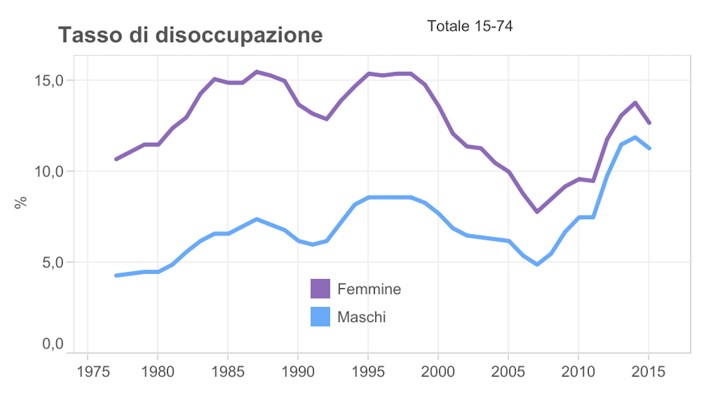
U.S. unemployment rate (% of labor force)
Fonte: ISTAT

Slide 10
Economic models
…are simplified versions of more complex realities
with irrelevant details stripped away
…are used to:
show relationships between variables
explain the economy’s behavior
devise policies to improve economic performance
Notes:
9

Slide 11
Example of a model: Supply and demand for new cars
Shows how various events affect the price and quantity of cars
Assumes the market is competitive: each buyer and seller is too small to affect the market price
Variables
Q^{d} = quantity of cars that buyers demand
Q^{s} = quantity of cars that producers supply
P = price of new cars
Y = aggregate income
P_{s} = price of steel (an input)
Notes:
10
Students know the auto market is not competitive. However, if all we want to know is how an increase in the price of steel or a fall in consumer income affects the price and quantity of autos, then it’s fine to use this model.
In general, making unrealistic assumptions is okay, even desirable, if they simplify the analysis without affecting the validity of the results.

Slide 12
The demand for cars
Demand equation: Q ^{d} = D (P, Y )
Shows that the quantity of cars consumers demand is related to the price of cars and aggregate income
Notes:
11

Slide 13
Digression: Functional notation
General functional notation shows only that the variables are related.
A specific functional form shows the precise quantitative relationship.
Example: D (P, Y ) = 60 – 10P + 2Y
Notes:
12
We often aren’t concerned with the exact quantitative relationship between variables, so we often use the general functional notation.

Slide 14
The market for cars: Demand
Demand equation:
Q ^{d} = D (P, Y )
The demand curve shows the relationship between quantity demanded and price, other things equal.
Notes:
13

Slide 15
The market for cars: Supply
Supply equation:
Q ^{s} = S (P, P_{S} )
The supply curve shows the relationship between quantity supplied and price, other things equal.
Notes:
14
P_{S} stands for the price of steel, an input in cars.

Slide 16
The market for cars: Equilibrium
Notes:
15
You may wish to remind students that prices move to clear the market (that is, price moves to the price for which the quantity supplied is equal to the quantity demanded).
For example, if the price is above the equilibrium price, then Quantity Supplied > Quantity Demanded, or there is a surplus. Firms then decrease their prices in order to make sales. The price falls until it reaches the equilibrium price.

Slide 17
The effects of an increase in income
Demand equation:
Q ^{d} = D (P, Y )
An increase in income increases the quantity of cars consumers demand at each price…
…which increases the equilibrium price and quantity.

Slide 18
The effects of a steel price increase
Supply equation:
Q ^{s} = S (P, P_{S} )
An increase in P_{s} reduces the quantity of cars producers supply at each price…
…which increases the market price and reduces the quantity.

Slide 19
Endogenous vs. exogenous variables
The values of endogenous variables are determined in the model.
The values of exogenous variables are determined outside the model: the model takes their values and behaviors as given.
In the model of supply and demand for cars,
endogenous variables: P, Q ^{d}, Q ^{s}
exogenous variables: Y, P_{s}
Notes:
18

Slide 20
NOW YOU TRY Supply and demand
Write down demand and supply equations for smartphones, include two exogenous variables in each equation.
Draw a supply–demand graph for smartphones and identify the equilibrium price and quantity.
Use your graph to show how a change in one of your exogenous variables affects the model’s endogenous variables.
Notes:
The PowerPoint slides for most chapters in this book contain one or more “Now You Try” slides. These slides contain questions or problems that serve to break up a lecture, give students an opportunity to apply what you’re teaching them, and give you a sense of whether they are “getting it.”
In the supply–demand model for smartphones:
Endogenous variables:
price of smartphones
quantity of smartphones
Exogenous variables:
consumer income
price of data and voice service (a complement)
price of landline phones and landline phone service (a substitute)
technology

Slide 21
The use of multiple models, part 1
No single model can address all the issues we care about.
For example, our supply–demand model of the car market…
can tell us how a fall in aggregate income affects price and quantity of cars
cannot tell us why aggregate income falls
Notes:
20

Slide 22
The use of multiple models, part 2
We will learn different models for studying different issues (e.g., unemployment, inflation, long-run growth).
For each new model, you should keep track of:
its assumptions
which variables are endogenous and which are exogenous
the questions it can help us understand and those it cannot
Notes:
21

Slide 23
Prices: Flexible vs. sticky, part 1
Market clearing: An assumption that prices are flexible and adjust to equate supply and demand.
In the short run, many prices are sticky—adjust sluggishly in response to changes in supply or demand. For example:
many labor contracts fix the nominal wage for a year or longer
many magazine publishers change prices only once every 3 to 4 years
Notes:
22

Slide 24
Prices: Flexible vs. sticky, part 2
The economy’s behavior depends partly on whether prices are sticky or flexible:
If prices are sticky (short run), demand may not equal supply, which explains:
unemployment (excess supply of labor)
why firms cannot always sell all the goods they produce
If prices are flexible (long run), markets clear, and the economy behaves very differently.
Notes:
23

Slide 25
Outline of this book (1 of 2)
Introductory material (Chapters 1, 2)
Classical theory (Chapters 3–7) How the economy works in the long run, when prices are flexible
Growth theory (Chapters 8, 9) The standard of living and its growth rate over the very long run
Business cycle theory (Chapters 10–14) How the economy works in the short run, when prices are sticky
Notes:
24
The portion of the book described on this slide comprises the core material. It is organized around time horizons: the long run (flexible prices), the very long run (growth in capital, the population, and technology itself), and the short run (sticky prices and economic fluctuations).
The next slide continues the outline.

Slide 26
Outline of this book (2 of 2)
Macroeconomic theory (Chapters 15–17) Macroeconomic dynamics, models of consumer behavior, theories of firms’ investment decisions
Macroeconomic policy (Chapters 18–19) Stabilization policy, government debt and deficits, financial crises
Notes:
25
Are you covering Chapter 2 next? The PowerPoint presentation for Chapter 2 includes some in-class exercises to reinforce concepts as they are presented. These exercises also help break up the lecture into smaller pieces. If you’d like to try them, please ask your students to bring calculators to the next class meeting.

Slide 27
CHAPTER SUMMARY, PART 1
Macroeconomics is the study of the economy as a whole, including
growth in incomes
changes in the overall level of prices
the unemployment rate
Macroeconomists attempt to explain the economy and to devise policies to improve its performance.

Slide 28
CHAPTER SUMMARY, PART 2
Economists use different models to examine different issues.
Models with flexible prices describe the economy in the long run; models with sticky prices describe the economy in the short run.
Macroeconomic events and performance arise from many microeconomic transactions, so macroeconomics uses many of the tools of microeconomics.

