Slide 1

National Income: Where it Comes From and Where It Goes
Macroeconomics
N. Gregory Mankiw
© 2019 Worth Publishers, all rights reserved
Notes:
The material in this chapter is the basis of much of the remaining material in this book. The time your students spend mastering this material will pay dividends throughout the semester.
This PowerPoint file contains many in-class exercises to break up the lecture and help students learn the concepts. Depending on your students’ backgrounds, some of these exercises may be too easy. You can hide or delete the corresponding slides to get through the chapter more quickly.

Slide 2
IN THIS CHAPTER, YOU WILL LEARN:
What determines the economy’s total output/income
How the prices of the factors of production are determined
How total income is distributed
What determines the demand for goods and services
How equilibrium in the goods market is achieved

Slide 3
Outline of model (1 of 2)
A closed economy, market-clearing model
Supply side
  factor markets (supply, demand, price)
  determination of output/income
Demand side
  determinants of C, I, and G
Equilibrium
  goods market
  loanable funds market
Notes:
It’s useful for students to keep in mind the big picture as they learn the individual components of the model in the following slides.

Slide 4
Factors of production
K = capital:
tools, machines, and structures used in production
L = labor:
the physical and mental efforts of workers
Notes:
In the simple model of this chapter, we think of capital as plant and equipment. In the real world, capital also includes inventories and residential housing, as discussed in Chapter 2.
Students may have learned in their principles course that “land” or “land and natural resources” is an additional factor of production. In macroeconomics, we mainly focus on labor and capital, though. So, to keep our model simple, we usually omit land as a factor of production, as we can learn a lot about the macroeconomy despite the omission of land.

Slide 5
The production function: Y = F (K , L)
Shows how much output (Y) the economy can produce from K units of capital and L units of labor
Reflects the economy’s level of technology
Exhibits constant returns to scale

Slide 6
Returns to scale: A review
Initially Y₁ = F (K₁ , L₁ )
Scale all inputs by the same factor z:
K₂ = zK₁ and L₂ = zL₁
(example: if z = 1.2, then all inputs are increased by 20%)
What happens to output, Y₂ = F (K₂, L₂ )?
If constant returns to scale, Y₂ = zY₁
If increasing returns to scale, Y₂ > zY₁
If decreasing returns to scale, Y₂ < zY₁
Notes:
This review includes seven slides. If you’d like to shorten this chapter, you might consider skipping a few of these slides.

Slide 7
Returns to scale: Example 1
constant returns to scale for any z > 0

Slide 8
Returns to scale: Example 2
increasing returns to scale for any z > 1

Slide 9
NOW YOU TRY
Returns to scale
Determine whether each of these production functions has constant, decreasing, or increasing returns to scale:
Notes:
To save time, ask half the class to do (a) and the other half to do (b).
To improve learning, pair students up. Ask one student in each pair to do (a) and the other to do (b), and then have each one teach his or her problem to the other.

Slide 10
NOW YOU TRY
Answers, part (a)
constant returns to scale for any z > 0

Slide 11
NOW YOU TRY
Answers, part (b)
constant returns to scale for any z > 0

Slide 12
Assumptions
Technology is fixed.
The economy’s supplies of capital and labor are fixed at:
Notes:
Emphasize that K and L (without bars on top) are variables—they can take on various magnitudes. On the other hand, $\overline{K}$ and $\overline{L}$ are specific values of these variables. Hence, K = $\overline{K}$ means that the variable K equals the specific amount $\overline{K}$.
Regarding the assumptions:
In the chapters on economic growth, we will relax these assumptions: K and L will grow in response to investment and population growth, respectively, and the level of technology will increase over time.

Slide 13
Determining GDP
Output is determined by the fixed factor supplies and the fixed state of technology:
Notes:
Again, emphasize that the notation F($\overline{K}$, $\overline{L}$) means we are evaluating the function at a particular combination of capital and labor. The resulting value of output is called $\overline{Y}$.

Slide 14
The distribution of national income
determined by factor prices, the prices per unit firms pay for the factors of production
  wage = price of L
  rental rate = price of K
Notes:
Recall from Chapter 2 that the value of output equals the value of income. The income is paid to the workers, capital owners, landowners, and so forth. We now explore a simple theory of income distribution.

Slide 15
Notation
W = nominal wage
R = nominal rental rate
P = price of output
W /P = real wage
(measured in units of output)
R /P = real rental rate
Notes:
It might be worthwhile to refresh students’ memory about nominal and real variables.
The nominal wage and rental rate are measured in currency units.
The real wage is measured in units of output.
To see this, suppose W = $10/hour and P = $2 per unit of output.
Then, W/P = ($10/hour) / ($2/unit of output) = 5 units of output per hour of work.
It’s true that the firm is paying the workers in money units, not in units of output. But the real wage is the purchasing power of the wage—the amount of stuff that workers can buy with their wage.

Slide 16
How factor prices are determined
Factor prices are determined by supply and demand in factor markets.
Recall that the supply of each factor is fixed.
What about demand?
Notes:
Since the distribution of income depends on factor prices, we need to see how factor prices are determined.
Each factor’s price is determined by supply and demand in a market for that factor. For instance, supply and demand for labor determine the wage.

Slide 17
Demand for labor
Assume that markets are competitive: each firm takes W, R, and P as given.
Basic idea: A firm hires each unit of labor if the cost does not exceed the benefit.
  cost = real wage
  benefit = marginal product of labor

Slide 18
Marginal product of labor (MPL)
Definition:
The extra output the firm can produce using an additional unit of labor (holding other inputs fixed):
MPL = F (K, L +1) – F (K, L)

Slide 19
NOW YOU TRY
Compute and graph MPL
L | Y | MPL
0 | 0 | n.a.
1 | 10 | ?
2 | 19 | ?
3 | 27 | 8
4 | 34 | ?
5 | 40 | ?
6 | 45 | ?
7 | 49 | ?
8 | 52 | ?
9 | 54 | ?
10 | 55 | ?
Determine MPL at each value of L.
Graph the production function.
Graph the MPL curve with MPL on the vertical axis and L on the horizontal axis.
Notes:
This exercise is a pretty basic review. It’s good for students who have not had principles of economics in a few years and for students whose graphing skills could benefit from some remedial attention. Many instructors could probably hide or omit this slide and the next one from their presentations.

Slide 20
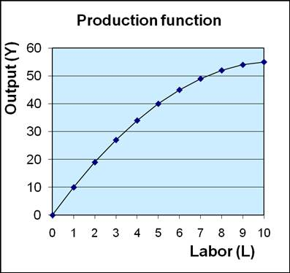
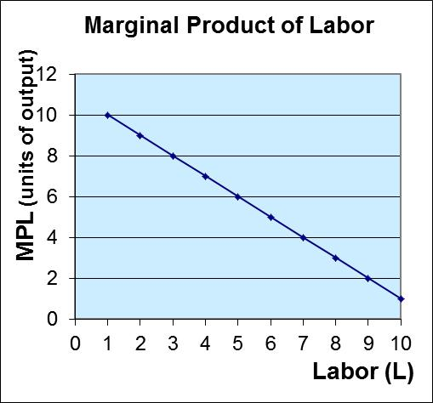
NOW YOU TRY
Compute and graph MPL, Answers

Slide 21
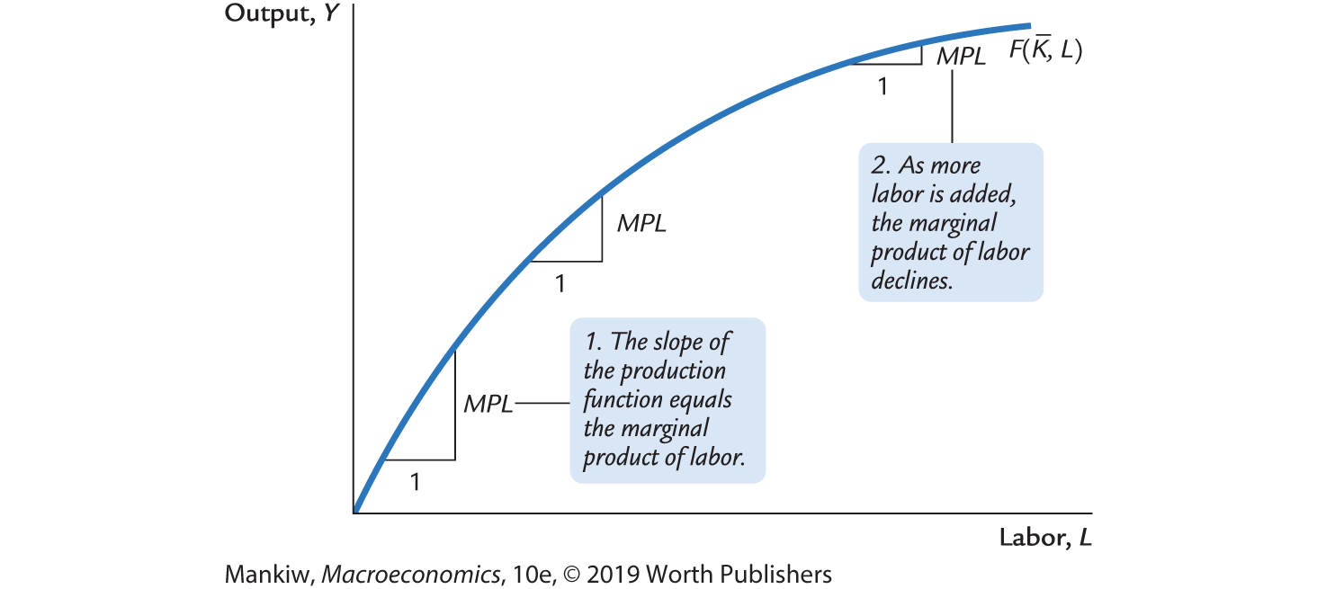
MPL and the production function
Notes:
It’s straightforward to see that MPL = the slope of the production function.
The definition of the slope of a curve is the amount the curve rises when you move one unit to the right. On this graph, moving one unit to the right simply means using one additional unit of labor. The amount the curve rises is the amount by which output increases: the MPL.

Slide 22
Diminishing marginal returns
As one input is increased (holding other inputs constant), its marginal product falls.
Intuition:
If L increases while holding K fixed, machines per worker falls, worker productivity falls.
Notes:
Tell the class that many production functions have this property.

Slide 23
NOW YOU TRY
Identifying diminishing returns
Which of these production functions have diminishing marginal returns to labor?

Slide 24
NOW YOU TRY
Identifying diminishing returns, answers
Which of these production functions have diminishing marginal returns to labor?
No, MPL = 15 for all L
Yes, MPL falls as L rises
Yes, MPL falls as L rises
Notes:
To get the answers:
Using calculus:
Take the derivative of F( ) with respect to L. The resulting expression is the MPL. Looking at this expression, determine whether MPL falls as L rises. (Or take the derivative of your MPL function w.r.t. L and see whether it’s positive, negative, or zero.)
Using algebra:
Plug in any value for K and another value for L.
See what happens if you increase L and then increase it again and then again.
This may require a calculator.
With a graph:
You can sketch a graph of these production functions (Y on the vertical axis, L on the horizontal axis, assuming a given value of K). If you know the general shape of the square root function, then it’s easy to tell that (b) and (c) have diminishing marginal returns.

Slide 25
NOW YOU TRY
MPL and labor demand
L | Y | MPL
0 | 0 | n.a.
1 | 10 | 10
2 | 19 | 9
3 | 27 | 8
4 | 34 | 7
5 | 40 | 6
6 | 45 | 5
7 | 49 | 4
8 | 52 | 3
9 | 54 | 2
10 | 55 | 1
Suppose W/P = 6.
If L = 3, should the firm hire more or less labor? Why?
If L = 7, should the firm hire more or less labor? Why?

Slide 26
NOW YOU TRY
MPL and labor demand, answers
L | Y | MPL
0 | 0 | n.a.
1 | 10 | 10
2 | 19 | 9
3 | 27 | 8
4 | 34 | 7
5 | 40 | 6
6 | 45 | 5
7 | 49 | 4
8 | 52 | 3
9 | 54 | 2
10 | 55 | 1
Suppose W/P = 6.
If L = 3, should the firm hire more or less labor? Why?
  Answer: More because the benefit of the 4th worker (MPL = 7) exceeds its cost (W/P = 6)
If L = 7, should the firm hire more or less labor? Why?
  Answer: Less because the 7th worker adds MPL = 4 units of output but costs the firm W/P = 6.
Notes:
If L = 3, then the benefit of hiring the fourth worker (MPL = 7) exceeds the cost of doing so (W/P = 6), so it pays for the firm to increase L.
If L = 7, then the firm should hire fewer workers: the 7th worker adds only MPL = 4 units of output yet costs W/P = 6.
The point of this slide is to get students to see the idea behind the labor demand = MPL curve.

Slide 27
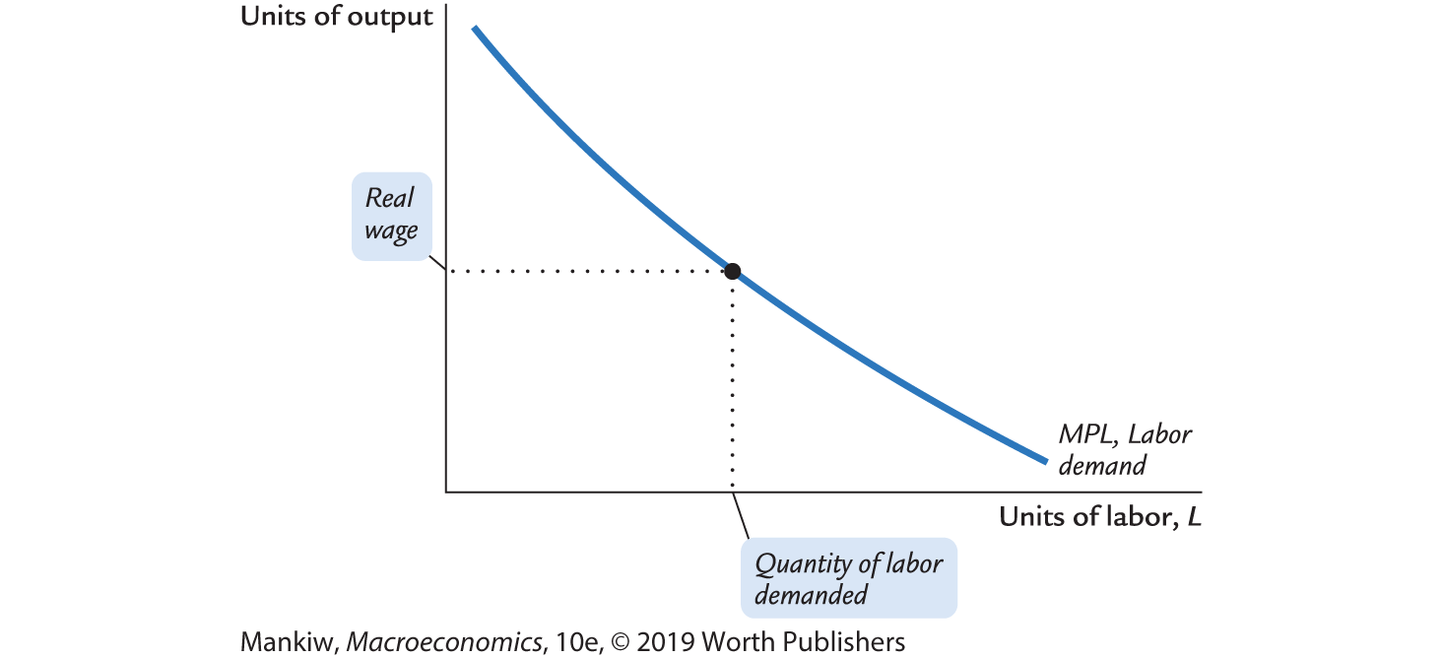
MPL and the demand for labor
Notes:
It’s easy to see that the MPL curve is the firm’s L demand curve.
Let L* be the value of L such that MPL = W/P.
Suppose L < L*. Then, the benefit of hiring one more worker (MPL) exceeds the cost (W/P), so the firm can increase profits by hiring one more worker.
Instead, suppose that L > L*. Then, the benefit of the last worker hired (MPL) is less than the cost (W/P), so the firm should reduce labor to increase its profits.
When L = L*, then the firm cannot increase its profits either by raising or lowering L.
Hence, the firm hires L to the point where MPL = W/P. This establishes that the MPL curve is the firm’s labor demand curve.

Slide 28
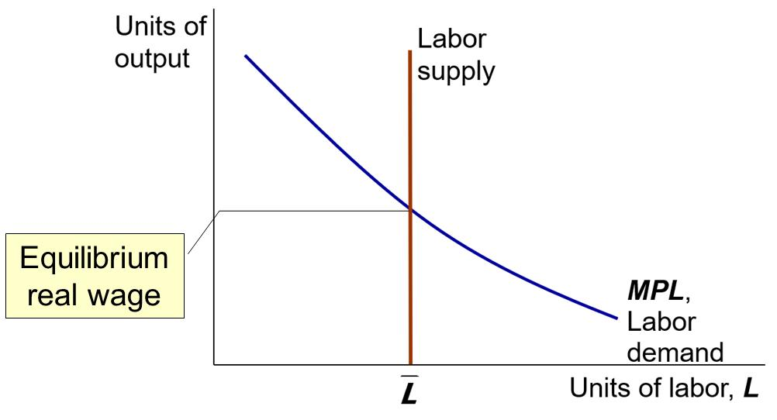
The equilibrium real wage
The real wage adjusts to equate labor demand with supply.
Notes:
The labor supply curve is vertical: we are assuming that the economy has a fixed quantity of labor, $\overline{L}$, whether the real wage is high or low.
Combining this labor supply curve with the demand curve we’ve developed in previous slides shows how the real wage is determined.

Slide 29
Determining the rental rate
We have just seen that MPL = W/P.
The same logic shows that MPK = R/P:
  Diminishing returns to capital:
  MPK falls as K rises
  The MPK curve is the firm’s demand curve for renting capital.
  Firms maximize profits by choosing K such that MPK = R/P.
Notes:
In our model, it’s easiest to think of firms renting capital from households (the owners of all factors of production). R/P is the real cost of renting a unit of K for one period of time.
In the real world, of course, many firms own some of their capital. But, for such a firm, the market rental rate is the opportunity cost of using its own capital instead of renting it to another firm. Hence, R/P is the relevant “price” in firms’ capital demand decisions, whether firms own their capital or rent it.

Slide 30
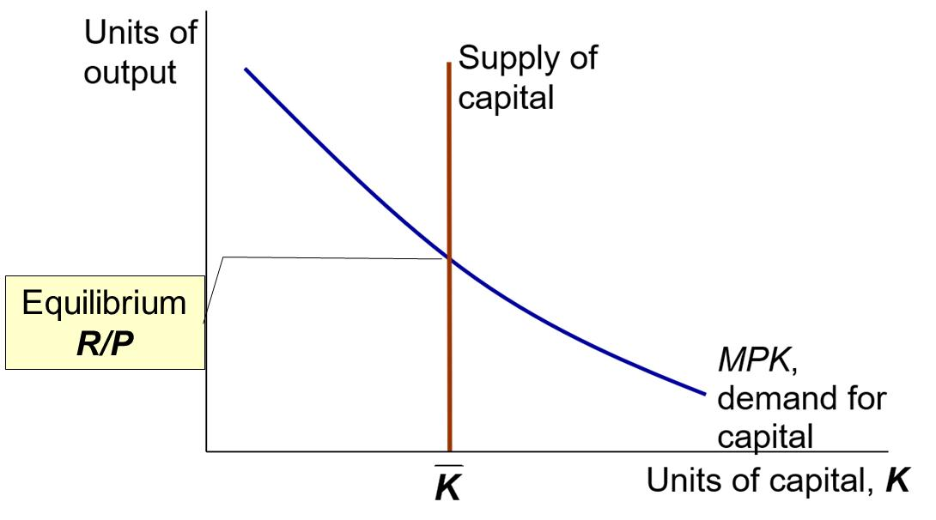
The equilibrium real rental rate
The real rental rate adjusts to equate demand for capital with supply.
Notes:
The previous slide uses the same logic behind the labor demand curve to assert that the capital demand curve is the same as the downward-sloping MPK curve.
The supply of capital is fixed (by assumption), so the supply curve is vertical.
The real rental rate (R/P) is determined by the intersection of the two curves.

Slide 31
The neoclassical theory of distribution
States that each factor input is paid its marginal product
A good starting point for thinking about income distribution

Slide 32
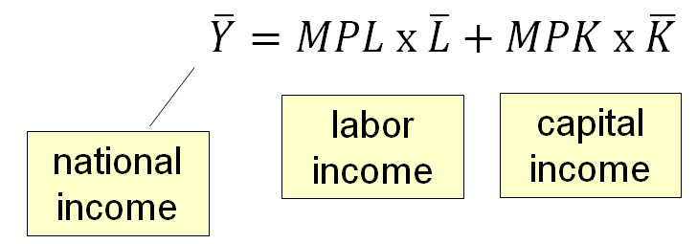
How income is distributed to L and K
If the production function has constant returns to scale, then
Notes:
The last equation follows from Euler’s theorem, discussed in the textbook.

Slide 33
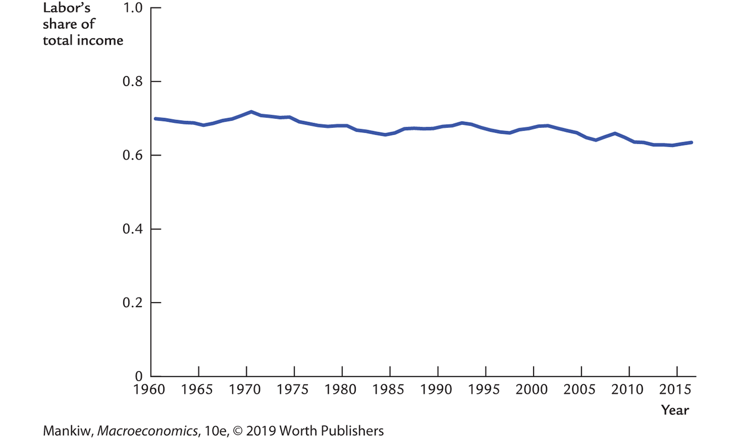
The ratio of labor income to total income in the United States, 1960–2010
Notes:
This graph appears in the textbook as Figure 3-5.
Source: U.S. Department of Labor
www.bea.gov > National Economic Accounts >Interactive Table Home > Table Selection >
Table 1.10 (Gross Domestic Income by Type of Income) and Table 1.12 (National Income by Type of Income)

Slide 34
Labor productivity and wages
Theory: wages depend on labor productivity U.S. data:
Time Period | Growth Rate of Labor Productivity | Growth Rate of Real Wages
1960–2016 | 2.0% | 1.8%
1960–1973 | 3.0 | 2.7
1973–1995 | 1.5 | 1.2
1995–2010 | 2.6 | 2.2
2010–2016 | 0.5 | 0.9
Notes:
The table shows the average annual rates of productivity and real wage growth in each time period. While not equal, the two series are very highly correlated.
The final row, 2010–2016, shows the “new normal”
Source: U.S. Department of Labor

Slide 35
Explanations for rising inequality
From The Race Between Education and Technology by Goldin and Katz:
  Technological progress has increased the demand for skilled relative to unskilled workers.
  Due to a slowdown in expansion of education, the supply of skilled workers has not kept up.
  Result: Rising gap between wages of skilled and unskilled workers.
Notes:
Implication for personal decision making: for most people, college and graduate school are investments well worth making.

Slide 36
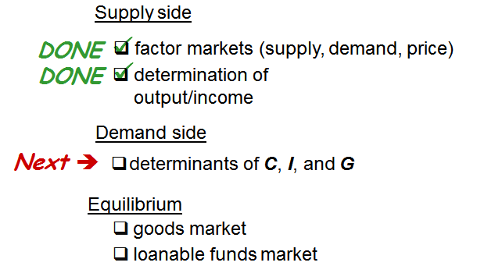
Outline of model (2 of 2)
A closed economy, market-clearing model
Notes:
We’ve now completed the supply side of the model.

Slide 37
Demand for goods and services
Components of aggregate demand:
  C = consumer demand for goods and services
  I = demand for investment goods
  G = government demand for goods and services
  (closed economy: no NX )

Slide 38
Consumption, C
Disposable income is total income minus total taxes: Y – T.
Consumption function: C = C (Y – T )
Definition: marginal propensity to consume (MPC) is the change in C when disposable income increases by one dollar.
Notes:
We assume it as costant.

Slide 39
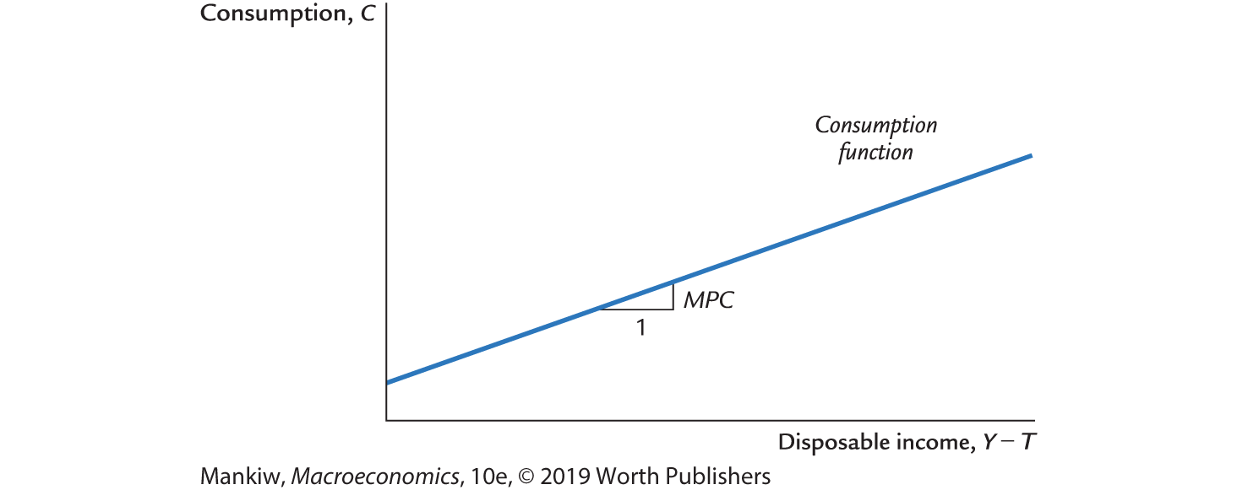
The consumption function

Slide 40
Investment, I
The investment function is I = I (r ), where r denotes the real interest rate, the nominal interest rate corrected for inflation.
The real interest rate is:
  the cost of borrowing
  the opportunity cost of using one’s own funds to finance investment spending
So, I depends negatively on r

Slide 41
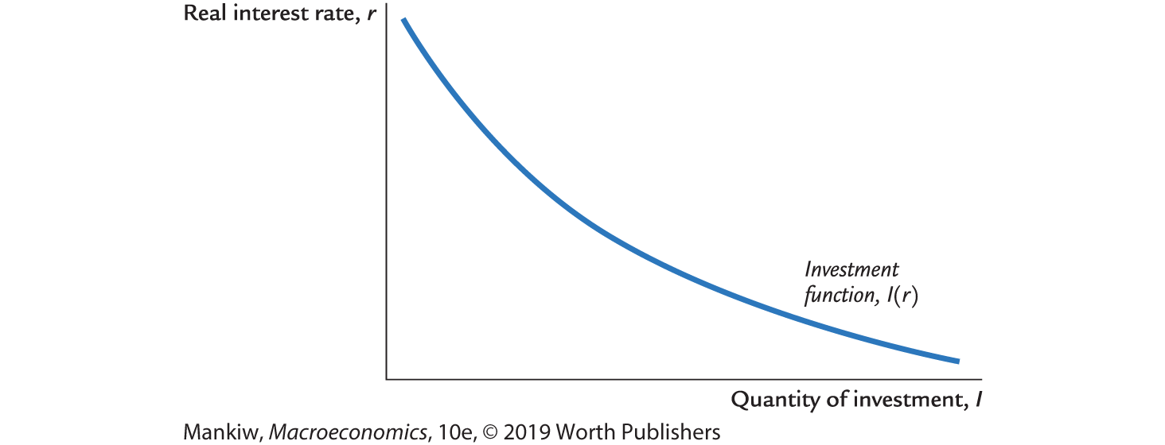
The investment function

Slide 42
Government spending, G
G = government spending on goods and services
G excludes transfer payments (for example, Social Security benefits, unemployment insurance benefits)
Assume that government spending and total taxes are exogenous:
Notes:
It might be useful to remind students of the meanings of the terms exogenous and transfer payments.

Slide 43
The market for goods and services
The real interest rate adjusts to equate demand with supply.
Notes:
In the equation for the equilibrium condition, note that the real interest rate is the only variable that doesn’t have a bar over it—it’s the only endogenous variable in the equation, and it adjusts to equate the demand and supply in the goods market.
When the full slide is showing, before you advance to the next one, you might want to note that the interest rate is important in financial markets as well, so we will next develop a simple model of the financial system.

Slide 44
The loanable funds market
A simple supply–demand model of the financial system.
One asset: “loanable funds”
  demand for funds: investment
  supply of funds: saving
  “price” of funds: real interest rate

Slide 45
Demand for funds: Investment
The demand for loanable funds . . .
  comes from investment:
  Firms borrow to finance spending on plant and equipment, new office buildings, etc. Consumers borrow to buy new houses.
  depends negatively on r:
  r is the “price” of loanable funds (cost of borrowing).

Slide 46
Loanable funds demand curve

Slide 47
Supply of funds: Saving
The supply of loanable funds comes from saving:
  Households use their saving to make bank deposits and purchase bonds and other assets. These funds become available to firms to borrow and finance investment spending.
  The government may also contribute to saving if it does not spend all the tax revenue it receives.

Slide 48
Types of saving
Private saving = (Y – T) – C
Public saving = T – G
National saving, S
  = private saving + public saving
  = (Y –T ) – C + T – G
  = Y – C – G
Notes:
After showing the definition of private saving:
Give the interpretation of the equation: Private saving is disposable income minus consumption spending
Explain why private saving is part of the supply of loanable funds: Suppose a person earns $50,000/year, pays $10,000 in taxes, and spends $35,000 on goods and services. There’s $5,000 remaining. What happens to that $5,000? The person might use it to buy stocks or bonds, or he/she might put it in his/her savings account or money market deposit account. In all of these cases, this $5,000 becomes part of the supply of loanable funds in the financial system.
After displaying public saving, explain the equation’s interpretation: public saving is tax revenue minus government spending.
Notice the analogy to private saving: both concepts represent income less spending. For the private household, income is (Y – T), and spending is C. For the government, income is T, and spending is G.

Slide 49
Notation: Δ = change in a variable
For any variable X, ΔX = “change in X ”
Δ is the Greek (uppercase) letter delta
Examples:
If ΔL = 1 and ΔK = 0, then ΔY = MPL.
More generally, if ΔK = 0, then
Δ(Y − T ) = ΔY − ΔT , so
ΔC = MPC × (ΔY − ΔT )
= MPC ΔY − MPC ΔT
Notes:
The delta notation will be used throughout the text, so it would be very helpful if your students started getting accustomed to it now.
If your students have taken a semester of calculus, tell them that ΔX is (practically) the same thing as dX (if ΔX is small). Furthermore, some basic rules from calculus apply here with Δs:
The derivative of a sum is the sum of the derivatives:
Δ(X+Y) = ΔX + ΔY
The product rule:
ΔXY = (ΔX)(Y) + (X)(ΔY)
In fact, you can derive the two arithmetic tricks for working with percentage changes presented in Chapter 2.
Just take the preceding expression for the product rule and divide through by XY to get (ΔXY)/XY = ΔX/X + ΔY/Y, the first of the two arithmetic tricks.

Slide 50
NOW YOU TRY
Calculate the change in saving
Suppose MPC = 0.8 and MPL = 20.
For each of the following, compute ΔS:
  ΔG = 100
  ΔT = 100
  ΔY = 100
  ΔL = 10
Notes:
This problem reinforces the concepts with concrete numerical examples. It’s also a good way to break up the lecture and get students actively involved with the material.

Slide 51
NOW YOU TRY
Calculate the change in saving, answers
Notes:
First, in the box at the top of the slide, we plug the given value for the MPC into the expression for ΔS and simplify.
Then, finding the answers is straightforward: just plug in the given values into the expression for ΔS.

Slide 52
Budget surpluses and deficits
If T > G, budget surplus = (T – G)
= public saving.
If T < G, budget deficit = (G – T) and public saving is negative.
If T = G, balanced budget, public saving = 0.
The U.S. government finances its deficit by issuing Treasury bonds—that is, borrowing.

Slide 53
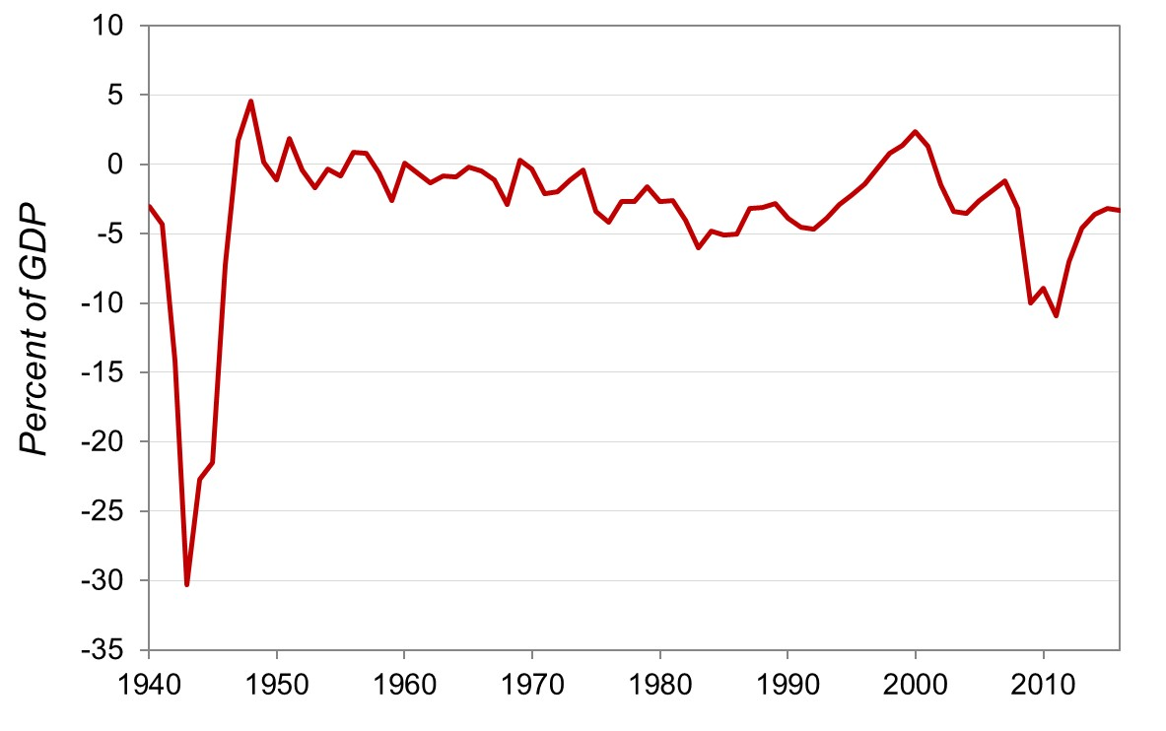
U.S. federal government surplus/deficit, 1940–2016
Notes:
(2012–2016 are estimates)
Notes:
The huge deficit in the early 1940s was due to World War II. Wars are expensive.
The budget is close to balanced in the 1950s and 1960s, and it begins a downward trend in the 1970s.
The early 1980s saw the largest deficits (as % of GDP) of the post-World War II era, due to the Reagan tax cuts, defense buildup, and growth in entitlement program outlays.
The budget begins a positive trend in the early 1990s, and a surplus emerges in the late 1990s. There are several possible explanations for the improvement. First, President Bush (the first one) broke his campaign promise not to raise taxes. Second, the Clinton administration barely squeaked a deficit reduction deal through Congress (with Al Gore casting the tie-breaking vote in the Senate). And third, and probably most importantly, there was a swelling of tax revenues due to the surge in economic growth and the stock market boom. (A stock market boom leads to large capital gains, which leads to large revenues from the capital gains tax.)
The budget swings to deficit again in 2001 due to the Bush tax cuts and a recession.
Recently, the budget deficit in current dollars has reached all-time highs, due to a sharp fall in tax receipts, the enactment of multibillion-dollar bailouts, and a large stimulus package.
Data source: http://www.gpoaccess.gov/usbudget/fy11/hist.html
Budget of the United States Government: Historical Tables Fiscal Year 2011, Table 1.2

Slide 54
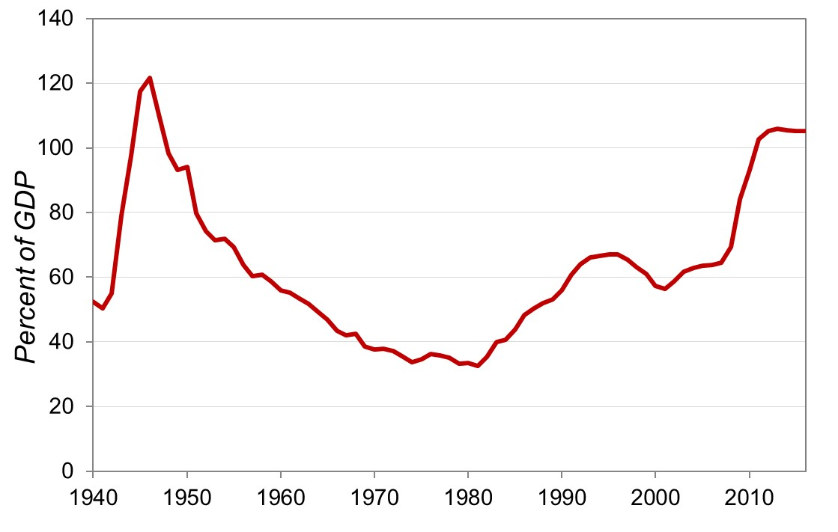
U.S. federal government debt, 1940–2016
Notes:
(2012–2016 are estimates)
A later chapter will give more details, but for now, tell students that the government finances its deficits by borrowing from the public. (This borrowing takes the form of selling Treasury bonds.) Persistent deficits over time imply persistent borrowing, which causes the debt to increase.
After World War II, occasional budget surpluses allowed the government to retire some of its World War II debt; also, normal economic growth increased the denominator of the debt-to-GDP ratio. Starting in the early 1980s, corresponding to the beginning of huge and persistent deficits, we see a huge increase in the debt ratio, from 32% in 1981 to 66% in 1995. In the mid-1990s, budget surpluses and rapid growth started to reduce the debt ratio, but it started rising again in 2001 due to the economic slowdown, the Bush tax cuts, and higher spending (Afghanistan and Iraq, war on terrorism, 2002 airline bailout, etc.).
The recent financial crisis/recession has increased the debt ratio, as revenues have fallen, while outlays (the stimulus package, bailouts) have sharply increased.
Source: http://www.gpoaccess.gov/usbudget/fy11/hist.html
Budget of the United States Government: Historical Tables Fiscal Year 2011, Table 7.1

Slide 55
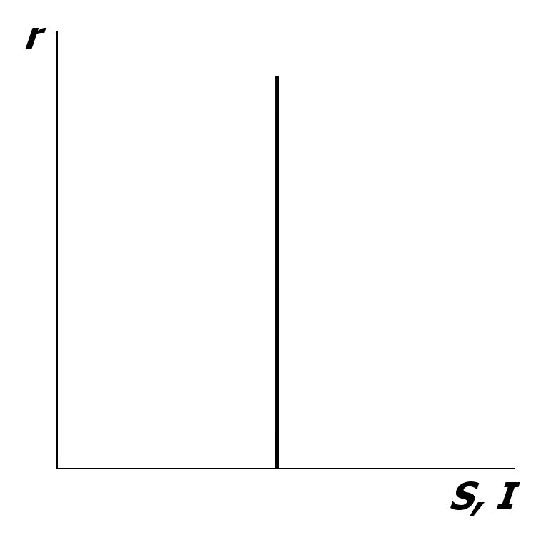
Loanable funds supply curve
National saving does not depend on r, so the supply curve is vertical.
Notes:
At the end of this chapter, we will briefly consider how things would be different if consumption (and therefore saving) were allowed to depend on the interest rate.
For now, though, they do not.

Slide 56
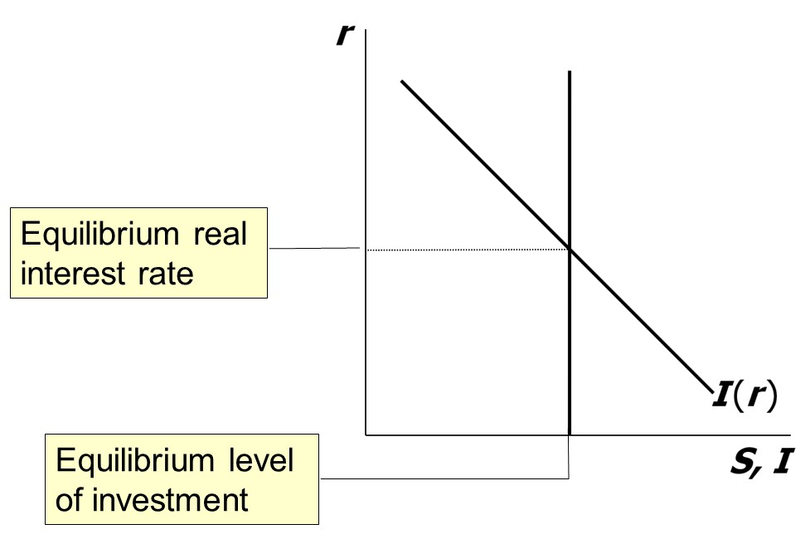
Loanable funds market equilibrium

Slide 57

The special role of r
r adjusts to equilibrate the goods market and the loanable funds market simultaneously:
If the loanable funds market is in equilibrium, then
Y – C – G = I
Add (C +G ) to both sides to get
Y = C + I + G (goods market equilibrium)
Thus,
Notes:
This slide establishes that we can use the loanable funds supply/demand diagram to see how the interest rate that clears the goods market is determined.
Explain that the symbol ⇔ means each one implies the other. The thing on the left implies the thing on the right and vice versa.
More shorthand: “eq’m” is short for “equilibrium.”

Slide 58
Digression: Mastering models
To master a model, be sure to know:
  Which of its variables are endogenous and which are exogenous.
  For each curve in the diagram, know:
  Definition
  intuition for slope
  all the things that can shift the curve
  Use the model to analyze the effects of each item in 2c.
Notes:
This is good general advice for students. They will learn many models in this course. Many exams include questions requiring students to show how some event shifts a curve and then use the model to analyze its effect on the endogenous variables. If students methodically follow the steps presented on this slide for each model they learn in this course (and other economics courses), they will likely do better on the exams and get more out of the course.

Slide 59
Mastering the loanable funds model (1 of 2)
Things that shift the saving curve:
  public saving
    fiscal policy: changes in G or T
  private saving
    preferences
    tax laws that affect saving
      401(k)
      IRA
      replace income tax with consumption tax
Notes:
Continuing from the previous slide, let’s look at all the things that affect the S curve. Then, we will pick one of those things and use the model to analyze its effects on the endogenous variables. Then, we’ll do the same for the I curve.

Slide 60
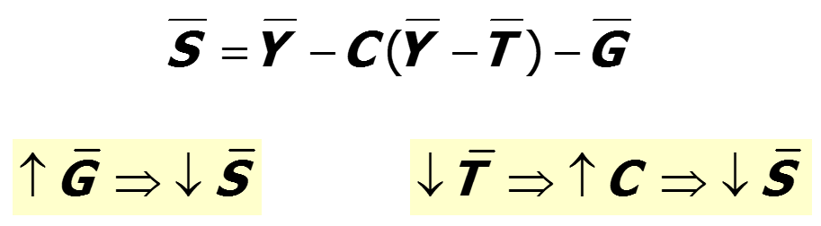
CASE STUDY: The Reagan Deficits (1 of 2)
Reagan policies during early 1980s:
  increases in defense spending: ΔG > 0
  big tax cuts: ΔT < 0
Both policies reduce national saving:

Slide 61
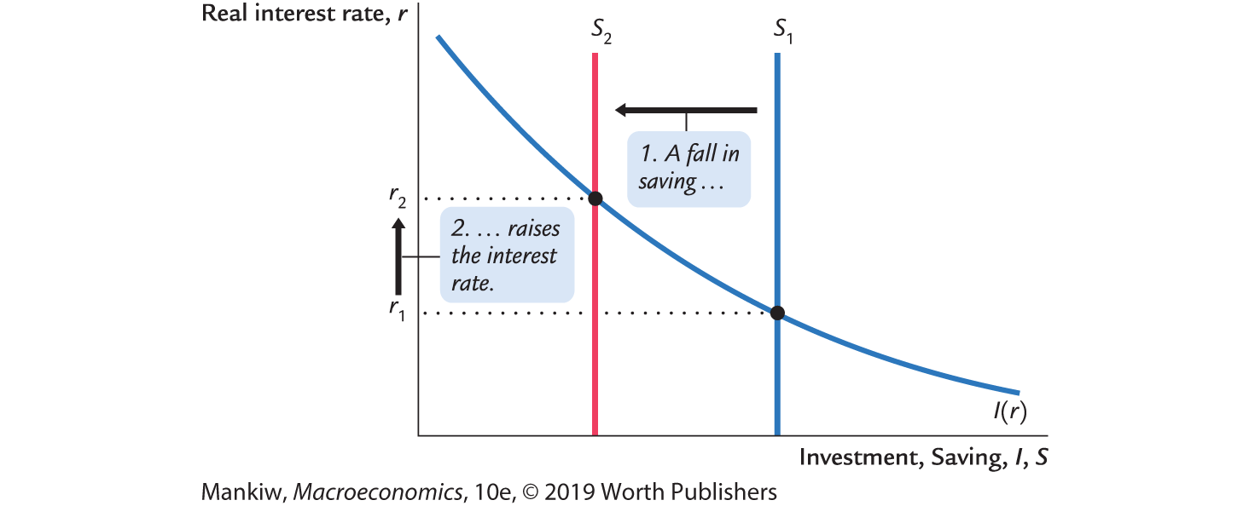
CASE STUDY: The Reagan Deficits (2 of 2)

Slide 62
Are the data consistent with these results?
 | 1970s | 1980s
T−G | −2.2 | −3.9
S | 19.6 | 17.4
r | 1.1 | 6.3
l | 19.9 | 19.4
T – G, S, and I are expressed as a percentage of GDP.
All figures are averages over the decade shown.
Notes:
Display the data line by line, noting that the data match the model’s predictions—except for investment.
The model says that investment should have fallen as much as savings. Ask students why they think it didn’t.
Answer: In our closed-economy model in Chapter 3, the only source of loanable funds is national saving. But the United States is actually an open economy. In the face of a fall in national saving (i.e., the domestic supply of loanable funds), firms can finance their investment spending by importing foreign loanable funds. More on this in an upcoming chapter.

Slide 63
NOW YOU TRY
The effects of saving incentives
Draw the diagram for the loanable funds model.
Suppose the tax laws are altered to provide more incentives for private saving.
(Assume that total tax revenue T does not change.)
What happens to the interest rate and investment?
Notes:
Students may be confused because we are (somehow) changing taxes but assuming that T is unchanged. Taxes have different effects. The total amount of taxes (T) affects disposable income. But even if we hold total taxes constant, a change in the structure or composition of taxes can have effects. Here, by holding total taxes constant, we ensure that neither disposable income nor public saving changes, yet the composition of taxes changes to give consumers an incentive to increase their saving.
Answer: The vertical S curve shifts right, causing the interest rate to fall and investment to rise. These effects are exactly the opposite, as pictured in the “Reagan deficits” case study a few slides earlier.

Slide 64
Mastering the loanable funds model (2 of 2)
Things that shift the investment curve:
  some technological innovations
    to take advantage of some innovations, firms must buy new investment goods
  tax laws that affect investment
    example: investment tax credit

Slide 65
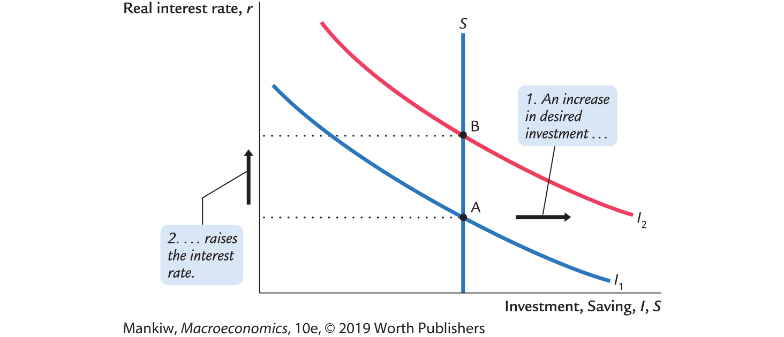
An increase in investment demand

Slide 66
Saving and the interest rate
Why might saving depend on r ?
How would the results of an increase in investment demand be different?
  Would r rise as much?
  Would the equilibrium value of I change?
Notes:
Suggestion: Display these questions and give your students three or four minutes, working in pairs, to try to find the answers. Then display the analysis on the next slide.
Reasons why saving might depend on r:
An increase in r makes saving more attractive and increases the reward for postponing consumption.
Many consumers finance their spending on big-ticket items like cars and furniture, and an increase in r makes such borrowing more expensive.
However, an increase in r might also reduce saving through the income effect: a higher interest rate makes net savers better off, so they purchase more of all “normal” goods. If current consumption is a normal good, then it will rise, and saving will fall. It is usually assumed that the substitution effect is at least as great as the income effect so that an increase in the interest rate will either increase saving or leave saving unchanged.

Slide 67
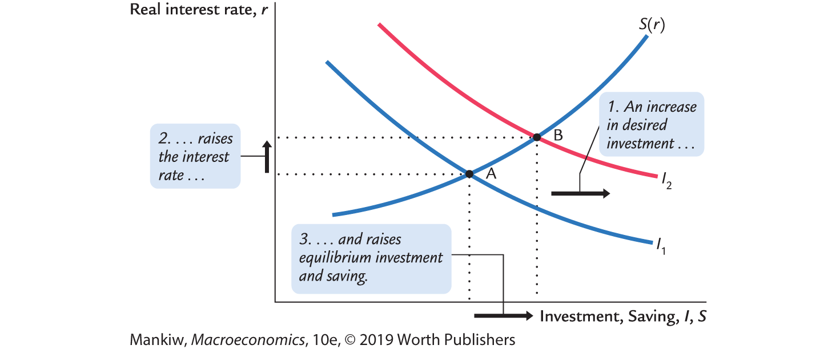
An increase in investment demand when saving depends on r

Slide 68
CHAPTER SUMMARY, PART 1
Total output is determined by:
  the economy’s quantities of capital and labor
  the level of technology
Competitive firms hire each factor until its marginal product equals its price.
If the production function has constant returns to scale, then labor income plus capital income equals total income (output).

Slide 69
CHAPTER SUMMARY, PART 2
A closed economy’s output is used for consumption, investment, and government spending.
The real interest rate adjusts to equate the demand for and supply of:
  goods and services.
  loanable funds.

Slide 70
CHAPTER SUMMARY, PART 3
A decrease in national saving causes the interest rate to rise and investment to fall.
An increase in investment demand causes the interest rate to rise but does not affect the equilibrium level of investment if the supply of loanable funds is fixed.

