Slide 1

Inflation: Its Causes, Effects, and Social Costs
Macroeconomics
N. Gregory Mankiw
© 2019 Worth Publishers, all rights reserved
Notes:
Chapter 5 covers the quantity theory of money, a simple theory that explains the long-run behavior of inflation fairly well. It also introduces the money demand function, L(i,Y), that will be used in the IS-LM model in later chapters. Chapter 5 explains the social costs of inflation and concludes with a discussion of the classical dichotomy and neutrality of money, a central topic in monetary theory.
Mostly, the material is not difficult, but it is theoretical, especially the discussion of the classical dichotomy and the neutrality of money.

Slide 2
IN THIS CHAPTER, YOU WILL LEARN:
The classical theory of inflation
Causes
Effects
social costs
“Classical”—assumes prices are flexible and markets clear
Applies to the long run

Slide 3
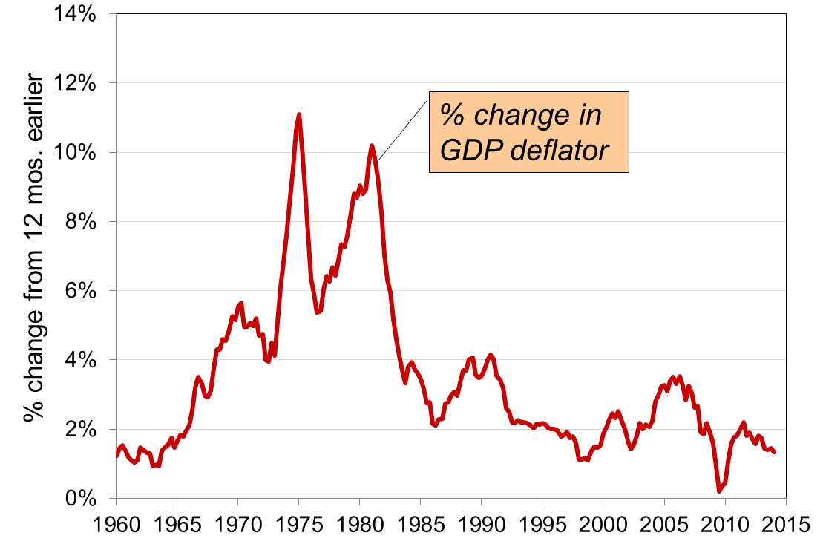
U.S. inflation and its trend, 1960–2014, part 1
Notes:
Over the short run, the inflation rate can be volatile. In later chapters, we will learn about the forces that affect inflation in the short run. In this chapter, we focus on . . .
Source: Federal Reserve Bank of St. Louis
http://research.stlouisfed.org/fred2/
GDPDEF (percentage change from a year ago)

Slide 4
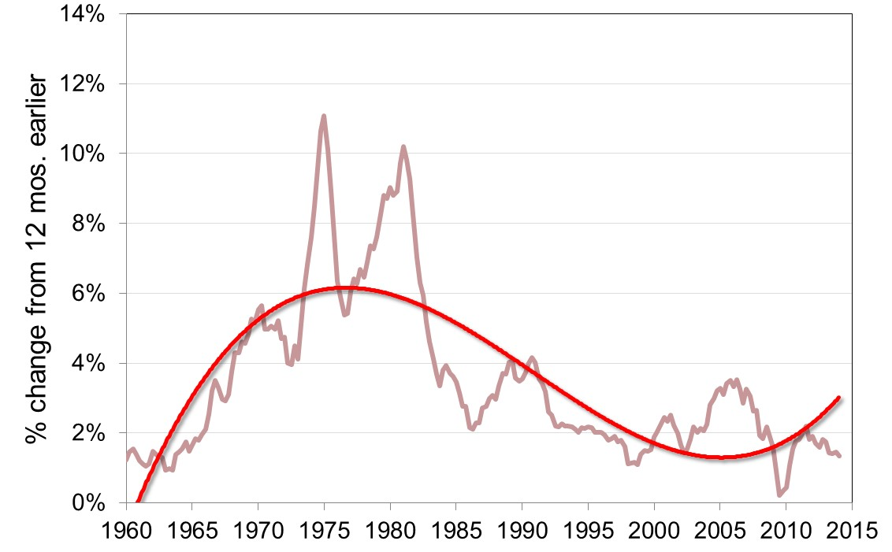
U.S. inflation and its trend, 1960–2014, part 2
Notes:
. . . the long-run trend behavior of inflation. We will learn a simple theory of inflation over the long run and see that its predictions are very consistent with U.S. and international data.
Note about the graph:
The long-run trend line was produced in Excel, type polynomial order 3.

Slide 5
The quantity theory of money
A simple theory linking the inflation rate to the growth rate of the money supply.
Begins with the concept of velocity…

Slide 6
Velocity, part 1
Basic concept: the rate at which money circulates
Definition: the number of times the average dollar bill changes hands in a given time period
Example: In 2018,
    $500 billion in transactions
    money supply = $100 billion
    The average dollar is used in five transactions in 2018
    So, velocity = 5
Notes:
In order for $500 billion in transactions to occur when the money supply is only $100 billion, each dollar must be used, on average, in five transactions.

Slide 7
Velocity, part 2
This suggests the following definition:
where
V = velocity
T = value of all transactions
M = money supply

Slide 8
Velocity, part 3
Use nominal GDP as a proxy for total transactions.
Then,
where
P = price of output (GDP deflator)
Y = quantity of output (real GDP)
P × Y = value of output (nominal GDP)
Notes:
You might ask students if they know the difference between nominal GDP and the value of transactions.
Answer: Nominal GDP includes the value of purchases of final goods; total transactions also includes the value of intermediate goods.
Even though they are different, they are highly correlated. Also, our models focus on GDP, and there’s lots of great data on GDP. So from this point on, we’ll use the income version of velocity.

Slide 9
The quantity equation
The quantity equation
M × V = P × Y
follows from the preceding definition of velocity.
It is an identity: it holds by definition of the variables.

Slide 10
Money demand and the quantity equation, part 1
M/P = real money balances, the purchasing power of the money supply.
A simple money demand function:
(M/P )^{d} = k Y
where
k = how much money people wish to hold for each dollar of income.
(k is exogenous)

Slide 11
Money demand and the quantity equation, part 2
Money demand: (M/P)^{d} = k Y
Quantity equation: M × V = P × Y
The connection between them: k = 1/V
When people hold lots of money relative to their incomes (k is large), money changes hands infrequently (V is small).

Slide 12
Back to the quantity theory of money
Starts with quantity equation
Assumes V is constant and exogenous:
Then, the quantity equation becomes:

Slide 13
The quantity theory of money, part 1
How the price level is determined:
  With V constant, the money supply determines nominal GDP (P ×Y).
  Real GDP is determined by the economy’s supplies of K and L and the production function (Chapter 3).
  The price level is P = (nominal GDP)/(real GDP).
Notes:
It’s worthwhile to underscore the order (logical order, though not necessarily chronological order) in which variables are determined in this model (as well as the other models students will learn in this course).
First, real GDP is already determined outside this model (real GDP is determined by the model from Chapter 3, which was completely independent of the money supply or velocity or other nominal variables).
Second, the quantity theory of money determines nominal GDP.
Third, the values of nominal GDP (PY) and real GDP (Y) together determine P (as a ratio of PY to Y).
If, on an exam or a homework problem, students forget the logical order in which endogenous variables are determined—or, on a more fundamental level, forget which variables are endogenous and which are exogenous—then they are much less likely to earn the high grades that most of them desire.
[Note the similarity between the way P is determined and the definition of the GDP deflator from Chapter 2.]

Slide 14
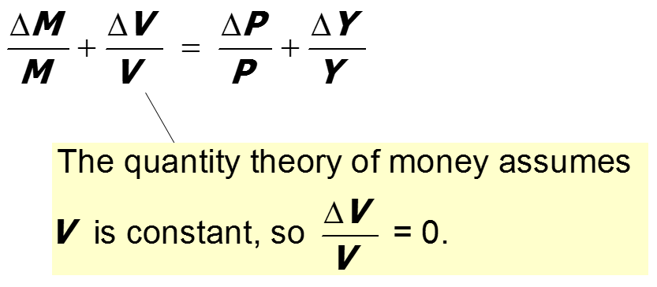
The quantity theory of money, part 2
Recall from Chapter 2:
The growth rate of a product equals the sum of the growth rates.
The quantity equation in growth rates:

Slide 15
The quantity theory of money, part 3
π (Greek letter pi ) denotes the inflation rate:
The result from the preceding slide:
Solve this result for π:

Slide 16
The quantity theory of money, part 4
Normal economic growth requires a certain amount of money supply growth to facilitate the growth in transactions.
Money growth in excess of this amount leads to inflation.
Notes:
This slide provides an intuitive way to understand the equation.
For students who are more comfortable with concrete numerical examples, you could offer the following:
Suppose real GDP is growing by 3% per year over the long run. Thus, production, income, and spending are all growing by 3%. This means that the volume of transactions will be growing as well.
The central bank can achieve zero inflation (on average over the long run) simply by setting the growth rate of the money supply at 3%, in which case exactly enough new money is being supplied to facilitate the growth in transactions.

Slide 17
The quantity theory of money, part 5
ΔY/Y depends on growth in the factors of production and on technological progress (all of which we take as given, for now).
Hence, the quantity theory predicts a one-for-one relationship between changes in the money growth rate and changes in the inflation rate.
Notes:
Note: The theory doesn’t predict that the inflation rate will equal the money growth rate. It predicts that a change in the money growth rate will cause an equal change in the inflation rate.

Slide 18
Confronting the quantity theory with data
The quantity theory of money implies:
  1. Countries with higher money growth rates should have higher inflation rates.
  2. The long-run trend in a country’s inflation rate should be similar to the long-run trend in the country’s money growth rate.
Are the data consistent with these implications?

Slide 19
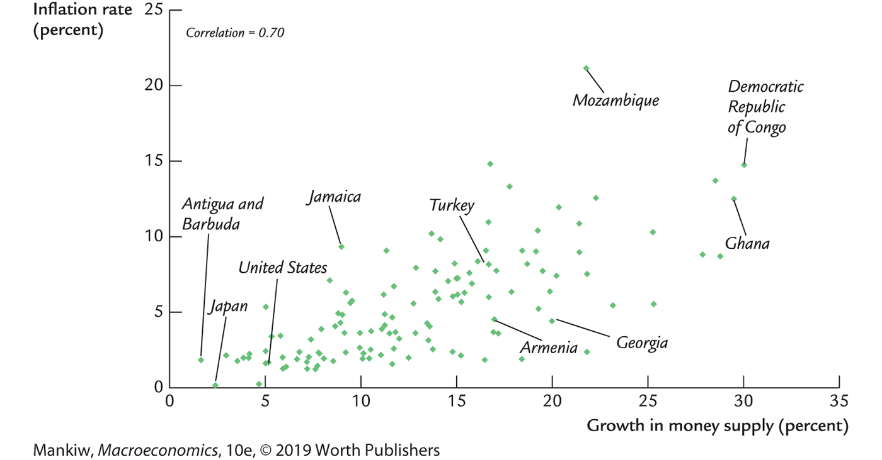
International data on inflation and money growth
Notes:
Figure 5-2, p. 110
Each variable is measured as an annual average over the period 2000–2013.
The strong positive correlation is evidence for the quantity theory of money.
Source: Money Supply Data - www.imf.org > Data > International Financial Statistics (IFS)
Inflation Data - www.imf.org > Data > World Economic Outlook

Slide 20
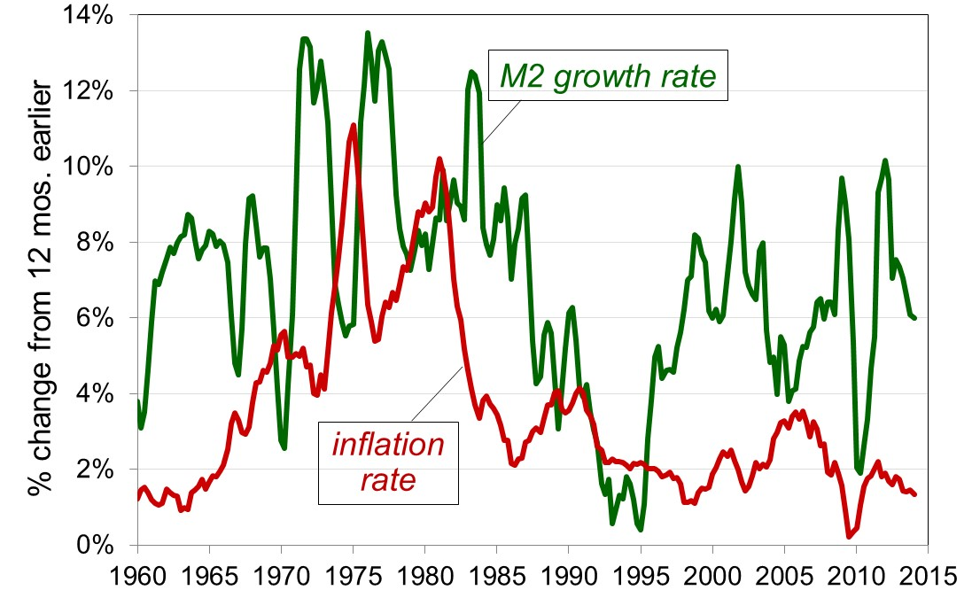
U.S. inflation and money growth, 1960–2014, part 1
Notes:
Source: Federal Reserve Bank of St. Louis
http://research.stlouisfed.org/fred2/
M2SL, percentage change from a year ago, quarterly aggregation method average
GDPDEF, percentage change from a year ago

Slide 21
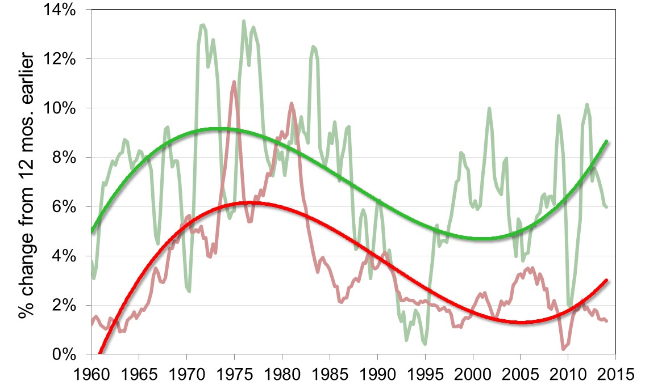
U.S. inflation and money growth, 1960–2014, part 2
Inflation and money growth have the same long-run trends as the quantity theory predicts.
Notes:
The quantity theory of money is intended to explain the long-run relationship of inflation and money growth, not the short-run relationship. In the long run, inflation and money growth are positively related, as the theory predicts.
(In the short run, however, inflation and money growth appear highly negatively correlated! One possible reason is that the causality is reversed in the short run: When inflation rises—or is expected to rise—the Fed cuts back on money growth. If the economy slumps and inflation falls, the Fed increases money growth. It might be appropriate to discuss this when covering the chapters on short-run fluctuations.)
Source: Federal Reserve Bank of St. Louis
http://research.stlouisfed.org/fred2/
M2SL, percentage change from a year ago, quarterly aggregation method average
GDPDEF, percentage change from a year ago

Slide 22
Seigniorage
To spend more without raising taxes or selling bonds, the government can print money.
The “revenue” raised from printing money is called seigniorage (pronounced SEEN-your-idge).
The inflation tax:
Printing money to raise revenue causes inflation. Inflation is like a tax on people who hold money.
Notes:
In the United States, seigniorage accounts for only about 3% of total government revenue. In Italy and Greece, seigniorage has often been more than 10% of total revenue. In countries experiencing hyperinflation, seigniorage is often the government’s main source of revenue, and the need to print money to finance government expenditure is a primary cause of hyperinflation.
See the Case Study “Paying for the American Revolution” on pp. 111–112.

Slide 23
Inflation and interest rates
Nominal interest rate, I not adjusted for inflation
Real interest rate, r adjusted for inflation:
r = i − π
Notes:
This slide will be very familiar to students who have recently taken an introductory economics course.

Slide 24
The Fisher effect
The Fisher equation: i = r + π
Chapter 3: S = I determines r .
Hence, an increase in π causes an equal increase in i.
This one-for-one relationship is called the Fisher effect.
Notes:
Note that S and I are real variables. In Chapter 3, we learned about the factors that determine S and I. These factors did not include the money supply, velocity, inflation, or other nominal variables.
Hence, in the classical (long-run) theory covered here in Chapter 5, changes in money growth or inflation do not affect the real interest rate. This is why there’s a one-for-one relationship between changes in the inflation rate and changes in the nominal interest rate.
(Again, the Fisher effect does not imply that the nominal interest rate equals the inflation rate. It implies that changes in the nominal interest rate equal changes in the inflation rate, given a constant value of the real interest rate.)

Slide 25
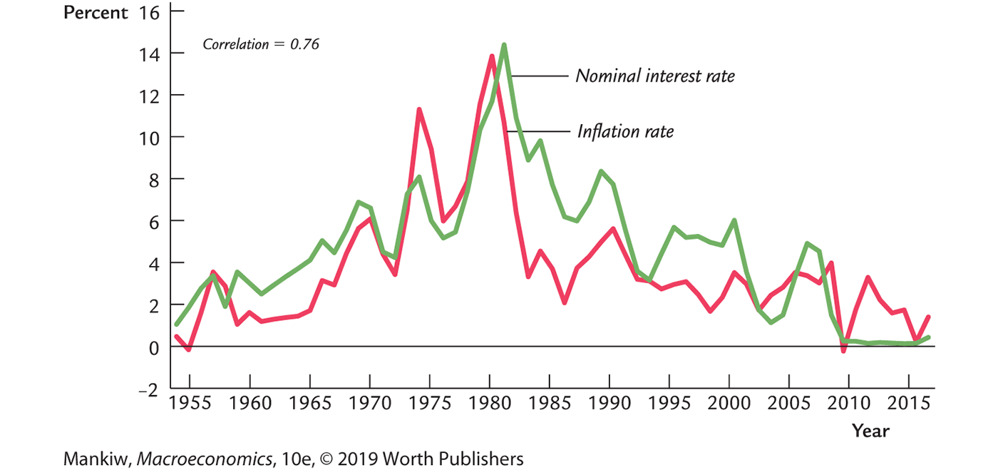
U.S. inflation and nominal interest rates, 1955-2015
Notes:
The data are consistent with the Fisher effect: inflation and the nominal interest rate are very highly correlated.
That they are not perfectly correlated does not contradict the Fisher effect. Over time, the saving and investment curves (see Chapter 3) move around, changing the real interest rate, which, in turn, causes the nominal interest rate to change for a given value of inflation.
Notice that the measure of inflation here is CPI. Previous slides used the GDP deflator. Students might notice that the inflation rate dips below zero in this figure but not in the previous figures.
About the data:
The inflation rate is the percentage change in the CPI from 12 months earlier.
(CPIAUCSL, monthly percentage change from a year ago)
The nominal interest rate is the 3-month treasury bill rate in the secondary market (TB3MS, monthly)
Data obtained from http://research.stlouisfed.org/fred2/

Slide 26
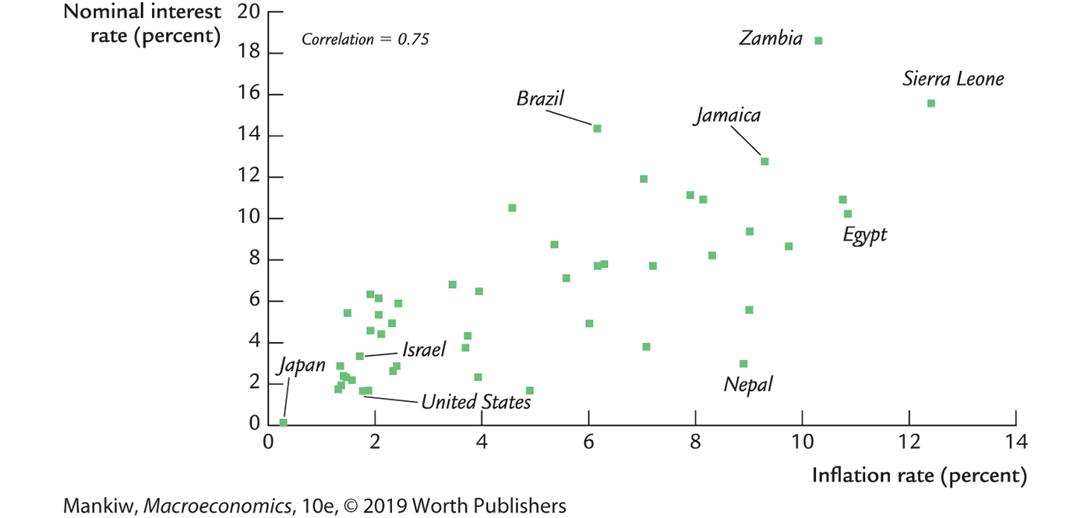
Inflation and nominal interest rates in 48 countries
Notes:
Sources: Interest Rate Data - www.imf.org > Data > International Financial Statistics (IFS)
Inflation Data - www.imf.org > Data > World Economic Outlook
Each variable is measured as an annual average over 2000–2013.
The nominal interest rate is the rate on short-term government debt.

Slide 27
NOW YOU TRY
Applying the theory
Suppose V is constant, M is growing 5% per year, Y is growing 2% per year, and r = 4.
Solve for i.
If the Fed increases the money growth rate by 2 percentage points per year, find Δi.
Suppose the growth rate of Y falls to 1% per year.
  What will happen to π?
  What must the Fed do if it wishes to keep π constant?
Notes:
This exercise gives students an immediate application of the quantity theory of money and the Fisher effect. The math is not difficult.

Slide 28
NOW YOU TRY
Applying the theory, answers
V is constant, M grows 5% per year, Y grows 2% per year, r = 4.
  First, find π = 5 − 2 = 3.
    Then, find i = r + π = 4 + 3 = 7.
  Δi = 2, the same as the increase in the money growth rate.
  If the Fed does nothing, Δπ = 1.
    To prevent inflation from rising, the Fed must reduce the money growth rate by 1 percentage point per year.

Slide 29
Two real interest rates
Notation:
π = actual inflation rate
(not known until after it has occurred)
Eπ = expected inflation rate
Two real interest rates:
i – Eπ = ex ante real interest rate:
the real interest rate people expect at the time they buy a bond or take out a loan
i – π = ex post real interest rate:
the real interest rate actually realized

Slide 30
Money demand and the nominal interest rate
In the quantity theory of money, the demand for real money balances depends only on real income Y.
Another determinant of money demand:
the nominal interest rate i.
  the opportunity cost of holding money (instead of bonds or other interest-earning assets).
So, money demand depends negatively on i.
Notes:
The concept of “money demand” can be a bit awkward for students the first time they learn it. Here’s a good way to explain it:
A consumer has a certain amount of wealth, which he/she must divide between money and other assets.
Money is nice because it’s very liquid. But money doesn’t pay interest (loosely speaking; more precisely, the nominal interest rate on money is zero, while the real rate equals minus the inflation rate).
The other assets are typically less liquid than money, but they typically generate some type of income (e.g., interest income in the case of bonds).
Therefore, there’s a tradeoff between liquidity and income: The more money the consumer holds in his/her portfolio, the greater the liquidity of his/her wealth but the less income he/she earns from it.

Slide 31
The money demand function, part 1
(M/P )^{d} = real money demand, depends
  negatively on i
    i is the opposite cost of holding money
  positively on Y
    higher Y increases spending on g&s
    so increases the need for money
(L is used for the money demand function because money is the most liquid asset.)
Notes:
An increase in the nominal interest rate represents the increase in the opportunity cost of holding money rather than bonds and would motivate the typical consumer to hold less of his/her wealth in the form of money and more in the form of bonds (or other interest-earning assets).
An increase in real income (other things equal) causes an increase in the consumer’s consumption and therefore spending. To facilitate this extra spending, the consumer will require more money. Thus, the consumer would like a larger fraction of his wealth to be in the form of money (rather than bonds, etc.). This might involve redeeming/selling some of his/her bonds. Or it might simply involve holding the additional income in the form of money rather than putting it into bonds.

Slide 32
The money demand function, part 2
When people are deciding whether to hold money or bonds, they don’t know what inflation will turn out to be.
Hence, the nominal interest rate relevant for money demand is r + Eπ.

Slide 33
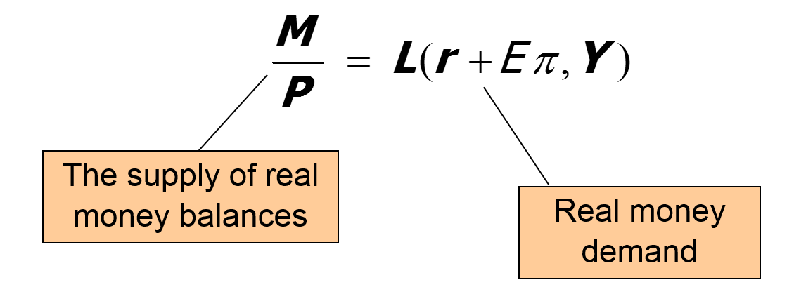
Equilibrium

Slide 34
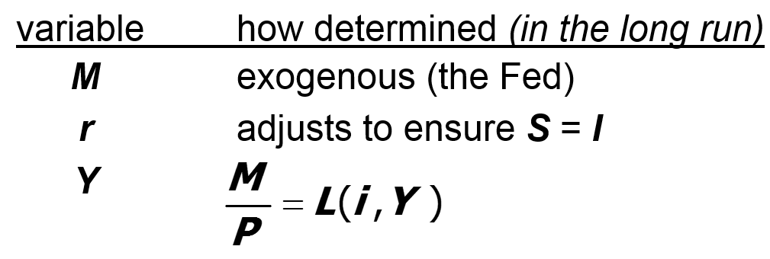
What determines what?
Notes:
Again, it is very important for students to learn the logical order in which variables are determined. For example, we do not need to know P in order to determine Y. We do need to know Y in order to determine L, and we need to know L and M in order to determine P.

Slide 35
How P responds to ΔM
For given values of r, Y, and Eπ , a change in M causes P to change by the same percentage—just like in the quantity theory of money.
Notes:
This slide shows the connection between the money market equilibrium condition and the (simpler) quantity theory of money, presented earlier in this chapter.

Slide 36
What about expected inflation?
Over the long run, people don’t consistently over- or under-forecast inflation,
so Eπ = π on average.
In the short run, Eπ may change when people get new information.
Example: The Fed announces it will increase M next year. People will expect next year’s P to be higher, so Eπ rises.
This affects P now, even though M hasn’t changed yet...
Notes:
This slide and the next correspond to the subsection of Chapter 5 titled “Future Money and Current Prices” on pp. 116–118.

Slide 37
How P responds to ΔEπ
For given values of r, Y, and M,

Slide 38
The classical view of inflation
The classical view:
A change in the price level is merely a change in the units of measurement.
Then, why is inflation a social problem?

Slide 39
NOW YOU TRY
Discussion question
Why is inflation bad?
What costs does inflation impose on society?
List all the costs you can think of.
Focus on the long run.
Think like an economist.
Notes:
Many of the social costs of inflation are not hard to figure out, if students “think like an economist.” The goal is to see if students can come up with problems listed in the following slides on their own.
Suggestion: After you pose the question, don’t immediately ask for students to volunteer their answers. Instead, tell them to think about the question for a moment, jot down their answers, and THEN ask for volunteers. You will get more participation (quantity and quality) this way, especially from students who don’t consider themselves fast thinkers.
After presenting the following slides (which describe the costs), see how many of the costs presented here were anticipated by the students’ responses to the questions on this slide.

Slide 40
A common misperception
Common misperception:
inflation reduces real wages
This is true only in the short run, when nominal wages are fixed by contracts.
(Chapter 3) In the long run, the real wage is determined by labor supply and the marginal product of labor, not the price level or inflation rate.
Consider the data . . .
Notes:
Encourage your students to check out the case study “What Economists and the Public Say About Inflation” on p. 119.

Slide 41
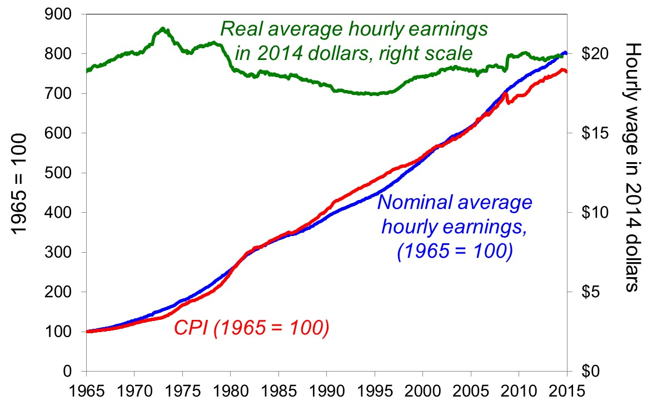
The CPI and average hourly earnings, 1965–2015
Notes:
The CPI has risen tremendously over the past 45 years. However, nominal wages have risen by a roughly similar magnitude.
If the common misperception were true, then the real wage should show exactly the opposite behavior of the CPI. It doesn’t. While the real wage is not constant, it exhibits no downward long-term trend.
(We wouldn’t expect the real wage to be constant over the long run; we would expect it to change in response to shifts in the labor supply and MPL curves.)
source: BLS
Obtained from: http://research.stlouisfed.org/fred2/
AHETPI, average hourly earnings: total private industries monthly
CPIAUCSL, CPI, all urban consumers, seasonally adjusted

Slide 42
The social costs of inflation
…fall into two categories:
costs when inflation is expected
costs when inflation is different from what people had expected

Slide 43
The costs of expected inflation: 1. Shoeleather cost
Definition: the costs and inconveniences of reducing money balances to avoid the inflation tax.
If π increases, i increases (why?), so people reduce their real money balances.
Remember: In long run, inflation does not affect real income or real spending.
The same monthly spending but lower average money holdings means more frequent trips to the bank to withdraw smaller amounts of cash.
Notes:
In the second bullet, the answer to the parenthetical “why?” is the Fisher effect.
Thanks to ATMs and Internet banking, the shoeleather cost is likely to be very small.

Slide 44
The costs of expected inflation: 2. Menu costs
Definition: the costs of changing prices.
Examples:
  cost of printing new menus and mailing out catalogs
  time spent trying to decide on what the new prices should be
The higher is inflation, the more frequently firms must change their prices and incur these costs.
Notes:
This might be a good time to let the class know that Mankiw is one of the leading experts on menu costs (http://gregmankiw.blogspot.com/2007/04/menu-costs.html)
Also, his blog features some interesting examples of companies avoiding menu costs:
1. http://gregmankiw.blogspot.com/2009/03/menu-costs-defeated.html
2. http://gregmankiw.blogspot.com/2008/12/how-to-avoid-menu-cost.html

Slide 45
The costs of expected inflation: 3. Relative price distortions
Firms facing menu costs change prices infrequently.
Example:
A firm issues new catalog each January.
As the general price level rises throughout the year, the firm’s relative price will fall.
Different firms change their prices at different times, leading to relative price distortions . . .
. . . causing microeconomic inefficiencies in the allocation of resources.

Slide 46
The costs of expected inflation: 4. Unfair tax treatment
Some taxes, such as the capital gains tax, are not adjusted to account for inflation.
Example:
  Jan 1: you buy $10,000 worth of Apple stock
  Dec 31: you sell the stock for $11,000, so your nominal capital gain is $1,000 (10%).
  Suppose π = 10% during the year.
  Your real capital gain is $0.
  Yet, you must pay taxes on your $1,000 nominal gain!
Notes:
In the 1970s, the income tax was not adjusted for inflation. There were a lot of people who received nominal salary increases large enough to push them into a higher tax bracket but not large enough to prevent their real salaries from falling in the face of high inflation. This led to political pressure to index the income tax brackets.
If inflation had been higher during 1995–2000, when lots of people were earning high capital gains, then there might have been more political pressure to index the capital gains tax.

Slide 47
The costs of expected inflation: 5. General inconvenience
Inflation makes it harder to compare nominal values from different time periods.
This complicates long-range financial planning.
Notes:
Examples:
Parents trying to decide how much to save for the future college expenses of their (now) young child
Thirtysomethings trying to decide how much to save for retirement
The CEO of a big corporation trying to decide whether to build a new factory, which will yield a revenue stream for 20 years or more

Slide 48
The costs of unexpected inflation: Arbitrary redistribution of purchasing power
Many long-term contracts are not indexed but are based on Eπ.
If π turns out to be different from Eπ , then some gain at others’ expense.
Example: borrowers and lenders
  If π > Eπ , then (i − π) < (i − Eπ )
  and purchasing power is transferred from lenders to borrowers.
  If π < E π, then purchasing power is transferred from borrowers to lenders.
Notes:
Ask students this rhetorical question: Would it upset you if somebody arbitrarily took wealth away from some people and gave it to others?
This, in effect, is what’s happening when inflation turns out to be different than expected.
Furthermore, it’s impossible to predict when inflation will turn out higher than expected, when it will be lower, and how big the difference will be. So, these redistributions of purchasing power are arbitrary and random.
The text gives a simple numerical example on p. 123.
(In the short run, when many nominal wages are fixed by contracts, there are transfers of purchasing power between firms and their employees whenever inflation is different than expected when the contract was written and signed.)

Slide 49
Additional cost of high inflation: Increased uncertainty
When inflation is high, it’s more variable and unpredictable: π turns out different from Eπ more often,
and the differences tend to be larger, though not systematically positive or negative.
So, arbitrary redistributions of wealth are more likely.
This increases uncertainty, making risk-averse people worse off.
Notes:
Not all students might remember what it means to be risk averse. You may wish to remind all students what risk averse means.

Slide 50
One benefit of inflation
Nominal wages are rarely reduced, even when the equilibrium real wage falls.
This hinders labor market clearing.
Inflation allows the real wages to reach equilibrium levels without nominal wage cuts.
Therefore, moderate inflation improves the functioning of labor markets.
Notes:
Students will better appreciate this point when they learn about the natural rate of unemployment in Chapter 7. In that chapter, we will see how the failure of wages to adjust contributes to a long-term unemployment problem.
A modern example of this benefit is in Spain:
https://blogs.imf.org/2014/03/04/euro-area-deflation-versus-lowflation/ shows how nominal wages are not falling in Spain due to low levels inflation.
https://fred.stlouisfed.org/series/LRHUTTTTESM156S tracks the unemployment rate for Spain. (unlike in the United States, Spanish unemployment kept increasing after 2011.).

Slide 51
Hyperinflation
Common definition: π ≥ 50% per month
All the costs of moderate inflation described above become HUGE under hyperinflation.
Money ceases to function as a store of value, and it may not serve its other functions (unit of account, medium of exchange).
People may conduct transactions with barter or a stable foreign currency.
Notes:
Page 124 has an excellent example of life during a hyperinflation. The example involves beer, a commodity with which your students may be somewhat familiar.
See also the two excellent case studies: “Hyperinflation in Interwar Germany” (pp. 126–127) and “Hyperinflation in Zimbabwe” (pp. 128–129).

Slide 52
What causes hyperinflation?
Hyperinflation is caused by excessive money supply growth.
When the central bank prints money, the price level rises.
If it prints money rapidly enough, the result is hyperinflation.

Slide 53
A few examples of hyperinflation
Country | Period | CPI inflation % per year | M2 growth % per year
Israel | 1983-85 | 338% | 305%
Brazil | 1987-94 | 1,256 | 1,451
Bolivia | 1983-86 | 1,818 | 1,727
Ukraine | 1992-94 | 2,089 | 1,029
Argentina | 1988-90 | 2,671 | 1,583
Dem. Republic of Congo/Zaire | 1990-96 | 3,039 | 2,373
Angola | 1995-96 | 4,145 | 4,106
Peru | 1988-90 | 5,050 | 3,517
Zimbabwe | 2005-07 | 5,316 | 9,914
Notes:
Source: World Development Indicators, World Bank.
Notes:
The inflation and money growth figures are computed as annual averages from the end of the first year to the end of the last year shown in each period.
During 2008, Zimbabwe’s hyperinflation continued and became spectacular. The table on this slide excludes 2008 data because it is missing from the WDI database. It’s easy to find estimates of Zimbabwe’s 2008 inflation, for example here: http://www.cato.org/zimbabwe. However, I cannot verify their reliability or find good data on Zimbabwe’s money supply in 2008.

Slide 54
Why governments create hyperinflation
When a government cannot raise taxes or sell bonds, it must finance spending increases by printing money.
In theory, the solution to hyperinflation is simple: stop printing money.
In the real world, this requires drastic and painful fiscal restraint.
Notes:
Before revealing the contents of this slide, you might consider asking students the following question:
“Solving the problem of hyperinflation is easy. Why, then, do governments allow hyperinflation to occur?”

Slide 55
The classical dichotomy, part 1
Real variables: measured in physical units—quantities and relative prices, for example:
  quantity of output produced
  real wage: output earned per hour of work
  real interest rate: output earned in the future by lending one unit of output today

Slide 56
The classical dichotomy, part 2
Nominal variables: measured in money units—for example:
  nominal wage: dollars per hour of work
  nominal interest rate: dollars earned in the future by lending one dollar today
  price level: number of dollars needed to buy a representative basket of goods

Slide 57
The classical dichotomy, part 3
Recall: Real variables were explained in Chapter 3, nominal ones in Chapter 5.
Classical dichotomy: the theoretical separation of real and nominal variables in the classical model, which implies nominal variables do not affect real variables.
Neutrality of money: idea that changes in the money supply do not affect real variables.
In the real world, money is approximately neutral in the long run.

Slide 58
CHAPTER SUMMARY, PART 1
Velocity: the ratio of nominal expenditure to money supply, the rate at which money changes hands
Quantity theory of money
  assumes velocity is constant
  concludes that the money growth rate determines the inflation rate
  applies in the long run
  consistent with cross-country and time-series data

Slide 59
CHAPTER SUMMARY, PART 2
Nominal interest rate
  equals real interest rate + inflation rate
  the opposite cost of holding money
Fisher effect: Nominal interest rate moves one-for-one with expected inflation.
Money demand
  depends only on income in the quantity theory
  also depends on the nominal interest rate
  if so, then changes in expected inflation affect the current price level

Slide 60
CHAPTER SUMMARY, PART 3
Costs of inflation
Expected inflation
shoeleather costs, menu costs, tax and relative price distortions, inconvenience of correcting figures for inflation
Unexpected inflation
all of the above plus arbitrary redistributions of wealth between debtors and creditors

Slide 61
CHAPTER SUMMARY, PART 4
Hyperinflation
  caused by rapid money supply growth when money is printed to finance government budget deficits
  stopping it requires fiscal reforms to eliminate
  the government’s need for printing money

Slide 62
CHAPTER SUMMARY, PART 5
Classical dichotomy
  In classical theory, money is neutral—does not affect real variables.
  So, we can study how real variables are determined without reference to nominal ones.
  Then, money market eq’m determines price level and all nominal variables.
  Most economists believe the economy works this way in the long run.

