Slide 1

The Open Economy
Macroeconomics
N. Gregory Mankiw
© 2019 Worth Publishers, all rights reserved
Notes:
Chapter 6 extends the long-run analysis of Chapters 3 and 5 to a small open economy.
This PowerPoint presentation contains a slide explaining why the United States is often called “the world’s largest debtor nation.” This information will help motivate what students will learn in the rest of the chapter, including the definition and meaning of trade surpluses and trade deficits, the link between the trade balance and net capital outflows, and the determination of real and nominal exchange rates.
The PowerPoint presentation contains a time-series graph on the “twin deficits” (budget and trade) and data on U.S. net indebtedness to the rest of the world.
These data suggest some questions: How did it come to this? Why has the United States had such huge trade deficits? What can the government do about this? These are among the many topics that students will better understand as they study this chapter.

Slide 2
IN THIS CHAPTER, YOU WILL LEARN:
Accounting identities for the open economy
The small open-economy model
  what makes it “small”
  how the trade balance and exchange rate are determined
  how policies affect trade balance and exchange rate

Slide 3
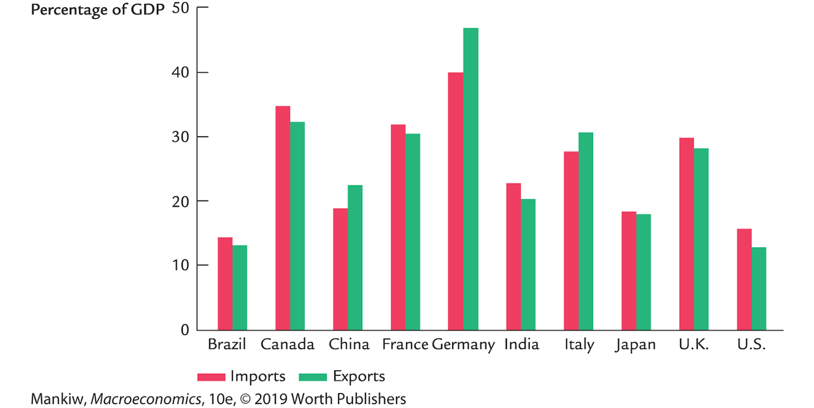
Imports and exports of selected countries, 2013
Notes:
In dollar terms, U.S. trade is huge, but as a percentage of GDP, it is smaller than that of many other countries.
Source: World Development Indicators, World Bank
http://databank.worldbank.org/ddp/home.do?Step=3&id=4

Slide 4
In an open economy,
spending need not equal output
saving need not equal investment
Notes:
“Spending need not equal output”
Residents of an open economy can spend more than the country’s output simply by importing foreign goods. Residents can spend less than output, and the extra output will be exported.
“Saving need not equal investment”
If individuals in an open economy want to save more than domestic firms want to borrow, no problem. The savers simply send their extra funds abroad to buy foreign assets. Similarly, if domestic firms want to borrow more than individuals are willing to save, then the firms simply borrow from abroad (i.e., sell bonds to foreigners).

Slide 5
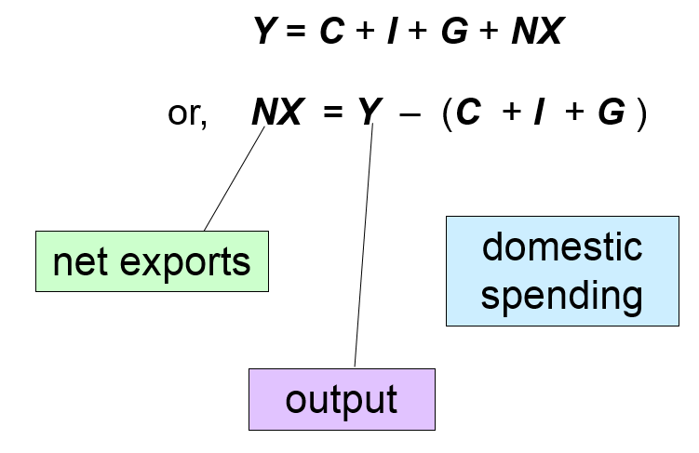
The national income identity in an open economy
Notes:
Solving this identity for NX yields the second equation, which says:
A country’s net exports—its net outflow of goods—equals the difference between its output and its expenditure.
Example: If we produce $500 billion worth of goods and buy only $400 billion worth, then we export the remainder.
Of course, NX can be a negative number, which would occur if our spending exceeds our income/output.

Slide 6
Trade surpluses and deficits
NX = X – IM = Y – (C + I + G)
Trade surplus:
output > spending and exports (X) > imports (IM)
Size of the trade surplus = NX
Trade deficit:
spending > output and imports > exports
Size of the trade deficit = –NX
Notes:
X: Exports
IM: Imports

Slide 7
International capital flows
Net capital outflow
  = S – I
  = net outflow of “loanable funds”
  = net purchases of foreign assets the country’s purchases of foreign assets minus foreign purchases of domestic assets
When S > I, country is a net lender
When S < I, country is a net borrower
Notes:
In Chapter 3, we examined a closed-economy model of the loanable funds market. Savers could only lend money to domestic borrowers. Firms borrowing to finance their investment could only borrow from domestic savers. Thus, S = I.
But in an open economy, S need not equal I. A country’s supply of loanable funds can be used to finance domestic investment or to finance foreign investment (e.g., buying bonds from a foreign company that needs funding to build a new factory in its country).
Similarly, domestic firms can finance their investment projects by borrowing loanable funds from domestic savers or by borrowing them from foreign savers.
International borrowing and lending is called “international capital flows” even though it’s not the physical capital that is flowing abroad—we don’t see factories uprooted and shipped to Mexico. Rather, what can flow internationally is “loanable funds,” or financial capital, which of course is used to finance the purchase of physical capital.
Note: Foreign investment might involve the purchase of financial assets—stocks and bonds and so forth—or physical assets, such as direct ownership in office buildings or factories. In either case, a person in one country ends up owning/financing part of the capital stock of another country.
The equation net capital outflow = S – I shows that, if a country’s savers supply more funds than its firms wish to borrow for investment, the excess of loanable funds will flow abroad in the form of net capital outflow (the purchase of foreign assets). Alternatively, if firms wish to borrow more than domestic savers wish to lend, then the firms borrow the excess on international financial markets; in this case, there’s a net inflow of loanable funds, and S < I.

Slide 8
The link between trade and capital flows
NX = Y – (C + I + G )
implies
NX = (Y – C – G ) – I
= S – I
trade balance = net capital outflow
Thus,
a country with a trade deficit (NX < 0)
is a net borrower (S < I ).
Notes:
This equation says that the net outflow of goods and services (net exports) equals the net outflow of financial capital (or loanable funds).
While the identity and its derivation are very simple, we learn a very important lesson from it:
A country (such as the United States) with persistent large trade deficits (NX < 0) also has low saving, relative to its investment, and is a net borrower of assets.

Slide 9
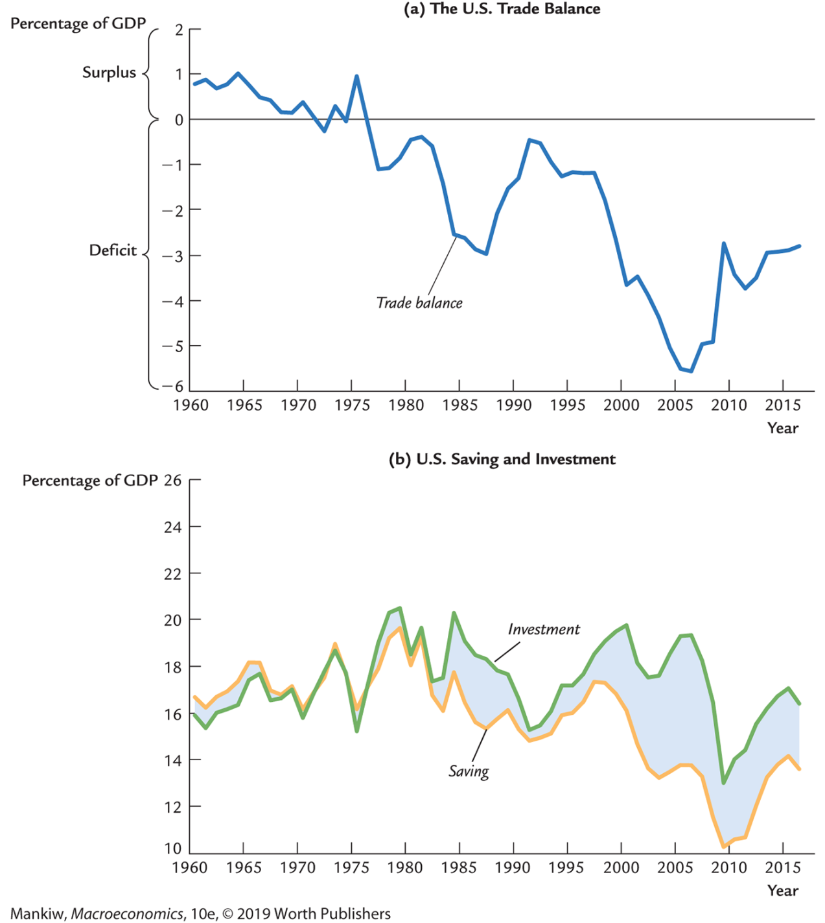
Saving, investment, and the trade balance 1960–2014
Notes:
Notice that investment > saving pretty consistently beginning in the early 1980s.
The trade balance is measured on the right-hand scale; note that the location of 0% is different on the two scales.
Source: Federal Reserve Bank of St. Louis
Notes: Investment was constructed as the sum of gross private domestic investment (GPDI), federal government defense investment (DGI), federal government nondefense investment (NDGI), and state and local investment (SLINV).
Saving is simply gross saving (GSAVE). The trade balance was constructed as saving minus investment.

Slide 10
U.S.: the world’s largest debtor nation
Every year since the 1980s: huge trade deficits and net capital inflows (that is, net borrowing from abroad)
As of December 31, 2014:
  U.S. residents owned $24.7 trillion worth of foreign assets
  Foreigners owned $31.6 trillion worth of U.S. assets
  U.S. net indebtedness to the rest of the world:
  $6.9 trillion—higher than any other country, hence U.S. is the “world’s largest debtor nation”
Notes:
Servicing this huge debt, of course, uses up some of our GDP each year, though fortunately relatively little: the United States, so far, has been able to borrow from abroad at lower interest rates than it lends to abroad.
However, this may well change. Just as credit card companies raise your interest rate when your balance rises above a certain level, the countries that hold U.S. assets may well require higher interest rates to make them willing to continue to finance our trade deficits.
How did it get to this point? Why do we have such huge trade deficits year after year? How do government policies affect the trade deficit? These are the questions your students will learn about in the rest of this chapter.
Source: Bureau of Economic Analysis, http://www.bea.gov
Look for “International Investment Position” under “International” or “International Economic Accounts”

Slide 11
Saving and investment in a small open economy
An open-economy version of the loanable funds model from Chapter 3
Includes many of the same elements:

Slide 12
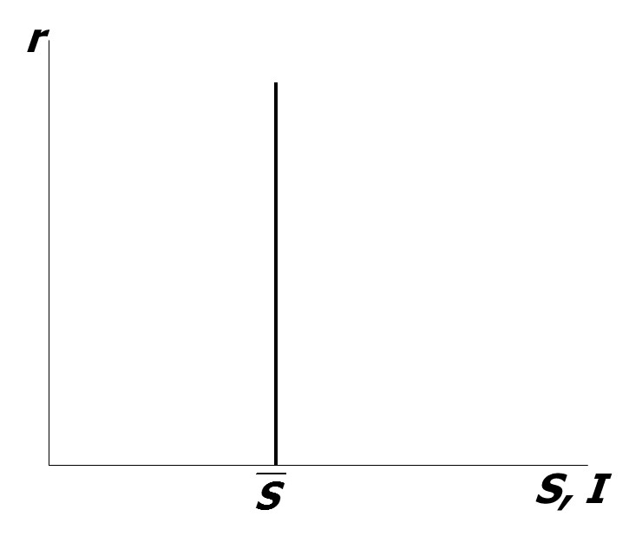
National saving: The supply of loanable funds
As in Chapter 3, national saving does not depend on the interest rate

Slide 13
Assumptions about capital flows
Domestic and foreign bonds are perfect substitutes (same risk, maturity, etc.)
Perfect capital mobility:
no restrictions on international trade in assets
Economy is small:
cannot affect the world interest rate, denoted r*
a and b imply r = r*
c implies r* is exogenous
Notes:
This slide is the first on which students see a foreign variable, in this case, the foreign interest rate r*. In general, a star or asterisk * on a variable denotes the foreign or world version of that variable.
Thus, Y* = foreign GDP, P* = foreign price level, etc.
The assumption that domestic and foreign bonds are perfect substitutes is implicit in the text but necessary for the equality of the domestic and foreign interest rates.
Students will realize that assumption a is unrealistic, and c is unrealistic for the United States (as well as Japan and the euro area). However, these assumptions keep our model simple, and we can still learn A LOT about how the world works (just as the model of supply and demand in perfectly competitive markets is often not realistic yet teaches us a great deal about how the world works). At the end of the chapter is a brief section discussing how the results we are about to derive differ in a large open economy. You may wish to have your students read the appendix to Chapter 5, which presents a formal model of the large open economy.

Slide 14
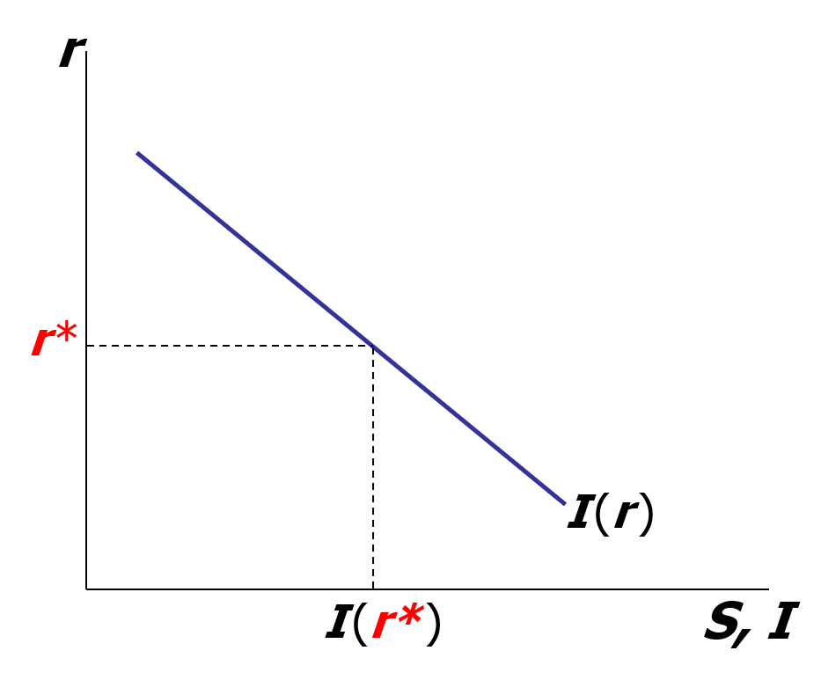
Investment: The demand for loanable funds
Investment is still a downward-sloping function of the interest rate,
but the exogenous world interest rate…
…determines the country’s level of
investment.
Notes:
The world interest rate is exogenous due to the small economy assumption.

Slide 15
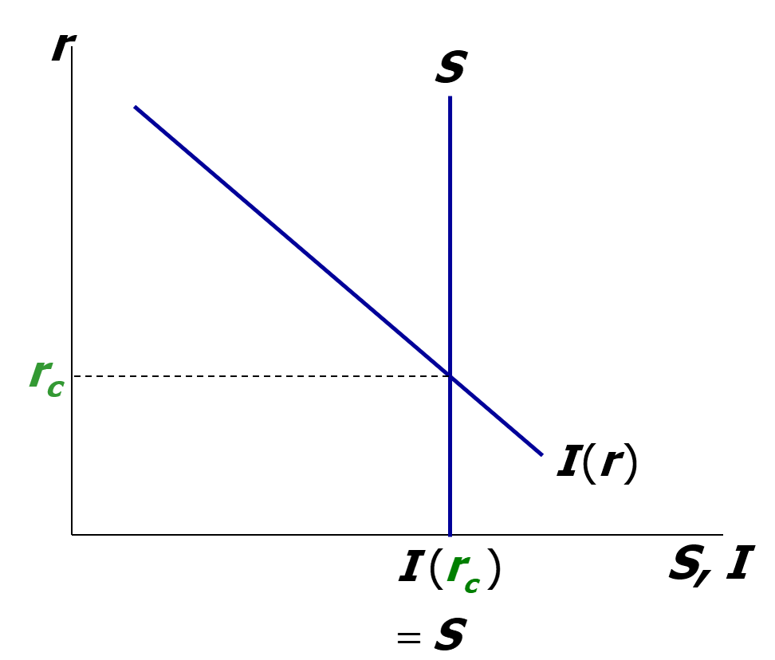
If the economy were closed…
. . . the interest rate would adjust to equate investment and saving.

Slide 16
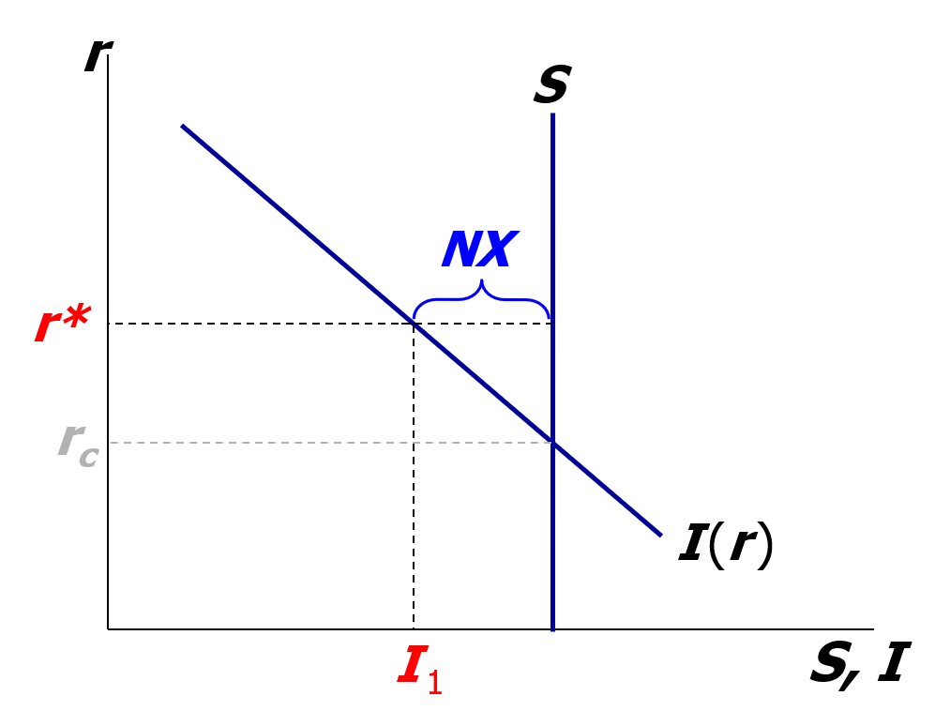
But in a small open economy…
the exogenous world interest rate determines investment…
…and the difference between saving and investment determines net capital outflow and net exports
Notes:
This graph really determines net capital outflow, not NX. But, the national accounting identities say that NX = net capital outflow, so we write “NX” on the graph as shown.
A little bit later in the chapter, we will see that it is the adjustment of the exchange rate that ensures that NX = net capital outflow. For now, though, students will just have to trust the accounting identities.

Slide 17
Three experiments:
Fiscal policy at home
Fiscal policy abroad
An increase in investment demand (exercise)
Notes:
In the textbook, NX = 0 in the economy’s initial equilibrium for each of these three experiments.
In these slides, NX > 0 in the initial equilibrium.
For completeness, you might have your students repeat the three experiments for the case of NX < 0 in the initial equilibrium. This would be a good homework or in-class exercise.

Slide 18
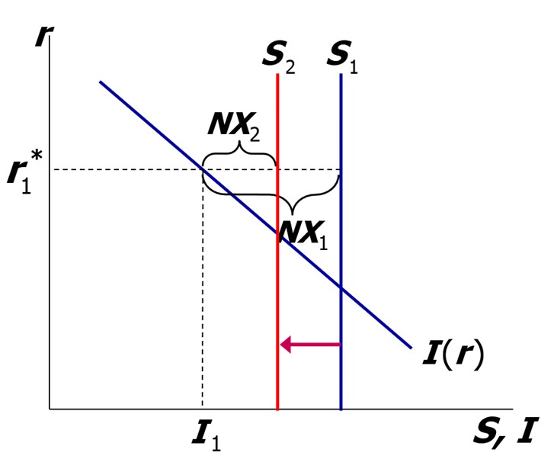
1. Fiscal policy at home (1 of 2)
An increase in G or decrease in T reduces saving.
Results:
Notes:
In a small open economy, the fixed world interest rate pins down the value of investment, regardless of fiscal policy changes. Thus, a $1 decrease in saving causes a $1 decrease in NX and net capital outflow.
Note that the analysis on this slide applies to ANYTHING that causes a decrease in saving. Other examples: a shift in consumer preferences regarding the tradeoff between saving and consumption or a change in the tax laws that reduces the incentive to save.
Our model generates a prediction: the government’s budget deficit and the country’s trade balance should be negatively related. Does this prediction come true in the real world? Let’s look at the data . . .

Slide 19
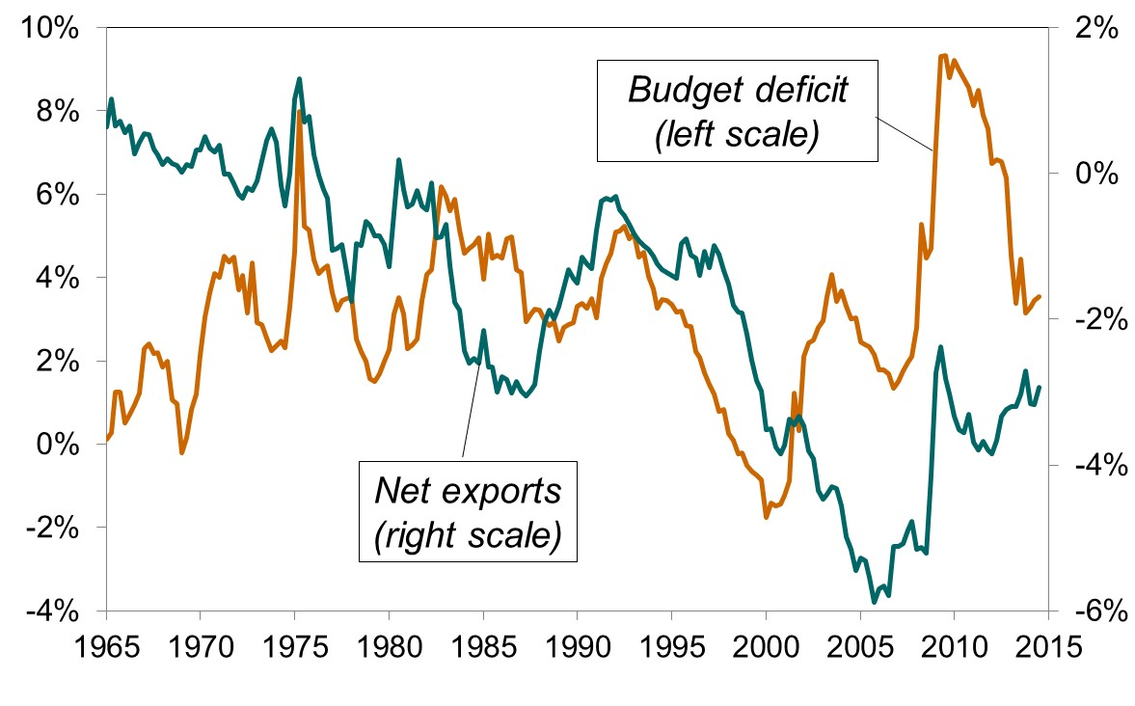
NX and the federal budget deficit (% of GDP), 1965–2014
Notes:
Our model implies a negative relationship between NX and the budget deficit. We observe this negative relationship during most periods.
There are some exceptions. For example, from 1991 to 2001, NX and the budget deficit fell due to a long expansion: rising incomes increased imports and tax revenues.
And, in 2008–2009, NX and the budget deficit rose as the economy faltered: falling incomes reduce both tax revenue and imports.
Source: Department of Commerce.
Obtained from: http://research.stlouisfed.org/fred2/

Slide 20
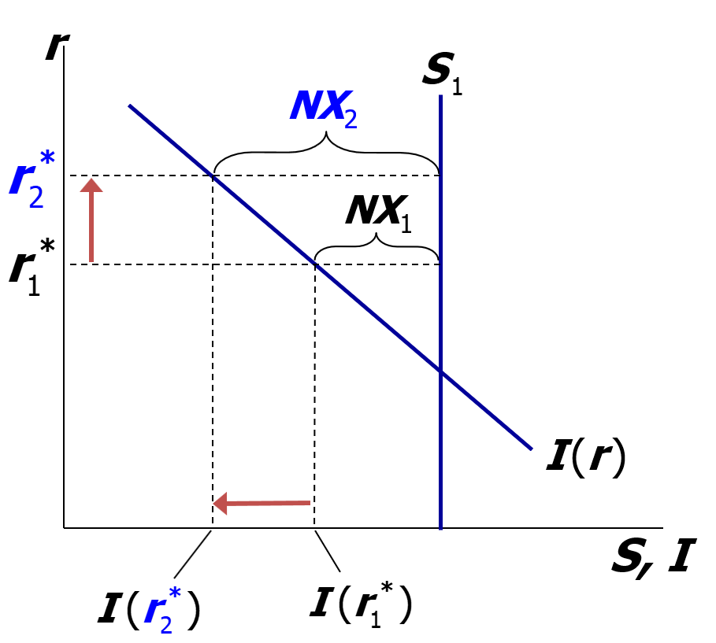
2. Fiscal policy abroad
Expansionary fiscal policy abroad raises the world interest rate.
Results:
Notes:
It might be worth taking a moment to explain that the world interest rate r* is determined by saving and investment in the world loanable funds market. S* is the sum of all countries’ saving; I* the sum of all countries’ investment. r* adjusts to equate I* with S*, just as in Chapter 3, because the world as a whole is a closed economy. A fiscal expansion in other countries would reduce S* and raise r* (same results as in Chapter 3).
The higher world interest rate reduces investment in our small open economy and, hence, reduces the demand for loanable funds. The supply of loanable funds (national saving) is unchanged, so there’s an increase in the amount of funds flowing abroad.

Slide 21
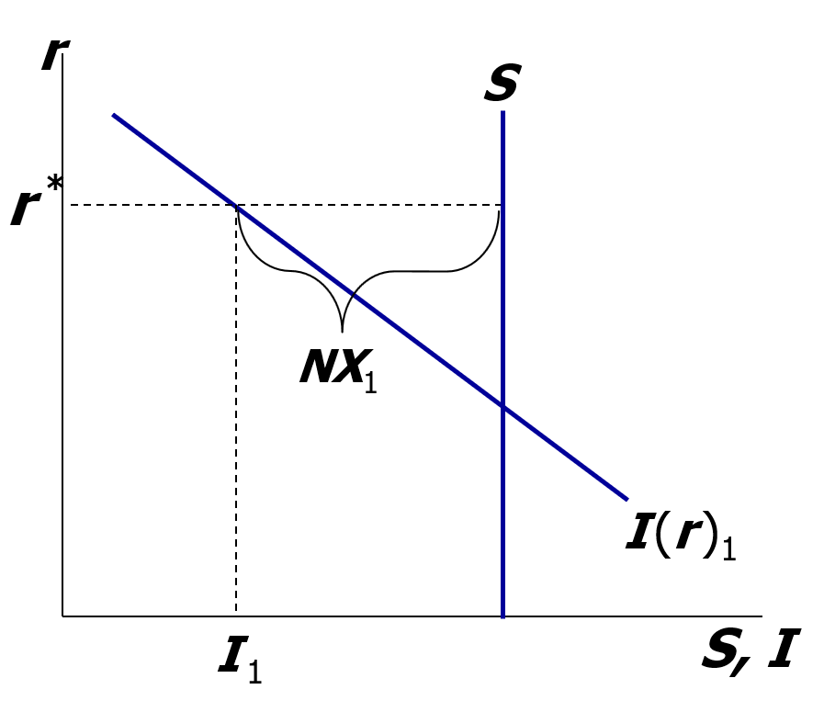
NOW YOU TRY
3. An increase in investment demand
Use the model to determine the impact of an increase in investment demand on NX, S, I, and
net capital outflow.
Notes:
Have students get out a piece of paper, draw this graph on it, and then do the analysis. A couple minutes should suffice.
It might be useful to have them compare their answers with the results from the closed economy case.

Slide 22
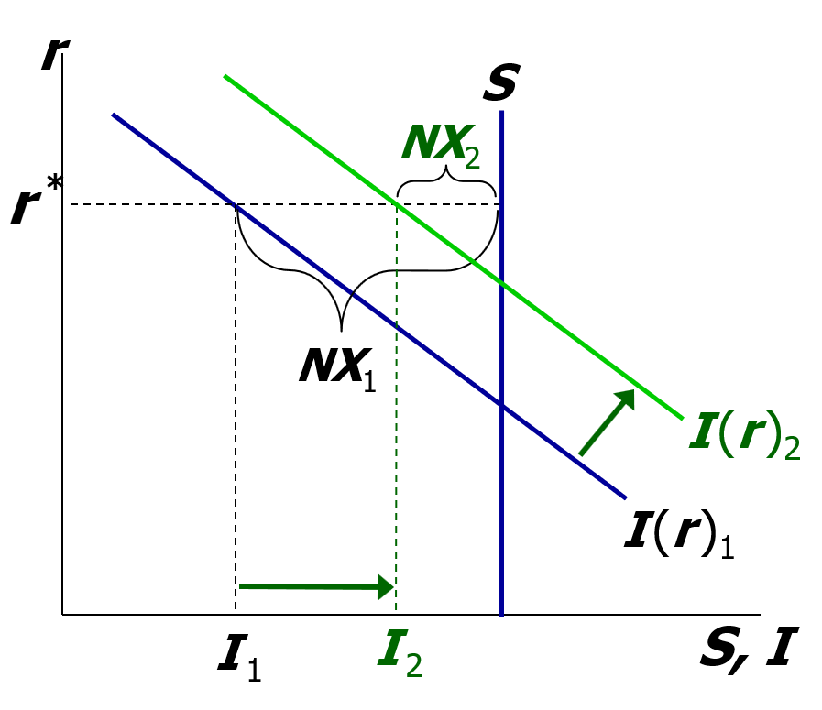
NOW YOU TRY
3. An increase in investment demand, answers
ΔI > 0, ΔS = 0, net capital outflow and NX fall by the amount ΔI
Notes:
Unlike in a closed economy, in an open economy investment is not constrained by the fixed (domestic) supply of loanable funds. Hence, the increase in a firm’s demand for loanable funds can be satisfied by borrowing abroad, which reduces net outflow of financial capital. And since net capital outflow = NX, we see a fall in NX equal to the increase in investment.

Slide 23
The nominal exchange rate
e = nominal exchange rate, the relative price of domestic currency in terms of foreign currency
(example: yen per dollar)
Notes:
Warning to students: Some textbooks and newspapers define the exchange rate as the reciprocal of the one here (example: dollars per yen instead of yen per dollar). The one here is easier to use because a rise in e corresponds to an “appreciation” of the country’s currency. Using the reciprocal would mean that a rise in e is a depreciation, which seems counterintuitive.
So it would be worthwhile to point out to students that a country’s e is simply the price (measured in foreign currency) of a unit of that country’s currency.

Slide 24
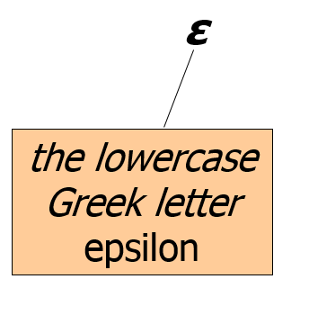
The real exchange rate
= real exchange rate, the relative price of domestic goods in terms of foreign goods
(example: Japanese Big Macs per U.S. Big Mac)

Slide 25
Understanding the units of ε
Notes:
Students often have trouble understanding the units of the real exchange rate. It’s worth explaining each line carefully and making sure students understand it before displaying the next line.
Note: The examples here and in the text are in terms of one good—Big Macs. But P and P* are the overall price levels of the domestic and foreign countries. Thus, they each measure the price of a basket of goods.
When you get to the bottom line, emphasize that the real exchange rate measures the amount of purchasing power in Japan that must be sacrificed for each unit of purchasing power in the United States.

Slide 26
~ McZample ~
One good: Big Mac
Price in Japan:
P* = 200 yen
Price in the U.S.:
P = $2.50
Nominal exchange rate
e = 120 yen/$
To buy a U.S. Big Mac, someone from Japan would have to pay an amount that could buy 1.5 Japanese Big Macs.

Slide 27
ε in the real world and our model
In the real world:
We can think of ε as the relative price of a basket of domestic goods in terms of a basket of foreign goods.
In our macro model:
There’s just one good, “output.”
So ε is the relative price of one country’s output in terms of the other country’s output.
Notes:
A good candidate for the basket of goods mentioned here is the CPI basket. Perhaps a better candidate would be a basket including all goods and services that comprise GDP. Then, the real exchange rate would measure the number of units of foreign GDP trade for one unit of domestic GDP.

Slide 28
How NX depends on ε
If ε rises:
  U.S. goods become more expensive relative to foreign goods
  exports fall, imports rise
  net exports fall

Slide 29
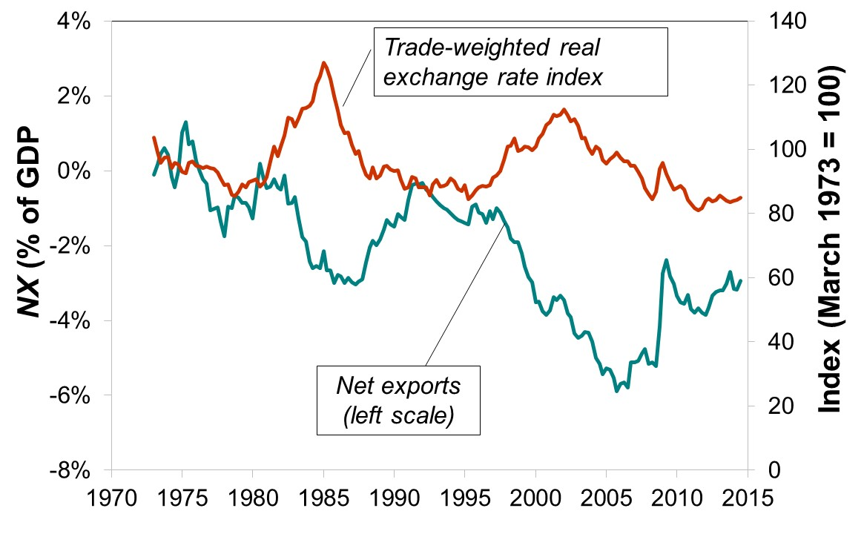
U.S. net exports and the real exchange rate, 1973–2015
Notes:
The real exchange rate here is a broad index. Source: Federal Reserve Statistical Release H.10, Board of Governors.
http://www.federalreserve.gov/releases/h10/summary/indexbc_m.txt
NX as a percentage of GDP was computed from NX and GDP source data from Department of Commerce, Bureau of Economic Analysis, obtained at http://research.stlouisfed.org/fred2/
The RER data are monthly, and the NX and Y data are quarterly, so the RER series shown in the graph is a quarterly series where each value is an average of the three monthly values from that quarter.

Slide 30
The net exports function
The net exports function reflects this inverse relationship between NX and ε :
NX = NX(ε )

Slide 31
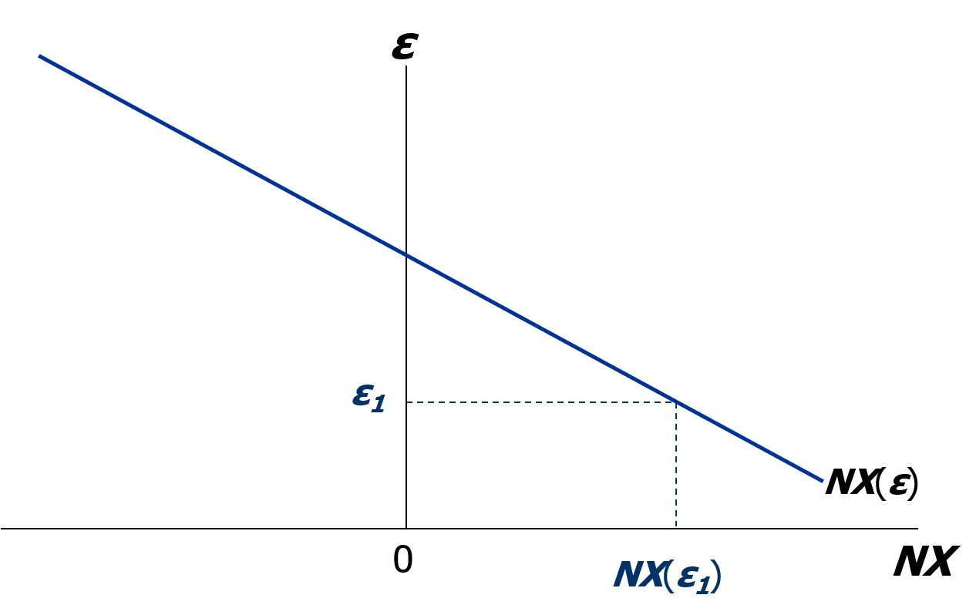
The NX curve for the United States, part 1
. . .so U.S. net exports will be high.
When ε is relatively low, U.S. goods are relatively inexpensive . . .

Slide 32
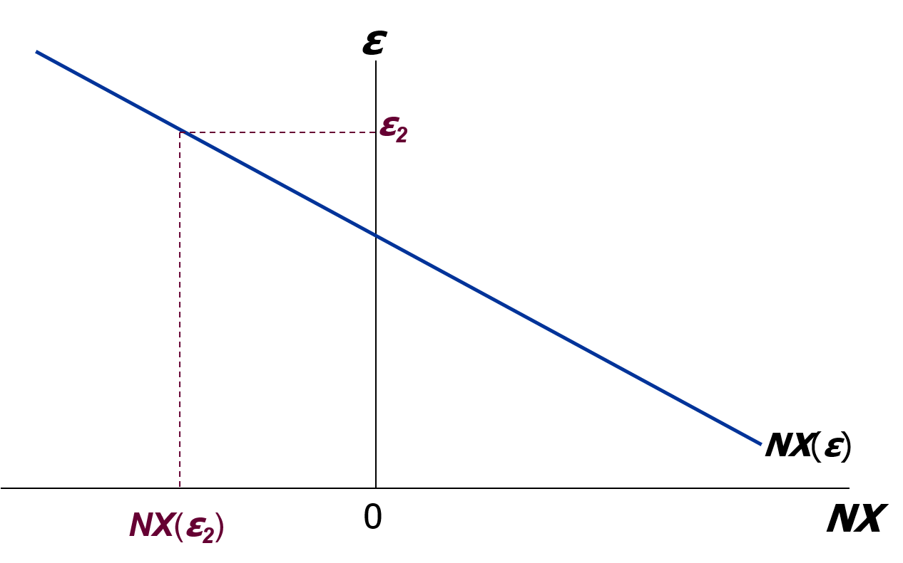
The NX curve for the United States, part 2
At high enough values of ε, U.S. goods become so expensive that we export less than we import.

Slide 33
How ε is determined (1 of 2)
The accounting identity says NX = S – I
We saw earlier how S – I is determined:
  S depends on domestic factors (output, fiscal policy variables, etc.)
  I is determined by the world interest rate r *
So, ε must adjust to ensure
Notes:
In the equation, ε is the only endogenous variable, hence this equation determines the value of ε.

Slide 34
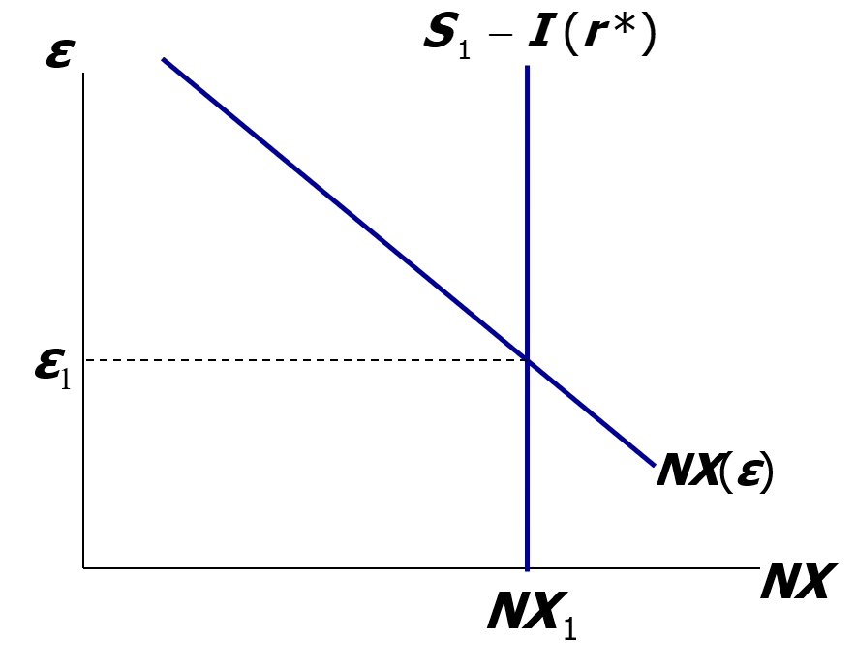
How ε is determined (2 of 2)
Neither S nor I depends on ε, so the net capital outflow curve is vertical.
ε adjusts to equate NX with net capital outflow, S − I.
Notes:
Note: At the lower-left corner (origin) of this graph, NX does NOT NECESSARILY EQUAL ZERO!
In fact, the zero on the horizontal axis may well be to the right of the vertical S – I line. (This is the case, for example, in the United States.)

Slide 35
Interpretation: Supply and demand in the foreign exchange market
Demand:
Foreigners need dollars to buy U.S. net exports.
Supply:
Net capital outflow (S − I )
is the supply of dollars to be invested abroad.
Notes:
WARNING: Don’t let your students confuse the demand for dollars in the foreign exchange market with demand for real money balances (Chapter 4) or the supply of dollars in the foreign exchange market with the supply of money (Chapter 4).
If you and your students are as detail-oriented as I am, consider this: NX is actually the net demand for dollars: foreign demand for dollars to purchase our exports minus our supply of dollars to purchase imports. Net capital outflow is the net supply of dollars: the supply of dollars from U.S. residents investing abroad minus the demand for dollars from foreigners buying U.S. assets.

Slide 36
Four experiments
1. Fiscal policy at home
2. Fiscal policy abroad
3. An increase in investment demand (exercise)
4. Trade policy to restrict imports

Slide 37
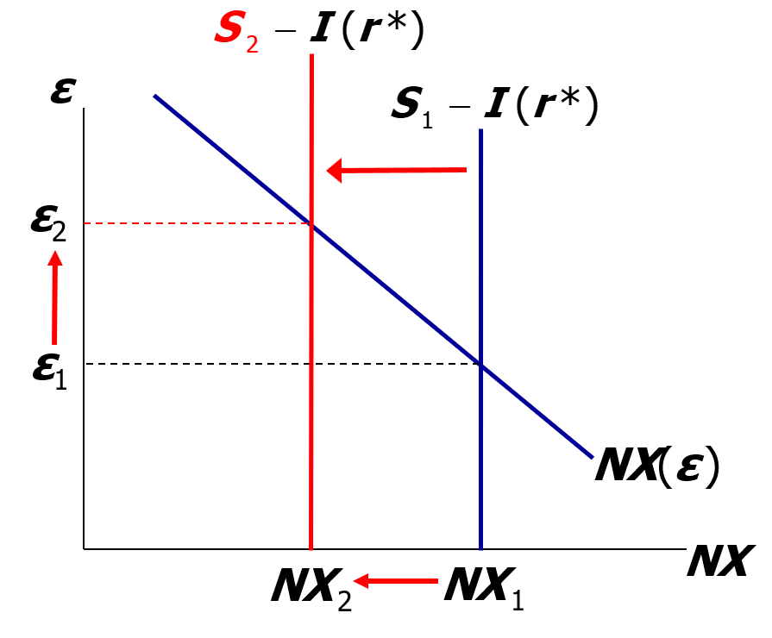
1. Fiscal policy at home (2 of 2)
A fiscal expansion reduces national saving, net capital outflow, and the supply of dollars
in the foreign exchange market…
…causing the real exchange rate to rise and NX to fall.

Slide 38
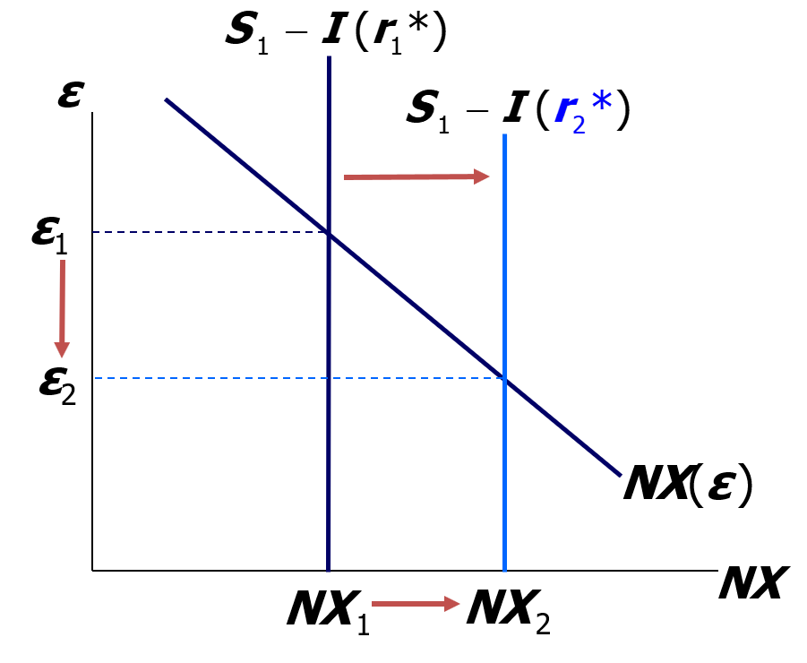
1. Fiscal policy abroad
An increase in r* reduces investment, increasing net capital outflow and the supply of dollars in the foreign exchange market…
…causing the real exchange rate to fall and NX to rise.

Slide 39
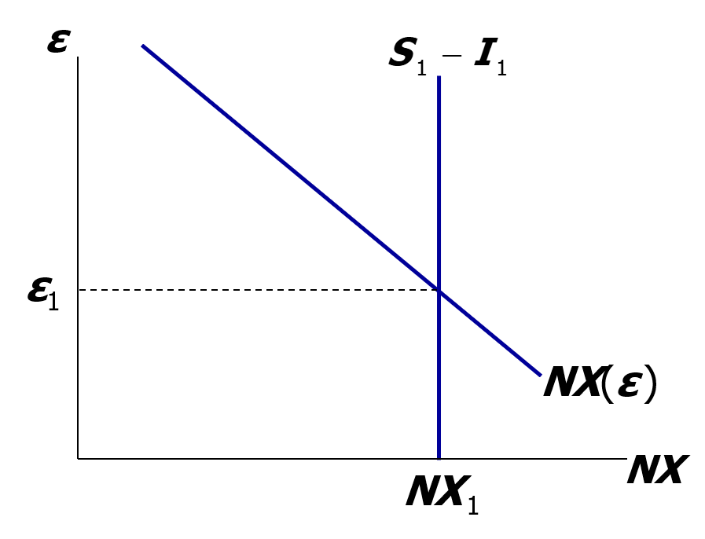
NOW YOU TRY
3. Increase in investment demand
Determine the impact of an increase in investment demand on net exports, net capital outflow,
and the real exchange rate.
Notes:
The previous “Now You Try” exercise also considered the effects of an increase in investment demand; this is a continuation of that exercise.

Slide 40
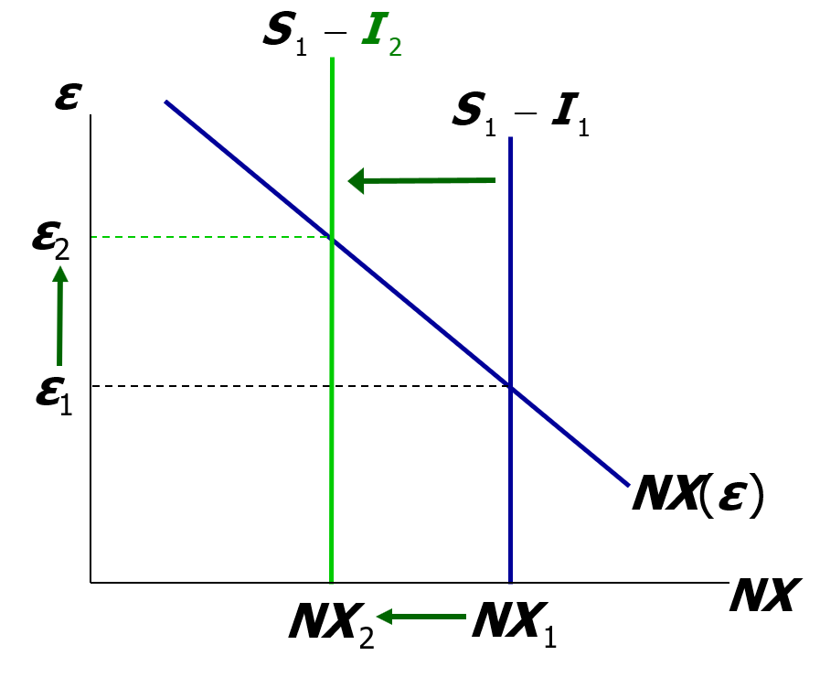
NOW YOU TRY
3. Increase in investment demand, answers
An increase in investment reduces net capital outflow and the supply of dollars in the foreign exchange market . . .
. . . causing the real exchange rate to rise and NX to fall.

Slide 41
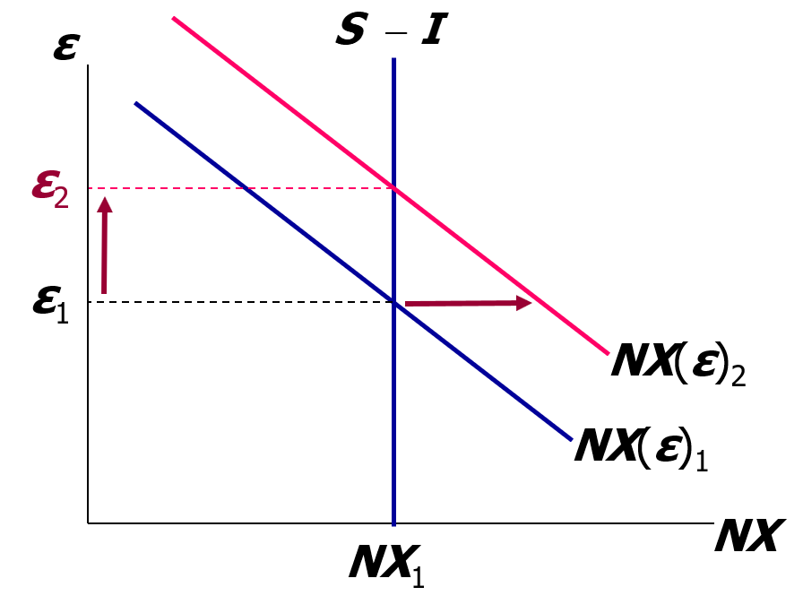
4. Trade policy to restrict imports, part 1
At any given ε, an import quota reduces IM, increases NX, and increases demand for dollars.
Trade policy doesn’t affect S or I , so capital flows and the supply of dollars remain fixed.
Notes:
The analysis here applies for import restrictions (tariffs, quotas) as well as export subsidies. It also applies for exogenous changes in preferences regarding domestic versus foreign goods.

Slide 42
4. Trade policy to restrict imports, part 2
Results:
Δε > 0
(demand increase)
ΔNX = 0
(supply fixed)
ΔIM < 0
(policy)
ΔEX < 0
(rise in ε )
Notes:
In this slide’s text box, the remarks in parentheses after each result provide an abbreviated explanation for that result.
The real exchange rate appreciates because the quota has raised the net demand for dollars associated with any given value of the exchange rate.
But the equilibrium level of net exports doesn’t change because the supply of dollars in the foreign exchange market (S - I) has not been affected by the trade policy. (Remember, S = Y – C - G, and the trade policy does not affect Y, C, or G; the policy also does not affect I, because I = I(r*) and r* is exogenous.)
The appreciation causes exports to fall.
And, since exports are lower but NX is unchanged, it must be the case that IM is lower, too, which is what you’d expect from a trade policy that restricts imports.

Slide 43
The determinants of the nominal exchange rate, part 1
Start with the expression for the real exchange rate:
Solve for the nominal exchange rate:

Slide 44
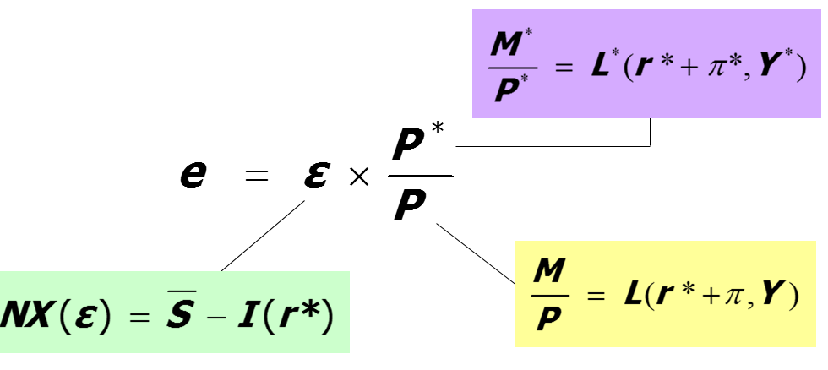
The determinants of the nominal exchange rate, part 2
So e depends on the real exchange rate and the price levels at home and abroad . . .
and we know how each of them is determined:
Notes:
It’s important here for students to learn the (logical, not necessarily chronological) order in which the variables are determined—that is, what causes what.

Slide 45
The determinants of the nominal exchange rate, part 3
Rewrite this equation in growth rates (see “Two Helpful Hints for Working with Percentage Changes” in Chapter 2):
For a given value of ε, the growth rate of e equals the difference between foreign and domestic inflation rates.
Notes:
Here we again see the classical dichotomy in action. The real exchange rate is determined by real factors, and nominal variables affect only nominal variables.
Suppose the United States is the home country and Mexico is the foreign (starred) country, and suppose that Mexico’s inflation rate (pi*) is higher than that of the United States. This equation implies that the greater Mexico’s inflation is relative to the United States, the faster the dollar should rise relative to the peso.
The next slide presents cross-country data consistent with this implication.

Slide 46
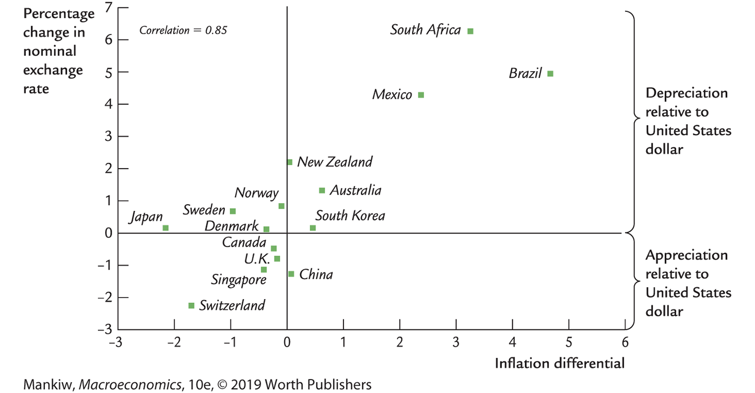
Inflation differentials and nominal exchange rates for a cross section of countries
Notes:
Figure 6-13 on p. 160. The horizontal axis measures the country’s inflation rate minus the U.S. inflation rate. The vertical axis measures the percentage change in the U.S. dollar exchange rate with that country. (Positive values mean the country’s currency depreciates relative to the dollar.)
This figure shows a positive relationship between the inflation differential and the rate of dollar appreciation: The higher a country’s inflation relative to U.S. inflation, the faster the U.S. dollar will appreciate against that country’s currency.
Source: International Financial Statistics

Slide 47
Purchasing-power parity (PPP), part 1
Two definitions:
  a doctrine that states that goods must sell at the same (currency-adjusted) price in all countries
  the nominal exchange rate adjusts to equalize the cost of a basket of goods across countries
Reasoning:
  arbitrage, the law of one price

Slide 48
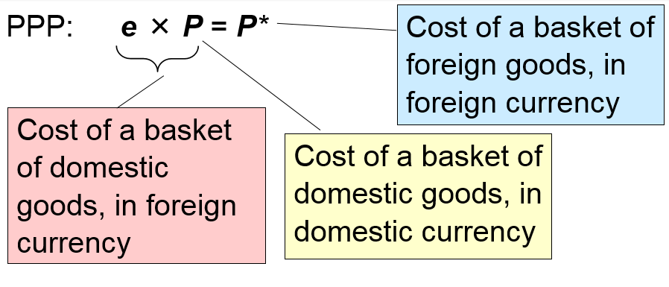
Purchasing-power parity (PPP), part 2
Solve for e: e = P*/ P
PPP implies that the nominal exchange rate between two countries equals the ratio of the countries’ price levels.
Notes:
PPP implies that the cost of a basket of goods (even a basket with just one good, like a Big Mac or a latte) should be the same across countries.
e × P = the foreign-currency cost of a basket of goods in the United States, while P*= the cost of a basket of foreign goods.
PPP implies that the baskets cost the same in both countries: eP = P*, which implies that e = P*/P.

Slide 49
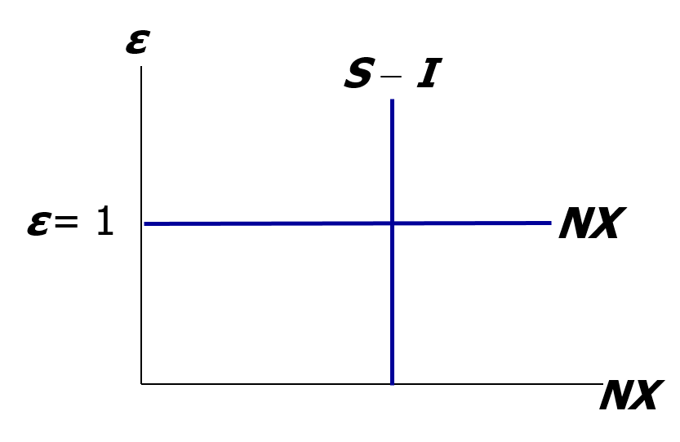
Purchasing-power parity (PPP), part 3
Under PPP, changes in (S – I ) have no impact on ε or e.
Notes:
Revisiting our model, PPP implies that the NX curve should be horizontal at ε = 1.
Intuition for the horizontal NX curve:
Under PPP, different countries’ goods are perfect substitutes, and international arbitrage is possible. If the relative price of U.S. goods falls even a tiny bit below 1, then there’s a profit opportunity: buy U.S. goods and sell them abroad. Hence, the tiniest drop in the U.S. real exchange rate causes a massive increase in NX. Similarly, if the relative price of U.S. goods rises even a tiny amount above 1, then it is profitable to buy foreign goods and sell them in the United States, so this arbitrage causes a massive increase in imports—and decrease in NX.
Thus, under PPP, the real exchange rate equals 1 regardless of net capital outflow S - I. Changes in S or I have no impact on the real exchange rate.

Slide 50
Does PPP hold in the real world?
No, for two reasons:
  International arbitrage is not possible
    nontraded goods
    transportation costs
  Different countries’ goods are not perfect substitutes
Yet PPP is a useful theory:
  It’s simple and intuitive.
  In the real world, nominal exchange rates tend toward their PPP values over the long run.

Slide 51
CASE STUDY: The Reagan Deficits Revisited
 | 1970s | 1980s | Actual change | Closed economy | Small open economy
G-T | 2.2 | 3.9 | ↑ | ↑ | ↑
S | 19.6 | 17.4 | ↓ | ↓ | ↓
r | 1.1 | 6.3 | ↑ | ↑ | no change
I | 19.9 | 19.4 | ↓ | ↓ | no change
NX | -0.3 | -2.0 | ↓ | no change | ↓
ε | 115.1 | 129.4 | ↑ | no change | ↑
Data: Decade averages; all except r and ε are expressed as a percentage of GDP; ε is a trade-weighted index.
Notes:
This is a continuation of the case study that began in Chapter 3 (in both the textbook and the PowerPoint presentation). It is placed here to motivate the last topic of Chapter 5: the U.S. as a large open economy.
As we saw in Chapter 3, the closed-economy model correctly predicted that national saving would fall and the interest rate would rise. But, the closed-economy model predicted that investment would fall as much as saving; actually, investment fell by much less than saving. Also, the closed-economy model by definition could not have predicted the effects on the trade balance or exchange rate.
The small open-economy model correctly predicted what would happen to NX and the real exchange rate, but incorrectly predicted that the interest rate and investment would not change.
In order to explain the U.S. experience, we need to combine the insights of the closed and small open-economy models.

Slide 52
The U.S. as a large open economy
So far, we’ve learned long-run models for two extreme cases:
  closed economy (Chapter 3)
  small open economy (Chapter 5)
A large open economy—like the U.S.—falls between these two extremes.
The results from large open-economy analysis are a mixture of the results for the closed and small open-economy cases.
For example . . .

Slide 53
A fiscal expansion in three models
A fiscal expansion causes national saving to fall.
The effects of this depend on openness and size.
 | Closed economy | Large open economy | Small open economy
r | rises | rises, but not as much as in a closed economy | no change
I | falls | falls, but not as much in a closed economy | no change
NX | no change | falls, but not as much as in an open economy | falls
Notes:
In the table, there’s a cell for NX in the closed economy column. Instead of putting “N.A.” in this cell, I put “no change.” Why? In a closed economy, EX = IM = NX = 0. After a change in saving, NX = 0 still. Hence, it is not incorrect to say “no change.” More importantly, we are trying to show students how the results for a large open economy are in between the results for the closed and small open cases. Looking at the items in the last row of the table, “falls, but not as much as in a small open economy” seems to be in between “no change” and “falls” but does not seem to be in between “N.A.” and “falls.”
It would be completely understandable if you still feel that “N.A.” should be in the closed economy NX cell of the table, so please feel free to edit that cell.

Slide 54
CHAPTER SUMMARY, PART 1
Net exports—the difference between:
  exports and imports
  a country’s output (Y) and its spending (C + I + G)
Net capital outflow equals:
  purchases of foreign assets minus foreign purchases of the country’s assets
  the difference between saving and investment

Slide 55
CHAPTER SUMMARY, PART 2
National income accounts identities
  Y = C + I + G + NX
  trade balance NX = S – I net capital outflow
Impact of policies on NX
  NX increases if policy causes S to rise
  or I to fall
  NX does not change if policy affects
  neither S nor I (example: trade policy)

Slide 56
CHAPTER SUMMARY, PART 3
Exchange rates
  nominal: the price of a country’s currency in terms of another country’s currency
  real: the price of a country’s goods in terms of another country’s goods
  The real exchange rate equals the nominal rate times the ratio of prices of the two countries.

Slide 57
CHAPTER SUMMARY, PART 4
How the real exchange rate is determined
  NX depends negatively on the real exchange rate, other things equal
  The real exchange rate adjusts to equate NX with net capital outflow

Slide 58
CHAPTER SUMMARY, PART 5
How the nominal exchange rate is determined:
  e equals the real exchange rate times the country’s price level relative to the foreign price level.
  For a given value of the real exchange rate, the percentage change in the nominal exchange rate equals the difference between the foreign and domestic inflation rates.

