Slide 1
Unemployment and the Labor Market
Macroeconomics
N. Gregory Mankiw
© 2019 Worth Publishers, all rights reserved
Notes:
This presentation has lots of data. Some of it is in the textbook (or is an updated version of what’s in the textbook), and some is additional data, including data that supports some of the textbook’s key points about the causes of the natural rate of unemployment.
Yet, it is one of the shorter chapters. It is also less difficult than the preceding chapters. So, most professors are able to cover this material more quickly than usual.

Slide 2
IN THIS CHAPTER, YOU WILL LEARN:
…about the natural rate of unemployment:
what it means
what causes it
understanding its behavior in the real world

Slide 3
Natural rate of unemployment
Natural rate of unemployment: The average rate of unemployment around which the economy fluctuates.
In a recession, the actual unemployment rate rises above the natural rate.
In a boom, the actual unemployment rate falls below the natural rate.
Notes:
The natural rate of unemployment is the “normal” unemployment rate the economy experiences when it is in neither a recession nor a boom.

Slide 4
Actual and natural rates of unemployment, U.S., 1960–2014
Notes:
Similar to Figure 7-1, p. 180, in the textbook.
The actual unemployment rate fluctuates considerably over the short run. These fluctuations are the focus of Part IV of the book.
For this chapter, though, our goal is to understand the behavior of the natural rate of unemployment, essentially the long-run trend in the unemployment rate.
Source: BLS, obtained from http://research.stlouisfed.org/fred2/
Unemployment data are based on seasonally adjusted monthly unemployment rates for the civilian non-institutional population of the United States.
The actual unemployment rate for each quarter is an average of the three monthly unemployment rates in that quarter.
The natural unemployment rate in a given quarter is estimated by averaging all unemployment rates from 10 years earlier to 10 years later; future unemployment rates are set at 5.5%. (Therefore, estimates of the natural rate may become less accurate toward the end of the sample period.)

Slide 5
A first model of the natural rate
Notation:
L = # of workers in labor force
E = # of employed workers
U = # of unemployed
U/L = unemployment rate

Slide 6
Assumptions
1. L is exogenously fixed.
2. During any given month,
s = rate of job separation, fraction of employed workers who lose or leave his/her jobs
f = rate of job finding, fraction of unemployed workers who find jobs
s and f are exogenous
Notes:
This slide spells out the three variables we assume to be exogenous: the labor force, the rate of job separation, and the rate of job finding.

Slide 7
The transitions between employment and unemployment
Notes:
Figure 7-2, p. 181
(Note: The sizes of the boxes containing the words “employed” and “unemployed” are not proportional to the number of people in each category.)

Slide 8
The steady-state condition
Definition: the labor market is in steady state, or long-run equilibrium, if the unemployment rate is constant.
The steady-state condition is:
Notes:
In order for the unemployment rate to be constant, the number of people who become unemployed in each month must equal the number of formerly unemployed people who find jobs.

Slide 9
Finding the “equilibrium” unemployment rate
f ×U = s ×E
= s ×(L – U)
= s ×L – s ×U
Solve for U/L:
(f + s) × U = s × L
so,
Notes:
The higher the rate of job separation, the higher the unemployment rate. The higher the rate of job finding, the lower the unemployment rate.

Slide 10
Example:
Each month,
1% of employed workers lose their jobs (s = 0.01)
19% of unemployed workers find jobs (f = 0.19)
Find the natural rate of unemployment:

Slide 11
Policy implication
A policy will reduce the natural rate of unemployment only if it lowers s or increases f.

Slide 12
Why is there unemployment? (1 of 2)
If job finding were instantaneous (f = 1), then all spells of unemployment would be brief, and the natural rate would be near zero.
There are two reasons why f < 1:
job search
wage rigidity

Slide 13
Job search and frictional unemployment
Frictional unemployment: caused by the time it takes workers to search for a job
occurs even when wages are flexible and there are enough jobs to go around
occurs because
workers have different abilities, preferences
jobs have different skill requirements
geographic mobility of workers not instantaneous
flow of information about vacancies and job candidates is imperfect

Slide 14
Sectoral shifts
sectoral shifts: changes in the composition of demand among industries or regions
example: technological change more jobs repairing computers, fewer jobs repairing typewriters
example: a new international trade agreement labor demand increases in export sectors, decreases in import-competing sectors
These scenarios result in frictional unemployment.
Notes:
Sometimes the unemployment caused by sectoral shifts is severe.
Due to increasing imports of cheaper foreign-made textiles (particularly since the expiration in 2005 of long-standing quotas on textiles from China), the U.S. textile industry has been in decline for years. Tens of thousands of workers in this industry have lost jobs.
Many of these workers are in their 50s and have worked in this industry for decades. Such workers are unlikely to have the skills necessary to get jobs available in newly booming industries, and they are less likely to invest in the acquisition of the necessary skills for these jobs. Hence, such workers are at greater risk for becoming “discouraged workers.”

Slide 15
More examples of sectoral shifts, part 1
Industrial revolution (1800s): agriculture declines, manufacturing soars
Energy crisis (1970s): demand shifts from larger cars to smaller ones
Health care spending as % of GDP:
1960: 5.2 2000: 13.8
1980: 9.1 2010: 17.9
In our dynamic economy, smaller sectoral shifts occur frequently, contributing to frictional unemployment.
Notes:
Most of the examples on this slide and the previous ones are big changes that have occurred over many years. These examples give students a good idea of what sectoral shifts are. Perhaps more important for the natural rate, though, are the many smaller changes that occur more frequently. Ours is a dynamic economy: the structure of demand is shifting almost continuously due to changes in preferences, technology, and the location of production. As a result, there is a near-continual flow of newly frictionally unemployed workers.
Sectoral shifts are distinct from recessions (which also cause unemployment). In recessions, there is a general fall in demand across industries, and the unemployment that results is cyclical. Sectoral shifts, though, are changes in the composition of demand across industries and lead to frictional unemployment, as described above.
Source of health expenditure data:
http://www.cms.hhs.gov/NationalHealthExpendData/02_NationalHealthAccountsHistorical.asp#TopOfPage

Slide 16
More examples of sectoral shifts, part 2
Government programs affecting unemployment include:
Government employment agencies disseminate info about job openings to better match workers and jobs.
Public job training programs help workers displaced from declining industries get skills needed for jobs in growing industries.
Notes:
You might want to “hide” (omit) this slide from your presentation if you plan on doing the class discussion in Slide 27, which asks students to think of things the government can do to try to reduce the natural rate of unemployment.

Slide 17
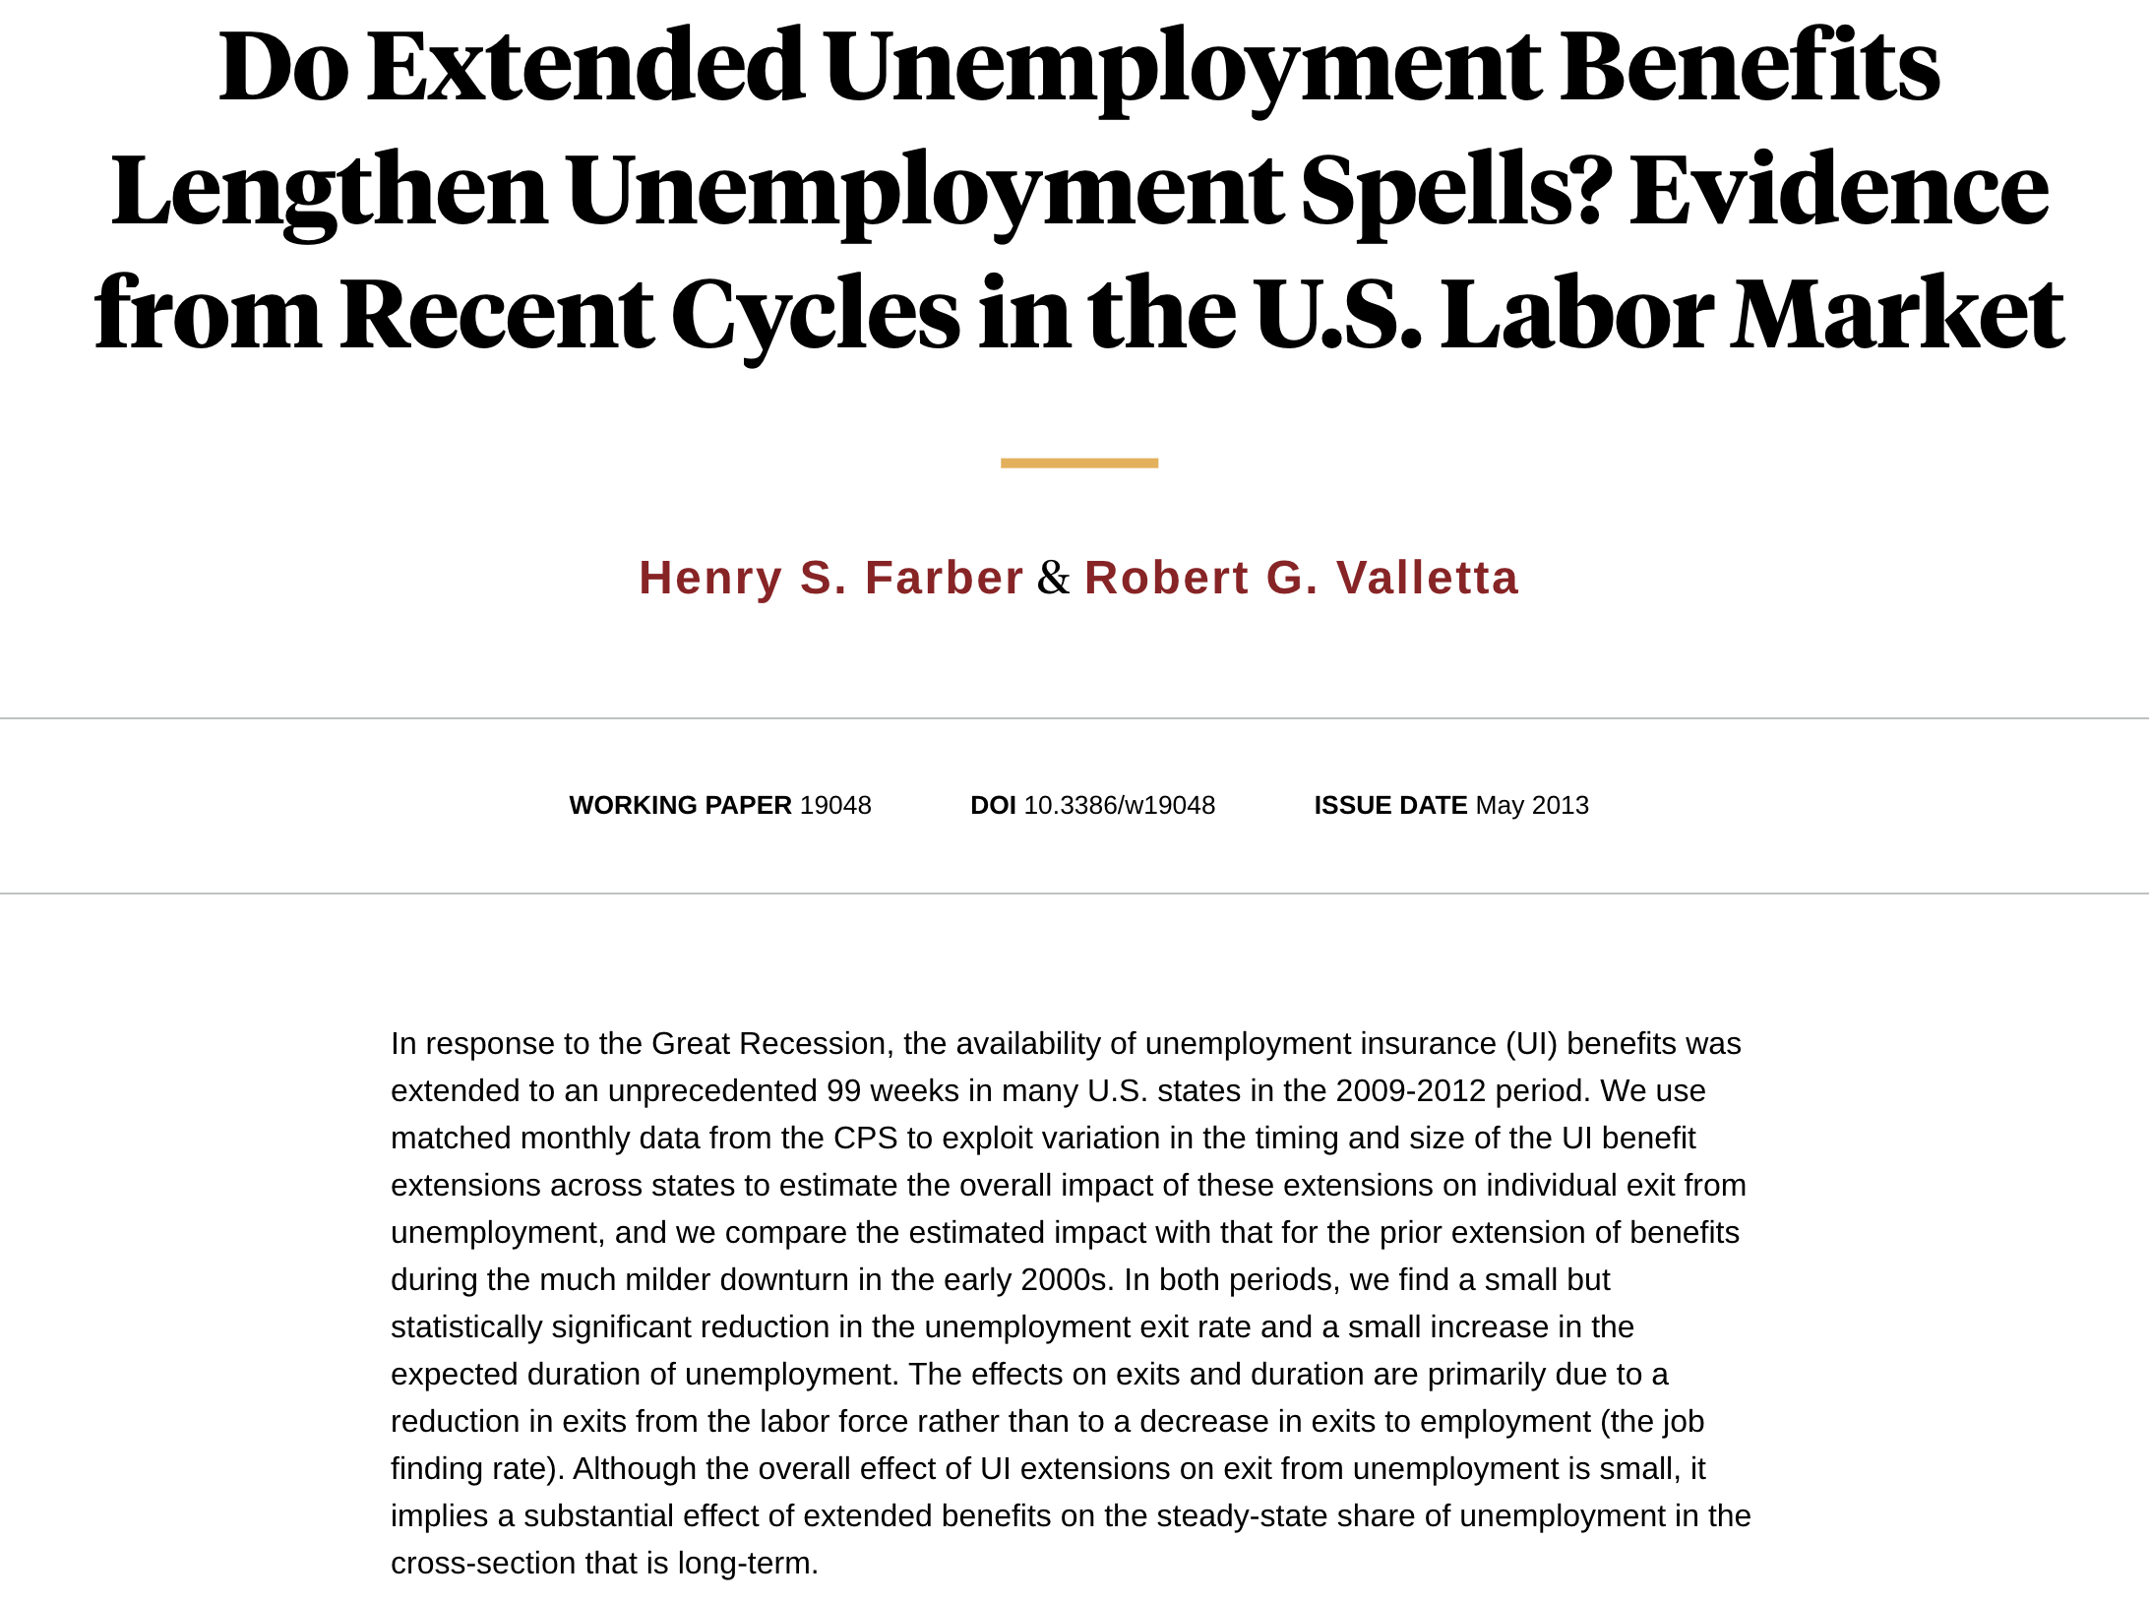
Unemployment insurance (UI)
UI pays part of a worker’s former wages for a limited time after the worker loses his/her job.
UI increases frictional unemployment because it reduces
the opportunity cost of being unemployed
the urgency of finding work
f
Studies: The longer a worker is eligible for UI, the longer the average spell of unemployment.
Notes:
The text includes a nice case study on unemployment insurance (p.192). It discusses evidence showing that unemployment insurance reduces the job finding rate.

Slide 18
Benefits of UI
By allowing workers more time to search:
UI may lead to better matches between jobs and workers
which would lead to greater productivity and higher incomes

Slide 19
Why is there unemployment? (2 of 2)
The natural rate of unemployment:
Two reasons why f < 1:
DONE ✓ 1. job search
Next ➔ 2. wage rigidity

Slide 20
Unemployment from real wage rigidity, part 1
If the real wage is stuck above its equilibrium level, there aren’t enough jobs to go around.
Notes:
Figure 7-3 on p.190.

Slide 21
Unemployment from real wage rigidity, part 2
If the real wage is stuck above its equilibrium level, there aren’t enough jobs to go around.
Then, firms must ration the scarce jobs among workers.
Structural unemployment: The unemployment resulting from real wage rigidity and job rationing.
Notes:
Other texts define “structural unemployment” as unemployment that results from a mismatch between the skills or locations of workers and the skill or location requirements of job openings. This would occur, for example, if there were a decrease in demand for domestic steel (and hence steel workers) and a simultaneous increase in demand for financial consulting services (and hence employees of such firms).
However, if wages are perfectly flexible, then the decrease in demand for steel workers would simply cause their wage to fall until all were again employed, and the increase in demand for workers in financial firms would simply increase until equilibrium in that labor market was reestablished. So, the critical ingredient for structural unemployment is wage rigidity—hence, Mankiw’s definition.

Slide 22
Reasons for wage rigidity
minimum-wage laws
labor unions
efficiency wages

Slide 23
1. Minimum-wage laws
The minimum wage may exceed the equilibrium wage of unskilled workers, especially teenagers.
Studies: a 10% increase in minimum wage reduces teen employment by 1–3%
But, the minimum wage cannot explain the majority of the natural rate of unemployment, as most workers’ wages are well above the minimum wage.

Slide 24
2. Labor unions
Unions exercise monopoly power to secure higher wages for their members.
When the union wage exceeds the equilibrium wage, unemployment results.
Insiders: employed union workers whose interest is to keep wages high
Outsiders: unemployed non-union workers who prefer equilibrium wages, so there would be enough jobs for them
Notes:
See p. 189 for more discussion about insiders and outsiders.
The theory has two implications we can confront with data:
Union members’ average earnings should be higher than non-union members’ average earnings.
The difference between union and non-union wages should be higher in industries that are more heavily unionized (and, hence, in which unions have more market power) than in less heavily unionized industries.
The following slide shows recent data on union membership and wage ratios by industry in the United States. The data are consistent with the theory.

Slide 25
Union membership and wage rations by industry, 2013
Industry | # Employed (1,000s) | U % of total | Wage ratio
Private sector (total) | 104,737 | 6.9 | 122.6
Government (total) | 20,450 | 37.0 | 121.1
Construction | 6,244 | 14.0 | 151.7
Mining | 780 | 7.2 | 96.4
Manufacturing | 13,599 | 10.5 | 107.2
Retail trade | 14,582 | 4.9 | 102.4
Transportation | 4,355 | 20.4 | 123.5
Finance, insurance | 6,111 | 1.1 | 90.2
Professional services | 12,171 | 2.1 | 99.1
Education | 4,020 | 13.0 | 112.6
Health care | 15,835 | 7.5 | 114.9
wage ratio = 100 × (union wage) / (nonunion wage)
Notes:
The wage ratio equals the average weekly earnings of union members divided by that of non-union members. (Here, “union members” does not include non-union members who are represented by unions; however, including them in these calculations does not substantively change the results.)
For example, in Transportation, 20.4% of workers are in unions, and on average they earn 23.5% more per week than non-union members in that industry.
In 2013, 11.8% of all workers in the United States were members of unions. The data on this slide show two things:
Union workers typically earn more than non-union workers (about 22% more, on average).
The greater the percentage of union workers in an industry, the higher the wage ratio. (The correlation is about 0.5.)
Source: BLS.gov
Note: Due to space constraints on the slide, a few industries were omitted.

Slide 26
3. Efficiency wages
Theories in which higher wages increase worker productivity by:
attracting higher-quality job applicants
increasing worker effort, reducing “shirking”
reducing turnover, which is costly to firms
improving health of workers (in developing countries)
Firms willingly pay above-equilibrium wages to raise productivity.
Result: structural unemployment

Slide 27
NOW YOU TRY Question for discussion
Use the material we’ve just covered to come up with a policy or policies to try to reduce the natural rate of unemployment.
Note whether your policy targets frictional or structural unemployment.
Notes:
It is useful to pause your lecture at this point and give students an opportunity to apply what you’ve covered so far to answer this policy question.
Possible answers:
Stop raising the (nominal) minimum wage so that its real value will gradually erode to zero.
Regulate unions (just like other monopolies are regulated) to reduce unions’ impact on wages.
Reduce the generosity of unemployment insurance benefits.
Implement government employment agencies to increase the accessibility of information about job vacancies and available workers.
Increase public funding to help retrain workers displaced from jobs in declining industries.
Suggestions for conducting the discussion:
If you ask for responses immediately after posing the question, it is likely that a small number of students will volunteer to participate—the same students who always do, the ones who are the best prepared and/or the quickest thinkers.
To elicit participation from a larger number of students, I suggest the following:
Pair students up. Allow 5–10 minutes for the students, working in their pairs, to come up with answers to the question. During this time, circulate around the room and ask the pairs if you can be of assistance, either to help them get started or give feedback on what they’re coming up with. Then reconvene the class and ask for volunteers.
Doing this increases the quantity and quality of participation: students who would not otherwise participate are more likely to do so because they have had time to formulate their answers and have had a chance to run their answers by a classmate. Additionally, even students who don’t participate in the class discussion will have at least had the opportunity to discuss the question with one other student.

Slide 28
The median duration of unemployment
The duration of unemployment typically rises in recessions—but its rise in 2008–2010 was unprecedented.
Notes:
Most spells are short term.
But most weeks of unemployment are attributable to a small number of long-term unemployed persons
This graph replicates Figure 7-4 on p. 193. See pp. 193–194 for some nice discussion of different perspectives on the recent rise in long-term unemployment. There are good quotes from Robert Barro and Paul Krugman.

Slide 29
Discouraged workers
discouraged workers: workers who have given up on looking for a job and are considered out of the labor force
marginally attached workers: persons not in the labor force who want and are available for work and who have looked for a job but have not recently looked for work
Discouraged workers are included in marginally attached workers.

Slide 30
Other measures of unemployment
Variable | Description | Rate
U-1 | Persons unemployed 15 weeks or longer, as a percent of the civilian labor force (includes only very long-term unemployed) | 1.7
U-2 | Job losers and persons who have completed temporary jobs, as a percent of the civilian labor force (excludes job leavers) | 2.1
U-3 | Total unemployed, as a percent of the civilian labor force (official unemployment rate) | 4.3
U-4 | Total unemployed, plus discouraged workers, as a percent of the civilian labor force plus discouraged workers | 4.7
U-5 | Total unemployed plus all marginally attacehd workers, as a percent of the civilian labor force plus all marginally attached workers | 5.3
U-6 | Total unemployed, plus all marginally attached workers, plus total employed part time for economic reasons, as a percent of the civilian labor force plus all marginally attached workers | 8.6
Notes:
You might want to ask students if we should be concerned with both U-3 (the official number) and U-6.

Slide 31
Labor force participation
Notes:
Figure 7-5, p. 196
Possible explanations for the decline:
1. Aging population (more retired people)
2. More disabled workers
3. Weak demand for unskilled works due to skill-based technological change and globalization
4. High rates of addiction to opioids
5. Expanded availability of video games

Slide 32
Unemployment in Europe, 1960–2013
Notes:
Figure 7-6, p. 198
Source: Bureau of Labor Statistics,
http://www.bls.gov/fls/home.htm

Slide 33
Why unemployment rose in Europe but not the United States
Shock Technological progress shifting labor demand from unskilled to skilled workers in recent decades
Effect in United States An increase in the “skill premium”—the wage gap between skilled and unskilled workers
Effect in Europe Higher unemployment, due to generous government benefits for unemployed workers and strong union presence

Slide 34
Percentage of workers covered by collective bargaining, selected countries
Turkey | 7%
South Korea | 12
United States | 12
Poland | 15
Japan | 17
Israel | 26
Canada | 29
United Kingdom | 30
Greece | 42
Switzerland | 49
Germany | 58
Australia | 60
Spain | 78
Italy | 80
Netherlands | 85
Sweden | 89
Belgium | 96
France | 98
Notes:
A subset of Table 7-1 (p.188), focusing on European countries.
Source: Same as the textbook.

Slide 35
CHAPTER SUMMARY, PART 1
The natural rate of unemployment
definition: the long-run average, or “steady-state,” rate of unemployment
depends on the rates of job separation and job finding
Frictional unemployment
due to the time it takes to match workers with jobs
may be increased by unemployment insurance

Slide 36
CHAPTER SUMMARY, PART 2
Structural unemployment
results from wage rigidity: the real wage remains above the equilibrium level
caused by: minimum wage, unions, efficiency wages
Duration of unemployment
most spells are short term
but most weeks of unemployment are attributable to a small number of long-term unemployed persons

Slide 37
CHAPTER SUMMARY, PART 3
Unemployment in the United States.
multiple measures of unemployment: U-3, U-6, etc.
decline in the labor-force participation rate

Slide 38
CHAPTER SUMMARY, PART 4
6. European unemployment
has risen sharply since 1970
probably due to generous unemployment benefits, strong union presence, and a technology-driven shift in demand away from unskilled workers

