Slide 1

Introduction to Economic Fluctuations
Macroeconomics
N. Gregory Mankiw
© 2019 Worth Publishers, all rights reserved
Notes:
This chapter has two main objectives: motivating the study of short-run fluctuations and introducing (a simple version of) the model of aggregate demand and aggregate supply.
Regarding the first objective, the chapter provides lots of data and discussion of the macroeconomy’s behavior in the short run. Regarding the second, the presentation here is best seen as providing the overall context or outline, which will be considerably fleshed out over the next few chapters.
This chapter is less difficult than most other chapters in the book, and all the concepts it introduces are all developed in more detail in the following chapters of Part IV. Therefore, you might consider spending a little less class time on this chapter than on other chapters.
Please note that the AD curve in this chapter is based on the quantity theory of money. This simple theory, familiar to students from earlier chapters, yields a simple AD curve, which is adequate for the purposes of this chapter’s basic introduction to AD/AS.

Slide 2
IN THIS CHAPTER, YOU WILL LEARN:
Facts about the business cycle
How the short run differs from the long run
An introduction to aggregate demand
An introduction to aggregate supply in the short run and in the long run
How the model of aggregate demand and aggregate supply can be used to analyze the short-run and long-run effects of “shocks.”

Slide 3
Facts about the business cycle
GDP growth averages 3–3.5% per year over the long run, with large fluctuations in the short run.
Consumption and investment fluctuate with GDP, but consumption tends to be less volatile and investment more volatile than GDP.
Unemployment rises during recessions and falls during expansions.
Okun’s law: the negative relationship between GDP and unemployment
Notes:
The four slides that follow provide data on each of these points.
Suggestion: “Hide” (omit) this slide from your presentation and instead give students this information orally as you display the following slides.

Slide 4
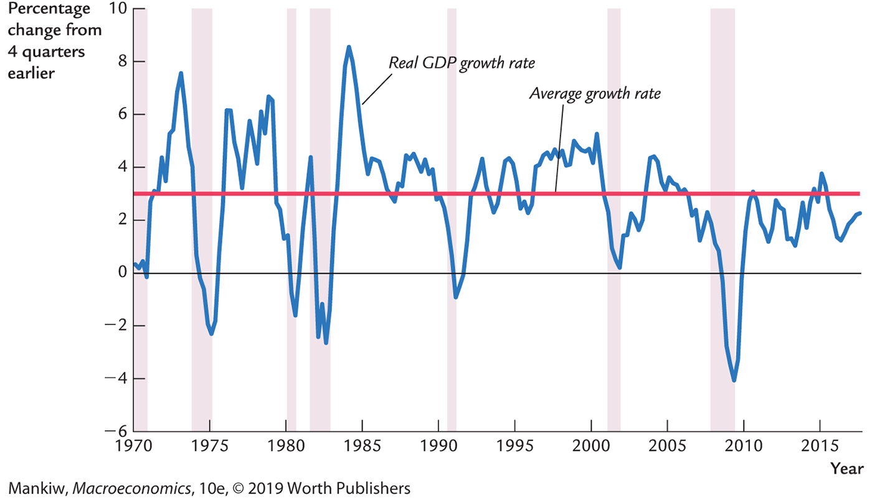
Growth rates of real GDP, consumption
Notes:
The shaded vertical bars denote recessions.
Over the long run, real GDP grows about 3 percent per year. Over the short run, though, there are substantial fluctuations in GDP, as this graph clearly shows.
This graph also shows the growth rate of consumption. It’s easy to see that consumption is usually less volatile than income. Consumers prefer smooth consumption, so they use saving as a buffer against income shocks.
(An exception occurs in the late 1990s, when consumption growth exceeded income growth— probably due to the stock market boom.)
Source of data: FRED

Slide 5
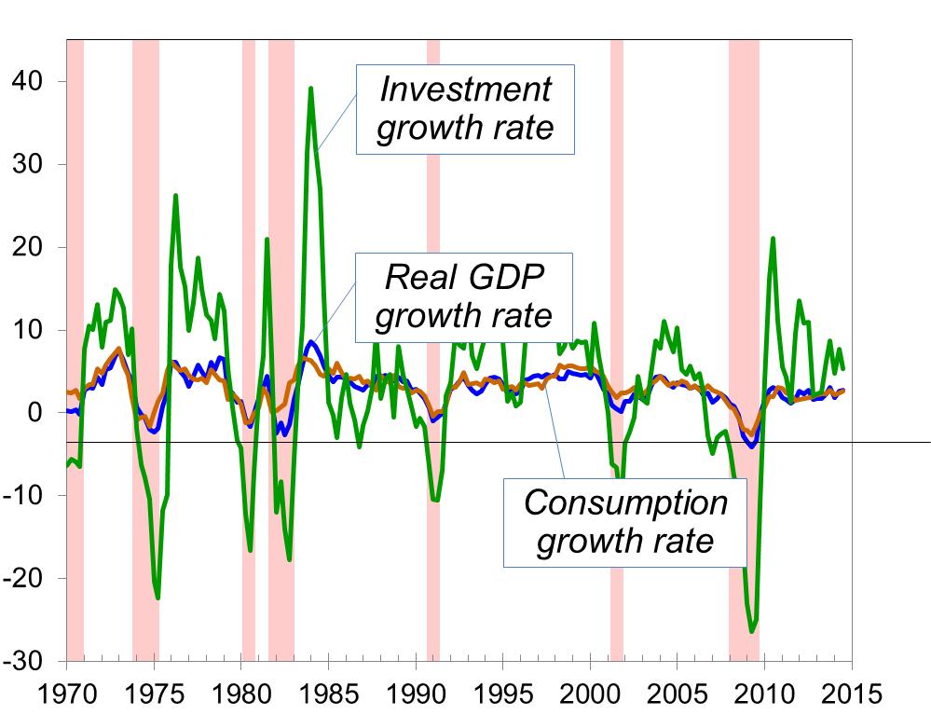
Growth rates of real GDP, consump., investment
Percent change from 4 quarters earlier
Notes:
This graph shows consumption growth and GDP growth, the same data from the previous slide, but now the vertical axis has a much bigger scale to accommodate the addition of investment growth.
The point: Investment is far more volatile than GDP or consumption.
Source: FRED

Slide 6
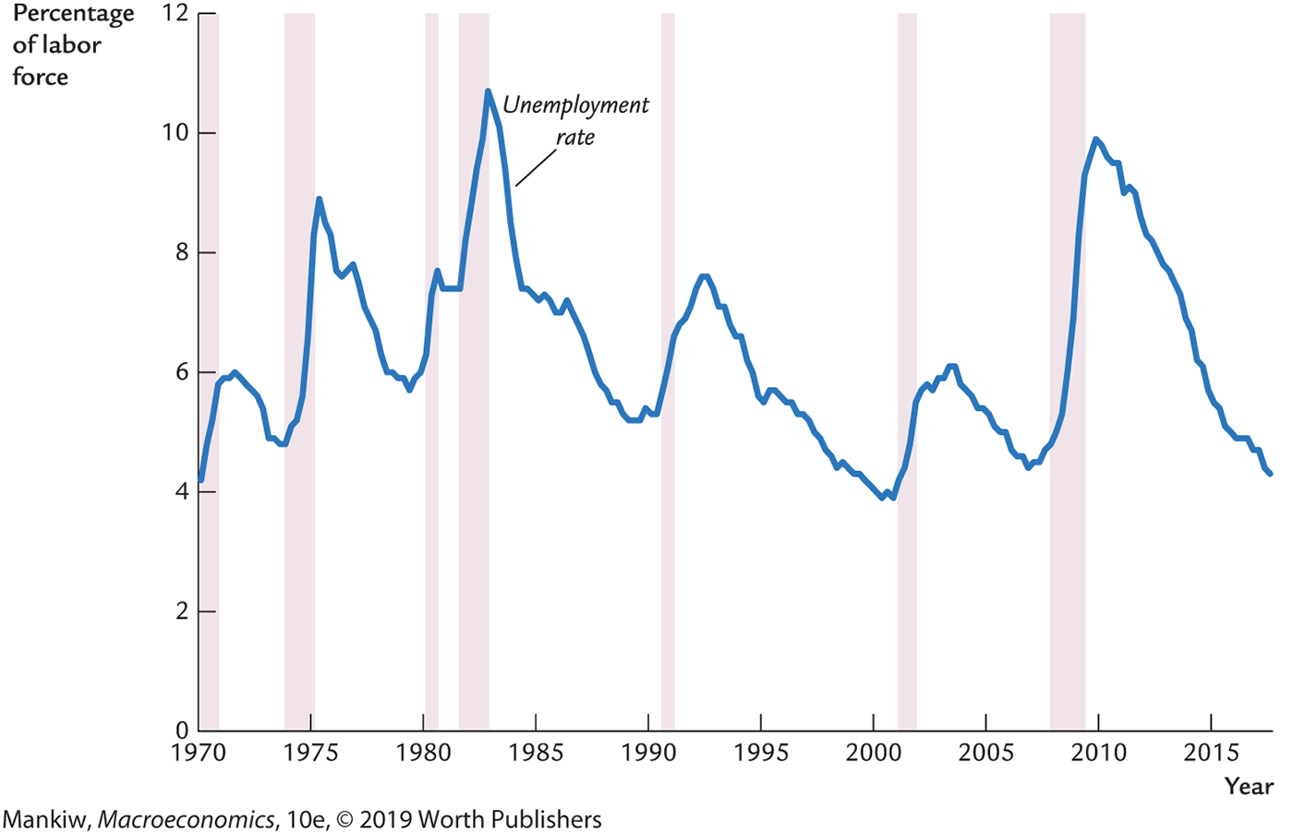
Unemployment
Notes:
The unemployment rate rises during recessions and falls during expansions.
Since the 1991 recession, the unemployment rate has lagged GDP growth, particularly in recoveries. In each of the three recessions since 1990, the unemployment rate has continued rising for a few months after the recession ends before it beginning to fall.
Source: FRED

Slide 7
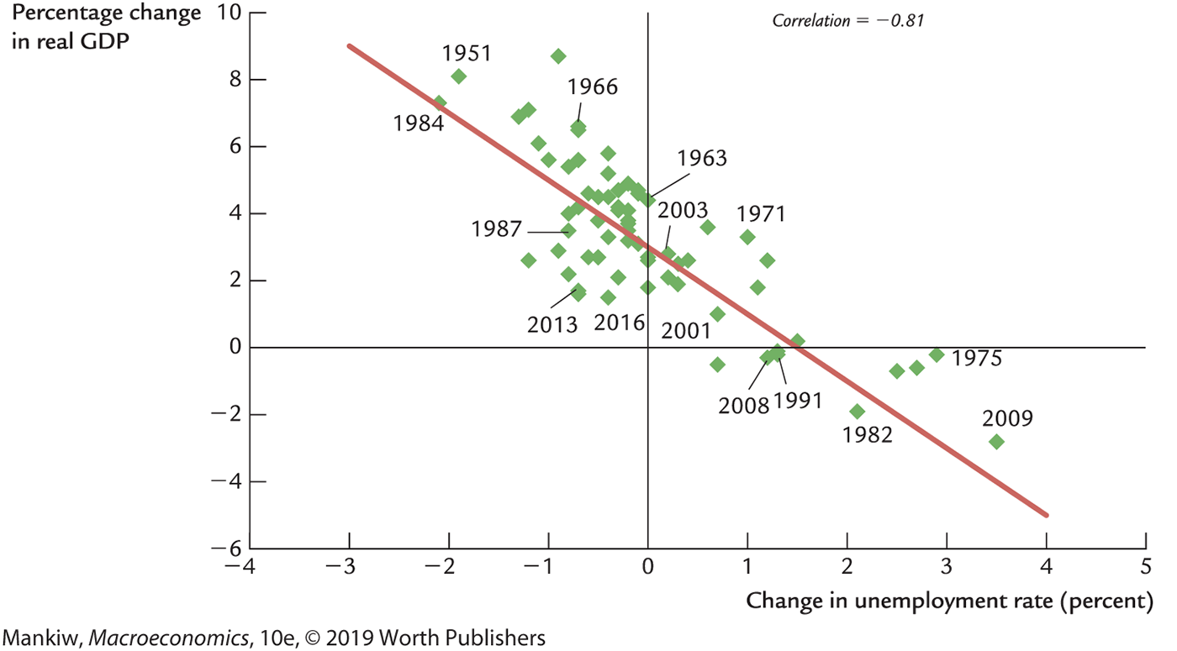
Okun’s law
Notes:
A replica of Figure 10-4, p. 280

Slide 8
Index of leading economic indicators
Published monthly by the Conference Board.
Aims to forecast changes in economic activity 6–9 months into the future.
Used in planning by businesses and government, despite not being a perfect predictor.

Slide 9
Components of the LEI index
Average workweek in manufacturing
Initial weekly claims for unemployment insurance
New orders for consumer goods and materials
New orders, nondefense capital goods
ISM new orders index
New building permits issued
Index of stock prices
Lending credit index
Yield spread (10-year minus 3-month) on Treasuries
Index of consumer expectations
Notes:
I’ve abbreviated some of the names to fit more neatly on this slide.
Pp. 281–283 provides a full list of complete names and a discussion of the role of each component in helping forecast economic activity.

Slide 10
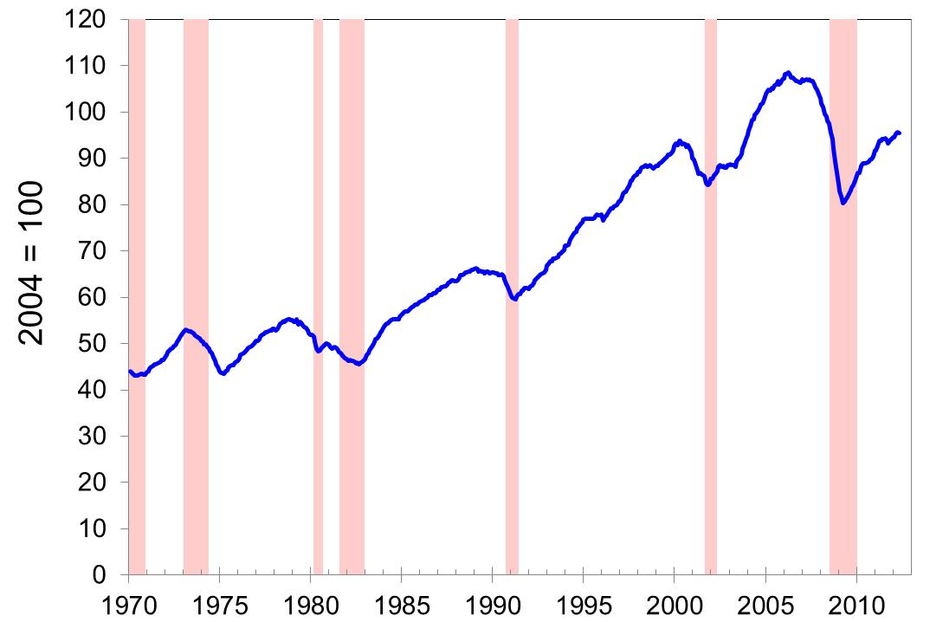
Index of leading economic indicators, 1970–2012
Notes:
The index turns downward a few months to a year before almost every recession. It also turns upward just prior to the end of almost every recession.
Source: Conference Board, http://www.conference-board.org

Slide 11
Time horizons in macroeconomics
Long run
Prices are flexible, responding to changes in supply or demand.
Short run
Many prices are “sticky” at a predetermined level.
The economy behaves much differently when prices are sticky.
Notes:
The material on this slide was introduced in Chapter 1, but it’s probably worth repeating at this point, especially since the behavior of prices is so critical for understanding short-run fluctuations.
It might also be worth reminding students that they (and most adults) are already aware of the concept of sticky prices. If they have a favorite beverage at Starbucks, ask if they can remember when its price was last increased. If they work, ask how long it’s been since their wage was last increased. Sticky prices are a fact of everyday life, even if most adults have not heard the term “sticky prices” or studied the implications of sticky prices for short-run economic fluctuations.

Slide 12
Recap of classical macro theory (Chapters 3-9)
Output is determined by the supply side:
  supplies of capital, labor
  technology
Changes in demand for goods and services (C, I, G) only affect prices, not quantities.
Assumes complete price flexibility.
Applies to the long run.
Notes:
Classical macroeconomic theory is what students learned in Chapters 3–9. This slide recaps an important lesson from classical theory that stands in sharp contrast to what we are about to cover now.

Slide 13
When prices are sticky
. . . output and employment also depend on demand, which is affected by:
  fiscal policy (G and T)
  monetary policy (M)
  other factors, like exogenous changes in C or I
Notes:
Chapters 10–12 focus on the closed economy case.
In an open economy, the list of things that affect aggregate demand is a bit longer. (See Chapter 13.)

Slide 14
The model of aggregate demand and supply
The paradigm most mainstream economists and policymakers use to think about economic fluctuations and policies to stabilize the economy
Shows how the price level and aggregate output are determined
Shows how the economy’s behavior is different in the short run and in the long run

Slide 15
Aggregate demand
The aggregate demand curve shows the relationship between the price level and the quantity of output demanded.
For this chapter’s intro to the AD/AS model, we use a simple theory of aggregate demand based on the quantity theory of money.
Chapters 10–12 develop the theory of aggregate demand in more detail.

Slide 16
The quantity equation as aggregate demand
From Chapter 4, recall the quantity equation:
M V = P Y
For given values of M and V, this equation implies an inverse relationship between P and Y . . .

Slide 17
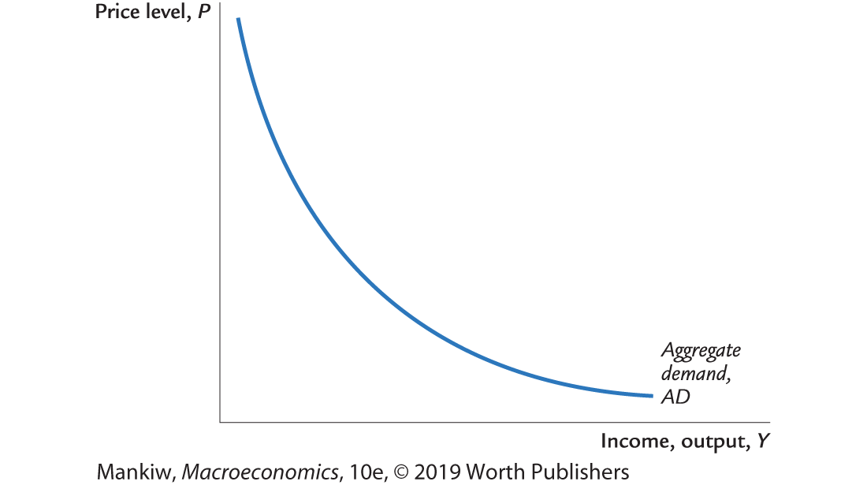
The downward-sloping AD curve
An increase in the price level causes a fall in real money balances (M/P), causing a decrease in the demand for goods and services.
Notes:
The textbook explains different ways of thinking about the AD curve’s slope.
Here’s one that uses the idea of the simple money demand function introduced in Chapter 5 (M/P = kY, where k = 1/V):
An increase in the price level causes a fall in real money balances and, therefore, a fall in the demand for goods and services (because the demand for output is proportional to real money balances, according to the simple money demand function implied by the quantity theory of money).
Here’s an explanation of the AD curve slope that doesn’t refer to the simple money demand function:
An increase in P reduces real money balances. In order to buy the same amount of stuff, velocity would have to increase. But, by definition, velocity is constant along the AD curve. For simplicity, suppose V = 1. With lower real money balances (or, equivalently, the same nominal balances but higher goods prices), people demand a smaller quantity of goods and services.

Slide 18
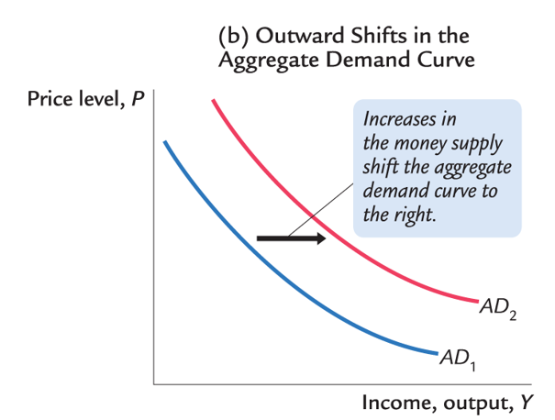
Shifting the AD curve
Notes:
For future reference (a bunch of slides later in this chapter), it will be useful to see how a change in M shifts the AD curve.
Pp. 289–290 discuss the shift. Here’s the idea: With velocity fixed, the quantity equation implies that PY is determined by M. An increase in M causes an increase in PY, which means higher Y for each value of P or higher P for each value of Y.
Or, for a given value of P, an increase in M implies higher real money balances. In the simple money demand function associated with the quantity theory, the demand for real balances is proportional to the demand for output, so output must rise at each P in order for real money demand to rise and equal the new, higher supply of real balances M/P.
Or, if you prefer, just have your students take on faith for now that an increase in the money supply shifts the AD curve to the right, and they will learn how this works in Chapters 11 and 12.

Slide 19
Aggregate supply in the long run
Recall from Chapter 3: In the long run, output is determined by factor supplies and technology
is the full-employment or natural level of output, at which the economy’s resources are fully employed.
“Full employment” means that unemployment equals its natural rate (not zero).
Notes:
Some textbooks also use the term “potential GDP” to mean the full-employment level of output.

Slide 20
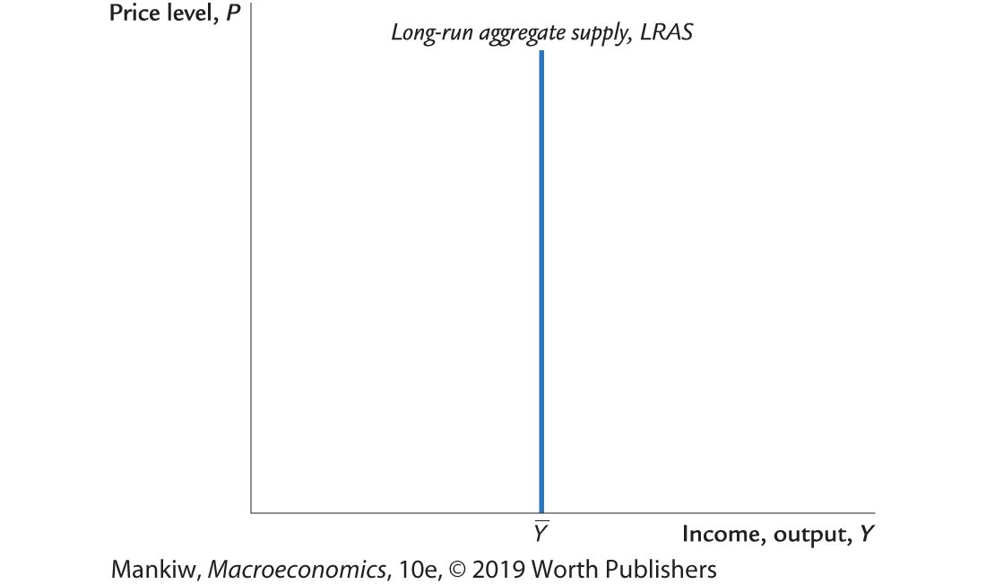
The long-run aggregate supply curve
Notes:
Sometimes it takes students a little while to understand why the LRAS curve is vertical, when the supply curves they learned in their micro principles class were mostly upward sloping.
Here’s an explanation they might find helpful:
P on the vertical axis is the economy’s overall price level—the average price of EVERYTHING. A 10% increase in the price level means that, on average, EVERYTHING costs 10% more. Thus, a firm can get 10% more revenue for each unit it sells. But the firm also pays an average of 10% more in wages, prices of intermediate goods, advertising, and so on. Thus, the firm has no incentive to increase output.
Another thought: We learn from microeconomics that a firm’s supply depends on the RELATIVE price of its output. If all prices increase by 10%, then each firm’s relative price is the same as before, so firms have no incentive to alter output.

Slide 21
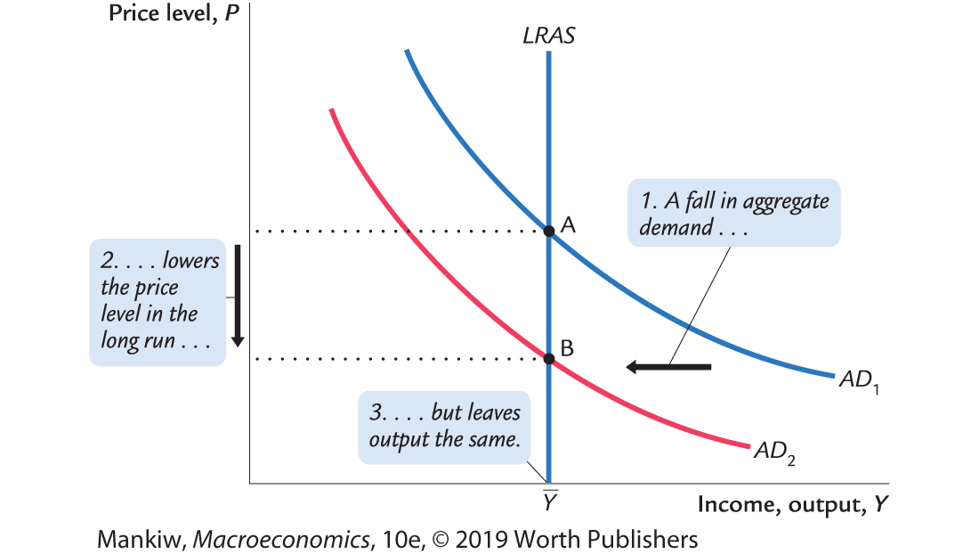
Long-run effects of an increase in M
Notes:
[The textbook does a fall in AD (Figure 10-8, p. 291); this slide does an increase.]
Notice that the results in this graph are exactly as we learned in Chapter 5: a change in the money supply affects the price level but not the quantity of output. Here, we are seeing these results on a graph with different variables on the axes (P and Y), but it’s the same model.

Slide 22
Aggregate supply in the short run
Many prices are sticky in the short run.
For now (and through Chapter 12), we assume
  all prices are stuck at a predetermined level in the short run.
  firms are willing to sell as much at that price level as their customers are willing to buy.
Therefore, the short-run aggregate supply (SRAS) curve is horizontal.
Notes:
The assumption that all prices are fixed in the short run is extreme. Chapter 14 derives the SRAS curve under more realistic assumptions.
Yet, the extreme assumption here is worth making.
The short-run response of output and employment to policies and shocks is the same (qualitatively) whether the SRAS curve is upward sloping or horizontal. But the horizontal SRAS curve makes the analysis much simpler: a shift in AD leaves P unchanged in the short run. This greatly simplifies analysis in the IS–LM–AD model (Chapters 11 and 12).
(With an upward-sloping SRAS curve, a shock to the IS and AD curves would change prices in the short run in addition to changing output. The change in prices would change the real money supply, which would shift the LM curve.)

Slide 23
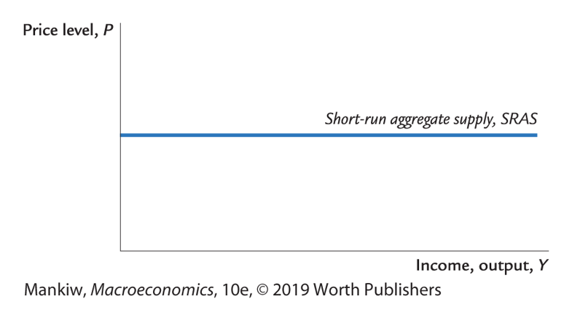
The short-run aggregate supply curve
The SRAS curve is horizontal:
The price level is fixed at a predetermined level, and firms sell as much as buyers demand.

Slide 24
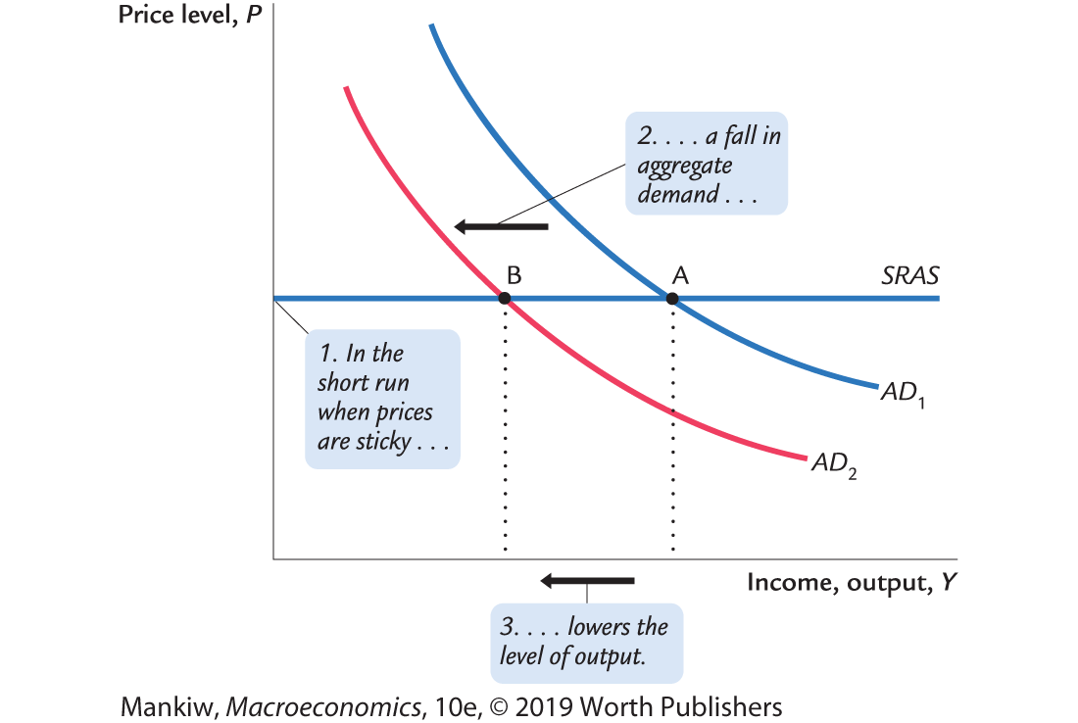
Short-run effects of an increase in M
Notes:
[The textbook (Figure 10-10 on p. 293) does a decrease in AD; this slide does an increase.]
What about the unemployment rate? Remember from Chapter 2: Okun’s law says that unemployment and output are negatively related. In the graph here, in order for firms to increase output, they require more workers. Employment rises, and the unemployment rate falls.

Slide 25
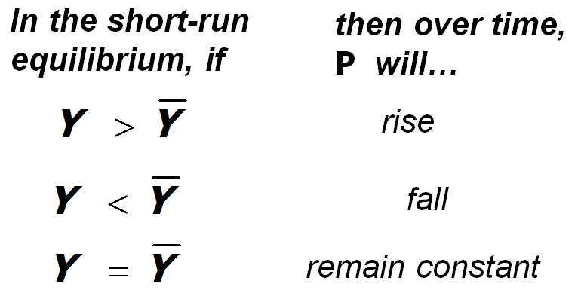
From the short run to the long run
Over time, prices gradually become “unstuck.” When they do, will they rise or fall?
The adjustment of prices is what moves the economy to its long-run equilibrium.
Notes:
You might want to discuss the intuition for the price adjustment in each case.
First, suppose aggregate demand is higher than the full-employment level of output in the economy’s initial short-run equilibrium. Then, there is upward pressure on prices: in order for firms to produce this above-average level of output, they must pay their workers overtime and make their capital work at a high intensity, which leads to more maintenance, repairs, and depreciation. For all these reasons, firms would like to raise their prices. In the short run, they cannot. But over time, prices gradually become “unstuck,” and firms can increase prices in response to these cost pressures.
Instead, suppose that output is below its natural rate. Then, there is downward pressure on prices: Firms can’t sell as much output as they’d like at their current prices, so they would like to reduce prices. With lower than normal output, firms won’t need as many workers as normal, so they cut back on labor, and the unemployment rate rises above the natural rate of unemployment. The high unemployment rate puts downward pressure on wages. Wages and prices are stuck in the short run, but over time, they fall in response to these pressures.
Finally, if output equals its normal (or natural) level, then there is no pressure for prices to rise or fall. Over time, as prices become “unstuck,” they will simply remain constant.

Slide 26
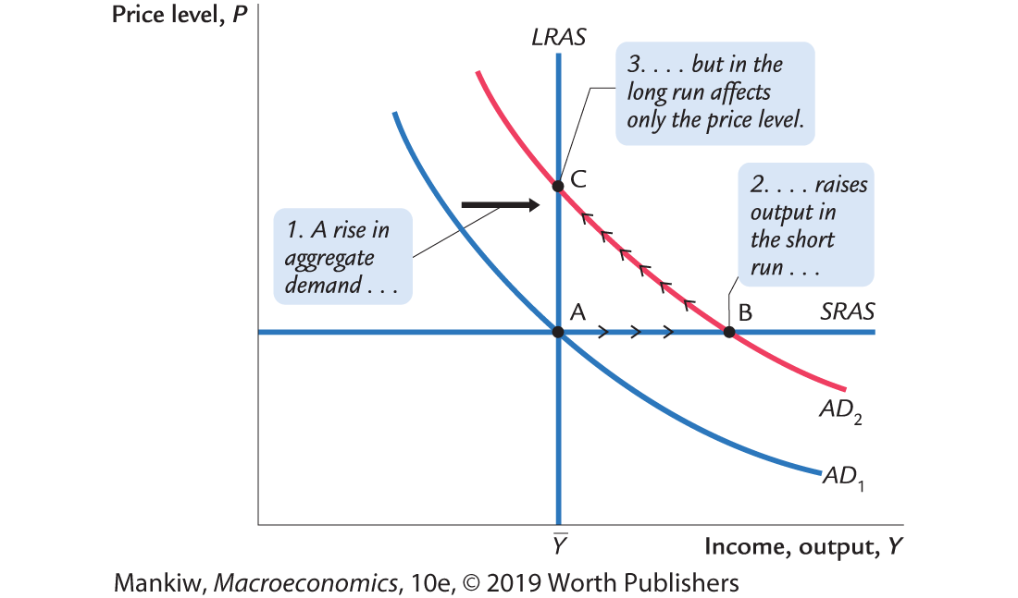
The short- and long-run effects of ΔM > 0
Notes:
[The textbook does a decrease in aggregate demand (Figure 10-12 on p. 294); this slide presents an increase in aggregate demand.]
This slide puts together the pieces that have been developed over the previous slides: the short-run and long-run effects, as well as the adjustment of prices over time that causes the economy to move from the short-run equilibrium at point B to the long-run equilibrium at C.
The economy starts at point A; output and unemployment are at their natural rates. The Fed increases the money supply, shifting AD to the right. In the short run, prices are sticky, so output rises. The new short-run equilibrium is at point B in the graph.
In order for firms to increase output, they hire more workers, so unemployment falls below the natural rate of unemployment, putting upward pressure on wages. The high level of demand for goods and services at point B puts upward pressure on prices.
Over time, as prices become unstuck, they begin to rise in response to these pressures. The price level rises, and the economy moves up its (new) AD curve, from point B toward point C.
This process stops when the economy gets to point C: output again equals the natural rate of output, and unemployment again equals the natural rate of unemployment, so there is no further pressure on prices to change.

Slide 27
How shocking!
shocks: exogenous changes in aggregate supply or demand
Shocks temporarily push the economy away from full employment.
example: exogenous decrease in velocity
  If the money supply is held constant, a decrease in V means people will be using their money in fewer transactions, causing a decrease in demand for goods and services.
Notes:
[The example in the textbook is an exogenous INCREASE in velocity.]
You may wish to remind students what it means to be exogenous.
The exogenous decrease in velocity corresponds to an exogenous increase in demand for real money balances (relative to income and transactions). This might occur in response to a wave of credit card fraud, which presumably would make nervous consumers more inclined to use cash in their transactions. If there’s an exogenous increase in real money demand (i.e., an increase NOT caused by an increase in Y), then M/P must increase as well; if the Fed holds M constant, then P must fall. Thus, the increase in real money demand causes a decrease in the value of P associated with each Y, and the AD curve shifts down.
The velocity shock is the only AD shock we can analyze at this point because (for this chapter only) we have derived the AD curve from the quantity theory of money.
In the following chapters, students will learn on a deeper level about other AD shocks they may recall from their introductory course, such as:
A stock market crash causes consumers to cut back on spending.
A fall in business confidence causes a decrease in investment.
A recession in a country with which we trade causes an exogenous decrease in their demand for our exports.

Slide 28
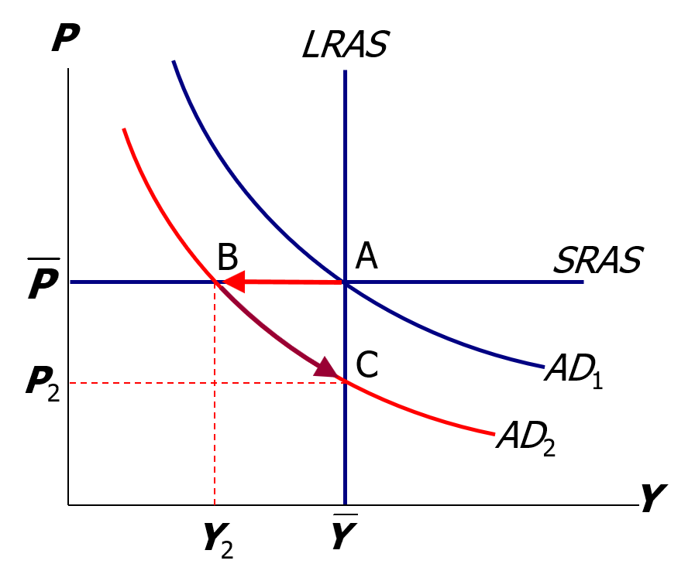
The effects of a negative demand shock
AD shifts left, depressing output and employment in the short run (B).
Over time, prices fall, and the economy moves down its demand curve toward full employment (C).
Notes:
Note the economy’s self-correction mechanism:
When in a recession, the economy—left to its own devices—fixes itself. The gradual adjustment of prices helps the economy recover from the shock and return to full employment. Of course, before the economy has finished self-correcting, a period of low output and high unemployment is endured.
You might use this slide to set the stage for the fiscal policy and monetary policy sections. Ask you students whether waiting for the economy to self-correct is worth having periods of unemployment.

Slide 29
Supply shocks
A supply shock alters production costs, affects the prices that firms charge (also called price shocks).
Examples of adverse supply shocks:
  Bad weather reduces crop yields, pushing up food prices.
  Workers unionize, negotiate wage increases.
  New environmental regulations require firms to reduce emissions. Firms charge higher prices to help cover the costs of compliance.
Favorable supply shocks lower costs and prices.

Slide 30
CASE STUDY: The 1970s oil shocks, part 1
Early 1970s: OPEC coordinated a reduction in the supply of oil.
Oil prices rose
11% in 1973
68% in 1974
16% in 1975
Such sharp oil price increases are supply shocks because they significantly impact production costs and prices.
Notes:
Oil is required to heat the factories in which goods are produced and to fuel the trucks that transport the goods from the factories to the warehouses to Walmart stores. A sharp increase in the price of oil, therefore, has a substantial effect on production costs.

Slide 31
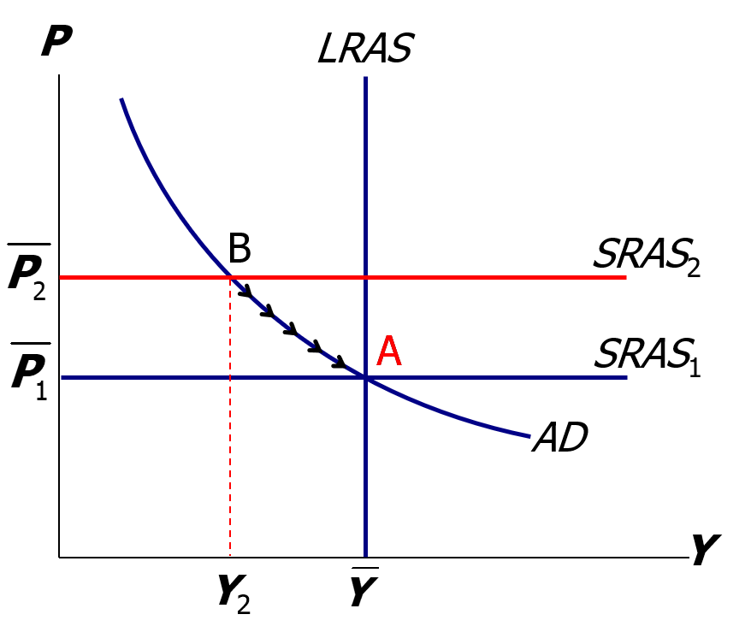
CASE STUDY: The 1970s oil shocks, part 2
The oil price shock shifts up SRAS, causing output and employment to fall (B).
In the absence of further price shocks, prices will fall over time, and economy moves back toward full employment (A).
Notes:
As output falls from Ybar to Y2 in the graph, we would expect to see unemployment increase above the natural rate of unemployment. (Recall from Chapter 2: Okun’s law says that output and unemployment are inversely related.)
Note the phrase “in the absence of further price shocks.” As we will see shortly, just as the economy was recovering from the first big oil shock, a second one came along.

Slide 32
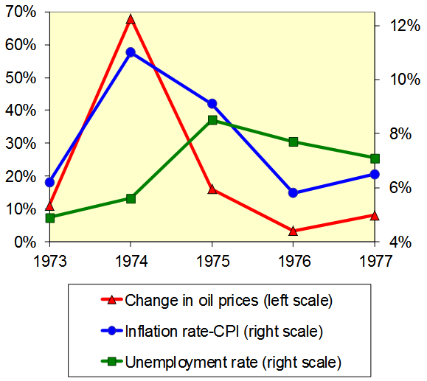
CASE STUDY: The 1970s oil shocks, part 3
Predicted effects
of the oil shock:
  inflation #
  output $
  unemployment #
…and then a gradual recovery
Notes:
This slide first summarizes the model’s predictions from the preceding slide and then presents data (from the text, p. 300) that supports the model’s predictions.

Slide 33
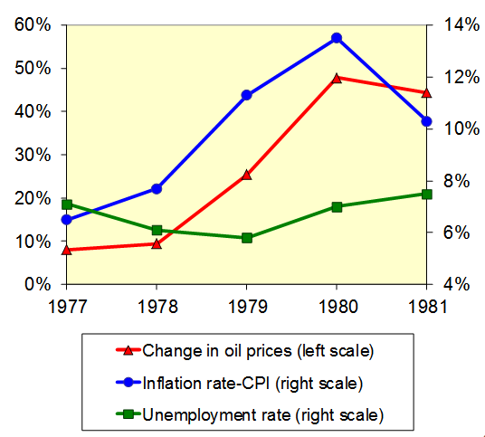
CASE STUDY: The 1970s oil shocks, part 4
Late 1970s: As the economy was recovering, oil prices shot up again, causing another huge supply shock!
Notes:
Data source: See p. 301 of the textbook.
This second shock was associated with the revolution in Iran. The Shah, who maintained cordial relations with the West, was deposed. The new leader, Ayatollah Khomeini, was considerably less friendly toward the West. (He even forbade his citizens from listening to Western music.)

Slide 34
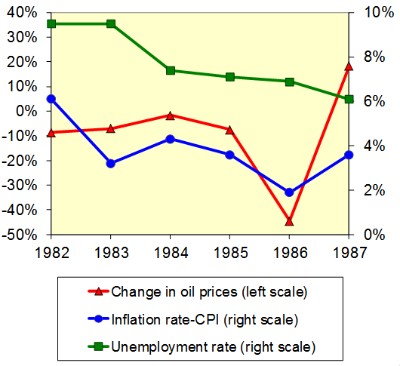
CASE STUDY: The 1980s oil shocks
1980s: A favorable supply shock—a significant fall in oil prices.
As the model predicts, inflation and unemployment fell.
Notes:
A few slides back, we analyzed the effects of an adverse supply shock. It might be worth noting that the predicted effects of a favorable supply shock are just the opposite: in the short run, the price level (or inflation rate) falls, output rises, and unemployment falls.
Looking at the graph: at first glance, it may seem that the fall in oil prices doesn’t occur until 1986. But remind students to look at the left-hand scale, on which 0 is in the middle, not at the bottom. Oil prices fell about 10% in 1982 and generally fell during most years between 1982 and 1986.

Slide 35
Stabilization policy
stabilization policy: policy actions aimed at reducing the severity of short-run economic fluctuations.
example: using monetary policy to combat the effects of adverse supply shocks
Notes:
Chapter 18 is devoted to stabilization policy.

Slide 36
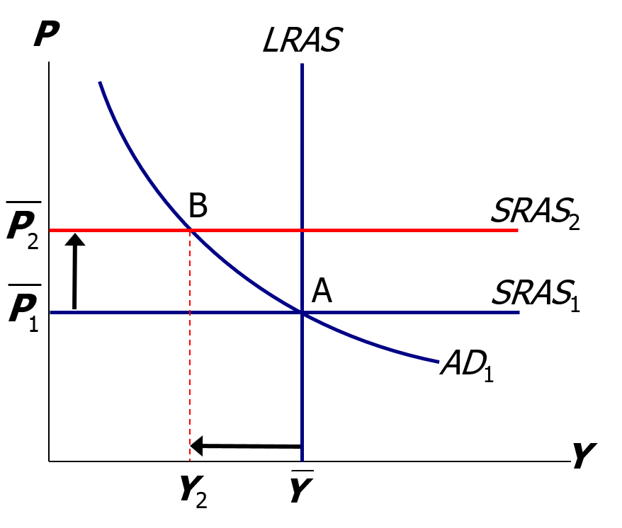
Stabilizing output with monetary policy, part 1
The adverse supply shock moves the economy to point B.

Slide 37
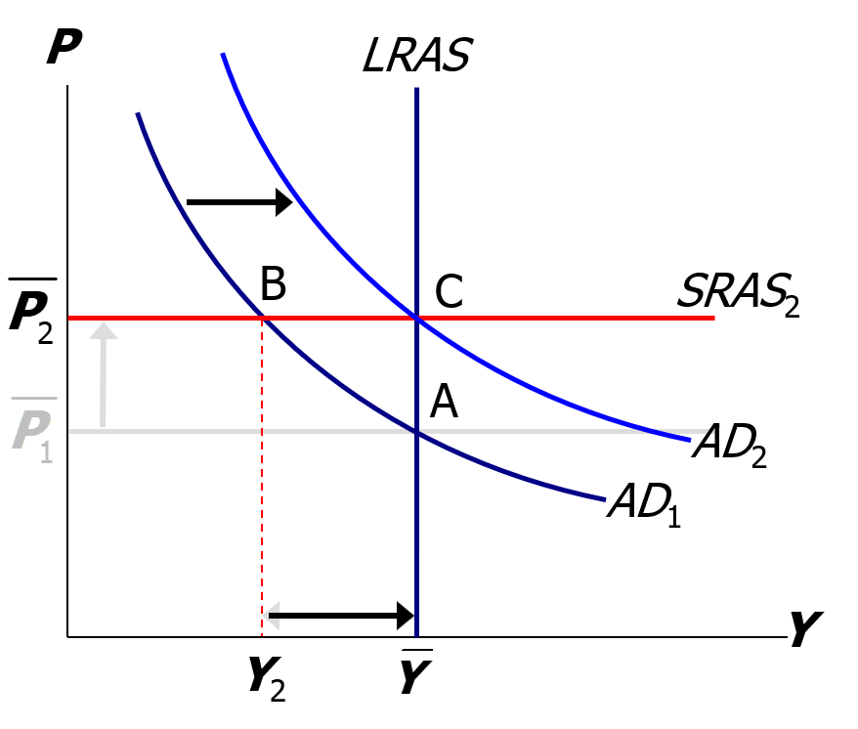
Stabilizing output with monetary policy, part 2
But the Fed accommodates the shock by raising aggregate demand (C).
results:
P is permanently higher, but Y remains at its full-employment level.
Notes:
Note: If the Fed correctly anticipates the sign and magnitude of the shock, then the Fed can respond as the shock occurs rather than after, and the economy would never go to point B—but would go immediately to point C.

Slide 38
CHAPTER SUMMARY, PART 1
Long run: prices are flexible, output and employment are always at their natural rates, and the classical theory applies.
Short run: prices are sticky, shocks can push output and employment away from their natural rates.
Aggregate demand and supply: a framework to analyze economic fluctuations

Slide 39
CHAPTER SUMMARY, PART 2
The aggregate demand curve slopes downward.
The long-run aggregate supply curve is vertical because output depends on technology and factor supplies but not prices.
The short-run aggregate supply curve is horizontal because prices are sticky at predetermined levels.

Slide 40
CHAPTER SUMMARY, PART 3
Shocks to aggregate demand and supply cause fluctuations in GDP and employment in the short run.
The Fed can attempt to stabilize the economy with monetary policy.

