Slide 1

Aggregate Demand I: Building the IS-LM Model
Macroeconomics
N. Gregory Mankiw
© 2019 Worth Publishers, all rights reserved
Notes:
This chapter builds the IS–LM model, which Chapter 12 will use extensively to analyze the effects of policies and economic shocks.
This chapter also introduces students to the Keynesian cross and liquidity preference models, which underlie the IS curve and LM curve, respectively.

Slide 2
IN THIS CHAPTER, YOU WILL LEARN:
About the IS curve and its relationship to:
  the Keynesian cross
  the loanable funds model
About the LM curve and its relationship to:
  the theory of liquidity preference
How the IS–LM model determines income and the interest rate in the short run when P is fixed

Slide 3
Context, part 1
Chapter 10 introduced the model of aggregate demand and aggregate supply.
Long run:
  prices flexible
  output determined by factors of production and technology
  unemployment equals its natural rate
Short run:
  prices fixed
  output determined by aggregate demand
  unemployment negatively related to output

Slide 4
Context, part 2
This chapter develops the IS–LM model, the basis of the aggregate demand curve.
We focus on the short run and assume the price level is fixed (so the SRAS curve is horizontal).
Chapters 11 and 12 focus on the closed-economy case. Chapter 13 presents the open-economy case.

Slide 5
The Keynesian cross
A simple closed-economy model in which income is determined by expenditure.
(due to J. M. Keynes)
Notation:
  I = planned investment
  PE = C + I + G = planned expenditure
  Y = real GDP = actual expenditure
Difference between actual and planned expenditure = unplanned inventory investment

Slide 6
Elements of the Keynesian cross
equilibrium condition:
Notes:
Stress that much of this model is very familiar to students: same consumption function as in previous chapters, same treatment of fiscal policy variables.
In equilibrium, there is no unplanned inventory investment: firms are selling everything they had intended to sell.

Slide 7
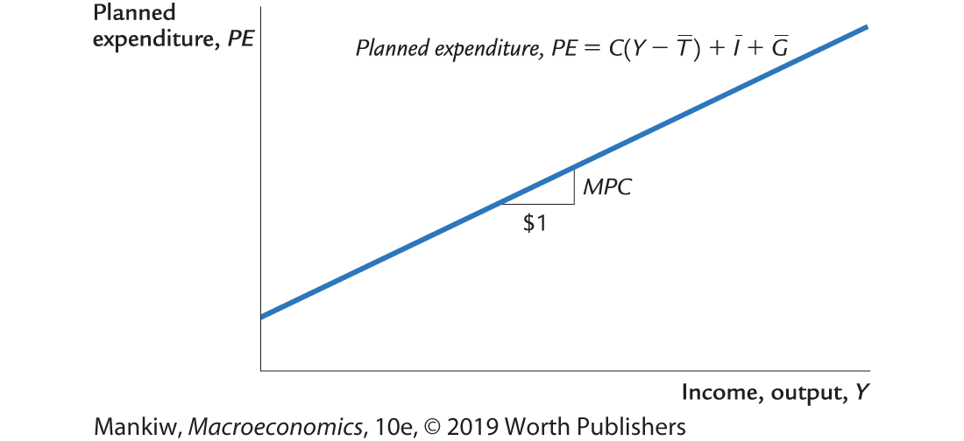
Graphing planned expenditure
Notes:
Why the slope of the PE line equals the MPC:
With I and G exogenous, the only component of (C + I + G) that changes when income changes is consumption. A one-unit increase in income causes consumption—and, therefore, PE—to increase by the MPC.
Recall from Chapter 3 that the marginal propensity to consume, MPC, equals the increase in consumption resulting from a one-unit increase in disposable income. Since T is exogenous here, a one-unit increase in Y causes a one-unit increase in disposable income.

Slide 8
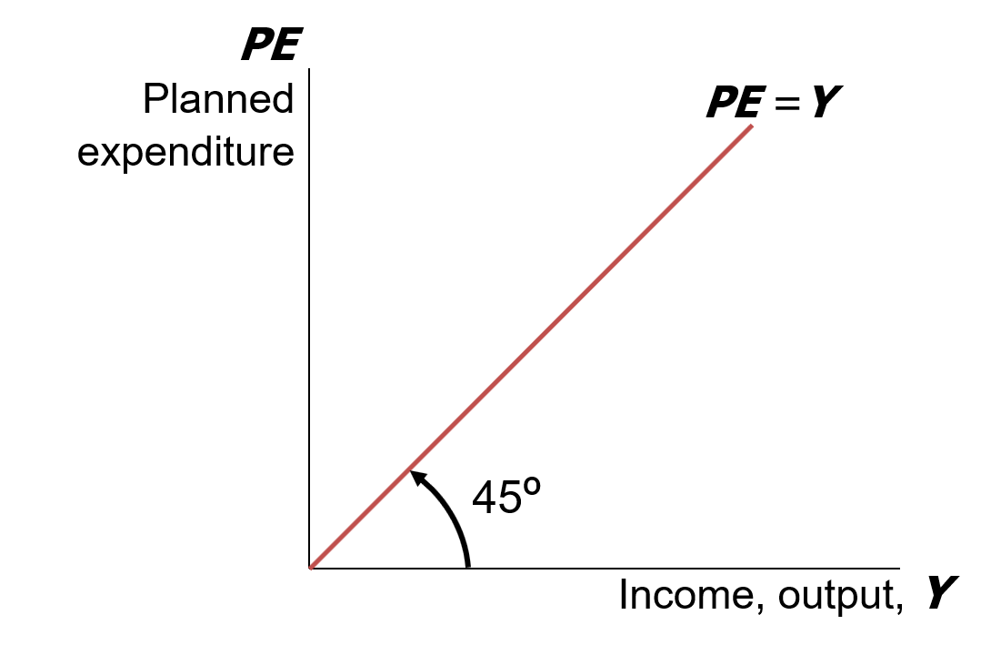
Graphing the equilibrium condition
Notes:
You can refer students back to how you calculated GDP: GDP (Y) is equal to total spending, or (aggregate) expenditure. Thus the 45-degree line incudes all the points on the graph where (planned) expenditure equals output. In equilibrium, planned expenditure needs to equal output.

Slide 9
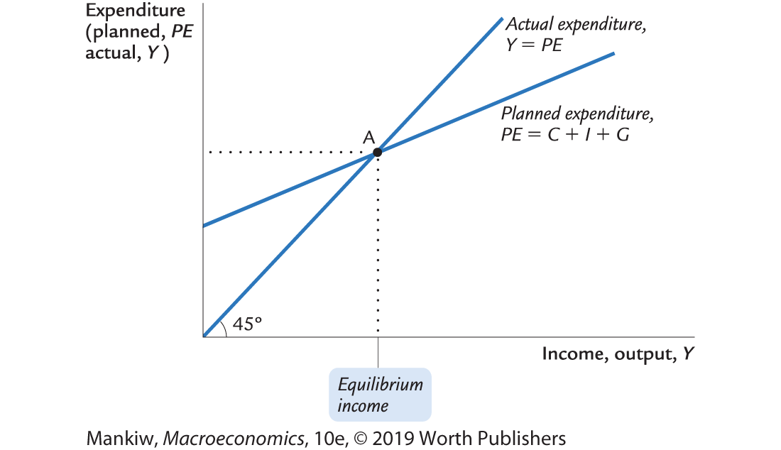
The equilibrium value of income
Notes:
The equilibrium point is the value of income at which the curves cross.
Notice we have two lines:
PE = Y
PE = C + I + G
Combining yields Y = C + I + G. This is our equation for GDP in a closed economy!
Be sure your students understand why the equilibrium income appears on both the horizontal and vertical axes.
Answer: In equilibrium, PE (which is measured on the vertical axis) equals Y (which is measured on the horizontal axis).

Slide 10
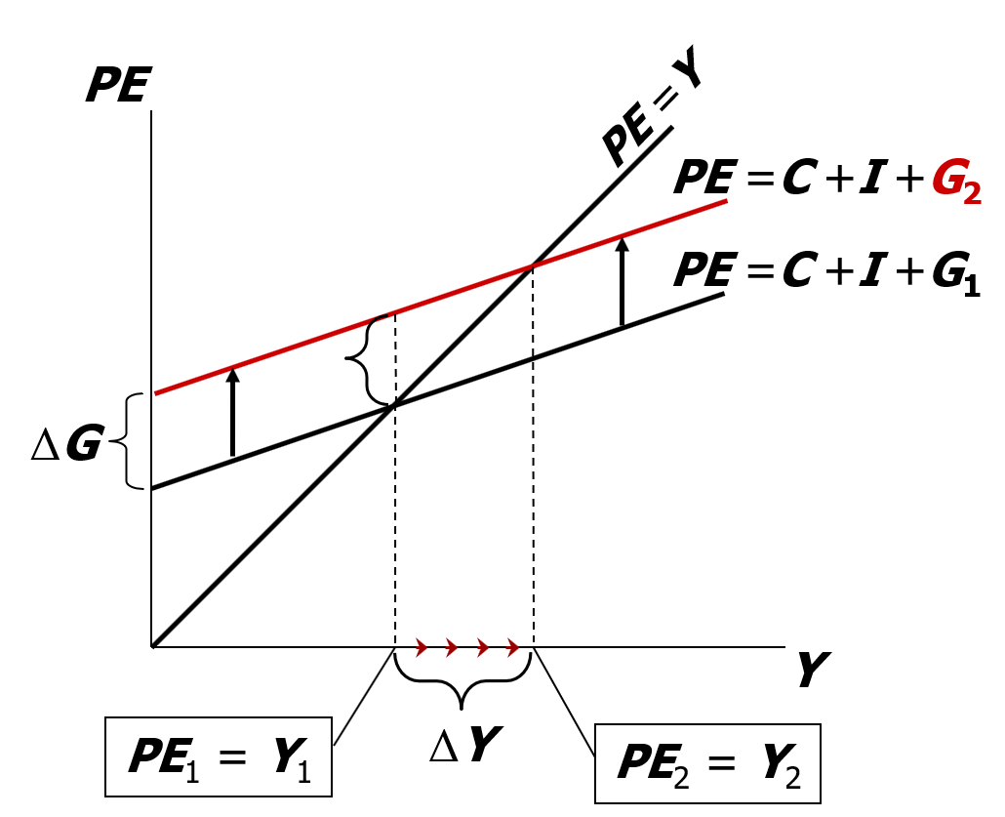
An increase in government purchases
At Y₁, there is now an unplanned drop in inventory . . .
. . . so firms increase output, and income rises toward a new equilibrium.

Slide 11
Solving for ΔY (1 of 2)
Collect terms with ΔY on the left side of the equals sign:
Solve for ΔY :

Slide 12
The government purchases multiplier
definition: the increase in income resulting from a $1 increase in G.
In this model, the govt purchases multiplier equals
Example: If MPC = 0.8, then
An increase in G causes income to increase 5 times as much!
Notes:
The textbook defines the multiplier as the increase in income resulting from a $1 increase in G.
However, G is a real variable (as is Y ).
So, if you wish to be more precise, consider defining the multiplier as “the increase in income resulting from a one-unit increase in G.”

Slide 13
Why the multiplier is greater than 1
Initially, the increase in G causes an equal increase in Y: ΔY = ΔG.
But Y causes C
which causes further Y
which then causes further C
which then causes further Y
So the final impact on income is much bigger than the initial ΔG.
Notes:
Students are better able to understand this if given a more concrete example, which you can explain as you display the elements on this slide.
For instance, suppose the government spends an additional $100 million on defense.
Then, the revenues of defense firms increase by $100 million, all of which becomes income to various groups: some of it is paid to the workers and engineers and managers, and the rest is profit paid as dividends to shareholders. Hence, total income rises $100 million (ΔY = $100 million = ΔG ).
The people whose income just rose by $100 million are also consumers, and they will spend the fraction MPC of this extra income.
Suppose MPC = 0.8, so C rises by $80 million. To be concrete, suppose they buy $80 million worth of Ford Explorers. Then, Ford sees its revenues increase by $80 million, all of which becomes income to Ford’s workers and shareholders (ΔY = $80 million). These folks spend the fraction MPC (0.8) of it, causing ΔC = $64 million (8/10 of $80 million). Suppose they spend all $64 million on the Hershey’s chocolate bars with the mint cookie bits inside. Then, Hershey Foods Corporation experiences a revenue increase of $64 million, which becomes income to Hershey’s owners and workers (ΔY = $64 million).
At this point in the story, the total impact on income is $100 million + $80 million + $64 million, which is much bigger than the government’s initial increase in spending. But this process continues, and the final impact on Y is $500 million (because the multiplier is 5).

Slide 14
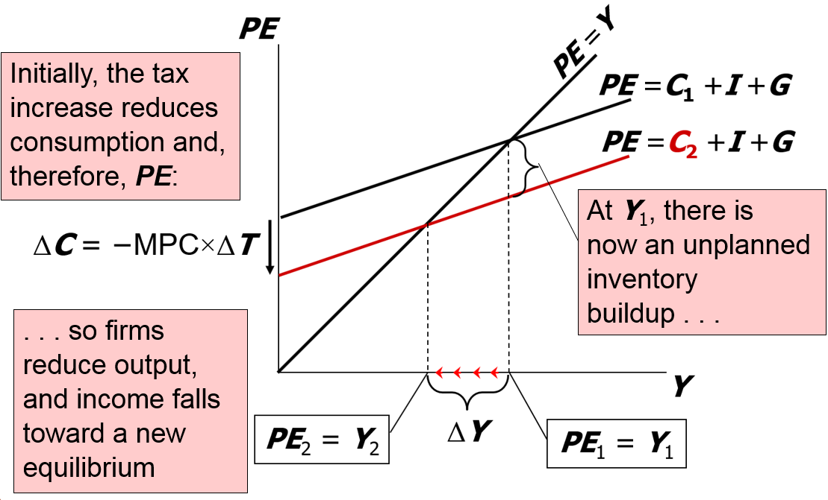
An increase in taxes
Notes:
Experiment: an increase in taxes (Note: the book does a decrease in taxes)
Suppose taxes are increased by ΔT. Because I and G are exogenous, they do not change. However, C depends on (Y – T). So, at the initial value of Y, a tax increase of ΔT causes disposable income to fall by ΔT, which causes consumption to fall by MPC × ΔT. Because consumption falls, the change in C is negative: ΔC = –MPC × ΔT.
C is part of planned expenditure. The fall in C causes the PE line to shift down by the size of the initial drop in C.
At the initial value of output, there is now unplanned inventory investment: Sales have fallen below output, so the unsold output adds to inventory.
In this situation, firms will reduce production, causing total output, income, and expenditure to fall.
The new equilibrium is at Y₂, where planned expenditure once again equals actual expenditure/output, and unplanned inventory investment is again equal to zero.

Slide 15
Solving for ΔY (2 of 2)
Final result:
Notes:
In a few slides, the slides will discuss the differences between the tax multiplier and the government spending multiplier. However, now might be a good time to ask students if they can spot the differences with:
negative sign
smaller in absolute value
and why the differences are there:
Tax increases (+) cause consumption to decrease (-)
When given a tax cut, consumers do not spend all of the extra money in their paycheck (MPC in the numerator)

Slide 16
The tax multiplier, part 1
Definition: the change in income resulting from a $1 increase in T :
If MPC = 0.8, then the tax multiplier equals

Slide 17
The tax multiplier, part 2
. . . is negative:
A tax increase reduces C, which reduces income.
. . . is greater than one (in absolute value):
A change in taxes has a multiplier effect on income.
. . . is smaller than the govt spending multiplier:
Consumers save the fraction (1 – MPC) of a tax cut, so the initial boost in spending from a tax cut is smaller than from an equal increase in G.

Slide 18
NOW YOU TRY
Practice with the Keynesian cross
Use a graph of the Keynesian cross to show the effects of an increase in planned investment on the equilibrium level of income/output.
Notes:
This in-class exercise not only gives students practice with the model, it also helps them understand the next topic: the derivation of the IS curve.

Slide 19
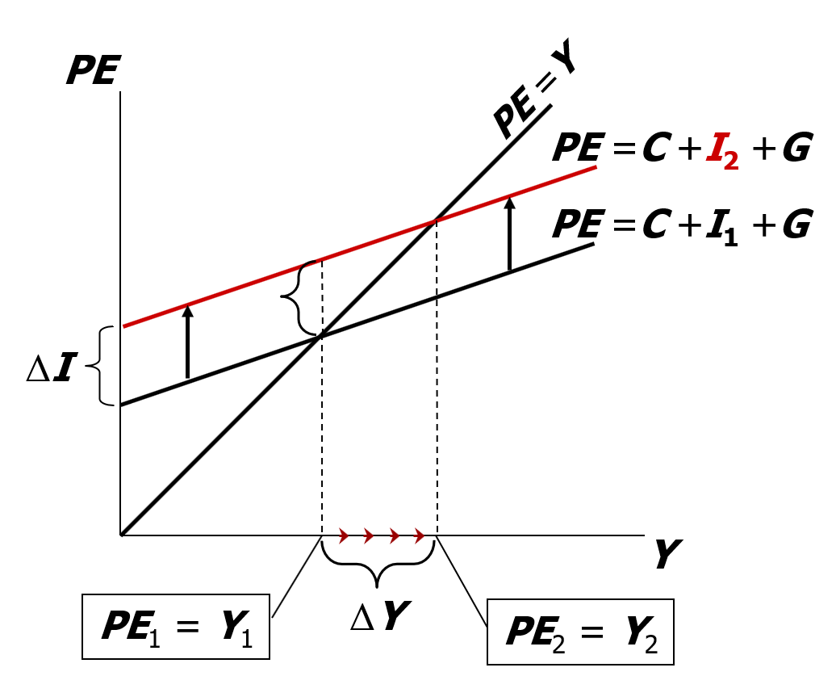
NOW YOU TRY
Practice with the Keynesian cross, answer
At Y₁, there is now an unplanned drop in inventory . . .
. . . so firms increase output, and income rises toward a new equilibrium.

Slide 20
The IS curve
definition: a graph of all combinations of r and Y that result in goods market equilibrium
example: actual expenditure (output)
= planned expenditure
The equation for the IS curve is:

Slide 21
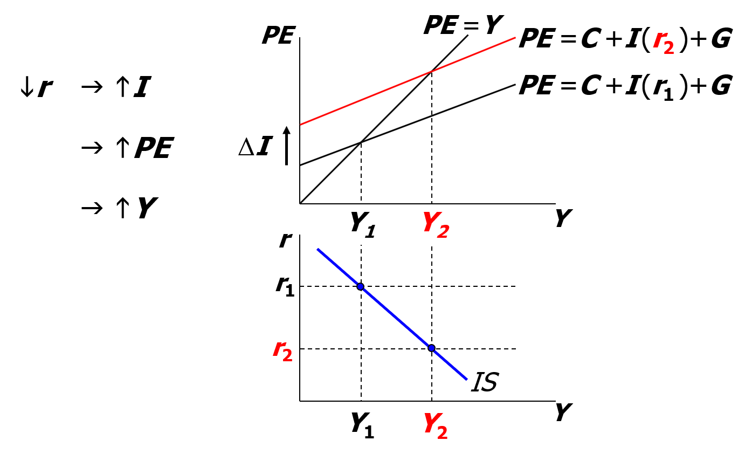
Deriving the IS curve
Notes:
Stress to students that the Keynesian cross is drawn vertically above the IS curve; the levels of output are the same in each.

Slide 22
When the IS curve is negatively sloped
A fall in the interest rate motivates firms to increase investment spending, which drives up total planned spending (PE).
To restore equilibrium in the goods market, output (a.k.a. actual expenditure, Y) must increase.
Notes:
This slide simply states the intuition behind the graphs on the preceding slide.
Suggestion: Omit this slide from your presentation and just give the students this information orally as you present the preceding slide.

Slide 23
Fiscal policy and the IS curve
We can use the IS–LM model to see how fiscal policy (G and T) affects aggregate demand and output.
Let’s start by using the Keynesian cross to see how fiscal policy shifts the IS curve . . .

Slide 24
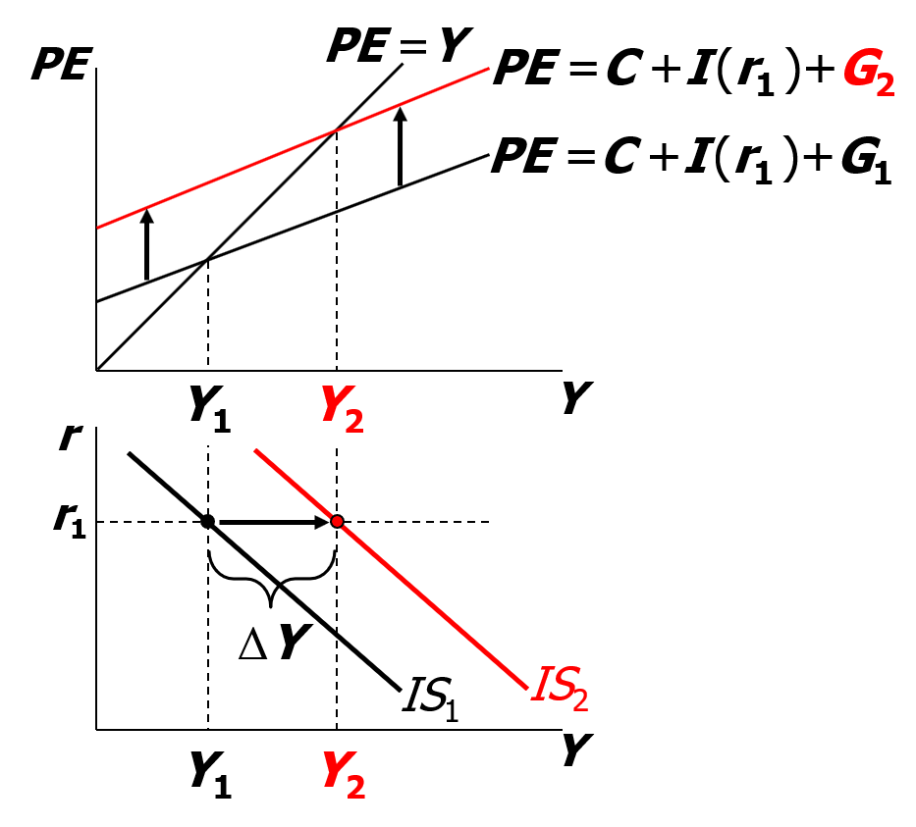
Shifting the IS curve: ΔG
At any value of r, G  PE  Y
. . . so the IS curve shifts to the right.
The horizontal distance of the IS shift equals
Notes:
This slide has two purposes. First, it shows which way the IS curve shifts when G changes. Second, it actually measures the distance of the shift.
We can measure either the horizontal or vertical distance of the shift. The horizontal distance of the IS curve shift is the change in Y required to restore goods market equilibrium AT THE INITIAL INTEREST RATE when G is raised.
Since the interest rate is unchanged at r₁, investment will also be unchanged. This is why, in the upper panel, we write “I(r₁)” in the PE equation for both expenditure curves—to remind us that investment and the interest rate are not changing.

Slide 25
NOW YOU TRY
Shifting the IS curve: ΔT
Use the diagram of the Keynesian cross or loanable funds model to show how an increase in taxes shifts the IS curve.
If you can, determine the size of the shift.
Notes:
One could also demonstrate the shift by using the loanable funds model.

Slide 26
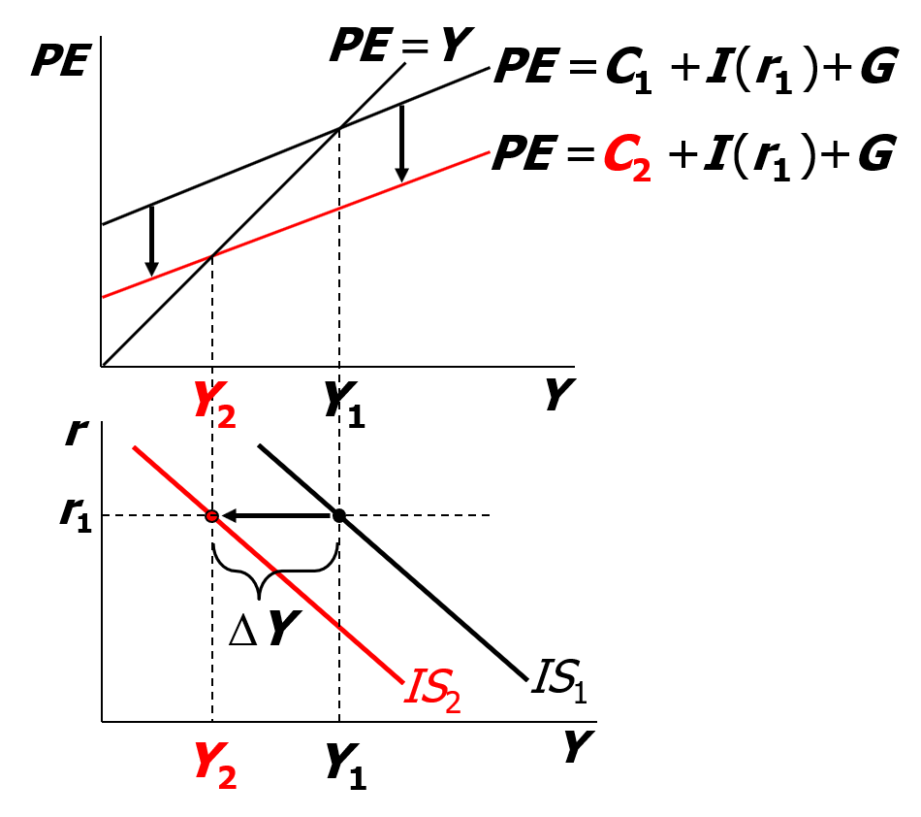
NOW YOU TRY
Shifting the IS curve: ΔT, answer
At any value of r, T  C  PE
. . . so the IS curve shifts to the left.
The horizontal distance of the IS curve shift equals
Notes:
To demonstrate the shift using the loanable funds model, note that the tax increase would increase national saving at each level of Y, causing a fall in the interest rate at each level of Y.

Slide 27
The theory of liquidity preference
due to John Maynard Keynes
a simple theory in which the interest rate is determined by money supply and money demand

Slide 28
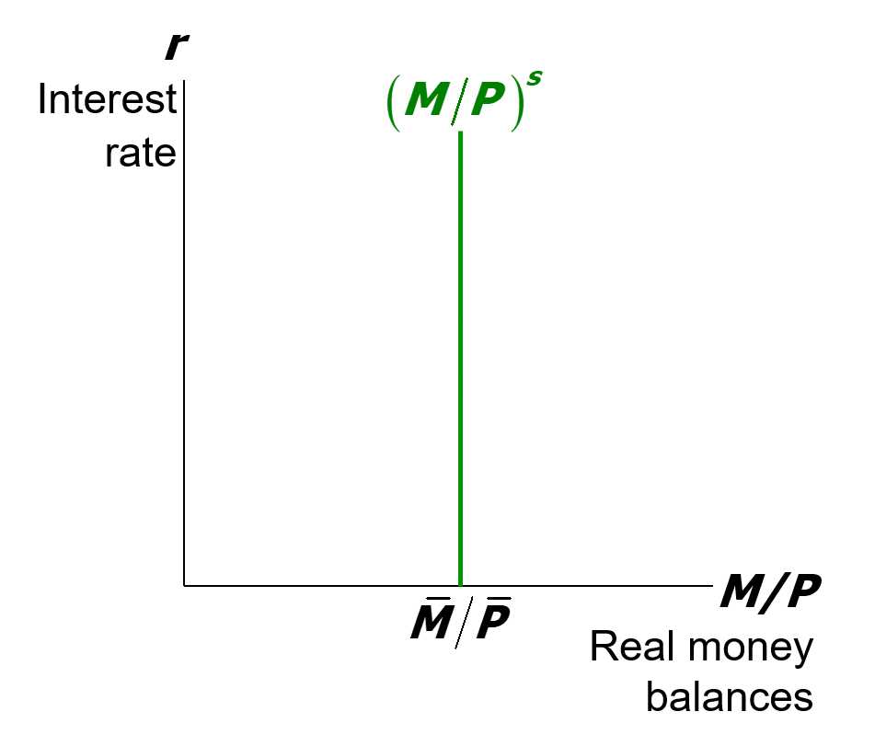
Money supply
The supply of real money balances is fixed:
Notes:
We are assuming a fixed supply of real money balances because P is fixed by assumption (short run), and M is an exogenous policy variable.

Slide 29
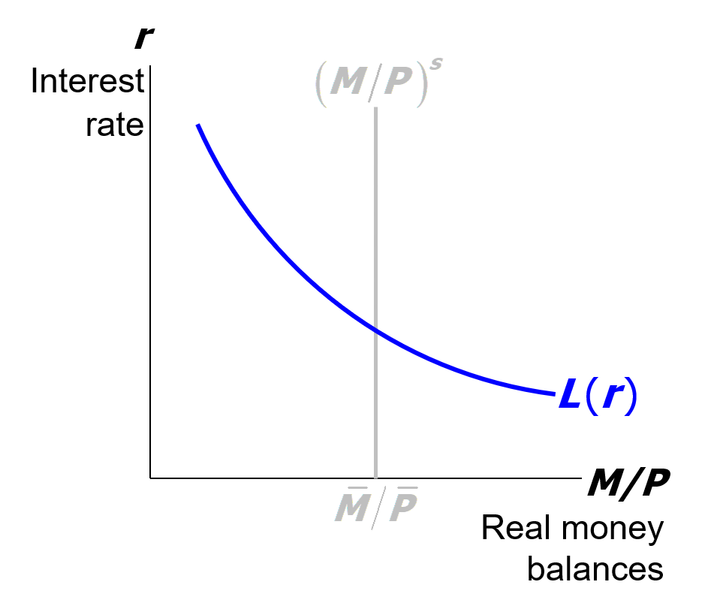
Money demand
Demand for real money balances:
Notes:
As described in Chapter 5, the nominal interest rate is the opportunity cost of holding money (instead of bonds), so money demand depends negatively on the nominal interest rate.
Here, we are assuming the price level is fixed, so π = 0 and r = i.

Slide 30
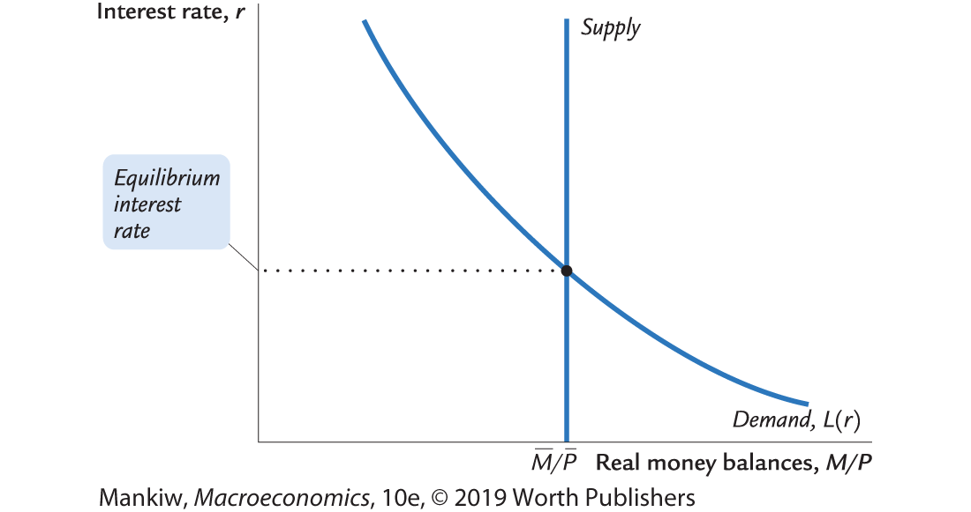
Equilibrium

Slide 31
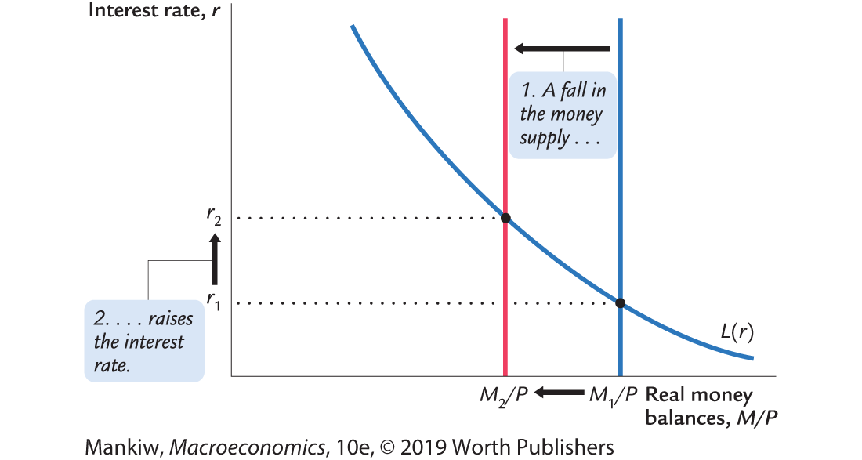
How the Fed raises the interest rate

Slide 32
CASE STUDY: Monetary tightening and interest rates, part 1
Late 1970s: π > 10%
Oct 1979: Fed Chair Paul Volcker announces that monetary policy would aim to reduce inflation
Aug 1979–April 1980: Fed reduces M/P 8.0%
Jan 1983: π = 3.7%
How do you think this policy change would affect nominal interest rates?
Notes:
This and the next slide summarize the case study on p. 324. The data source is given on the next slide.
At this point, students have learned two theories about the effects of monetary policy on interest rates. This case study shows that both theories are relevant, using a real-world example to remind students that the classical theory of Chapter 5 applies in the long run, while the liquidity preference theory applies in the short run.

Slide 33
CASE STUDY: Monetary tightening and interest rates, part 2
The effects of a monetary tightening on nominal interest rates
 | Short run | Long run
Model | Liquidity preference (Keynesian) | Quantity theory, Fisher effect (classical)
Prices | Sticky | Flexible
Prediction | Δi > 0 | Δi < 0
Actual outcome | 8/1979: i = 10.4% 4/1980: i = 15.8% | 8/1979: i = 10.4% 1/1983: i = 8.2%
Notes:
Since prices are sticky in the short run, the liquidity preference theory predicts that both the nominal and real interest rates will rise in the short run. And, in fact, both did. (However, the inflation rate was not zero, and it actually increased, so the real interest rate didn’t rise as much as the nominal interest rate did during the period shown.)
In the long run, the quantity theory of money says that monetary tightening should reduce inflation. The Fisher effect says that the fall in π should cause an equal fall in i. By January 1983 (which is “the long run” from the viewpoint of 1979), inflation and nominal interest rates had fallen. (However, they did not fall by equal amounts. This doesn’t contradict the Fisher effect, though, as other economic changes caused movements in the real interest rate.)
About the data:
i = 3-month rate on commercial paper
% change in M/P from previous slide: I computed M1/CPI (the measure used in the case study) and then computed the percentage change in M1/CPI over the 8-month period beginning with the month in which Volcker became the Fed chair, August 1979.
Source: FRED database, Federal Reserve Bank of St. Louis.

Slide 34
The LM curve
Now let’s put Y back into the money demand function:
The LM curve is a graph of all combinations of r and Y that equate the supply and demand for real money balances.
The equation for the LM curve is:

Slide 35
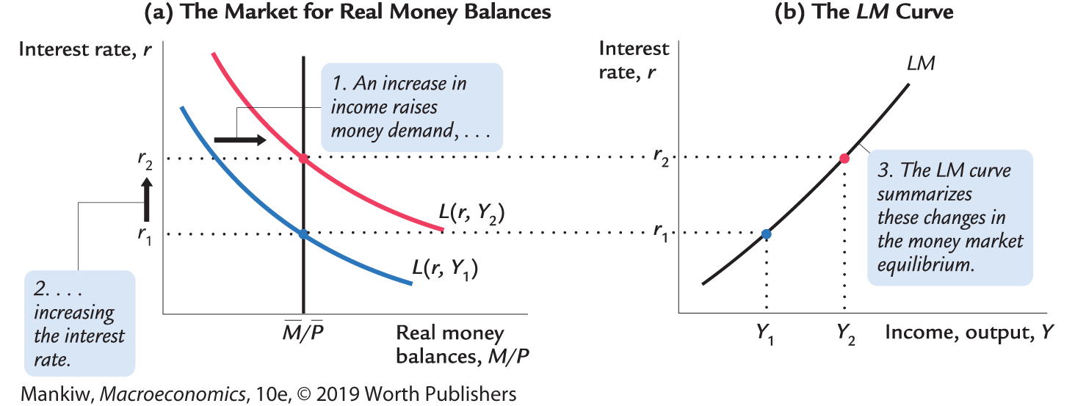
Deriving the LM curve
Notes:
Similarly to how we went from the Keynesian cross to the IS curve, how these two graphs are drawn is important.
Here the LM curve is drawn so it shares the same values of the interest rate as the market for real money balances. Students may draw this derivation incorrectly in their notes. Help them understand that the derivation is set up in a specific manner.

Slide 36
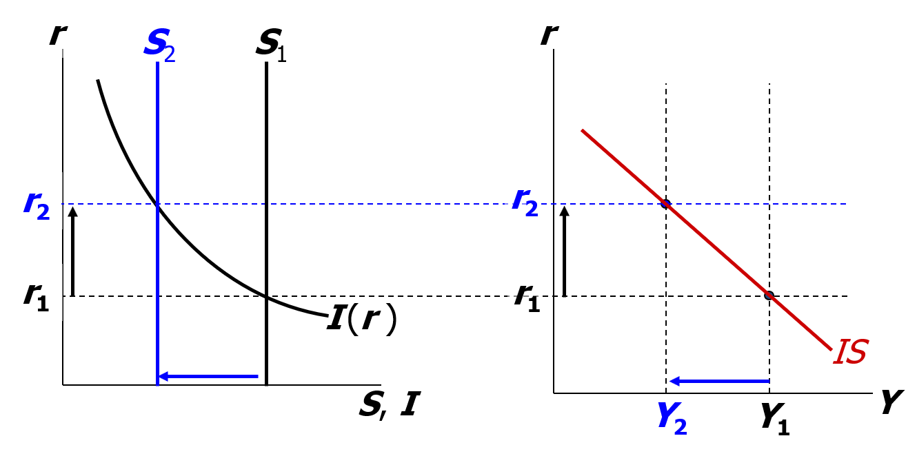
The IS curve and the loanable funds model
(a) The loanable funds model
(b) The IS curve
Notes:
***
This material was covered in previous editions of the textbook but was deleted to help make room for newer material in other chapters. I have “hidden” this slide rather than delete it, since many professors still may wish to show their students how the IS curve is just another expression of the familiar loanable funds model from Chapter 3.
***
The IS curve can also be derived from the (hopefully now familiar) loanable funds model from chapter 3.
A decrease in income from Y₁ to Y₂ causes a fall in national saving.
(Recall, S = Y-C-G)
The fall in saving causes a reduction in the supply of loanable funds. The interest rate must rise to restore equilibrium to the loanable funds market.
Now we can see where the IS curve gets its name:
When the loanable funds market is in equilibrium, investment = saving. The IS curve shows all combinations of r and Y such that investment (I) equals saving (S). Hence, IS curve.

Slide 37
Why the LM curve is upward sloping
An increase in income raises money demand.
Since the supply of real balances is fixed, there is now excess demand in the money market at the initial interest rate.
The interest rate must rise to restore equilibrium in the money market.
Notes:
This slide simply states the intuition behind the graphs on the preceding slide.
Suggestion: Omit this slide from your presentation and just give the students this information orally as you present the preceding slide.

Slide 38
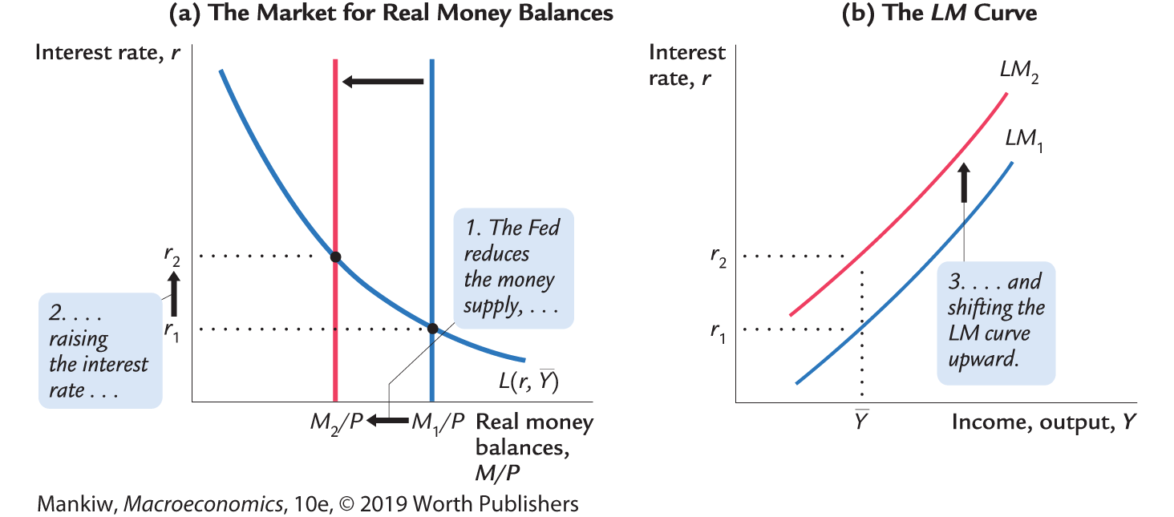
How ΔM shifts the LM curve
Notes:
You might consider helping your students understand the analytical difference between looking at a shift as a horizontal shift and looking at it as a vertical shift.
We can think of the LM curve shift as a vertical shift:
When the Fed reduces M, the vertical distance of the shift tells us what happens to the equilibrium interest rate associated with a given value of income.
Or, we can think of the LM curve shifting horizontally:
When the Fed reduces M, the horizontal distance of the shift tells us what would have to happen to income to restore money market equilibrium at the initial interest rate. (The graphical analysis would be a little different from what’s depicted on this slide.)

Slide 39
NOW YOU TRY
Shifting the LM curve
Suppose a wave of credit card fraud causes consumers to use cash more frequently in transactions.
Use the liquidity preference model to show how these events shift the LM curve.

Slide 40
NOW YOU TRY Shifting the LM curve, answer
Notes:
If consumers desire to use cash more frequently, money demand will exogenously increase— that is, each (r, Y) pair will be associated with higher money demand than before. In the liquidity preference model, the money demand curve shifts upward/rightward.
Hence, at the initial value of income, the interest rate must rise to restore equilibrium in the money market. As a result, the LM curve shifts up: each value of income (such as the initial income) is associated with a higher interest rate than before.

Slide 41
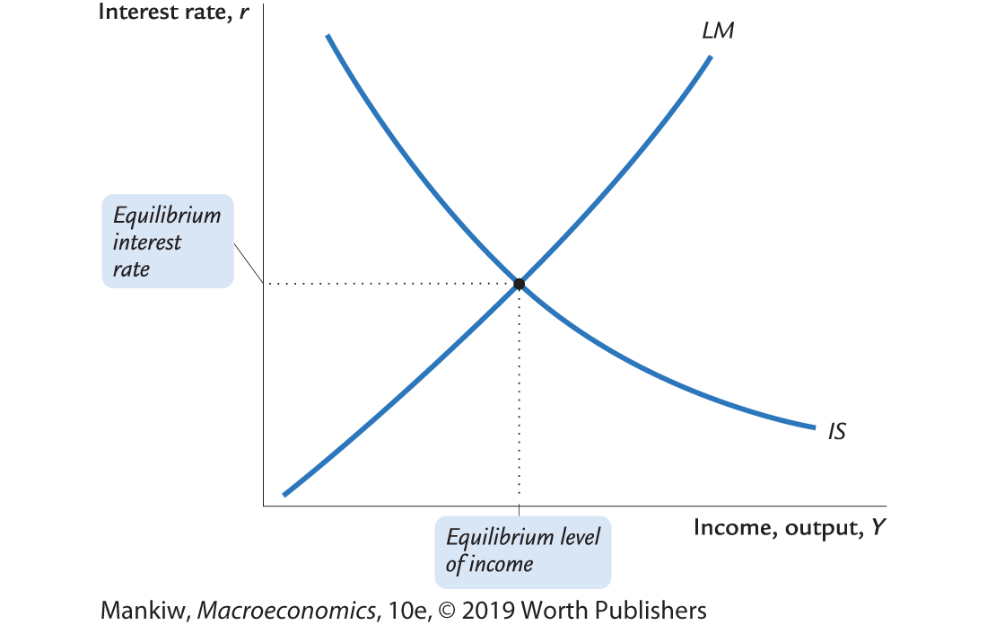
The short-run equilibrium
The short-run equilibrium is the combination of r and Y that simultaneously satisfies the equilibrium conditions in the goods and money markets:

Slide 42
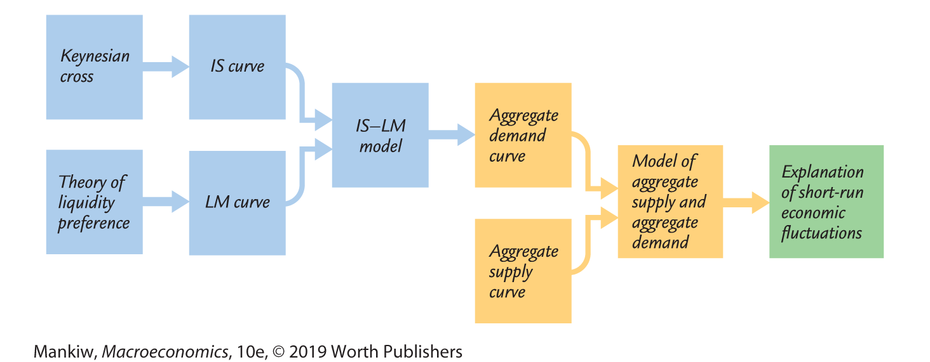
The big picture
Notes:
Let students know that the IS–LM model is used to derive the AD curve.
This schematic diagram (similar to Figure 11-14, p. 328) shows how the different pieces of the theory of short-run fluctuations fit together.

Slide 43
Preview of Chapter 12
In Chapter 12, we will
  use the IS–LM model to analyze the impact of policies and shocks.
  learn how the aggregate demand curve comes from IS-LM.
  use the IS–LM and AD–AS models together to analyze the short-run and long-run effects of shocks.
  use our models to learn about the Great Depression.
Notes:
This slide serves as a bridge between this chapter and the next one.

Slide 44
CHAPTER SUMMARY, PART 1
Keynesian cross
  basic model of income determination
  takes fiscal policy and investment as exogenous
  fiscal policy has a multiplier effect on income
IS curve
  comes from Keynesian cross when planned investment depends negatively on interest rate
  shows all combinations of r and Y that equate planned expenditure with actual expenditure on goods and services

Slide 45
CHAPTER SUMMARY, PART 2
Theory of liquidity preference
  basic model of interest rate determination
  takes money supply and price level as exogenous
  an increase in the money supply lowers the interest rate
LM curve
  comes from liquidity preference theory when money demand depends positively on income
  shows all combinations of r and Y that equate demand for real money balances with supply

Slide 46
CHAPTER SUMMARY, PART 3
IS–LM model
  The intersection of the IS and LM curves shows the unique point (Y, r ) that satisfies equilibrium in both the goods and money markets.

