Slide 1

Aggregate Demand II: Applying the IS-LM Model
Macroeconomics
N. Gregory Mankiw
© 2019 Worth Publishers, all rights reserved
Notes:
This is a very substantial chapter, and it’s among the most challenging in the text. I encourage you to go over this chapter a little more slowly than average or at least recommend to your students that they study it extra carefully.
I have included a number of in-class exercises to give students immediate reinforcement of concepts as they are covered and also to break up the lecture. If you need to get through the material more quickly, you can omit some or all of these exercises (perhaps assigning them as homework instead).
To complement the book’s case study on the 2008–2009 financial crisis and recession, these slides include lots of data for you to show and discuss with your students. Your students will need to read the Case Study in their textbooks, preferably before you present this data. My hope is that the data will help bring the theory to life and convey to students the excitement of studying macroeconomics in the current era.

Slide 2
IN THIS CHAPTER, YOU WILL LEARN: PART 1
Chapter 10 introduced the model of aggregate demand and supply.
Chapter 11 developed the IS–LM model, the basis of the aggregate demand curve.
Notes:
If you wish, delete this slide and give students this information orally.

Slide 3
IN THIS CHAPTER, YOU WILL LEARN: PART 2
How to use the IS–LM model to analyze the effects of shocks, fiscal policy, and monetary policy
How to derive the aggregate demand curve from the IS–LM model
Several theories about what caused the Great Depression

Slide 4
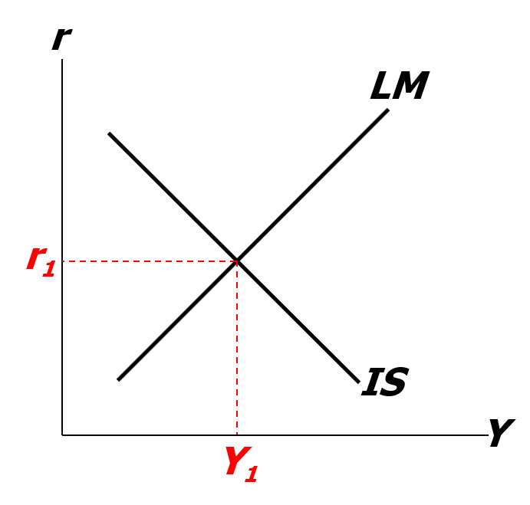
Equilibrium in the IS-LM model
The IS curve represents equilibrium in the goods market.
The LM curve represents money market equilibrium.
The intersection determines
the unique combination of Y and r that satisfies equilibrium in both markets.
Notes:
Review/recap of the very end of Chapter 11.

Slide 5
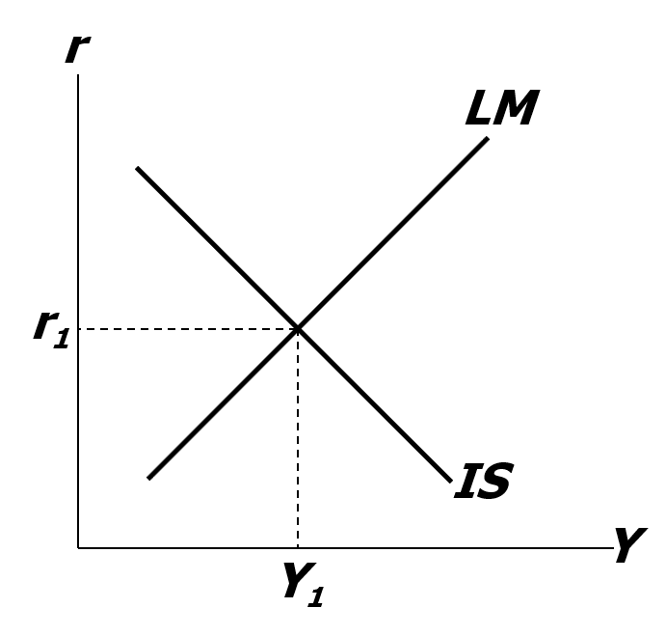
Policy analysis with the IS-LM model
We can use the IS–LM model to analyze the effects of
  fiscal policy: G and/or T
  monetary policy: M
Notes:
You may wish to highlight that G, T, and M are exogenous (which is represented by the bar over the letter). The fact that these are exogenous will be brought up again in a few slides.

Slide 6
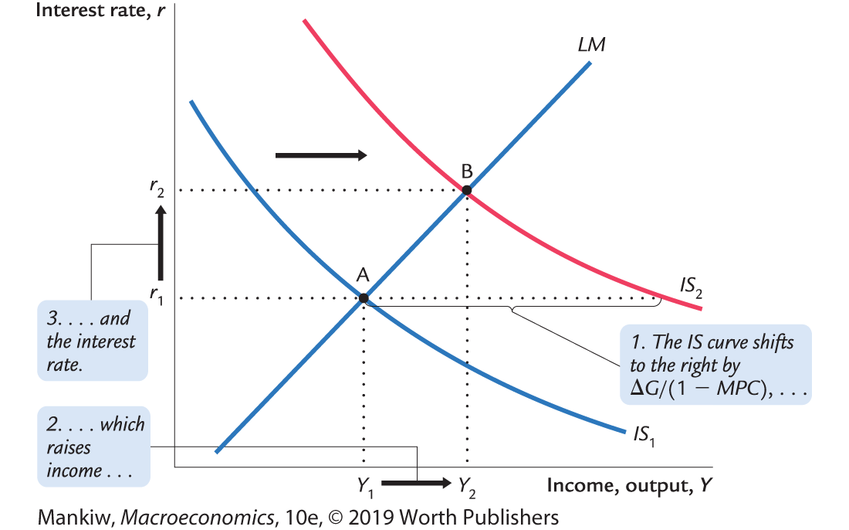
An increase in government purchases
Notes:
Chapter 11 showed that an increase in G causes the IS curve to shift to the right by (ΔG)/(1 – MPC).
This differs from most intro economics course. 1/(1 – MPC) is no longer the increase in Y but rather how far out the IS curve shifts. The reason Y goes up by a smaller amount than in an intro course is that there is crowding out (Point 3)

Slide 7
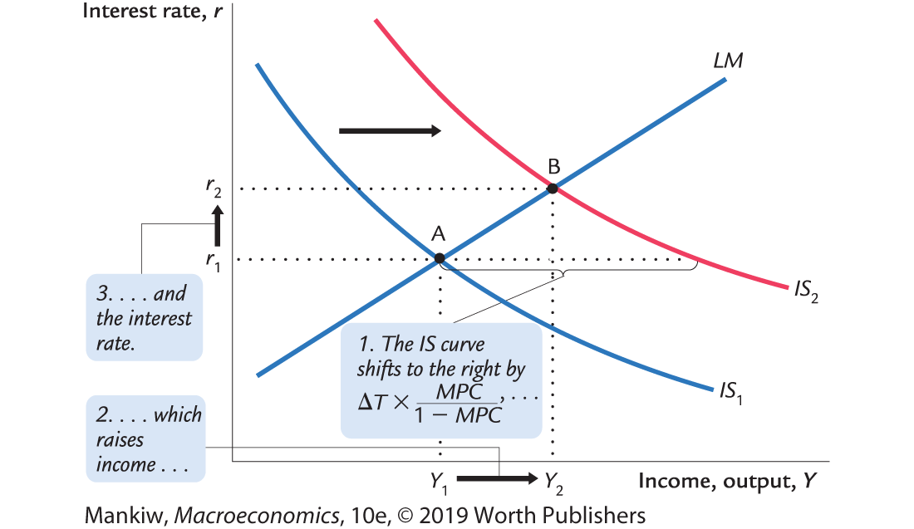
A tax cut
Notes:
Chapter 11 used the Keynesian cross to show that a decrease in T causes the IS curve to shift to the right by (−MPCΔT)/(1 − MPC).
If your students ask why the IS curve shifts to the right when there’s a negative sign in the expression for the shift, remind them that ΔT < 0 for a tax cut, so the expression actually is positive.
The term showing the distance of the shift in the IS curve is almost the same as in the case of a government spending increase, where the numerator of the fraction equals (1) for government spending rather than (−MPC) for the tax cut. Here’s the intuition: Every dollar of a government spending increase adds to aggregate spending. However, for tax cuts, the fraction (1 − MPC) of the tax cut leaks into saving, so aggregate spending only rises by MPC times the tax cut.

Slide 8
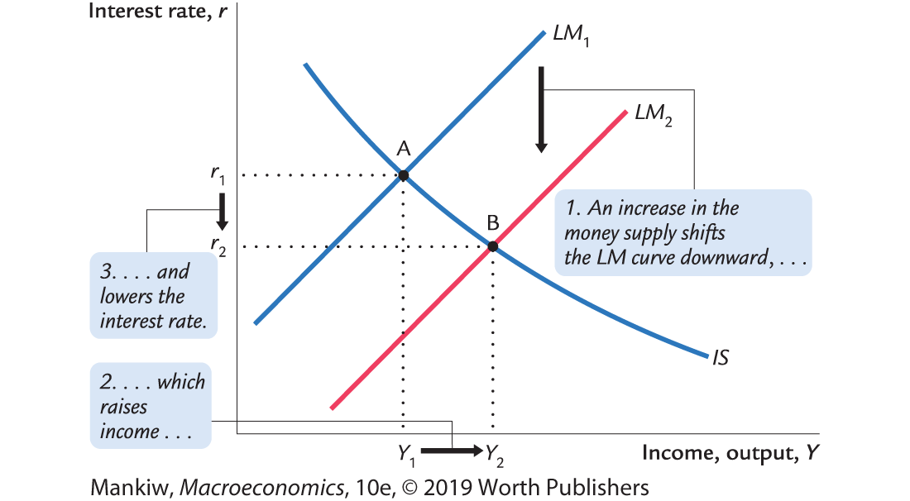
Monetary policy: An increase in M
Notes:
Chapter 11 showed that an increase in M shifts the LM curve to the right.
Here is a richer explanation for the LM shift:
The increase in M causes the interest rate to fall. [People like to keep optimal proportions of money and bonds in their portfolios; if money is increased, then people try to re-attain their optimal proportions by “exchanging” some of the money for bonds: they use some of the extra money to buy bonds. This increase in the demand for bonds drives up the price of bonds—and causes interest rates to fall (since interest rates are inversely related to bond prices).
The fall in the interest rate induces an increase in investment demand, which causes output and income to increase.
The increase in income causes money demand to increase, which increases the interest rate (though doesn’t increase it all the way back to its initial value; instead, this effect simply reduces the total decrease in the interest rate).

Slide 9
Interaction between monetary and fiscal policy
Model:
  Monetary and fiscal policy variables (M, G, and T) are exogenous.
Real world:
  Monetary policymakers may adjust M in response to changes in fiscal policy or vice versa.
  Such interactions may alter the impact of the original policy change.

Slide 10
The Fed’s response to ΔG > 0
Suppose Congress increases G.
Possible Fed responses:
  Hold M constant
  Hold r constant
  Hold Y constant
In each case, the effects of ΔG are different . . .

Slide 11
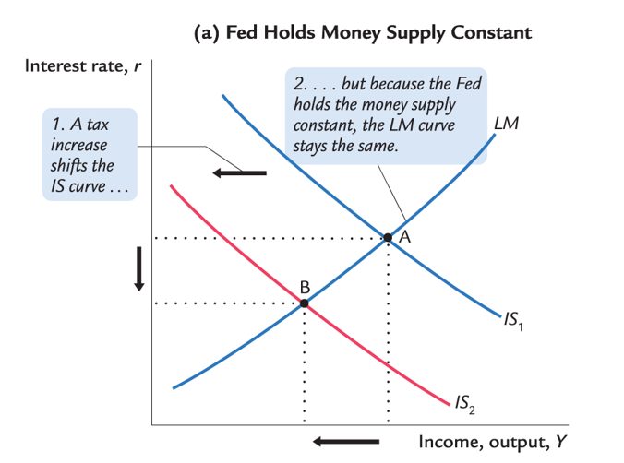
Response 1: Hold M constant

Slide 12
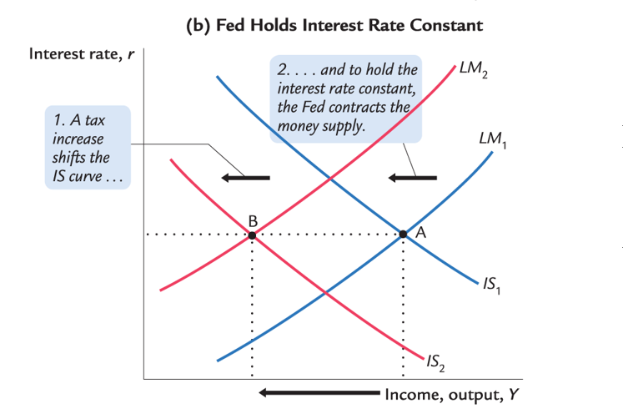
Response 2: Hold r constant

Slide 13
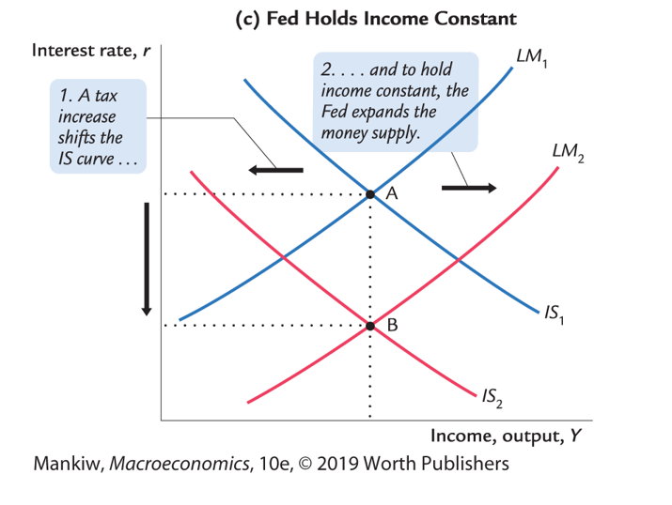
Response 3: Hold Y constant

Slide 14
Shocks in the IS-LM model, part 1
IS shocks: exogenous changes in the demand for goods and services.
Examples:
  stock market boom or crash
   change in households’ wealth
   ΔC
  change in business or consumer confidence or expectations
   ΔI and/or ΔC

Slide 15
Shocks in the IS-LM model, part 2
LM shocks: exogenous changes in the demand for money.
Examples:
  A wave of credit card fraud increases demand for money.
  More ATMs or the Internet reduce money demand.

Slide 16
NOW YOU TRY
Analyze shocks with the IS-LM model
Use the IS–LM model to analyze the effects of
  a housing market crash that reduces consumers’ wealth
  consumers using cash in transactions more frequently in response to an increase in identity theft
For each shock,
  use the IS–LM diagram to determine the effects on Y and r.
  figure out what happens to C, I, and the unemployment rate.
Notes:
Earlier slides showed how to use the IS–LM model to analyze fiscal and monetary policy. Now is a good time for students to get some hands-on practice with the model. Also, note that part (b) helps students learn that shocks and policies can potentially affect all of the model’s endogenous variables, not just the ones that are measured on the axes.
Suggestion: Instead of having students work on these exercises individually, get them into pairs. Have one student of each pair works on the first shock and the other student work on the second shock. Give them 5 minutes to work individually on the analysis of the shock. Then allow 10 minutes (5 for each student) for students to present their results to their partners. This activity gives students immediate application and reinforcement of the concepts, so students learn them better and will then better understand and appreciate the remainder of this chapter.

Slide 17
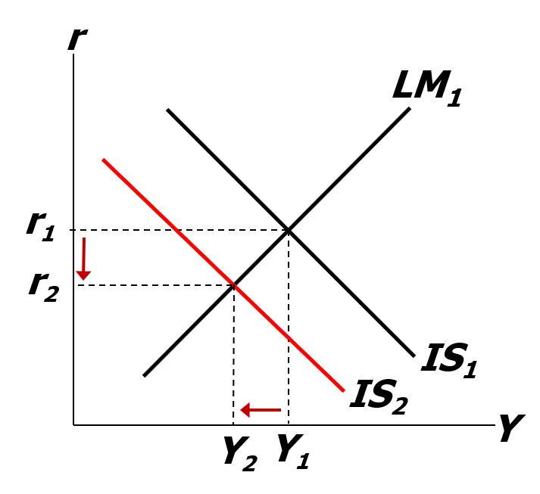
NOW YOU TRY
Analyze shocks with the IS-LM model, answer, part 1
IS shifts left, causing r and Y to fall.
C falls due to lower wealth and lower income,
I rises because r is lower
u rises because Y is lower
(Okun’s law)
Notes:
1a. The IS curve shifts to the left because consumers cut back on spending in response to the decrease in their wealth. This causes Y and r to fall.
1b. C falls for two reasons: the housing market crash and the fall in income. In this simple model, I depends only on the interest rate, which falls, causing I to rise. u rises because firms need less labor when they are producing less output (recall Okun’s law).

Slide 18
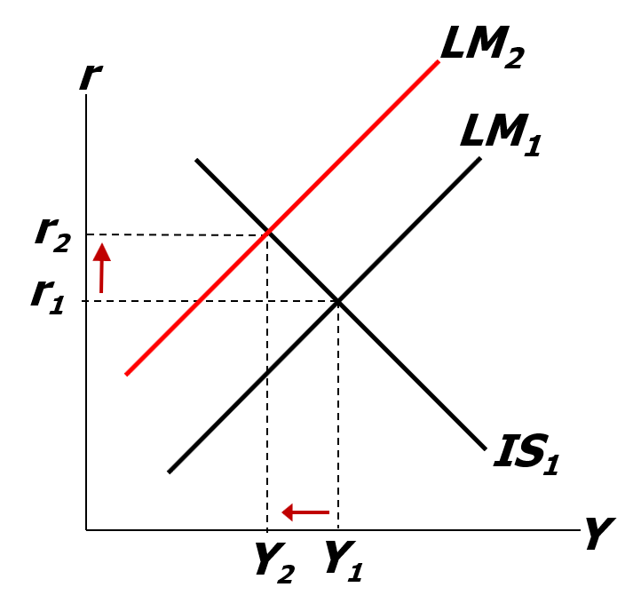
NOW YOU TRY
Analyze shocks with the IS-LM model, answer, part 2
LM shifts left, causing r to rise and Y to fall.
C falls due to lower income.
I falls because r is higher.
u rises because Y is lower.
(Okun’s law)
Notes:
2a. (This is a continuation of the in-class exercise at the end of the Chapter 11 PowerPoint presentation.) The increase in money demand shifts the LM curve to the left: We are assuming that all other exogenous variables, including M and P, remain unchanged, so an increase in money demand causes an increase in the value of r associated with each value of Y (this can be seen easily using the liquidity preference diagram). This translates to an upward (that is, leftward) shift in the LM curve. This shift causes Y to fall and r to rise.
2b. The fall in income causes a fall in C. The increase in r causes a fall in I. The fall in Y causes an increase in u.

Slide 19
CASE STUDY: The U.S. recession of 2001, part 1
During 2001:
  2.1 million jobs lost, unemployment rose from 3.9% to 5.8%.
  GDP growth slowed to 0.8% (compared to 3.9% average annual growth during 1994–2000).

Slide 20
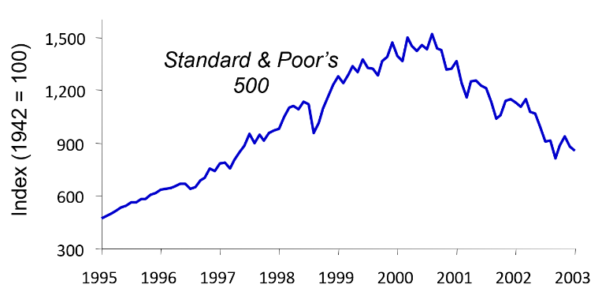
CASE STUDY: The U.S. recession of 2001, part 2
Causes: 1) Stock market decline  iC
Notes:
Starting in mid-2000, the S&P 500 began a downward trend. The fall in stock prices eroded the wealth of millions of U.S. consumers. They responded by reducing consumption.

Slide 21
CASE STUDY: The U.S. recession of 2001, part 3
Causes: 2) 9/11
  increased uncertainty
  fall in consumer and business confidence
  result: lower spending, IS curve shifted left
Causes: 3) Corporate accounting scandals
  Enron, WorldCom, etc.
  reduced stock prices, discouraged investment

Slide 22
CASE STUDY: The U.S. recession of 2001, part 4
Fiscal policy response: shifted IS curve right
  tax cuts in 2001 and 2003
  spending increases
    airline industry bailout
    NYC reconstruction
    Afghanistan war
Notes:
The war was a response to the 9/11 attacks, not to the recession. But wars involve significant fiscal policy expansion, which increases aggregate demand and alleviates or ends recessions.

Slide 23
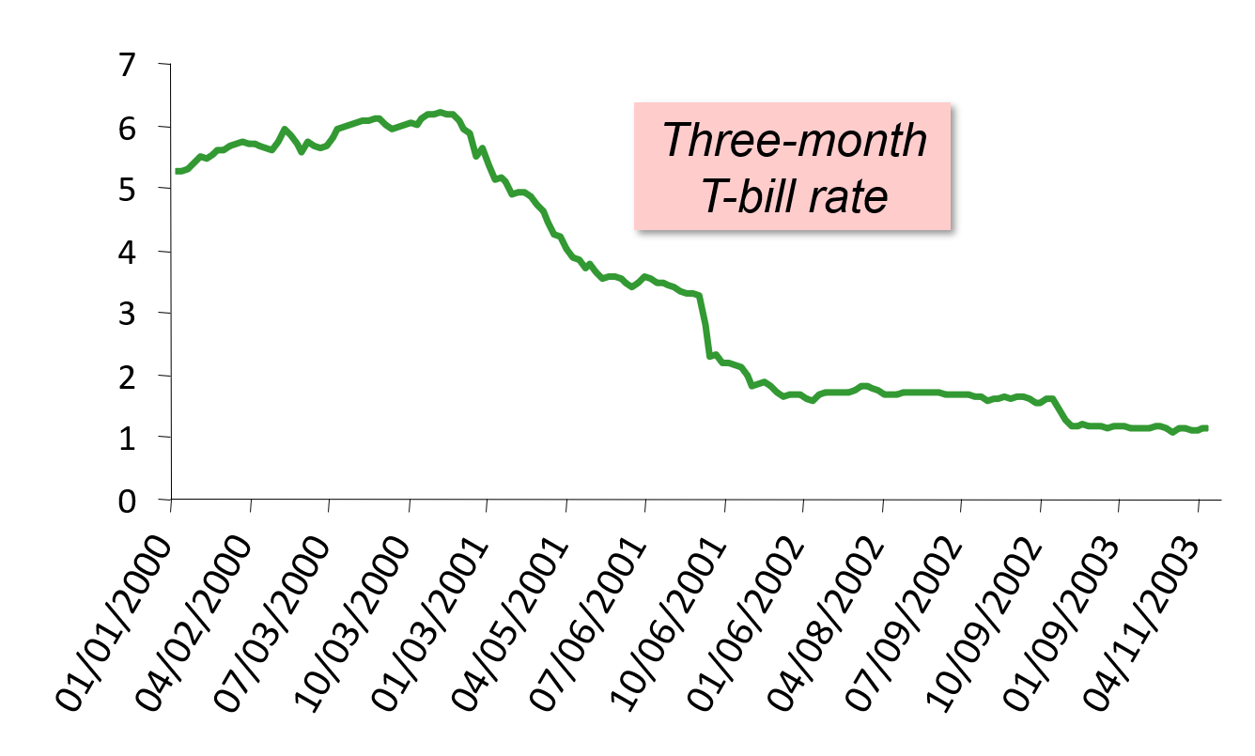
CASE STUDY: The U.S. recession of 2001, part 5
Monetary policy response: shifted LM curve right
Notes:
Easier monetary policy shifted the LM curve to the right, causing interest rates to fall, as shown in this graph.

Slide 24
What is the Fed’s policy instrument? Part 1
The news media commonly report the Fed’s policy changes as interest rate changes, as if the Fed has direct control over market interest rates.
In fact, the Fed targets the federal funds rate—the interest rate banks charge one another on overnight loans.
The Fed changes the money supply and shifts the LM curve to achieve its target.
Other short-term rates typically move with the federal funds rate.
Notes:
You may wish to highlight why targets is in red. The Fed tries to keep the federal funds rate in a narrow band of interest rates. You can bring up https://fred.stlouisfed.org/series/FEDFUNDS#0.
Even at flat portions of the graph, such as 2006–2007, the interest rate fluctuates between 5.24% and 5.26%.

Slide 25
What is the Fed’s policy instrument? Part 2
Why does the Fed target interest rates instead of the money supply?
  They are easier to measure than the money supply.
  The Fed might believe that LM shocks are more prevalent than IS shocks. If so, targeting the interest rate stabilizes income better than targeting the money supply.

Slide 26
IS-LM and aggregate demand
So far, we’ve been using the IS–LM model to analyze the short run, when the price level is assumed to be fixed.
However, a change in P would shift LM and would therefore affect Y.
The aggregate demand curve (introduced in Chapter 10) captures this relationship between P and Y.

Slide 27
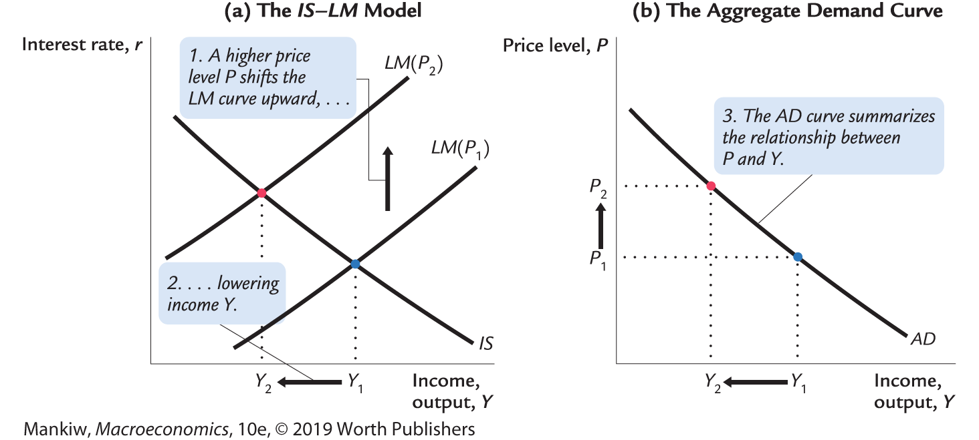
Deriving the AD curve
Notes:
It might be useful to explain to students the reason why we draw P₁ before drawing the LM curve:
The position of the LM curve depends on the value of M/P. M is an exogenous policy variable. So, if P is low (like P₁ in the lower panel of the diagram), then M/P is relatively high, so the LM curve is over toward the right in the upper diagram. If P is high, like P₂, then M/P is relatively low, so the LM curve is more toward the left.
Because the value of P affects the position of the LM curve, we label the LM curves in the upper panel as LM(P₁) and LM(P₂).

Slide 28
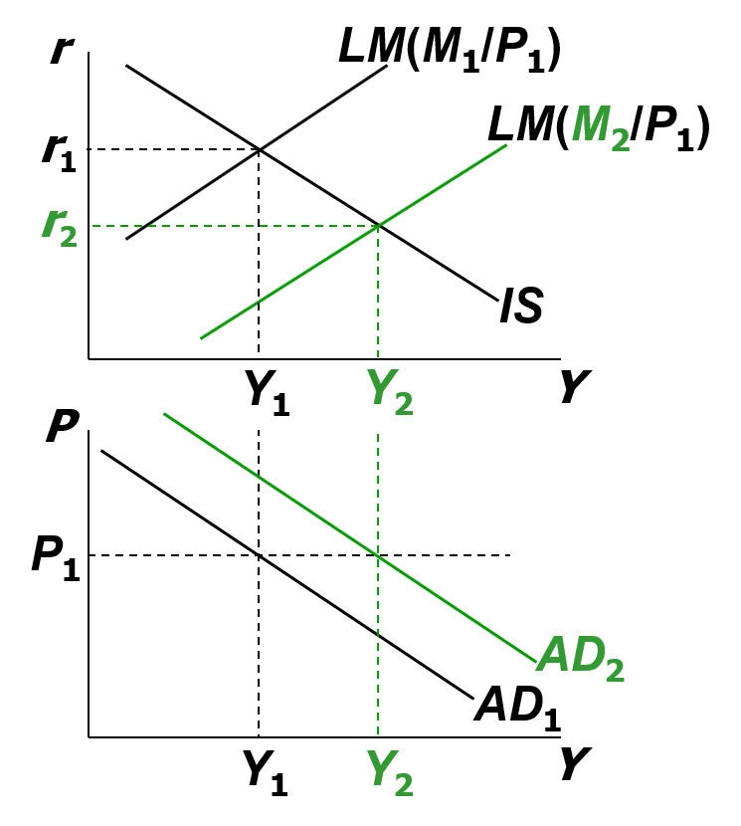
Monetary policy and the AD curve
The Fed can increase aggregate demand:
M  LM shifts right
 r
 I
 Y at each value of P
Notes:
It’s worth taking a moment to explain why we are holding P fixed at P₁:
To find out whether the AD curve shifts to the left or right, we need to find out what happens to the value of Y associated with any given value of P. This is not to say that the equilibrium value of P will remain fixed after the policy change (though, in fact, we are assuming that P is fixed in the short run). We just want to see what happens to the AD curve.
Once we know how the AD curve shifts, we can then add the AS curves (short or long run) to find out what, if anything, happens to P (in the short run or in the long run).

Slide 29
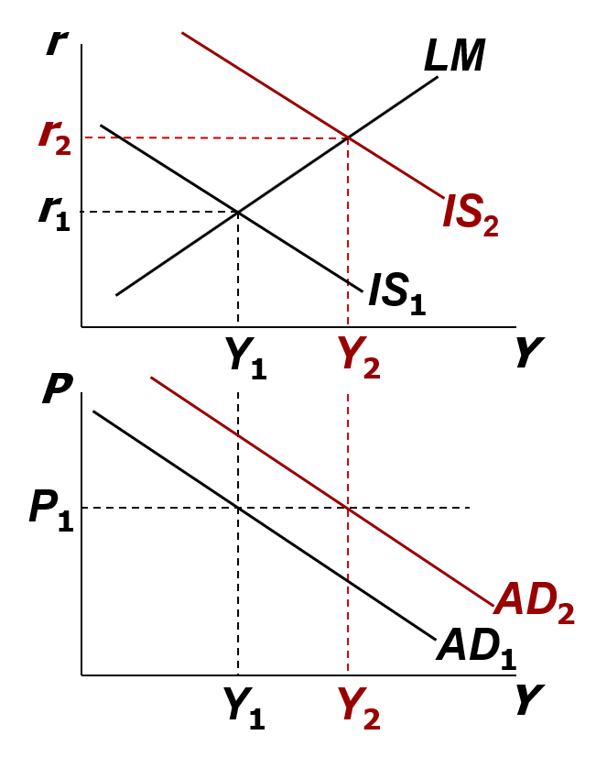
Fiscal policy and the AD curve
Expansionary fiscal policy (hG and/or iT) increases agg. demand:
T  C
 IS shifts right
 Y at each value of P
Notes:
As with the previous graphs, this graph is drawn the way it is for a reason: the top and bottom graphs have the same axis, and thus Y₁ in the top graph corresponds to the same level of output on the bottom graph. You’ll want to make sure students draw the derivation correctly.

Slide 30
IS-LM and AD-AS in the short run and in the long run
Recall from Chapter 10: The force that moves the economy from the short run to the long run is the gradual adjustment of prices.
Notes:
The next few slides put our IS–LM–AD in the context of the bigger picture—the AD–AS model in the short run and long run, which was introduced in Chapter 10.

Slide 31
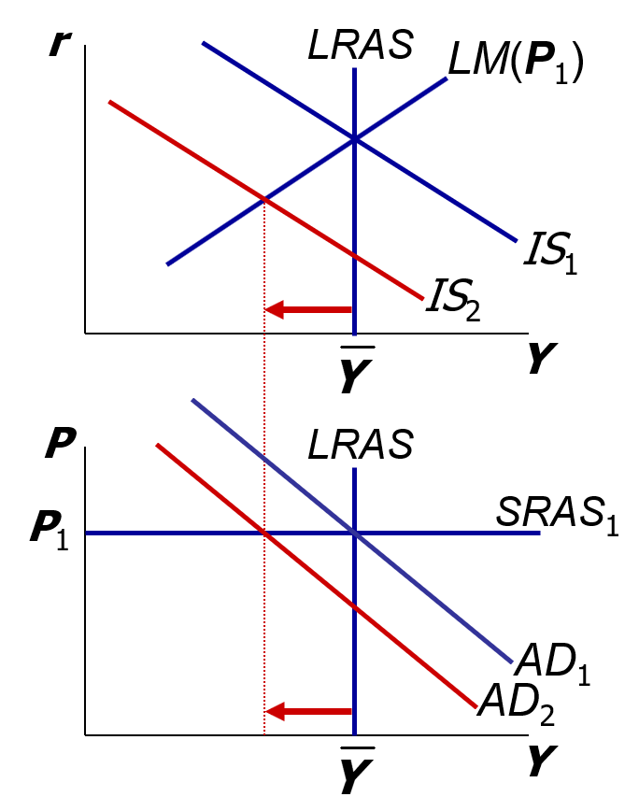
The SR and LR effects of an IS shock, part 1
A negative IS shock shifts IS and AD left, causing Y to fall.
Notes:
Abbreviations:
SR = short run
LR = long run
The analysis that begins on this slide continues on the following slides.

Slide 32
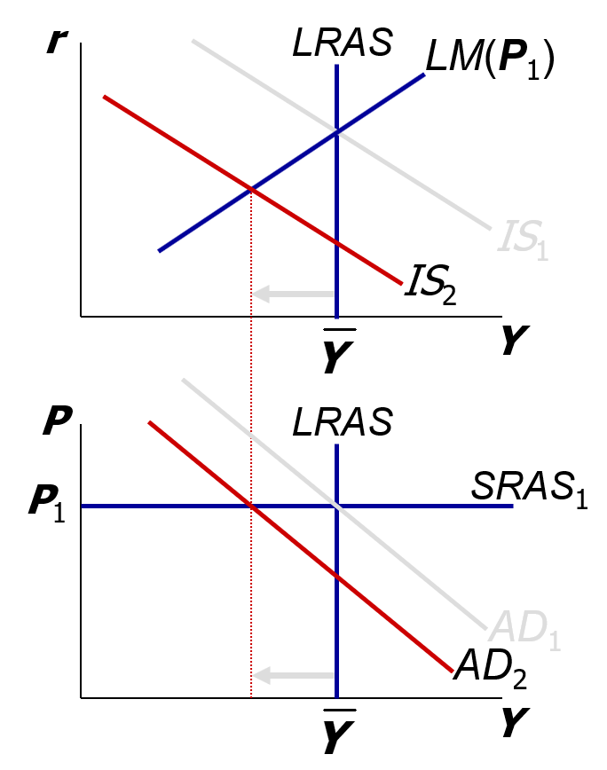
The SR and LR effects of an IS shock, part 2
In the new short-run equilibrium,

Slide 33
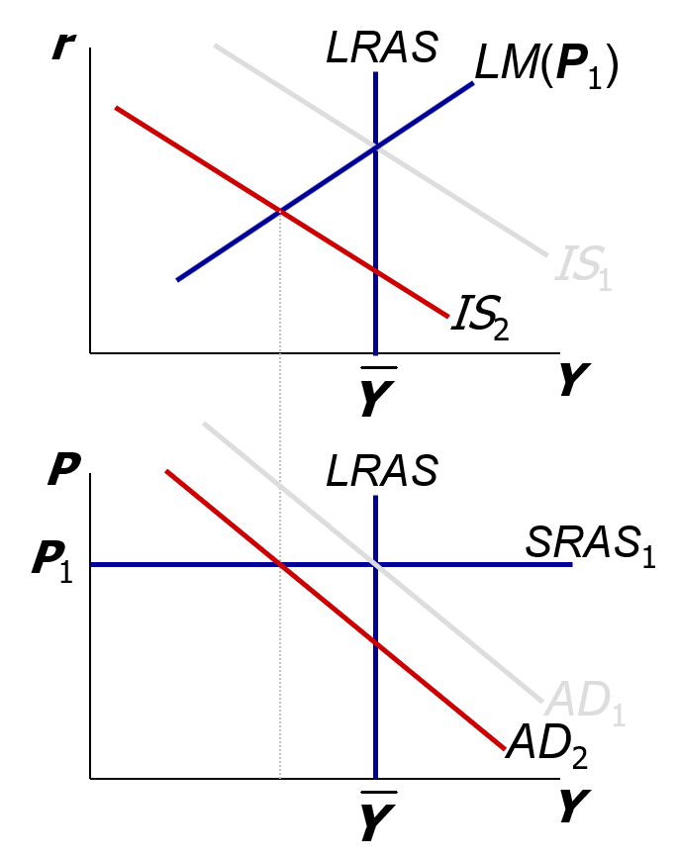
The SR and LR effects of an IS shock, part 3
In the new short-run equilibrium,
Over time, P gradually falls, causing:
  SRAS to move down
  M/P to increase, which causes LM to move down

Slide 34
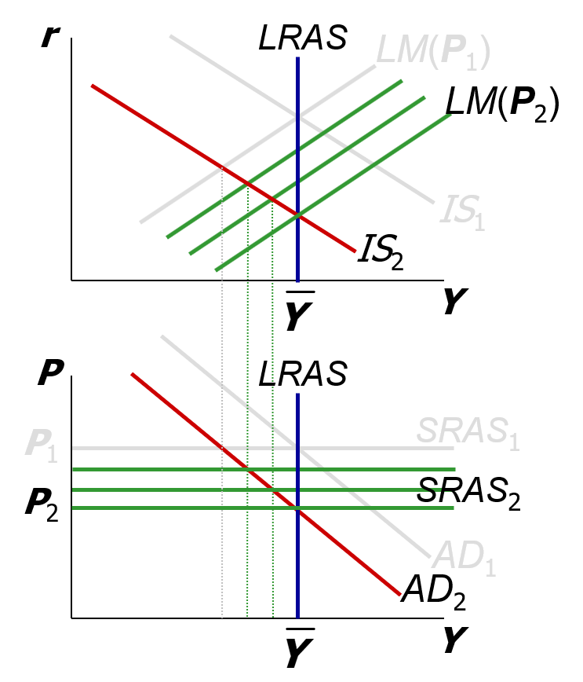
The SR and LR effects of an IS shock, part 4
Over time, P gradually falls, causing:
  SRAS to move down
  M/P to increase, which causes LM to move down

Slide 35
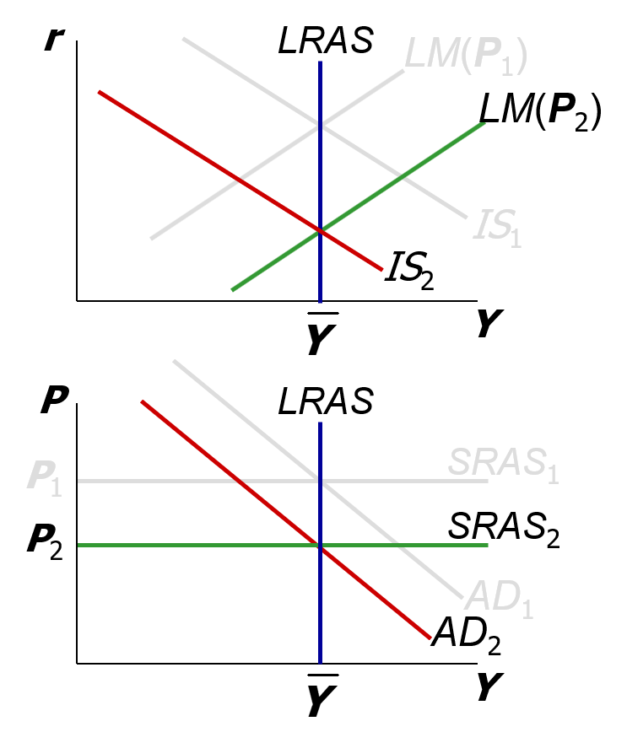
The SR and LR effects of an IS shock, part 5
This process continues until the economy reaches a long-run equilibrium with
Notes:
A good thing to do: Go back through this experiment again and see if your students can figure out what is happening to the other endogenous variables (C, I, u) in the short run and in the long run.

Slide 36
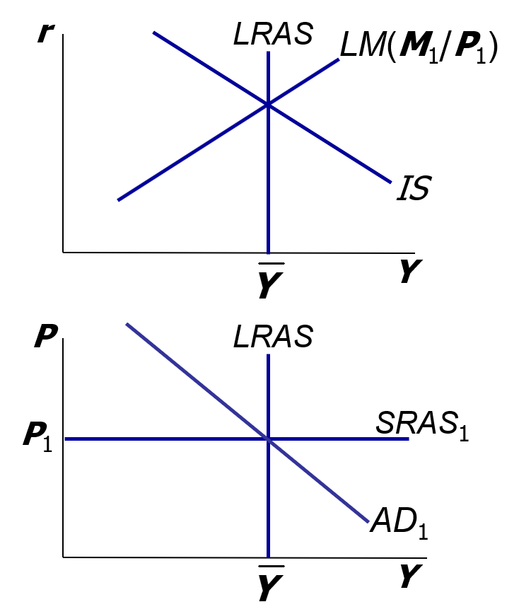
NOW YOU TRY
Analyze SR and LR effects of ΔM
Draw the IS–LM and AD–AS diagrams as shown here.
Suppose the Fed increases M. Show the short-run effects on your graphs.
Show what happens in the transition from the short run to the long run.
How do the new long-run equilibrium values of the endogenous variables compare to their initial values?
Notes:
This exercise has two objectives:
1. To give students immediate reinforcement of the preceding concepts
2. To show them that money is neutral in the long run, just like in Chapter 5
You might have your students try other exercises using this framework:
To illustrate the short-run and long-run effects of expansionary fiscal policy, have students compare the long-run results in this framework with the results they obtained when doing the same experiment in Chapter 3 (the loanable funds model).
Immediately after a negative shock pushes output below its natural rate, show how monetary or fiscal policy can be used to restore full employment immediately (that is, without waiting for prices to adjust).

Slide 37
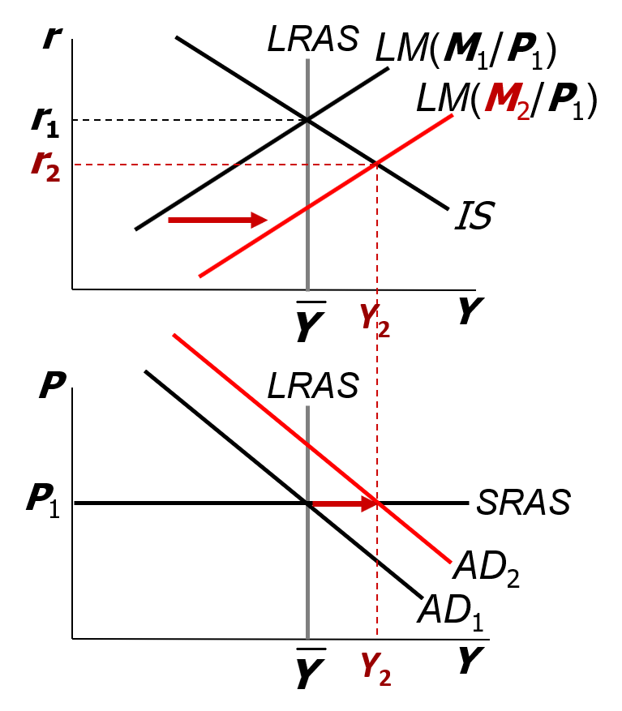
NOW YOU TRY
Analyze SR and LR effects of ΔM, answer, part 1
LM and AD shift right.
r falls, Y rises above

Slide 38
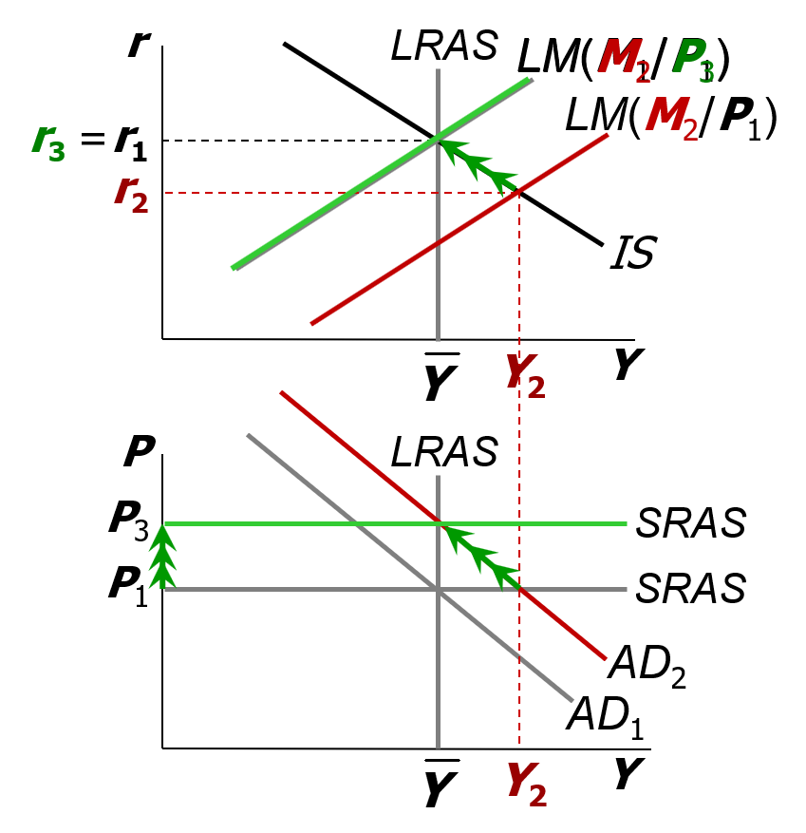
NOW YOU TRY
Analyze SR and LR effects of ΔM, answer, part 2
Over time,
  P rises
  SRAS moves upward
  M/P falls
  LM moves leftward
New long-run eq’m
  P higher
  all real variables back at
  their initial values
Money is neutral in the long run.

Slide 39
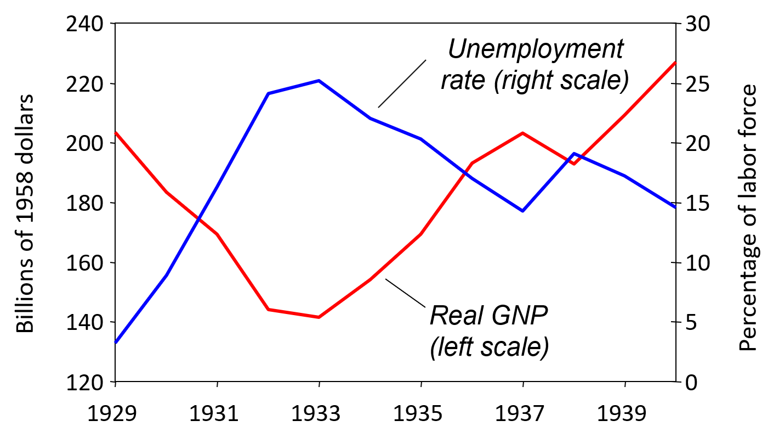
The Great Depression
Notes:
This chart presents data from Table 12-1 on pp. 348–349 of the text. For data sources, see the notes accompanying that table.
Things to note:
Note the magnitude of the fall in output and increase in unemployment: in 1933, the unemployment rate is over 25%!!
There’s a very strong negative correlation between output and unemployment.

Slide 40
THE SPENDING HYPOTHESIS: Shocks to the IS curve
Asserts the Depression was largely due to an exogenous fall in the demand for goods and services—a leftward shift of the IS curve.
Evidence:
output and interest rates both fell, which is what a leftward IS shift would cause.

Slide 41
THE SPENDING HYPOTHESIS: Reasons for the IS shift
Stock market crash reduced consumption
  Oct 1929–Dec 1929: S&P 500 fell 17%
  Oct 1929–Dec 1933: S&P 500 fell 71%
Drop in investment
  Correction after overbuilding in the 1920s.
  Widespread bank failures made it harder to obtain financing for investment.
Contractionary fiscal policy
  Politicians raised tax rates and cut spending to combat increasing deficits.
Notes:
In item 2, I’m using the term correction in the stock market sense.

Slide 42
THE MONEY HYPOTHESIS: A shock to the LM curve
Asserts that the Depression was largely due to the huge fall in the money supply.
Evidence: M1 fell 25% during 1929–1933.
But, two problems with this hypothesis:
  P fell even more, so M/P actually rose slightly during 1929–1931.
  Nominal interest rates fell, which is the opposite of what a leftward LM shift would cause.

Slide 43
THE MONEY HYPOTHESIS AGAIN: The effects of falling prices, part 1
Asserts that the severity of the Depression was due to a huge deflation:
P fell 25% during 1929–1933.
This deflation was probably caused by the fall in M, so perhaps money played an important role after all.
In what ways does a deflation affect the economy?

Slide 44
THE MONEY HYPOTHESIS AGAIN: The effects of falling prices, part 2
The stabilizing effects of deflation:
P  (M/P)  LM shifts right  Y
Pigou effect:
  P  (M/P )
   consumers’ wealth 
   C
   IS shifts right
   Y

Slide 45
THE MONEY HYPOTHESIS AGAIN: The effects of falling prices, part 3
The destabilizing effects of expected deflation:
E π
   r  for each value of i
   I because I = I (r)
   planned expenditure and agg. demand 
   income and output 
Notes:
The textbook (starting on p. 351) uses an “extended” IS–LM model, which includes both the nominal interest rate (measured on the vertical axis) and the real interest rate (which equals the nominal rate less expected inflation). Because money demand depends on the nominal rate, which is measured on the vertical axis, the change in expected inflation doesn’t shift the LM curve. However, investment depends on the real interest rate, so the fall in expected inflation shifts the IS curve: each value of i is now associated with a higher value of r, which reduces investment and shifts the IS curve to the left. Results: income falls, i falls, and r rises—which is exactly what happened from 1929 to 1931 (see Table 12-1).
This slide gives the basic intuition, which students often can grasp more quickly and easily than the graphical analysis. After you cover this material in your lecture, it will be easier for your students to grasp the analysis on pp. 351–352.

Slide 46
THE MONEY HYPOTHESIS AGAIN: The effects of falling prices, part 4
The destabilizing effects of unexpected deflation:
debt-deflation theory
P (if unexpected)
   transfers purchasing power from borrowers to lenders
   borrowers spend less, lenders spend more
   if borrowers’ propensity to spend is larger than lenders’, then aggregate spending falls, the IS curve shifts left, and Y falls

Slide 47
Why another Depression is unlikely
Policymakers (or their advisers) now know much more about macroeconomics:
  The Fed knows better than to let M fall so much, especially during a contraction.
  Fiscal policymakers know better than to raise taxes or cut spending during a contraction.
Federal deposit insurance makes widespread bank failures very unlikely.
Automatic stabilizers make fiscal policy expansionary during an economic downturn.
Notes:
Examples of automatic stabilizers:
The income tax: people pay less taxes automatically if their income falls
Unemployment insurance: prevents income—and hence spending—from falling as much during a downturn

Slide 48
CASE STUDY: The 2008-2009 financial crisis and recession
2009: Real GDP fell, u-rate approached 10%
Important factors in the crisis:
  early 2000s Federal Reserve interest rate policy
  subprime mortgage crisis
  bursting of house price bubble, rising foreclosure rates
  falling stock prices
  failing financial institutions
  declining consumer confidence, drop in spending on consumer durables and investment goods
Notes:
The following slides are meant to complement rather than substitute for the case study in the textbook (p. 353–355). These slides contain a wealth of data on various aspects of the economic crisis. My hope is that these slides will spark lively discussion in your class, as students develop a context for understanding key parts of the crisis and evaluate how the parts fit together (and fit with the textbook models).
As students are younger, they might not remember living through the worse days of the Great Recession. So these slides should help set the stage for students. The Great Recession is the macroeconomic event of most people’s lives.
Of course, the crisis is more complicated than can be captured by a few slides or a two-page case study in a textbook. I encourage you to assign your students additional readings, writing projects, or class presentations on the crisis. This is an exciting time to be learning macroeconomics!

Slide 49
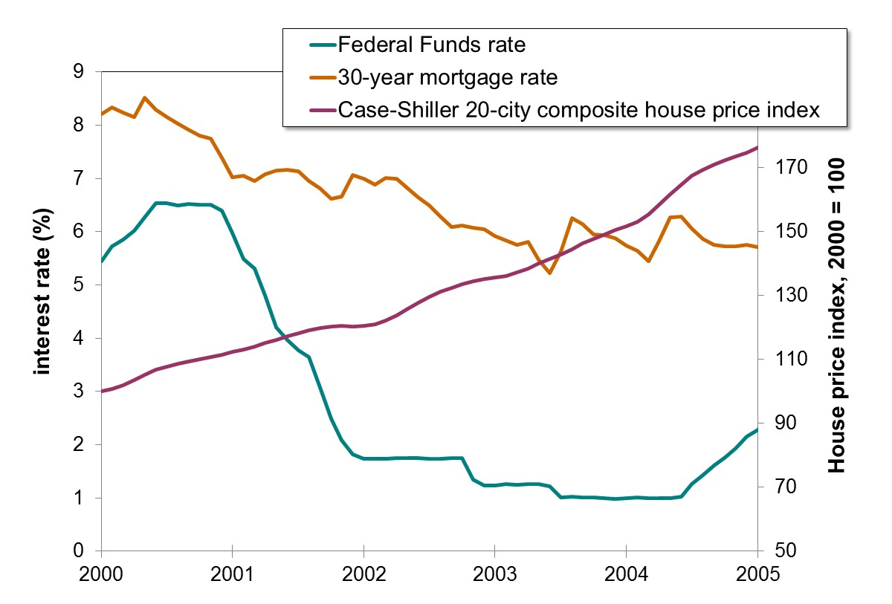
Interest rates and house prices
Notes:
Setting the stage for the 2008–2009 economic crisis:
The recession of 2001 prompted the Federal Reserve to cut the Fed funds rate steeply over the period 2001–2004. This is one explanation for the drop in mortgage rates that occurred over the same period. As these rates fell, housing prices rose, as shown here by the Case–Shiller 20-city composite index—a measure of average housing prices in 20 major U.S. real estate markets.
(Off-topic, possibly: Another explanation for the behavior of rates and house prices: a global savings glut from abroad flowed into the United States.)
Sources:
House price index is from
http://www2.standardandpoors.com/portal/site/sp/en/us/page.topic/indices_csmahp/0,0,0,0,0,0,0,0,0,1,1,0,0,0,0,0.html
or Google “Case Shiller Index”
Interest rate data is from FRED, the Federal Reserve Bank of St. Louis database, at http://research.stlouisfed.org/fred2/

Slide 50
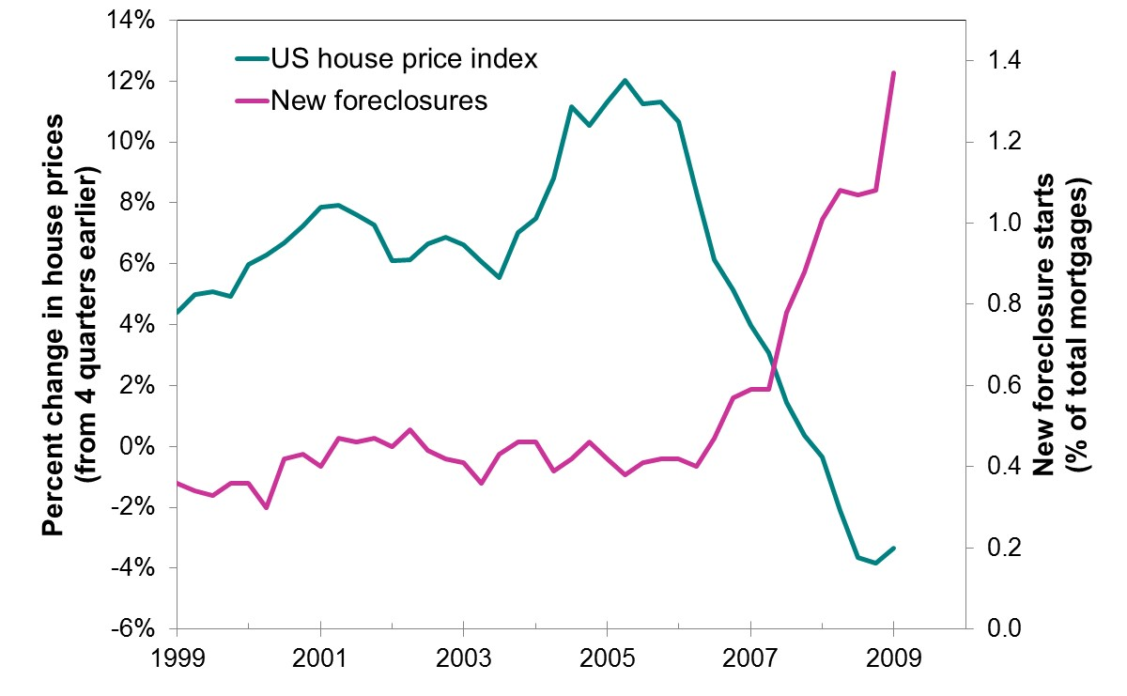
Change in U.S. house price index and rate of new foreclosures, 1999–2009
Notes:
The housing bubble pops, driving up foreclosure rates:
The data show rapid house price appreciation in the early to mid-2000s, which falls starting in 2005 and turns negative in 2007.
Looking at the period 2005–2009, the rate of house price appreciation falls while the rate of new foreclosure starts rising.
How to interpret these data:
“New foreclosure starts” is the number of new foreclosures in the quarter as a percentage of the total number of mortgages.
The house price data shown is the percentage change in the U.S. index from four quarters earlier. (Note: This is a different house price index than the one on the previous slide, though both tell the same story.)
Sources:
Mortgage Banker’s Association (for foreclosure starts) and Federal Housing Finance Authority (for house price indexes).

Slide 51
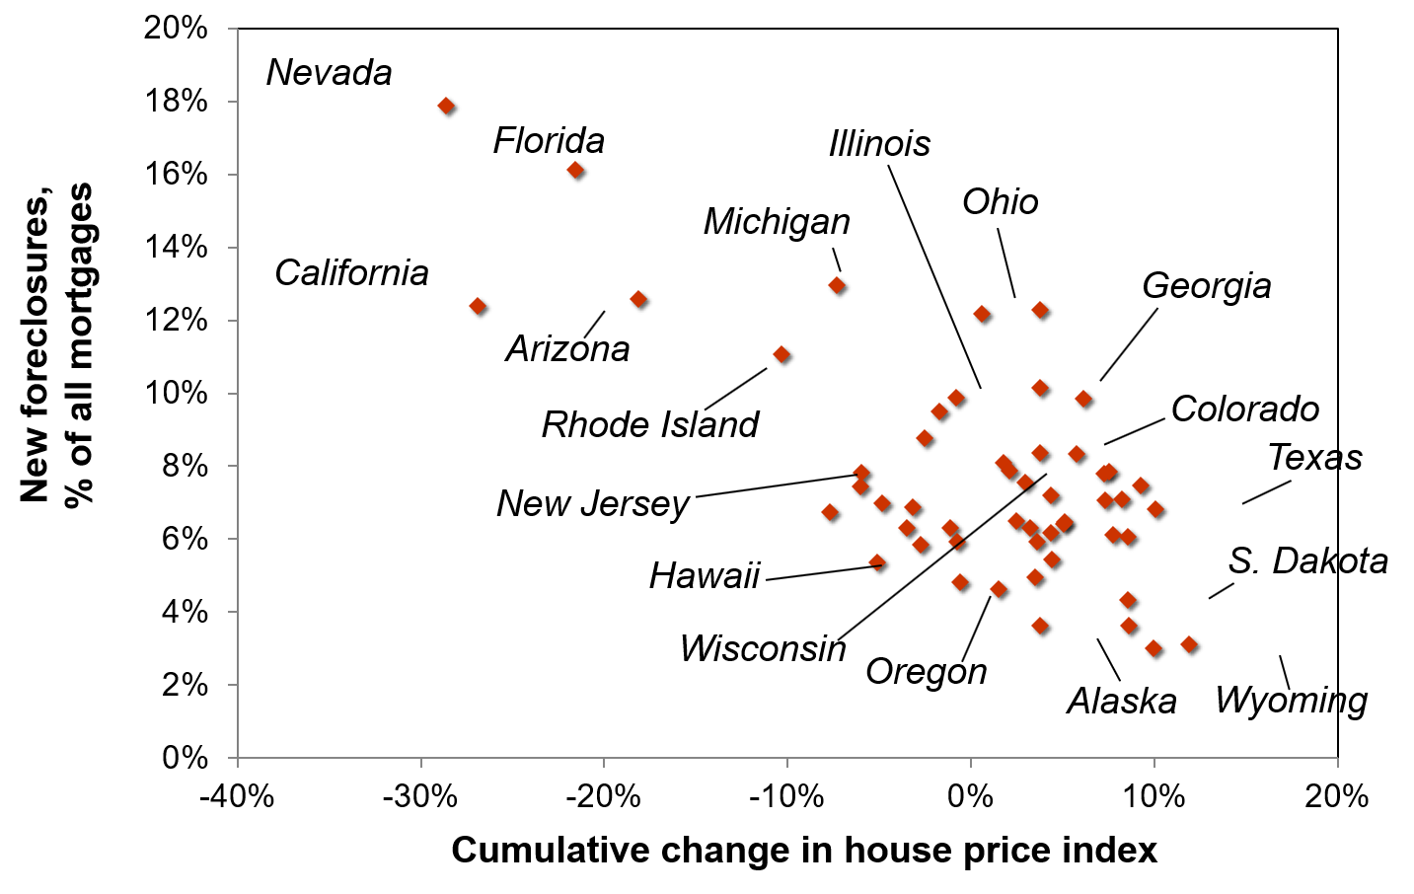
House price change and new foreclosures, 2006:Q3–2009:Q1
Notes:
States with the biggest price drops tended to have the most new foreclosures:
The horizontal axis measures the cumulative change in the state’s house price index during 2006:3–2009:1. The vertical axis measures the number of new foreclosure starts in the state as a percentage of all outstanding mortgages in the state, summed over the period 2006:3–2009:1.
This graph shows that states with larger housing price crashes tended to have higher foreclosure rates.
Sources:
Mortgage Banker’s Association (for foreclosure starts) and Federal Housing Finance Authority (for house price indexes).

Slide 52
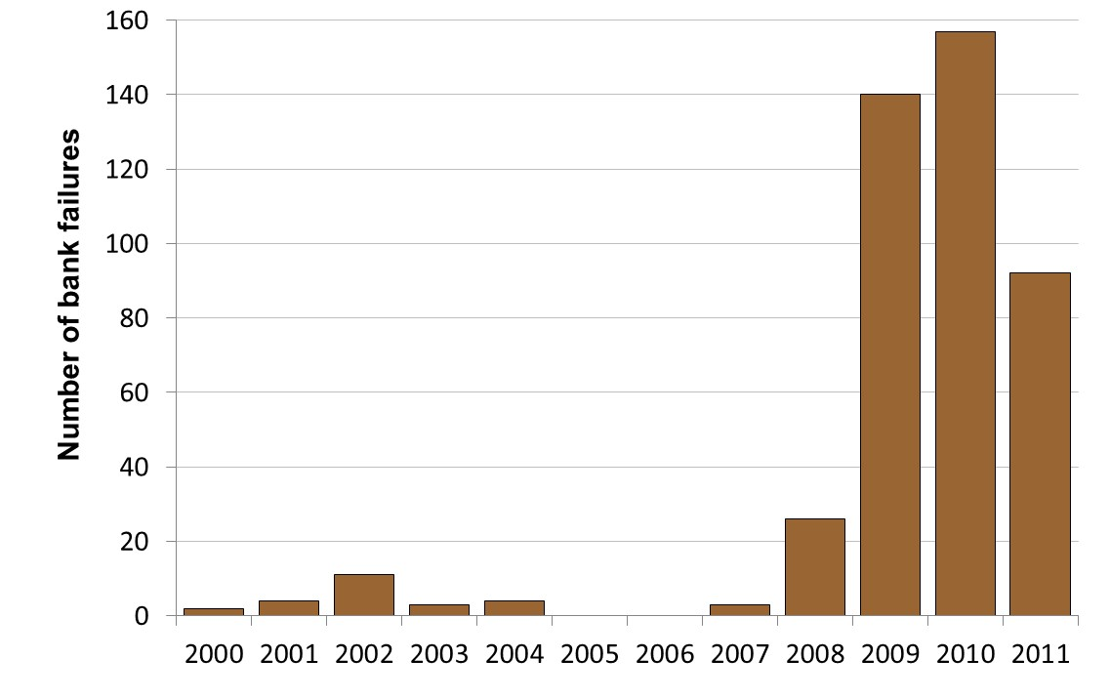
U.S. bank failures by year, 2000–2011
Notes:
The housing market crisis led to rising bank failures.
The 2009 and 2010 values dwarf all previous years since 2000. However, it’s worth noting that the 2008 value, 26, is much higher than the preceding years.
In fact, prior to 2008, there’s only one year (2002) with more than 5 bank failures. So, the 2008 value is extreme up to that point, but the 2009 value is so extreme as to make the 2008 value seem almost normal.
Source: FDIC.
This page lists all of the banks that have failed, by name:
http://www.fdic.gov/bank/individual/failed/banklist.html

Slide 53
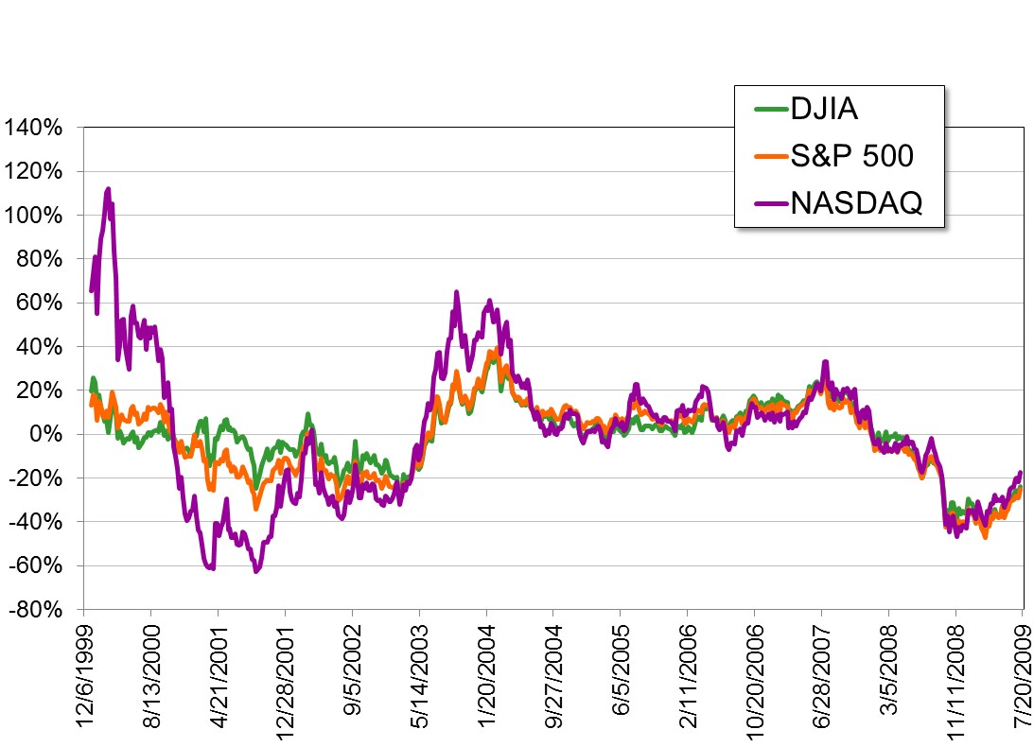
Major U.S. stock indexes (% change from 52 weeks earlier)
Notes:
Recent stock market behavior plays an important role:
This chart begins at the end of 1999, when the tech stock bubble was about to pop. In 2000–2001, you can see the fall in stock prices (especially in the Nasdaq composite, which heavily weights tech stocks). This drop in stock prices was a factor in the 2001 recession.
All three indexes registered negative growth until about June 2003. Growth was strong for a while, until moderating in about July 2004. Stock price growth bounced around between about 0 and 20% through the end of 2007, then turned sharply negative in 2008.
Source: finance.yahoo.com
Dow Jones Industrial Average symbol: ^DJI
S&P500 symbol: ^GSPC
Nasdaq Composite Index symbol: ^IXIC
click on “historical prices”
specify frequency, date range

Slide 54
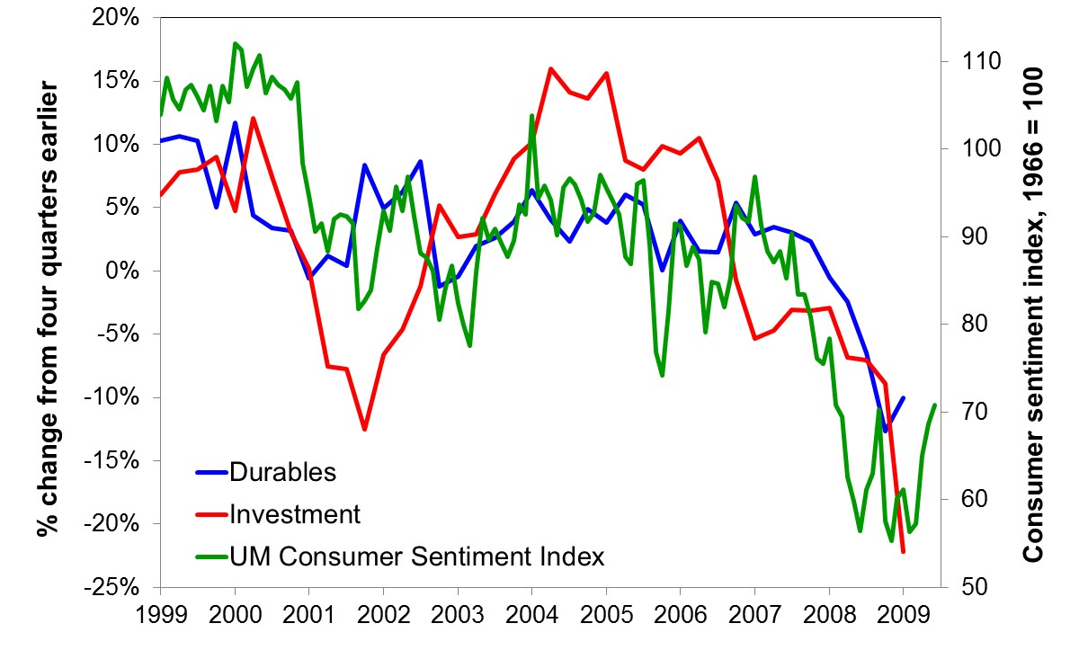
Consumer sentiment and growth in consumer durables and investment spending
Notes:
Consumer confidence crashes, bringing down durables and investment spending:
The University of Michigan Index of Consumer Sentiment is a measure of consumer confidence and is highly correlated with the more famous Consumer Confidence Index published by the Conference Board. (I’m using the UM index because it’s free and in the public domain, while the Conference Board index is proprietary and not free.)
The graph shows a strong relationship among the three series: as consumer confidence falls, consumer spending on durables slows down and turns negative, as does investment spending.
Sources: Durables and investment from the Bureau of Economic Analysis, U.S. Department of Commerce
Consumer Sentiment Index from the University of Michigan Survey Research Center
All three series obtained from FRED, http://research.stlouisfed.org/fred2/

Slide 55
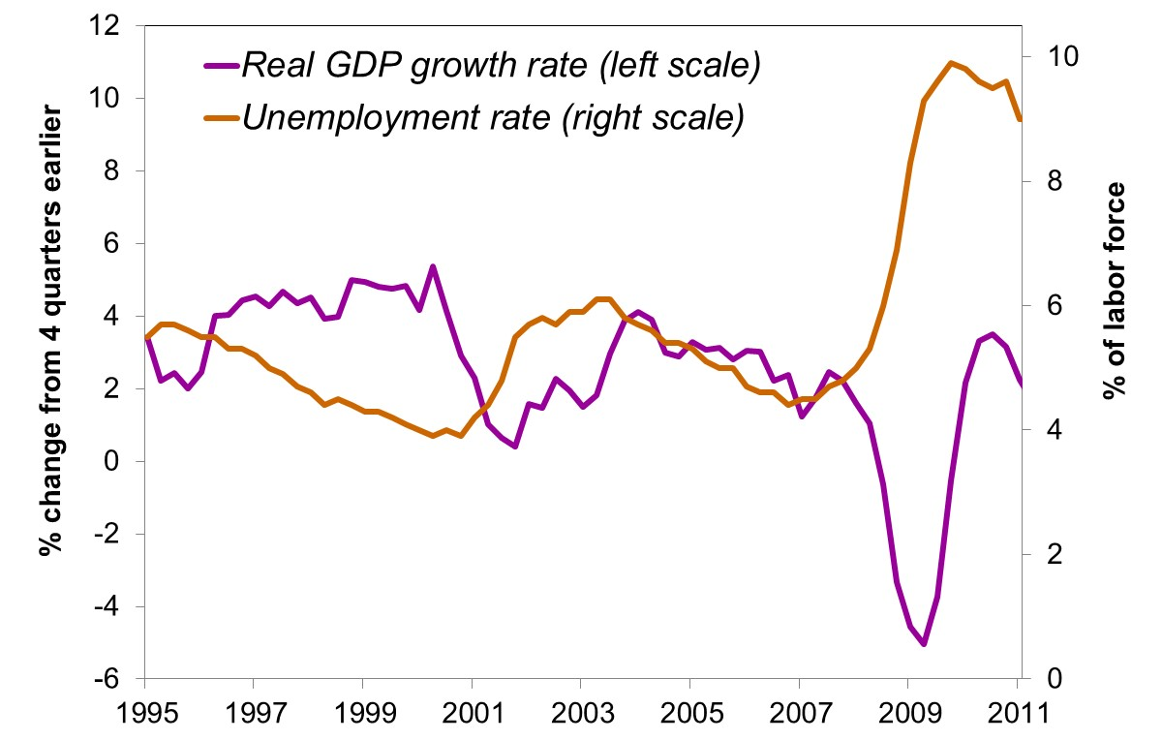
Real GDP growth and unemployment
Notes:
Result: the strongest recession in decades
2001 recession: GDP growth falls, unemployment rises
2002–2007 recovery: GDP growth speeds up, then slows down but remains positive. Unemployment, a lagging indicator, begins coming down in mid-2003.
2008–2009: The housing crisis, rising foreclosure rates, failing financial institutions, falling consumer confidence, and falling consumer and business spending finally take their toll, sending the economy into the strongest recession in decades.

Slide 56
CHAPTER SUMMARY, PART 1
IS–LM model
  a theory of aggregate demand
  exogenous: M, G, T,
  P exogenous in short run, Y in long run
  endogenous: r,
  Y endogenous in short run, P in long run
  IS curve: goods market equilibrium
  LM curve: money market equilibrium

Slide 57
CHAPTER SUMMARY, PART 2
AD curve
  shows relationship between P and the IS–LM model’s equilibrium Y.
  negative slope because
  P  (M/P)  r  I  Y
  expansionary fiscal policy shifts IS curve right, raises income, and shifts AD curve right.
  expansionary monetary policy shifts LM curve right, raises income, and shifts AD curve right.
  IS or LM shocks shift the AD curve.

