Slide 1
Aggregate Supply and the Short-Run Tradeoff Between Inflation and Unemployment
Macroeconomics
N. Gregory Mankiw
© 2019 Worth Publishers, all rights reserved
Notes:
Chapter 14 has two parts. The first part concerns aggregate supply. In the preceding chapters, we made the simple and extreme assumption that all prices were “stuck” in the short run. This assumption implied a horizontal short-run aggregate supply curve. More realistic models of aggregate supply imply an upward-sloping SRAS curve. This chapter presents two of the most prominent models.
The second half of the chapter is devoted to the Phillips curve and related issues. The section uses a few lines of algebra to derive an expression for the Phillips curve from the SRAS equation. This is followed by a discussion of adaptive and rational expectations, as well as the sacrifice ratio. The chapter concludes by contrasting the notion of hysteresis with the natural rate hypothesis.
To help your students master the material, it would be helpful to assign homework or in-class exercises in which students use the models to analyze the effects of policies and shocks. Right before the introduction of the Phillips curve would be a good time to have students work an exercise using the IS–LM–AD–AS model with a positively sloped SRAS curve. The key difference is that, in the short run, a shift in AD causes P to change, which changes M/P, which shifts LM a bit, which explains why the short-run change in output is smaller when SRAS is upward-sloping than when it is horizontal.

Slide 2
IN THIS CHAPTER, YOU WILL LEARN:
About two models of aggregate supply in which output depends positively on the price level in the short run
About the short-run tradeoff between inflation and unemployment, known as the Phillips curve

Slide 3
Introduction, part 1
In previous chapters, we assumed that the price level P was “stuck” in the short run.
This implies a horizontal SRAS curve.
Now, we consider two prominent models of aggregate supply in the short run:
Sticky-price model
Imperfect-information model

Slide 4
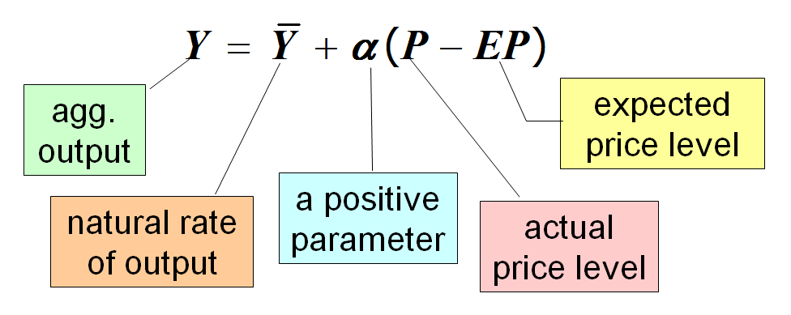
Introduction, part 2
Both models imply:
Other things equal, Y and P are positively related, so the SRAS curve is upward sloping.

Slide 5
The sticky-price model, part 1
Reasons for sticky prices:
long-term contracts between firms and customers
menu costs
firms not wishing to annoy customers with frequent price changes
Assumption:
Firms set their own prices (as in monopolistic competition).
Notes:
If you don’t like the appearance of the term “monopolistic competition” in this slide, just change the parenthetical comment to “(that is, firms have some market power)” or something to that effect.

Slide 6
The sticky-price model, part 2
An individual firm’s desired price is:
where a > 0.
Suppose there are two types of firms:
firms with flexible prices—set prices as above
firms with sticky prices—must set their prices before they know how P and Y will turn out:
Notes:
Interpretation of the first equation:
If output is at its natural rate, then each firm’s optimal price is the same as the overall price level. When the economy is weak (output is below its natural rate), firms set their prices lower, and in a boom, when demand is high, firms set their prices higher.
Remind your students that E is the expectation operator introduced in Chapter 5.
Hence, EP is the expected price level, and (EY – EYbar) is the expected deviation of output from its natural, full-employment level.

Slide 7
The sticky-price model, part 3
Assume that sticky-price firms expect that output will equal its natural rate. Then,
To derive the aggregate supply curve, first find an expression for the overall price level.
s = fraction of firms with sticky prices. Then, we can write the overall price level as . . .
Notes:
Remind your students that the firm’s desired price is lowercase p, while the price level in the economy is uppercase P. Although in the previous slide this is easy to see, students often forget or make a mistake in their notes when writing down the equation.

Slide 8
The sticky-price model, part 4
Subtract (1 − s)P from both sides:
Divide both sides by s:
Notes:
You might want to show, or at least remind, your students the intermediate step of distributing the (1 – s) through [P + a(Y – Ybar)] before the (1 – s)P can be subtracted from both sides.

Slide 9
The sticky-price model, part 5
High EP g high P If firms expect high prices, then firms that must set prices in advance will set them high. Other firms respond by setting prices high.
High Y g high P When income is high, the demand for goods is high. Firms with flexible prices set prices high.
The greater the fraction of flexible-price firms, the smaller is s and the bigger the effect of ΔY on P.

Slide 10
The sticky-price model, part 6
Finally, derive the AS equation by solving for Y :
Notes:
a > 0 from the earlier slides. s > 0 as it is a share of firms. Thus alpha is positive.

Slide 11
The imperfect-information model, part 1
Assumptions:
All wages and prices are perfectly flexible, and all markets are clear.
Each supplier produces one good and consumes many goods.
Each supplier knows the nominal price of the good she produces but does not know the overall price level.

Slide 12
The imperfect-information model, part 2
The supply of each good depends on its relative price: the nominal price of the good divided by the overall price level.
The supplier doesn’t know price level at the time she makes her production decision so uses EP.
Suppose P rises but EP does not.
Supplier thinks her relative price has risen, so she produces more.
With many producers thinking this way, Y will rise whenever P rises above EP.

Slide 13
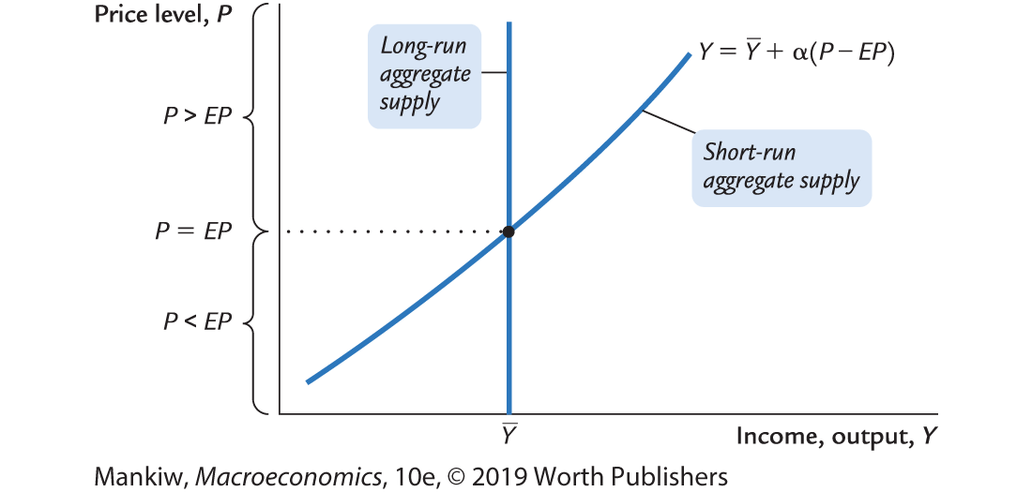
Summary and implications, part 1
Notes:
The following is not in the text, but you and your students may find it worthwhile:
There are good reasons to believe that the SRAS curve is bow-shaped in the real world (that is, the curve is steeper at high levels of output than at low levels of output). And there are good reasons why we should care about this.
Why the SRAS curve is bow-shaped:
At low levels of output, there are lots of unutilized and underutilized resources available, so it is not terribly costly for firms to increase output, and therefore firms do not require a big increase in prices to make them willing to increase output by a given amount. In contrast, at very high levels of output, when unemployment is below the natural rate and capital is being used at higher-than-normal intensity levels, it is relatively costly for firms to increase output further. Hence, a larger increase in prices is required to make firms willing to increase their output.
Why the curvature matters:
When policymakers increase aggregate demand, output rises (good) and prices rise (not good). An important question arises: How much of the bad thing (higher prices) must we tolerate to get some of the good thing (higher output)? The answer depends on how steep the SRAS curve is.
When President Reagan cut taxes in the early 1980s, the economy was just coming out of a severe recession and was on the flatter part of the SRAS curve; hence, the tax cuts affected output a lot and inflation very little. In contrast, when taxes are cut during normal or boom times, when we’re on the steeper part of the SRAS curve, tax cuts would likely be inflationary.
Figure 14-1, p.416
Idiosyncrasy alert:
If α is constant, then the SRAS curve should be linear, strictly speaking. However, in the text, it is drawn with a bit of curvature (which I have reproduced here).

Slide 14
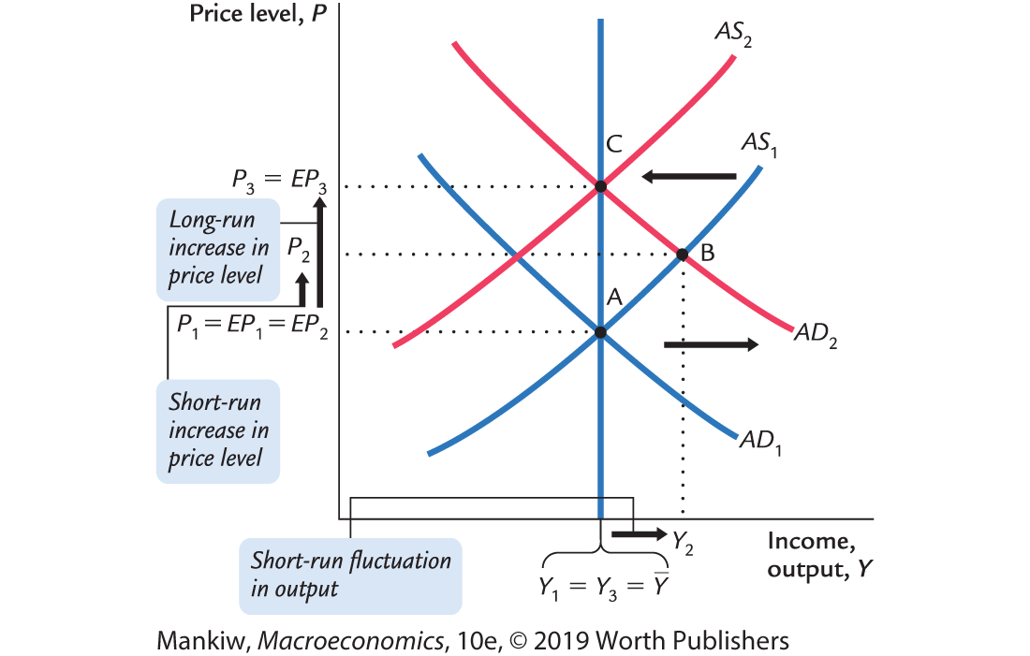
Summary and implications, part 2
SRAS equation:
Notes:
Follow along:
Start at Ybar = Y₁ and P₁.
Then there is a positive AD shift, which shifts AD₁ to AD₂.
The shift then results in a new short-run equilibrium at Y₂ and P₂, the intersection of AD₂ and SRAS₁.
The price level adjusts.
The price level adjustment shifts SRAS₁ back to SRAS₂. The new long-run equilibrium is at Ybar=Y₃ and P₃. Here LRAS, SRAS₂, and AD₂ all intersect.
This graph has two lessons for students:
First, changes in the expected price level shift the SRAS curve (this should be clear from the equation, as should be the fact that a change in the natural rate of output will shift the SRAS curve).
The second lesson concerns the adjustment of the economy back to full-employment output.

Slide 15
Inflation, unemployment, and the Phillips curve
The Phillips curve states that π depends on:
expected inflation, Eπ
cyclical unemployment: the deviation of the actual rate of unemployment (u) from the natural rate (u^{n})
supply shocks, ν (Greek letter nu).
where β > 0 is an exogenous constant.
Notes:
β measures the responsiveness of inflation to cyclical unemployment.

Slide 16
Deriving the Phillips curve from SRAS
Notes:
Here are the explanations:
Equation (1) is the SRAS equation.
Solve (1) for P to get (2).
To get (3), add the supply shock term to (2).
To get (4), subtract last year’s price level (P₋₁) from both sides.
To get (5), write π in place of (P – P₋₁) and Eπ in place of (EP – P₋₁). Note that the change in the price level is not exactly the inflation rate, unless we interpret P as the natural log of the price level.
Equation (6) captures the relationship between output and unemployment from Okun’s law: the deviation of output from its natural rate is inversely related to cyclical unemployment.
Substituting (6) into (5) gives (7), the Phillips curve equation introduced on the preceding slide.

Slide 17
Comparing SRAS and the Phillips curves
SRAS curve: Output is related to unexpected movements in the price level.
Phillips curve: Unemployment is related to unexpected movements in the inflation rate.

Slide 18
Adaptive expectations
Adaptive expectations: an approach that assumes people form their expectations of future inflation based on recently observed inflation.
A simple version: expected inflation = last year’s actual inflation
Then, Phillips curve equation becomes

Slide 19
Inflation inertia
In this form, the Phillips curve implies that inflation has inertia:
In the absence of supply shocks or cyclical unemployment, inflation will continue indefinitely at its current rate.
Past inflation influences expectations of current inflation, which in turn influences the wages and prices that people set.

Slide 20
Two causes of rising and falling inflation
cost-push inflation: inflation resulting from supply shocks
Adverse supply shocks typically raise production costs and induce firms to raise prices, pushing inflation up.
demand-pull inflation: inflation resulting from demand shocks
Positive shocks to aggregate demand cause unemployment to fall below its natural rate, which pulls the inflation rate up.
Notes:
Of course, a favorable supply shock that lowers production costs will push inflation down, and a negative demand shock that raises cyclical unemployment will pull inflation down.

Slide 21
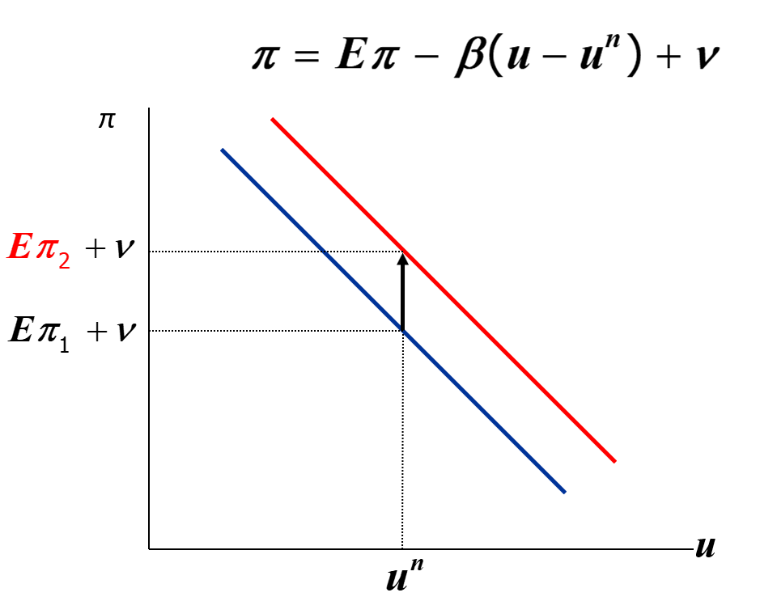
Shifting the Phillips curve
People adjust their expectations over time, so the tradeoff only holds in the short run.
Example: an increase in Eπ shifts the short-run Phillips curve upward.
Notes:
After displaying this slide, you might consider giving your students an exercise using the Phillips curve. One possibility would be to ask them to draw a graph of the Phillips curve and then show what happens to it in the face of an adverse supply shock or an increase in the natural rate of unemployment, giving intuition for each.
The intuition for why an increase in the natural rate shifts the Phillips curve upward (or rightward) is as follows:
At any given value of actual unemployment, an increase in the natural rate implies a decrease in cyclical unemployment, which increases inflation by increasing pressures for wages to rise. Thus, each value of unemployment has a higher value of inflation than before.

Slide 22
The sacrifice ratio, part 1
To reduce inflation, policymakers can contract aggregate demand, causing unemployment to rise above the natural rate.
The sacrifice ratio measures the percentage of a year’s real GDP that must be forgone to reduce inflation by 1 percentage point.
A typical estimate of the ratio is 5.

Slide 23
The sacrifice ratio, part 2
Example: To reduce inflation from 6% to 2%, must sacrifice 20% of one year’s GDP:
GDP loss = (inflation reduction) × (sacrifice ratio)
= 4 × 5
This loss could be incurred in 1 year or spread over several (example: 5% loss for each of 4 years).
The cost of disinflation is lost GDP. One could use Okun’s law to translate this cost into unemployment.

Slide 24
Rational expectations
Ways of modeling the formation of expectations:
adaptive expectations: People base their expectations of future inflation on recently observed inflation.
rational expectations: People base their expectations on all available information, including information about current and prospective future policies.
Notes:
Here’s a good example to illustrate the difference between adaptive and rational expectations.
Suppose the Fed announces a shift in priorities, from maintaining low inflation to maintaining low unemployment without regard for inflation; this shift will start affecting policy next week.
If expectations are adaptive, then expected inflation will not change because it is based on past inflation. The Fed’s announcement pertains to the future and has no impact on past inflation.
If expectations are rational, then expected inflation will increase right away, as people factor this announcement into their forecasts.

Slide 25
Painless disinflation?
Proponents of rational expectations believe that the sacrifice ratio may be very small:
Suppose u = u^{n} and π = Eπ = 6%, and suppose the Fed announces that it will do whatever is necessary to reduce inflation from 6% to 2% as soon as possible.
If the announcement is credible, then Eπ will fall, perhaps by the full 4 points.
Then, π can fall without an increase in u.
Notes:
Here’s an interesting and important implication:
Central banks that are politically independent are typically more credible than those that are puppets of elected officials. Hence, in countries with central banks that are NOT politically independent, it is usually far costlier to reduce inflation. A very worthwhile reform, therefore, would be for governments to give their central banks independence.

Slide 26
Calculating the sacrifice ratio for the Volcker disinflation, part 1
Year | Unemployment Rate u | Natural Rate u^{n} | Cyclical Unemployment u − u^{n}
1982 | 9.7% | 6.0% | 3.7%
1983 | 9.6 | 6.0 | 3.6
1984 | 7.5 | 6.0 | 1.5
1985 | 7.2 | 6.0 | 1.2
 |  |  | Total 10.0%
Notes:
The natural rate of unemployment is assumed to be 6.0% during the early 1980s.

Slide 27
Calculating the sacrifice ratio for the Volcker disinflation, part 2
From previous slide: Inflation fell by 6.7%, and total cyclical unemployment was 9.5%.
Okun’s law: 1% of unemployment = 2% of lost output
Thus, 9.5% cyclical unemployment = 19.0% of a year’s real GDP.
Sacrifice ratio = (lost GDP) / (total disinflation)
= 19/6.7 = 2.8 percentage points of GDP were lost for each 1 percentage point reduction in inflation.

Slide 28
The natural-rate hypothesis
Our analysis of the costs of disinflation and of economic fluctuations in the preceding chapters is based on the natural-rate hypothesis:
Changes in aggregate demand affect output and employment only in the short run.
In the long run, the economy returns to the levels of output, employment, and unemployment described by the classical model (Chapters 3–9).
Notes:
The natural rate hypothesis allows us to study the long run separately from the short run.

Slide 29
An alternative hypothesis: Hysteresis
hysteresis: the long-lasting influence of history on variables such as the natural rate of unemployment.
Negative shocks may increase u^{n}, so the economy may not fully recover.

Slide 30
Hysteresis: Why negative shocks may increase the natural rate
While worker are cyclically unemployed, their skills may deteriorate, and they may not find a job when the recession ends.
Cyclically unemployed workers may lose their influence on wage setting; then, insiders (employed workers) may bargain for higher wages for themselves.
Result: The cyclically unemployed “outsiders” may become structurally unemployed when the recession ends.

Slide 31
CHAPTER SUMMARY, PART 1
Two models of aggregate supply in the short run:
sticky-price model
imperfect-information model
Both models imply that output rises above its natural rate when the price level rises above the expected price level.

Slide 32
CHAPTER SUMMARY, PART 2
Phillips curve
derived from the SRAS curve
states that inflation depends on
expected inflation
cyclical unemployment
supply shocks
presents policymakers with a short-run tradeoff between inflation and unemployment

Slide 33
CHAPTER SUMMARY, PART 3
How people form expectations of inflation:
adaptive expectations
based on recently observed inflation
implies “inertia”
rational expectations
based on all available information
implies that disinflation may be painless

Slide 34
CHAPTER SUMMARY, PART 4
The natural rate hypothesis and hysteresis:
the natural rate hypotheses
changes in aggregate demand can affect output and employment only in the short run
hysteresis
aggregate demand can have permanent effects on output and employment

