Slide 1
The Financial System: Opportunities and Dangers
Macroeconomics
N. Gregory Mankiw
© 2019 Worth Publishers, all rights reserved
Notes:
This chapter begins with an excellent discussion of the functions performed by the financial system. Next, it explores the common features of financial crises, with emphasis on the U.S. financial crisis in 2008–2009. Finally, it discusses policy measures to respond to a current crisis and prevent future crises. The chapter ends with a brief case study on the European sovereign debt crisis.
These PowerPoint slides include the data provided in the chapter and additional data on the European crisis.
The slides also include three short active learning activities appearing before each of the three main sections of the chapter.

Slide 2
IN THIS CHAPTER, YOU WILL LEARN:
About the functions a healthy financial system performs
About the common features of financial crises
About government policies to alleviate or prevent crises

Slide 3
BRAINSTORM What the financial system does
What functions does the financial system perform?
Take 2 minutes and try to think of two or three functions and write them down.
Then, we’ll compare answers.
Notes:
Studies of learning behavior show that brainstorming is a powerful pedagogical technique. First, different students will already know some of this stuff, so this exercise gets students to help create the knowledge rather than being passive receptors of it. Second, students who aren’t sure of the answers but try to anticipate them will listen more keenly to the following material to see if they were right. Third, this activity is a break from lecture and an opportunity for students to use their brains to try to come up with some answers.
I suggest allowing students 2 quiet minutes to think of some answers. Then, ask for volunteers to share what they came up with.
Note: Asking for volunteers after giving students 1 or 2 minutes to formulate their responses results in greater participation than asking for volunteers immediately after posing the question. Students who are sharp but not fast will appreciate the opportunity to think through their ideas.
Variation: During the 2 minutes, have students work in pairs. Sharing an idea with a partner is, in a sense, a low-risk way of auditioning it, which builds the confidence needed to share the idea in the larger group. Also, brainstorming often works better in small groups than individually because “two heads are better than one.”
One final suggestion: During the 2 minutes, insert a blank slide after this one. When you ask for volunteers, type (concise paraphrased versions of) their responses right on the slide.

Slide 4
WHAT THE FINANCIAL SYSTEM DOES 1. Financing investment, part 1
The financial system helps channel funds from savers—households with income they do not need to spend immediately . . .
. . . to investors—firms that need funds to finance investment projects
Notes:
The first function of the financial system recalls the loanable funds model introduced in Chapter 3.

Slide 5
WHAT THE FINANCIAL SYSTEM DOES 1. Financing investment, part 2
financial system: the institutions in the economy that facilitate the flow of funds between savers and investors
The financial system includes
financial markets, like the stock market, through which households directly provide funds for investment
financial intermediaries, like banks or mutual funds, through which households indirectly provide funds for investment

Slide 6
WHAT THE FINANCIAL SYSTEM DOES 1. Financing investment, part 3
debt finance: selling bonds to raise funds for investment
A bond represents a loan from the bondholder to the firm.
equity finance: selling stock to raise funds for investment
A share of stock represents an ownership claim by the shareholder in the firm.
Notes:
Depending on the structure of your institution, business school students might have a better grasp on these topics than econ students. You may wish to have the business school students explain debt versus equity financing.

Slide 7
WHAT THE FINANCIAL SYSTEM DOES 1. Financing investment, part 4
Financial intermediaries accept funds from savers and direct them to investors.
For example, banks accept deposits from households and make loans to firms.
Other examples: mutual funds, pension funds, and insurance companies

Slide 8
WHAT THE FINANCIAL SYSTEM DOES 2. Sharing risk, part 1
Many people are risk averse: other things equal, they dislike uncertainty.
The financial system allows people to share risks:
Investors can share the risk that their projects will fail with the savers who provide the funds.
Savers may be willing to accept these risks for the prospect of a higher return than they could earn otherwise.

Slide 9
WHAT THE FINANCIAL SYSTEM DOES 2. Sharing risk, part 2
Many people are risk averse: other things equal, they dislike uncertainty.
The financial system allows people to share risks:
Savers can reduce risk through diversification: providing funds to many different investors with uncorrelated assets.
Diversification can reduce idiosyncratic risks, risks that differ across individual businesses.
Diversification cannot reduce systematic risks, which affect most/all businesses.
Notes:
Avoiding idiosyncratic risks is a fancy way of saying, “don’t put all your eggs in one basket.”
In contrast a systematic risk would be finding out all baskets have a design flaw.

Slide 10
WHAT THE FINANCIAL SYSTEM DOES 3. Dealing with asymmetric information, part 1
asymmetric information: a situation in which one party to a transaction has more information about it than the other party
adverse selection: a situation in which people with hidden knowledge about attributes sort themselves in a way that disadvantages people with less information
Example: Investors who know their projects are less likely to succeed are more eager to finance the projects with other people’s funds.
Notes:
A common example of asymmetric information is the used car market, where the car seller knows more about a car than does the buyer.

Slide 11
WHAT THE FINANCIAL SYSTEM DOES 3. Dealing with asymmetric information, part 2
moral hazard: a situation that arises from hidden knowledge about actions and occurs when imperfectly monitored agents act in dishonest or inappropriate ways
Example: entrepreneurs investing other people’s money are not as careful as if they were investing their own funds

Slide 12
WHAT THE FINANCIAL SYSTEM DOES 3. Dealing with asymmetric information, part 3
The financial system helps mitigate the effects of asymmetric information.
Example: banks
Banks address adverse selection by screening borrowers for adverse hidden attributes that savers might not detect.
Banks address moral hazard by restricting how loan proceeds are spent or by monitoring the borrowers.

Slide 13
WHAT THE FINANCIAL SYSTEM DOES 4. Fostering economic growth, part 1
In the Solow model, there is one type of capital; in the real world, there are many types.
Firms with lucrative investment projects are willing to pay higher interest rates to attract funds than are firms with less desirable projects.
The financial system helps channel funds to projects with the highest expected returns relative to their risk.

Slide 14
WHAT THE FINANCIAL SYSTEM DOES 4. Fostering economic growth
Government helps facilitate this function by providing quality legal institutions, such as:
prosecuting fraud to reduce moral hazard
enforcing disclosure requirements to reduce adverse selection

Slide 15
BRAINSTORM Financial system failure
Suppose the financial system becomes unable to perform the function of channeling funds from savers to borrowers.
Take 2 minutes to think of two or three specific consequences and write them down.
Then we’ll compare answers.
Notes:
Use this brief activity to break up your lecture and segue to the next part of the chapter. The activity asks students to anticipate specific effects of a credit crunch.
Variation: Have students brainstorm in pairs.
Suggested answers:
If firms cannot get short-term loans to bridge the gap between incurring production costs and receiving revenue from production, firms will cut back on production. The short-run aggregate supply curve will shift leftward/upward.
Consumers who cannot borrow will spend less on big-ticket consumption goods like cars, furniture, and appliances, which are typically bought on credit. Firms that cannot borrow will spend less on investment projects. As a result, the IS curve will shift to the left, aggregate demand will fall, output will fall, and unemployment will rise.
The decrease in investment will slow down the rates of capital accumulation and productivity growth, reducing living standards in the long run.

Slide 16
COMMON FEATURES OF FINANCIAL CRISES 1. Asset-price booms and busts
Financial crises often follow a period of optimism and a speculative asset-price bubble.
Eventually, optimism turns to pessimism, and the bubble bursts, causing asset prices to drop.
In the 2008–2009 crisis, the crucial asset was housing: house prices soared until 2006, then dropped 30% by 2009.
Notes:
This and the following five slides provide a text-based summary of the subsection “The Anatomy of a Crisis” (pp. 525–531).
Then, a single slide replicates (and animates) Figure 18-2 on p. 531 and provides a graphical summary of the discussion.

Slide 17
COMMON FEATURES OF FINANCIAL CRISES 2. Insolvencies at financial institutions
Falling asset prices cause defaults on bank loans.
Since banks are highly leveraged, defaults greatly reduce their capital, increasing the risk of insolvencies.
In 2008–2009, many banks held mortgages and assets backed by mortgages. Falling house prices sharply increased mortgage defaults, pushing many financial institutions toward bankruptcy.

Slide 18
COMMON FEATURES OF FINANCIAL CRISES 3. Falling confidence
Insolvencies at some banks reduce confidence in others, and individuals with uninsured deposits withdraw their funds.
To replace their shrinking reserves, banks must sell assets. Selling by many banks causes steep price declines—called a fire sale.
In 2008–2009, the collapse of Bear Stearns and Lehman Brothers reduced confidence in other large institutions, many of which were interdependent.

Slide 19
FYI: The TED spread
The TED spread measures the perceived credit risk of banks.
Definition: TED spread = rate on 3-month interbank loans – rate on 3-month T-bills (expressed in basis points)
The TED spread is usually between 10 and 50 basis points.
In a financial crisis, falling confidence in banks causes the TED spread to rise . . .
Notes:
This slide and the next one correspond to the FYI box “The TED Spread” on p. 529.
The TED spread is a good indicator of problems in the banking system.
It may be worth reminding students that a basis point is 1/100 of a percentage point.

Slide 20
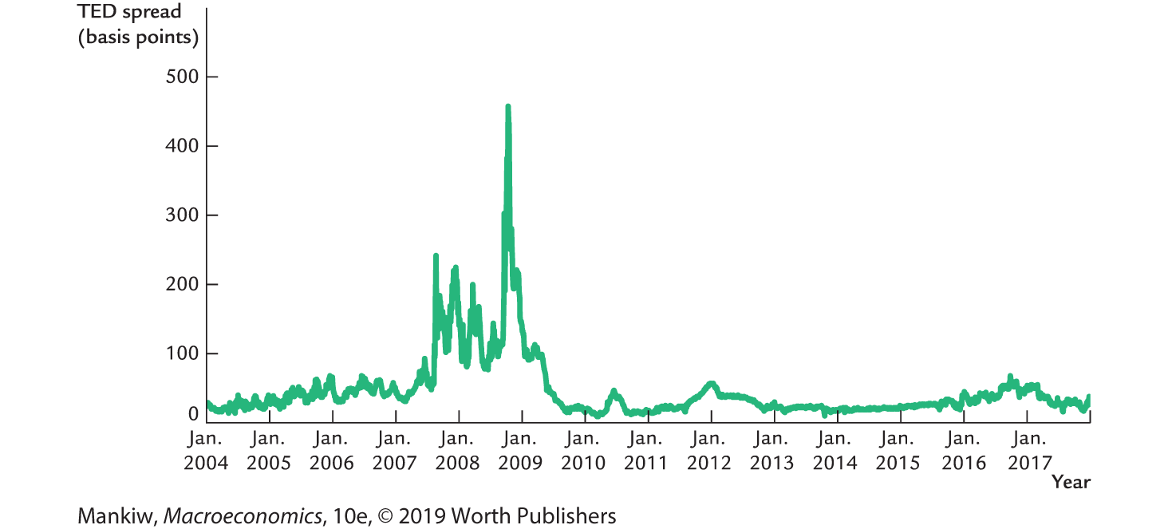
The TED spread, 2003–2015
Notes:
Source: FRED
The TED spread is constructed as the difference between the 3-month Eurodollar deposit rate (series MED3 in FRED) and the 3-month secondary market Treasury bill rate (series TB3MS in FRED). The difference is multiplied by 100 to express it in basis points.

Slide 21
COMMON FEATURES OF FINANCIAL CRISES 4. Credit crunch
Frequent defaults and insolvencies make it hard for investors—even those with good credit and lucrative projects—to get loans.
In 2008–2009, banks sharply reduced lending to consumers for buying homes and to businesses for expanding operations or buying inventories.

Slide 22
COMMON FEATURES OF FINANCIAL CRISES 5. Recession
With less credit available, consumer and business spending declines, reducing aggregate demand.
Result: output falls, unemployment rises.
In 2008–2009, unemployment rose above 10% and remained very high for many months after the financial crisis.

Slide 23
COMMON FEATURES OF FINANCIAL CRISES 6. A vicious circle
The recession reduces profits, asset values, and household incomes, which increases defaults, bankruptcies, and stress on financial institutions.
The financial system’s problems and the economy’s downturn reinforce each other.
In 2008–2009, the vicious circle was apparent, creating fears the economy would spiral out of control.

Slide 24
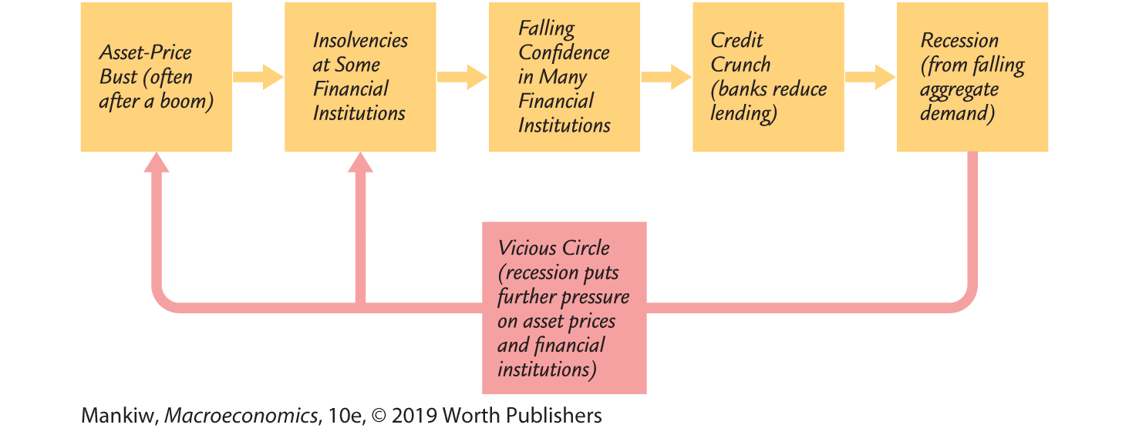
The Anatomy of a Financial Crisis
Notes:
The figure on this slide replicates Figure 18-2 on p. 531. It summarizes the six common features of financial crises in flow chart form.
In presentation mode, each click of your mouse or pointer will cause an additional part of this figure to appear, so you can discuss each part before revealing the next one.

Slide 25
Who should be blamed for the financial crisis of 2008–2009?
Possible culprits include:
The Federal Reserve
Home buyers
Mortgage brokers
Investment banks
Rating agencies
Regulators
Government policymakers
All of them likely deserve a share of the blame.
Notes:
This slide corresponds to the case study on pp. 531–532, which provides additional information about the role played by each of these “culprits.”
The Fed kept interest rates very low following the 2001 recession, and this contributed to a boom in debt-based real estate investment.
Many home buyers borrowed and spent more than they could afford on houses. Speculators purchased houses with borrowed funds, betting that prices would continue rising. When house prices began falling, many homeowners and speculators defaulted on their debts.
Mortgage brokers immediately sold the mortgage loans they made, so they bore no default risk and therefore had little incentive to verify the creditworthiness of borrowers. To expand their business to people who might not otherwise be able to afford to buy houses, they offered complex loans with low initial payments that exploded later.
Investment banks purchased mortgages and bundled them into mortgage-backed securities (MBS). They sold these MBS to institutions such as banks and pension funds that were not fully aware of the risks they were taking on.
Rating agencies evaluate the riskiness of debt instruments to better inform prospective buyers. Prior to the financial crisis, they gave high ratings to mortgage-backed securities that later turned out to be very risky. The textbook states “the models these agencies used to evaluate the risks were based on dubious assumptions” (p. 532). Additionally, it is well known that the agencies earned their income, in part, from the companies whose assets they were evaluating, creating a clear conflict of interest.
The textbook (p. 532) notes that regulators did not consider the possibility of a substantial decline in housing prices or the systemic problems it would cause the financial system. Additionally, many observers believe the crisis was exacerbated in general by inadequate regulation of the financial system (for example, the lack of capital requirements for firms selling complex derivatives such as credit default swaps).
Government policymakers have for years encouraged home buying with policies such as the mortgage interest tax deduction and the establishment of government-sponsored enterprises (Fannie Mae, Freddie Mac) promoting mortgage lending. These policies have led to increased borrowing and home buying, including by households that probably would have been better off renting.

Slide 26
BRAINSTORM Government policies
What should the government do if a financial crisis occurs?
Can the government prevent financial crises?
Take 2 minutes to try to think of a specific policy to alleviate a financial crisis and another policy to prevent future crises.
Notes:
The final 2-minute brainstorming session takes us into the last part of the chapter.

Slide 27
POLICY RESPONSES TO A CRISIS 1. Conventional monetary policy
The central bank can expand the money supply to lower interest rates and encourage spending.
The Fed reduced the federal funds rate to nearly zero by 12/2008, but this was insufficient.
(Recall the liquidity trap
from Chapter 12.)

Slide 28
POLICY RESPONSES TO A CRISIS 2. Conventional fiscal policy
The government can increase spending and cut taxes.
Fiscal policymakers enacted a stimulus of $168 billion in 2008 and a stimulus of $787 billion in 2009.
But the large and growing government debt sharply limited further stimulus measures.
Notes:
The size of the government debt prompted a heated debate among policymakers and observers over the benefits of additional stimulus versus the costs of additional debt.

Slide 29
POLICY RESPONSES TO A CRISIS 3. Lender of last resort
Runs on banks can create a liquidity crisis, in which solvent banks have insufficient funds to satisfy depositors’ withdrawals.
The central bank can make direct loans to these banks, acting as a lender of last resort.
In 2008–2009, the Fed acted as lender of last resort to many banks and to shadow banks, which perform many of the same functions as banks and were experiencing similar problems.

Slide 30
POLICY RESPONSES TO A CRISIS 4. Injections of government funds
The government can use public funds to prop up the financial system:
Give funds to those who have experienced losses (example: federal deposit insurance)
Make risky loans (example: loans to AIG in 2008)
Inject capital into ailing institutions, taking an ownership stake (example: TARP)
Using public funds to prop up ailing institutions is controversial and may increase moral hazard.

Slide 31
POLICIES TO PREVENT CRISES 1. Focusing on shadow banks
Shadow banks engage in financial intermediation and include investment banks, hedge funds, private equity firms, and insurance companies.
Their deposits are not federally insured, so they are not heavily regulated like traditional banks and can take on much more risk.
Their failures can hurt the broader economy, so many policymakers suggest limiting the risk they can take, increasing capital requirements for them, and allowing more government oversight.

Slide 32
POLICIES TO PREVENT CRISES 2. Restricting size
Institutions deemed “too big to fail” have a moral hazard problem.
Some proposals would limit the size of financial institutions to reduce the harm their failures would cause to the rest of the financial system.
Proposals include limiting mergers and increasing capital requirements for larger banks.
Notes:
Another proposal, not mentioned in the text, is taxing “bigness.” Then, institutions without economies of scale would remain limited in size, but those with economies of scale could pay the tax to enjoy the gains from scale.
All of these proposals are controversial; their proponents argue that they’d reduce financial instability, but opponents contend they would reduce gains from economies of scale and increase costs.

Slide 33
POLICIES TO PREVENT CRISES 3. Reducing excessive risk taking
To prevent financial firms from failing, some propose limits on excessive risk taking.
Problem: defining “excessive”
The Dodd–Frank Act of 2010 includes the Volcker rule, which prohibits commercial banks from making certain types of speculative investments.

Slide 34
POLICIES TO PREVENT CRISES 4. Making regulation work better
The regulatory apparatus overseeing the financial system is highly fragmented.
Dodd–Frank and other measures seek to coordinate the various regulatory agencies and improve the effectiveness of financial industry oversight.
Even now, Congress is considering rolling back some features of Dodd–Frank

Slide 35
POLICIES TO PREVENT CRISES 5. Taking a macro view of regulation
Traditionally, financial regulation has been microprudential, aiming to reduce the risk of distress in individual financial institutions.
Today, financial regulation is also macroprudential, aiming to reduce system-wide distress to protect against declines in production and employment.
Notes:
See pp. 538–539 for more information.

Slide 36
The European sovereign debt crisis, part 1
Debt problems in Greece:
Rising government debt, revelations that Greece may have misreported its finances in earlier years
Greek bonds downgraded, prices fell, interest rates shot up as markets worried that Greece might default
Repercussions throughout Europe:
Many European banks held Greek bonds, whose falling values pushed them toward bankruptcy.
Policymakers worried that banks would fail, causing a credit crunch and economic downturn.
Notes:
The next few slides correspond to the case study on pp. 539–540.

Slide 37
The European sovereign debt crisis, part 2
Bailing out Greece:
The ECB and healthier countries in Europe made loans to Greece to prevent an immediate default. The loans came with conditions that Greece enact austerity measures to improve its finances.
Taxpayers in countries providing the funds resented the bailouts. Greek citizens resented the austerity measures, and rioting ensued.
Other countries with problems:
Many feared a Greek default would lead to a run on bonds from Spain, Portugal, Ireland, and Italy.
Notes:
You should let students know that ECB stands for European Central Bank, which is the central bank for the European Union.
Technically the ECB serves as the central bank for the euro area, but the distinction is most likely not worth discussing.

Slide 38
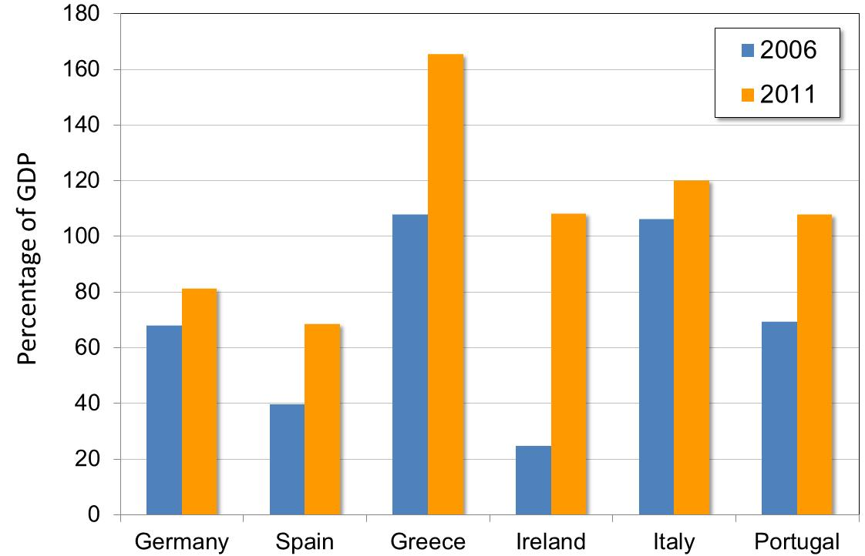
Government debt in 2006 and 2011
Notes:
Government finances worsened dramatically in many European countries.
Source: European Central Bank, Statistical Data Warehouse, http://sdw.ecb.europa.eu/reports.do?node=100000192
- Reports
- Monthly Bulletin
- 6 Government finance
- 6.2 Government debt

Slide 39
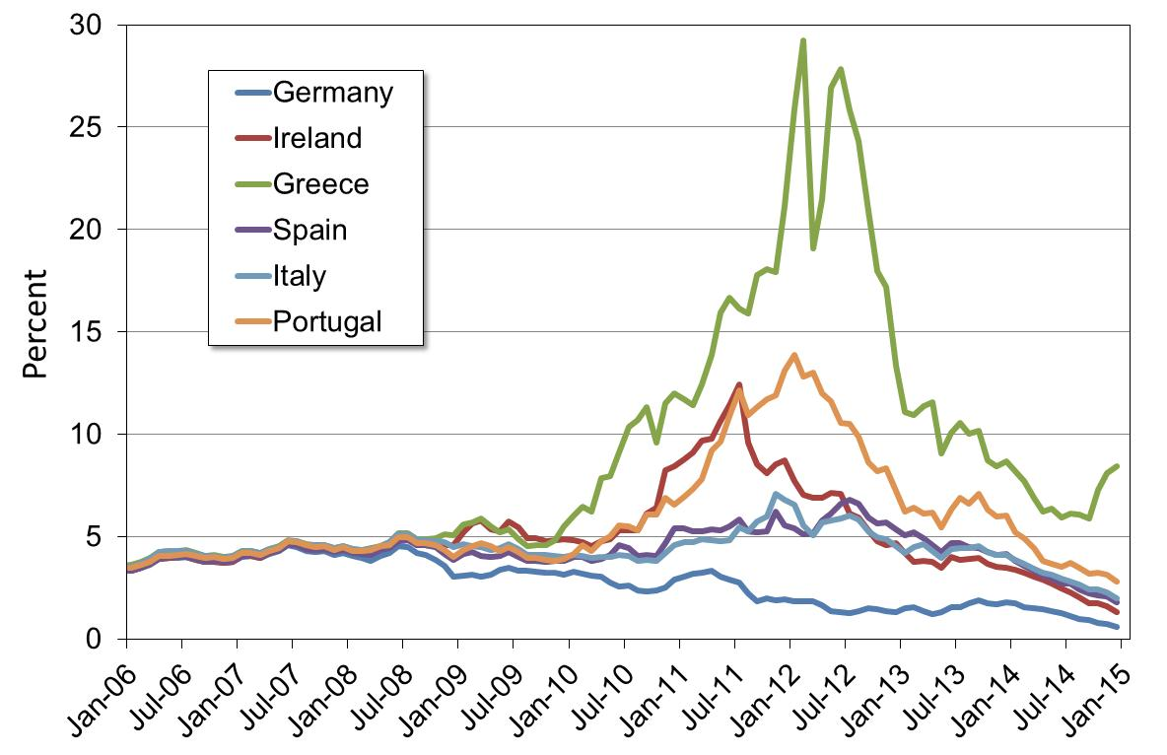
Interest rates on 10-year bonds
Notes:
Notice that the interest rates are virtually identical until mid-2008.
Greece’s government bonds were downgraded to junk bond status. As a result, Greece’s government had to pay extraordinary interest rates to borrow additional funds.
In other countries, the rise in rates was less dramatic but still painful: even a modest increase in borrowing costs diverts funds that could otherwise be used to provide essential public services.
Source: European Central Bank, https://www.ecb.europa.eu/stats/money/long/html/index.en.html

Slide 40
CHAPTER SUMMARY, PART 1
A healthy financial system serves several purposes, including:
channeling funds from saving to investment
allocating risk
mitigating problems arising from asymmetric information
fostering economic growth

Slide 41
CHAPTER SUMMARY, PART 2
A financial crisis begins with a sharp decline in asset prices, often after a speculative bubble.
The fall in asset prices leads to insolvencies, which reduce confidence in the financial system and spur depositors to withdraw their funds.
As a result, banks reduce lending, causing a credit crunch. Business and consumer spending fall, causing an economic downturn.
In a vicious circle, the downturn puts further pressure on asset prices and financial institutions.

Slide 42
CHAPTER SUMMARY, PART 3
Policymakers can respond to a crisis in several ways: by using conventional monetary and fiscal policy to expand aggregate demand, the central bank can provide liquidity by acting as a lender of last resort and the government can use public funds to prop up the financial system.
Policies that aim to prevent future crises include focusing more on regulating shadow banks, restricting the size of financial firms, limiting excessive risk taking, and reforming the regulatory agencies that oversee the financial system.

