Slide 1
The Microfoundations of Consumption and Investment
Macroeconomics
N. Gregory Mankiw
© 2019 Worth Publishers, all rights reserved
Notes:
This long chapter is a survey of the most prominent work on consumption since Keynes. It is particularly useful to students who expect to continue with graduate studies in economics.
After reviewing the Keynesian consumption function and its implications, the chapter presents Irving Fisher’s theory of intertemporal choice, the basis for much subsequent work on consumption. This section of the chapter uses indifference curves and budget constraints. The chapter and this PowerPoint presentation do not require or assume that students know these tools. But if they do not, this section of the chapter is the most difficult.
The chapter then presents the life-cycle and permanent income hypotheses and also discusses Hall’s Random Walk Hypothesis.
Finally, there is a brief discussion of some very recent work by Laibson and others on psychology and economics, in particular how the pull of instant gratification can cause consumers to deviate from perfect rationality.

Slide 2
IN THIS CHAPTER, YOU WILL LEARN, PART 1
an introduction to the most prominent work on consumption, including:
John Maynard Keynes: consumption and current income
Franco Modigliani: the life-cycle hypothesis
Milton Friedman: the permanent income hypothesis
Robert Hall: the random-walk hypothesis
David Laibson: the pull of instant gratification

Slide 3
IN THIS CHAPTER, YOU WILL LEARN, PART 2
leading theories to explain investment
why investment is negatively related to the interest rate
things that shift the investment function
why investment rises during booms and falls during recessions

Slide 4
Keynes’s conjectures
0 < MPC < 1
Average propensity to consume (APC) falls as income rises. (APC = C/Y)
Income is the main determinant of consumption.
Notes:
The MPC was defined in Chapter 3 and used in various chapters since.

Slide 5
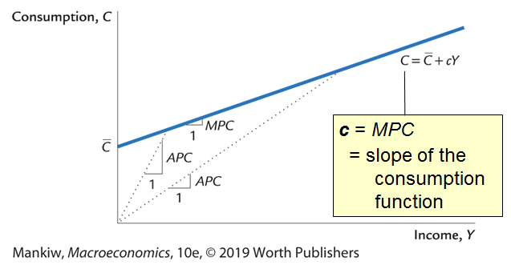
The Keynesian consumption function, part 1
Notes:
Interpretations of Cbar:
autonomous consumption: the portion of consumption that does not depend on income
the value of consumption if income were zero.
a shift parameter

Slide 6
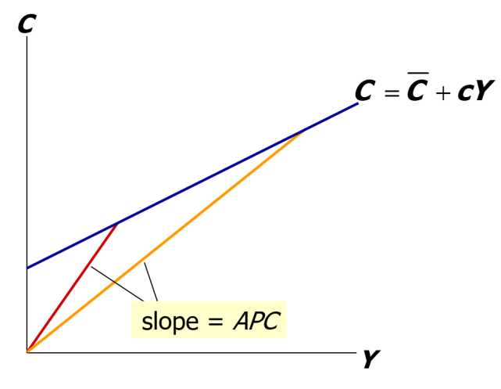
The Keynesian consumption function, part 2
As income rises, consumers save a bigger fraction of their income, so APC falls.
Notes:
Pick a point on the consumption function; that point represents a particular combination of consumption and income.
Now draw a ray from the origin to that point. The slope of that ray equals the average propensity to consume at that point.
(Why? The slope equals the rise over the run. The rise from zero to that point equals the value of C at that point. The run from zero to that point equals the value of Y at that point. Hence, the rise over the run equals C/Y, or the APC.)
At higher values of Y, the APC (or the slope of the ray from the origin) is smaller. This is what Keynes conjectured: at higher values of income, people spend a smaller fraction of their income.

Slide 7
Early empirical successes: Results from early studies
Households with higher incomes:
consume more, so MPC > 0
save more, so MPC < 1
save a larger fraction of their income, so APC i as Y h
Very strong correlation between income and consumption: income seemed to be the main determinant of consumption

Slide 8
Problems for the Keynesian consumption function
Based on the Keynesian consumption function, economists predicted that C would grow more slowly than Y over time.
This prediction did not come true:
As incomes grew, APC did not fall, and C grew at the same rate as income.
Simon Kuznets showed that C/Y was very stable from decade to decade.

Slide 9
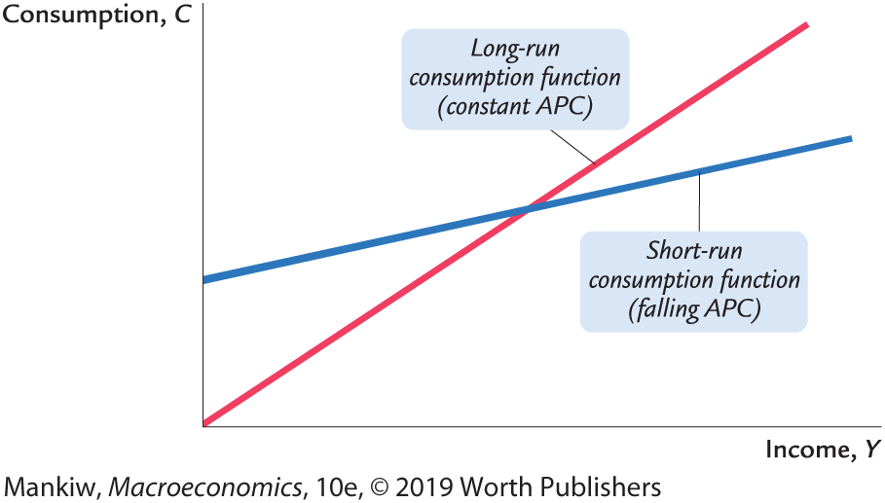
The consumption puzzle
Notes:
Figure 19-2, p.479.

Slide 10
The Life-Cycle Hypothesis, part 1
due to Franco Modigliani (1950s)
The Life-Cycle Hypothesis (LCH) says that income varies systematically over the phases of the consumer’s life cycle, and saving allows the consumer to achieve smooth consumption.

Slide 11
The Life-Cycle Hypothesis, part 2
The basic model:
W = initial wealth
Y = annual income until retirement (assumed constant)
R = number of years until retirement
T = lifetime in years
Assumptions:
zero real interest rate (for simplicity)
consumption smoothing is optimal
Notes:
The consumer’s initial wealth could be zero, or could be a gift or inheritance from her parents.

Slide 12
The Life-Cycle Hypothesis, part 3
Lifetime resources = W + RY
To achieve smooth consumption, consumer divides her resources equally over time:
C = (W + RY)/T, or
C = αW + βY
where
α = (1/T) is the marginal propensity to consume out of wealth
β = (R/T) is the marginal propensity to consume out of income

Slide 13
Implications of the Life-Cycle Hypothesis, part 1
The LCH can solve the consumption puzzle:
The life-cycle consumption function implies
APC = C/Y = α(W/Y) + β
Across households, income varies more than wealth, so high-income households should have a lower APC than low-income households.
Over time, aggregate wealth and income grow together, causing APC to remain stable.

Slide 14
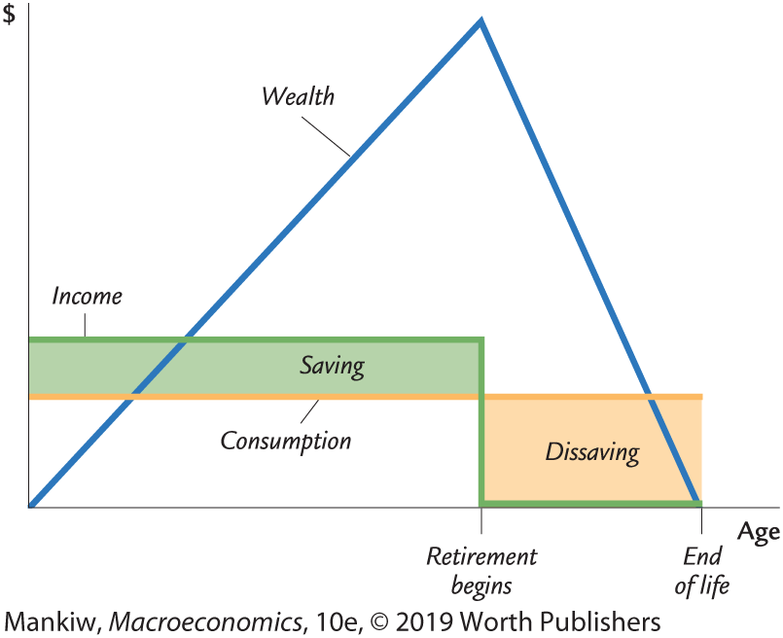
Implications of the Life-Cycle-Hypothesis, part 2
LCH implies that saving varies systematically over a person’s lifetime.
Notes:
Figure 19-5, p.492.

Slide 15
The Permanent Income Hypothesis, part 1
due to Milton Friedman (1957)
Y = Y ^{P} + Y ^{T}
where
Y = current income
Y ^{P} = permanent income average income, which people expect to persist into the future
Y ^{T} = transitory income temporary deviations from average income
Notes:
Permanent Income: Maria, who has a law degree, earned more this year than John, who is a high school dropout. Maria’s higher income resulted from higher permanent income because her education will continue to provide her a higher salary.
Transitory Income: Sue, a Florida orange grower, earned less than usual this year because a freeze destroyed her crop. Julio, a California orange grower, earned more than usual because the freeze in Florida drove up the price of oranges. Julio’s higher income resulted from higher transitory income because he is no more likely than Sue to have good weather next year.

Slide 16
The Permanent Income Hypothesis, part 2
Consumers use saving & borrowing to smooth consumption in response to transitory changes in income.
The Permanent Income Hypothesis (PIH) consumption function:
C = αY ^{P}
where a is the fraction of permanent income that people consume per year.

Slide 17
The Permanent Income Hypothesis, part 3
The PIH can solve the consumption puzzle:
The PIH implies APC = C / Y = α Y ^{P}/ Y
If high-income households have higher transitory income than low-income households, APC is lower in high-income households.
Over the long run, income variation is due mainly (if not solely) to variation in permanent income, which implies a stable APC.

Slide 18
PIH vs. LCH
Both: people try to smooth their consumption in the face of changing current income.
LCH: current income changes systematically as people move through their life cycle.
PIH: current income is subject to random, transitory fluctuations.
Both can explain the consumption puzzle.

Slide 19
The Random-Walk Hypothesis, part 1
due to Robert Hall (1978)
based on PIH, in which forward-looking consumers base consumption on expected future income
Hall adds the assumption of rational expectations, that people use all available information to forecast future variables like income.

Slide 20
The Random-Walk Hypothesis, part 2
If PIH is correct and consumers have rational expectations, then consumption should follow a random walk: changes in consumption should be unpredictable.
A change in income or wealth that was anticipated has already been factored into expected permanent income, so it will not change consumption.
Only unanticipated changes in income or wealth that alter expected permanent income will change consumption.

Slide 21
Implication of the R-W Hypothesis
If consumers obey the PIH and have rational expectations, then policy changes will affect consumption only if they are unanticipated.
Notes:
This result is important because many policies affect the economy by influencing consumption and saving. For example, a tax cut to stimulate aggregate demand only works if consumers respond to the tax cut by increasing spending. The R-W Hypothesis implies that consumption will respond only if consumers had not anticipated the tax cut.
This result also implies that consumption will respond immediately to news about future changes in income. Students connect with the following example: Suppose a student is job-hunting in her senior year for a job that will begin after graduation. If the student secures a job with a higher salary than she had expected, she is likely to start spending more now in anticipation of the higher-than-expected permanent income.

Slide 22
The Psychology of Instant Gratification, part 1
Previous theories assume that consumers are rational and act to maximize lifetime utility.
Recent studies by David Laibson and others consider the psychology of consumers.

Slide 23
The Psychology of Instant Gratification, part 2
Consumers consider themselves to be imperfect decision makers.
In one survey, 76% said they were not saving enough for retirement.
Laibson: The “pull of instant gratification” explains why people don’t save as much as a perfectly rational lifetime utility maximizer would save.

Slide 24
Two questions and time inconsistency
Would you prefer (A) a candy today, or (B) two candies tomorrow?
Would you prefer (A) a candy in 100 days, or (B) two candies in 101 days?
In studies, most people answered (A) to 1 and (B) to 2.
A person confronted with question 2 may choose (B).
But in 100 days, when confronted with question 1, the pull of instant gratification may induce her to change her answer to (A).
Notes:
Simple definition: A person’s preferences are time-inconsistent if they alter their decisions simply because time passes.

Slide 25
Summing up consumption
Keynes: consumption depends primarily on current income.
Recent work: consumption also depends on
expected future income
Wealth
Interest rates
Economists disagree over the relative importance of these factors, borrowing constraints, and psychological factors.

Slide 26
Moving on: Three types of investment
Business fixed investment: businesses’ spending on equipment and structures for use in production.
Residential investment: purchases of new housing units (either by occupants or landlords).
Inventory investment: the value of the change in inventories of finished goods, materials and supplies, and work in progress.
Notes:
This chapter will focus on business fixed investment. Fixed investment accounts for ~3/4 of all investment

Slide 27
Understanding business fixed investment
The standard model of business fixed investment: the neoclassical model of investment
Shows how investment depends on:
MPK
interest rate
tax rules affecting firms
Notes:
Remind students that MPK is the Marginal Product of Capital. It ahs been a while since this was discussed so students may benefit from a refresher. You might wish to ask students if they remember what MPF stands for and try to explain the concept to the class.

Slide 28
Two types of firms
For simplicity, assume two types of firms:
Production firms rent the capital they use to produce goods and services.
Rental firms own capital, rent it to production firms.
In this context, “investment” is the rental firms’ spending on new capital goods.
Notes:
Note: Many students find it easier to learn the following material by separating the investment decision from the production decision.
Of course, the lessons apply to real-world firms that actually do both functions.

Slide 29
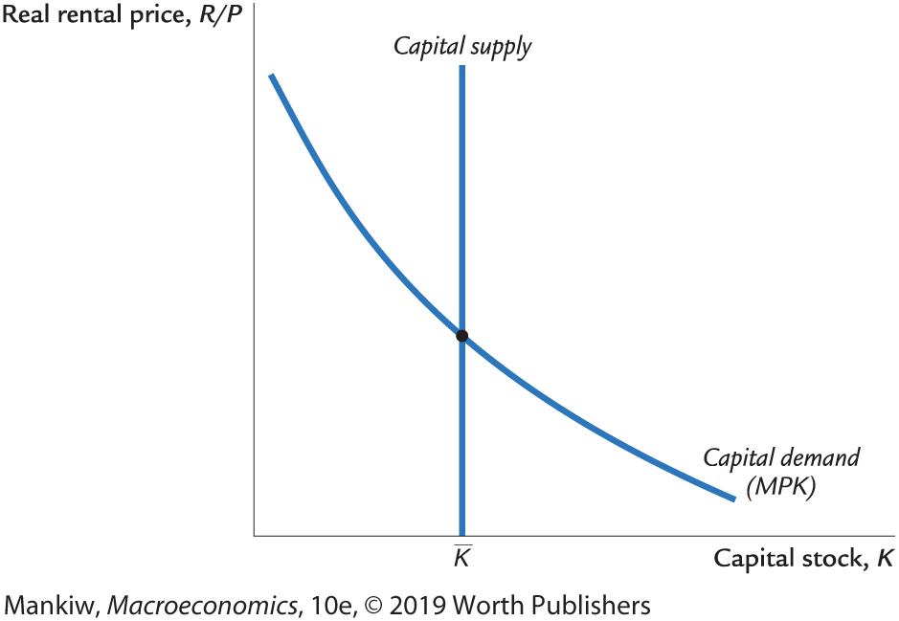
The capital rental market
Production firms must decide how much capital to rent.
Recall from Chap. 3: Competitive firms rent capital to the point where MPK = R/P.
Notes:
The graph of the rental market for capital is review from Chapter 3. As you present it to your students, it might be worthwhile to briefly review each piece (why the supply curve is vertical, why demand = MPK).

Slide 30
Factors that affect the rental price
For the Cobb-Douglas production function,
the MPK (and hence equilibrium R/P ) is
The equilibrium R/P would increase if:
K (e.g., earthquake or war)
L (e.g., pop. growth or immigration)
A (technological improvement or deregulation)
Notes:
(It might be worth reminding students that A represents the level of technology, and α is a number between 0 and 1 that equals capital’s share of national income.)
We use the C-D function for two reasons: First, we can make the ideas here more concrete with a specific functional form, and second, because the C-D function will be familiar to most students from earlier chapters (Chapter 3 and the economic growth chapters).
If students are wondering where the MPK equation comes from, either refer them to Chapter 3, or, if they are acquainted with basic calculus, take the derivative of the C-D production function with respect to K.
Regarding the impact of an increase in A on R/P: We usually associate A with technology. However, A represents anything that affects the amount of output that can be produced from a given bundle of inputs. For example, firms use resources (in this context, L and/or K) to comply with regulations (some labor time is used to fill out forms; some capital is used to reduce emissions of nasty things into the air or rivers). A relaxation of regulations would allow firms to divert these resources from compliance with regulations to production, causing output to increase. Hence, a deregulation could cause A to rise.

Slide 31
Rental firms’ investment decisions
Rental firms invest in new capital when the benefit of doing so exceeds the cost.
The benefit (per unit capital): R/P, the income that rental firms earn from renting the unit of capital to production firms.

Slide 32
The cost of capital, part 1
Components of the cost of capital:
interest cost: i × P_{K}, where P_{K} = nominal price of capital
depreciation cost: δ × P_{K}, where δ = rate of depreciation
capital loss: −ΔP_{K} (a capital gain, ΔP_{K} > 0, reduces cost of K )
Add these three parts to get the total cost of capital:
Notes:
Interest cost: If firms borrow in the loanable funds market (from chapter 3) to finance their purchases of capital, then they incur interest. But even if firms use their own funds, they incur an opportunity cost equal to the interest they could have earned had they purchased Pk worth of bonds instead of spending Pk to buy a piece of capital.
Depreciation cost:
Remind students of the depreciation rate, the percentage of capital that wears out each period. If the firm starts the period with $1000 worth of capital and the depreciation rate = 0.03, then at the end of the period, the value of the firm’s capital equals (1-0.03)$1000 = $970.

Slide 33
The cost of capital, part 2
Example: car rental company (capital: cars)
Suppose P_{K} = $10,000, i = 0.10, δ = 0.20, and ΔP_{K}/P_{K} = 0.06
Then, interest cost = $1000
depreciation cost = 2000
capital loss = −600
total cost = $2400
Notes:
If the price of capital, Pk, falls during the period, then firm incurs a capital loss, which increases its cost of capital.
In this example, the price of capital rises, so the “capital loss” is negative. (Or, there’s a capital gain which we subtract from the cost, because the increase in the price of new capital reduces the cost of capital.)

Slide 34
The cost of capital, part 3
For simplicity, assume ΔP_{K}/P_{K} = π.
Then, the nominal cost of capital equals P_{K}(i + δ − π) = P_{K}(r + δ)
and the real cost of capital equals
The real cost of capital depends positively on:
the relative price of capital
the real interest rate
the depreciation rate
Notes:
The assumption in the first line says that the price of capital rises as fast as the general price level.
The real cost of capital equals the nominal cost divided by the price level, just as the real wage equals the nominal wage divided by P.

Slide 35
The rental firm’s profit rate
A firm’s net investment depends on its profit rate:
If profit rate > 0, then increasing K is profitable
If profit rate < 0, then the firm increases profits by reducing its capital stock (i.e., not replacing capital as it depreciates)
Notes:
In plain English, the profit rate equals
(the rental price of capital) minus (the user cost of capital)

Slide 36
Net investment & gross investment
Hence,
where I_{n}[ ] is a function that shows how net investment responds to the incentive to invest.
Total spending on business fixed investment equals net investment plus replacement of depreciated K:
Notes:
The equation in the yellow box simply states “net investment depends on the profit rate.”
It might be useful to remind students that gross investment is simply net investment plus depreciation.

Slide 37
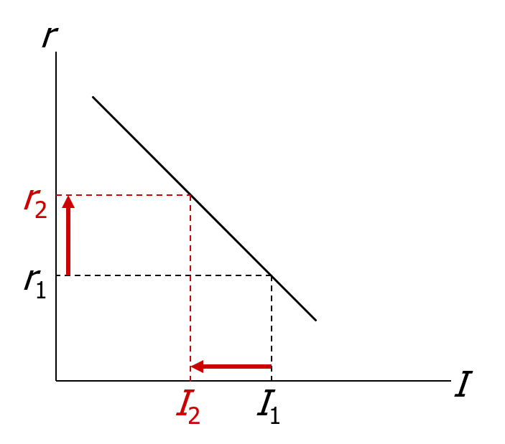
The investment function, part 1
An increase in r :
raises the cost of capital
reduces the profit rate
and reduces investment
Notes:
Finally, we see where our familiar investment function comes from.

Slide 38
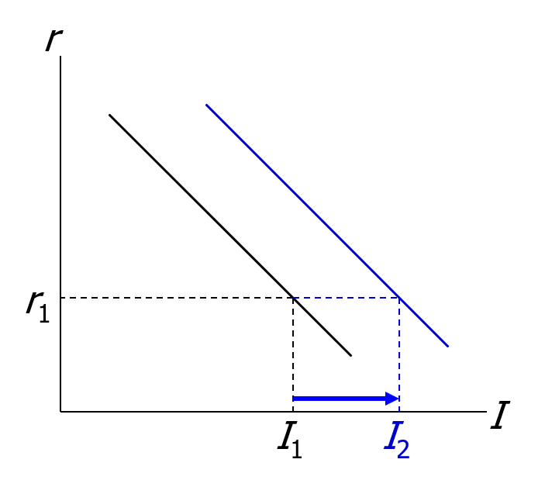
The investment function, part 2
An increase in MPK or decrease in P_{K}/P
increases the profit rate
increases investment at any given interest rate
shifts I curve to the right
Notes:
Here’s a challenge for particularly bright students:
Ask what happens to the investment curve given an increase in the depreciation rate. Tell them to justify their answer based on the investment equation we have derived.
Answer: The impact on the curve is ambiguous.
The depreciation rate appears in two different places in the equation.
First, it appears in the expression for the profit rate, which is the argument of the net investment function. An increase in the depreciation rate would raise the cost of capital and hence reduce the profit rate and the incentive to invest (*net* investment). This would tend to shift the curve left.
Second, the depreciation rate appears as a coefficient on K. An increase in the depreciation rate means that more investment (*gross* investment) is needed to replace depreciating capital and keep the total capital stock at its optimal level. This effect would shift the curve right.
The net impact of the two opposing forces is ambiguous, without knowing the specific form of the I_{n}( ) function.
Note: This exercise is simply for practice, and does not correspond to a real-world policy example.

Slide 39
Taxes and investment
Two of the most important tax policies affecting investment:
Corporate income tax
Investment tax credit
Notes:
Recently the United States made major changes to the corporate tax rate. There has been a lengthy discussion on the effects of the corporate tax cut on the economy. Your students might have questions about the tax cut.

Slide 40
Corporate income tax: A tax on profits
Impact on investment depends on definition of “profit.”
In our definition (rental price minus cost of capital), depreciation cost is measured using current price of capital, and the corporate income tax would not affect investment.
But, the legal definition uses the historical price of capital.
If P_{K} rises over time, then the legal definition understates the true cost and overstates profit,
so firms could be taxed even if their true economic profit is zero.
Thus, corporate income tax discourages investment.
Notes:
Why the corporate income tax doesn’t affect investment when profits are defined as in the textbook:
Let τ be the tax rate and—for this note only—let π denote the profit rate as defined above. The after-tax profit rate equals (1−τ)π. The firm’s investment decision depends on whether its profit rate is positive. As long as τ < 1, then the sign of (1−τ)π equals the sign of π. I.e., if an investment project is profitable without the tax, it will be profitable (though less so) with the tax.
Why using the historical price to compute depreciation understates the true cost of capital:
Consider the car rental example from a few slides ago. Suppose that when the car was originally purchased, the price was only $8000. Then, according to the government, depreciation is only $1600 = 0.2 (the depreciation rate) times $8000 (the historical price of capital). So, according to the government, the total cost of capital is only $2000, which is $400 less than the true economic cost of capital. Thus, the government is taxing the car rental firm τ(π + 400) instead of τπ.
(Please forgive my use of π to represent profit in this note when everywhere else we are using it to represent inflation.)

Slide 41
The Investment Tax Credit (ITC)
The ITC reduces a firm’s taxes by a certain amount for each dollar it spends on capital.
Hence, the ITC effectively reduces P_{K} , which increases the profit rate and the incentive to invest.

Slide 42
Tobin’s q
numerator: the stock market value of the economy’s capital stock.
denominator: the actual cost to replace the capital goods that were purchased when the stock was issued.
If q > 1, firms buy more capital to raise the market value of their firms.
If q < 1, firms do not replace capital as it wears out.

Slide 43
Relation between q theory and neoclassical theory
The stock market value of capital depends on the current & expected future profits of capital.
If MPK > cost of capital, then profit rate is high, which drives up the stock market value of the firms, which implies a high value of q.
If MPK < cost of capital, then firms are incurring losses, so their stock market values fall, so q is low.

Slide 44
The stock market and GDP, part 1
Reasons for a relationship between the stock market and GDP:
A wave of pessimism about future profitability of capital would:
cause stock prices to fall
cause Tobin’s q to fall
shift the investment function down
cause a negative aggregate demand shock

Slide 45
The stock market and GDP, part 2
Reasons for a relationship between the stock market and GDP:
A fall in stock prices would:
reduce household wealth
shift the consumption function down
cause a negative aggregate demand shock

Slide 46
The stock market and GDP, part 3
Reasons for a relationship between the stock market and GDP:
A fall in stock prices might reflect bad news about technological progress and long-run economic growth.
This implies that aggregate supply and full-employment output will be expanding more slowly than people had expected.

Slide 47
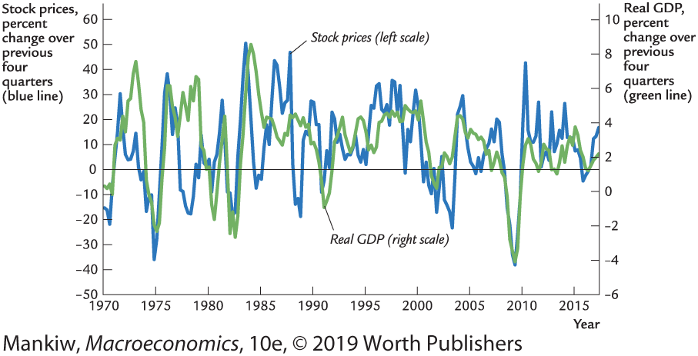
The stock market and GDP
Notes:
Similar to Figure 19-
The figure shows that the stock market and GDP tend to move together, but the association is far from precise.
Source: FRED.
Stock market: series DJIA, quarterly (end of period), percent change from year ago
Real GDP: series GDPC1, quarterly, percent change from year ago

Slide 48
Financing constraints
Neoclassical theory assumes firms can borrow to buy capital whenever doing so is profitable.
But some firms face financing constraints: limits on the amounts they can borrow (or otherwise raise in financial markets).
A recession reduces current profits. If future profits expected to be high, investment might be worthwhile. But if firm faces financing constraints and current profits are low, firm might be unable to obtain funds.

Slide 49
CHAPTER SUMMARY, PART 1
Keynesian consumption theory
Keynes’s conjectures
MPC is between 0 and 1
APC falls as income rises
current income is the main determinant of current consumption
Empirical studies
in household data & short time series: confirmation of Keynes’s conjectures
in long-time series data: APC does not fall as income rises

Slide 50
CHAPTER SUMMARY, PART 2
Modigliani’s life-cycle hypothesis
Income varies systematically over a lifetime.
Consumers use saving & borrowing to smooth consumption.
Consumption depends on income & wealth.

Slide 51
CHAPTER SUMMARY, PART 3
Friedman’s permanent-income hypothesis
Consumption depends mainly on permanent income.
Consumers use saving & borrowing to smooth consumption in the face of transitory fluctuations in income.

Slide 52
CHAPTER SUMMARY, PART 4
Hall’s random-walk hypothesis
Combines PIH with rational expectations.
Main result: changes in consumption are unpredictable, occur only in response to unanticipated changes in expected permanent income.

Slide 53
CHAPTER SUMMARY, PART 5
Laibson and the pull of instant gratification
Uses psychology to understand consumer behavior.
The desire for instant gratification causes people to save less than they rationally know they should.

Slide 54
CHAPTER SUMMARY, PART 6
Investment depend negatively on the real interest rate.
Things that shift the investment function:
Technological improvements raise MPK and raise business fixed investment.
Increase in population raises demand for, price of housing and raises residential investment.
Economic policies (corporate income tax, investment tax credit) alter incentives to invest.

Slide 55
CHAPTER SUMMARY, PART 7
Investment is the most volatile component of GDP over the business cycle.
Fluctuations in employment affect the MPK and the incentive for business fixed investment.

