Slide 1
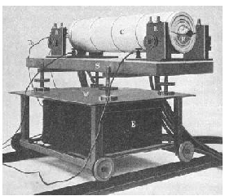
Lecture 1- Insights in Electrodynamics
Introductory Notes
From the black-body radiation to the zero point energy
Otto Lummer and Ferdinand Kurlbaum's black-body experiment from 1898: platinum cylinder sheet within a ceramic tube (Hoffmann, 2000, Physikalische Blätter Volume 56, Issue 12, p 43).

Slide 2
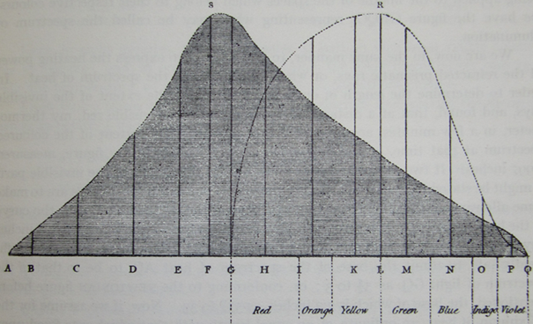
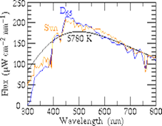
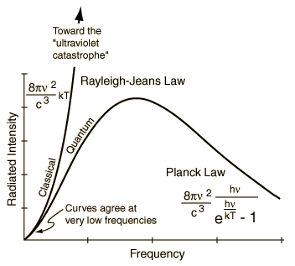
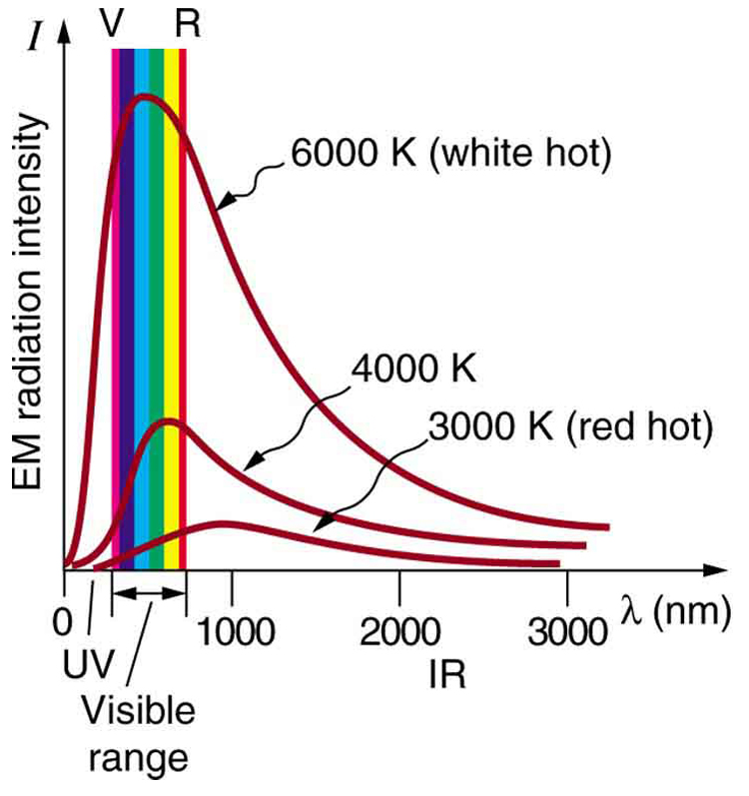
The spectrum of the Sun as seen from above the Earth's atmosphere, together with the spectrum of a blackbody at 5780 K with the same total flux as the Sun, and the spectrum of CIE D65 `daylight' normalized to the solar flux at 560 nm. The Sun's spectrum was taken from R. L. Kurucz, I. Furenlid, J. Brault & L. Testerman (1984) Solar Flux Atlas from 296 to 1300 nm.
Spectral energy distribution for the Sun as observed by Herschel. We note that the peak is shifted to the IR because of the prism used (Herschel W., 1800: Experiments on the solar and on the terrestrial rays that occasion heat … (2d part). Philosophical Transactions of the Royal Society, 90, 437-538.)
Classical ED
PLANCK

Slide 3
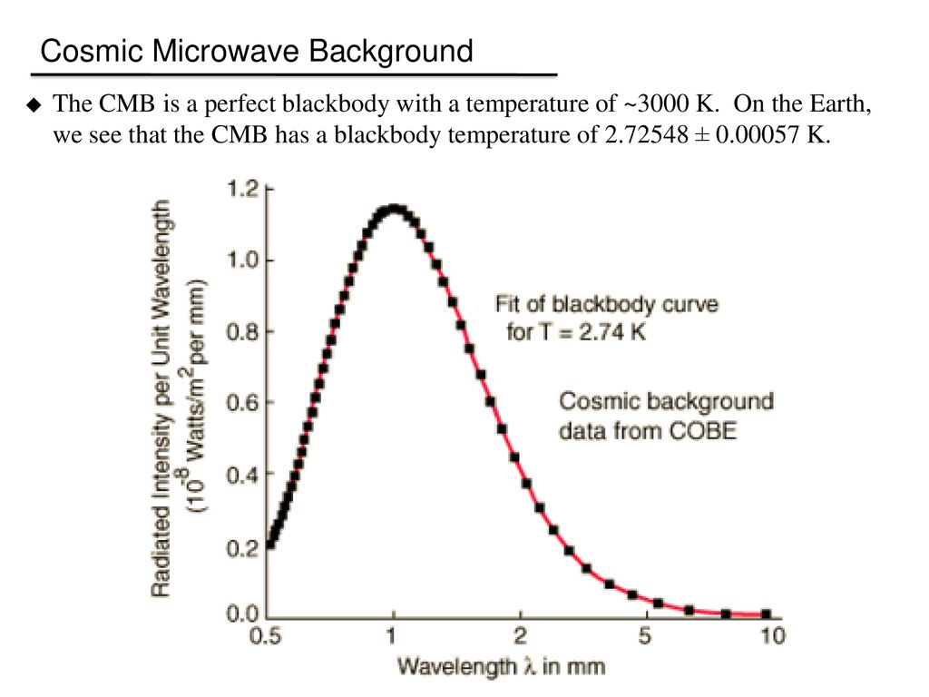
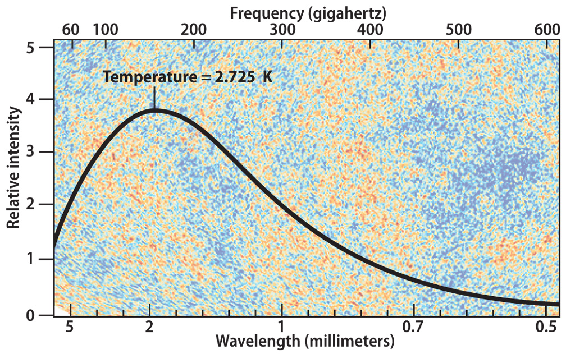
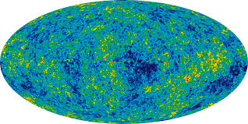
COSMIC MICROWAVE BACKGROUND FITS THE PLANK LAW

Slide 4
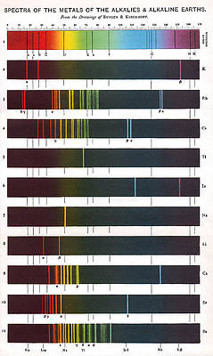
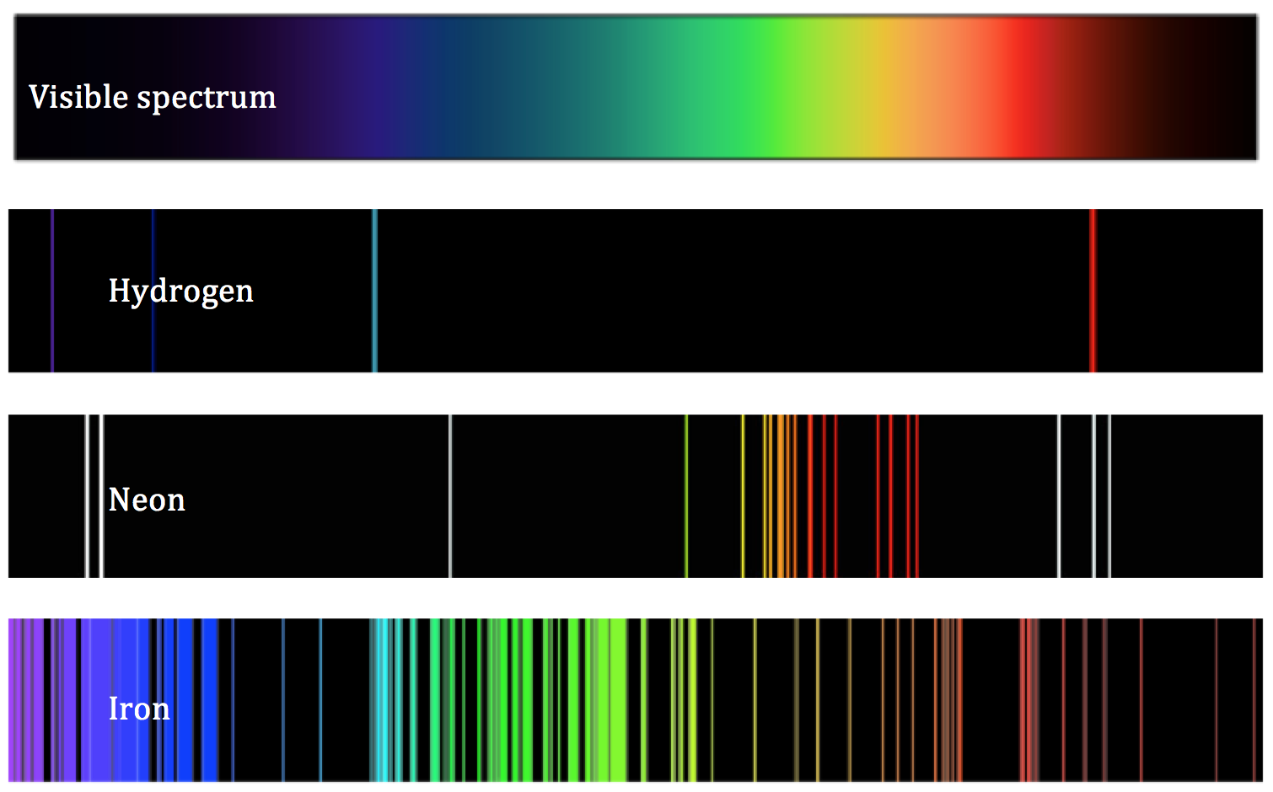
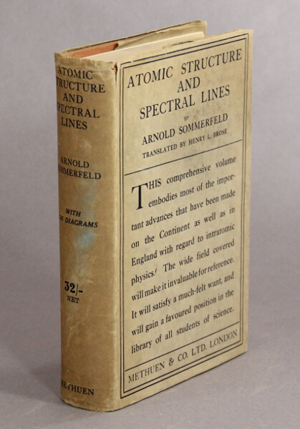
THE PLANCK LOW CAN BE REGARDED AS THE QUANTISATION
OF THE EM RADIATION WITH MATTER. IS NOT THR QUANTISATION OF THE EM FIELD.
THAT CAN BE COSIDERED AS THE QUANTISATION OF THE ENERGY THAT A CLASSICAL
EXCHANGE WITH A LORENTZ OSCILLATOR.

Slide 5
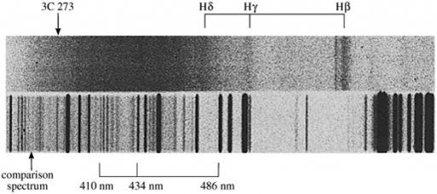
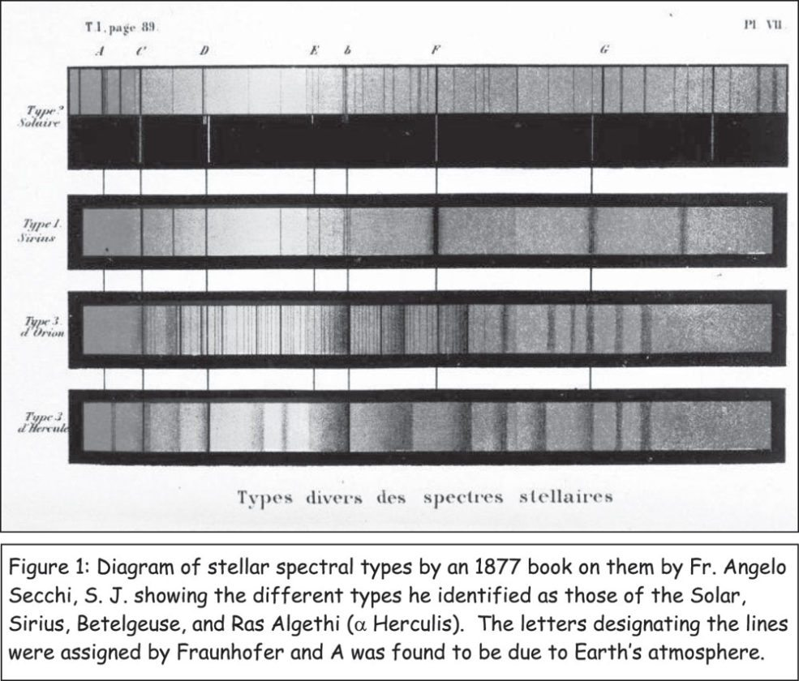
QUESTIONS:
1- WHAT IS THE RELATION BETWEEN THE LORENTZ OSCILLATOR AND THE THE BLACK-BODY RADIATION ?
2- WHAT IS THE RELATION BETWEEN THE BLACK-BODY RADIATION AND TH EMISSION/ABSORPTION OF LIGHT?
3- THE CLASSICAL ED (LORENTZ OSCILLATOR) PREDICT CORRECTLY LA LINE SHAPE AND THE LIFETIME OF THE ABSORPTION EMISSION/ABSORPTION OF LIGHT OF AN OPTICAL TRANSITION. CAN PREDICT ALSO THE INTENSITY AND THE EXPERIMENTAL FACT THAT ONLY SOME OPTICAL TRANSITIONS ARE OBSERVED?
An historic QSO optical spectrum, which was taken using a photographic plate. The darker areas are regions where the intensity of light is higher. The top rectangle is the spectrum of the radio galaxy 3C 273, while the lower rectangle is the spectrum of a comparison emission line source. In both spectra three common lines of hydrogen have been indicated. The lines in the spectrum of 3C 273 appear at a redshift z = 0.158

Slide 6
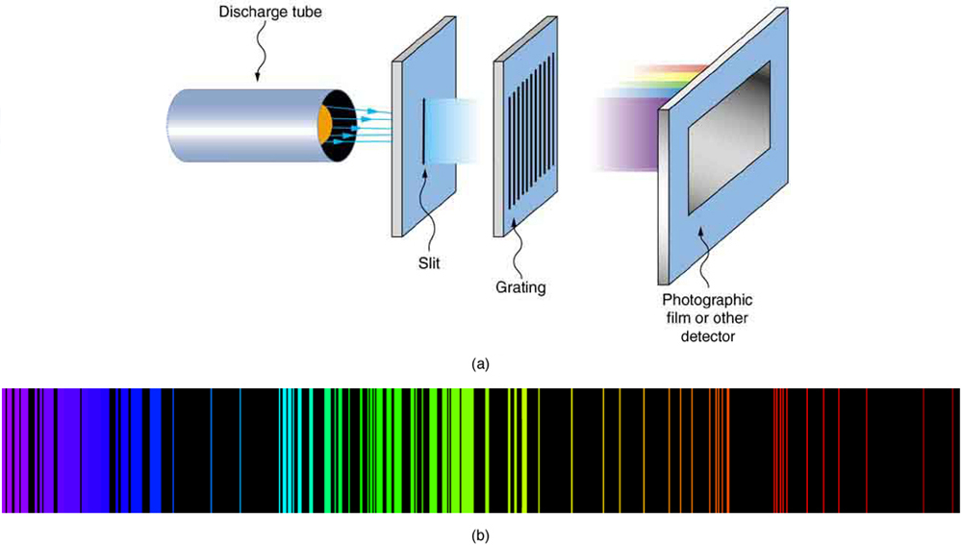
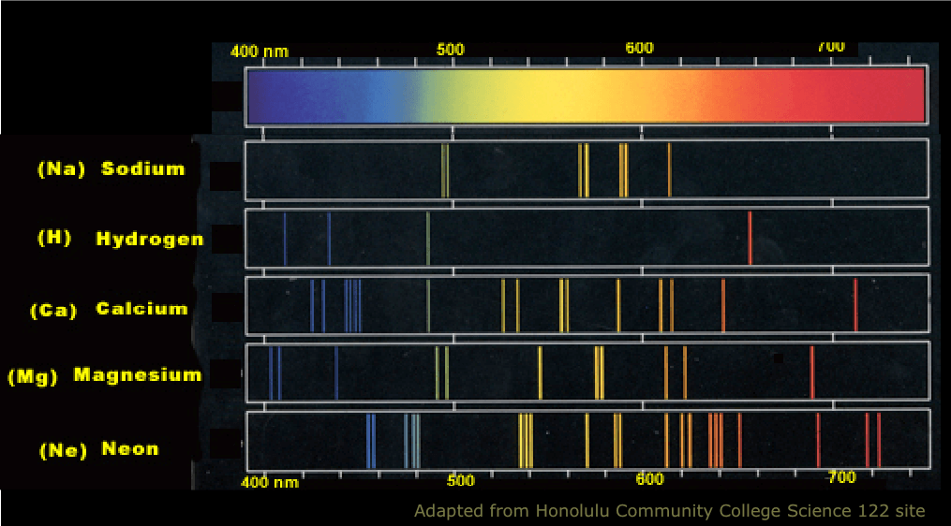
THE CLASSICAL ED CANNOT PREDICT THE POSITION
OF THESE EMISSIONS (ABSORPTIONS) AND THE
INTENSITY. FURTHERMORE, CLASSICAL ED CANNOT
PREDIC WHU=ICH LINE WE WILL SEE. BUT IT CAN
PREDICT THE LORENTIAN LINE SHAPE AND THE
REFRACTIVE INDEX.

Slide 7
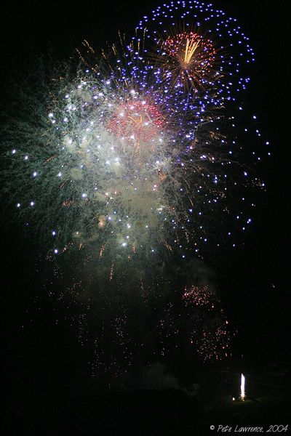
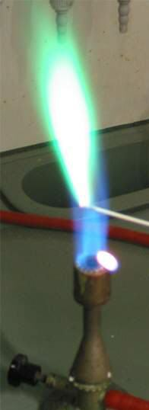
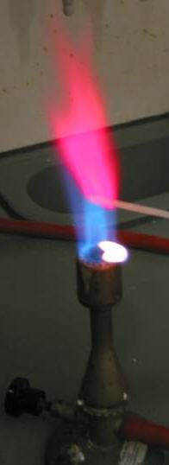
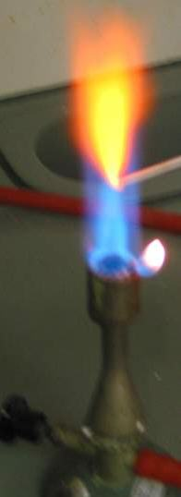
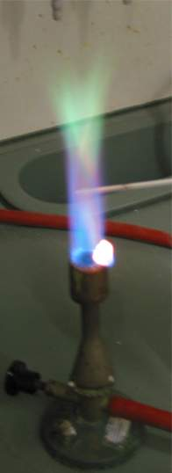

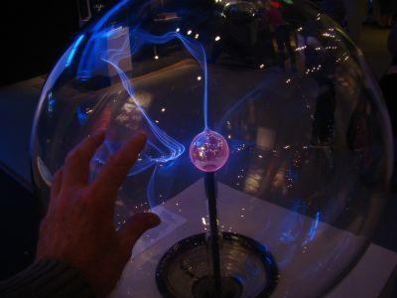
WHY DO WE SEE THESE EMISSIONS (COLORS)?
https://www.nist.gov/pml/atomic-spectroscopy-compendium-basic-ideas-notation-data-and-formulas
https://www.itp.uni-hannover.de/fileadmin/arbeitsgruppen/zawischa/static_html/atoms.html
Cu Li Ca B
ELECTRICAL
DISCHARGE
CHEMICAL REACTIONS/NOT THERMODINAMICS
K_{B}T TOO LOW

Slide 8
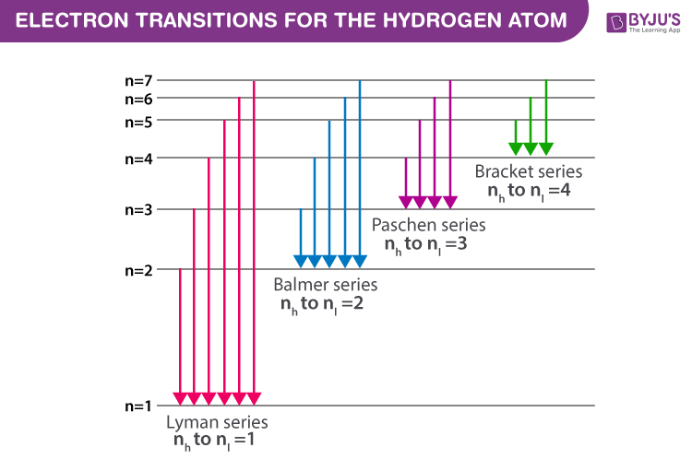
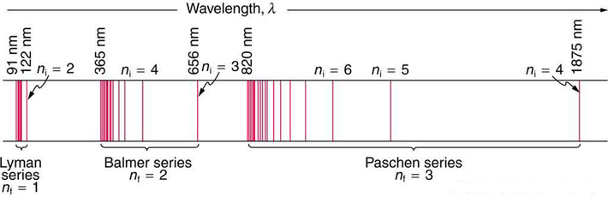
WHY THESE TRANSITIONSCAN GENERATE LIGHT
OR ABSORB LIGHT?
LIGHT CAN BE GENERATED WHEN MATTER
INTERACT (STIMULATED EMISSION)
OR DOES NOT INTERACT WITH AN EM FIELD
(SPONTANEOUS EMISSION)
THESE SPECTRAL SERIES
CAN BE RATIONALIZED WITH
THE BOHR’S MODEL- AFULLY
“MECHANICAL MODEL’

Slide 9
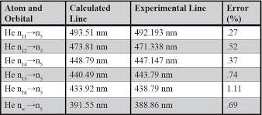
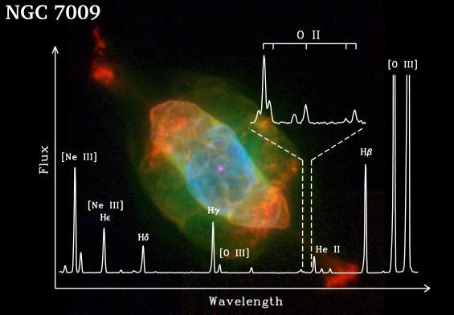
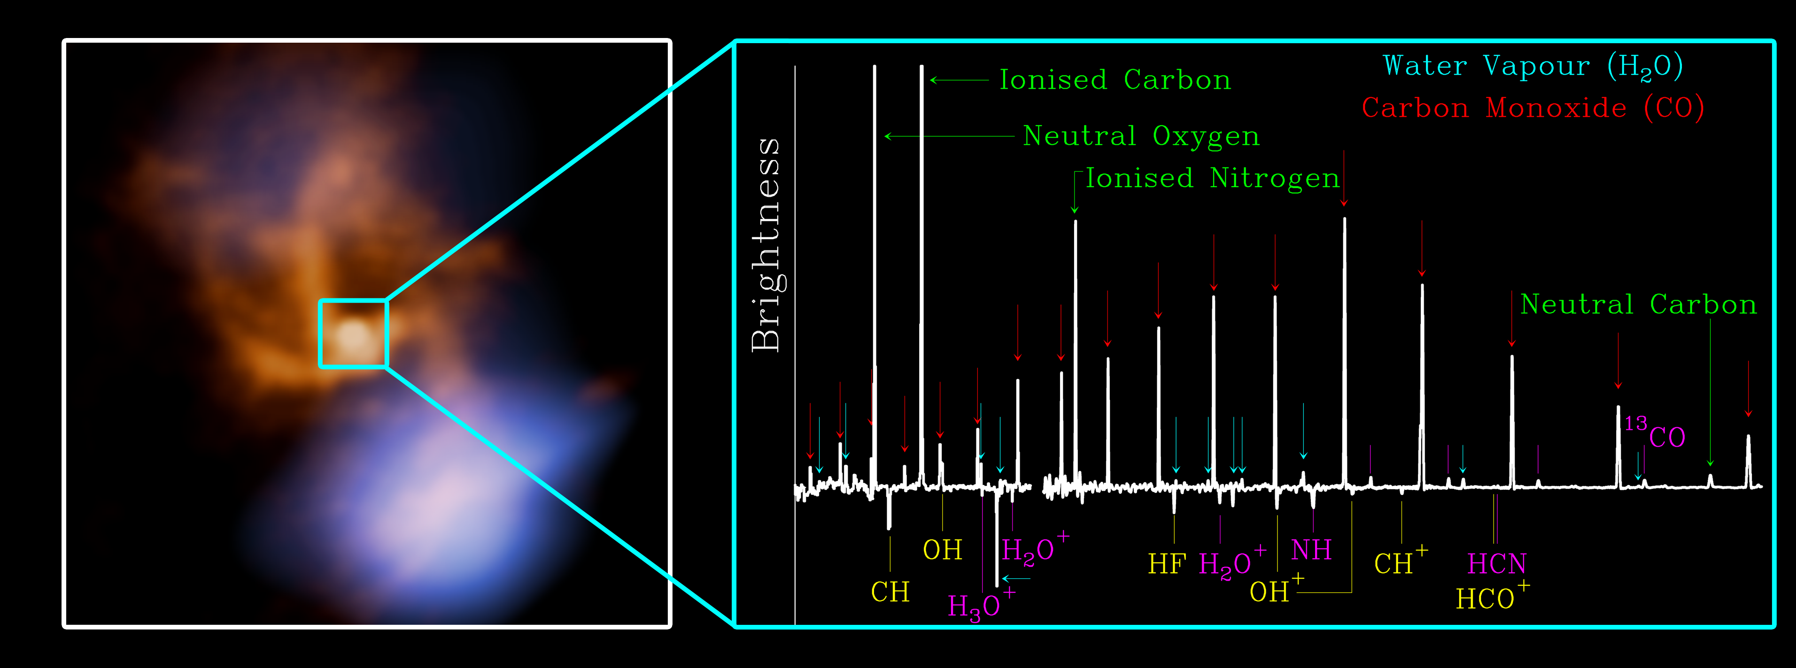

Slide 10

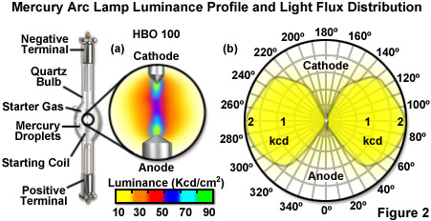
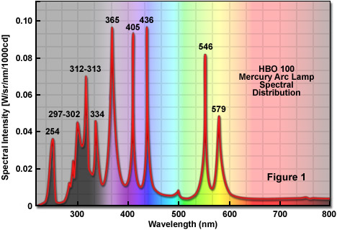
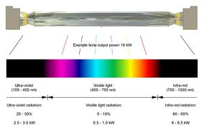
THE THERMAL LIGHT

Slide 11
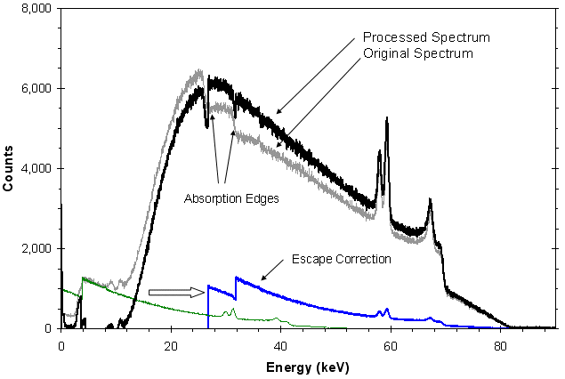
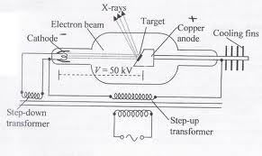
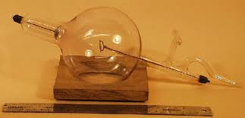
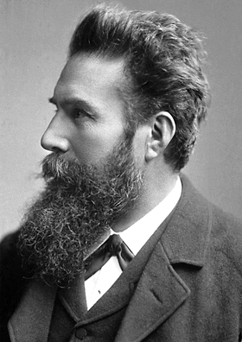
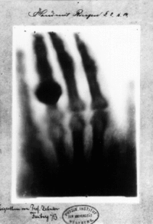
AN UNKNOWN THERMAL LIGHT

Slide 12
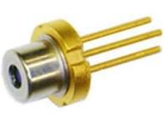
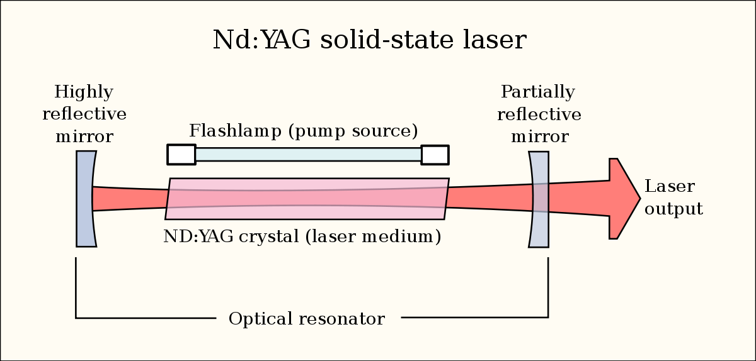
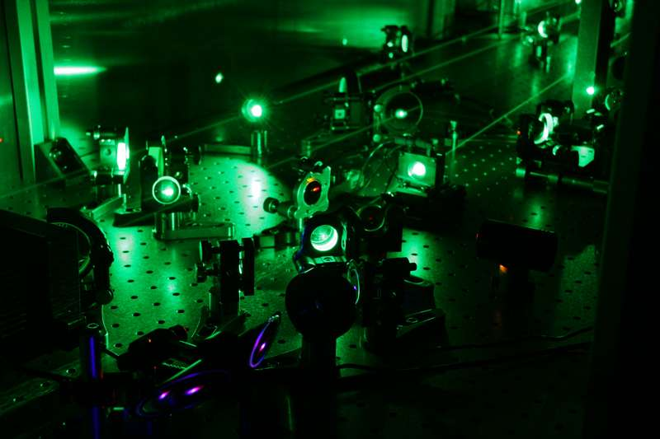
QUANTUM LIGHT
WHAT IS AN OPTICAL
RESONATOR?
Diodo LASER ------------- LNC728PS01WW 783Nm, Infrarossi, 200mW, 3 Pin, Massimo 3 V
~ Euro 29

Slide 13
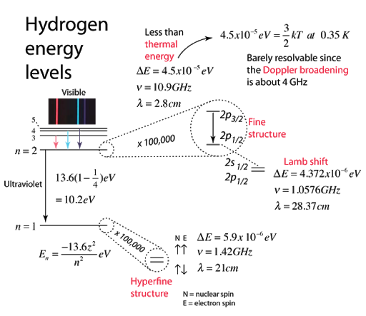
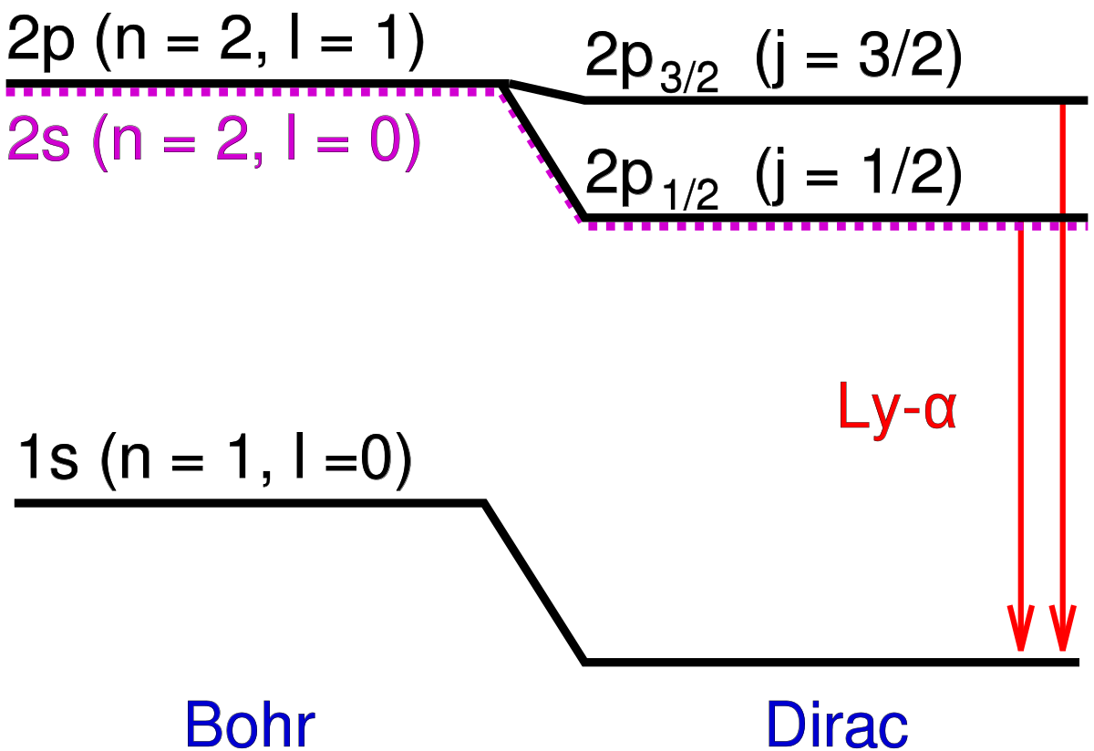
A VERY VERY INTERESTION STORY

Slide 14
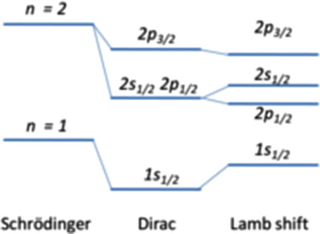
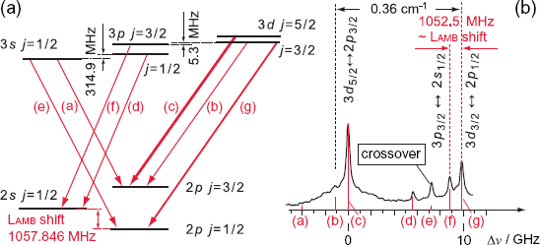
TO UNDERSTAND THIS TINY SHIFT
WE NEED TO QUANTISE THE EM
FIELD
Bohr

Slide 15
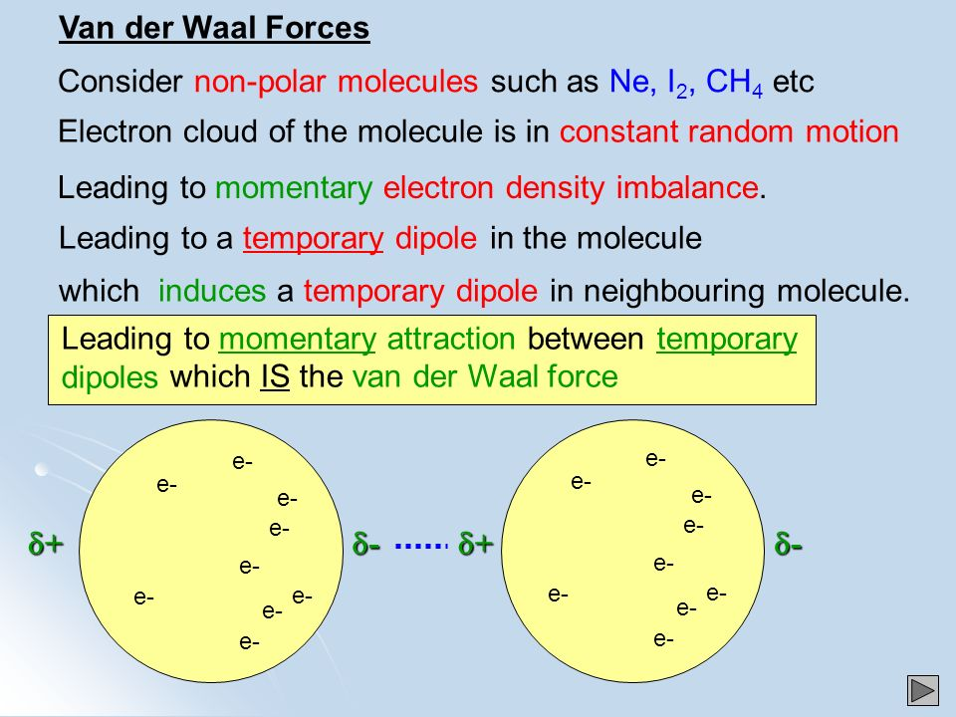
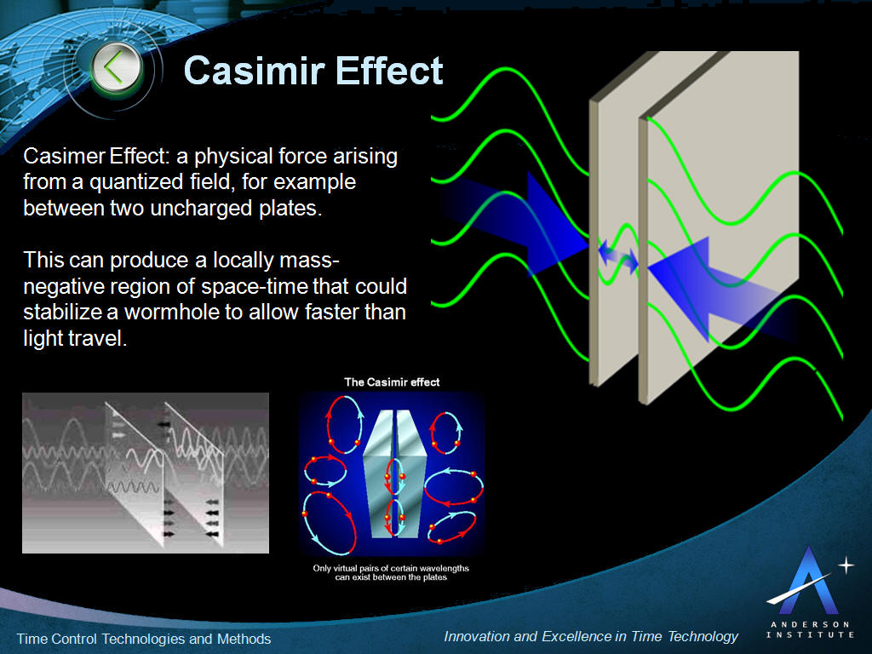
THE ZERO POINT ENERGY
In quantum physics, a quantum fluctuation (or vacuum state fluctuation or vacuum fluctuation) is the temporary random change in the amount of energy in a point in space,^{[2]} as prescribed by Werner Heisenberg's uncertainty principle. They are tiny random fluctuations in the values of the fields which represent elementary particles, such as electric and magnetic fields which represent the electromagnetic force carried by photons, W and Z fields which carry the weak force, and gluon fields which carry the strong force.
Another consequence is the Casimir effect. One of the first observations which was evidence for vacuum fluctuations was the Lamb shift in hydrogen. In July 2020 scientists report that they, for the first time, measured that quantum vacuum fluctuations can influence the motion of macroscopic, human-scale objects by measuring correlations below the standard quantum limit between the position/momentum uncertainty of the mirrors of LIGO and the photon number/phase uncertainty of light that they reflect.
SOURCE : WIKIPEDIA – QUANTUM FLUCTUATION

Slide 16
WE MAST GO STEP-BY-STEP TO BUILD UP A SUITABLE THEORY FOR DESCRIBING THE
TRAJECTORY OF A CHARGE PARTICLE(S) IN ELECTRIC, MAGNETIC AND EM FIELDS.
THE FIRST STEP WE MUST TAKE IS TO CONSIDER A TRANSTION TO AN ADANCED MECHANICS
TO DESCRIBE THE TRAJECTORIES OF CHARGE PARTICLES (REMEMBER THAT SAYING
CHARGE PARTICLE IMPLIES MASSIVE PARTICLES).
THIS IS WHAT WE NEED
1- DESCRPTION OF THE EM FIELDS AND EM INTERACTIONS BY THE PRINCIPLE OF LEAST ACTION (ACTUALLY THE PRINCIPLE OF STATIONARY ACTION).
THIS IMPLIES TO WORK OUT THE EM LAGRANGIAN AND HAMILTONIAN.
THIS IS THE SCOPE OF THE FIRST LECTURES.
LET ME REMIND HERE THAT THE PRINCIPLE OF STATIONARY ACTION IS THE MOST COMPACT FORM OF THE CLASSICAL LAWS OF PHYSICS. IT SUMMARIZES EVERYTHING (CLASSICAL MECHANICS, ELECTROMAGNETISM, GENERAL RELATIVITY, QUATUM MECHANICS...)

Slide 17
2- CLASSICAL DESCRIPTION OF THE BLACK-BODY RADIATION BY CLASSICAL ED:
RAYLEIGH-JEANS EQUATION.
3- DERIVATION OF THE PLANCK FORMULAAND MEANING OF THE PLANCK
QUANTISATION.
4- THE TWO LEVEL MODEL
5- THE QM MODEL AND THEFORMULATION OF THE HAMILTONIAN
INTERACTION TERM
6- THE “FERMI GOLDEN RULE” AND THE COMPARISON WITH THE EXPERIMENTS.
7- QUANTISATION OF THE EM FIELD. THE ZERO POINT ENERGY. A GLANCE TO THE QED
AND QFT.

