Slide 1
Robotics
a.a. 2020-2021

Slide 2
Introduction
Robotics

Slide 3
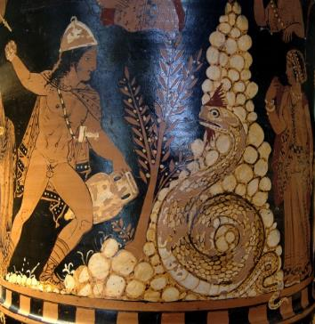
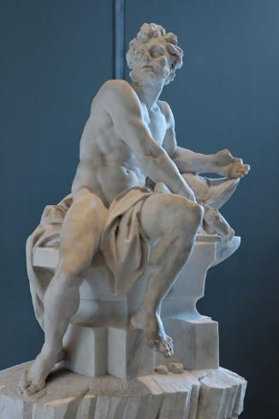
Some history: legends
Origins in the ancient world
Concepts of artificial servants and companions date at least as far back as the ancient legends of Cadmus, who is said to have sown dragon teeth that turned into soldiers
The legend of Pygmalion’s statue of Galatea that came to life
In Greek mythology, Hephaestus created utilitarian three-legged tables that could move about under their own power
The clay golems of Jewish legend
Cadmus
Hephaestus

Slide 4
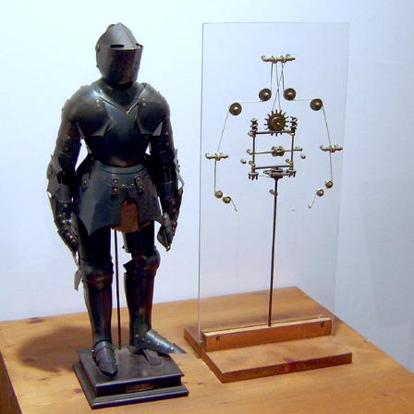
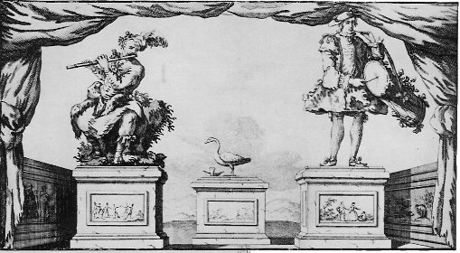
The early beginnings
1495
Leonardo da Vinci’s mechanical knight
1737
Jacques de Vaucanson’s automata
  flute player
  tambourine player
  “The Digesting Duck"

Slide 5
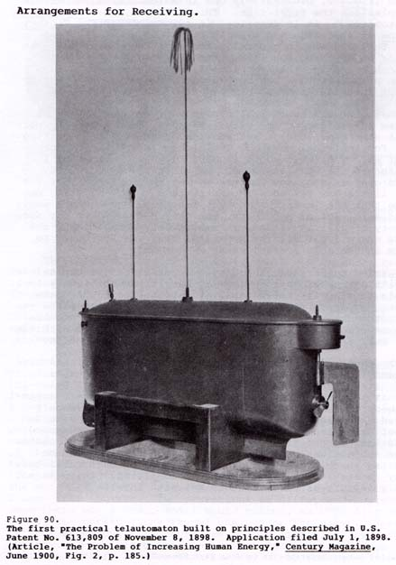
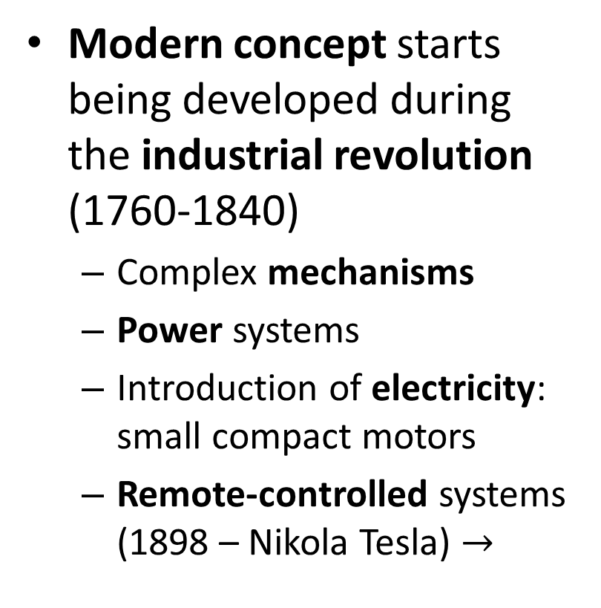
Industrial application
Modern concept starts being developed during the industrial revolution (1760-1840)
  Complex mechanisms
  Power systems
  Introduction of electricity: small compact motors
  Remote-controlled systems (1898 – Nikola Tesla) $→$

Slide 6
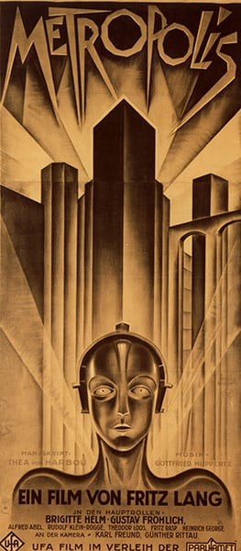
Origin of the name
The term "robot" was first used to denote fictional automata in the 1921 play R.U.R. (Rossum's Universal Robots) by the Czech writer Karel Čapek.
  According to Čapek, the word was created by his brother Josef from the Czech robota, meaning servitude.
In 1941 and 1942, Isaac Asimov formulated the Three Laws of Robotics, and in the process coined the word "robotics".

Slide 7
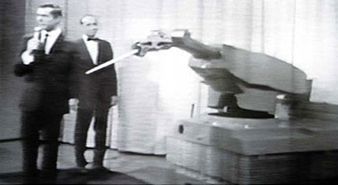
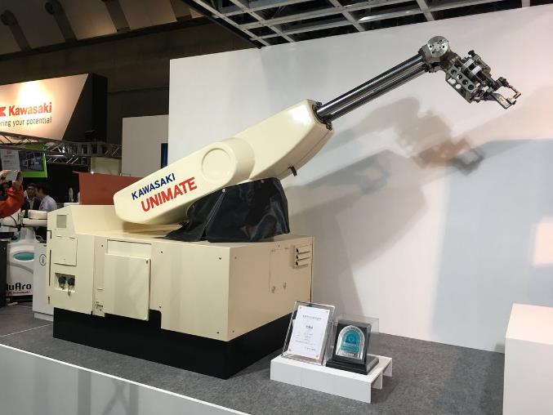
First modern robot
Unimate
  George Devol in 1954
Transporting die castings from an assembly line and welding these parts on auto bodies
Dangerous task for workers
  Toxic fumes
  Heat
  Dangerous heavy machinery

Slide 8
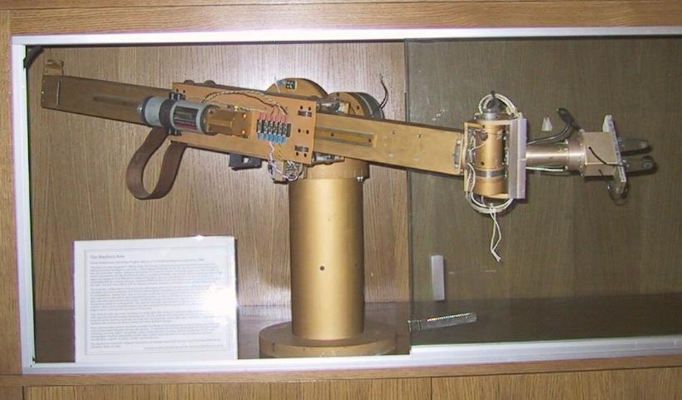
First computer-controlled robot
Stanford arm
  Victor Scheinman
  1969
First electronic computer-controlled robotic arm

Slide 9
…and now?
Situation:
Many processes are still manual
… thus require skilled workers
Dangerous machineries
Transportation of semi-finished products is often done manually

Slide 10
Automation
Automation may be a possible solution:
  It increases efficiency
  It decreases operating costs
  It increases safety
Industrial automation is carried out by:
  Robotics
  Internal transport and conveyor systems
  Vision systems
  Sensing, automatic controls, …

Slide 11
Robotics
The current situation is that robotics is entering with determination in the industry (as already happened in many fields, e.g. automotive)
We will see the fundamentals of robotics
… and how robotics can be taken advantage of

Slide 12
Robot
Definition
A machine capable of carrying out a complex task automatically.

Slide 13
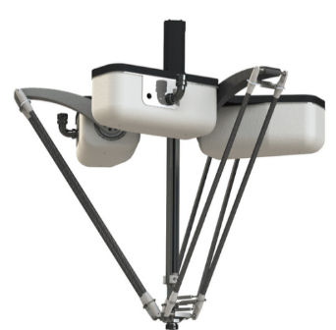
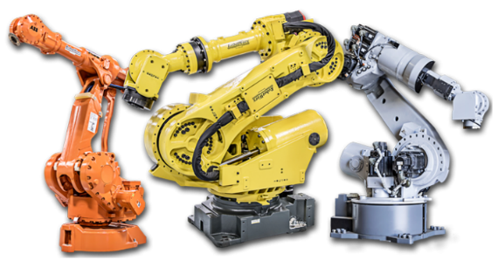
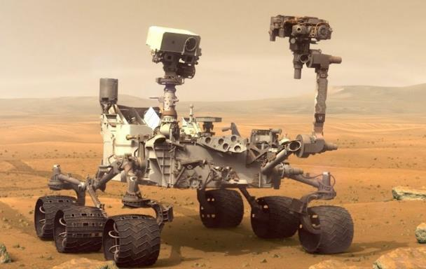
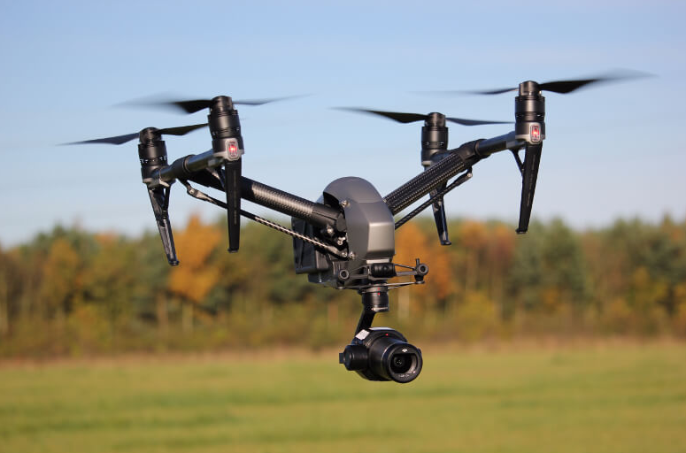
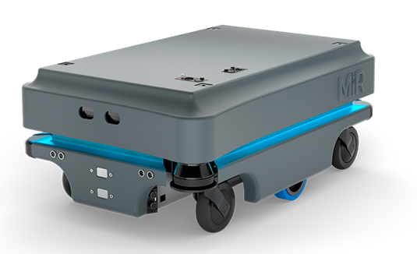
Robots
Classification
  Stationary
  Mobile
Industrial robots
Rovers
Flying
Mobile robots

Slide 14
Other classifications
Power source:
  Electrical
  Pneumatic/hydraulic
  Nuclear
  «Green»

Slide 15
And more...
Kinematic structure ("type of mechanism")
Size of the work envelope
Size of the robot
Mass of the robot
Load capability
Etc.

Slide 16
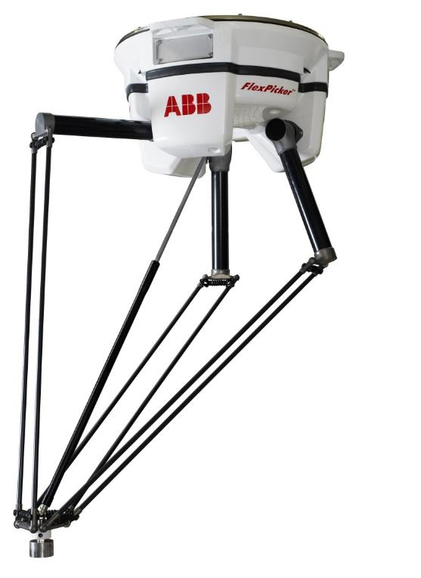
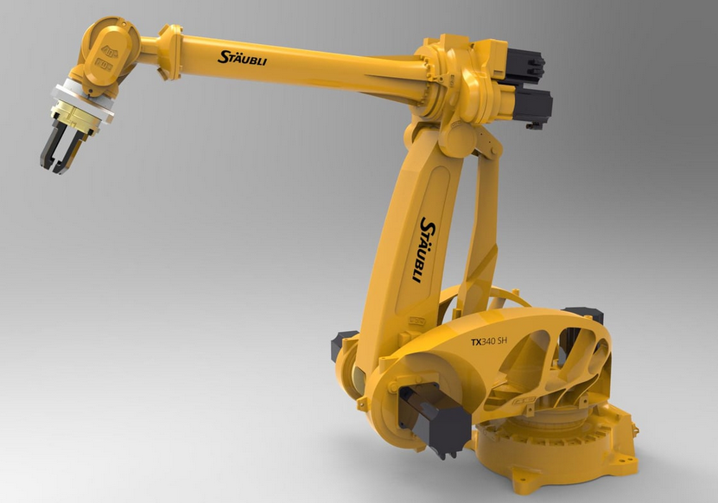
Industrial robot
A robot used for manufacturing:
  Automated
  Programmable
  Can move on 2 or more axis
Parallel robot / delta robot
Serial robot / Serial manipulator

Slide 17
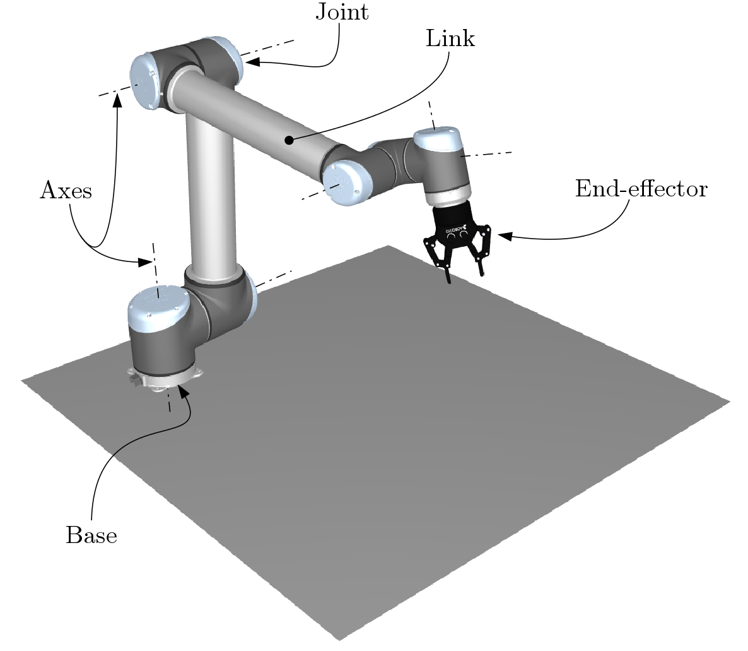
Industrial Robot: some definitions

Slide 18

Links, joints and axes
Link
  Rigid body which is part of a robot
Joint
  Connection between two links
Axes
  Geometrical entities that
  determine the motion of
  the joints (linear/rotational)

Slide 19
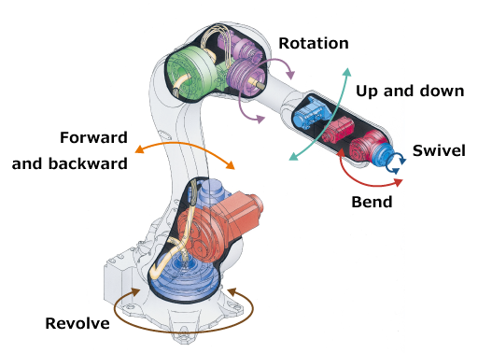
Joints

Slide 20
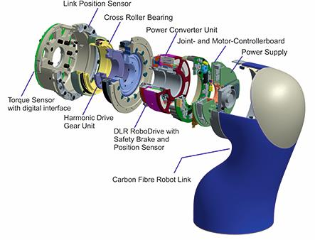
Joints

Slide 21
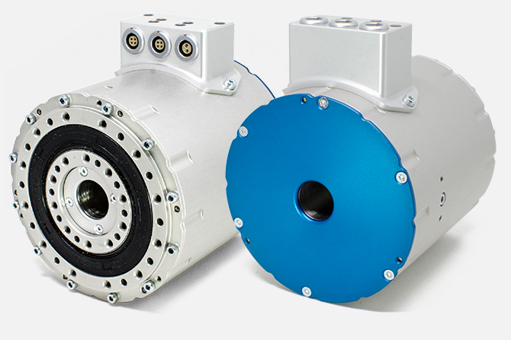
Actuators
Robotic actuators
Motor + gearbox
Linear or rotational
Must provide good accuracy

Slide 22
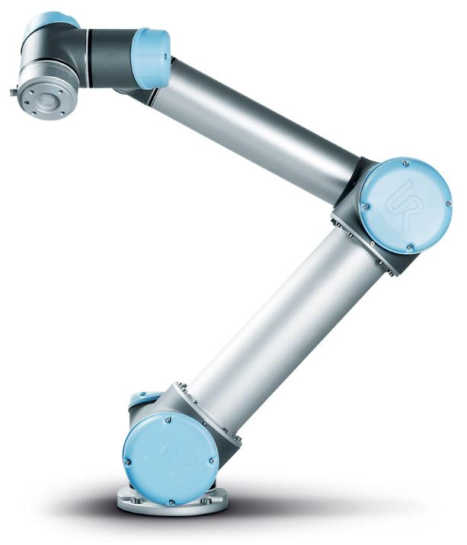
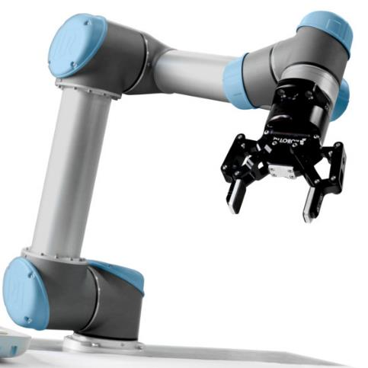
End-effectors and tools
End-effector
  The component that manoeuvres the tool so that it interacts with the environment
Tool
  Component that is attached to the end-effector,
  Necessary to perform the interaction:
    Painting,
    Grabbing, …

Slide 23
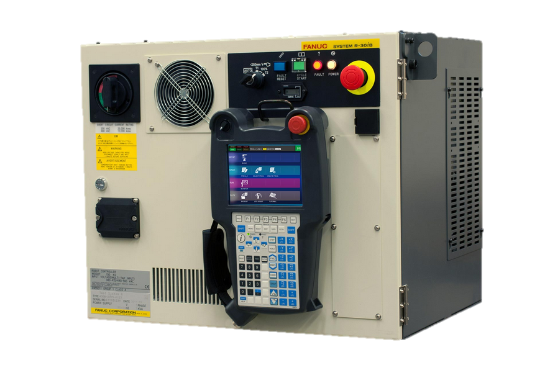
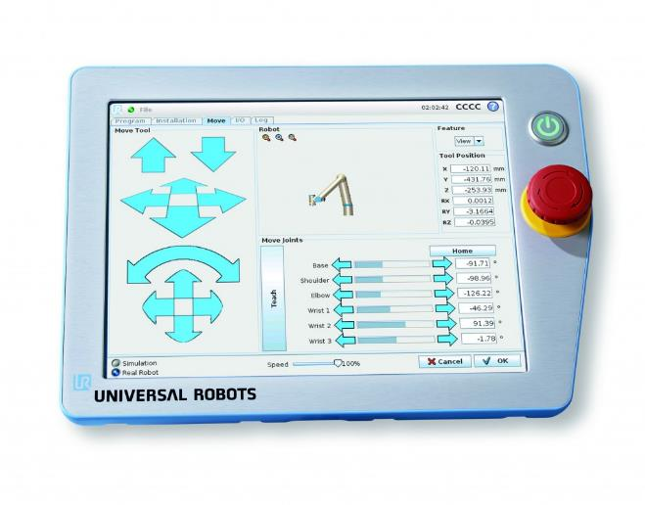
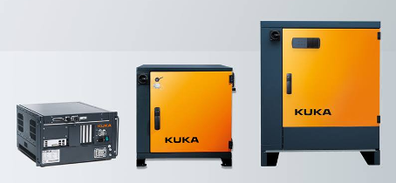
Control apparatus
Controller
Teach pendant

Slide 24
Attributes of a robot
Payload
  How much mass the robot can lift and manipulate
Speed
  How fast the robot can position the end-effector
  Individual joints have speed limits as well
Acceleration
  How quickly the end-effector can accelerate
  Individual joints have acceleration limits as well
  Trouble to reach the specified speed for short movements or in complex paths requiring frequent changes of direction

Slide 25
Attributes of a robot
Accuracy
  How closely a robot can reach a commanded position.
  Accuracy can be improved:
    external sensing with feedback (e.g. vision system)
    calibration
  Accuracy can vary:
    with speed
    position
    with payload
Repeatability
  How well the robot will return to a programmed position.
  Not the same as accuracy

Slide 26
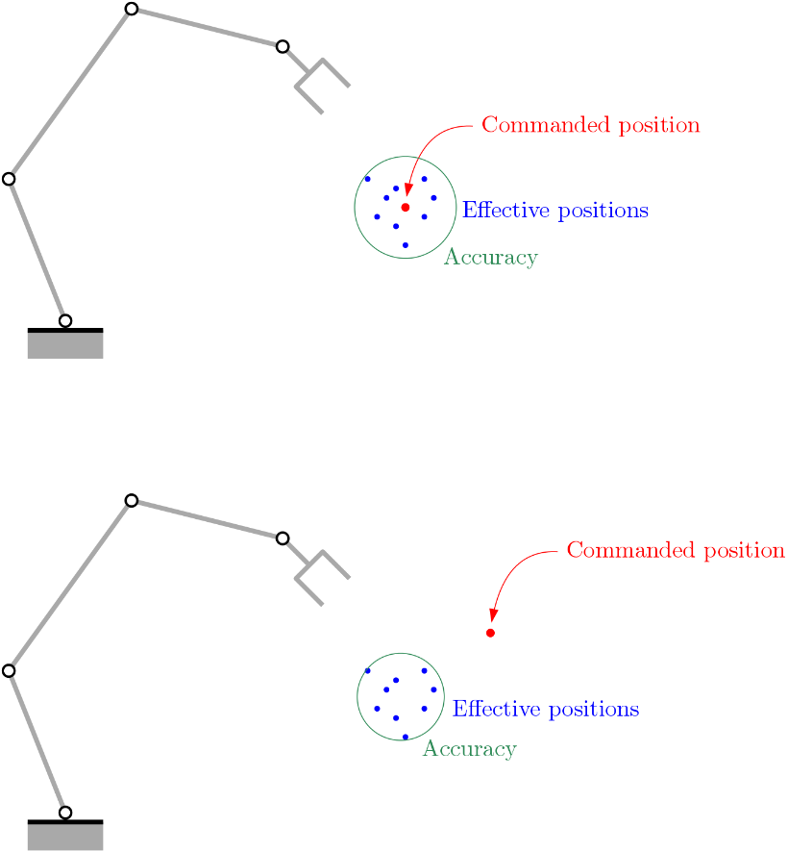
Accuracy vs. repeatability
Accuracy
  Distance of the EE from the commanded position
Repeatability
  Spread of the EE positions
Repeatability

Slide 27
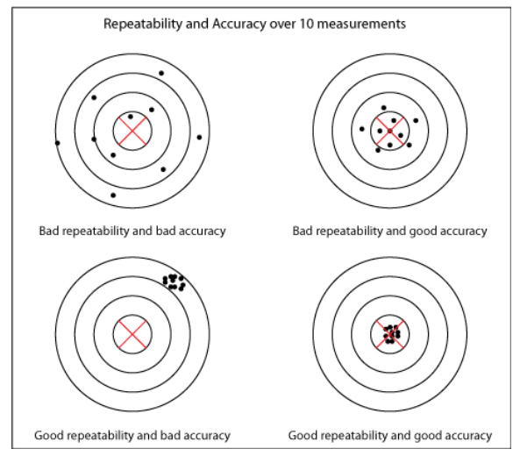
Accuracy vs. repeatability

Slide 28
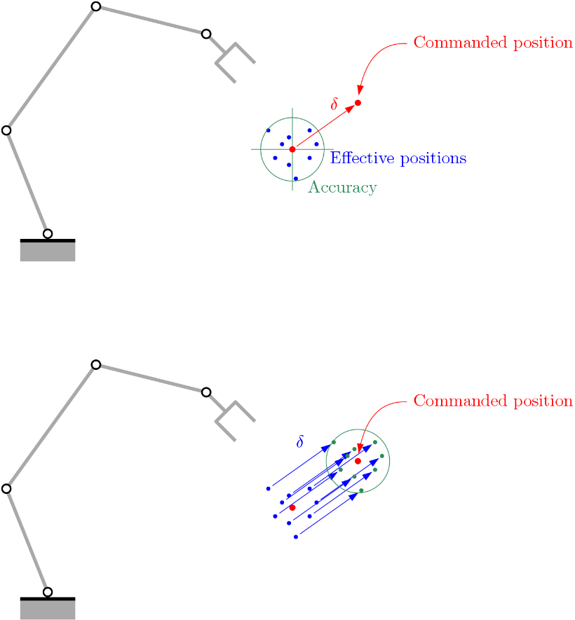
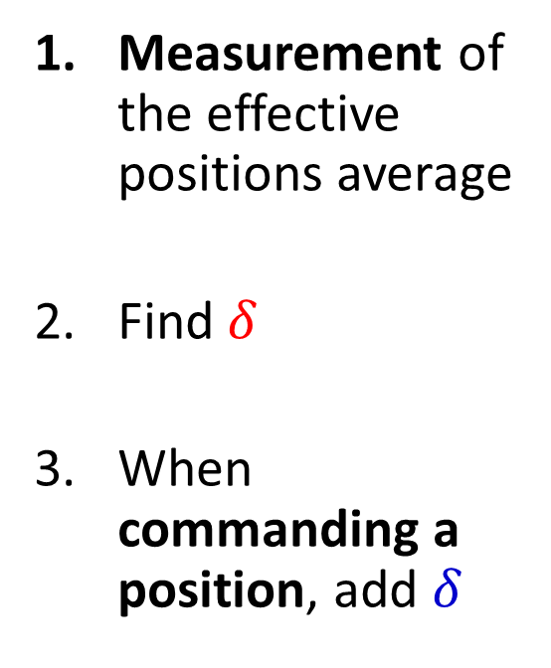
Robot calibration
Measurement of the effective positions average
Find $δ$
When commanding a position, add $δ$
Repeatability envelope

Slide 29
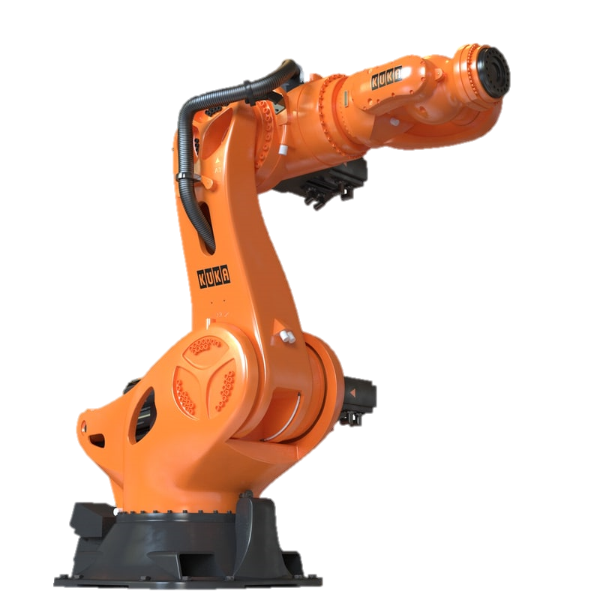
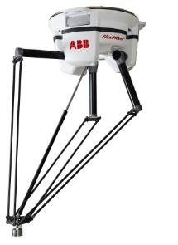
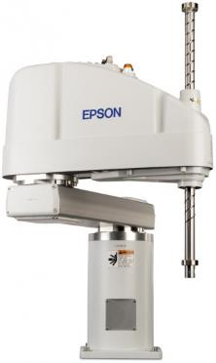
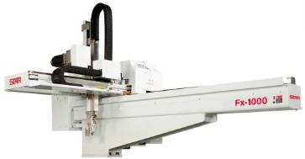
Types of robots
Serial robot
Parallel robot
SCARA
Cartesian
Video 1 (panels pick and place)
Video 2 (milling)
Video 3 (nail hammering)

Slide 30
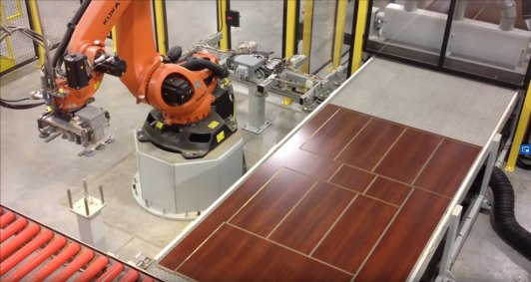
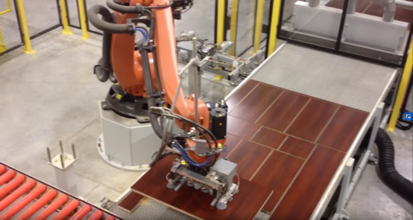
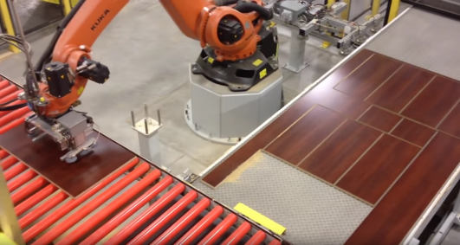
Video 1 (panels pick and place)
The robot picks up the end-effector
The robot picks up one panel with a vacuum gripper
Pick and Place
The robot places the panel on a conveyor system

Slide 31
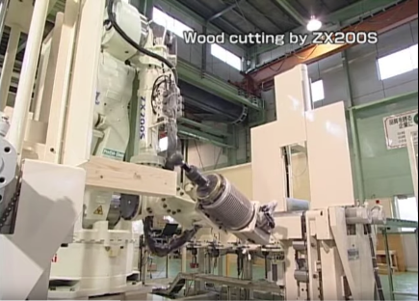
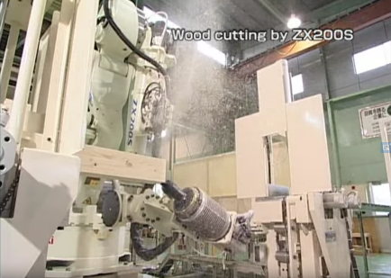
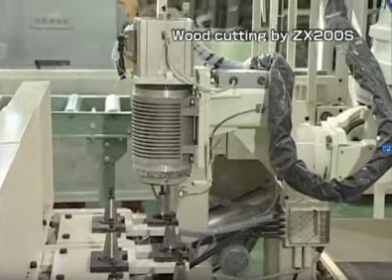
Video 2 (milling)
Positioning
Machining
Using tool to perform milling operation
Tool change

Slide 32
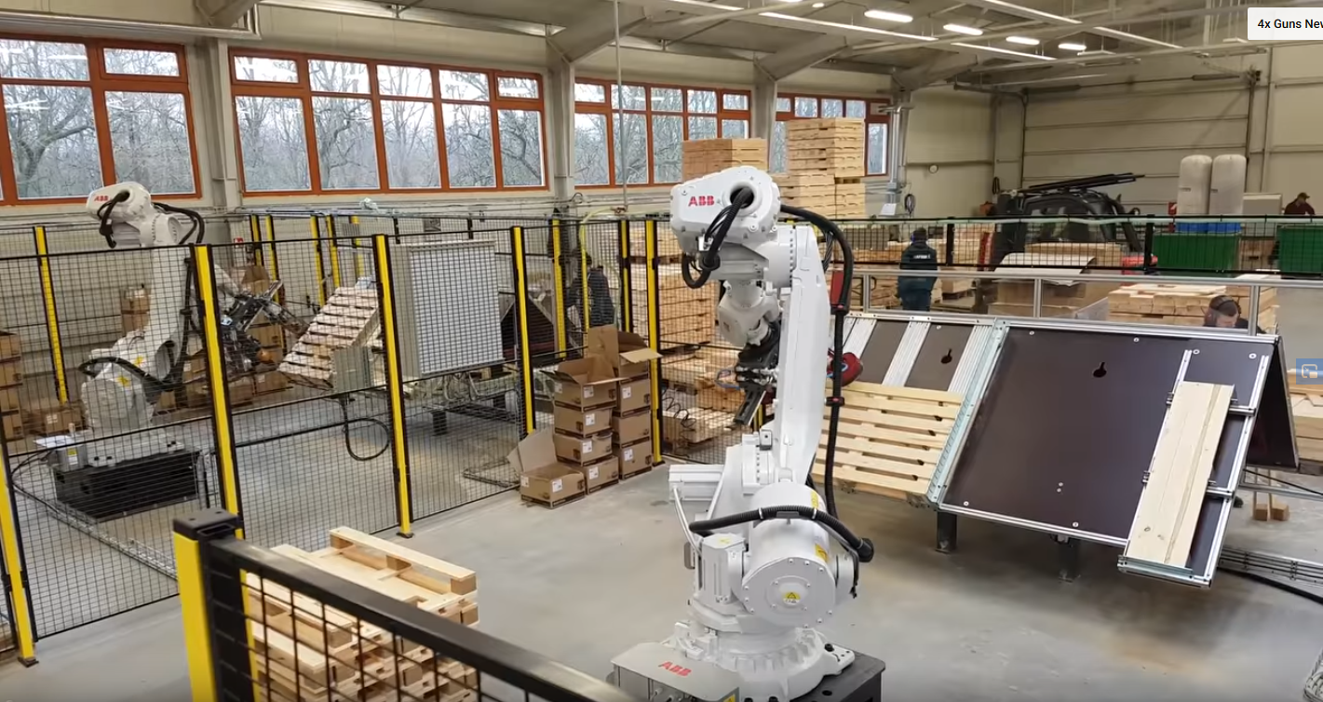
Video 3 (nail hammering)

Slide 33
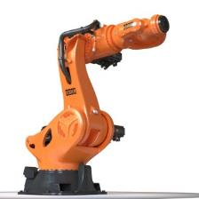
Types of robots
Serial robot
Parallel robot
SCARA
Cartesian
Video

Slide 34
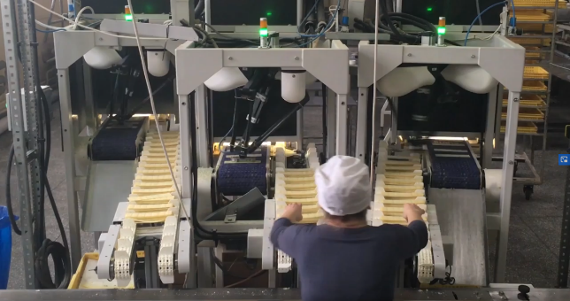
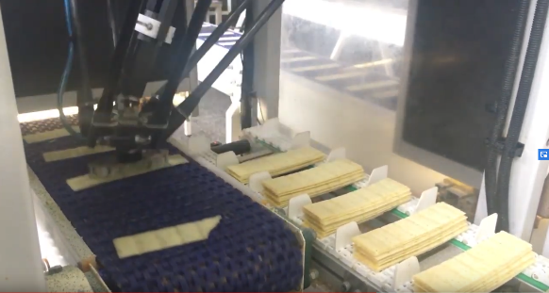
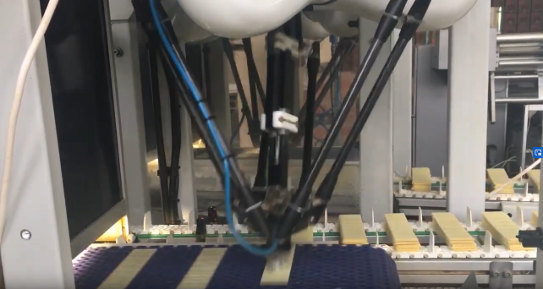
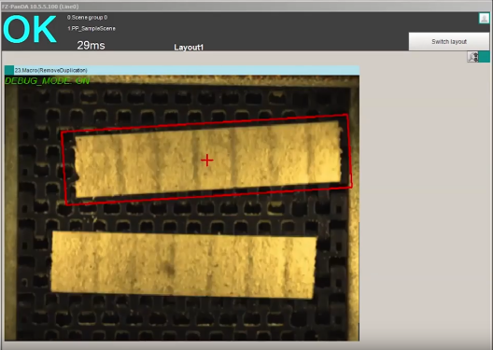
Video Delta
Fault detection with computer vision
Food industry pick/place/selection

Slide 35

Types of robots
Serial robot
Parallel robot
SCARA
Cartesian
Selective
Compliance
Assembly
Robot
Arm
Video

Slide 36
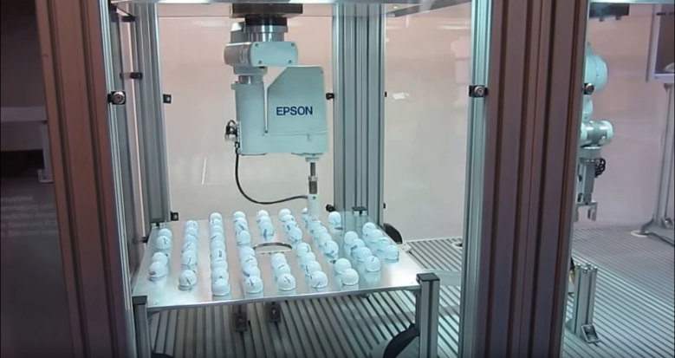
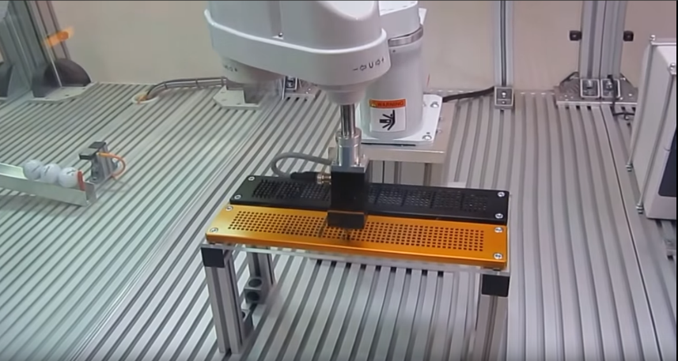
Video SCARA

Slide 37
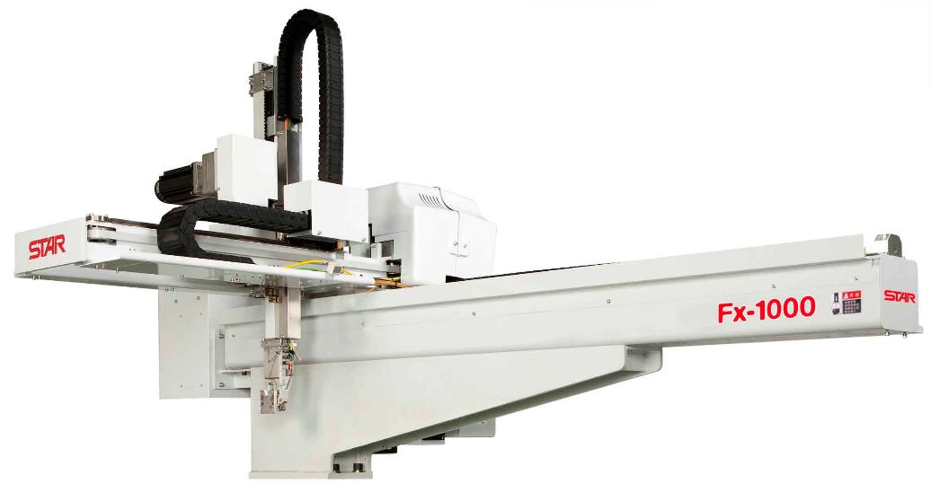
Types of robots
Serial robot
Parallel robot
SCARA
Cartesian
Video

Slide 38
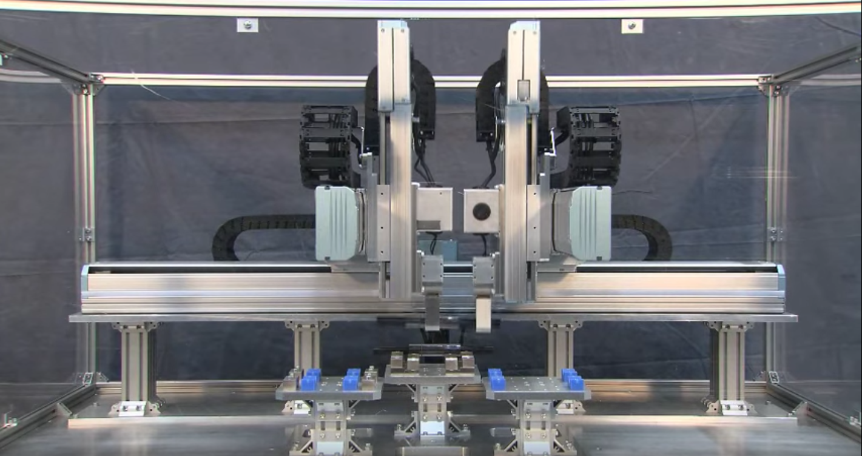
Video CARTESIAN
Two Cartesian robots on the same structure

Slide 39
Robotics: outline
Robotics

Slide 40
Robotics
Mechanical theory
  Mechanisms and degrees of freedom
  Kinematics (direct and inverse)
  Euler angles
  Workspace and joint-space
  Redundancy and Singularity
Control
  Path planning
  Position, force and impedance control
  Path teaching
Robotic systems
  Robots functional schematics
  End-effectors and tools
Industrial examples: painting and pick & place

