Slide 1
Robotics
Part IV
a.a. 2020-2021
Furniture technology

Slide 2
Path planning
Robotics

Slide 3




Path planning
The act of generating the inputs for the robot control system to perform the intended paths or trajectories
  Path: the set of points (positions) that the robot must encounter in its operation
  Trajectory: the path where a time constraint is applied to each point; therefore a velocity is defined for each point (and consequently an acceleration)
  Both of these can be
  defined or determined
  in the workspace or in
  the joint-space
x
$$t=4s$$
x
$$t=1s$$
$$t=3s$$
$$t=2s$$
Notes:
Show on roboDK

Slide 4
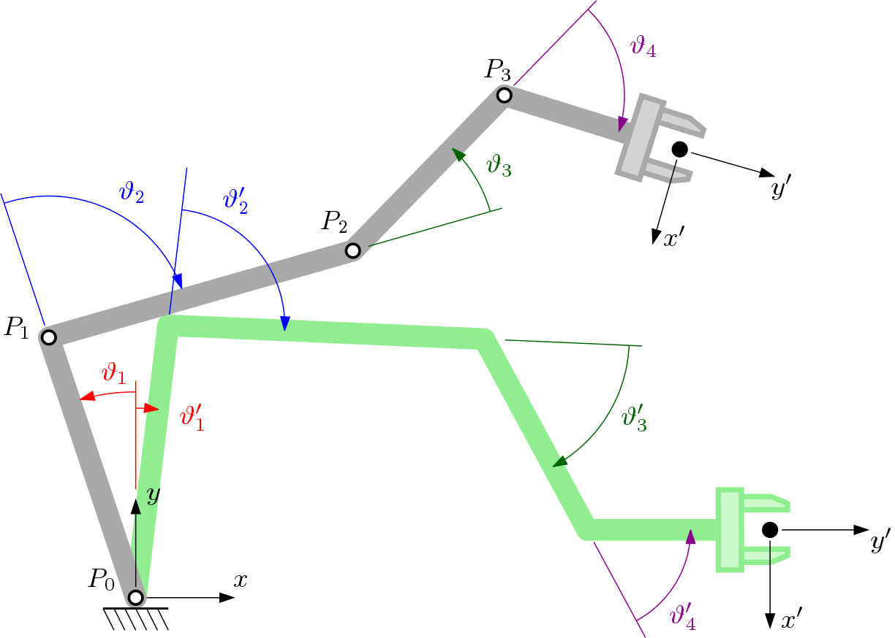
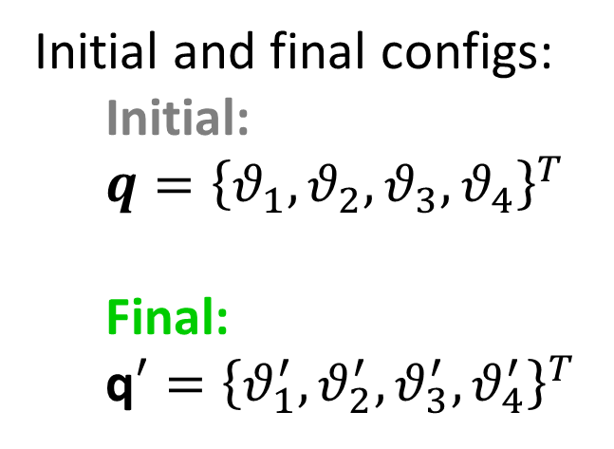
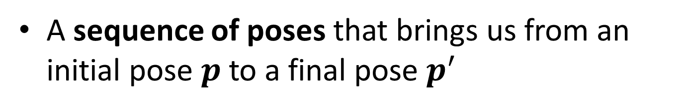
Point-to-point
A sequence of poses that brings us from an initial pose $p$ to a final pose $p^{′}$
Initial and final configs:
  Initial:
  $q={\left\{θ_{1},θ_{2},θ_{3},θ_{4}\right\}}^{T}$
  Final:
  q$′={\left\{θ_{1}^{′},θ_{2}^{′},θ_{3}^{′},θ_{4}^{′}\right\}}^{T}$

Slide 5
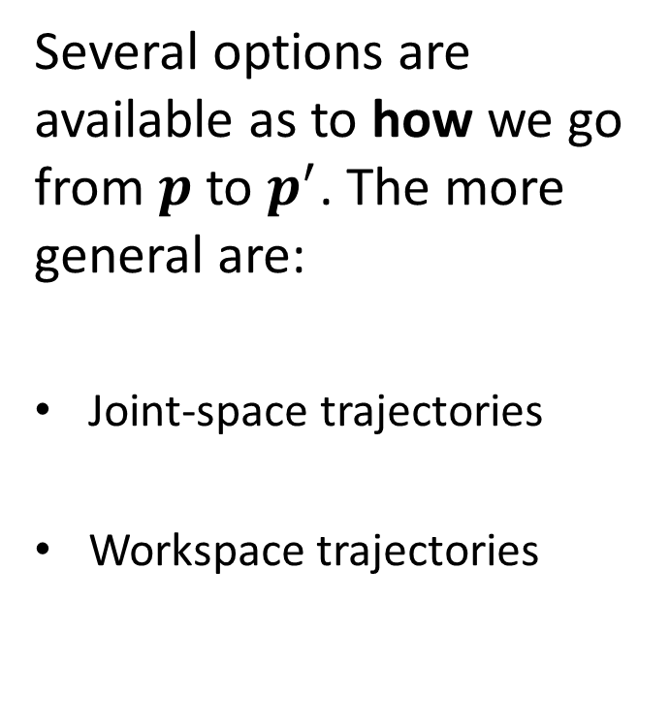
Point-to-point
Several options are available as to how we go from $p$ to $p^{′}$. The more general are:
Joint-space trajectories
Workspace trajectories

Slide 6
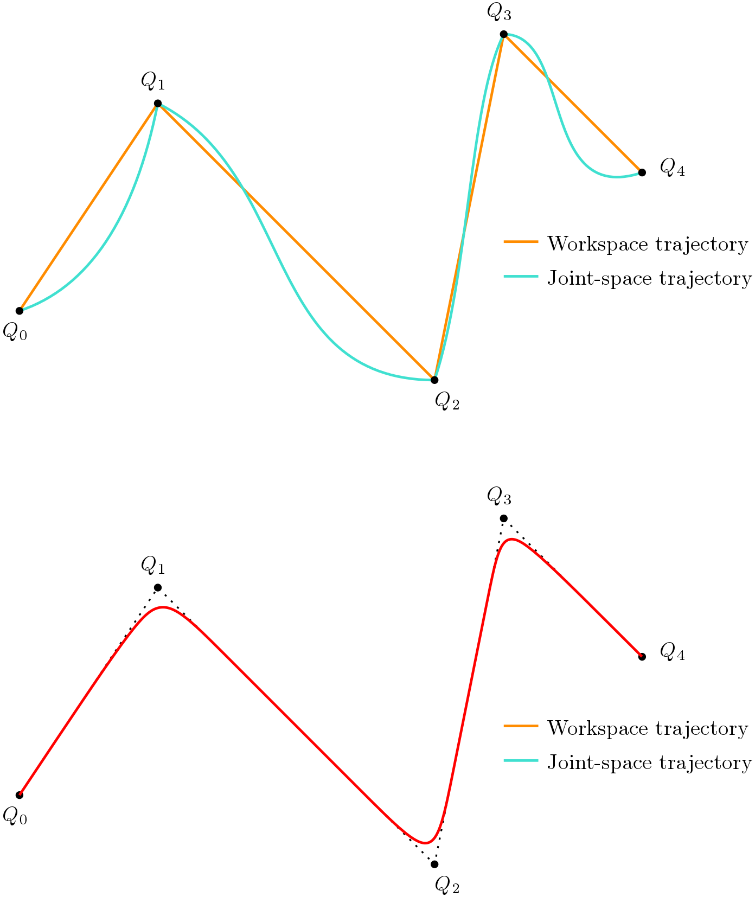
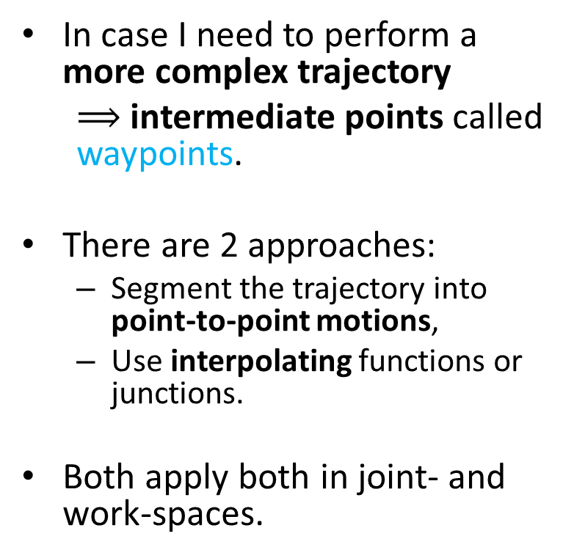
Sequence of points
In case I need to perform a more complex trajectory
  $⟹$ intermediate points called waypoints.
There are 2 approaches:
  Segment the trajectory into point-to-point motions,
  Use interpolating functions or junctions.
Both apply both in joint- and work-spaces.

Slide 7
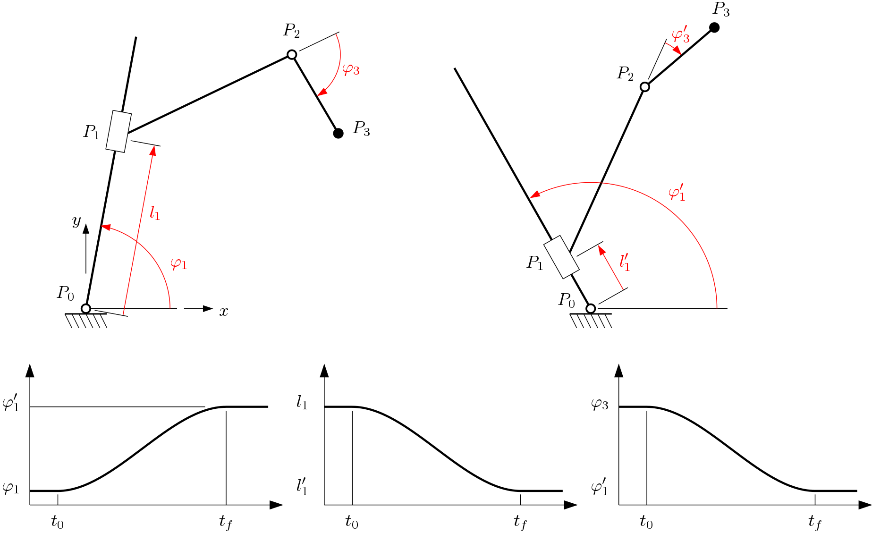


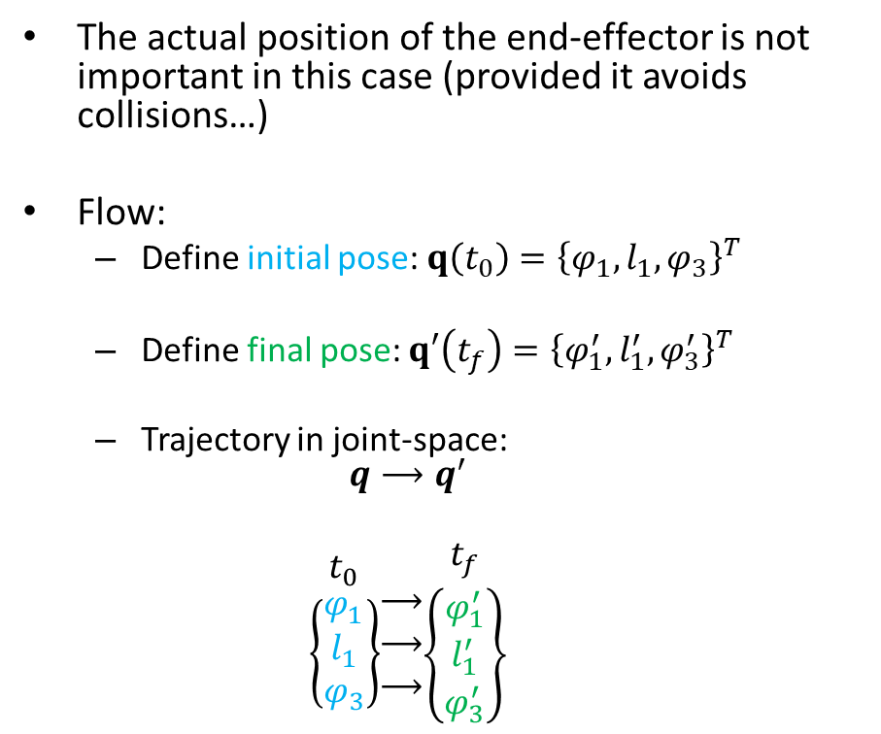
Joint-space trajectories
The actual position of the end-effector is not important in this case (provided it avoids collisions…)
Flow:
  Define initial pose: $q\left(t_{0}\right)={\left\{φ_{1},l_{1},φ_{3}\right\}}^{T}$
  Define final pose: $q′\left(t_{f}\right)={\left\{φ_{1}^{′},l_{1}^{′},φ_{3}^{′}\right\}}^{T}$
  Trajectory in joint-space:
  $q⟶q^{′}$
  $$\begin{matrix}t_{0} \\ \left\{\begin{matrix}φ_{1}^{} \\ l_{1} \\ φ_{3}\end{matrix}\right\}\end{matrix}\begin{matrix} \\ ⟶ \\ ⟶ \\ ⟶\end{matrix}\begin{matrix}t_{f} \\ \left\{\begin{matrix}φ_{1}^{′} \\ l_{1}^{′} \\ φ_{3}^{′}\end{matrix}\right\}\end{matrix}$$
$$p\left(t_{0}\right)$$
$$p\left(T\right)$$

Slide 8

Joint-space trajectories
The actual position of the end-effector is not important in this case (provided it avoids collisions…)
Flow:
  Define initial pose: $q\left(t_{0}\right)={\left\{φ_{1},l_{1},φ_{3}\right\}}^{T}$
  Define final pose: $q′\left(t_{f}\right)={\left\{φ_{1}^{′},l_{1}^{′},φ_{3}^{′}\right\}}^{T}$
  Trajectory in joint-space:
  $q⟶q^{′}$
  $$\begin{matrix}t_{0} \\ \left\{\begin{matrix}φ_{1} \\ l_{1} \\ φ_{3}\end{matrix}\right\}\end{matrix}\begin{matrix} \\ ⟶ \\ ⟶ \\ ⟶\end{matrix}\begin{matrix}t_{f} \\ \left\{\begin{matrix}φ_{1}^{′} \\ l_{1}^{′} \\ φ_{3}^{′}\end{matrix}\right\}\end{matrix}$$
$$p\left(t_{0}\right)$$
$$p\left(T\right)$$

Slide 9
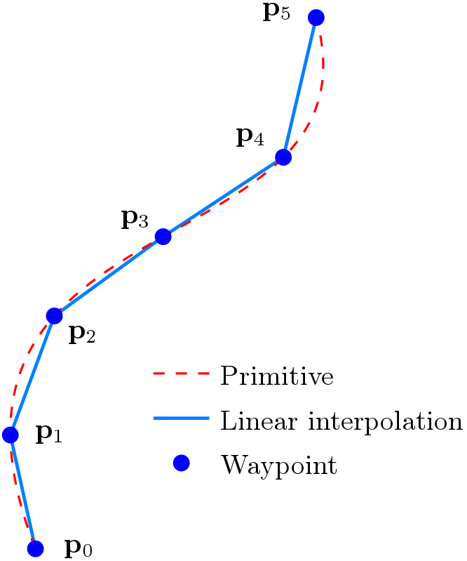
Workspace trajectories
Considerably more complex
Methods:
  Waypoints
  Using motion primitives
Usually an hybrid approach is used:
  Macroscopically
    Motion primitives defines a
    succession of close waypoints
  Microscopically
    Linear interpolation is used
    to “connect the dots”

Slide 10
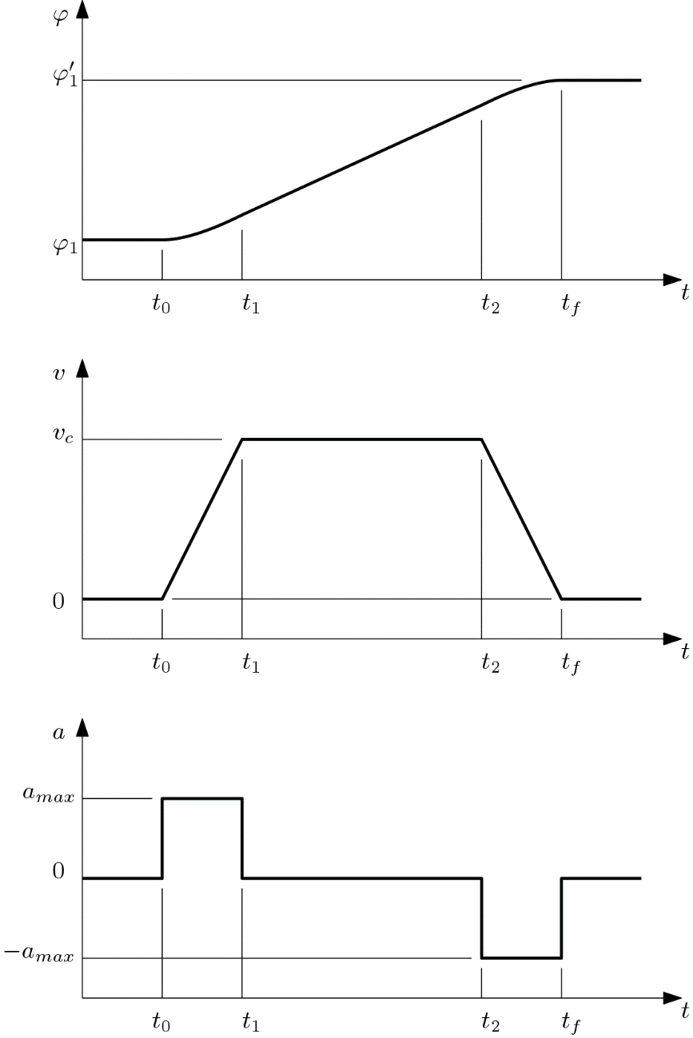
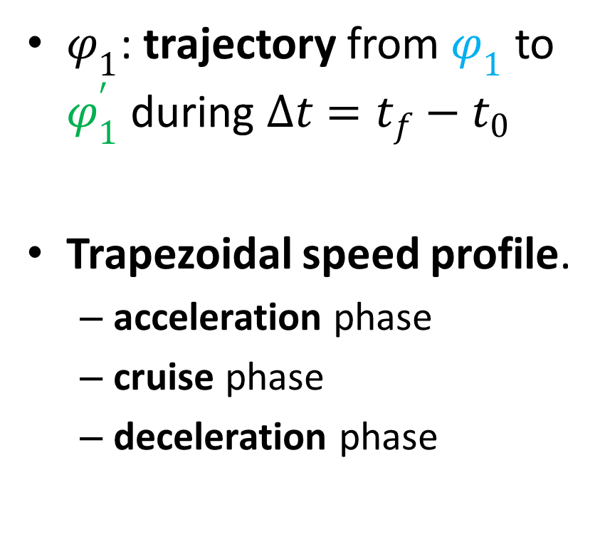
Speed profile
$φ_{1}$: trajectory from $φ_{1}$ to $φ_{1}^{′}$ during $Δt=t_{f}−t_{0}$
Trapezoidal speed profile.
  acceleration phase
  cruise phase
  deceleration phase

Slide 11
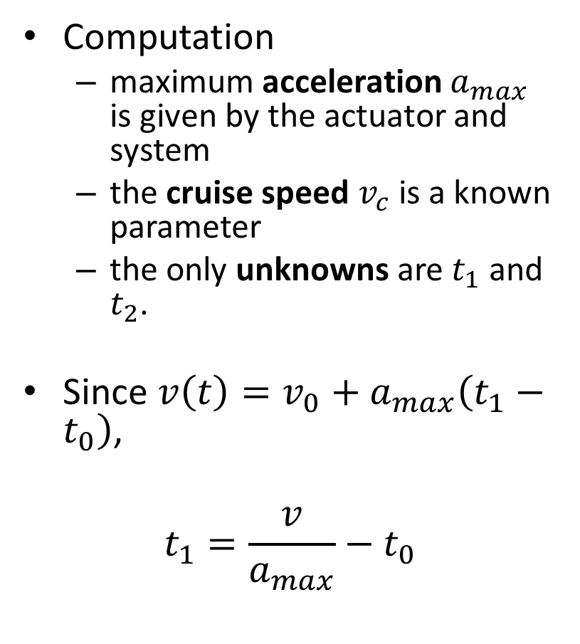
Speed profile
Computation
  maximum acceleration $a_{max}$ is given by the actuator and system
  the cruise speed $v_{c}$ is a known parameter
  the only unknowns are $t_{1}$ and $t_{2}$.
Since $v\left(t\right)=v_{0}+a_{max}\left(t_{1}−t_{0}\right)$,
$$t_{1}=\frac{v}{a_{max}}−t_{0}$$
Notes:
Show what happens when Delta t is small and the v_cruise can’t be reached!

Slide 12
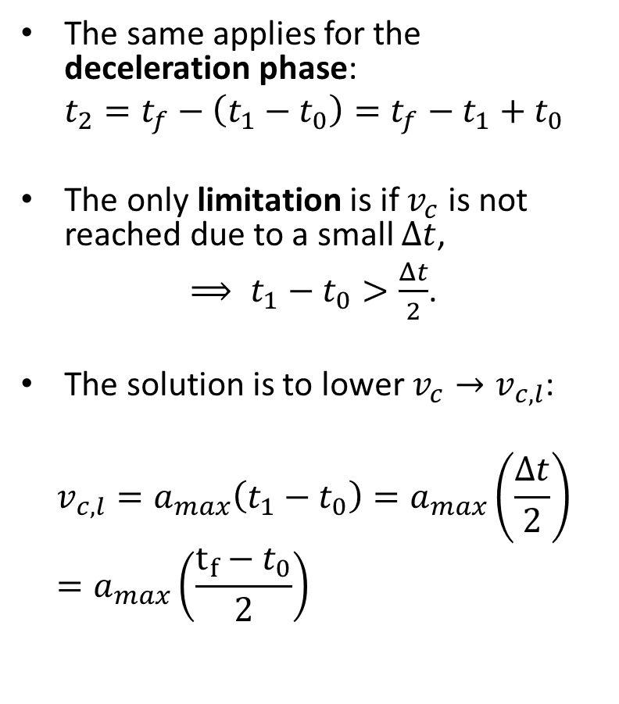
Speed profile
The same applies for the deceleration phase:
$$t_{2}=t_{f}−\left(t_{1}−t_{0}\right)=t_{f}−t_{1}+t_{0}$$
The only limitation is if $v_{c}$ is not reached due to a small $Δt$,
$⟹ t_{1}−t_{0}>\frac{Δt}{2}$.
The solution is to lower $v_{c}→v_{c,l}$:
$$v_{c,l}=a_{max}\left(t_{1}−t_{0}\right)=a_{max}\left(\frac{Δt}{2}\right)=a_{max}\left(\frac{t_{f}−t_{0}}{2}\right)$$
Notes:
Show what happens when Delta t is small and the v_cruise can’t be reached!

Slide 13
D.o.F. = f(application)
Robotics

Slide 14
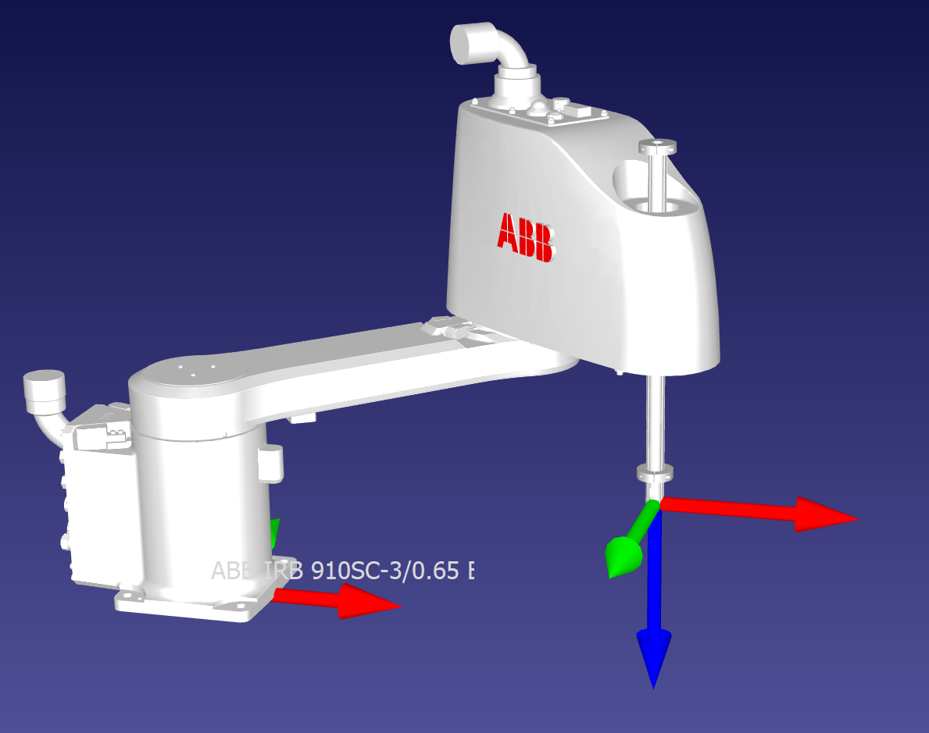
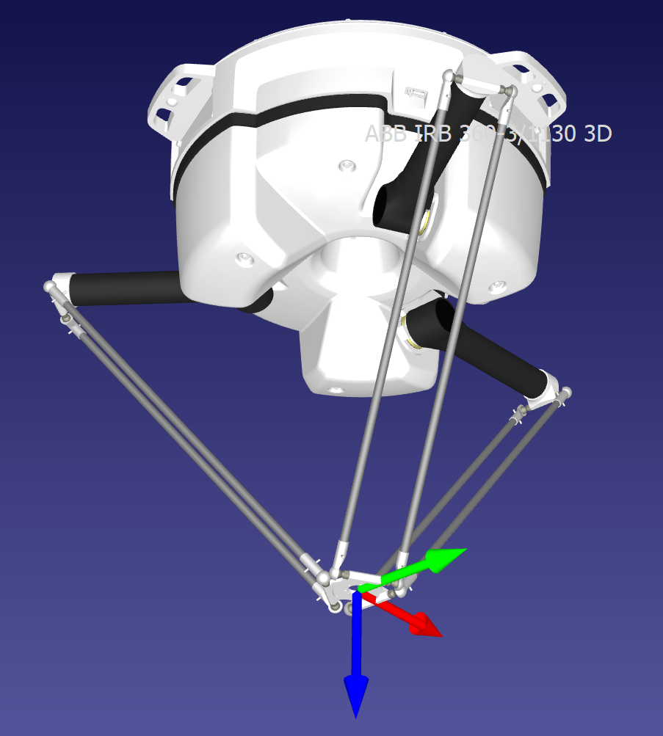
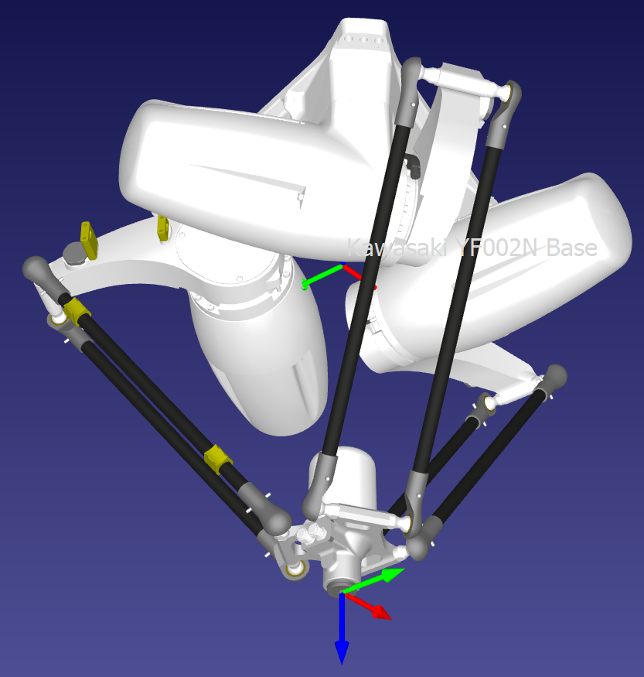
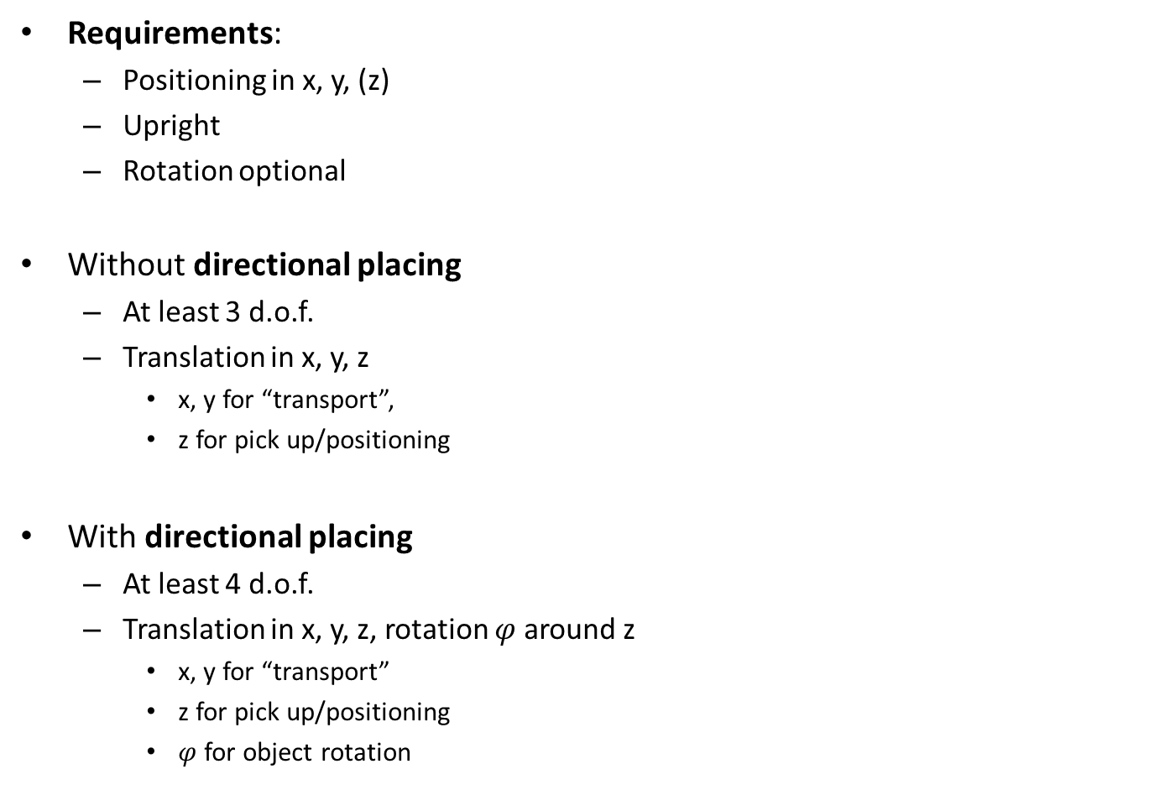
2D Pick and place
Requirements:
  Positioning in x, y, (z)
  Upright
  Rotation optional
Without directional placing
  At least 3 d.o.f.
  Translation in x, y, z
    x, y for “transport”,
    z for pick up/positioning
With directional placing
  At least 4 d.o.f.
  Translation in x, y, z, rotation $φ$ around z
    x, y for “transport”
    z for pick up/positioning
    $φ$ for object rotation

Slide 15
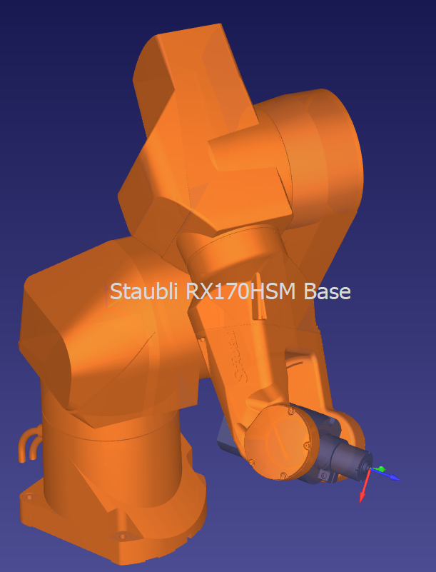
Welding
Requirements
  Motion in x, y, z
  Rotation around the tool is unnecessary
D.o.F.
  3 translations
  2 rotations
  Total 5

Slide 16
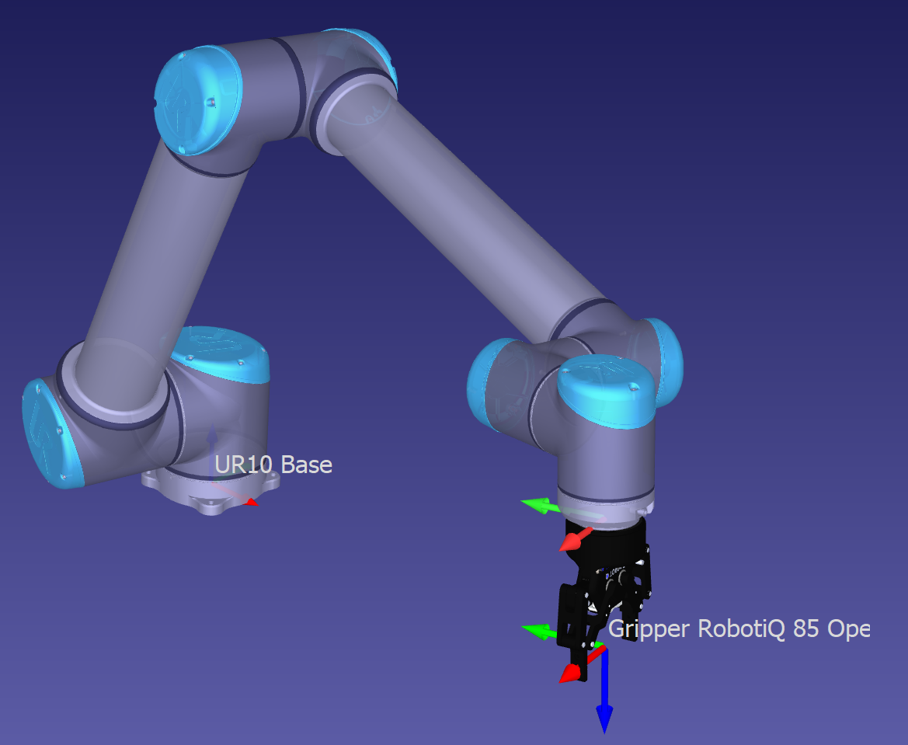
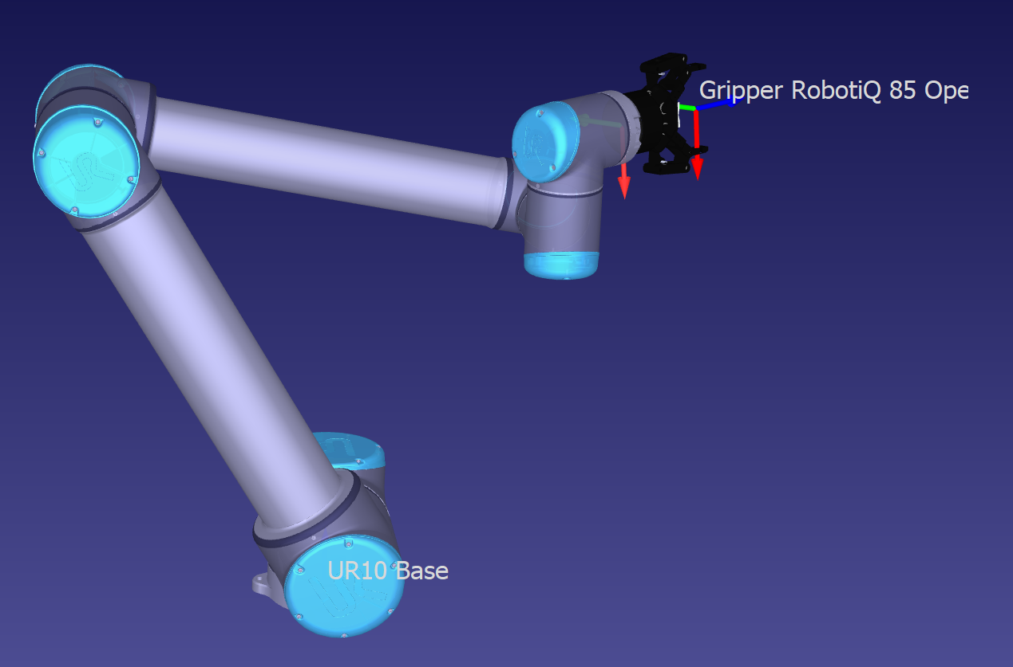
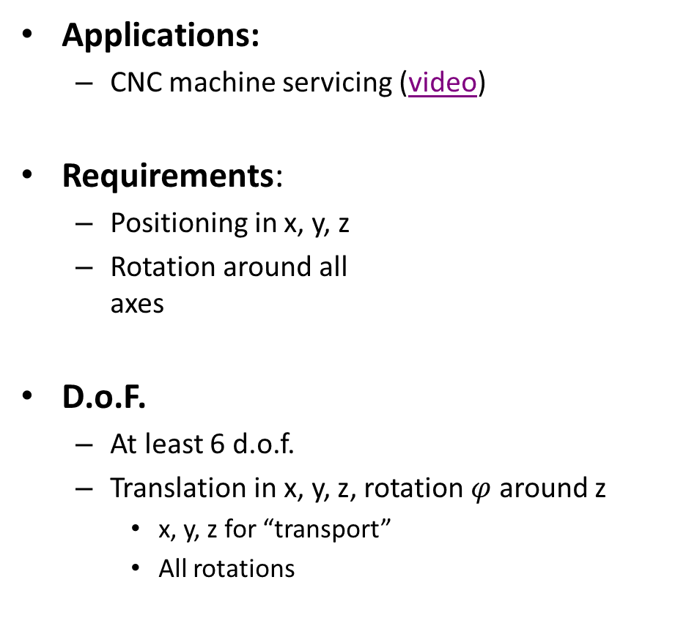
3D Pick and place
Applications:
  CNC machine servicing (video)
Requirements:
  Positioning in x, y, z
  Rotation around all
  axes
D.o.F.
  At least 6 d.o.f.
  Translation in x, y, z, rotation $φ$ around z
    x, y, z for “transport”
    All rotations

Slide 17
Control
Robotics

Slide 18
Control
In general there are 2 types of control systems:
  Open loop
    (also feedforward)
  Closed loop
    (also feedback)

Slide 19
Open-loop
The controller acts without any knowledge of the behavior of the system
Control signal
Controller
System
Behavior
Input

Slide 20
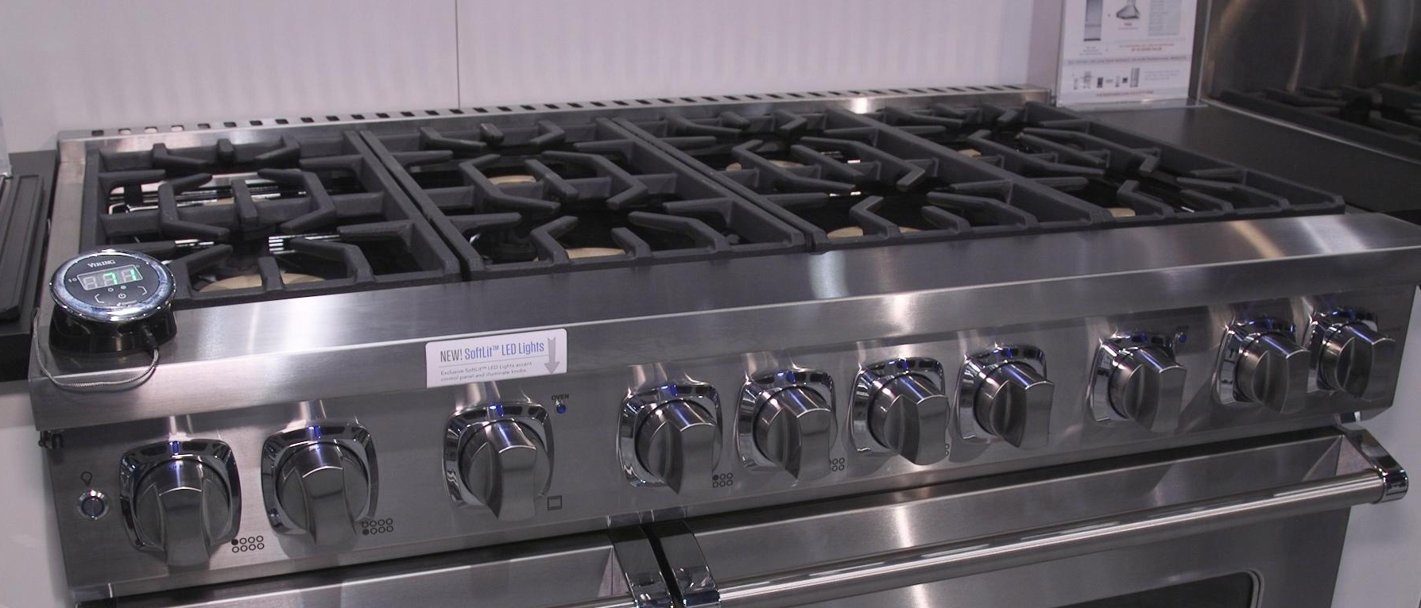
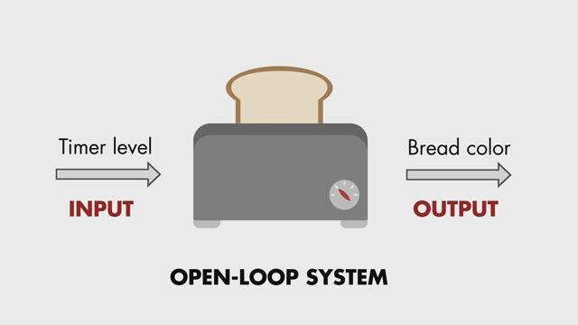

Open-loop
Examples:
  A toaster
  A cooking range
  Gas pedal of a car

Slide 21
Closed-loop
The controller acts taking into account the behavior of the system
Control signal
Controller
System
Behavior
Input
Sensor
Sensor signal

Slide 22
Closed-loop
Examples:
  A thermostat
    It senses the temperature and keeps it at the desired setpoint (decided by the user)
  The cruise-control of a car
    It keeps the speed of the car at the setpoint by measuring the current speed

Slide 23
Closed-loop
More on the cruise-control
  Some old types were simple locks on the accelerator pedal
  New ones take into consideration the real speed of the car
Question
  What kind of controllers were the old ones? And the new ones?
  What would happen on a slope in the two cases?

Slide 24
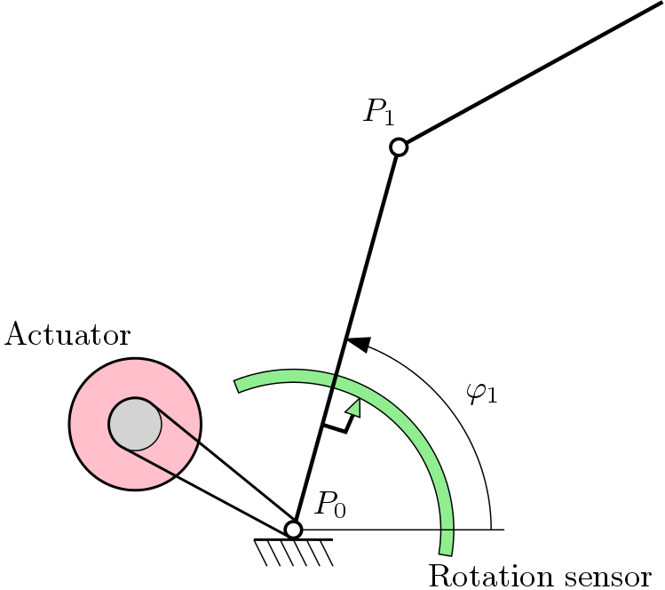
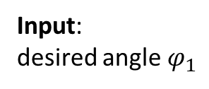
Control in robotics
Control is mainly applied at actuator level
Position control!
Actual angle
Controller
System
Input:
desired angle $φ_{1}$
Control signal: current/voltage to actuator
Measured angle
Sensor

Slide 25
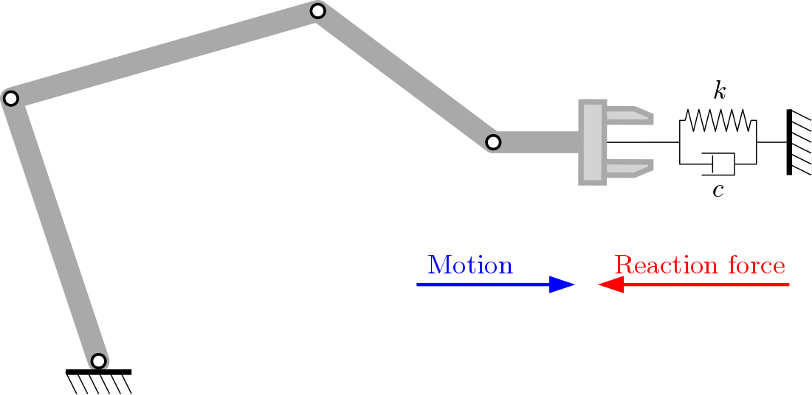
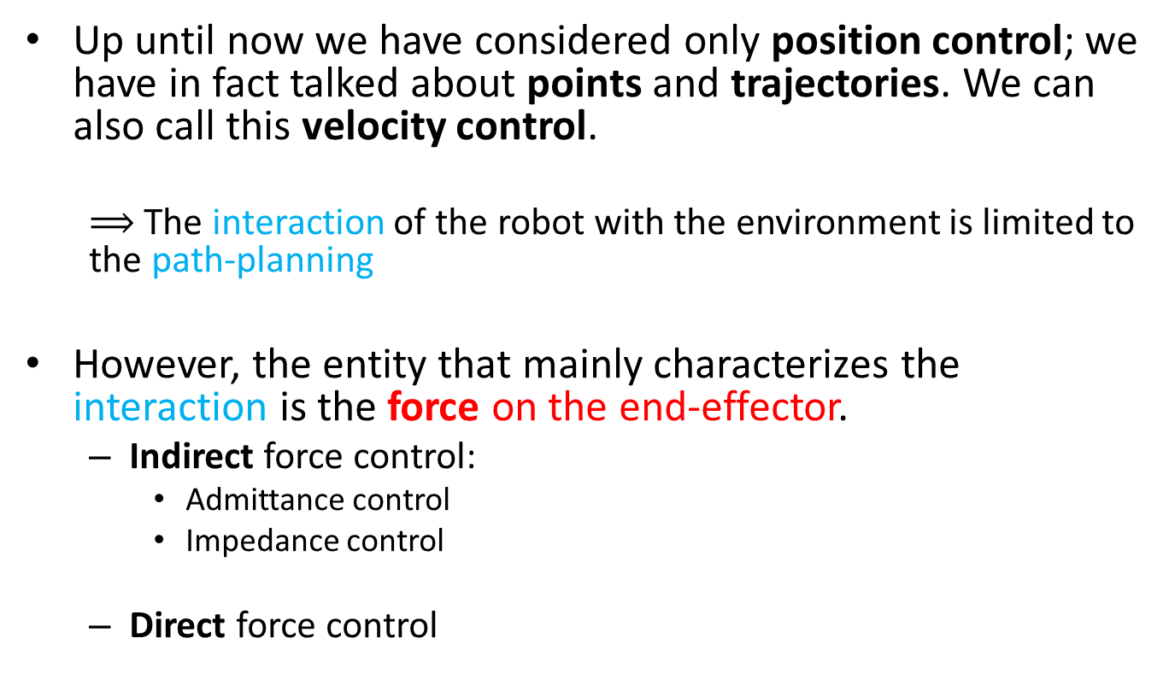
Control
Up until now we have considered only position control; we have in fact talked about points and trajectories. We can also call this velocity control.
  $⟹$ The interaction of the robot with the environment is limited to the path-planning
However, the entity that mainly characterizes the interaction is the force on the end-effector.
  Indirect force control:
    Admittance control
    Impedance control
  Direct force control

Slide 26
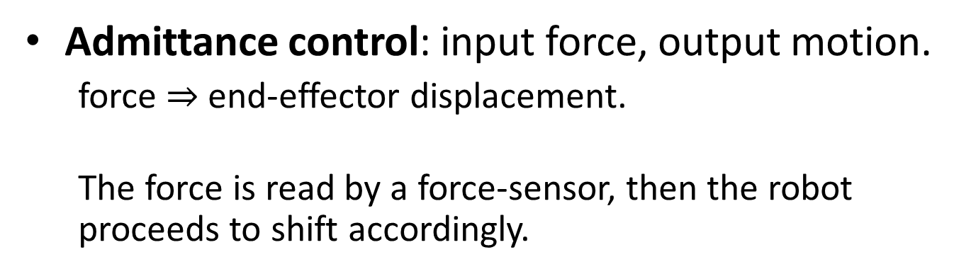
Admittance control
Admittance control: input force, output motion.
  force $⇒$ end-effector displacement.
  The force is read by a force-sensor, then the robot proceeds to shift accordingly.

Slide 27
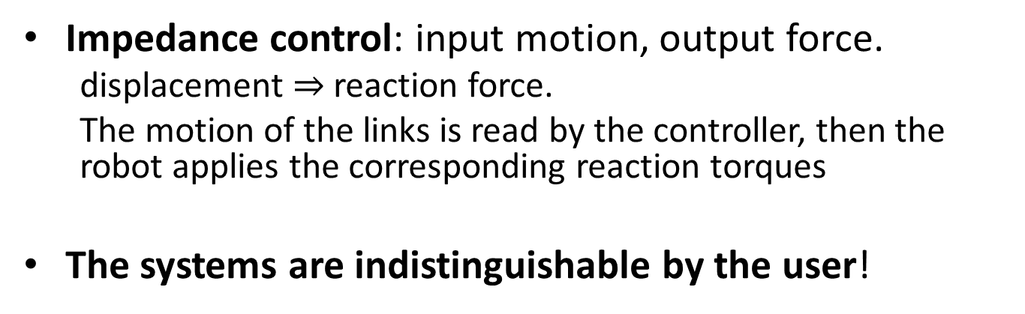
Impedance control
Impedance control: input motion, output force.
  displacement $⇒$ reaction force.
  The motion of the links is read by the controller, then the robot applies the corresponding reaction torques
The systems are indistinguishable by the user!
Video pin-insertion
Video SCARA

Slide 28
Direct force control
implements both a target position and a target force, in parallel
In general this requires precise knowledge of the task!

Slide 29
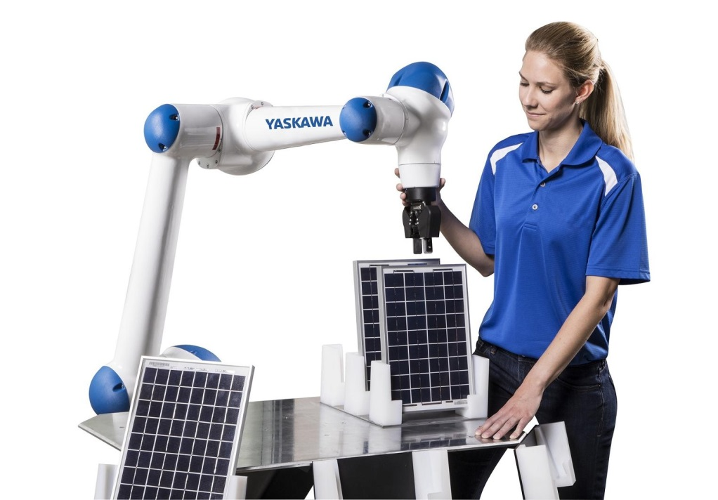
Path teaching
Direct manipulation of the end-effector or of the robot itself by the operator.
The operator can physically move the end-effector in the desired position and record them into the program.
  This achieves point-to-point motion easily.
  Useful for repetitive tasks that have non-variable waypoints
Also called “hand-guiding”
Video KUKA
Generally, the robot
controller operates via
impedance or admittance
control during the teaching.

