Slide 1
Robotics and Mechatronics
Part III
a.a. 2020-2021
Furniture technology

Slide 2
Kinematics
Robotics and Mechatronics

Slide 3
Kinematics
Kinematics
  Description of the motion of set of points or bodies without considering the masses involved and the consequent dynamical effects
Kinematics analysis
  The study of the position and configuration of a mechanism and its evolution in time,

Slide 4
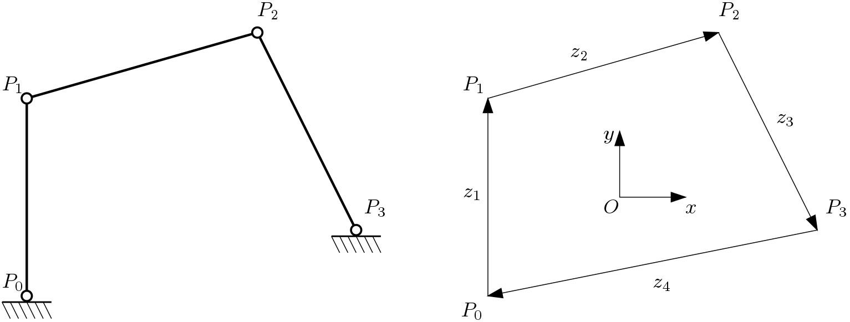
Representation
Notation is based on vector calculus
Each link is a vector between two joints
Frame link

Slide 5
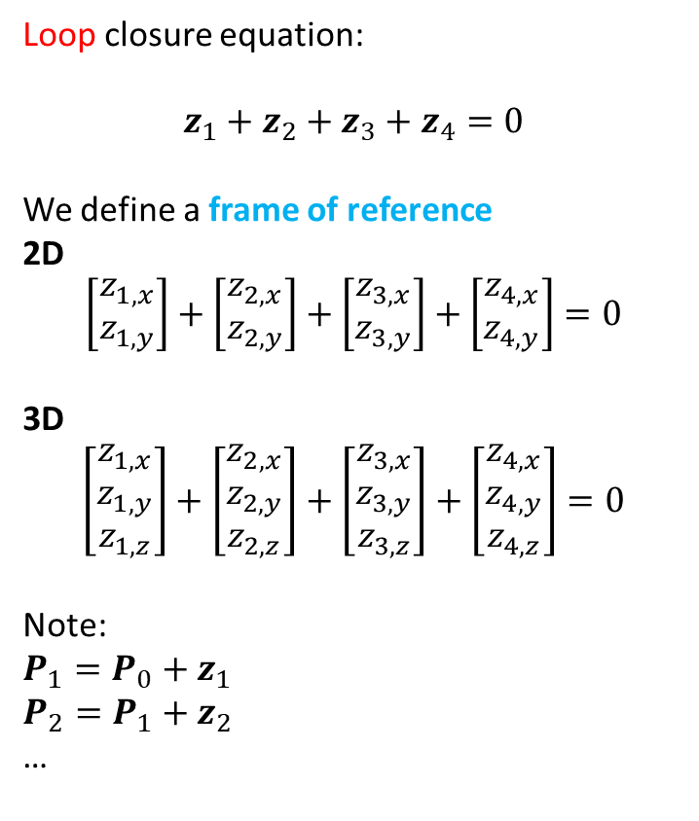
Representation
Loop closure equation:
$$z_{1}+z_{2}+z_{3}+z_{4}=0$$
We define a frame of reference
2D
$$\left[\begin{aligned}z_{1,x} \\ z_{1,y}\end{aligned}\right]+\left[\begin{aligned}z_{2,x} \\ z_{2,y}\end{aligned}\right]+\left[\begin{aligned}z_{3,x} \\ z_{3,y}\end{aligned}\right]+\left[\begin{aligned}z_{4,x} \\ z_{4,y}\end{aligned}\right]=0$$
3D
$$\left[\begin{aligned}z_{1,x} \\ z_{1,y} \\ z_{1,z}\end{aligned}\right]+\left[\begin{aligned}z_{2,x} \\ z_{2,y} \\ z_{2,z}\end{aligned}\right]+\left[\begin{aligned}z_{3,x} \\ z_{3,y} \\ z_{3,z}\end{aligned}\right]+\left[\begin{aligned}z_{4,x} \\ z_{4,y} \\ z_{4,z}\end{aligned}\right]=0$$
Note:
$$P_{1}=P_{0}+z_{1}$$
$$P_{2}=P_{1}+z_{2}$$
…
Loop
Frame of reference

Slide 6
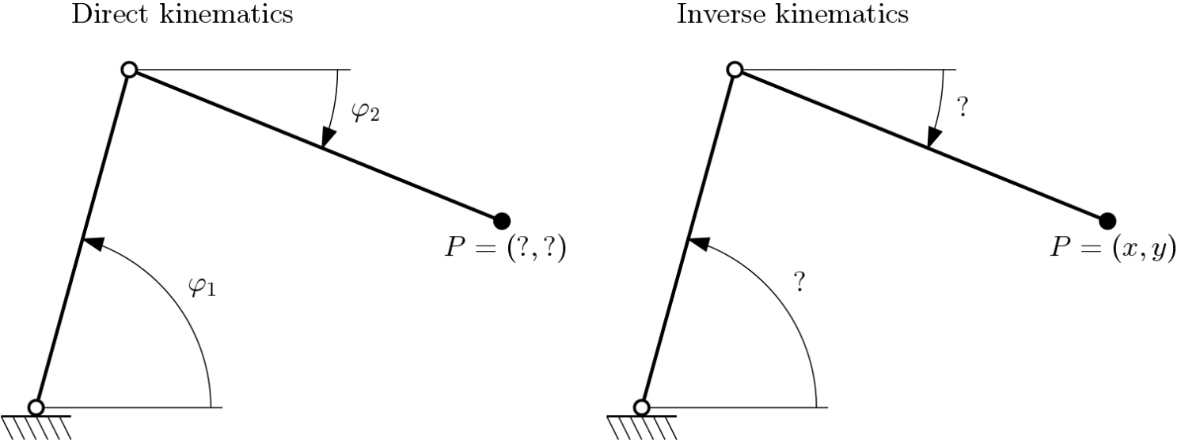
Kinematics analysis
Direct kinematics
The independent variables are known (for example the angle of the joints)
The aim is to calculate the geometrical configuration of the points of the mechanism.
Inverse kinematics
The geometrical configuration of the points is known
The aim is to calculate how the independent variables are configured.

Slide 7
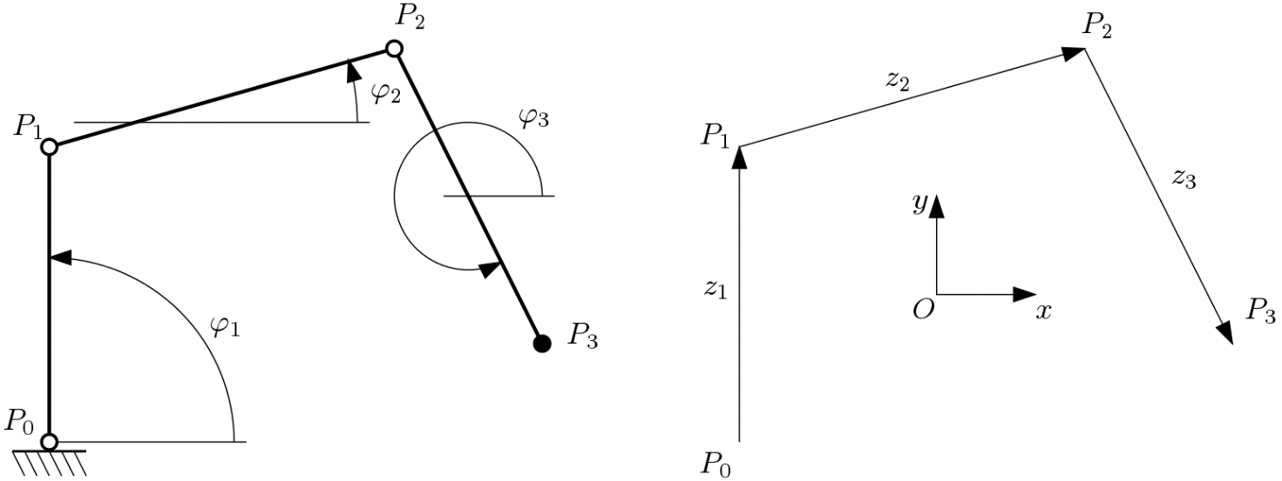
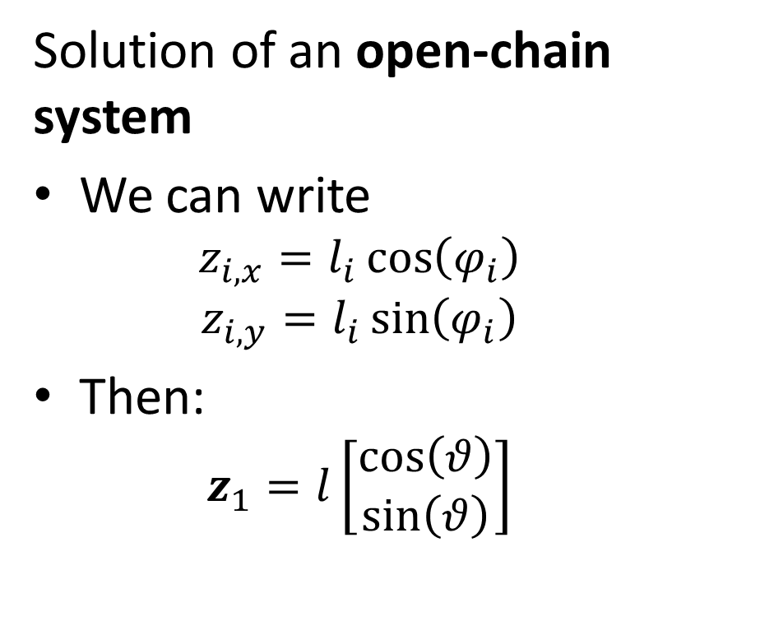
Kinematics analysis
Solution of an open-chain system
We can write
  $$z_{i,x}=l_{i}\cos\left(φ_{i}\right)$$
  $$z_{i,y}=l_{i}\sin\left(φ_{i}\right)$$
Then:
  $$z_{1}=l\left[\begin{aligned}\cos\left(θ\right) \\ \sin\left(θ\right)\end{aligned}\right]$$

Slide 8
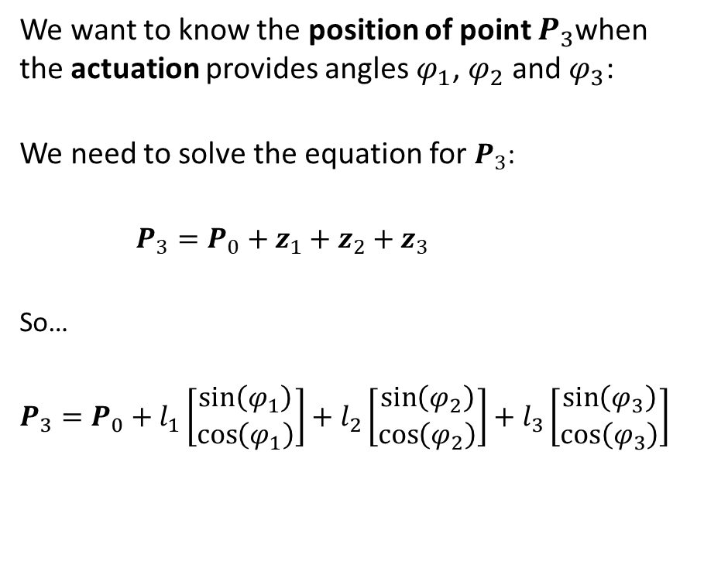
Direct kinematics: open-chain
We want to know the position of point $P_{3}$when the actuation provides angles $φ_{1}$, $φ_{2}$ and $φ_{3}$:
We need to solve the equation for $P_{3}$:
$P_{3}=P_{0}+z_{1}+z_{2}+z_{3}$
So…
$$P_{3}=P_{0}+l_{1}\left[\begin{aligned}\sin\left(φ_{1}\right) \\ \cos\left(φ_{1}\right)\end{aligned}\right]+l_{2}\left[\begin{aligned}\sin\left(φ_{2}\right) \\ \cos\left(φ_{2}\right)\end{aligned}\right]+l_{3}\left[\begin{aligned}\sin\left(φ_{3}\right) \\ \cos\left(φ_{3}\right)\end{aligned}\right]$$
How many DOFs?

Slide 9
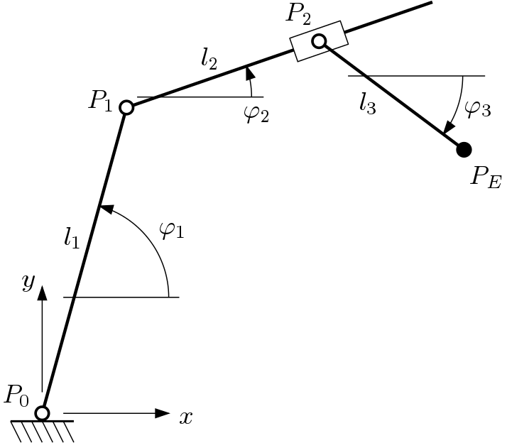

Exercise
Calculate $P_{E}$
  $$l_{1}=1$$
  $$l_{2}=0.3$$
  $$l_{3}=0.5$$
  $$φ_{1}=0.9π$$
  $$φ_{2}=0.3π$$
  $$φ_{3}=−0.4π$$

Slide 10

Exercise
Calculate $P_{E}$
  $$l_{1}=1$$
  $$l_{2}=0.3$$
  $$l_{3}=0.5$$
  $$φ_{1}=0.9π$$
  $$φ_{2}=0.3π$$
  $$φ_{3}=−0.4π$$
Solution:
  $$P_{E}=\left[\begin{aligned}−0.620 \\ 0.076\end{aligned}\right]$$

Slide 11
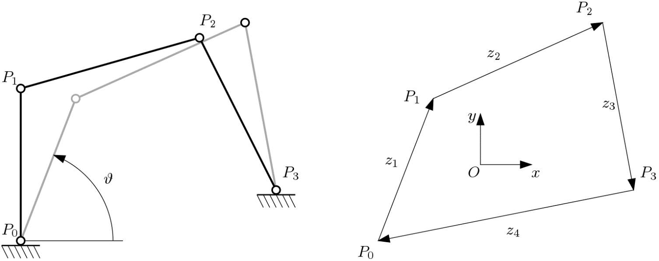
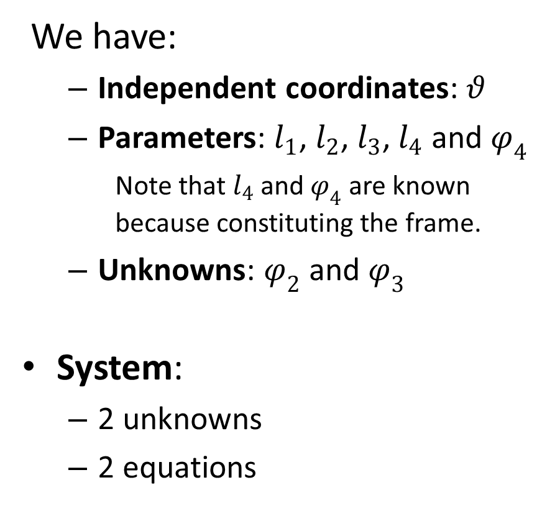
Direct kinematics: closed-chain
We have:
  Independent coordinates: $θ$
  Parameters: $l_{1}$, $l_{2}$, $l_{3}$, $l_{4}$ and $φ_{4}$
    Note that $l_{4}$ and $φ_{4}$ are known because constituting the frame.
  Unknowns: $φ_{2}$ and $φ_{3}$
System:
  2 unknowns
  2 equations
How many DOFs?
Unknowns!

Slide 12
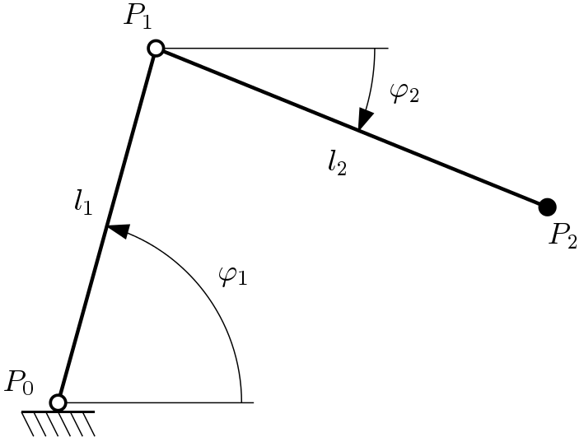
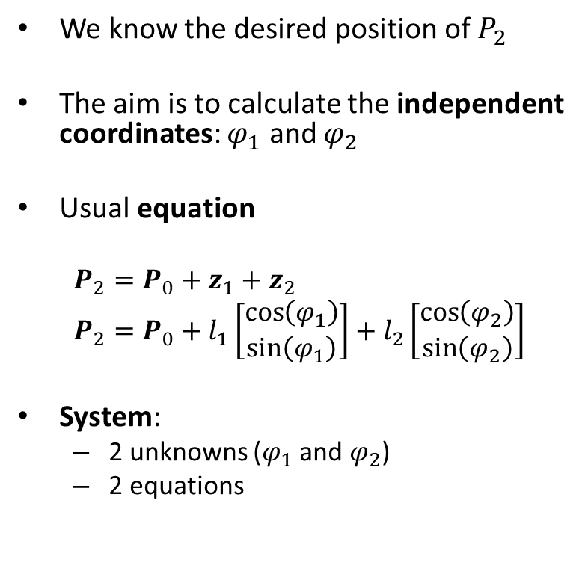
Inverse kinematics: open-chain
We know the desired position of $P_{2}$
The aim is to calculate the independent coordinates: $φ_{1}$ and $φ_{2}$
Usual equation
  $$P_{2}=P_{0}+z_{1}+z_{2}$$
  $$P_{2}=P_{0}+l_{1}\left[\begin{aligned}\cos\left(φ_{1}\right) \\ \sin\left(φ_{1}\right)\end{aligned}\right]+l_{2}\left[\begin{aligned}\cos\left(φ_{2}\right) \\ \sin\left(φ_{2}\right)\end{aligned}\right]$$
System:
  2 unknowns ($φ_{1}$ and $φ_{2}$)
  2 equations

Slide 13
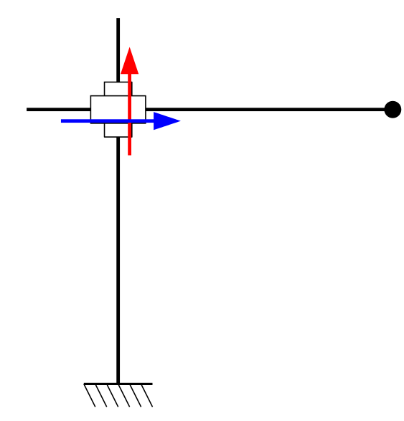







Exercise
Given $P_{e}$
Determine $l_{1}$ and $l_{2}$
$$P_{1}$$
$$l_{2}$$
$$P_{e}$$
$$l_{1}$$
$$P_{0}$$

Slide 14
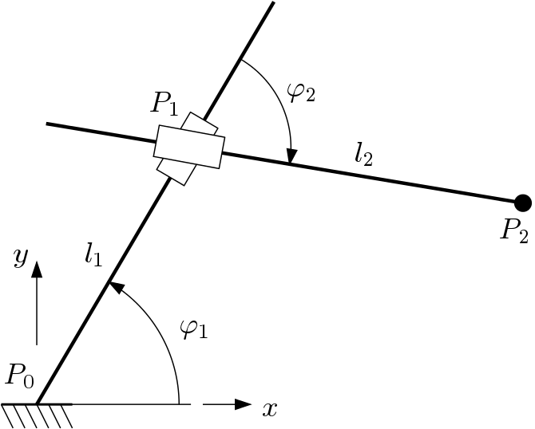
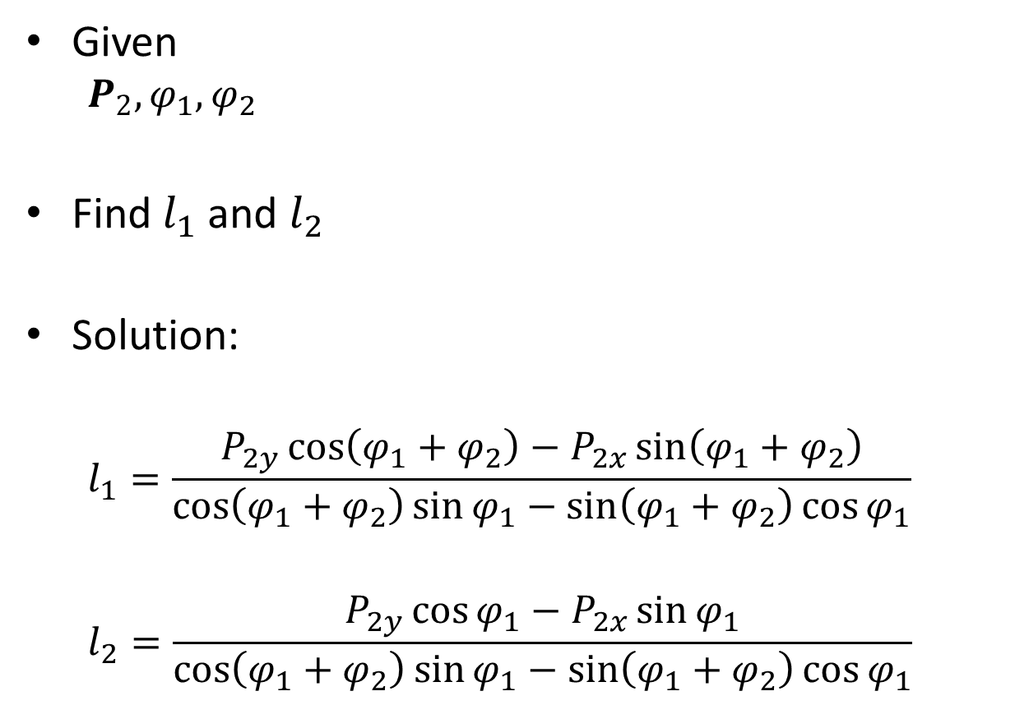
Example
Given
  $$P_{2}, φ_{1}, φ_{2}$$
Find $l_{1}$ and $l_{2}$
Solution:
  $$l_{1}=\frac{P_{2y}\cos\left(φ_{1}+φ_{2}\right)−P_{2x}\sin\left(φ_{1}+φ_{2}\right)}{\cos\left(φ_{1}+φ_{2}\right)\sin{φ_{1}}−\sin\left(φ_{1}+φ_{2}\right)\cos{φ_{1}}}$$
  $$l_{2}=\frac{P_{2y}\cos{φ_{1}−P_{2x}\sin{φ_{1}}}}{\cos\left(φ_{1}+φ_{2}\right)\sin{φ_{1}}−\sin\left(φ_{1}+φ_{2}\right)\cos{φ_{1}}}$$

Slide 15
Orientation (2D)
In 2D space a single angle is sufficient to determine the rotational configuration of a body.

Slide 16
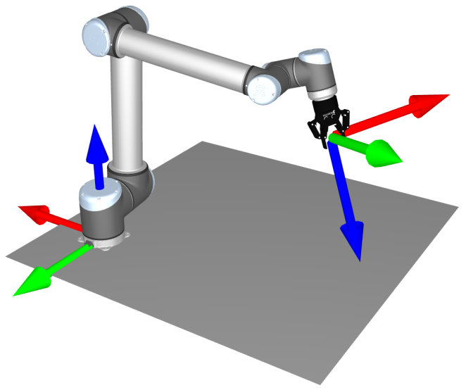
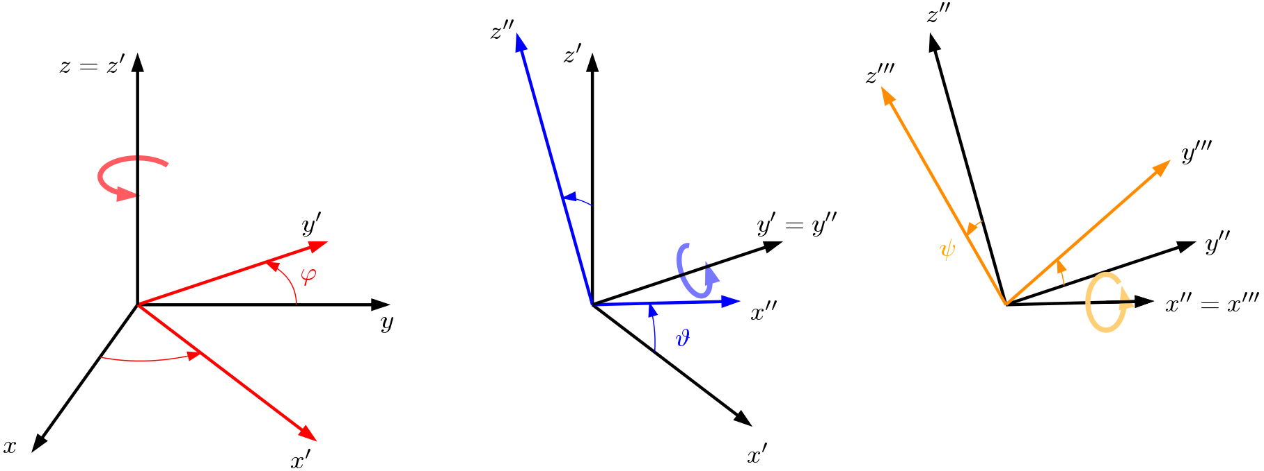
Orientation (3D)
In 3D space we need 3 angles.
  They are commonly called Euler Angles
  Precise succession
  Result is dependent on the choice of the succession.
This is an ZYX rotation. There can also be ZYX or even ZYZ. The ZYX rotation is also called Roll-Pitch-Yaw (RPY) rotation.
Euler angles

Slide 17
Workspace and joint-space
Robotics

Slide 18
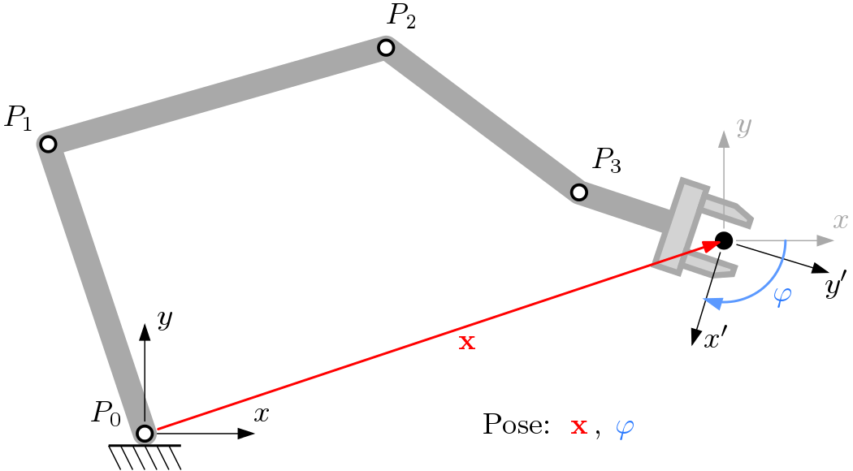
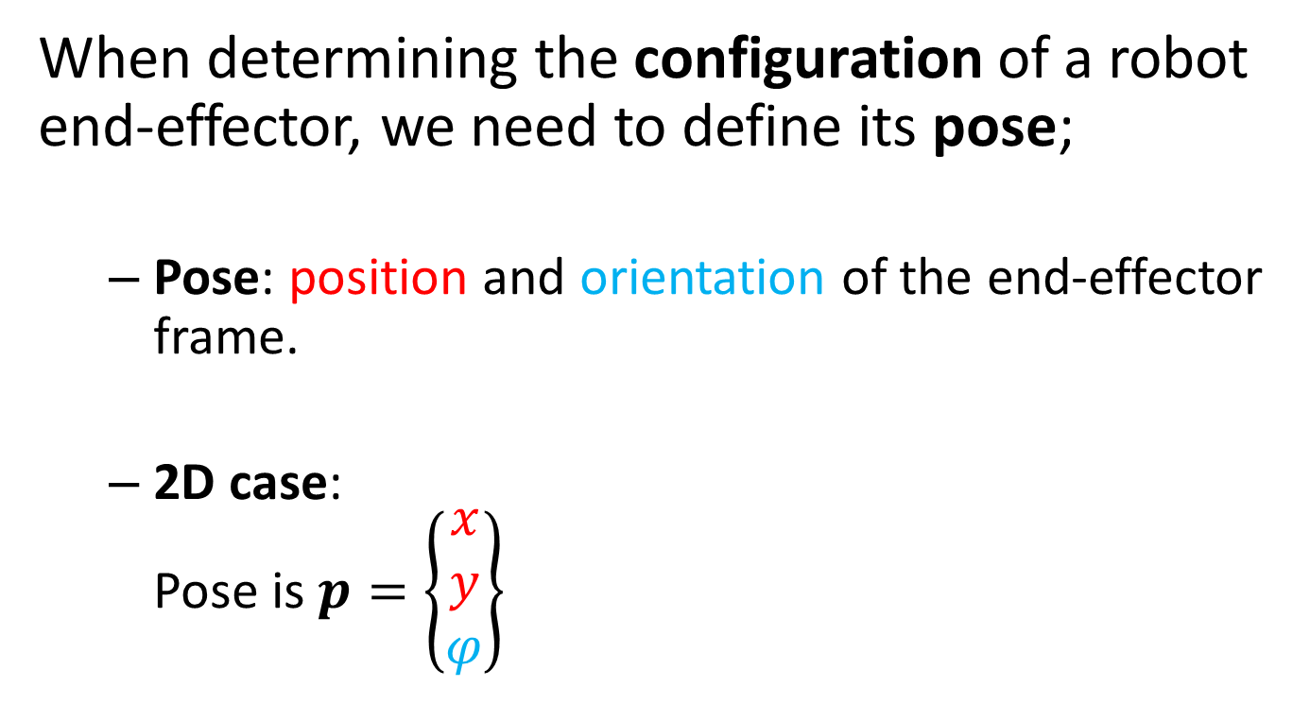
Pose
When determining the configuration of a robot end-effector, we need to define its pose;
  Pose: position and orientation of the end-effector frame.
  2D case:
  Pose is $p=\left\{\begin{aligned}x \\ y \\ φ\end{aligned}\right\}$

Slide 19
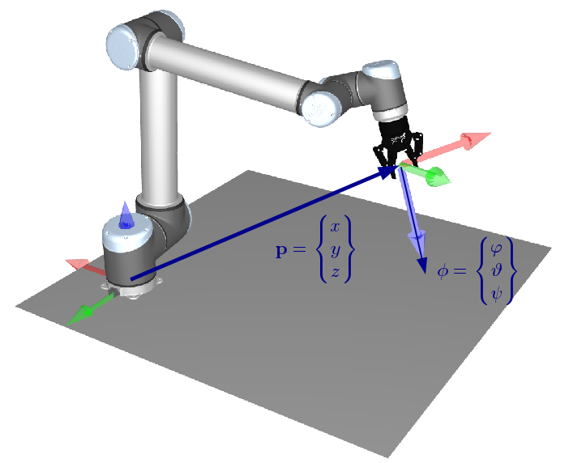

Pose (3D)
In the 3D case:
  Pose is $p=\left\{\begin{aligned}x \\ y \\ z \\ φ \\ θ \\ ψ\end{aligned}\right\}$

Slide 20

Workspace
Pose:
  2D: $p=\left\{\begin{aligned}x \\ y \\ φ\end{aligned}\right\}$
  3D: $p=\left\{\begin{aligned}x \\ y \\ z \\ φ \\ θ \\ ψ\end{aligned}\right\}$
The space where the position ${\left[x y\right]}^{T}$ part of $p$ is defined, is called workspace or operational space

Slide 21
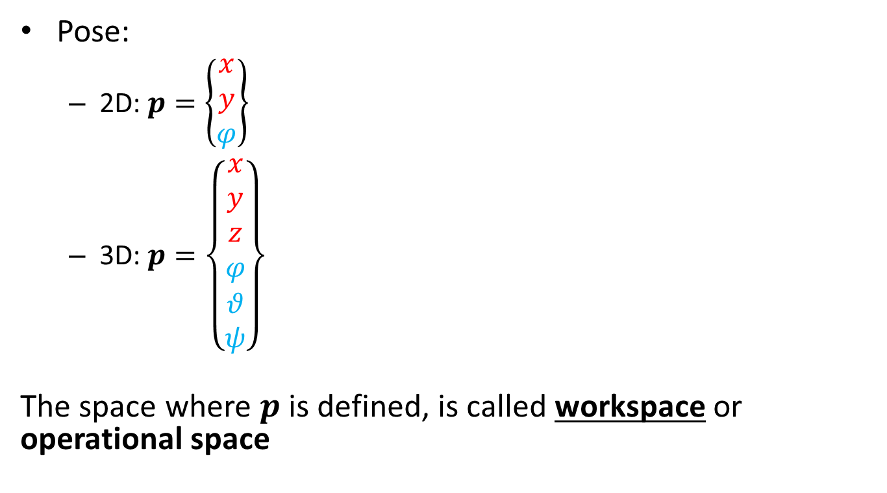
Workspace
Pose:
  2D: $p=\left\{\begin{aligned}x \\ y \\ φ\end{aligned}\right\}$
  3D: $p=\left\{\begin{aligned}x \\ y \\ z \\ φ \\ θ \\ ψ\end{aligned}\right\}$
The space where $p$ is defined, is called workspace or operational space

Slide 22
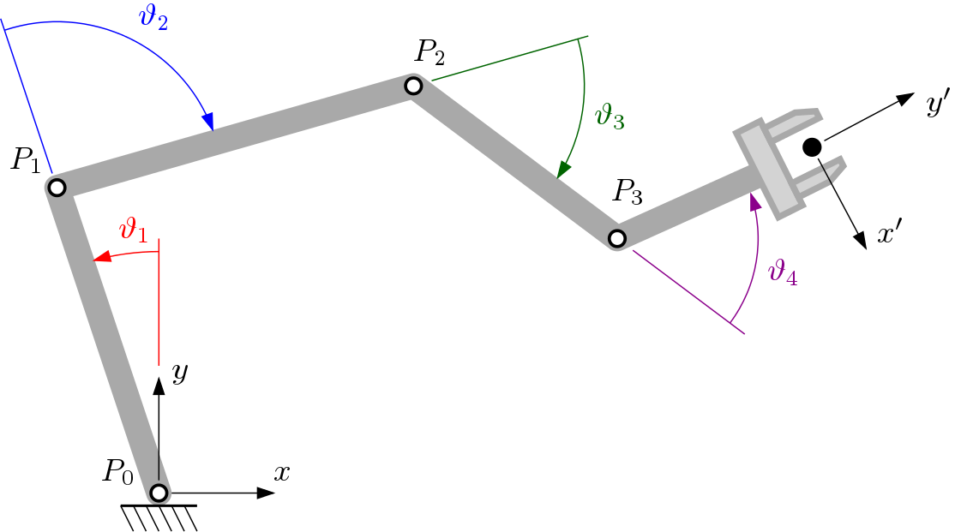
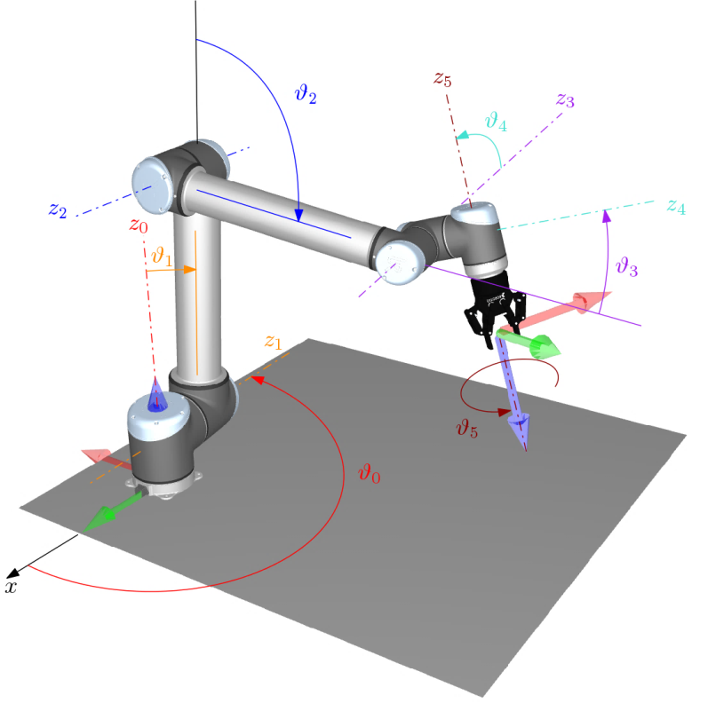
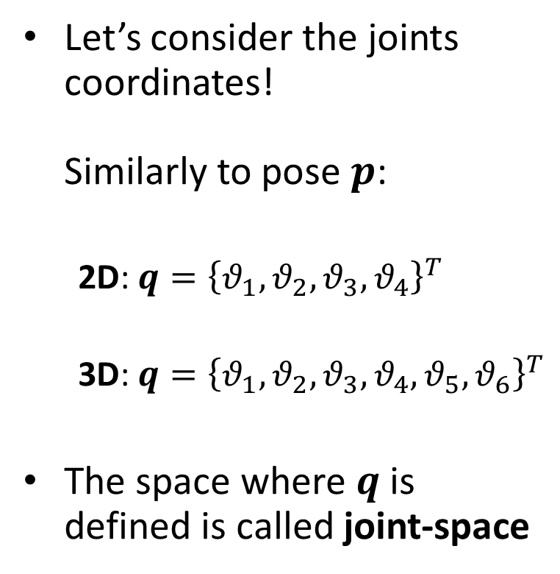
Joint-space
Let’s consider the joints coordinates!
Similarly to pose $p$:
  2D: $q={\left\{θ_{1},θ_{2},θ_{3},θ_{4}\right\}}^{T}$
  3D: $q={\left\{θ_{1},θ_{2},θ_{3},θ_{4},θ_{5},θ_{6}\right\}}^{T}$
The space where $q$ is defined is called joint-space

Slide 23
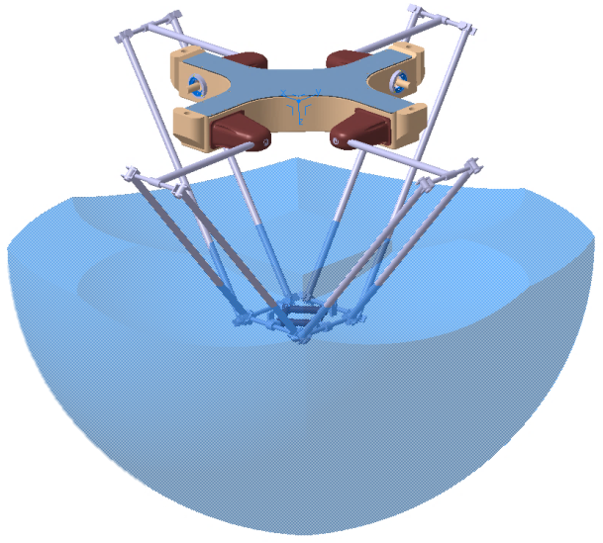
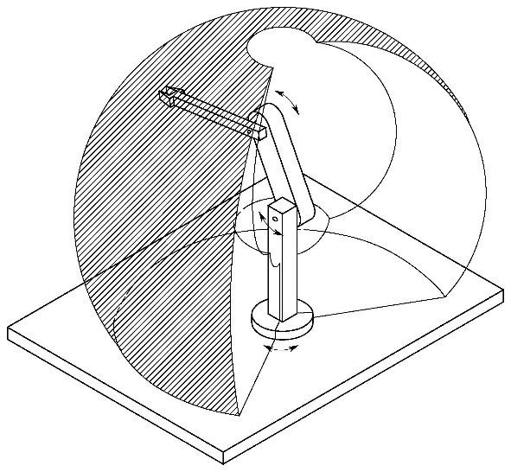
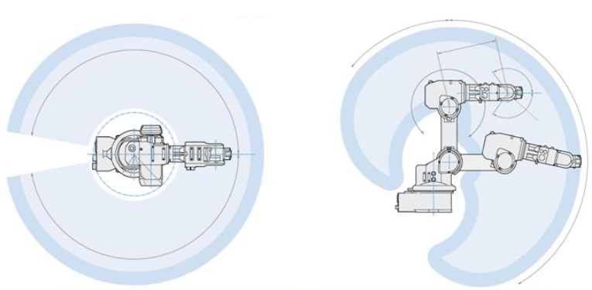
Work/joint-space topology
Both workspaces and joint-spaces are limited:
  Workspaces: by the reach or orientation of the end-effector
  Joint-spaces: by the mechanical limits of the joints and actuators
Workspaces

Slide 24
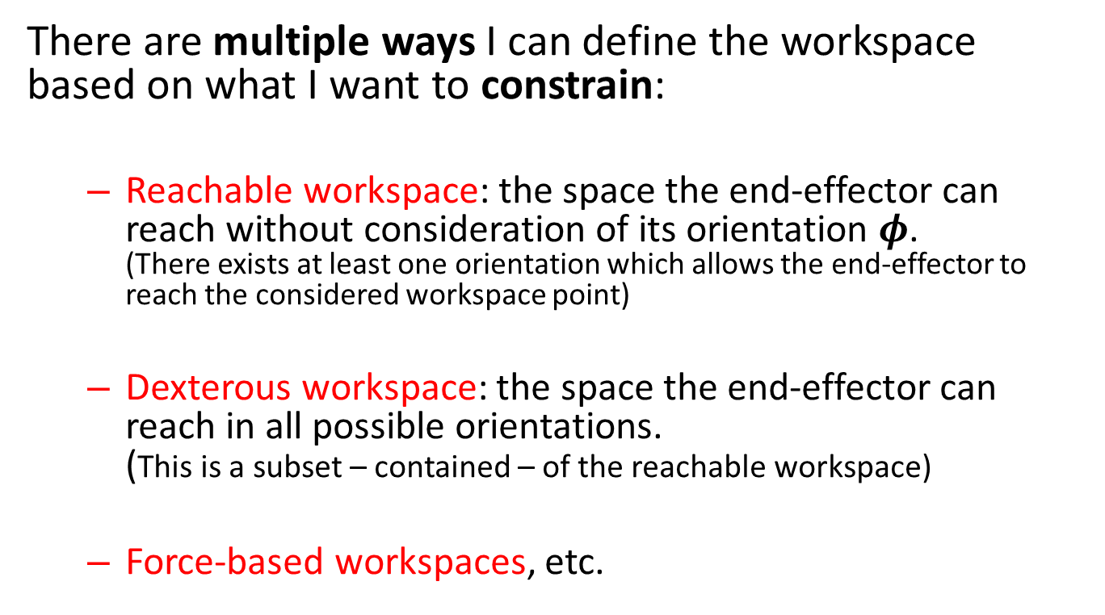
Workspace
There are multiple ways I can define the workspace based on what I want to constrain:
  Reachable workspace: the space the end-effector can reach without consideration of its orientation $φ$.
  (There exists at least one orientation which allows the end-effector to reach the considered workspace point)
  Dexterous workspace: the space the end-effector can reach in all possible orientations.
  (This is a subset – contained – of the reachable workspace)
  Force-based workspaces, etc.

Slide 25
Redundancy and singularity
Robotics

Slide 26
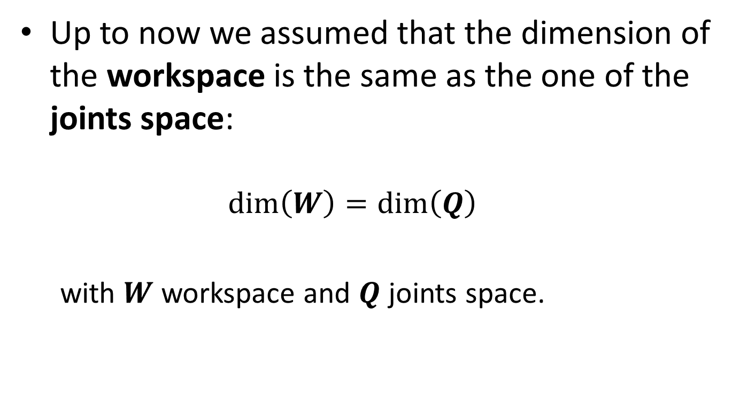
Introduction
Up to now we assumed that the dimension of the workspace is the same as the one of the joints space:
  $$\dim\left(W\right)=\dim\left(Q\right)$$
  with $W$ workspace and $Q$ joints space.

Slide 27
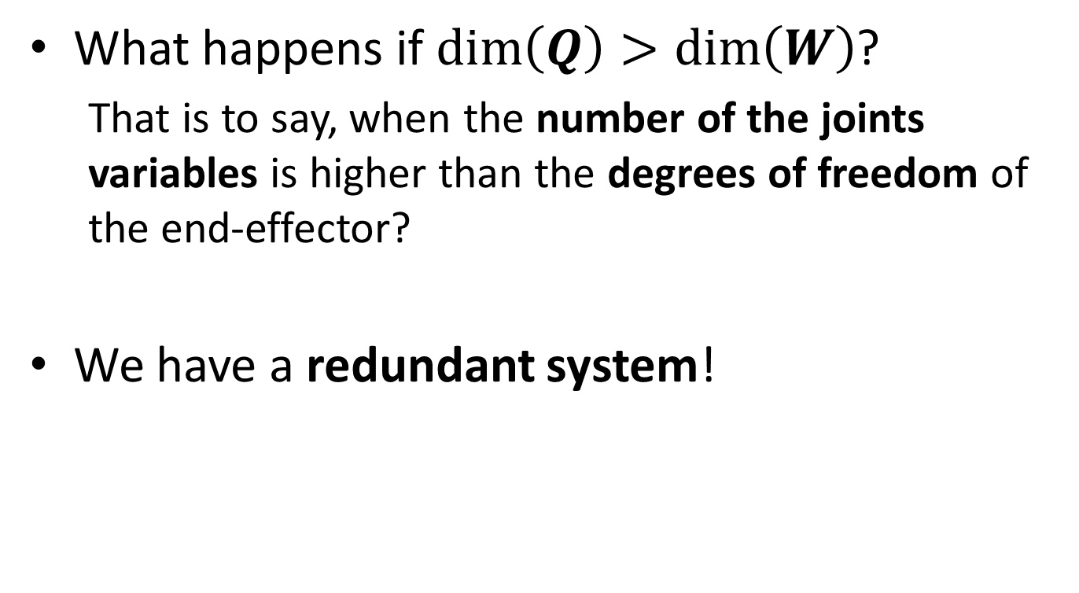
Redundancy
What happens if $\dim\left(Q\right)>\dim\left(W\right)$?
  That is to say, when the number of the joints variables is higher than the degrees of freedom of the end-effector?
We have a redundant system!

Slide 28
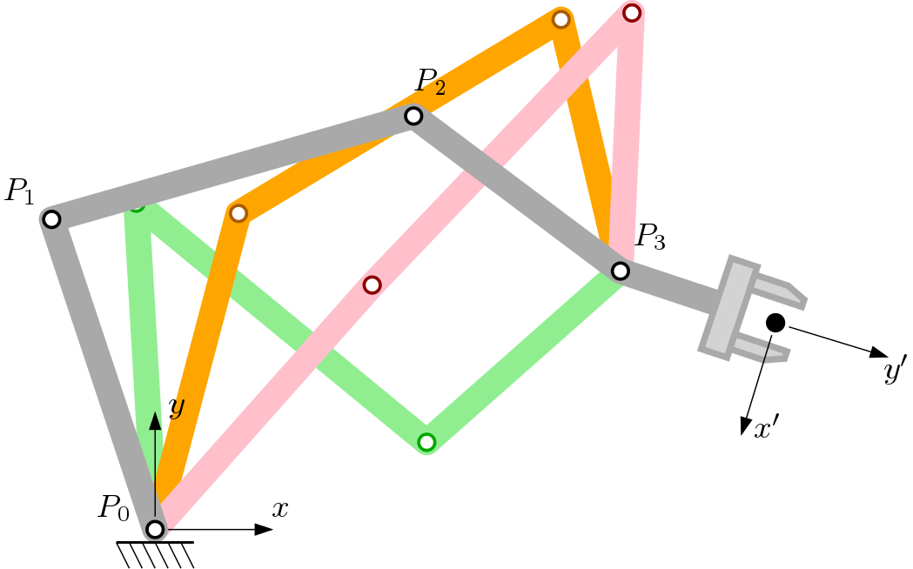
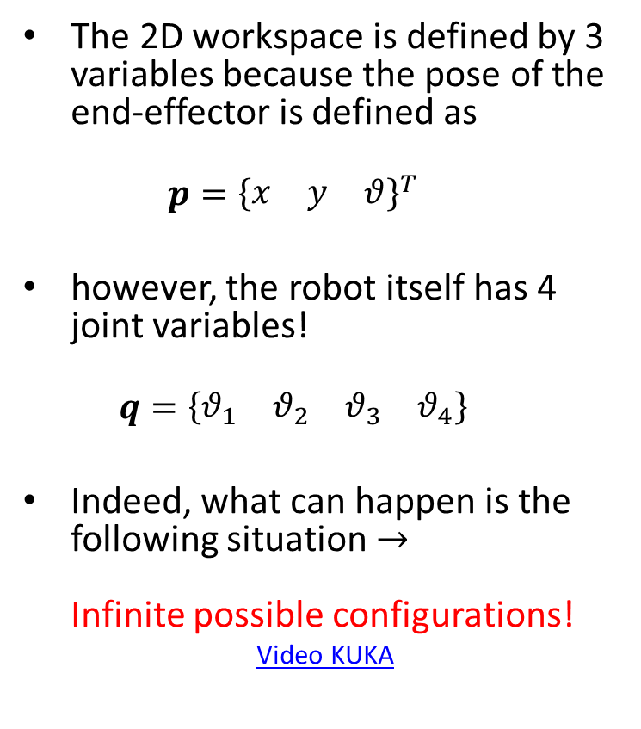
Redundancy
The 2D workspace is defined by 3 variables because the pose of the end-effector is defined as
  $$p={\left\{\begin{matrix}x & y & θ\end{matrix}\right\}}^{T}$$
however, the robot itself has 4 joint variables!
  $$q=\left\{\begin{matrix}θ_{1} & θ_{2} & θ_{3} & θ_{4}\end{matrix}\right\}$$
Indeed, what can happen is the following situation $→$
Infinite possible configurations!
Video KUKA

Slide 29
Redundancy
Considerations:
  a non-redundant manipulator has a finite number of possible configurations that can lead to a specific pose
  this means that if there are obstacles to avoid, it might be possible that large parts of the workspace are precluded
  A redundant system, on the other hand, is able to better adapt to occluded workspaces.

Slide 30
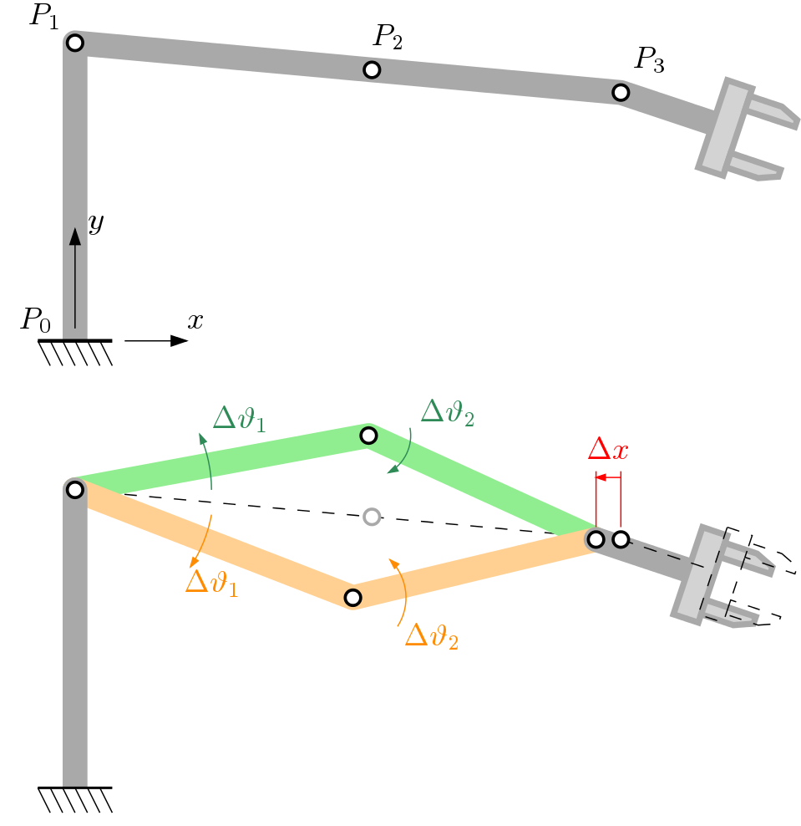
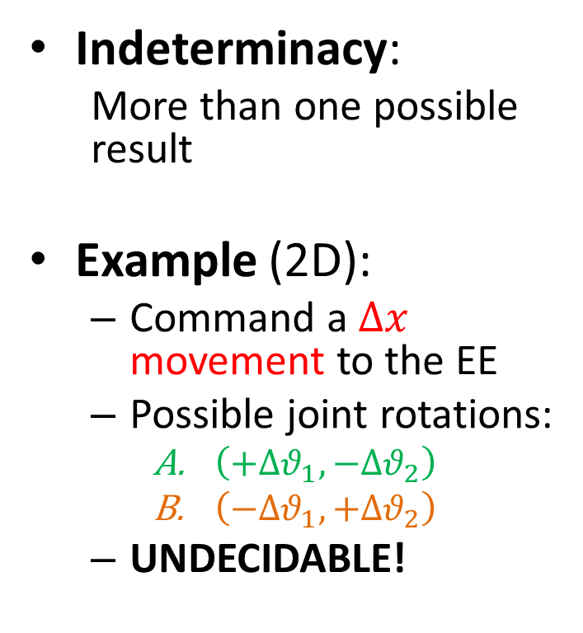
Singularity
Indeterminacy:
  More than one possible result
Example (2D):
  Command a $Δx$ movement to the EE
  Possible joint rotations:
    $\left(+Δθ_{1},−Δθ_{2}\right)$
    $\left(−Δθ_{1},+Δθ_{2}\right)$
  UNDECIDABLE!
Notes:
Show the NORMAL (non-singular) problem as an example on the whiteboard.

Slide 31
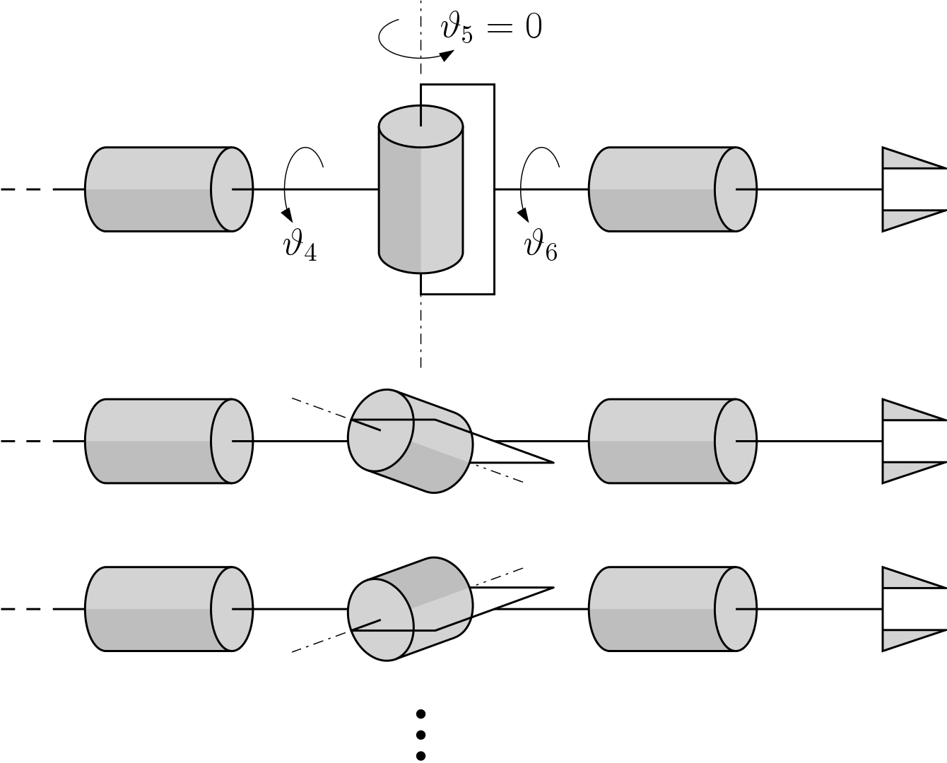
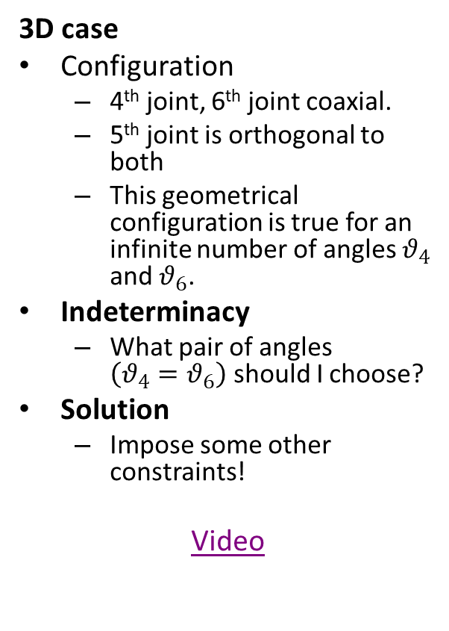
Singularity
3D case
Configuration
  4th joint, 6th joint coaxial.
  5th joint is orthogonal to both
  This geometrical configuration is true for an infinite number of angles $θ_{4}$ and $θ_{6}$.
Indeterminacy
  What pair of angles $\left(θ_{4}=θ_{6}\right)$ should I choose?
Solution
  Impose some other constraints!
Video

Slide 32
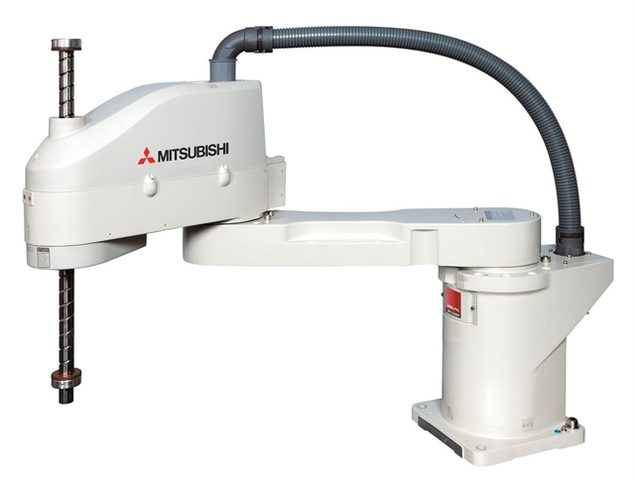
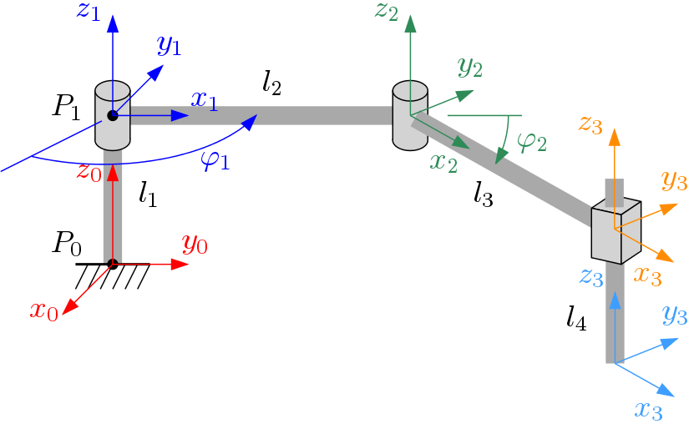
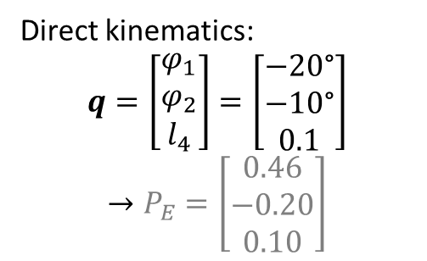
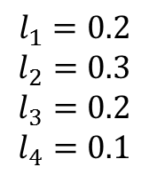
Exercise: SCARA direct kinematics
$$l_{1}=0.2$$
$$l_{2}=0.3$$
$$l_{3}=0.2$$
$$l_{4}=0.1$$
Direct kinematics:
$$q=\left[\begin{aligned}φ_{1} \\ φ_{2} \\ l_{4}\end{aligned}\right]=\left[\begin{aligned}−20\text{°} \\ −10\text{°} \\ 0.1\end{aligned}\right]$$
$$→P_{E}=\left[\begin{aligned}0.46 \\ −0.20 \\ 0.10\end{aligned}\right]$$

Slide 33
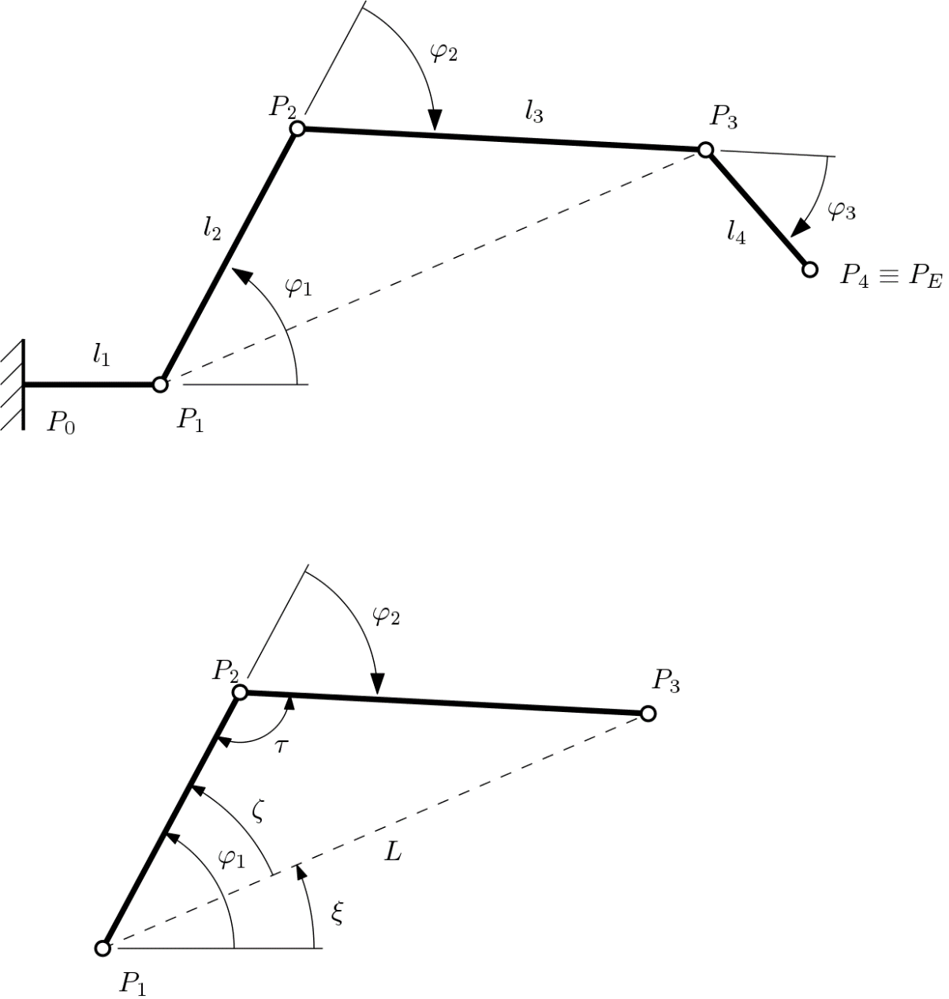
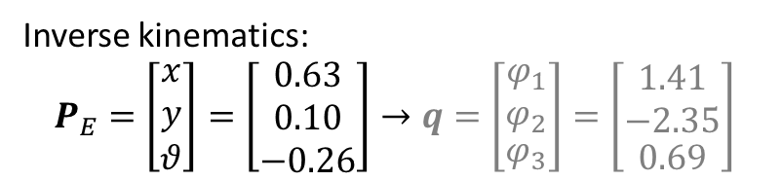
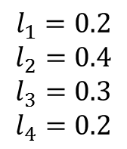
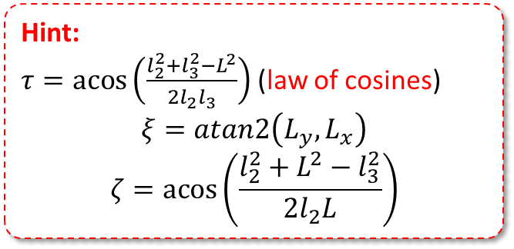
Exercise: inverse kinematics
y
$$l_{1}=0.2$$
$$l_{2}=0.4$$
$$l_{3}=0.3$$
$$l_{4}=0.2$$
Hint:
$τ=\operatorname{acos}\left(\frac{l_{2}^{2}+l_{3}^{2}−L^{2}}{2l_{2}l_{3}}\right)$ (law of cosines)
$$ξ=atan2\left(L_{y},L_{x}\right)$$
$$ζ=\operatorname{acos}\left(\frac{l_{2}^{2}+L^{2}−l_{3}^{2}}{2l_{2}L}\right)$$
x
Inverse kinematics:
$$P_{E}=\left[\begin{aligned}x \\ y \\ θ\end{aligned}\right]=\left[\begin{aligned}0.63 \\ 0.10 \\ −0.26\end{aligned}\right]→q=\left[\begin{aligned}\begin{aligned}φ_{1} \\ φ_{2}\end{aligned} \\ φ_{3}\end{aligned}\right]=\left[\begin{aligned}\begin{aligned}1.41 \\ −2.35\end{aligned} \\ 0.69\end{aligned}\right]$$

Slide 34
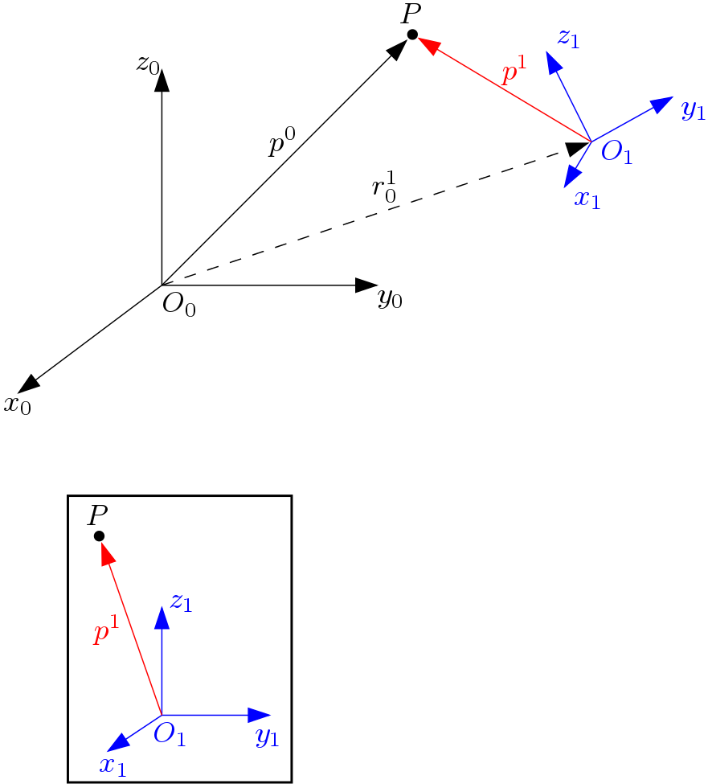
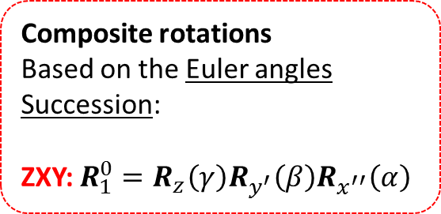


Transformations
Transformations $0→1$:
  Translation $r_{1}^{0}$
  Rotation $R_{1}^{0}$
$$p^{0}=r_{1}^{0}+R_{1}^{0}p^{1}$$
0
1
$$R_{x}\left(α\right)=\left[\begin{matrix}1 & 0 & 0 \\ 0 & \cos{α} & −\sin{α} \\ 0 & \sin{α} & \cos{α}\end{matrix}\right]$$
$$R_{y}\left(β\right)=\left[\begin{matrix}\cos{β} & 0 & \sin{β} \\ 0 & 1 & 0 \\ −\sin{β} & 0 & \cos{β}\end{matrix}\right]$$
$$R_{z}\left(γ\right)=\left[\begin{matrix}\cos{γ} & −\sin{γ} & 0 \\ \sin{γ} & \cos{γ} & 0 \\ 0 & 0 & 1\end{matrix}\right]$$
Composite rotations
Based on the Euler angles
Succession:
ZXY: $R_{1}^{0}=R_{z}\left(γ\right)R_{y^{′}}\left(β\right)R_{x^{′′}}\left(α\right)$

Slide 35

Homogeneous transformations
Joining the translation and rotation together
Homogeneous vector:
$$\tilde{p}=\left[\begin{matrix}\left[p\right] \\ 1\end{matrix}\right]$$
Homogeneous matrix transformation:
$$A_{1}^{0}=\left[\begin{matrix}R_{1}^{0} & r_{1}^{0} \\ 0^{T} & 1\end{matrix}\right]$$
Application:
$${\tilde{p}}^{0}=A_{1}^{0}{\tilde{p}}^{1}$$
$${\tilde{p}}^{1}={\left(A_{1}^{0}\right)}^{−1}{\tilde{p}}^{0}$$

Slide 36


Example
$${\tilde{p}}^{1}={\left[0 1 1 1\right]}^{T}$$
$$r_{1}^{0}={\left[0 0 3\right]}^{T}$$
$$R_{1}^{0}=R_{z}\left(0\right)R_{y^{′}}\left(0\right)R_{x^{′′}}\left(−π/4\right)$$
$$=\left[\begin{matrix}1 & 0 & 0 \\ 0 & 0.7 & 0.7 \\ 0 & −0.7 & 0.7\end{matrix}\right]$$
$$A_{1}^{0}=\left[\begin{matrix}R_{1}^{0} & r_{1}^{0} \\ 0^{T} & 1\end{matrix}\right]=\left[\begin{matrix}\left[\begin{matrix}1 & 0 & 0 \\ 0 & 0.7 & 0.7 \\ 0 & −0.7 & 0.7\end{matrix}\right] & \left[\begin{matrix}0 \\ 0 \\ 3\end{matrix}\right] \\ \left[\begin{matrix}0 & 0 & 0\end{matrix}\right] & 1\end{matrix}\right]=\left[\begin{matrix}1 & 0 & 0 & 0 \\ 0 & 0.7 & 0.7 & 0 \\ 0 & −0.7 & 0.7 & 3 \\ 0 & 0 & 0 & 1\end{matrix}\right]$$
$${\tilde{p}}^{0}=A_{1}^{0}{\tilde{p}}^{1}=\left[\begin{matrix}1 & 0 & 0 & 0 \\ 0 & 0.7 & 0.7 & 0 \\ 0 & −0.7 & 0.7 & 3 \\ 0 & 0 & 0 & 1\end{matrix}\right]\left[\begin{matrix}0 \\ 1 \\ 1 \\ 1\end{matrix}\right]=\left[\begin{aligned}0 \\ 1.4 \\ 3 \\ 1\end{aligned}\right]$$

Slide 37




Composition
Homogeneous vector
$${\tilde{p}}^{i}=\left[\begin{aligned}p_{x}^{i} \\ p_{y}^{i} \\ p_{z}^{i} \\ 1\end{aligned}\right]$$
2
3
1
2
$$p^{0}=A_{1}^{0}p^{1}$$
$$p^{1}=A_{2}^{1}p^{2}$$
$$p^{2}=A_{3}^{2}p^{3}$$
$$p^{0}=A_{1}^{0}p^{1}=A_{1}^{0}A_{2}^{1}p^{2}$$
$$\left[…\right]$$
$$p^{0}=A_{1}^{0}A_{2}^{1}A_{3}^{2}p^{3}=A_{3}^{0}p^{3}$$
0
1

