Slide 1
Robotics
Part II
a.a. 2020-2021

Slide 2
Mechanisms and degrees of freedom
Robotics

Slide 3
Mechanisms
Mechanism
  Device that transforms input forces and movement into a desired set of output forces and movement
Input
Output
Forces
Mechanism
Forces
Motion
Motion

Slide 4
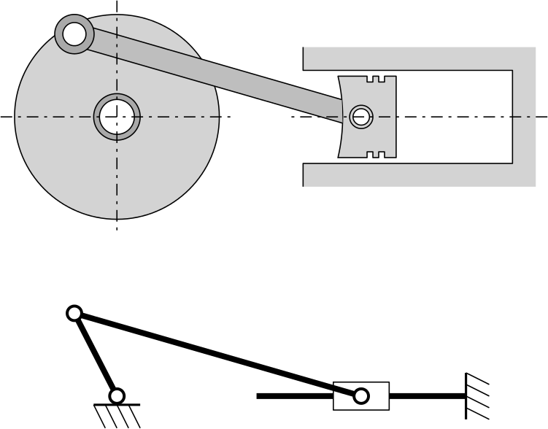
Mechanisms
Input
Example:
Torque
Rotation
Mechanism
Output
Force
Alternative motion

Slide 5
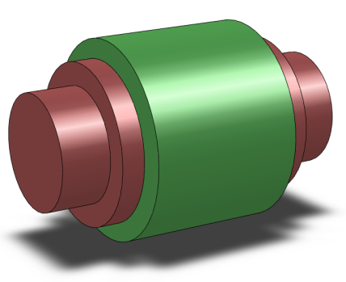
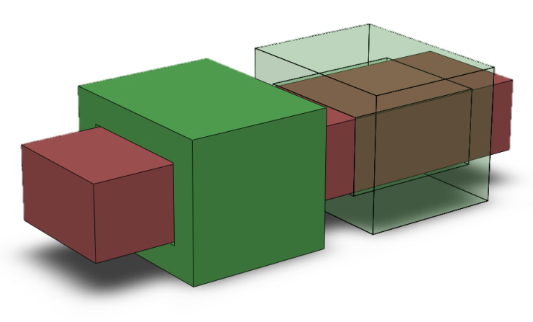
Kinematic pairs
A kinematic pair is a connection between two bodies that imposes constraints on their relative movement.
For example:
  Revolute pair
  Prismatic joint
Allowed motion
Constrained motions

Slide 6
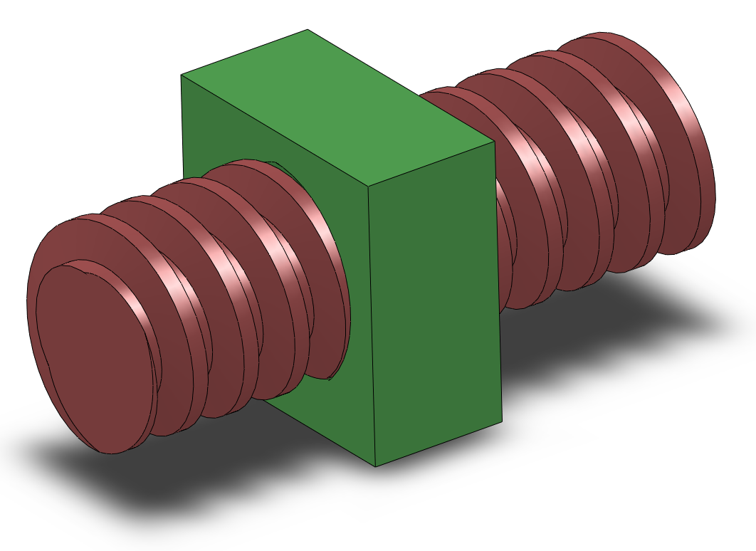
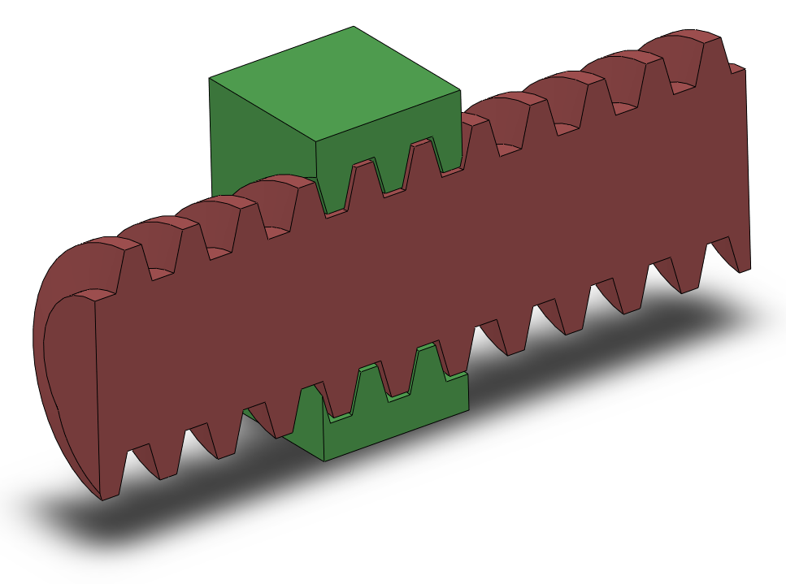
Kinematic pairs
Screw joint
  Rotation and translation are dependent

Slide 7
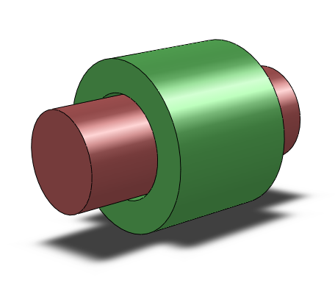
Kinematic pairs
Cylindrical pair
  Allowed motions:
    Translation
    Rotation
Allowed motions

Slide 8
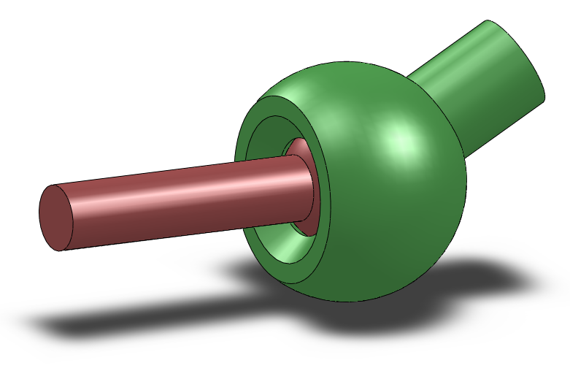
Kinematic pairs
Spherical pair
  Allowed motions:
    All rotations
Allowed motions

Slide 9
Kinematic pairs
Other type of kinematic pairs
  Cams, and others…

Slide 10
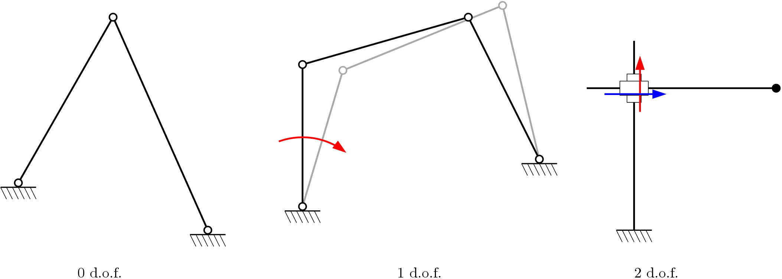
Degrees of freedom
The number of degrees of freedom (DOF) of a mechanical system (mechanism) is the number of independent parameters that define its configuration.
Parameters that allow independent motion.
Independent parameter 1
Independent parameter 2
Independent parameter

Slide 11
Degrees of freedom
A body (e.g. a link) in 3D space has 6 DOF
  Translation along X, Y, Z (3 DOF)
  Rotation along X, Y, Z (3 DOF)
A body in 2D space (a plane) has 3 DOF
  Translation along X, Y (2 DOF)
  Rotation along Z (1 DOF)

Slide 12
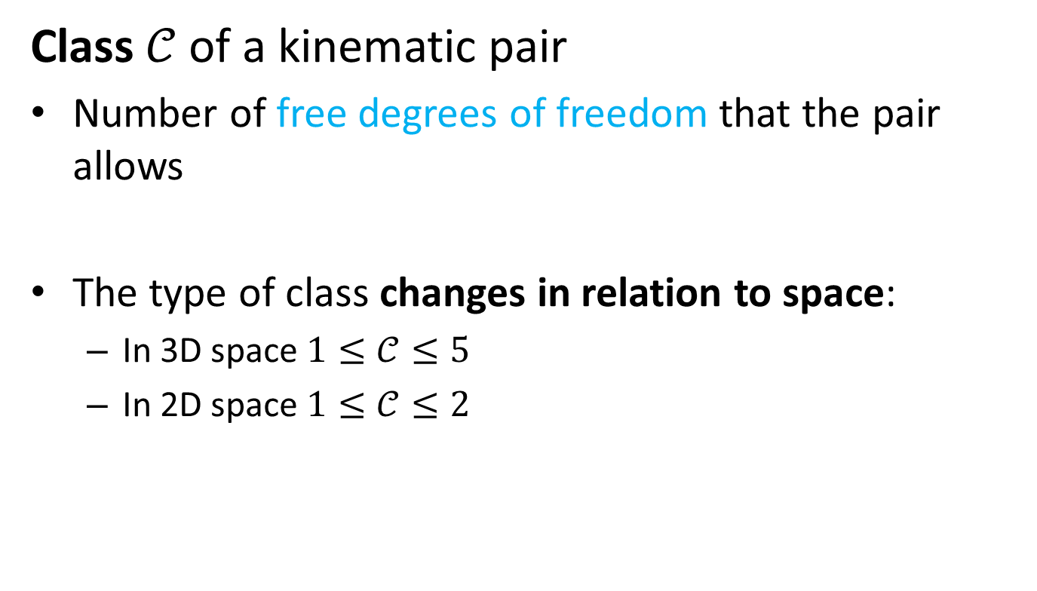
Degrees of freedom
Class $𝒞$ of a kinematic pair
Number of free degrees of freedom that the pair allows
The type of class changes in relation to space:
  In 3D space $1≤𝒞≤5$
  In 2D space $1≤𝒞≤2$

Slide 13
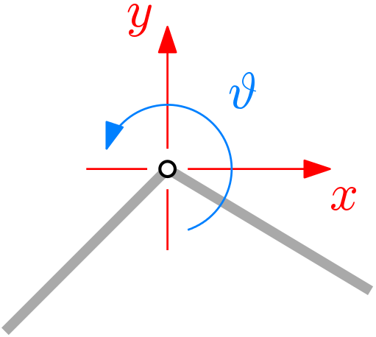

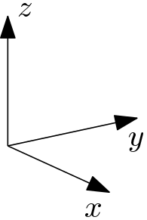


Class of kinematic pairs
Revolute joint
  In 2D
    Constrained: x, y motions
    Free: rotation
  In 3D
    Constrained:
      x,y,z motions
      rotations around x, z
    Free:
      rotation around y
$$𝒞=1$$
$$𝒞=1$$

Slide 14
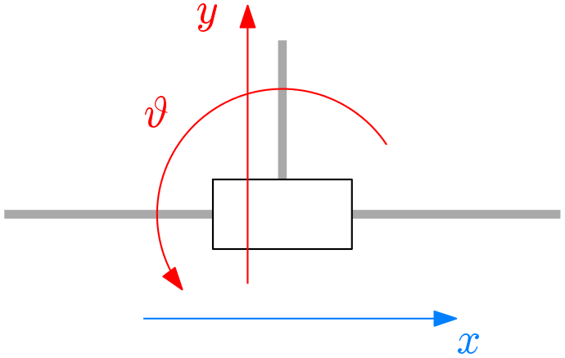
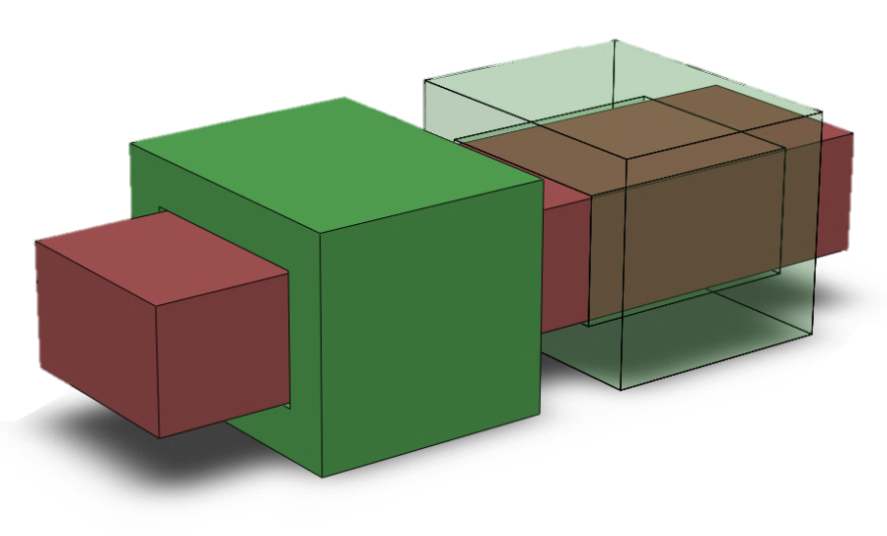



Class of kinematic pairs
Prismatic joint
  In 2D
    Constrained:
      y motion
      $θ$ rotation
    Free: x motion
  In 3D
    Constrained:
      x,z motions
      rotations around x, y, z
    Free:
      y motion
$$𝒞=1$$
$$𝒞=1$$

Slide 15

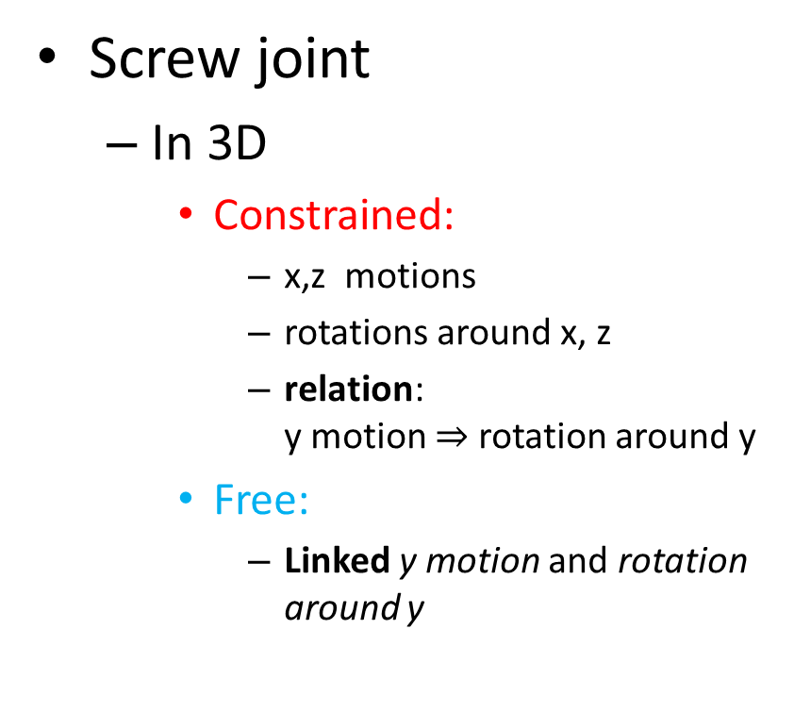
Class of kinematic pairs
Screw joint
  In 3D
    Constrained:
      x,z motions
      rotations around x, z
      relation:
      y motion $⇒$ rotation around y
    Free:
      Linked y motion and rotation around y
$$𝒞=1$$

Slide 16

Class of kinematic pairs
Cylindrical pair
  In 3D
    Constrained:
      x,z motions
      rotations around x, z
    Free:
      y motion
      rotation around y
$$𝒞=2$$

Slide 17

Class of kinematic pairs
Spherical pair
  In 3D
    Constrained:
      x, y, z motions
    Free:
      rotations around x
      rotations around y
      rotations around z
$$𝒞=3$$

Slide 18
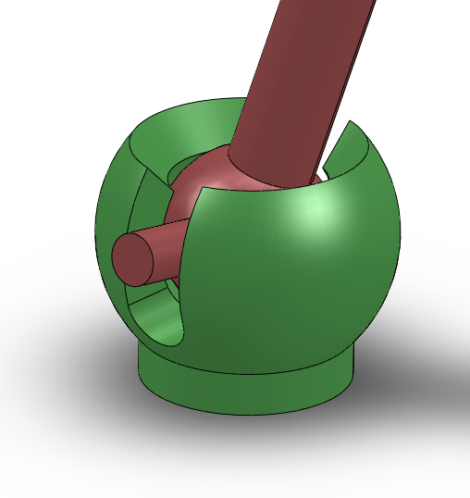

Class of kinematic pairs
Guided spherical pair
  In 3D
    Constrained:
      x, y, z motions
      rotations around z
    Free:
      rotations around x
      rotations around y
$$𝒞=2$$

Slide 19
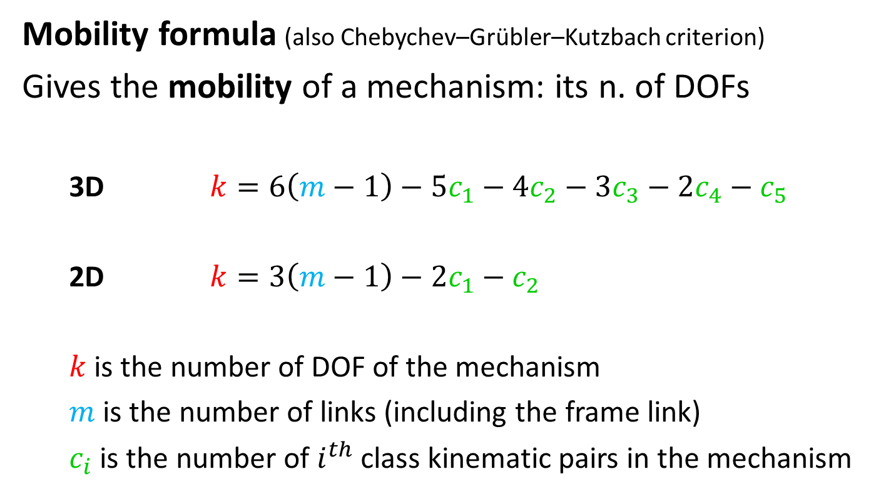
Mobility
Mobility formula (also Chebychev–Grübler–Kutzbach criterion)
Gives the mobility of a mechanism: its n. of DOFs
  3D $k=6\left(m−1\right)−5c_{1}−4c_{2}−3c_{3}−2c_{4}−c_{5}$
  2D $k=3\left(m−1\right)−2c_{1}−c_{2}$
  $k$ is the number of DOF of the mechanism
  $m$ is the number of links (including the frame link)
  $c_{i}$ is the number of $i^{th}$class kinematic pairs in the mechanism

Slide 20




Mobility
Example:
$$k=3\left(m−1\right)−2c_{1}−c_{2}$$
$$3\left(3−1\right)−2⋅3=0$$
$$3\left(4−1\right)−2⋅4=1$$
$$3\left(3−1\right)−2⋅2=2$$
Open chain: no Frame link
Frame link

Slide 21
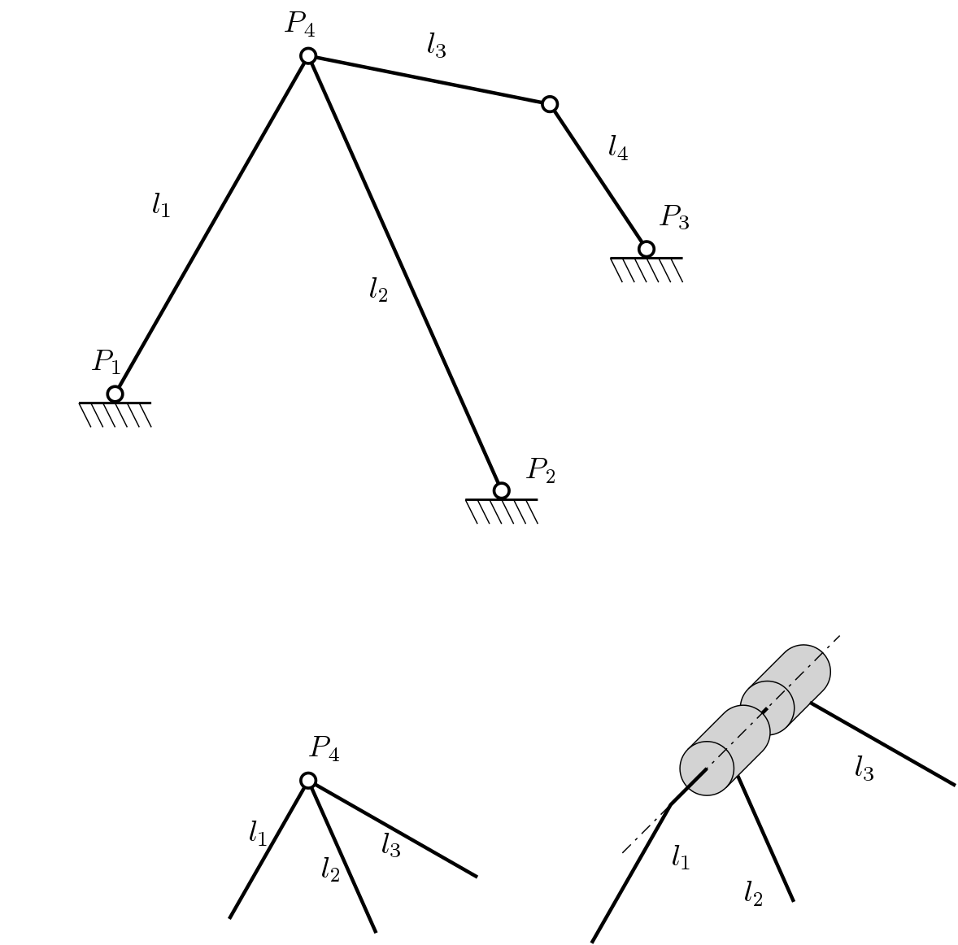
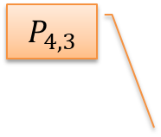

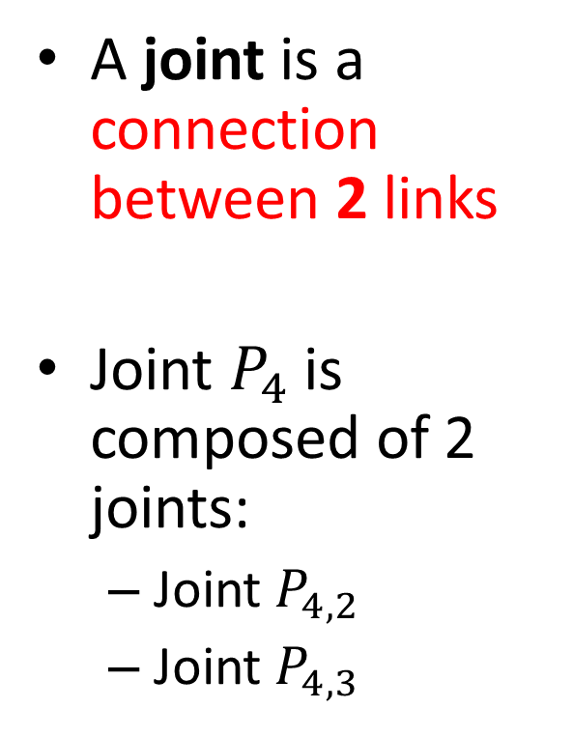
Hidden joints
A joint is a connection between 2 links
Joint $P_{4}$ is composed of 2 joints:
  Joint $P_{4,2}$
  Joint $P_{4,3}$
$$P_{4,3}$$
$$P_{4,2}$$
Notes:
This has no redundant constraints; in fact, once accepted that the mechanism is
stationary, take out each link and see that the resulting mechanism is mobile.
This means that no redundant constraint is present.

Slide 22
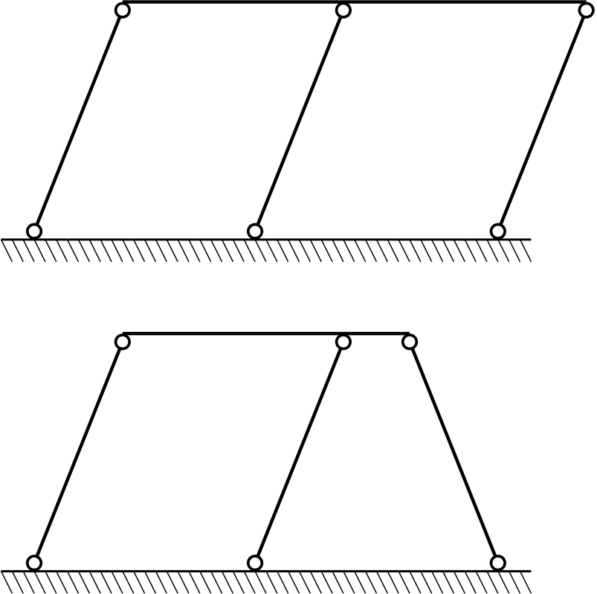
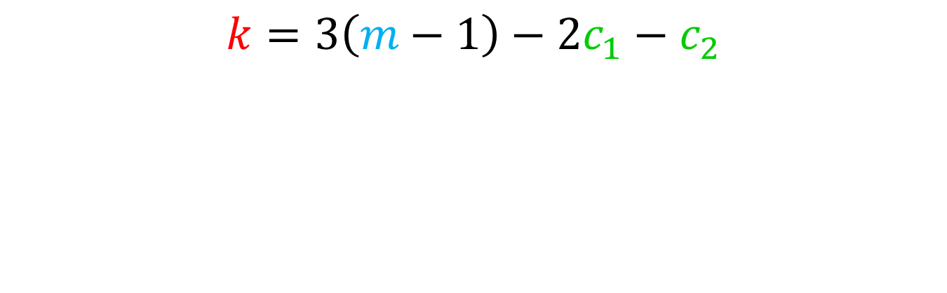
Special case: Redundant constraints
$$k=3\left(m−1\right)−2c_{1}−c_{2}$$

Slide 23
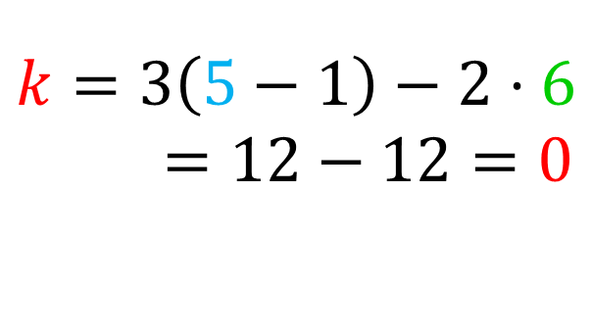

Redundant constraints
$$k=3\left(5−1\right)−2⋅6=12−12=0$$
$$k=3\left(5−1\right)−2⋅6=12−12=0$$

Slide 24
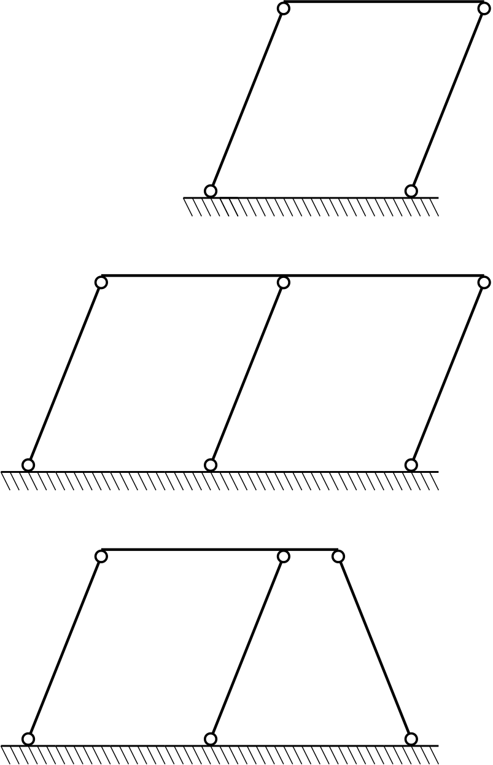

Redundant constraints
The first link on the left provides no additional constraint.
Equivalent
$$k=3\left(4−1\right)−2⋅4=9−8=1$$

Slide 25
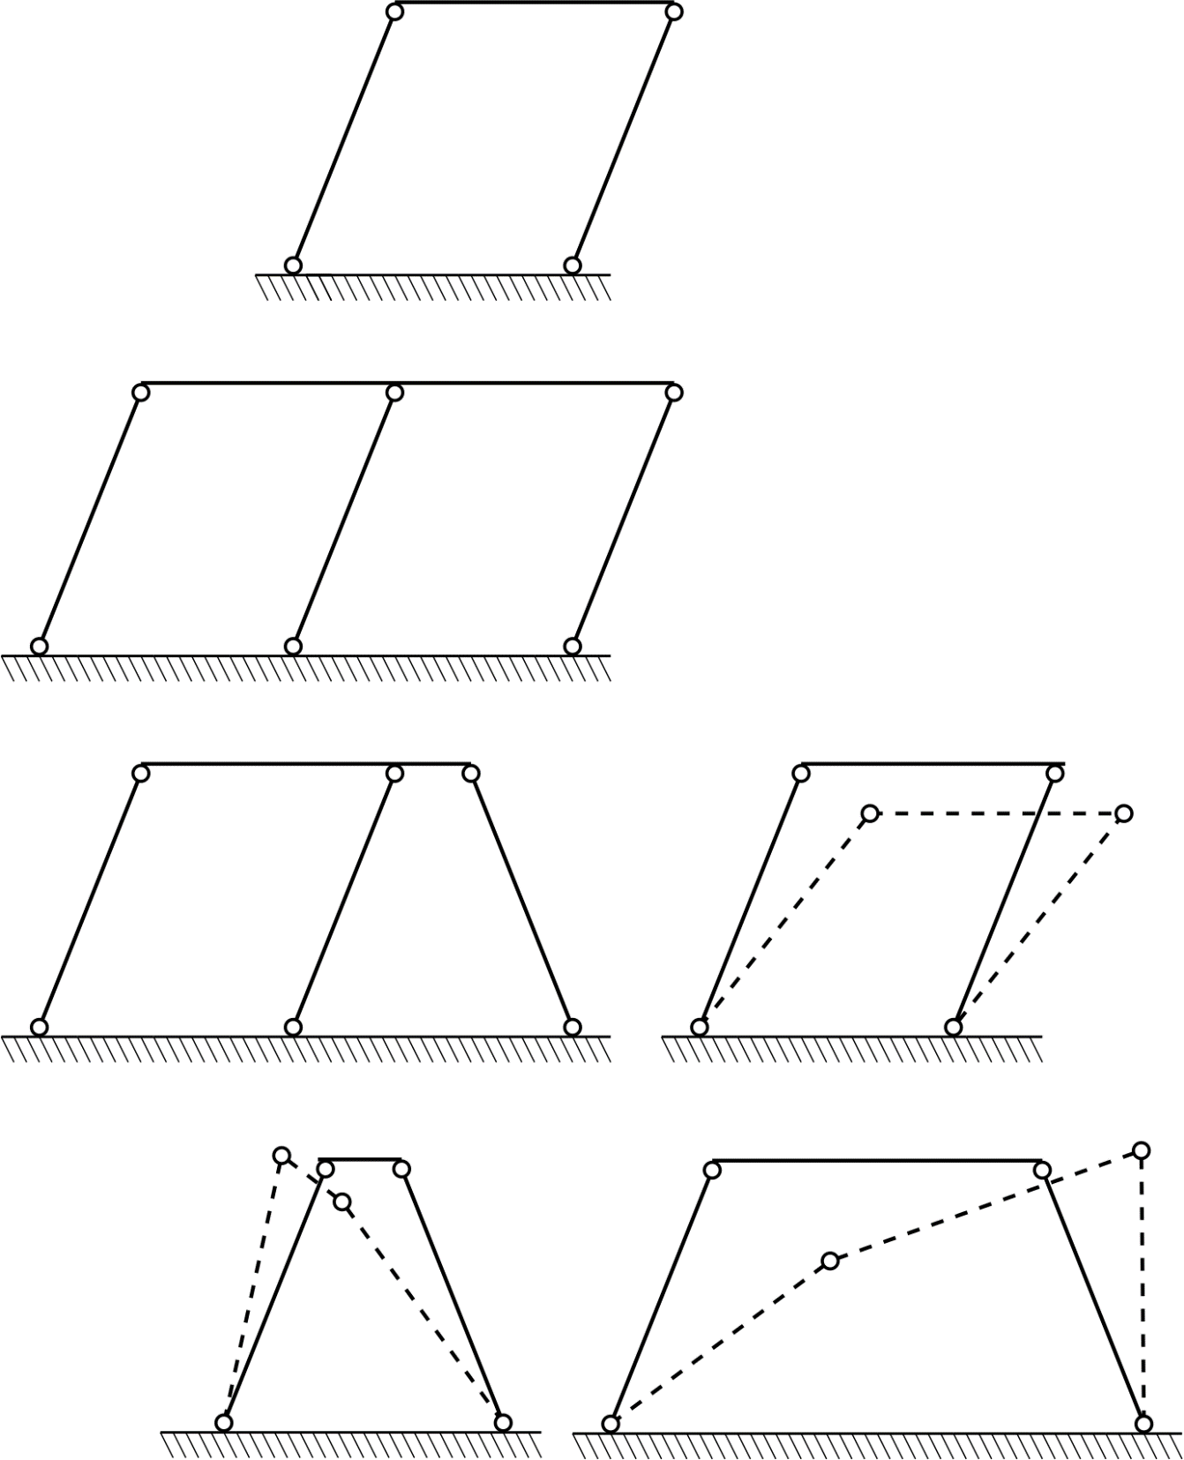
Redundant constraints

Slide 26
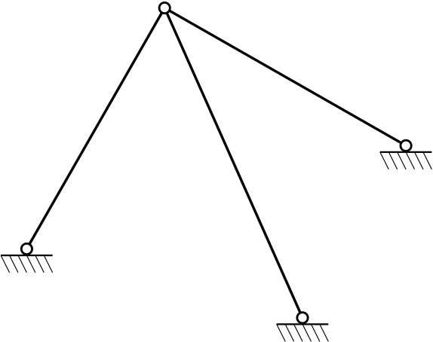

Special case: ?
$$k=3\left(m−1\right)−2c_{1}−c_{2}$$
Notes:
This has redundant AND hidden constraints!

Slide 27
Special case: ?
Hidden constraint!
Redundant constraint!
Notes:
This has redundant constraints!

Slide 28
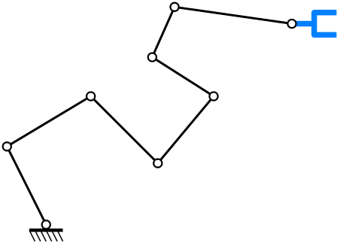
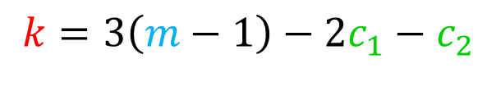
Special case
$$k=3\left(m−1\right)−2c_{1}−c_{2}$$

Slide 29
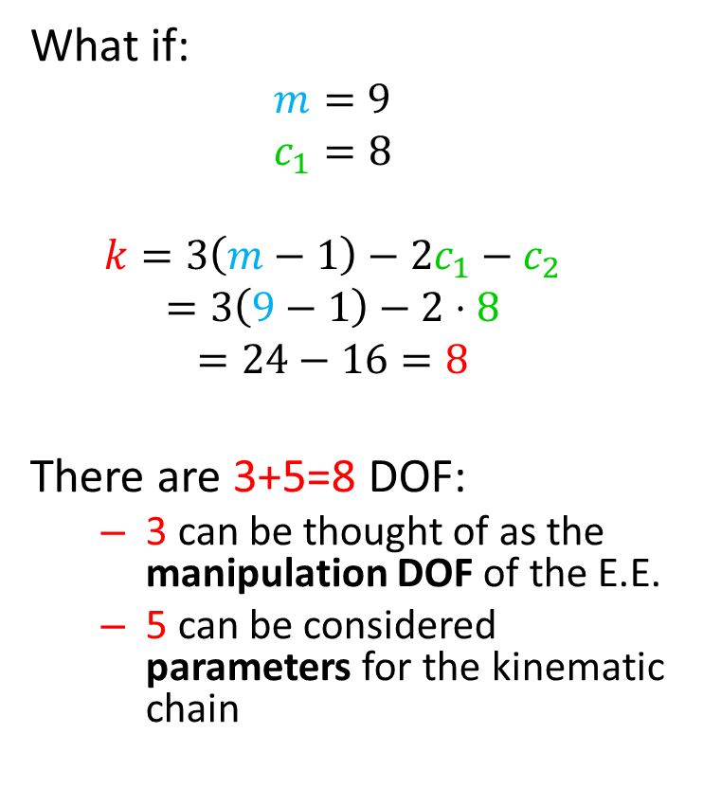
Special case
What if:
  $$m=9$$
  $$c_{1}=8$$
  $$k=3\left(m−1\right)−2c_{1}−c_{2}$$
  $$=3\left(9−1\right)−2⋅8$$
  $$=24−16=8$$
There are 3+5=8 DOF:
  3 can be thought of as the manipulation DOF of the E.E.
  5 can be considered parameters for the kinematic chain

Slide 30
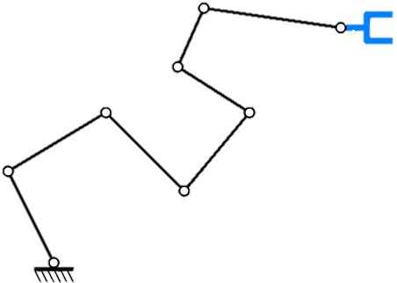
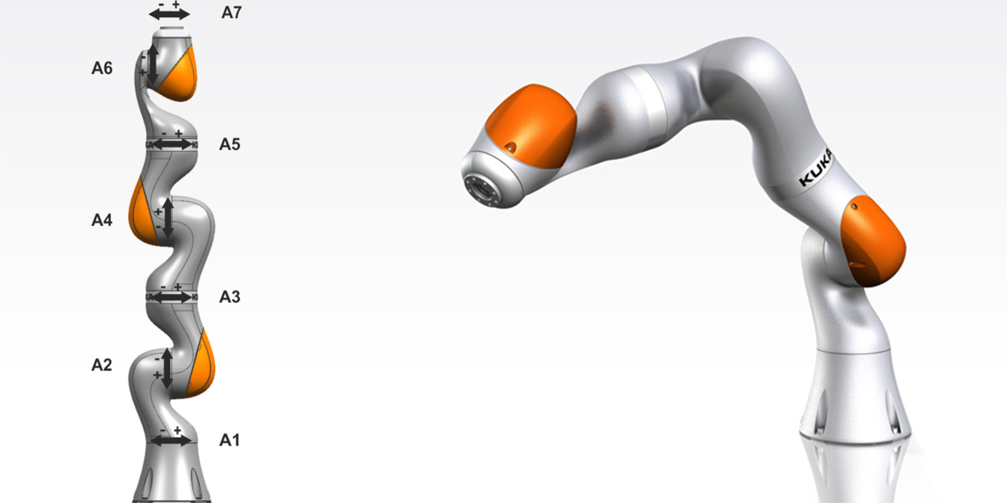
Special case
Why is this important?
Kinematically redundant robots

Slide 31
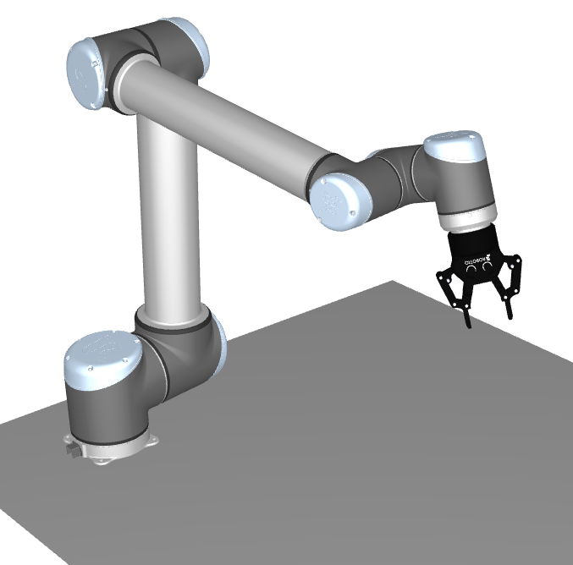
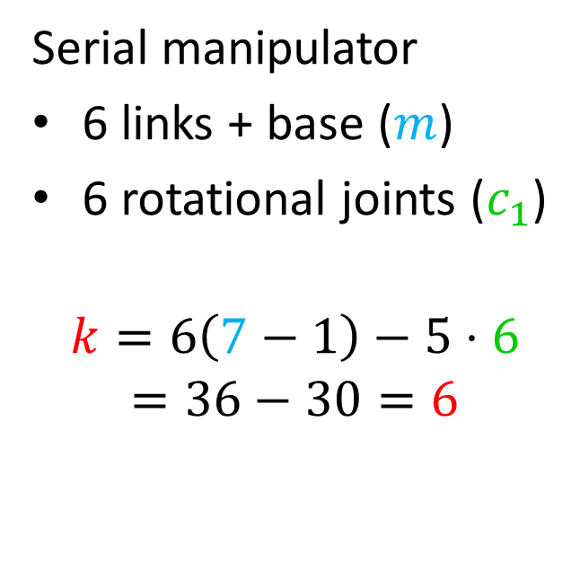

Mobility
Example:
$$k=6\left(m−1\right)−5c_{1}−4c_{2}−3c_{3}−2c_{4}−c_{5}$$
Serial manipulator
6 links + base ($m$)
6 rotational joints ($c_{1}$)
$$k=6\left(7−1\right)−5⋅6$$
$$=36−30=6$$
3
4
5
5
6
6
3
4
7
2
2
1
1

Slide 32
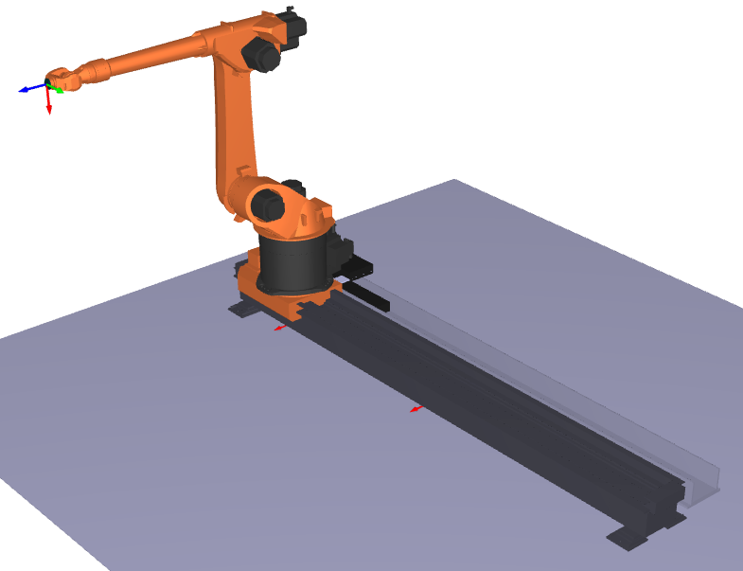
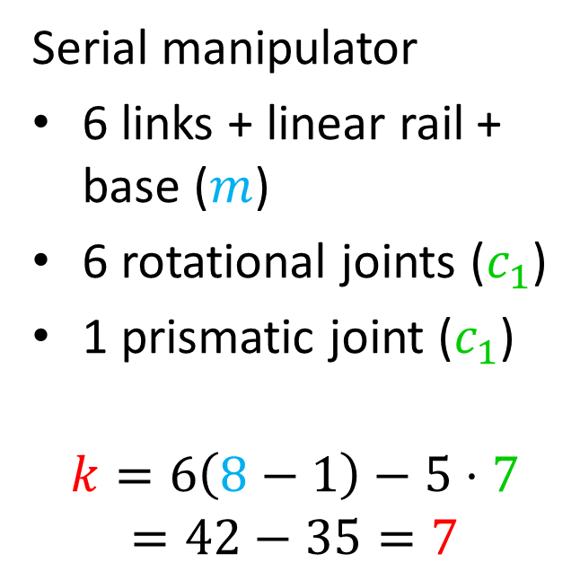
Mobility
Example:
$$k=6\left(m−1\right)−5c_{1}−4c_{2}−3c_{3}−2c_{4}−c_{5}$$
Serial manipulator
6 links + linear rail + base ($m$)
6 rotational joints ($c_{1}$)
1 prismatic joint ($c_{1}$)
$$k=6\left(8−1\right)−5⋅7$$
$$=42−35=7$$

Slide 33
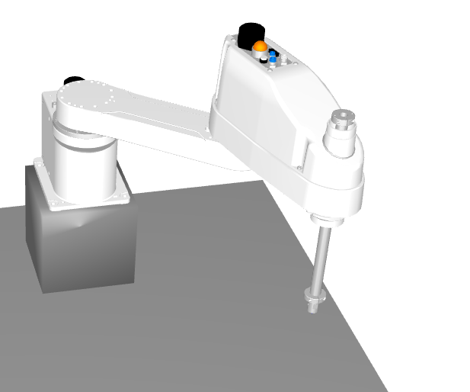
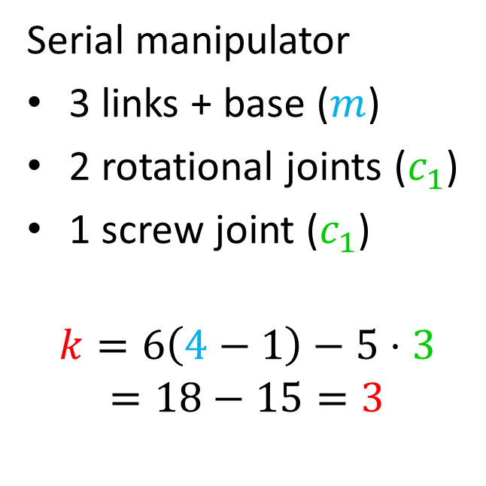
Mobility
Example:
$$k=6\left(m−1\right)−5c_{1}−4c_{2}−3c_{3}−2c_{4}−c_{5}$$
Serial manipulator
3 links + base ($m$)
2 rotational joints ($c_{1}$)
1 screw joint ($c_{1}$)
$$k=6\left(4−1\right)−5⋅3$$
$$=18−15=3$$

Slide 34
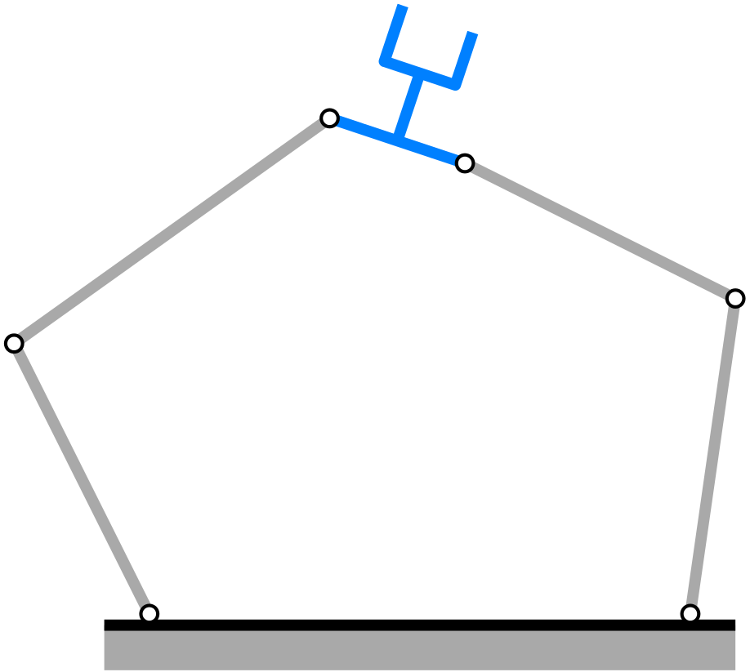
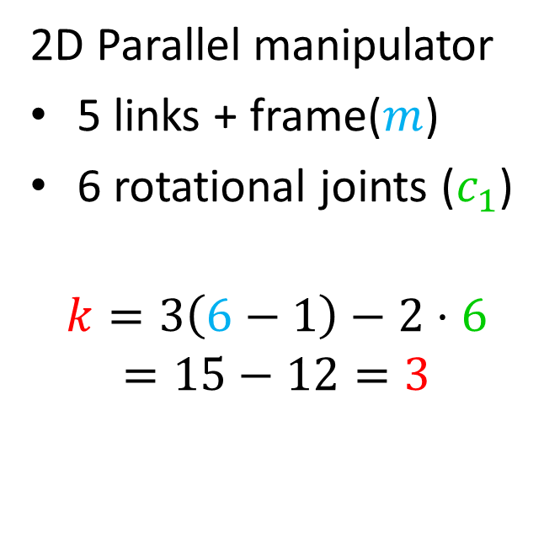

Mobility
Example:
$$k=3\left(m−1\right)−2c_{1}−c_{2}$$
2D Parallel manipulator
5 links + frame($m$)
6 rotational joints ($c_{1}$)
$$k=3\left(6−1\right)−2⋅6$$
$$=15−12=3$$

Slide 35
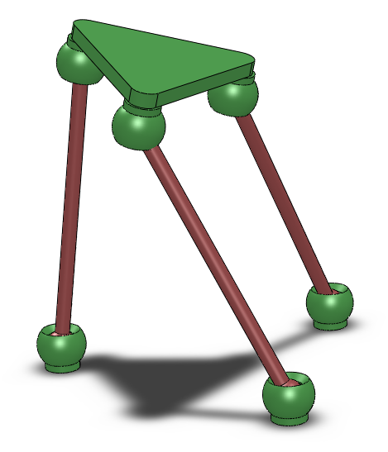
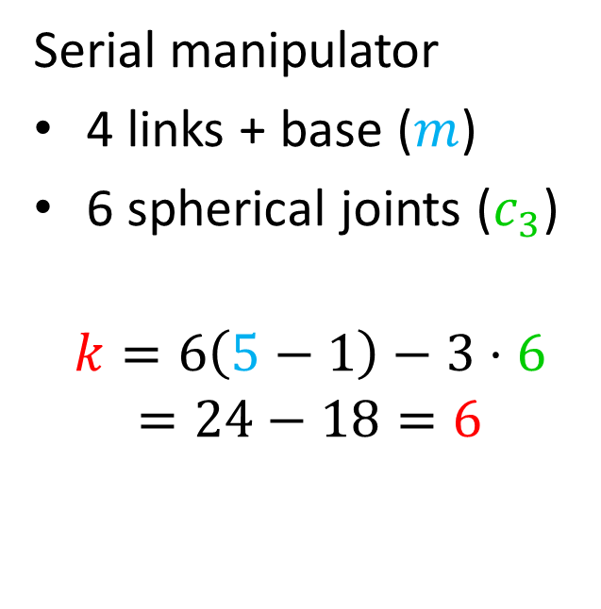
Mobility
Example:
$$k=6\left(m−1\right)−5c_{1}−4c_{2}−3c_{3}−2c_{4}−c_{5}$$
Serial manipulator
4 links + base ($m$)
6 spherical joints ($c_{3}$)
$$k=6\left(5−1\right)−3⋅6$$
$$=24−18=6$$
?

Slide 36
Mobility
3-DOF
3-DOF

Slide 37
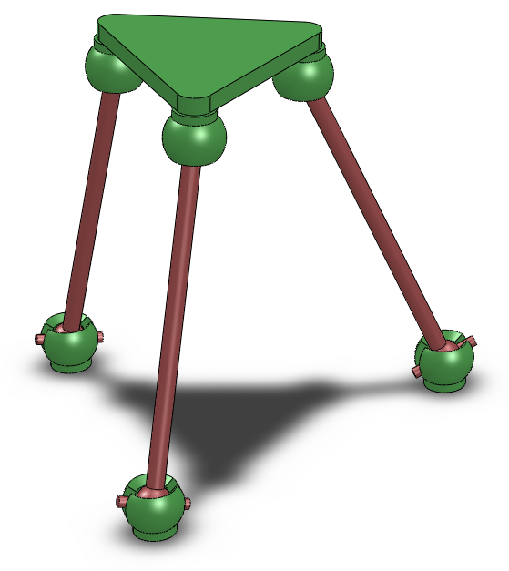
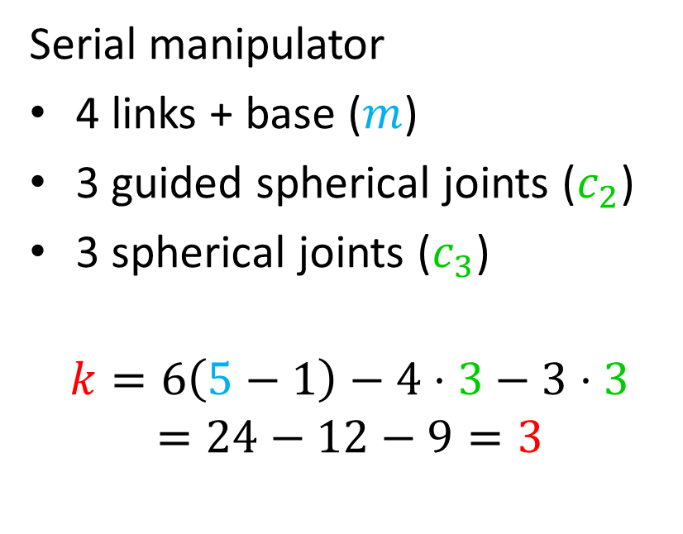
Mobility
Example:
$$k=6\left(m−1\right)−5c_{1}−4c_{2}−3c_{3}−2c_{4}−c_{5}$$
Serial manipulator
4 links + base ($m$)
3 guided spherical joints ($c_{2}$)
3 spherical joints ($c_{3}$)
$$k=6\left(5−1\right)−4⋅3−3⋅3$$
$$=24−12−9=3$$

Slide 38
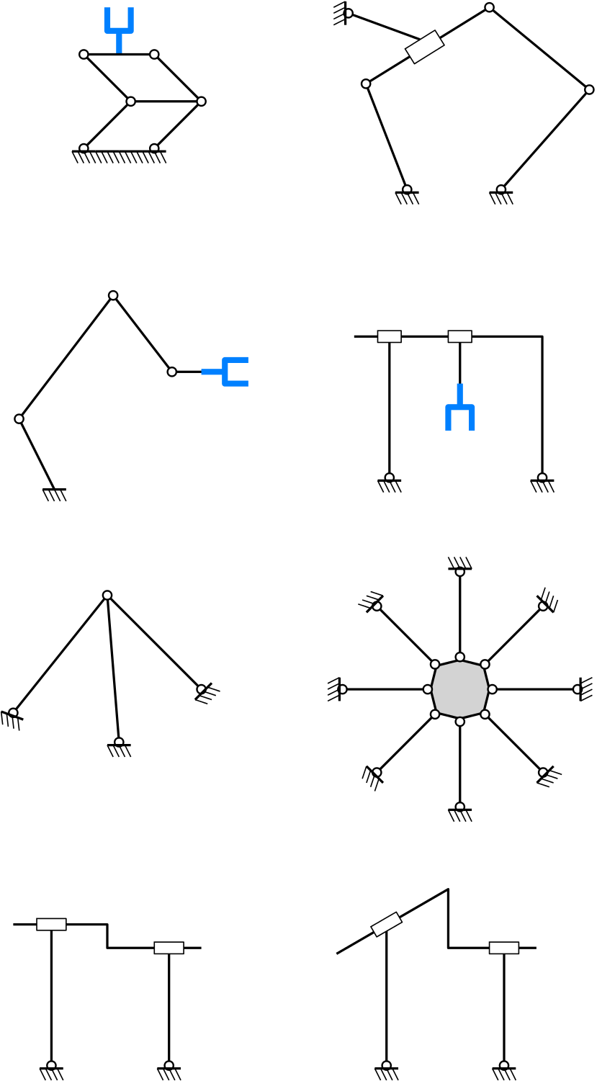

Exercises: planar mechanisms
2D $k=3\left(m−1\right)−2c_{1}−c_{2}$
Notes:
solutions:
2 (hidden), 1, 0 (redundant), 0 (redundant),
3, 1, 1, 1

Slide 39
Exercises: planar mechanisms
2D $k=3\left(m−1\right)−2c_{1}−c_{2}$
Notes:
solutions:
2 (hidden), 1, 0 (redundant), 0 (redundant),
3, 1, 1, 1

Slide 40
Exercises: planar mechanisms
2D $k=3\left(m−1\right)−2c_{1}−c_{2}$
Notes:
solutions:
2 (hidden), 1, 0 (redundant), 0 (redundant),
3, 1, 1, 1

Slide 41
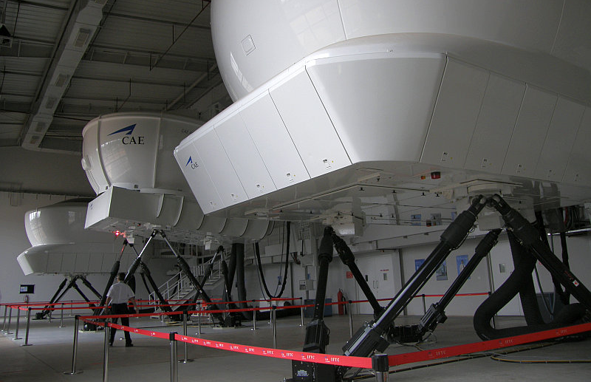
Exercise: Gough-Stewart platform (1)
Platform
Linear actuator
Video
Class 2 or 3 joints

Slide 42
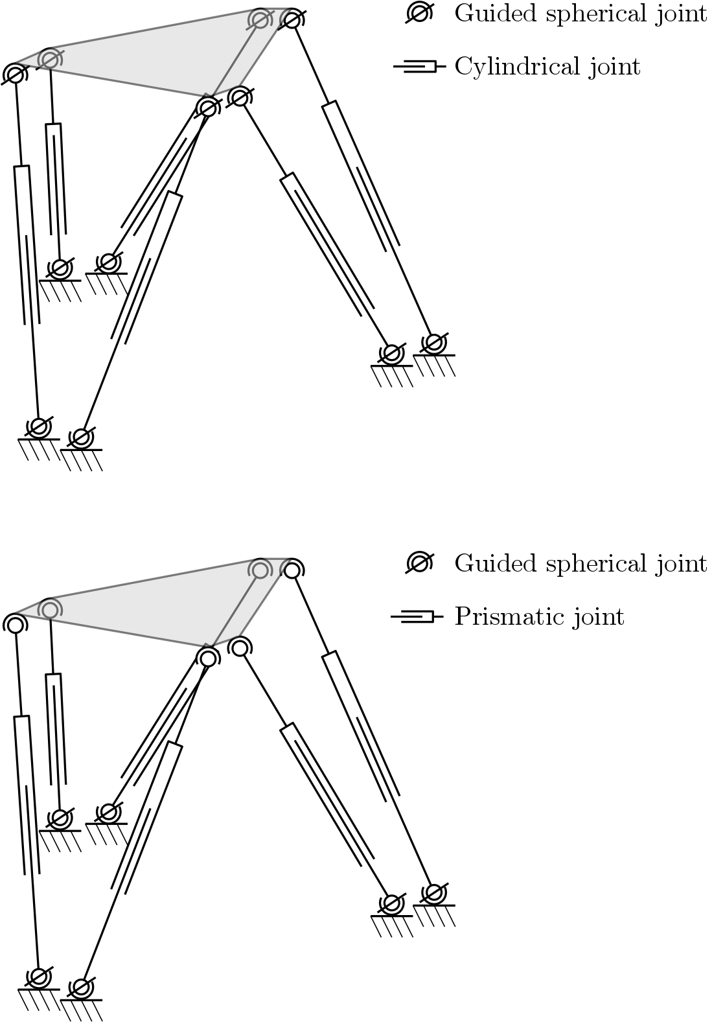
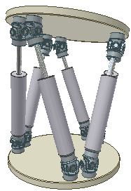
Exercise: Gough-Stewart platform (2)
3D $k=6\left(m−1\right)−5c_{1}−4c_{2}−3c_{3}−2c_{4}−c_{5}$
Notes:
% Soluzione 1 (sferici + prismatiche)
m = 6*2+2;
c1 = 6*1;
c2 = 6*1;
c3 = 6*1;
K= 6

Slide 43
Exercise: Gough-Stewart platform (3)
3D $k=6\left(m−1\right)−5c_{1}−4c_{2}−3c_{3}−2c_{4}−c_{5}$
Notes:
% Soluzione 1 (sferici guidati + cilindriche)
m = 6*2+2;
c1 = 6*0;
c2 = 6*3;
c3 = 6*0;
K= 6

Slide 44
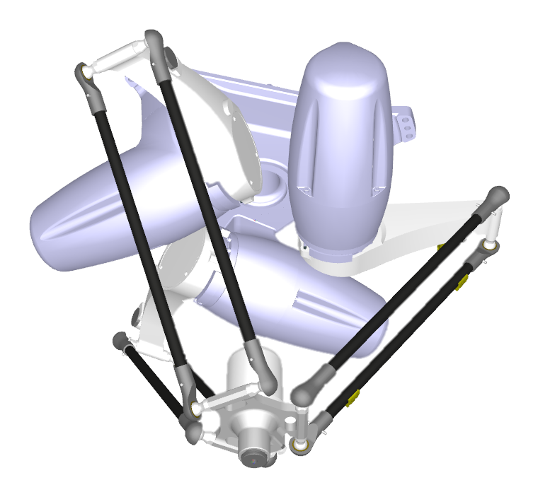
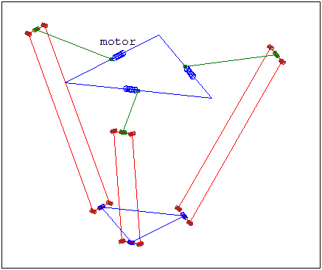
Exercise: Delta robot (1)
Frame
Actuator
Spherical joint
Link
End-effector

Slide 45

Exercise: Delta robot (2)
First let’s locate indeterminate links
Notes:
% Soluzione 1 (SOVRABBONDANTE)
m = 3*3+2; % 3*(2 link + leva) + base + ee
c1 = 3*1; % 3 motori
c2 = 3*0;
c3 = 3*4; % 3*4 giunti sferici su leva
K = 9 (-6)
% Soluzione 2
m = 3*3+2; % 3*(2 link + leva) + base + ee
c1 = 3*1; % 3 motori
c2 = 3*2; % 3*2 giunti sferici guidati su leva
c3 = 3*2; % 3*2 giunti sferici su ee
K = 3
% Soluzione 3 (LINK EQUIVALENTE)
m = 3*2+2; % 3*(2 link + leva) + base + ee
c1 = 3*1; % 3 motori
c2 = 3*2;
c3 = 3*0; % 3*4 giunti sferici su leva
6*(m-1) - 5*c1 - 4*c2 - 3*c3
K = 3

Slide 46


Exercise: Delta robot (3)
3D $k=6\left(m−1\right)−5c_{1}−4c_{2}−3c_{3}−2c_{4}−c_{5}$
Notes:
% Soluzione 1 (SOVRABBONDANTE)
m = 3*3+2; % 3*(2 link + leva) + base + ee
c1 = 3*1; % 3 motori
c2 = 3*0;
c3 = 3*4; % 3*4 giunti sferici su leva
K = 9 (-6)
% Soluzione 2
m = 3*3+2; % 3*(2 link + leva) + base + ee
c1 = 3*1; % 3 motori
c2 = 3*2; % 3*2 giunti sferici guidati su leva
c3 = 3*2; % 3*2 giunti sferici su ee
K = 3
% Soluzione 3 (LINK EQUIVALENTE)
m = 3*2+2; % 3*(2 link + leva) + base + ee
c1 = 3*1; % 3 motori
c2 = 3*2;
c3 = 3*0; % 3*4 giunti sferici su leva
6*(m-1) - 5*c1 - 4*c2 - 3*c3
K = 3

Slide 47


Mobility
Example:
$$k=6\left(m−1\right)−5c_{1}−4c_{2}−3c_{3}−2c_{4}−c_{5}$$

Slide 48

Mobility
Example:
$$k=6\left(m−1\right)−5c_{1}−4c_{2}−3c_{3}−2c_{4}−c_{5}$$

Slide 49


Mobility
Example:
$$k=3\left(m−1\right)−2c_{1}−c_{2}$$
Notes:
m = 9
n(c1) = 11
k = 3(9-1) – 2*11 = 24 – 22 = 2

