Slide 1
Robotics
Part V
a.a. 2020-2021
Furniture technology

Slide 2
Functional schematics of a robot
Robotics

Slide 3
Robotic system
Physical machine
  Structure
  Actuators
  Sensors
Controller
  Operates the robot:
    Manipulation,
    Perception,
    Intelligent and adaptive behaviour,
    Data acquisition, processing, visualization and storage,
  Is a Real-time Control System (RCS) (at least partially):
    Each action is linked to a specific time

Slide 4
Actuation
Robotic actuator
Motor + gearbox
Linear and/or rotational
Provide good precision
Small or zero backlash

Slide 5
Actuator
Definition
An Actuator is a component of a machine that is responsible for moving and controlling a mechanism or system

Slide 6
Actuator types
Based on various principles:
  Electro-mechanical
    Electric motor, gearbox
    Linear/rotational
  Pneumatic/hydraulic
    use of a fluid
    pumps, motors, hydraulic cylinders, …
  Magnetic
    Electro-magnets
    Magnetic manipulation (grasping, levitation, …)
Servomechanism or servomotor is an actuator with closed-loop control

Slide 7
Electro-mechanical actuators
Power
Controller
Control system
Motor
Gearbox
Mechanism
High speed
Low torque
High torque
Low speed
Actuator
Sensor
Feedback
Sensor
Servomechanism

Slide 8
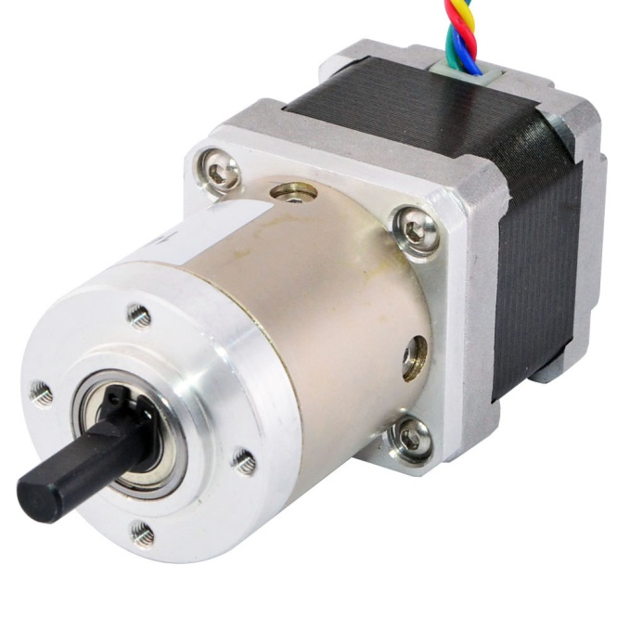
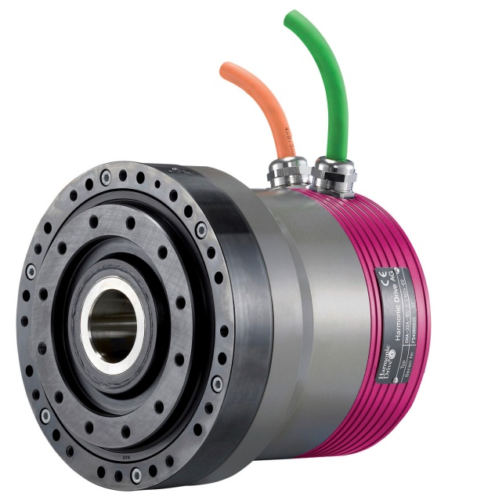
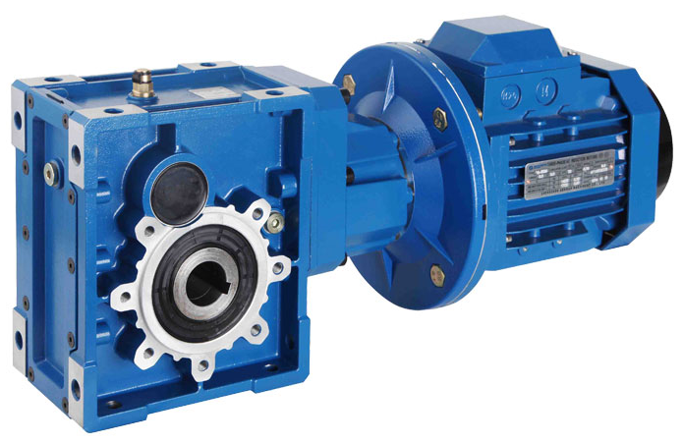
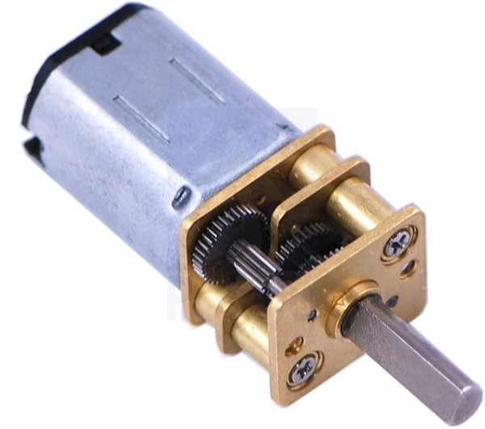
Rotary actuators
Deliver a rotary motion
Based on an electric motor
  Brushed
  Brushless (requires a driver)
  Stepper motor (requires a driver)
Can have a gearbox, often with a reduction

Slide 9
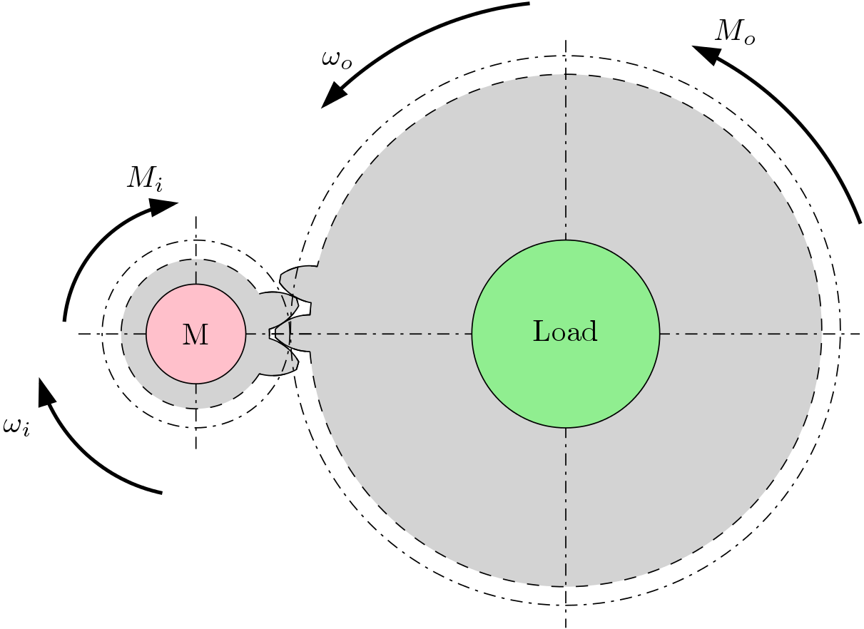



Gearbox
Transmission ratio:
  $$τ=\frac{ω_{o}}{ω_{i}}=\frac{{v_{t,o}}/{r_{o}}}{{v_{t,i}}/{r_{i}}}=\frac{r_{i}}{r_{o}}$$
Since $F_{t,i}=F_{t,o}$:
  $M_{i}/r_{i}=M_{o}/r_{o}$,
  $τ=\frac{r_{i}}{r_{o}}=\frac{M_{o}}{M_{i}}$.
$$F_{t,i}$$
$$F_{t,o}$$

Slide 10
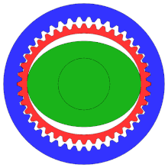
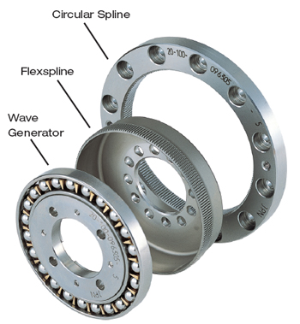
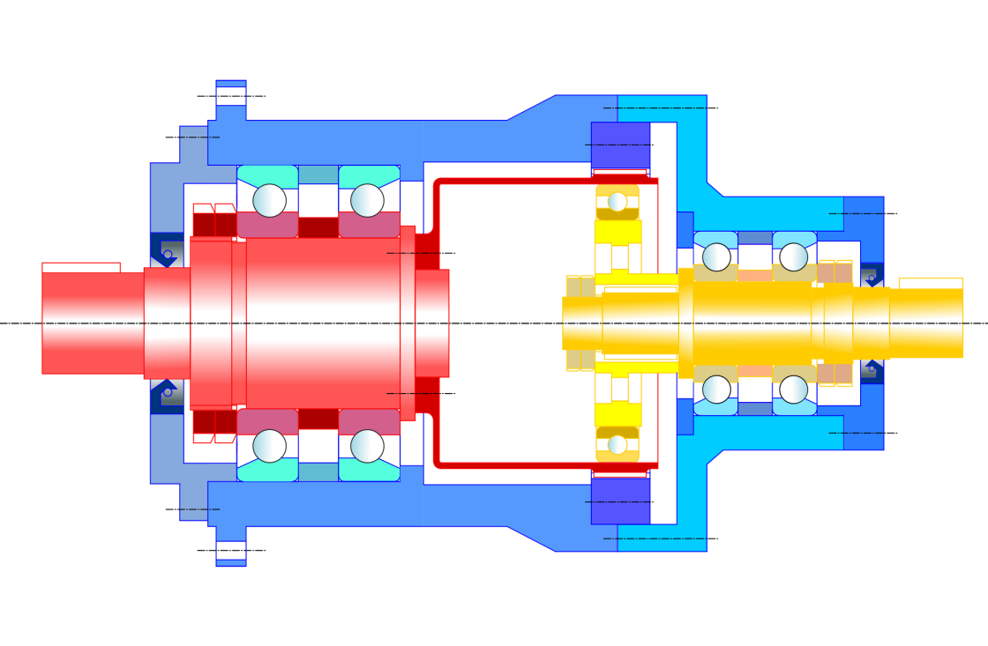
Harmonic drive
Circular spline
Flexible spline
Wave generator
Video

Slide 11
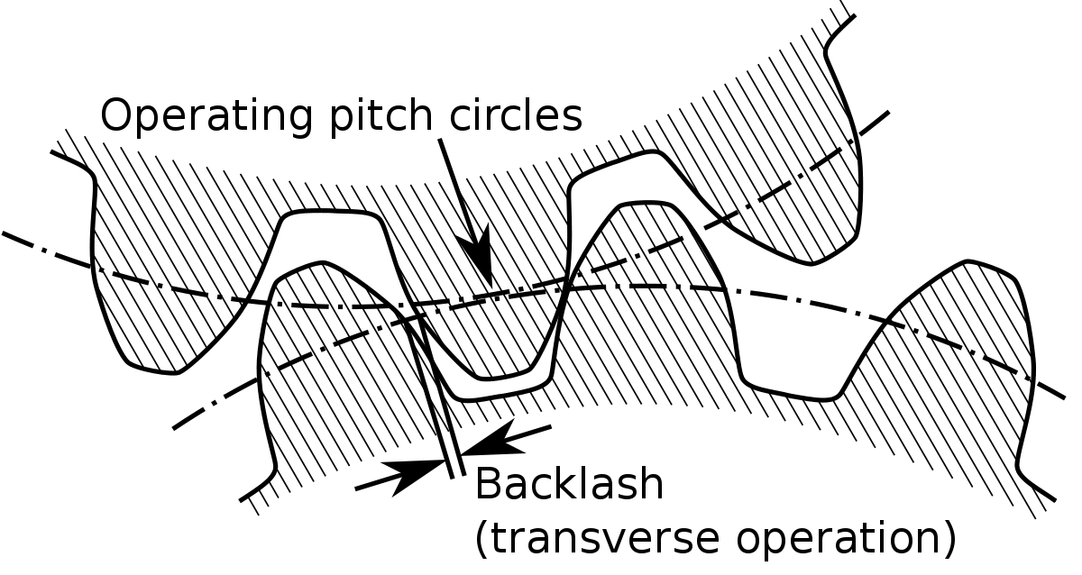
Backlash
Driven gear
Driving gear

Slide 12
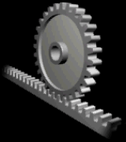
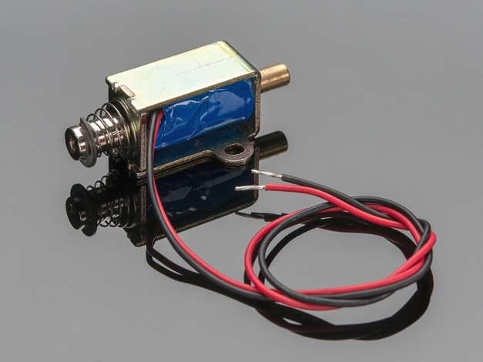
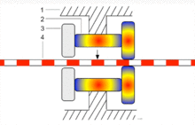
Linear actuators
Delivers a linear motion
  Usually through a special gearbox:
    Lead-screw/ball-screw
    Rack and pinion
    Belt drive
    Crankshaft
    Cam
  Other types
    Hydraulic/pneumatic
    Magnetic (electromechanical solenoid)
  Exotic
    Piezoelectric drive
    Wax motor

Slide 13
Controller
Definition
A robot controller is a combination of hardware and software to program and control a single or multiple robots.

Slide 14
Controller Hierarchy
A hierarchical structure connects the various functional modules of the system, which are:
  Sensorial modules,
  Model modules,
  Decisional models,
Four hierarchical levels exist:
  Task level
  Action level
  Primitive level
  Servo level

Slide 15
Hierarchical levels
Task level
  “pick the object in A and place it in B”
  “Spot weld at this location”
  “Perform this milling operation on that wooden beam”
  Each of these tasks needs the controller to query its databases to figure out what actions are needed; also, it needs to evaluate data coming from sensors.
Decisional module
Model module
Sensorial module

Slide 16
Hierarchical levels
Action level
  Task is decomposed into basic actions
  Controller determines the intermediate configurations/poses that are necessary
  Controller decides how to implement them (e.g. workspace or joints space)
  How to plan the motion
    Waypoints
    Avoid singular configurations
    It needs to evaluate sensory information for avoiding obstacles
    end-stops etc.
Decisional module
Model module
Sensorial module

Slide 17
Hierarchical levels
Primitive level
  Actions are received from the above level and the controller defines the control strategy
    Position control, force control, etc.
  Path planning is finally performed
  Sensory information is useful to determine if the actions are performing according to plan: divergences happen during collisions, occlusions etc.
Decisional module
Model module
Sensorial module

Slide 18
Hierarchical levels
Servo level
  Primitives are received
  Control signals are produced to be sent to the servo actuators.
  Decisional module
    Performs micro-interpolation on the nominal trajectory to account for the dynamics of the manipulator
  Model module
    Gives the decisional module the values based on the current configuration of the manipulator
  Sensor module
    Provides information on the position and state of the various actuators, which finally closes the control loop.
Decisional module
Model module
Sensorial module

Slide 19
Hierarchical levels
Recap:
  Task level
  Action level
  Primitive level
  Servo level
Necessity grows for real-time systems

Slide 20
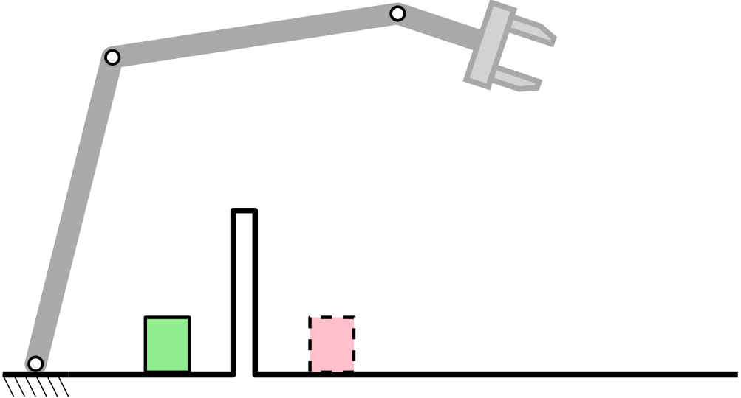
Exercise
Describe the sequence of actions necessary to pick the green object and place it in the red location.
Solution:
  Task level
    Database query: task definition
    Sensor query: determine the location of objects/obstacles/targets
  Action level
    Define basic actions
    Evaluate feasibility
    (sensors –> obstacles, workspace etc.)
    Define waypoints
  Primitive level
    Select control strategy (e.g. position control)
    Evaluate sensor outputs for collisions
  Servo level
    Evaluation of sensors for control loop feedback
    Micro-interpolation based on model
    Generation of control signals

Slide 21
End-effectors and tools
Robotics

Slide 22
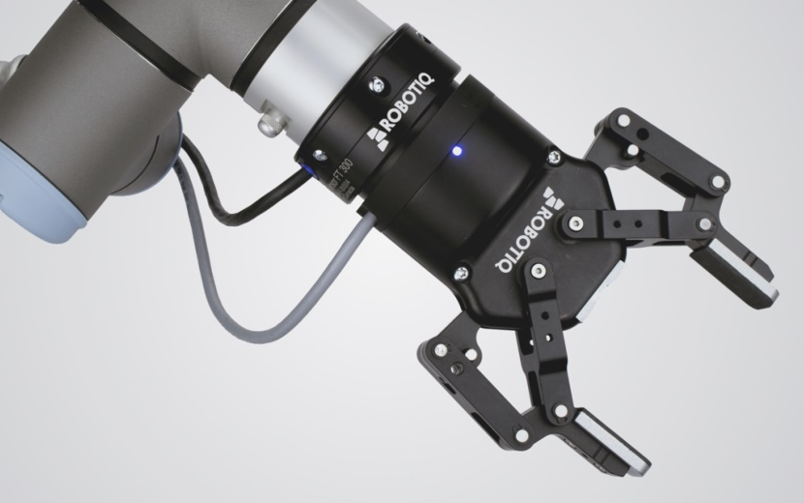
End-effectors and tools
Strict definition
  The EE is the last link of the serial
  manipulator, on which tools and
  grippers are attached.
  Sometimes using the term EE the
  tool/gripper is implied.
The end-effector and/or tool are the interface between the object and the robot through which the task is carried out.
Types of end-effectors
  Grippers: allow the robot to manipulate the object
  Machining tools: can directly influence the material characteristics of the object
  Measurement devices.

Slide 23
Grippers
The act of manipulating the object is called grasping, and the ability or degree of the robot to perform this is called prehension
There are some different grasping principles, based on specific phenomenological characteristics of prehension:
  Impactive: jaws, claws, pincers. The object experiences some sort of either form closure (relying on geometry) or force closure (friction)
  Ingressive: pins, needles. Penetration in the object is used for prehension
  Astrictive: suction caps. Pressure differential is used as grasping force
  Contigutive: adhesion. Glues, electrostatic, magnetic.

Slide 24

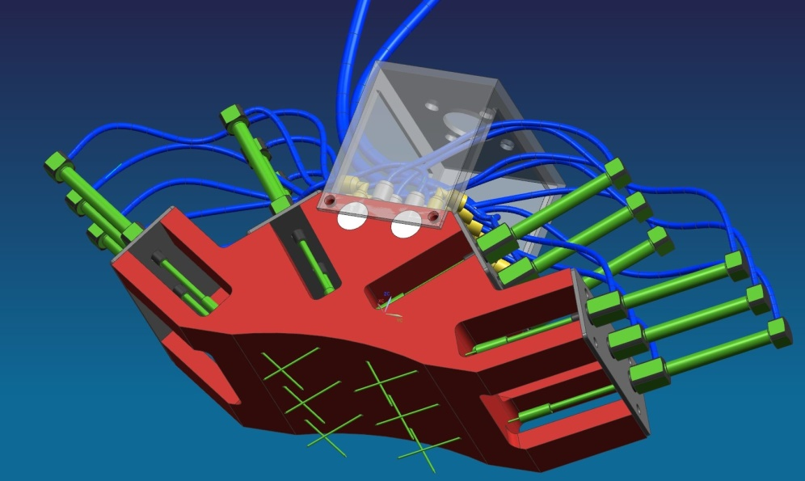
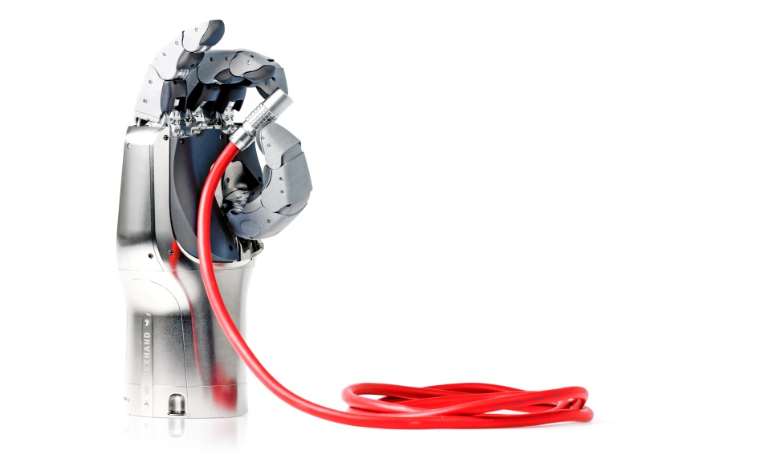
Grippers
Impactive
Ingressive
Force/form closure

Slide 25
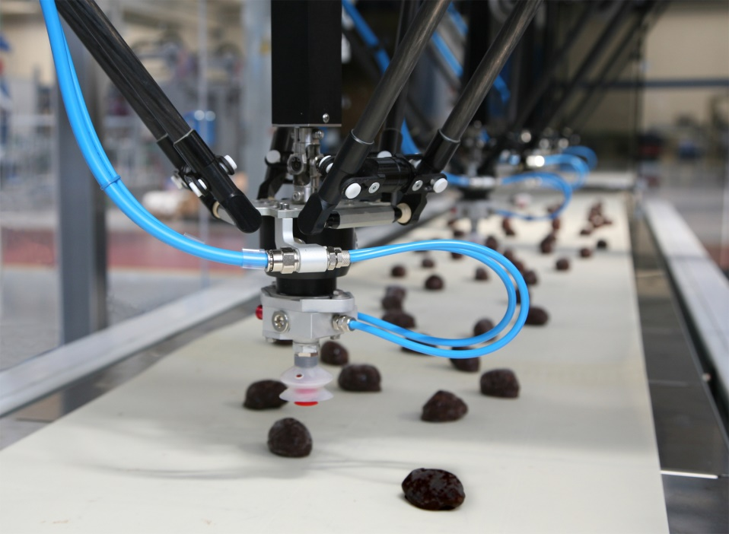
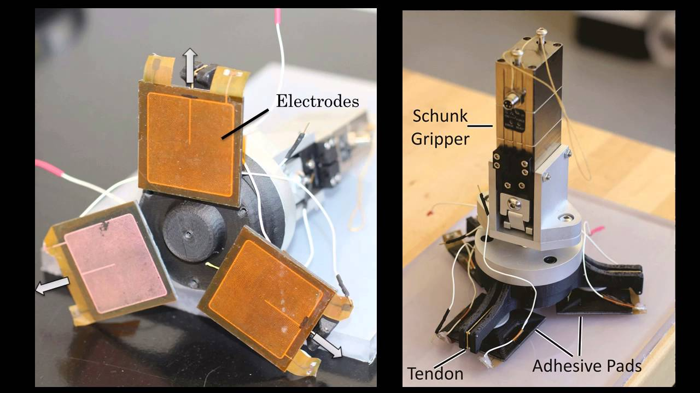
Grippers
Astrictive
Contigutive

Slide 26
Machining tools
A machining tool is generally fixed either on the ground or structure, or on some part of the robot itself (e.g. last link/ee)
Many tools are available:
  Machining tools,
  Welding heads,
  3D printing heads, …

Slide 27
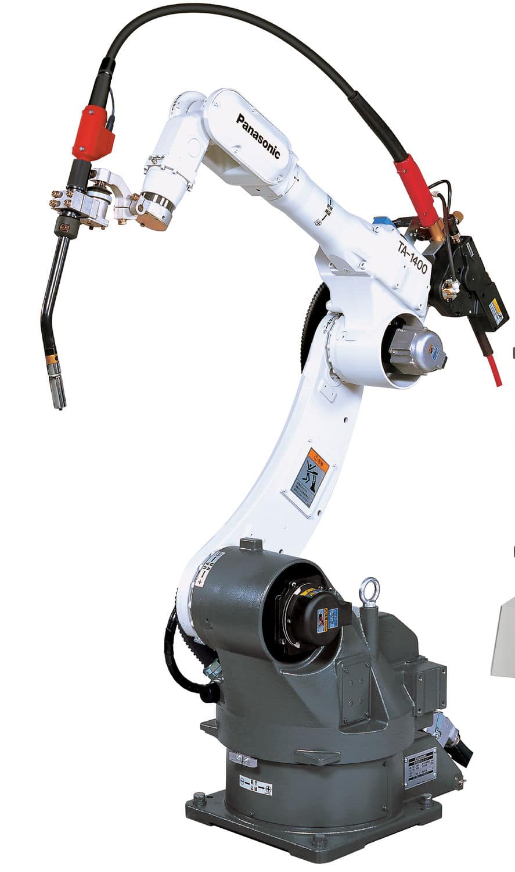
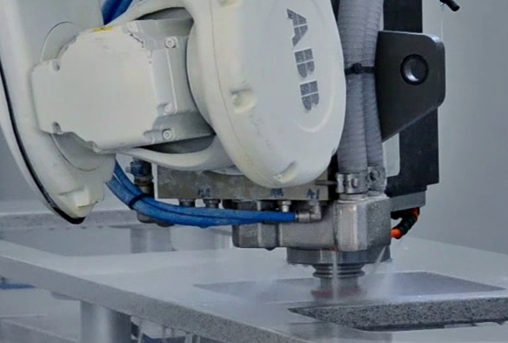
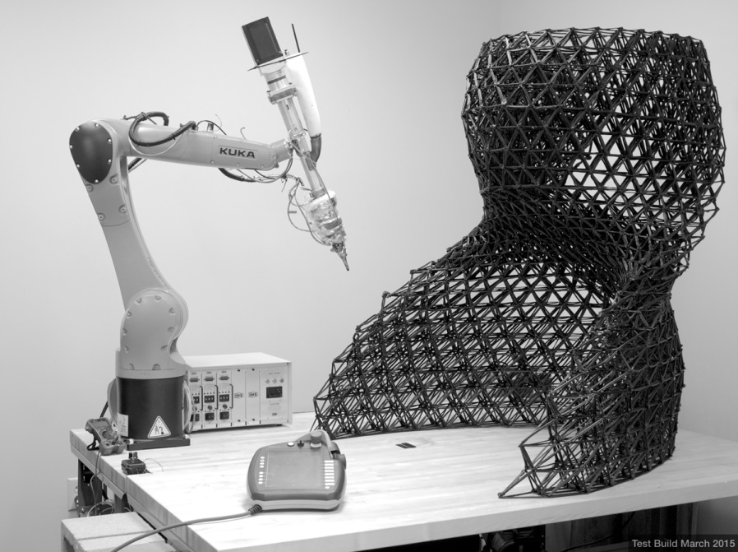
Tools
Milling head
3D printing head
Welding head

Slide 28
Measurement devices
Inspection and measurement. Various types:
  Contact: probes, force sensors, etc.
  Contactless: vision-based perception, laser scan, etc.

Slide 29
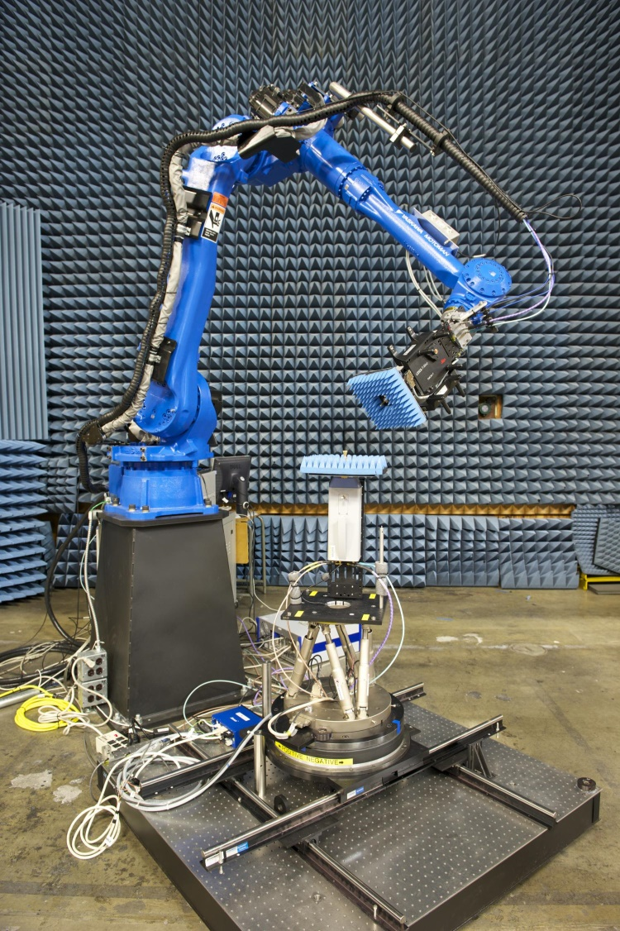
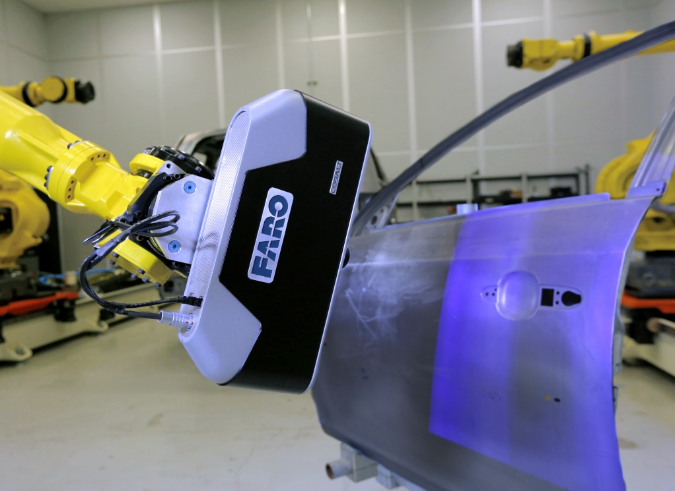
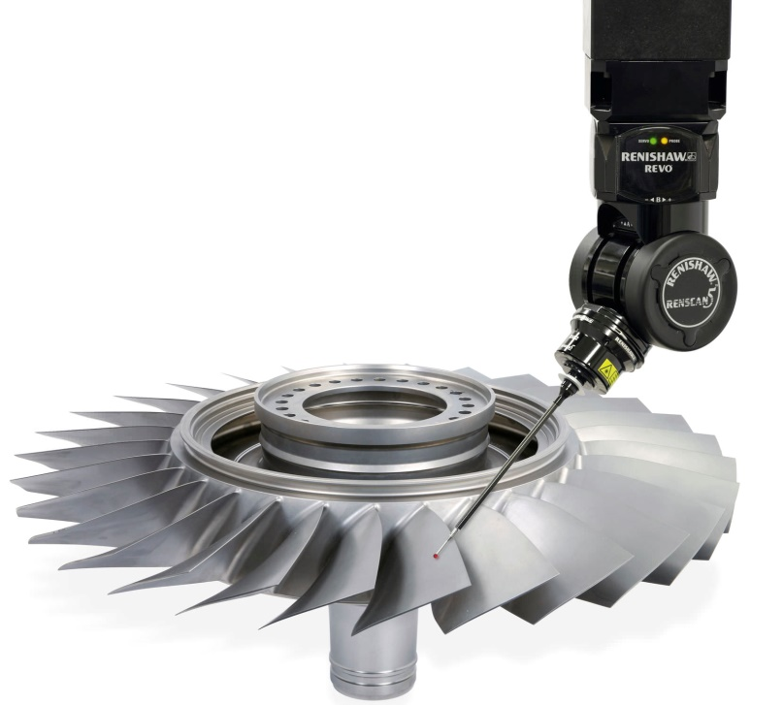
Measurement devices
Optical inspection system
Contact probe
RF probe

Slide 30
Industrial examples
Robotics

Slide 31
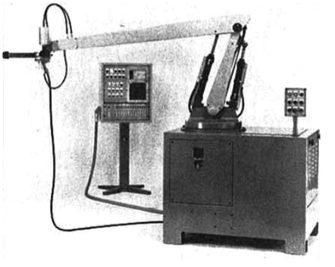
Industrial robot painting
Automotive painting is one of the oldest examples of application of robotics in the industry.
The first painting robot: Trallfa 1969 (now ABB)
Painting robots are used
almost universally:
  Automotive
  Wood and furniture industries
  Etc.

Slide 32
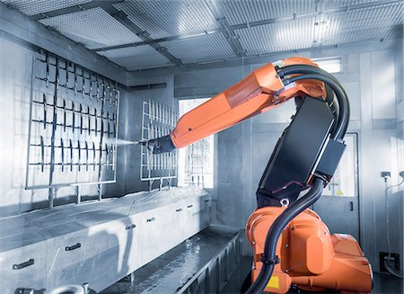
Industrial robot painting
Spray paint gun
Dedicated room/enclosure
Target/ product
Support
Conveyor

Slide 33
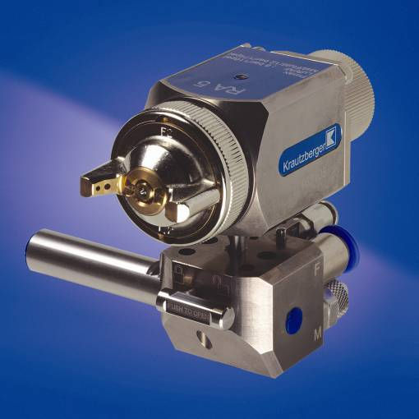
Industrial robot painting
Nozzle
Spray paint gun
  Requires:
  Paint line
  Compressed air line
Types
  Rotary bell sprayer
  Venturi effect sprayer
  …
Type of stroke
  Circular
  Elliptical
  Line
  Depends on the application!

Slide 34
Industrial robot painting
Robots are well suited for this task:
  Target objects are of a complex geometry and require agile systems
  delivering an uniform coat of paint. This is especially the case with furniture.
Examples
  Video
    chairs; complex movements arising from the complex geometries of the target objects.
  Video
    Kitchen panels; simple geometries, but uniformity of movement and speed is important.

Slide 35
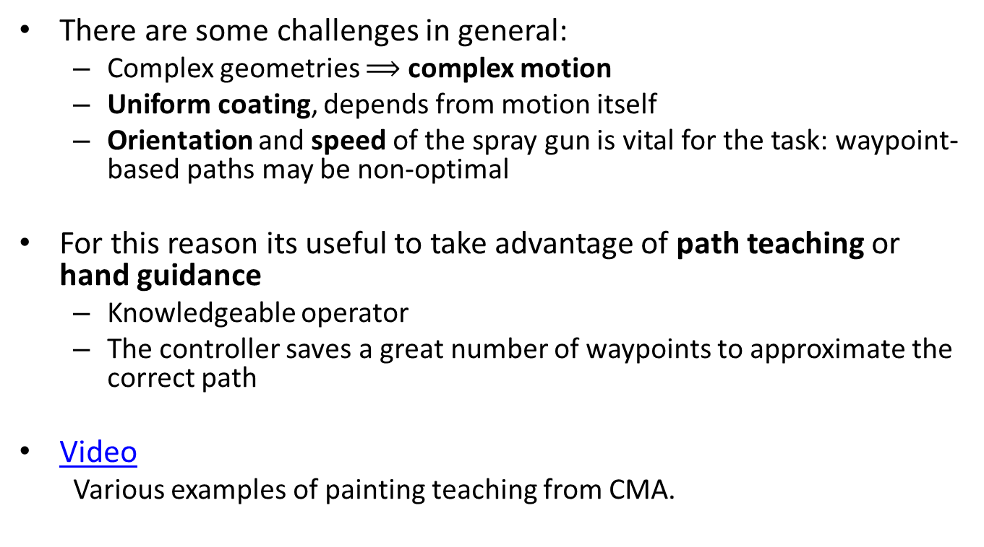
Industrial robot painting
There are some challenges in general:
  Complex geometries $⟹$ complex motion
  Uniform coating, depends from motion itself
  Orientation and speed of the spray gun is vital for the task: waypoint-based paths may be non-optimal
For this reason its useful to take advantage of path teaching or hand guidance
  Knowledgeable operator
  The controller saves a great number of waypoints to approximate the correct path
Video
  Various examples of painting teaching from CMA.

