Slide 1
Major classes of nanomaterials and their benefits

Slide 2
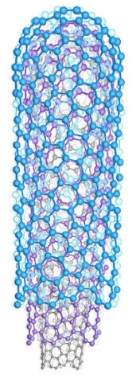
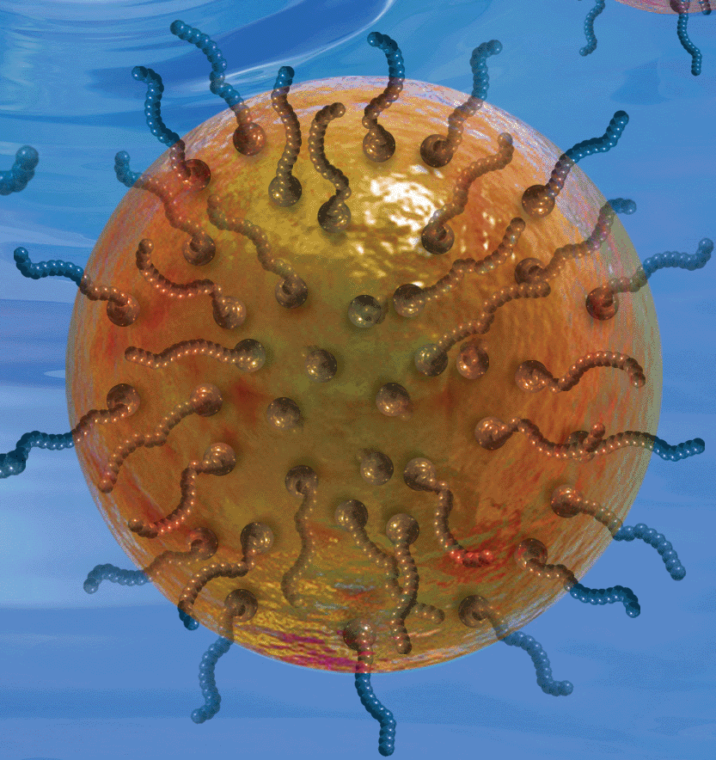
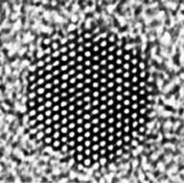
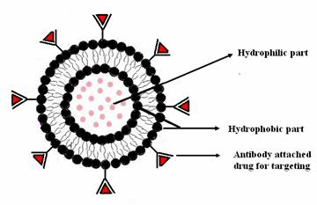
Major Classes of Nanomaterials and Sample Applications
Category | Chemical Composition | Product example
Fullerenes, Nanotubes; Nanowires | carbon, boron nitrides | Anti-static fabrics
Metals | silver, gold, iron, copper | Anti-microbial wound dressings
Ceramics (metal oxides) | titanium dioxide, zinc oxide, cerium oxide | Sunscreen filters, self-cleaning glass
Semiconductors (Quantum dots) | cadmium selenide, cadmium telluride | Medical imaging agents
Polymeric | hydrocarbon polymers | Drug delivery devices
Notes:
Trainer Notes:
One way to categorize nanomaterials is by their chemical composition. Many of the most commercially important nanomaterials can be categorized into one of the five classes listed here.
Fullerenes, Nanotubes; Nanowires: Most materials in this class are made from carbon. These include the family of compounds derived from the C₆₀ molecule known as buckminsterfullerene or buckyball, as well as the class of materials known as nanotubes. Nanotubes are simply elongated versions of the buckyball and can exist in single-walled, double-walled or multi-walled configurations.
Metals: There are many examples of nanometals in use today. The most commercially relevant is likely to be nanosilver, which is prized for its potent and broad-spectrum antimicrobial properties. Nanosilver is used in a number of consumer products ranging from spray disinfectants to toothpaste and teddy bears, as well as in many medical applications such as wound dressings and catheters. Nanosilver is even being researched for use in animal feed to reduce the need for conventional antibiotics
Ceramics: Another very broad class of materials that includes titanium dioxide, which is used in sunscreens and to coat so-called “self-cleaning glass”, as well as cerium oxide, which is a fuel additive that promotes greater fuel efficiency.
Semiconductors (Quantum Dots): These exhibit very bright photoluminescence and can be used as medical imaging agents. Unlike conventional dyes, quantum dots do not degrade quickly and have much brighter luminescence, thus enhancing the signal in a medical image. Their surfaces can be modified to direct them to specific cells in the body, including cancer cells which can aid in disease detection.
Polymeric: Polymeric nanoparticles are small beads made from polymeric hydrocarbons. They can serve as containers for drug molecules and can be designed to deliver the drug to the precise location via surface modification with biomarkers that target a certain type of cell, for example. Polymeric nanoparticles are also used in the cosmetics industry to encapsulate active ingredients and potentially deliver them beneath the epidermis.

Slide 3
Balancing the Benefits and Risks
Nanomaterials’ special physical and chemical properties may lead to unexpected interactions with biological and environmental systems.
Notes:
Trainer Notes:
The novelty of certain nanomaterials may be a double-edged sword. Society supports the development of novel nanoscale materials because of their different physical and chemical properties. But this novelty could result in unwanted impacts on humans or the natural environment. As we’re developing technologies to solve one problem we should ensure we are not contributing to another.
There is a growing body of information about nanomaterial toxicity that must be considered in designing and implementing a safe workplace. That’s where we’re going next.
Image Credit: Scale-Microsoft Clipart

Slide 4
100 Kg H₂O
V = 100 L
V = a³ = 100 dm³ a = 4.64 dm
Surface 6 x a² = 129 dm²
1 cube
100 Kg H₂O
V_{i} = 1 L
V_{i} = a_{i} ³ = 1 dm³ a = 1 dm
Total surface 100 x 6 x a_{i} ²
= 600 dm²
100 cubes

Slide 5
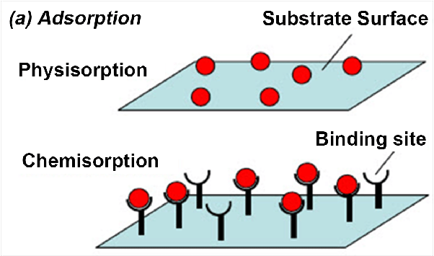
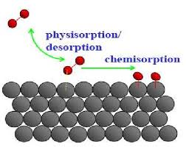
Physisorption and chemisorption

Slide 6
Adsorption and Reaction at Surfaces
PHYSISORPTION | CHEMISORPTION
WEAK, LONG RANGE BONDING Van der Waals interactions (e.g. London dispersion, dipole-dipole).. | STRONG, SHORT RANGE BONDING Chemical bonding involving orbital overlap and charge transfer.
NOT SURFACE SPECIFIC Physisorption takes place between all molecules on any surface providing the temperature is low enough. | SURFACE SPECIFIC Marked variation between crystal planes E.g. Chemisorption of hydrogen takes place on transition metals but not on gold or mercury.
ΔΗ_{ads} = 5 ….. 50 kJ mol⁻¹ Related to factors like molecular mass and polarity (i.e. ~ heat of liquefaction) | ΔΗ_{ads} = 50 ….. 500 kJ mol⁻¹ Wide range (related to the chemical bond strength)
Non activated with equilibrium achieved relatively quickly. Increasing temperature always reduces surface coverage. | Can be activated, in which case equilibrium can be slow and increasing temperature can favour adsorption.
No surface reactions. | Surface reactions may take place:- Dissociation, reconstruction, catalysis.
MULTILAYER ADSORPTION BET Isotherm used to model adsorption equilibrium. | MONOLAYER ADSORPTION Langmuir Isotherm used to model adsorption equilibrium..

