Slide 1
Robotics and Mechatronics
25 March 2021
Mobile Robots

Slide 2
25 March 2021
Due to the COVID-19 “Coronavirus” emergency, this lecture series will be given remotely
For info/questions, please contact me at:
  sseriani@units.it
  +39 040 558 2540

Slide 3
Something about me
Stefano Seriani, born in Trieste (Italy) in 1986.
B.E. in 2010 from the University of Trieste with a thesis on the development of a synchrotron light microtomography device.
M.Sc. in mechanical engineering (2012) from the same university with a thesis on bolted assemblies for space structures, developed at ICAM Toulouse, for the CNES (Centre national d'études spatiales).
Ph.D. in 2016 at the University of Trieste, for my research on Large Workspace Robots.
Research Fellow at the Institute of Robotics and Mechatronics of the German space agency (DLR), working on the development of hybrid locomotion solutions for planetary exploration rovers.
Research Fellow and Assistant Professor at the University of Trieste, studying mobile robots, space robotics and industrial robotics.

Slide 4
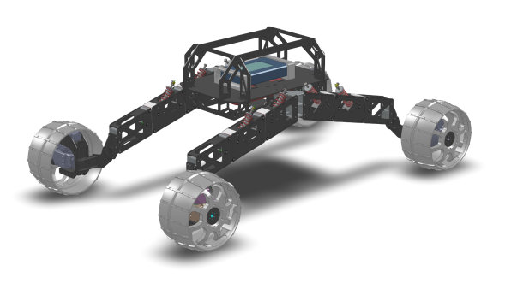
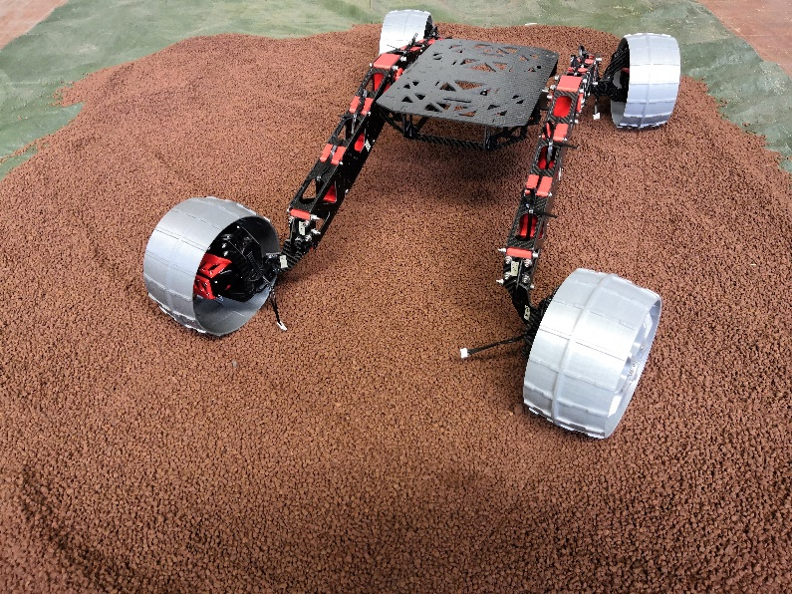
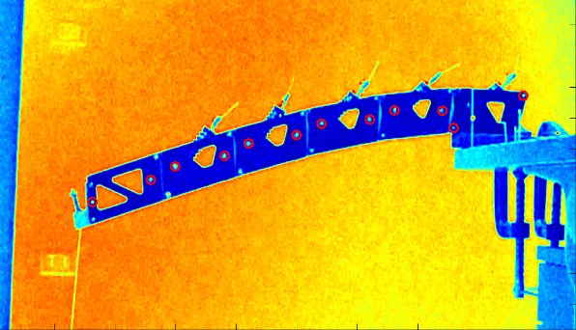
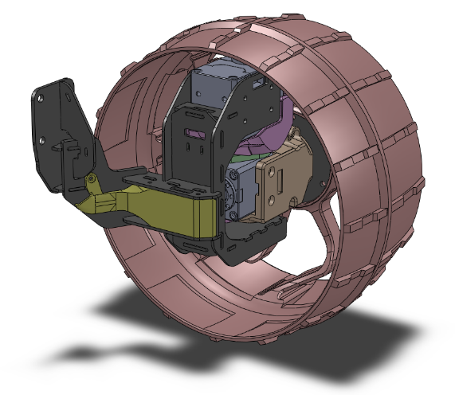
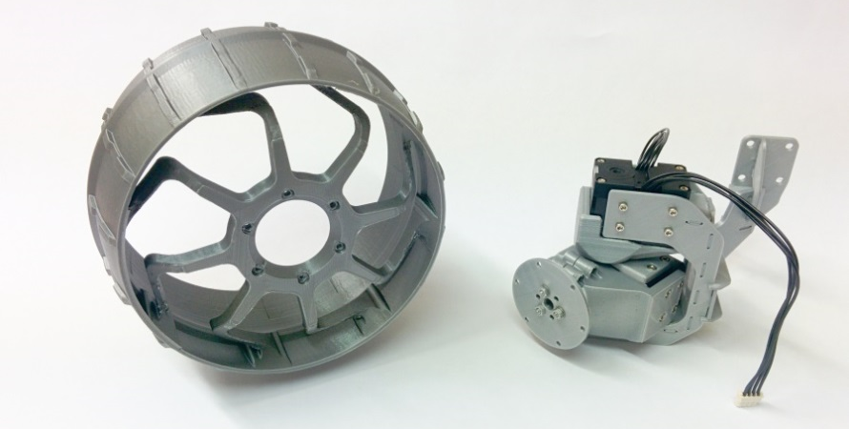
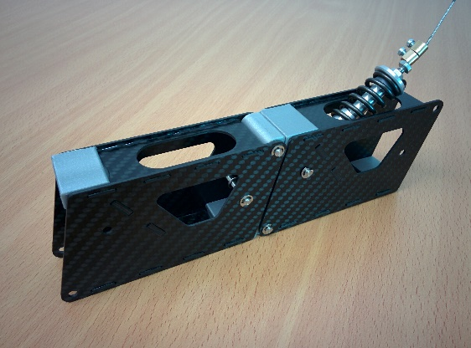
Research
My research interests include:
  Space robotics
  Mobile robotics
  Applied mechanics
  Computer-vision

Slide 5
Course
Contact information
  Seriani Stefano
  E-mail: sseriani@units.it
  Phone: +39 040 558.2540
  Consultation
    Appointment required (via email)
    Monday 13:00-15:00

Slide 6
Main topics
Mobile robotics (50%)
Sensing in robotics (20%)
Mapping/navigation (30%)

Slide 7
Notice
MATLAB Academic license
https://dia.units.it/it/dipartimento/node/32619

Slide 8
Exam
Exam modality:
Oral exam
Details
Evaluation
  Oral exam:
    3 questions, 10 points each,
    Final mark (0-30) = oral exam mark (0-30),
    1 additional question for honors.

Slide 9
Suggested reads
Robotica - Modellistica, pianificazione e controllo, B. Siciliano, L. Sciavicco, L. Villani, G. Oriolo
Robotics - Modelling, Planning and Control, Bruno Siciliano, Lorenzo Sciavicco (english version)
Introduction to Autonomous Mobile Robots, R. Siegwart, I.R. Nourbakhsh
Lecture presentation in power point (Seriani)

Slide 10
Course material
https://moodle2.units.it/course/view.php?id=7292

Slide 11
Timetable
For now…
Monday | Tuesday | Wednesday | Thursday | Friday
--- |  |  | 2h 15:15-16:45 No break
After mid-april/may…
Monday | Tuesday | Wednesday | Thursday | Friday
--- |  |  | 2h 15:15-16:45 No break | 3h 14:15-16:45 1 break

