Slide 1
Methods for comparing representations of Artificial Neural Networks
Marco Zullich, PhD Student @ Dept. of Engineering and Architecture
University of Trieste

Slide 2
WHY COMPARING REPRESENTATIONS OF ARTIFICIAL NEURAL NETWORKS?
The dynamics behind the training process of SGD are still vaguely understood, as are the generalization capability and some properties of hidden representations
It may be interesting, for instance, to compare layers during training
On the other hand, given two identically structured ANNs trained on the same dataset with two different random seeds, do they learn similar representations or the representations are different even if the final performance is the same?
Can we establish connections between the representations learned by ANNs and by their biological counterpart?

Slide 3
COMPARING LAYERS OF ARTIFICIAL NEURAL NETWORKS (ANNS)
What defines two ANNs as «similar»?
Their parameters (weights)
Their outputs
Their neurons
…other ideas?

Slide 4
Comparing anns by their neurons
What are their values given the input?
How can we approximate their probability density (given the data manifold) over $ℝ$?
$p\left(a_{ij} | x\right)$
«How does the neuron respond to the data manifold»?
→ evaluate the network over a limited, yet «large enough» dataset of points
and collect the neurons activations.
«Monte-Carlo approximation»

Slide 5
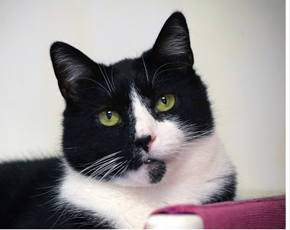
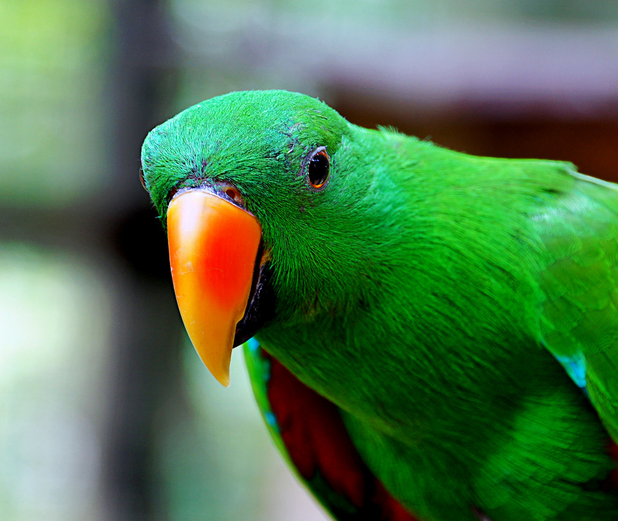
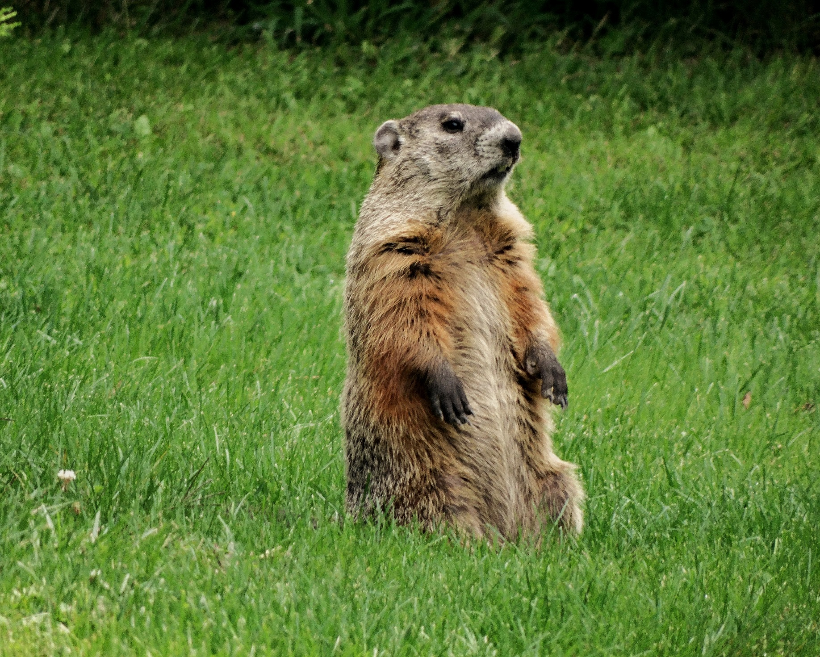
A bit more formally
Layer 1
$p$neurons
ANN
Activation matrix $n×p$
Dataset
$n$images
Activation vectors
size $p$
Representation of layer 1

Slide 6
Comparing two single-dimensional layers
$$p$$
$$p$$
$$n$$
$$n$$
What techinques do you know for comparing two matrices of the same size?

Slide 7
Comparing matrices with cosine similarity
The cosine similarity is a similarity metric between two vectors lying in the same space
Is equivalent to the cosine of the angle between the two
$$v_{1}^{T}v_{2}=\left\|v_{1}\right\|⋅\left\|v_{2}\right\|⋅\cos{(θ)}$$
$$θ$$
hence
$$v_{1}$$
$$v_{2}$$
$$\cos\left(θ\right)= \frac{v_{1}^{T}v_{2}}{\left\|v_{1}\right\|⋅\left\|v_{2}\right\|}= \frac{\left\langle v_{1},v_{2}\right\rangle }{\left\|v_{1}\right\|⋅\left\|v_{2}\right\|}$$
What is wrong with cosine similarity when comparing two flattened layers?

Slide 8
THE requisite OF ROTATION INVARIANCE
One of the properties of the neural network is that, by carefully changing the order of the neurons (and their corresponding weights) in the hidden layers, we can obtain two networks behaving identically
Ideally we would like a similarity metric to be invariant to that property
If we view the neurons as directions within the space of representations
the permutation can be seen as a rotation within this space
and the requirement becomes rotational invariance.

Slide 9
…an additional requisite
In addition to the rotational invariance requisite, we would also like our metric to be more flexible and adapt to generic situations in which the two layers have different sizes
In pratical terms…
$$p$$
$$q$$
$$n$$
$$n$$
$$p⋚q$$

Slide 10
Introducing canonical correlation analysis (CCA)
CCA is a technique introduced in the ‘30s by the statistician Harold Hotelling
Is a technique for establishing connections between two generic sets of continuous variables called phenomena
$X=\left(X_{1}, …,X_{p}\right); Y=\left(Y_{1},…, Y_{q}\right), p⋛q$
We operate by constructing a so-called view of these two phenomena
We consider $n$ statistical units (individuals)
We evaluate these individuals over our phenomena

Slide 11
Cca {2}
Now, we may store these views in two matrices, $M_{X}, M_{Y}$
$$M_{X}$$
$$p$$
$$M_{Y}$$
$$q$$
$$n$$
$$n$$

Slide 12
CCA {3}
CCA acts by applying a linear transformation to two unknown vectors $w_{X}∈ℝ^{p}, w_{y}∈ℝ^{q}$
The linear transformation is the one implied by $M_{X}$ and $M_{Y}$
$M_{X}w_{X}=z_{X}∈ℝ^{n}; M_{Y}w_{Y}=z_{Y}∈ℝ^{n}$
The constraint over $w_{X}, w_{y}$ is that the corresponding $z_{X}, z_{y}$
are unit vectors
have maximum Pearson correlation.
Geometrically, Pearson correaltion = cosine of enclosing angle $θ$ (*)
$$z_{X}=M_{X}w_{X}$$
$$w_{X}$$
$$M_{X}$$
$$θ$$
$z_{Y}$= $M_{Y}w_{Y}$
$$w_{Y}$$
$$M_{Y}$$
Does this ring a bell?
(*) for 0-mean random variables/representations

Slide 13
CCA {4}
Call $ρ≜\cos{θ}$ → CANONICAL CORRELATION (CC)
We now wish to obtain another set $w_{X}^{(2)}, w_{Y}^{(2)}$
Such that the corresponding $z_{X}^{(2)}, z_{Y}^{(2)}$ respect all previous properties
and they’re orthogonal to $z_{X}, z_{y}$ respectively
We will have the corresponding $ρ^{(2)}≤ρ$
We can find an iterative method which produces a decreasing sequence of CCs $\left(ρ^{\left(1\right)},…,ρ^{\left(\min\left(p,q\right)\right)}\right)$

Slide 14
CCA {5}
We can summarize all this in matrix notation
$W_{X}∈ℝ^{p×\min\left(p,q\right)}, Z_{X}∈ℝ^{n×\min{(p,q)}}$ (analogous for $W_{Y}, Z_{Y}$)
$M_{X}W_{X}=Z_{X}$ (analogous for $W_{Y}, Z_{Y}, M_{Y}$)
The rows of $Z_{X}$ hold the s.c. canonical variables
$Z_{X}, Z_{Y}$ are orthonormal bases of the space $ℝ^{n}$
Pearson correlation between $z_{X}^{(i)}, z_{Y}^{(i)}$is maximum
$Ρ={\left(ρ^{\left(i\right)}\right)}_{i}$ is trivially obtained as the row-wise cosine similarity between $Z_{X}, Z_{Y}$

Slide 15
CCA {6}
Singular Value Decomposition (SVD)
But how can we obtain $W_{X}, W_{Y}$?
$$Σ_{XX}^{−1/2}Σ_{XY}Σ_{YY}^{−1/2}=USV$$
$$Σ_{XX}$$
$$VAR(M_{X})$$
Left singular vectors
${Σ_{XX}^{1/2}u}_{i}$ yields the corresponding $w_{X}^{(i)}$
$$Σ_{YY}$$
$$VAR(M_{Y})$$
Right singular vectors
${Σ_{YY}^{1/2}v}_{i}$ yields the corresponding $w_{Y}^{(i)}$
$$Σ_{XY}$$
$$COV({M_{X},M}_{Y})$$
Singular values
$s_{i}$ corresponds to the canonical correlation $ρ_{}^{(i)}$

Slide 16
MEAN CCA SIMILARITY
$$ρ^{(1)}$$ | $$ρ^{(2)}$$ | $$ρ^{(3)}$$ | … | $$ρ^{(r)}$$
$$r=\min{(p,q)}$$
These coefficient convey an information on relatedness between $M_{X}$ and $M_{Y}$.
$${CCA}_{sim}\left(M_{X}, M_{Y}\right)≜\frac{\sum_{j=1}^{r}{ρ^{(j)}}}{r}$$
Mean CCA similarity

Slide 17
Recap on cca
$X, Y$ are our layers
$M_{X}, M_{Y}$are our representations
Study connections between two phenomena $X, Y$ of possibly different sizes
Build views by means of $n$ observations over $X, Y→M_{X}, M_{Y}$
Linearly project the columns of $M_{X}, M_{Y}$ in orthonormal bases of size $ℝ^{n}→Z_{X}, Z_{Y}$
The projection maximizes correlation $ρ$ between rows of these two bases
$ρ$’s can be easily obtained one-shot via SVD applied on variance-covariance matrices of $M_{X}, M_{Y}$

Slide 18
Svcca [1]
A technique thought explicitly for applying CCA to compare ANN layers
Assumption: most of the neurons within a layer contribute close to nothing to the variance of its representation
Operate SVD for dimensionality reduction
$$M_{X}$$
$$p$$
$$U$$
$$S$$
$$V^{T}$$
$$p$$
$$n$$
$$p$$
$$s_{jj}^{2}=VAR{\left(M_{X}\right)}_{j}$$
$$s_{jj}≥s_{kk}, j>k$$
=
$$p$$
$$n$$
$$n$$
Operate CCA and obtain similarity

Slide 19
Similarity of representations using kernels
Linear kernel over a representation $M_{X}$
$$L_{X}=M_{X}M_{X}^{T}∈ℝ^{n×n}$$
$$L_{Y}=M_{Y}M_{Y}^{T}∈ℝ^{n×n}$$
To measure the dissimilarity between these two matrices, we can use the inner product of their vectorized version
$$\left\langle vec\left(L_{X}\right), vec(L_{Y})\right\rangle =tr(L_{X}L_{Y})$$
$$={\left\|M_{Y}^{T}M_{X}\right\|}_{Fr}^{2}$$
Note: $COV\left(A,B\right)= \frac{AB^{T}}{n−1}⇒{\left\|COV\left(A,B\right)\right\|}^{2}=\frac{{\left\|AB^{T}\right\|}^{2}}{{\left(n−1\right)}^{2}}$
$={\left(n−1\right)}^{2}$ ${\left\|COV\left(M_{X}^{T},M_{Y}^{T}\right)\right\|}^{2}$
$${\left\|COV\left(M_{X}^{T},M_{Y}^{T}\right)\right\|}^{2}= \frac{tr(L_{X}L_{Y})}{{\left(n−1\right)}^{2}}$$

Slide 20
Hilbert schmidt independence criterion (hsic)
$${\left\|COV\left(M_{X}^{T},M_{Y}^{T}\right)\right\|}^{2}= \frac{tr(L_{X}L_{Y})}{{\left(n−1\right)}^{2}}$$
HSIC for linear kernels
$$HSIC\left(\tilde{K_{X}},\tilde{K_{Y}}\right)= \frac{tr(\tilde{K_{X}}\tilde{K_{Y}})}{{\left(n−1\right)}^{2}}$$
$\tilde{K_{X}}=K_{X}(I −n^{−1}{11}^{T})$ kernels centered w.r.t. row and column means
HSIC is a statistic for determining whether two generic sets of variables are independent
$HSIC→0$ stochastic independence
$HSIC→1$ stochastic dependence

Slide 21
Centered kernel alignment (cka)
Normalization of HSIC
$$CKA\left(\tilde{K_{X}},\tilde{K_{Y}}\right)=\frac{HSIC\left(\tilde{K_{X}},\tilde{K_{Y}}\right)}{\sqrt{HSIC\left(\tilde{K_{X}},\tilde{K_{X}}\right)HSIC\left(\tilde{K_{Y}},\tilde{K_{Y}}\right)}}=\frac{{\left\langle \tilde{K_{X}}\tilde{,K_{Y}}\right\rangle }^{}}{\left\|\tilde{K_{X}}\right\|\left\|\tilde{K_{Y}}\right\|}∈[0,1]$$
Linear CKA
$${CKA}_{lin}\left(M_{X}, M_{Y}\right)=\frac{{\left\|M_{Y}^{T}M_{X}\right\|}^{2}}{\left\|M_{X}^{T}M_{X}\right\|\left\|M_{Y}^{T}M_{Y}\right\|}∈[0,1]$$

Slide 22
CHOICE OF KERNELS
Radial Basis Function (RBF) kernel:
$κ\left(x,y\right)= exp\left(\frac{−{\left\|x−y\right\|}^{2}}{2σ^{2}}\right)$
[2] cites no substantial difference between using RBF kernel with $σ∈ [0.2, 0.6]$ w.r.t. a linear kernel
On the other hand, [3] refers that CKA with RBF with very small sigma may be a better choice for a more accurate similarity metric, but more on that on the next keynote.

Slide 23
ON THE DESIRABLE AND INDESIRABLE INVARIANCES OF METRICS
Invariance to orthogonal transformations was already discussed before
Invariance to isotropic scaling (arbitrary scaling of the features)
$SIM\left(M_{X}, M_{Y}\right)= SIM\left(αM_{X}, βM_{y}\right), α,β∈ℝ^{+}$
Good
Good
Invariance to invertible linear transformations
Bad
This invariance poses problems when $n<p$, as for full-rank matrices $A, B$,
the similarity $SIM\left(A,C\right)=SIM\left(B,C\right)$ [2]
The training process is sensible w.r.t. invertible linear transforms. Just think of BATCH NORMALIZATION

Slide 24
Summary of metrics invariances
Table from [2].

Slide 25
AUGMENTING CKA WITH INFORMATION ON GRADIENTS
[4] proposes an augmentation of CKA by incorporating information on gradients for the given layer(s)
$$M_{X}$$
$$p$$
$$G_{X}$$
$$p$$
$$K_{X}={K_{M}}_{X}⊙{K_{G}}_{X}$$
$$n$$
$$n$$
$$K_{Y}={K_{M}}_{Y}⊙{K_{G}}_{Y}$$
$$κ(⋅,⋅)$$
$$κ(⋅,⋅)$$
$${CKA}_{Gr.}\left(\tilde{K_{X}},\tilde{K_{Y}}\right)=\frac{\left\langle \tilde{K_{X}},\tilde{K_{Y}}\right\rangle }{\left\|\tilde{K_{X}}\right\|\left\|\tilde{K_{Y}}\right\|}$$
$$K_{M_{X}}$$
$$K_{G_{X}}$$

Slide 26
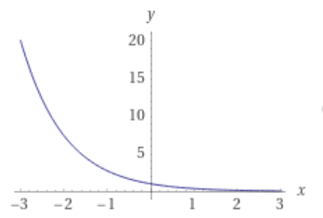
Why cka and cca might be wrong
Classical statistics:
FIXED features (variables)
VARIABLE datapoints (observations)
$p$ fixed; $n → ∞ ⁡$
High dimensional statistics [7]:
VARIABLE features (variables)
VARIABLE datapoints (observations)
$$p →∞; n →∞$$
In Deep Learning, the focus is either on depth and width. In wide ANNs, we're essentially increasing p which may be way larger than n.
Consider moreover that both CCA and CKA are essentially based on the concept of COVARIANCE.
Maybe, we might want to detach from a classical statistical view and go to more "non-parametric" techniques to obtain metrics.
Most of the results we know and use everyday in research adhere to this paradigm.
e.g. law of large numbers
In high dimensional statistics, some results from classical statistics do not hold or may present abnormally large errors
$$P\left(\left\|Σ−\hat{Σ}\right\|≥δ\right)≤2p\exp\left(\frac{−nδ^{2}}{2b\left(\left\|Σ\right\|+δ\right)}\right), b∈ℝ, δ→0^{+}$$
What is this?
Linear increase
Negative exponential decay
Error of covariance estimator $\hat{Σ}$

Slide 27
IMD
CRAZY STUFF!
IMD is a metric recently proposed at ICLR 2020 [6]
Compares generic data manifolds, unaligned and different in dimension
Underlying theory is absurdly difficult
If you really want to have a go at it
https://github.com/xgfs/imd
Focus is on generative models and language models, but it should work fine on simple MLPs as well

Slide 28
recapping
Unaligned representations: Neuron $i$ in ANN 1 might not be the same as neuron $i$ in ANN2
Metrics such as CKA and (SV)CCA overcome these hurdles
Comparing hidden representations produced by MLPs is a difficult task
Different dimensionalities:
Representations may not be composed by the same number of neurons
Curse of dimensionality:
Human intuition fails when the number of variables (neurons) in the representation is very high
High dimensional statistics:
Regular statistical results may fail when p→inf. It is shown that covariance is tricky in that scenario

Slide 29
references
Raghu, Maithra, et al. "Svcca: Singular vector canonical correlation analysis for deep learning dynamics and interpretability." NeurIPS, 2018.
Kornblith, Simon, et al. "Similarity of neural network representations revisited." International Conference on Machine Learning. PMLR, 2019.
Doimo, Diego, et al. "Hierarchical nucleation in deep neural networks." NeurIPS, 2020.
Tang, Shuai, et al. "Similarity of neural networks with gradients." arXiv preprint arXiv:2003.11498 (2020).
Zullich, Marco, et al. "Investigating Similarity Metrics for Convolutional Neural Networks in the Case of Unstructured Pruning". ICPRAM, 2020.
Tsitsulin, Anton, et al. "The Shape of Data: Intrinsic Distance for Data Distributions." ICLR, 2020.
Wainwright, Martin J. High-dimensional statistics: A non-asymptotic viewpoint. Vol. 48. Cambridge University Press, 2019.

