Slide 1
wORKSHOp 1 HEALTH homosexuality and discrimination: a case from Ghana
DEVELOPMENT ANTHROPOLOGY
UNIVERSITY OF TRIESTE
MA IN DIPLOMACY AND INTERNATIONAL
COOPERATION STUDIES
Enrica - Camilla

Slide 2
LGBT Community: its perception Cultural elements in comparison
Ghana
Religion
Family’s disown
Ghanaian Criminal Code
Punishment for same- sex relations
Public opinion
Community’s opposition and reluctance
Western World
Secularization
Fall of secular conservative thinking
Legitimization
EU is a LGBTIQ freedom zone
Public opinion
General acceptance & support

Slide 3
Exceptions
Poland + Hungary
Open & harsh opposition to LGBT community (Politics + Religion)
PL: Extreme conservative thinking
HU: vote against the legal recognition of transgender people
South Africa
Johannesburg, Durban & Cape Town
Acceptance of the LGBT community + Free tourism destination

Slide 4
Indiscriminate discrimination: are you a witch ?
Ghana (Today)
Harmful events attributed to women
Europe (1450 – 1750)
Attributed to women in lower social classes + magic to influence the flow of events

Slide 5
Discrimination: how to cope
Art as tool to express one’s true self:
The case of Drama Queens

Slide 6
From local to global
Dialogue with local communities: understand the issue
Taking actions: promote communication between parties + interactive/ informative workshops
Spreading awareness: involve the global community (Amnesty International, ILGA)
Support coming from global stakeholders to local projects

Slide 7
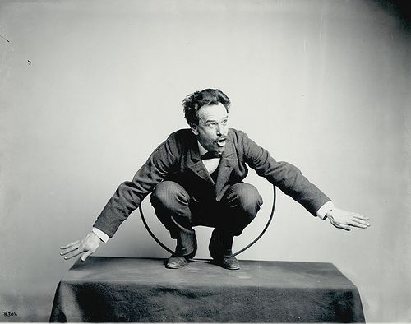
Theory for practice
Franz Boas’ Cultural relativism:
understanding the culture based on the context

Slide 8
Thank you for your attention!
Do you have any question?

Slide 9
List of references
Essere gay in Africa può costare la vita: la situazione Paese per Paese: https://www.amnesty.it/diritti-gay-africa/
European witchcraft European witchcraft – Wikipedia
European Parliament resolution of 11 March 2021 on the declaration of the EU as an LGBTIQ Freedom Zone Texts adopted - Declaration of the EU as an LGBTIQ Freedom Zone - Thursday, 11 March 2021 (europa.eu)
GENDER IDENTITY, GENDER EXPRESSION AND SEX CHARACTERISTICS PROGRAMME: https://ilga.org/gender-identity-gender-expression-sex-characteristics
Ghana, i movimenti LGBT+ che sfidano pregiudizi e patriarcato: https://vociglobali.it/2021/02/01/ghana-i-movimenti-lgbt-che-sfidano-pregiudizi-e-patriarcato/
LGBT rights in South Africa LGBT rights in South Africa - Wikipedia
PROTECTDEFENDERS.EU: https://ilga.org/protectdefenders-eu
RELIGION AND HOMOSEXUALITY IN GHANA: ASSESSING THE FACTORS CONSTRAINING THE LEGALISATION OF HOMOSEXUALITY IN GHANA: A STUDY OF THE KLOTTEY KORLE SUB-METROPOLITAN AREA OF ACCRA Religion and Homosexuality in Ghana Assessing the Factors Constraining the Legalisation of Homosexuality in Ghana A Study of the Klottey Korle Sub-Metropolitan Area of Accra.pdf (ug.edu.gh)
Witchcraft in Ghana Witchcraft in Ghana - Wikipedia
Cultural relativism: http://anthrotheory.pbworks.com/w/page/29518607/Boasian%20Anthropology%3A%20Historical%20Particularism%20and%20Cultural%20Relativism (Chapter II, section a)
Franz Boas. Encyclopedia Britannica. https://www.britannica.com/biography/FranzBoas#ref210128
Notes taken in class (17/03/21)

