Slide 1
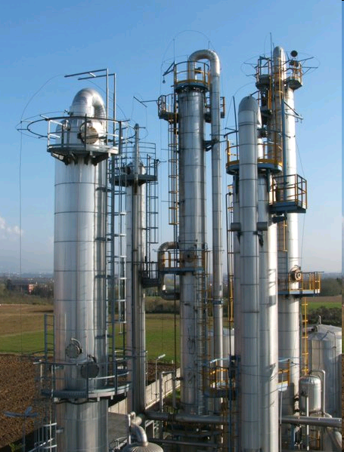
RadFrac – Rigorous method for multicomponent distillation
Maurizio Fermeglia
Maurizio.fermeglia@units.it
Department of Engineering & Architecture
University of Trieste

Slide 2
Agenda
Introduction to RadFrac in ASPEN+
Setup
Results
Plotting results
Design specifications
Efficiencies, trays and packings
Distillation shortcut methods
Example

Slide 3
Objectives
Understand the requirements for designing a rigorous separation column, starting from shortcut methods
Enter the minimum input required for the RadFrac fractional model
Implement Design Specification
Introduce column efficiency and hydraulic calculations

Slide 4
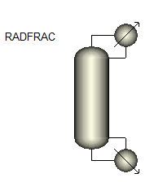
RadFrac in Aspen Plus
Vapor-Liquid or Vapor-Liquid-Liquid phase simulation of:
Ordinary distillation
Absorption, reboiled absorption
Stripping, reboiled stripping
Azeotropic distillation
Reactive distillation
Configuration options:
Any number of feeds
Any number of side draws
Total liquid draw off and pumparounds
Any number of heaters
Any number of decanters

Slide 5
RadFrac Flowsheet Connectivity
Legend:
Optional stream
Heat stream
Material Stream
Vapor Distillate
Top-Stage or Condenser Heat Duty
1
Heat
Liquid distillate
Reflux
Water distillate
Feed
Side products
Heat
Pseudo Streams
Pumparound
Feed
Heat
Decanter
Heat
Return
Product
Boil-up
Bottom Stage or Reboiler Heat Duty
Heat
N-stage
Bottoms

Slide 6
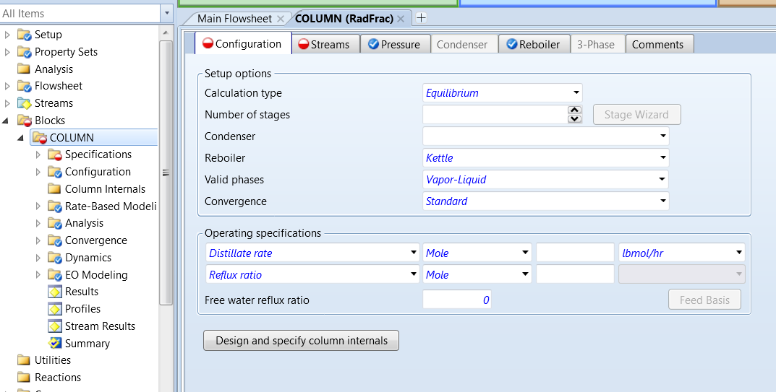
RadFrac Setup Configuration Sheet
Specify:
Calculation Type: Equilibrium, Rate-Based
Number of stages
Condenser and reboiler configuration: Total, Partial, Kettle, Thermosyphon, etc…
Valid Phases
Convergence
Column operating specifications: Distillate Rate, Reflux Ratio, Distillate to Feed Ration, Condenser/Reboiler Duty, etc.

Slide 7
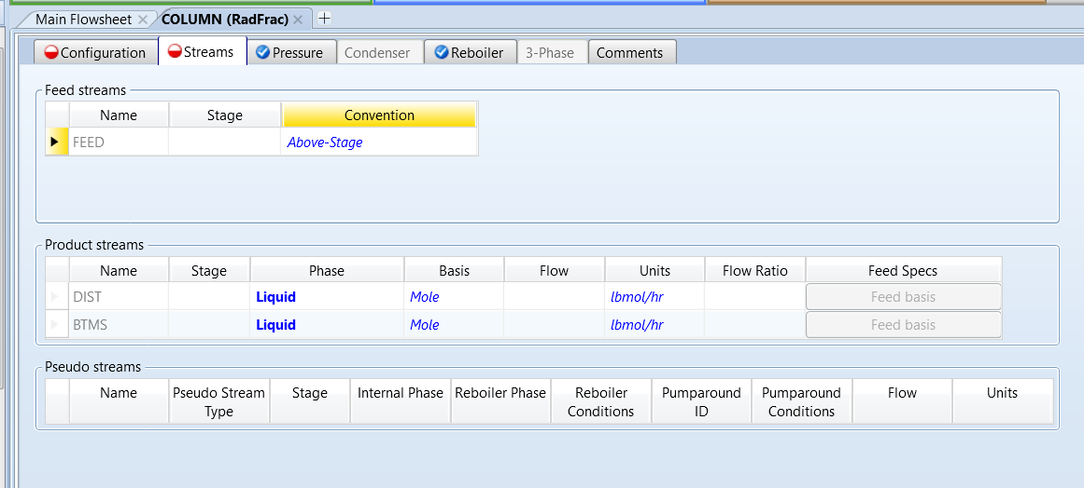
RadFrac Setup Streams Sheet
Specify:
Feed stage location
Feed stream convention: Above stage, On-Stage, On-Stage-Liquid, On-Stage-Vapor, Decanter (for VLL calculations only)
Bottom and overhead product streams
Side products

Slide 8
Feed Convention
L_{n-2}
V_{n-1}
L_{n-2}
V_{n-1}
n-1
n-1
V_{feed}
Pre-Flash
L_{n-1}
V_{n}
L_{n-1}
V_{n}
Feed to stage n
L_{feed}
Feed to stage n
n
n
L_{n}
V_{n+1}
L_{n}
V_{n+1}
On-Stage
On-Stage: RadFrac introduces both liquid and vapor portions of the feed flow to the stage specified
On-Stage Liquid and On-Stage-Vapor: similar to On-Stage, but no flash is ever performed with these specifications. Feed is treated as being entirely in the phase specified
Above-Stage (default)
RadFrac introduces the material stream between adjacent stages – the liquid portion flows to the specified stage and the vapor portion flows to the stage above

Slide 9
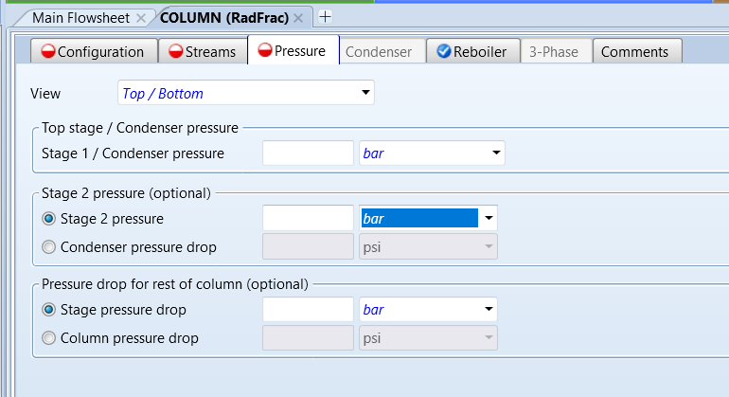
RadFrac Setup Pressure Sheet
Specify one of:
Top/Bottom Pressure: Pressure in Stage 1/Condenser represents column pressure if no pressure drop is specified. It is possible to specify pressure drop information on a stage-wise or full column basis
Pressure profile
Section pressure drop:

Slide 10
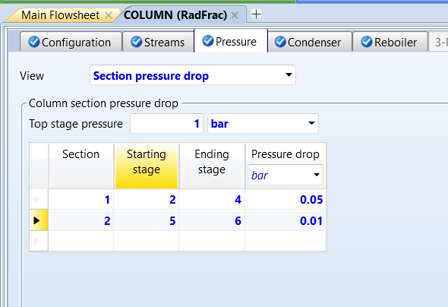
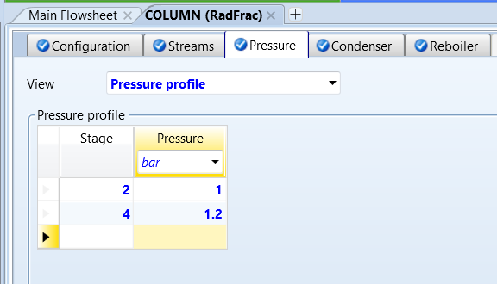
RadFrac Setup Pressure Sheet
Pressure profile:
This option allows the user to specify pressures for any stage in the column
Stage pressure not entered (Stage 3 in this case) are linearly interpolated or extrapolated from specified values
Section pressure drop:
This option lets the user specify pressures drop across any range of stages in the column
Top Stage pressure is required

Slide 11
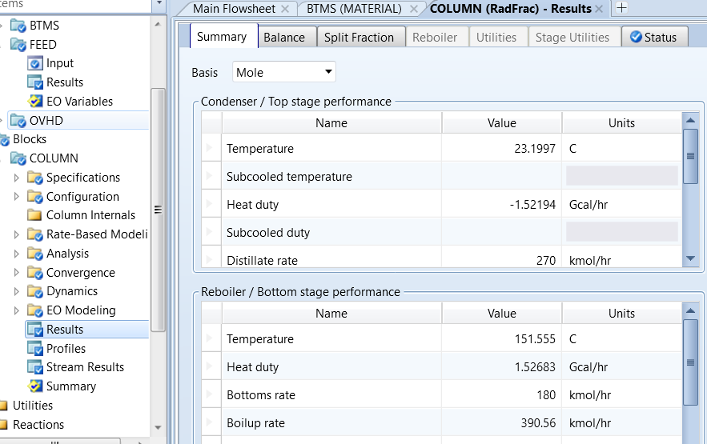
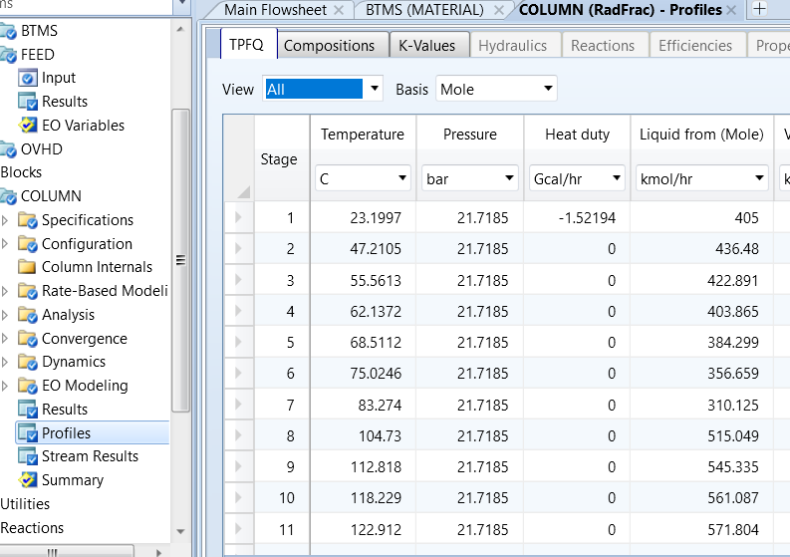
RadFrac Results
Results sheets:
Info on Condenser and Reboiler
Mass and Energy Balance
Split fraction of components
Profiles:
Temperature, Pressure, Flows, Heat of each stage
Composition variations
K-values (ratio of volatilities, partial pressures, mole frac, … of a component between two phases in equilibrium)

Slide 12
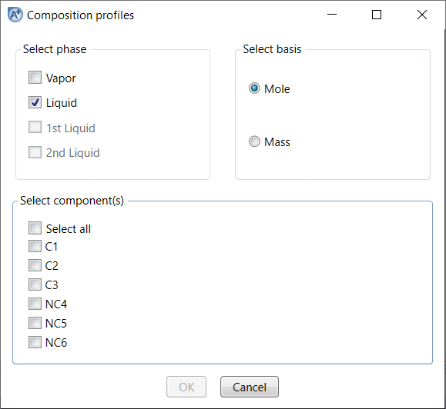
Plotting RadFrac Results
Use the Plotting Tool from the Home tab of the ribbon to quickly generate plot results of a simulation:
Assay data analysis
Physical property analysis
Data regression analysis
Profiles for all separation models including RadFrac, MultiFrac and PetroFrac
Sensitivity Analysis
Provide additional information if requested, such as phases, components, etc…

Slide 13
Define RadFrac parameters
We need to define these parameters:
Number of stages
Type of condenser/reboiler
Any two of the available operating specifications
Feed stage
Pressure

Slide 14
Using Design Specification
Design Specification sheet
Design specifications can be specified inside the RadFrac block
using Design Specs and Vary forms (in Specifications)
One or more RadFrac inputs can be manipulated (Vary)
to achieve specifications for one or more RadFrac performance parameters
RadFrac Vary variables must be a input to the block (usually on the Specifications sheet):
More complex columns have additional options
Examples: pump around heater, stage duty, side draw rate
The number of Specs should, in most cases, be equal to the number of varies
Vary sheet

Slide 15
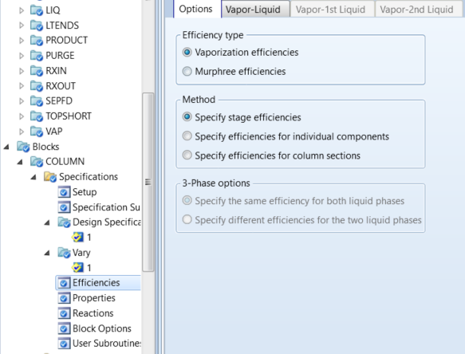
Specifying Efficiencies in RadFrac
RadFrac assumes total equilibrium on each separation stage
For non-ideal separation, you can specify Efficiencies
For trayed columns: Nstages= Ntrays+2
Matches real equipment
Enter efficiencies to match plant performance
RadFrac accepts Vaporization and Murphree efficiencies
Entered on component, stage or section basis

Slide 16
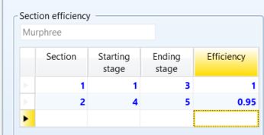
Specifying Efficiencies in RadFrac
Specify efficiencies on Vapor-Liquid sheet
Stages and efficiencies not entered are linearly interpolated from specified values
Murphree efficiencies are preferred as vaporization efficiencies can alter the temperature profile and thus relative volatilities
$$ε_{mV}=\frac{y_{n}−y_{n+1}}{y_{n}^{eq}−y_{n+1}}$$
$$ε_{mL}=\frac{x_{n}−x_{n−1}}{x_{n}^{eq}−x_{n−1}}$$

Slide 17
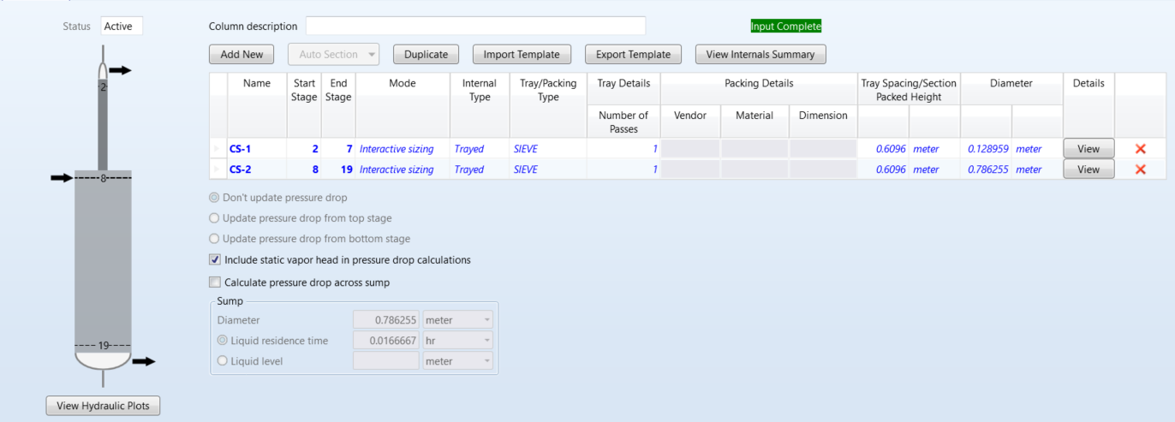
Sizing and Rating for Trays and Packing
Extensive capabilities to size, rate, and perform pressure drop calculations for trayed and packed columns
Calculations are based on vendor-recommended procedures when available.
Tray and packing calculations do NOT affect column separation by default.
Rating specifications are used when performing cost analysis

Slide 18
RadFrac Convergence Notes
Ensure that column operating conditions are feasible
Check that physical property issues are properly addressed
If the column err/tol is decreasing fairly consistently, increasing the max number of iterations (RadFrac | Convergence | Convergence | Basic Sheet
Convergence without Design Specs and Vary to initialize the column before adding (or revealing) specs and varys
Provide Temperature estimates for some stages in the column using RadFrac | Convergence | Estimates | Temperature sheet (for absorbers)
Provide composition estimates for some sates in the column using RadFrac | Convergence | Estimates | L and V Composition sheet (for non-ideal systems)
Consider different convergence methods on RadFrac | Specifications | Setup | Configuration Sheet
Remember to reinitialize the simulation every time!
18

Slide 19
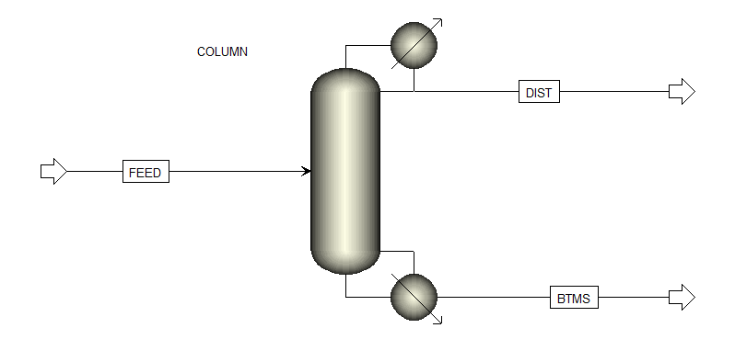
Demo RadFrac: Set up a methanol tower
Components Methanol - water
Property Method: NRTL-RK
Feed Stream:
Mole fractions: 60 mole% methanol, 40 mole% water
Mass Flow: 100 kmol/hr
Pressure: 1.1 bar
Condition: saturated liquid (V/F=0)
Radfrac column:
31 trays
Feed tray: 20
Total condenser, kettle reboiler
Top stage pressure: 1.1 bar
Pressure drop per stage: 0.0005 bar
Distillate to feed ratio: 0.598
Molar reflux ratio: 0.496
Results:
Any Warning?
Heat Duties?
Plot the compositions and understand what is going on
Did we achieve a good separation? If not try to increase distillate rate to 60 kmol/hr and more

Slide 20
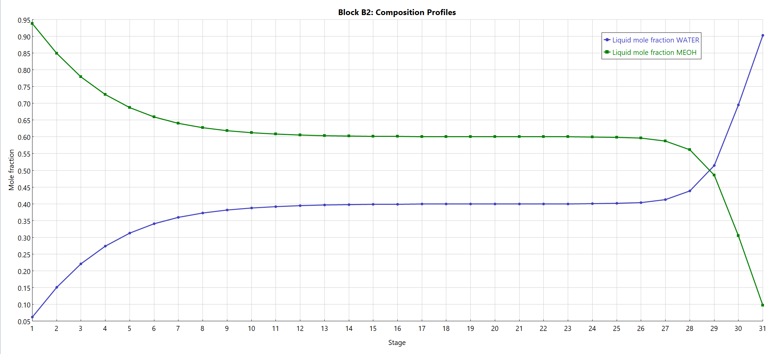
Demo RadFrac: Set up a methanol tower
Results
Separation not good: purity meOH in D= 0.938, purity water in B= 0.902
Concertation profiles are flat for many stages around feed stage
Increase D/F to 0.65 → purity meOH in D= 0.923, purity water in B= 1
Increase D/F to 0.70 → purity meOH in D= 0.857, purity water in B= 1
Decrease D/F to 0.55 → purity meOH in D= 0.938, purity water in B= 0.813

Slide 21
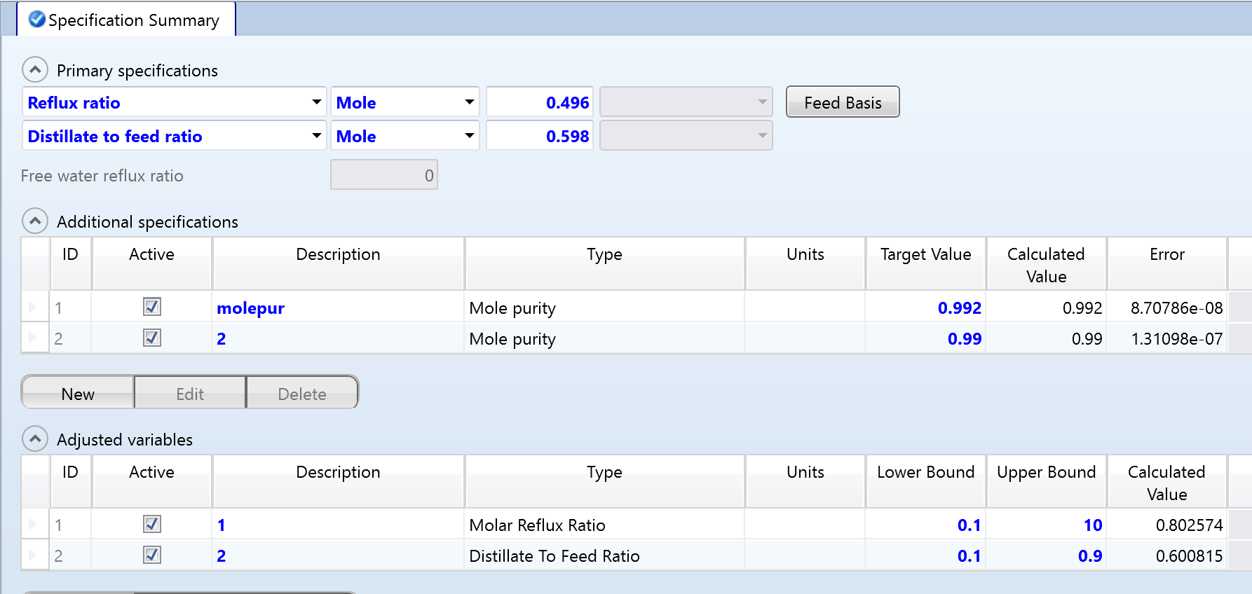
Demo RadFrac: Set up a methanol tower
Add design specifications
Des spec 1 → purity MeOH in DISTIL
Des spec 2 → purity Water in BOTTOM

Slide 22
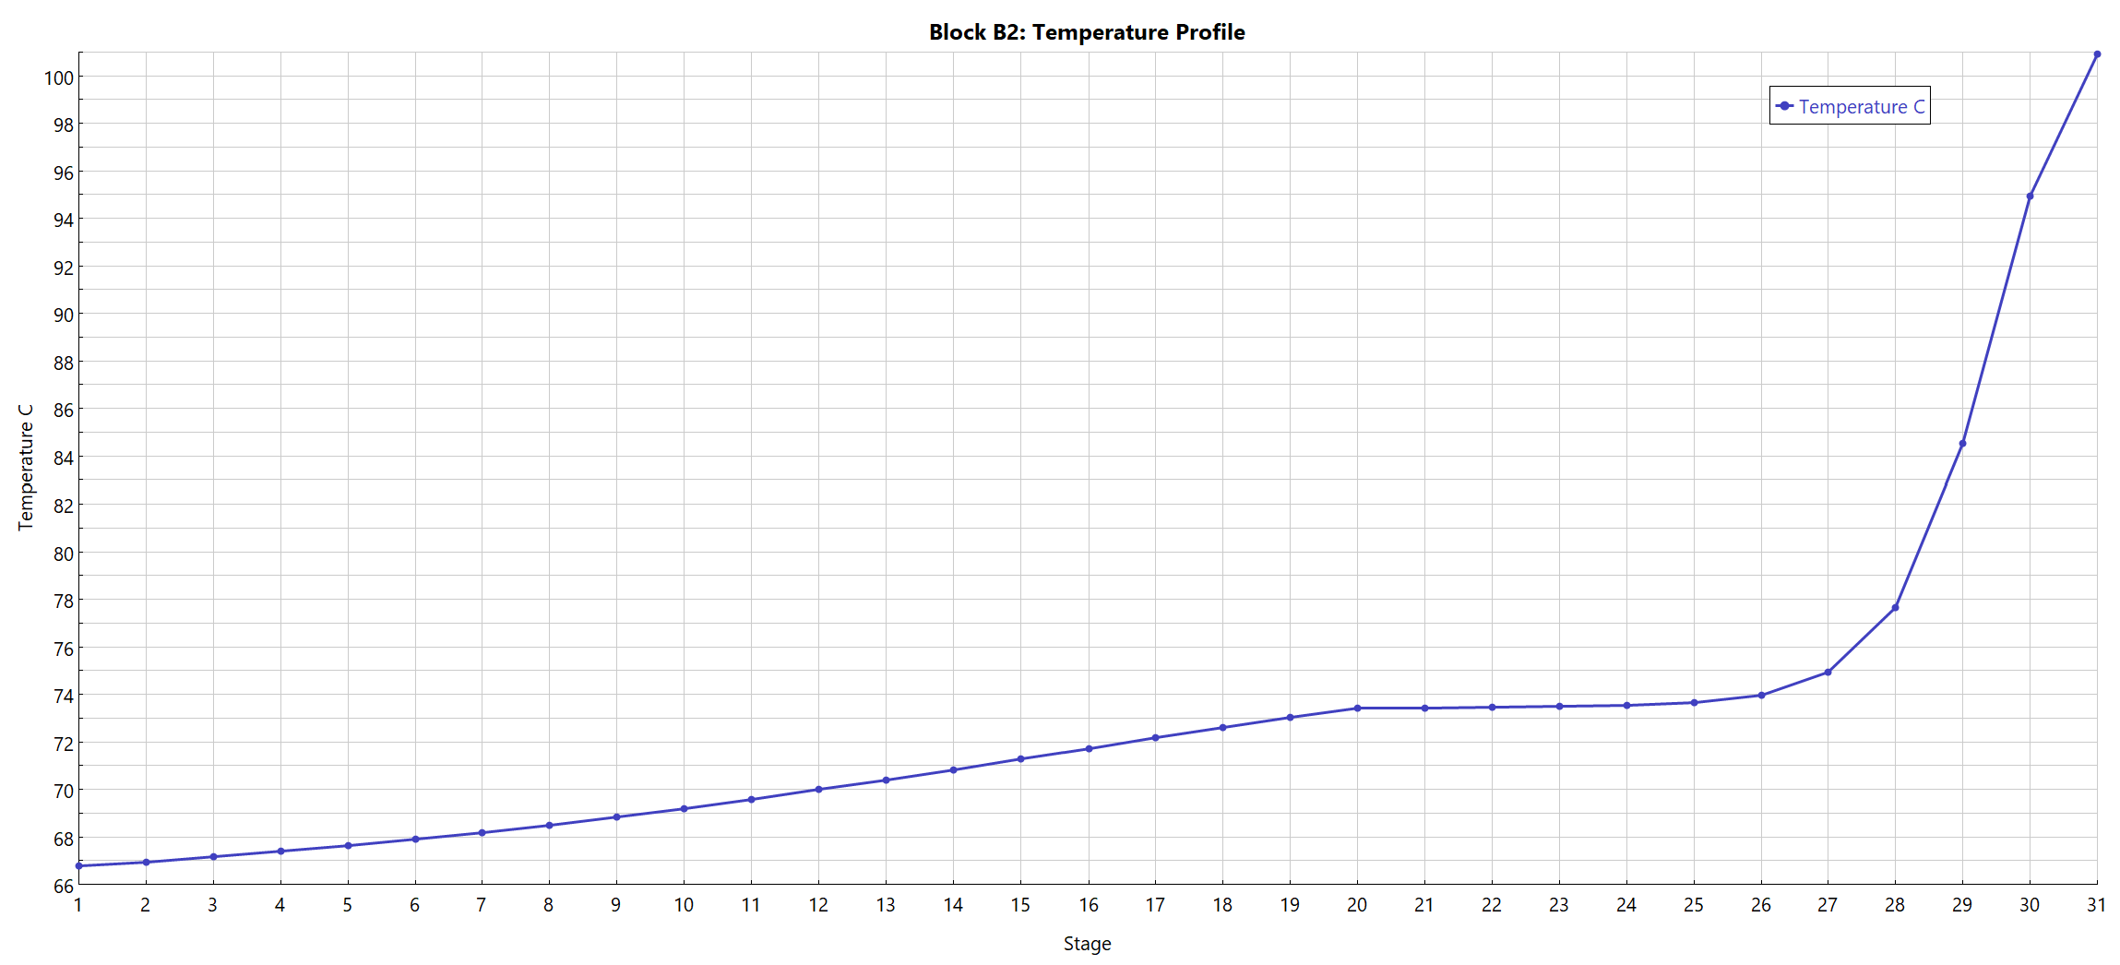
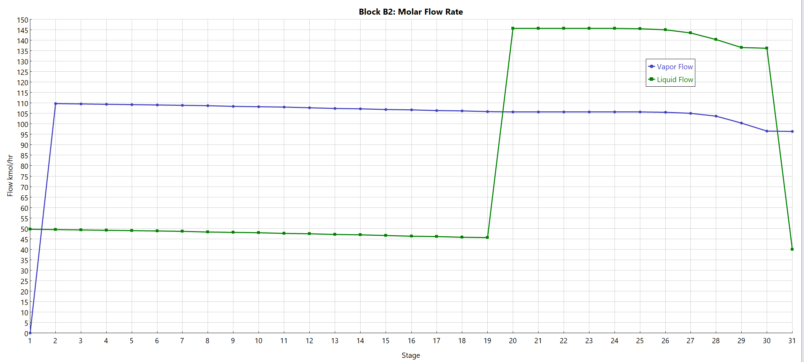
Demo RadFrac: Set up a methanol tower
Results
Temperature
Flow rates

Slide 23
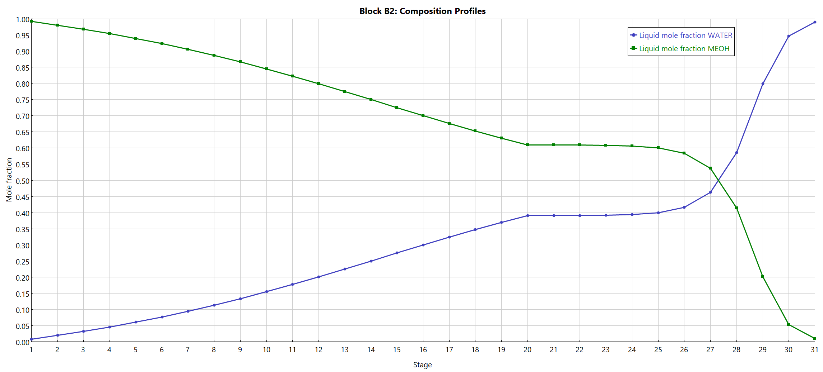
Demo RadFrac: Set up a methanol tower
Results: compositions

