Slide 1

R.I.S.E.
Resilient Integrated Structural Elements
8 April 2021
Seminar

Slide 2




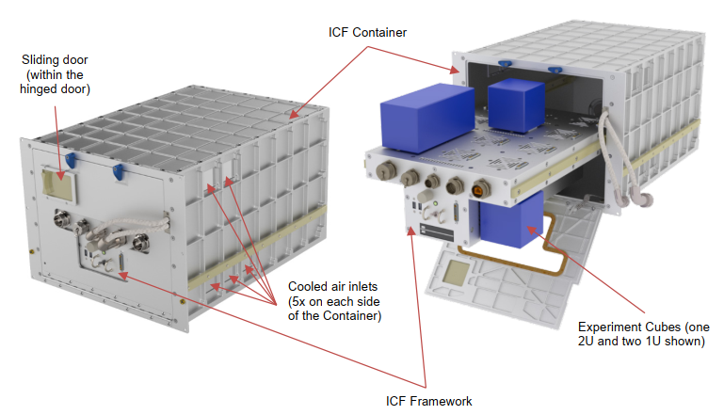
Launch
Launch financed by ESA through Space Exploration Masters 2018, and ASI through a University partnership
Launch in 2023 (approx.),
The experiment will be housed in the ICE-Cubes rack aboard the International Space Station.
Team:
  Stefano Seriani
  Emanuele A. Slejko
  Paolo Gallina
  Vanni Lughi
  Anna Gregorio

Slide 3
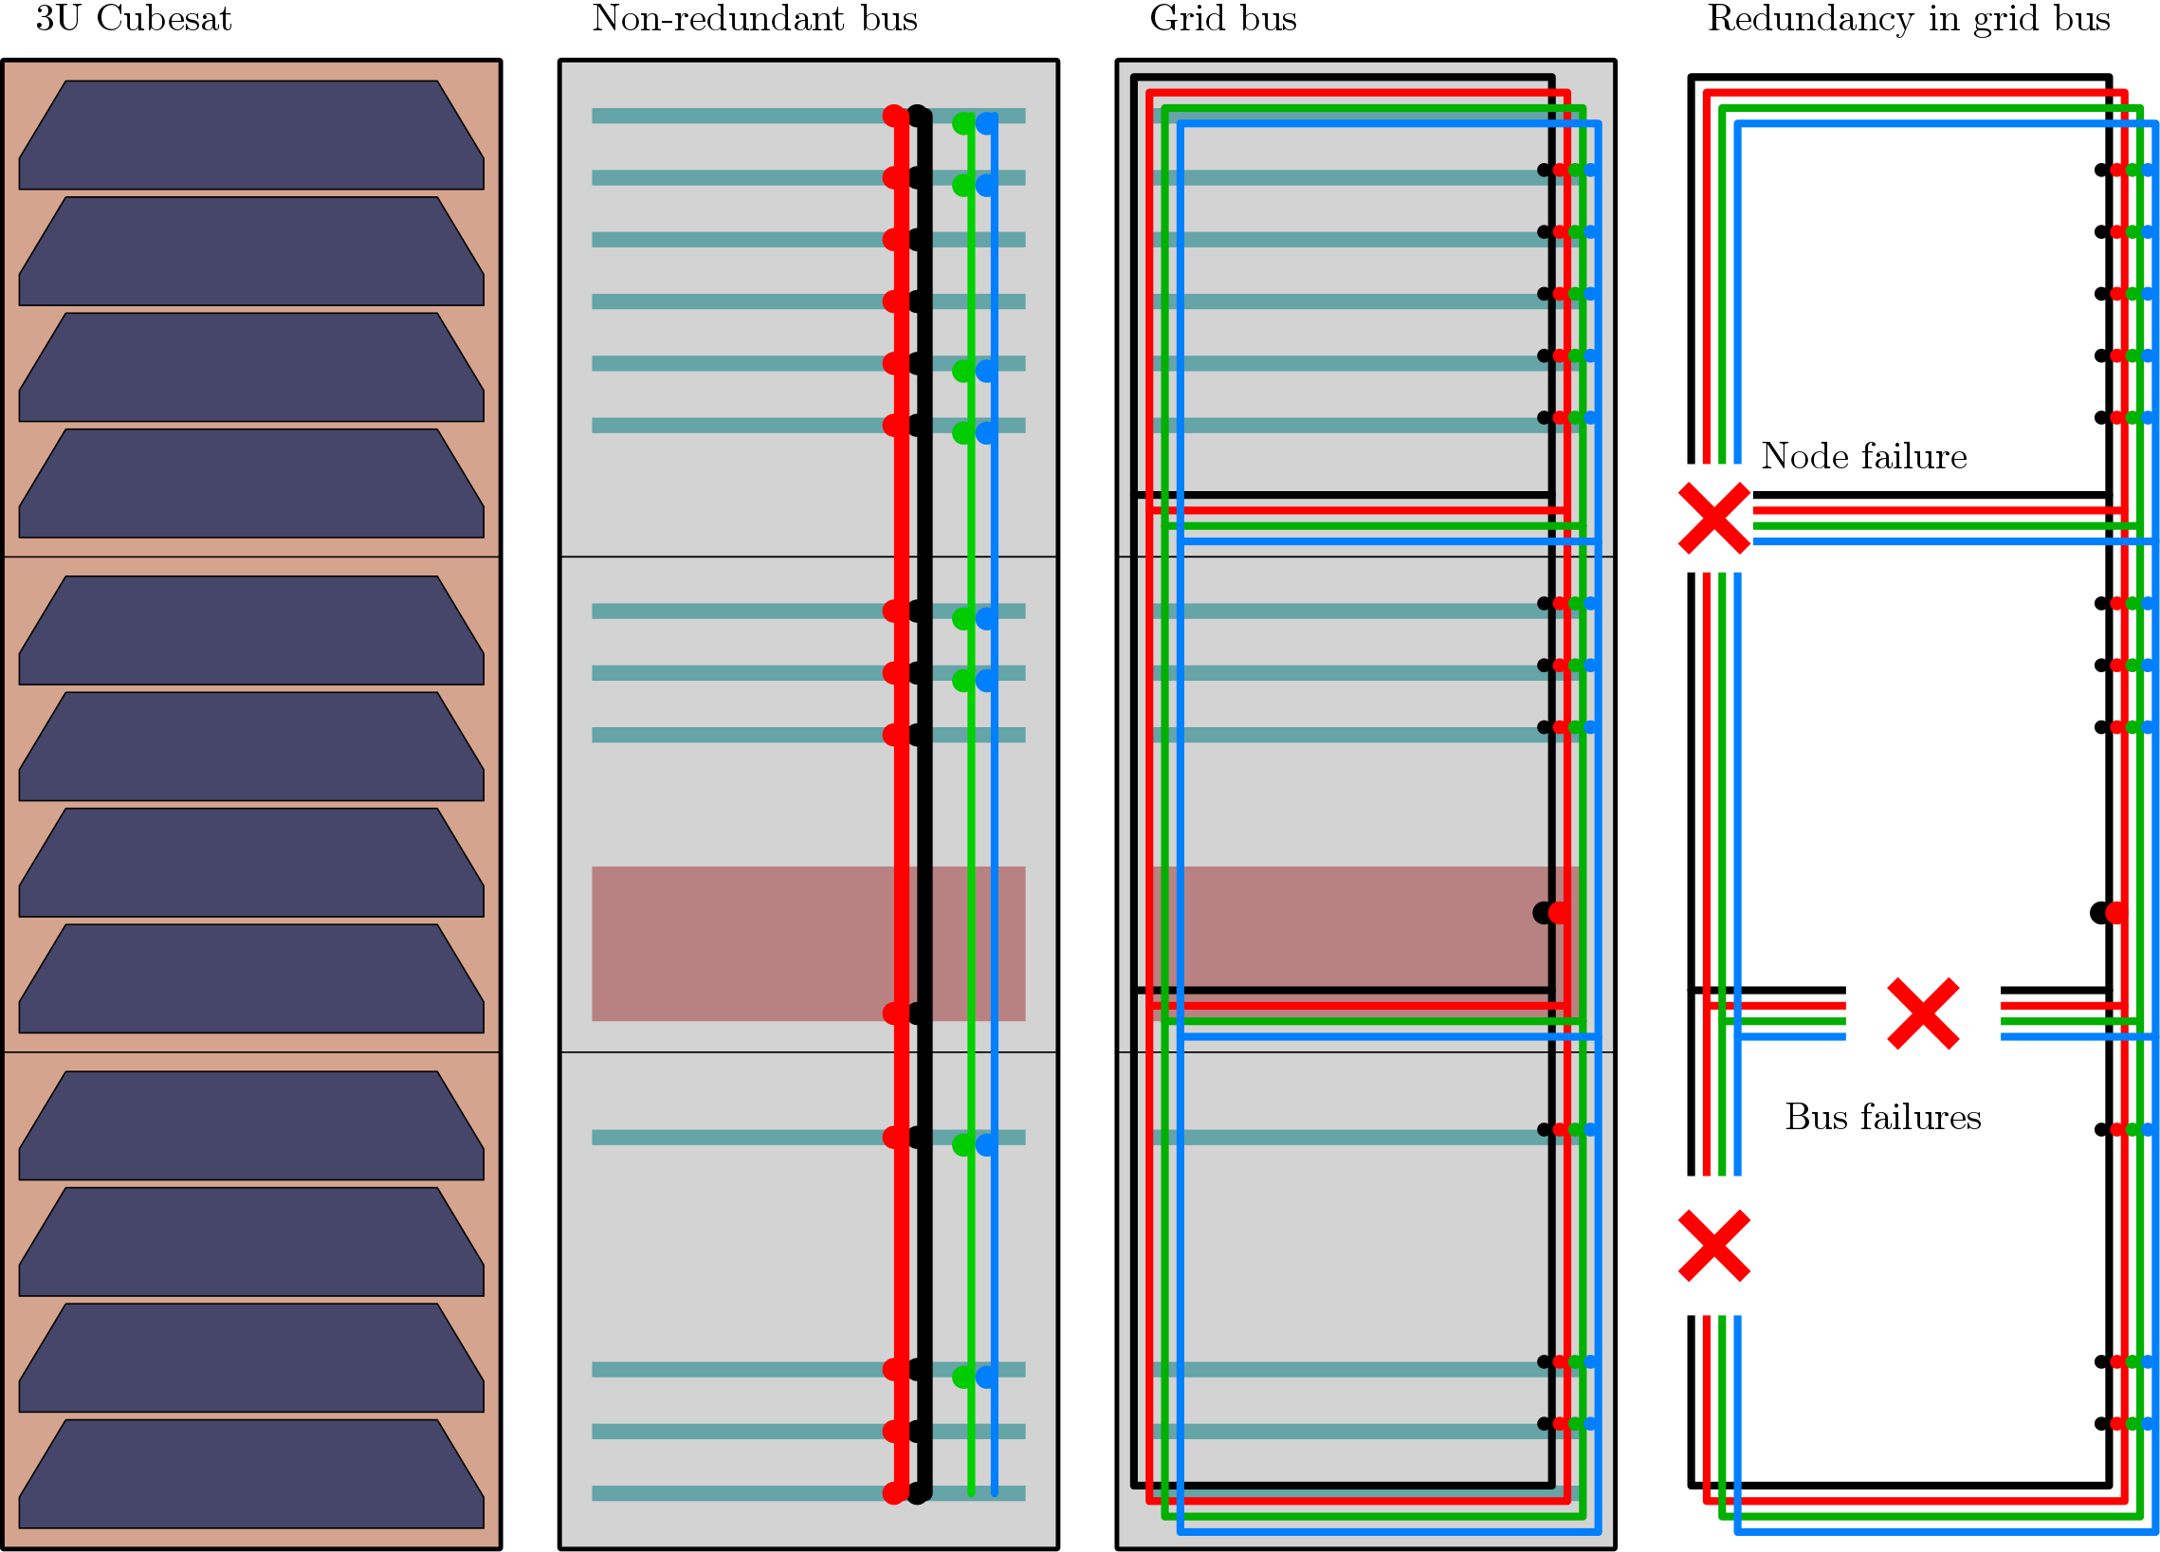
Electronic boards
Battery
Battery
State of the art
RISE

Slide 4
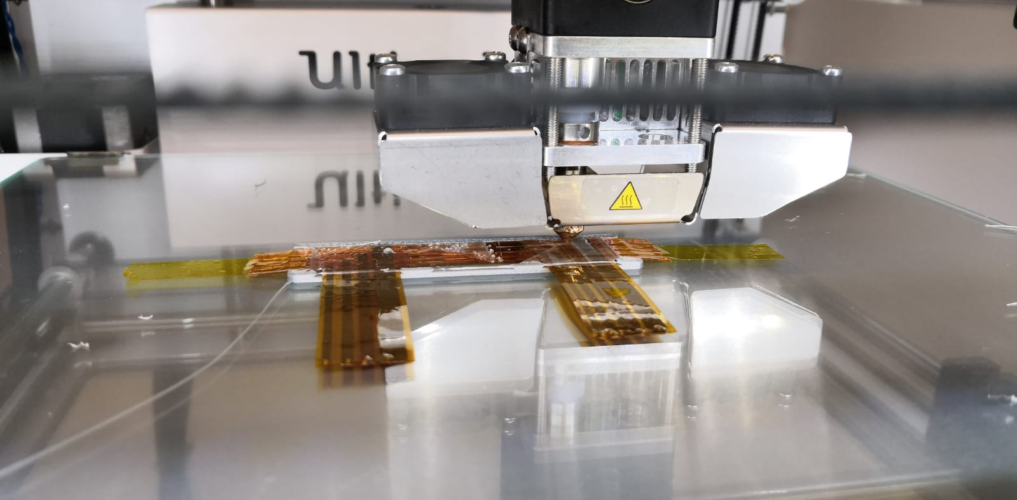
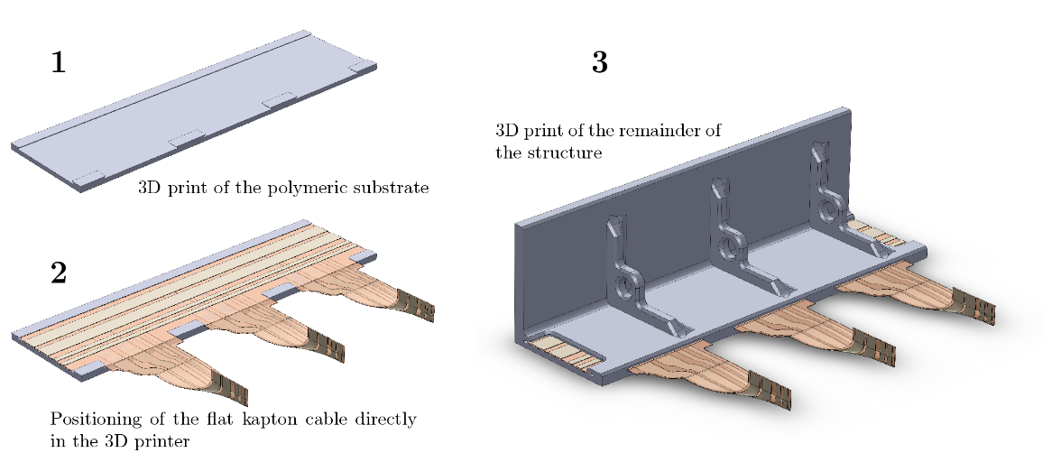
Manufacturing technology
Flexible circuit

Slide 5
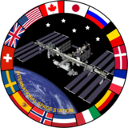
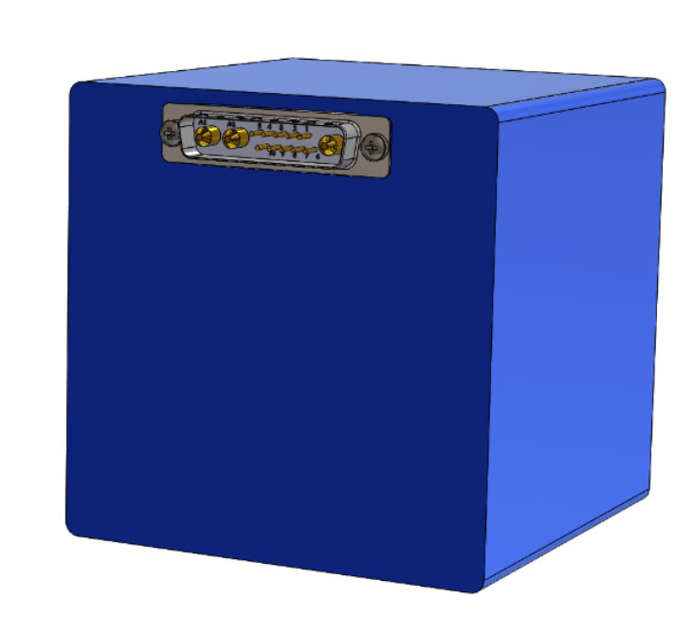
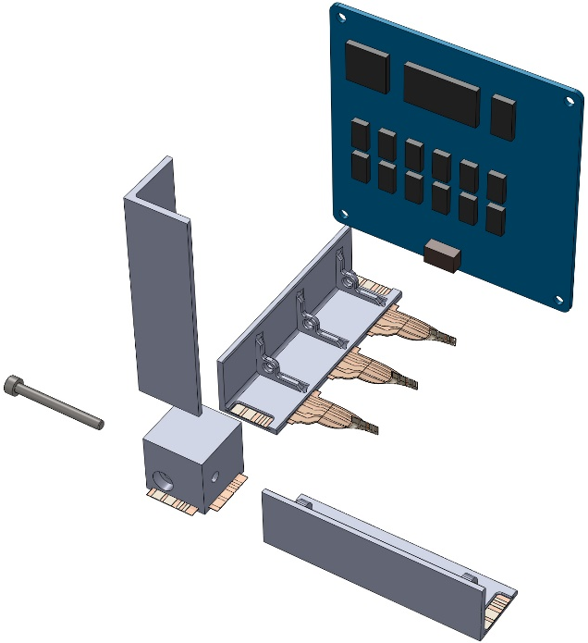
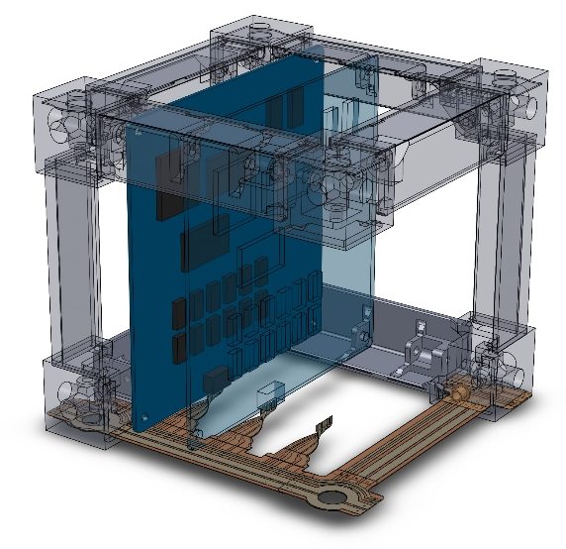
Integration in experiment

Slide 6
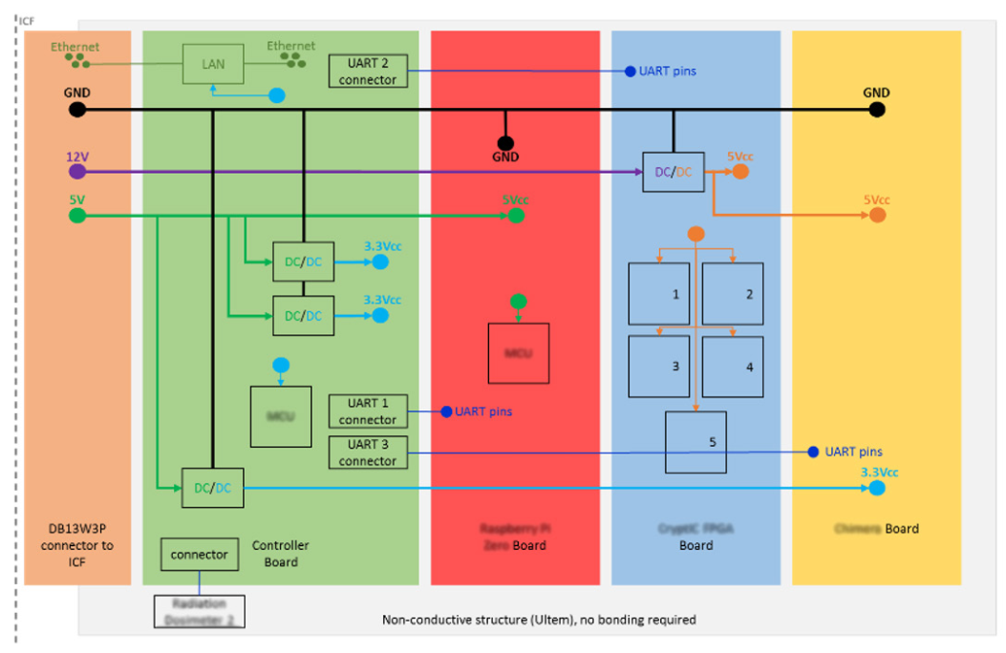
Electrical diagram: example

Slide 7
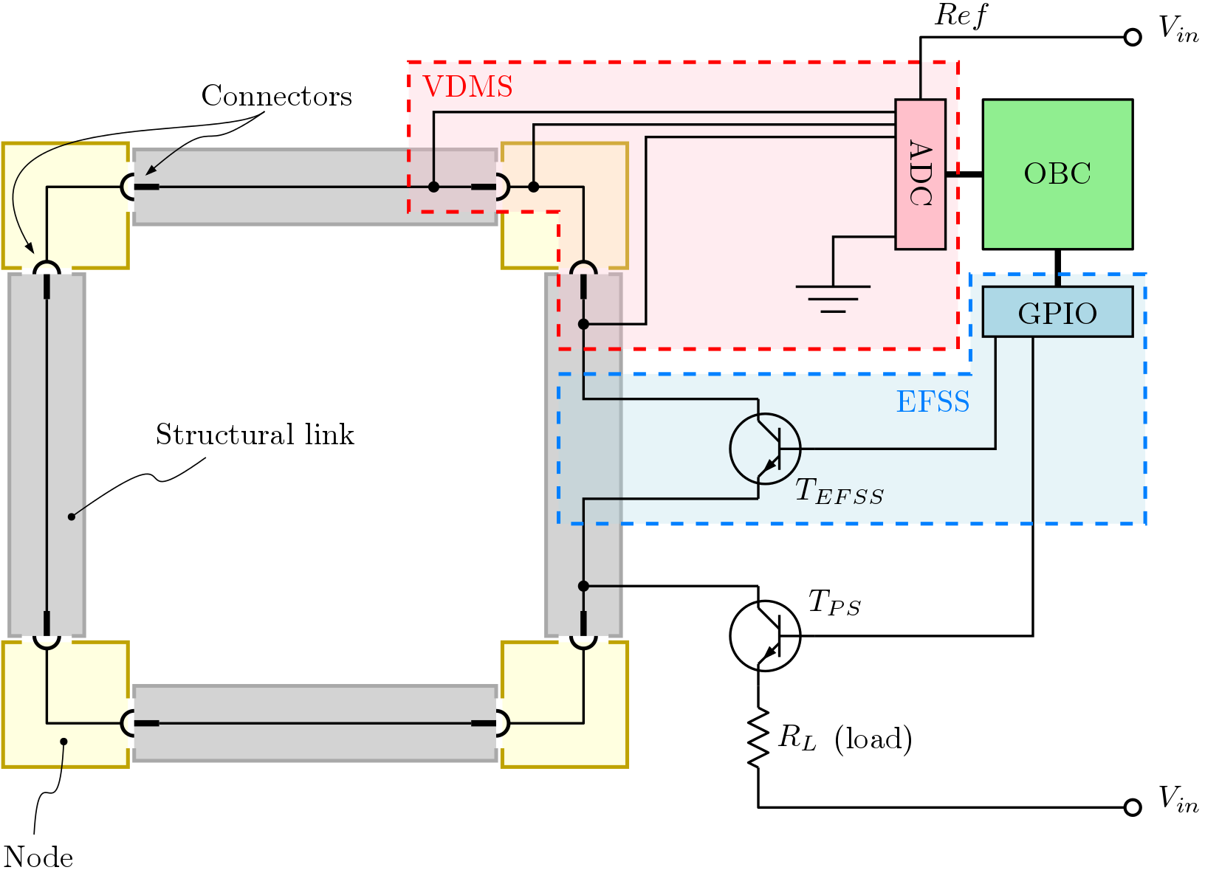
Electrical diagram

Slide 8
Thesis topics:
Programming of on-board computer
  Raspberry pi
  Telemetry/telecommand based on the YAMCS stack (yamcs.org)
  Webcam streaming
Electronics design
  Subsystem: electrical bus failure simulation
  Subsystem: voltage drop measurement
  Subsystem: electromagnet actuation

