Slide 1
ADSORPTION PLOT for Ce_{0.5}Zr_{0.5}O₂

Slide 2
Chemisorption, surface area and metal dispersion

Slide 3
Chemisorption for probing metal surface areas
Objective
determine number of accessible metal sites
Exploit high reactivity of metal surface atoms
- let them react with small molecules (H₂, O₂, CO, etc.)
- count the number of molecules that have reacted
- knowing the stoichiometry of the reaction you obtain the number of metal surface atoms
Choice of the probe molecule
- must be selective for reaction with metal vs. support
- must be selective for reaction with surface atoms (not with bulk)
- reaction must be «irreversible»

Slide 4
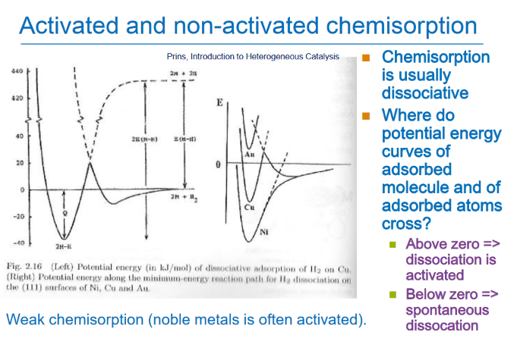

Slide 5
