Slide 1
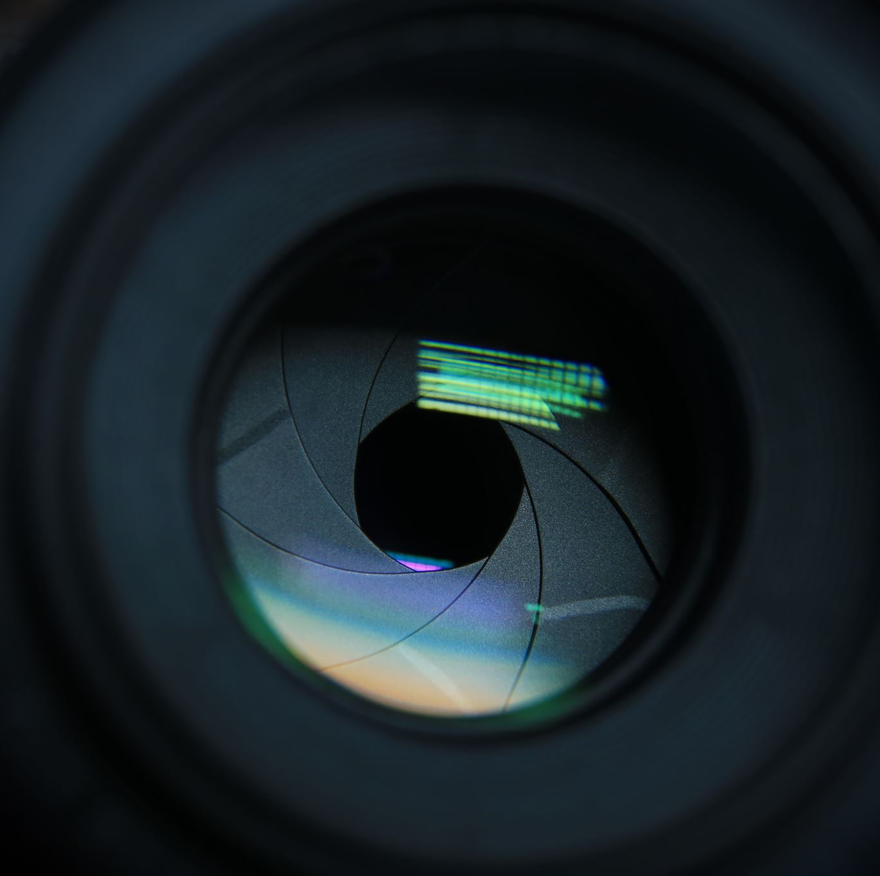
Intro to Computer Vision
From hand-crafted features to Convolutional Neural Networks
Marco Zullich, PhD student @ DIA, UniTS
Alessio Ansuini, adjunct professor @ DMG, UniTS
April 12, 2021

Slide 2
WHAT DO YOU SEE IN THIS IMAGE?
It’s-a-me, Marco!

Slide 3
And this?
Queen Elizabeth II
Geoff Hurst
Rimet Cup
Joy
Shame
Victory

Slide 4
What does a computer see?
234​ | 235​ | 236​ | 236​ | 237​ | 237​ | 237​ | 238​ | 238​ | 239​ | 238​ | 239​ | 239​ | 239​ | 239​ | 238​ | 239​ | 239​ | 239​ | 239​ | 238​ | 238​ | 238​ | 237​ | 237​ | 237​ | 236​ | 235​ | 235​ | 234​
234​ | 235​ | 236​ | 237​ | 237​ | 237​ | 237​ | 238​ | 238​ | 239​ | 239​ | 239​ | 239​ | 239​ | 239​ | 239​ | 239​ | 239​ | 239​ | 239​ | 238​ | 238​ | 237​ | 237​ | 237​ | 237​ | 236​ | 235​ | 234​ | 234​
234​ | 235​ | 236​ | 236​ | 237​ | 237​ | 237​ | 238​ | 238​ | 239​ | 239​ | 239​ | 239​ | 239​ | 239​ | 239​ | 239​ | 239​ | 239​ | 239​ | 238​ | 238​ | 237​ | 237​ | 237​ | 236​ | 236​ | 235​ | 234​ | 234​
234​ | 235​ | 236​ | 236​ | 237​ | 236​ | 237​ | 238​ | 238​ | 239​ | 239​ | 197​ | 85​ | 217​ | 240​ | 214​ | 226​ | 239​ | 239​ | 239​ | 238​ | 237​ | 237​ | 237​ | 237​ | 236​ | 236​ | 235​ | 234​ | 233​
233​ | 234​ | 235​ | 236​ | 237​ | 237​ | 237​ | 236​ | 230​ | 152​ | 62​ | 38​ | 89​ | 38​ | 46​ | 114​ | 133​ | 209​ | 222​ | 238​ | 238​ | 237​ | 237​ | 237​ | 237​ | 236​ | 235​ | 235​ | 234​ | 233​
233​ | 234​ | 235​ | 236​ | 236​ | 237​ | 236​ | 219​ | 127​ | 16​ | 17​ | 13​ | 7​ | 6​ | 18​ | 35​ | 87​ | 216​ | 238​ | 238​ | 237​ | 237​ | 237​ | 237​ | 236​ | 235​ | 235​ | 234​ | 233​ | 233​
233​ | 234​ | 234​ | 235​ | 236​ | 237​ | 235​ | 210​ | 16​ | 2​ | 13​ | 20​ | 16​ | 19​ | 2​ | 22​ | 38​ | 48​ | 204​ | 238​ | 237​ | 238​ | 237​ | 236​ | 236​ | 235​ | 234​ | 233​ | 233​ | 232​
233​ | 233​ | 234​ | 234​ | 235​ | 236​ | 180​ | 16​ | 48​ | 185​ | 192​ | 183​ | 182​ | 163​ | 61​ | 7​ | 2​ | 32​ | 171​ | 208​ | 228​ | 234​ | 233​ | 233​ | 233​ | 231​ | 231​ | 228​ | 228​ | 227​
233​ | 233​ | 233​ | 235​ | 235​ | 230​ | 16​ | 46​ | 174​ | 192​ | 192​ | 192​ | 191​ | 185​ | 179​ | 170​ | 61​ | 29​ | 187​ | 227​ | 222​ | 231​ | 231​ | 231​ | 230​ | 228​ | 229​ | 227​ | 226​ | 226​
229​ | 229​ | 229​ | 229​ | 230​ | 221​ | 14​ | 63​ | 173​ | 176​ | 177​ | 182​ | 180​ | 161​ | 172​ | 171​ | 129​ | 31​ | 217​ | 223​ | 223​ | 230​ | 230​ | 230​ | 230​ | 229​ | 228​ | 227​ | 225​ | 225​
227​ | 227​ | 228​ | 228​ | 228​ | 33​ | 31​ | 107​ | 167​ | 185​ | 182​ | 181​ | 185​ | 179​ | 189​ | 173​ | 150​ | 21​ | 225​ | 223​ | 228​ | 227​ | 227​ | 225​ | 225​ | 223​ | 223​ | 220​ | 218​ | 219​
220​ | 222​ | 226​ | 225​ | 210​ | 12​ | 10​ | 172​ | 58​ | 26​ | 19​ | 73​ | 147​ | 164​ | 143​ | 155​ | 161​ | 16​ | 207​ | 221​ | 222​ | 222​ | 221​ | 219​ | 221​ | 220​ | 219​ | 219​ | 217​ | 216​
212​ | 213​ | 216​ | 216​ | 149​ | 2​ | 17​ | 170​ | 100​ | 40​ | 62​ | 53​ | 163​ | 126​ | 4​ | 6​ | 81​ | 12​ | 219​ | 215​ | 222​ | 221​ | 220​ | 220​ | 219​ | 218​ | 216​ | 215​ | 216​ | 213​
208​ | 211​ | 211​ | 209​ | 82​ | 4​ | 91​ | 190​ | 162​ | 133​ | 92​ | 116​ | 168​ | 139​ | 13​ | 58​ | 80​ | 34​ | 2​ | 210​ | 214​ | 217​ | 219​ | 219​ | 217​ | 216​ | 217​ | 215​ | 213​ | 212​
207​ | 207​ | 206​ | 207​ | 85​ | 90​ | 152​ | 174​ | 184​ | 178​ | 169​ | 161​ | 174​ | 139​ | 79​ | 63​ | 146​ | 8​ | 167​ | 195​ | 204​ | 212​ | 215​ | 214​ | 212​ | 211​ | 209​ | 206​ | 202​ | 203​
204​ | 204​ | 205​ | 208​ | 157​ | 113​ | 105​ | 170​ | 173​ | 171​ | 124​ | 165​ | 165​ | 157​ | 163​ | 187​ | 185​ | 9​ | 199​ | 181​ | 201​ | 204​ | 205​ | 204​ | 205​ | 203​ | 203​ | 201​ | 199​ | 199​
201​ | 202​ | 203​ | 201​ | 153​ | 162​ | 141​ | 150​ | 100​ | 51​ | 123​ | 75​ | 75​ | 6​ | 114​ | 112​ | 146​ | 30​ | 201​ | 198​ | 195​ | 200​ | 201​ | 202​ | 202​ | 203​ | 201​ | 200​ | 199​ | 199​
198​ | 199​ | 199​ | 176​ | 17​ | 110​ | 144​ | 124​ | 93​ | 99​ | 134​ | 107​ | 99​ | 105​ | 118​ | 32​ | 67​ | 149​ | 128​ | 194​ | 202​ | 202​ | 202​ | 202​ | 202​ | 200​ | 200​ | 199​ | 196​ | 195​
195​ | 198​ | 198​ | 197​ | 108​ | 0​ | 120​ | 105​ | 130​ | 142​ | 144​ | 150​ | 142​ | 115​ | 75​ | 105​ | 84​ | 198​ | 192​ | 194​ | 201​ | 201​ | 200​ | 200​ | 200​ | 199​ | 198​ | 197​ | 196​ | 194​
9​ | 10​ | 8​ | 4​ | 203​ | 7​ | 29​ | 77​ | 87​ | 154​ | 143​ | 106​ | 76​ | 107​ | 126​ | 101​ | 78​ | 189​ | 197​ | 199​ | 199​ | 199​ | 199​ | 199​ | 198​ | 197​ | 195​ | 194​ | 194​ | 191​
9​ | 7​ | 3​ | 224​ | 210​ | 0​ | 148​ | 51​ | 89​ | 113​ | 167​ | 154​ | 128​ | 151​ | 132​ | 33​ | 159​ | 192​ | 195​ | 195​ | 196​ | 196​ | 196​ | 196​ | 195​ | 194​ | 194​ | 191​ | 191​ | 190​
12​ | 121​ | 211​ | 202​ | 192​ | 2​ | 153​ | 28​ | 80​ | 54​ | 112​ | 82​ | 112​ | 107​ | 63​ | 35​ | 178​ | 190​ | 192​ | 192​ | 194​ | 193​ | 193​ | 194​ | 193​ | 191​ | 193​ | 191​ | 190​ | 190​
25​ | 185​ | 128​ | 191​ | 197​ | 88​ | 138​ | 104​ | 25​ | 5​ | 28​ | 13​ | 17​ | 15​ | 5​ | 47​ | 27​ | 117​ | 110​ | 185​ | 187​ | 185​ | 186​ | 186​ | 188​ | 190​ | 190​ | 189​ | 187​ | 186​
55​ | 45​ | 138​ | 188​ | 180​ | 207​ | 110​ | 114​ | 63​ | 28​ | 29​ | 12​ | 8​ | 18​ | 8​ | 12​ | 69​ | 34​ | 86​ | 98​ | 101​ | 163​ | 178​ | 178​ | 177​ | 178​ | 175​ | 177​ | 179​ | 180​
59​ | 39​ | 90​ | 159​ | 152​ | 147​ | 48​ | 105​ | 75​ | 63​ | 58​ | 10​ | 26​ | 73​ | 11​ | 14​ | 75​ | 18​ | 60​ | 78​ | 83​ | 96​ | 121​ | 171​ | 172​ | 173​ | 172​ | 170​ | 169​ | 168​
16​ | 23​ | 24​ | 125​ | 174​ | 147​ | 129​ | 64​ | 91​ | 74​ | 49​ | 49​ | 63​ | 10​ | 14​ | 18​ | 21​ | 13​ | 20​ | 44​ | 62​ | 82​ | 99​ | 84​ | 148​ | 173​ | 171​ | 168​ | 167​ | 165​
25​ | 18​ | 19​ | 164​ | 168​ | 162​ | 185​ | 131​ | 65​ | 81​ | 57​ | 30​ | 7​ | 19​ | 24​ | 17​ | 20​ | 65​ | 12​ | 22​ | 27​ | 44​ | 65​ | 95​ | 77​ | 96​ | 169​ | 167​ | 167​ | 163​
28​ | 21​ | 16​ | 16​ | 141​ | 136​ | 176​ | 166​ | 182​ | 63​ | 65​ | 39​ | 23​ | 23​ | 4​ | 0​ | 16​ | 27​ | 27​ | 18​ | 26​ | 27​ | 27​ | 51​ | 61​ | 65​ | 10​ | 23​ | 167​ | 164​
17​ | 22​ | 16​ | 15​ | 189​ | 191​ | 107​ | 103​ | 27​ | 72​ | 67​ | 158​ | 17​ | 3​ | 2​ | 35​ | 27​ | 52​ | 35​ | 28​ | 21​ | 33​ | 34​ | 26​ | 40​ | 16​ | 13​ | 9​ | 9​ | 165​
11​ | 20​ | 24​ | 18​ | 29​ | 187​ | 190​ | 156​ | 118​ | 60​ | 8​ | 7​ | 28​ | 25​ | 26​ | 40​ | 10​ | 4​ | 4​ | 11​ | 22​ | 22​ | 27​ | 26​ | 17​ | 7​ | 10​ | 10​ | 14​ | 21​

Slide 5
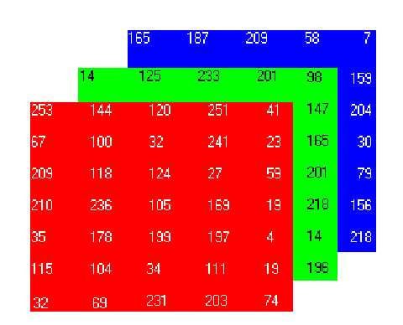
Color images
CIELAB
CMYK
HSV
and many more…
RGB
There exists a great variety of encodings of color images
All these encodings work as composition of multiple color channels
min = 0; max = 255
$$w$$
$$h$$
B
G
R
Credits: Application of Digital Image Processing to Marker-free Analysis of Human Gait (Courtney, J. 2001)

Slide 6
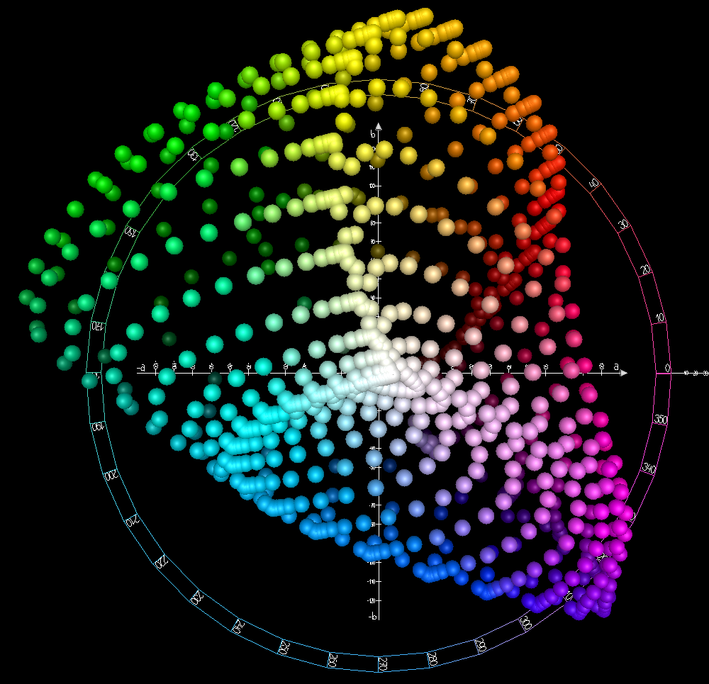
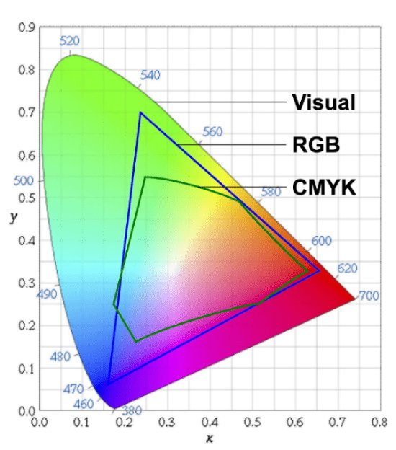
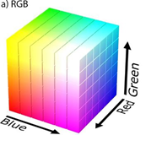
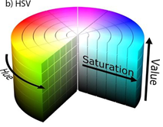
Color spaces (encodings)
Apart from RGB, there exist a myriad of other color spaces, each with its own pros and cons.
CIELAB
RGB
HSV
CMYK
…
Tailored to project on screen
More intuitive for humans than RGB
Image credits
1) and 2) https://medium.com/neurosapiens/segmentation-and-classification-with-hsv-8f2406c62b39
3) https://aldertech.com/color-101-color-spaces/
4) https://commons.wikimedia.org/wiki/File:CIELAB_color_space_top_view.png
Can you guess what it’s good for? (printing)
Perceptual uniformity

Slide 7
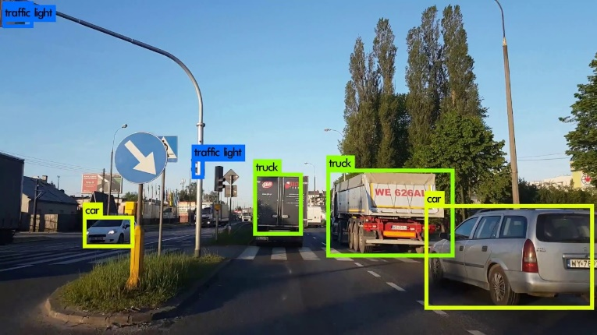
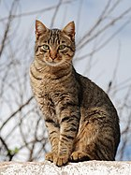
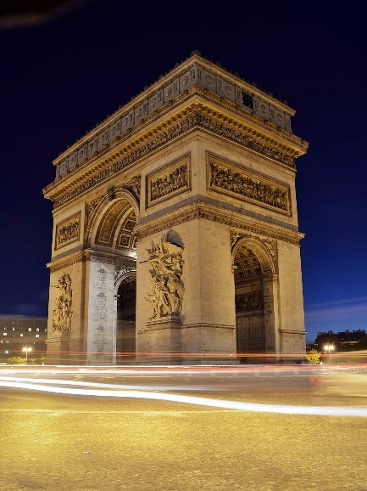
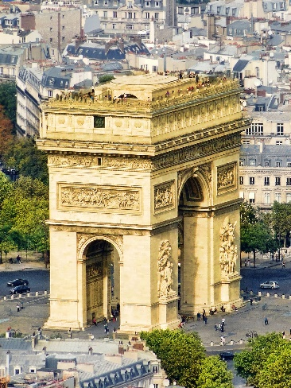
The multiple facets of recognition
Object Detection
Find specific categories of objects in an image
cat
dog
hippo
Category-level Recognition
Categorize an image as belonging to one specific category
Instance Recognition
Recognize an instance of an object in a novel environment or from a novel viewpoint
Credits: https://reckoning.dev/yolo-v4/; https://www.pexels.com/photo/cars-france-landmark-lights-2344/; https://commons.wikimedia.org/wiki/File:Arc_de_Triomphe,_Paris_3_October_2010.jpg; https://upload.wikimedia.org/wikipedia/commons/thumb/4/4d/Cat_November_2010-1a.jpg/140px-Cat_November_2010-1a.jpg

Slide 8
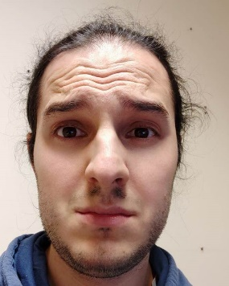
Recognition: the old way
In «classical» CV, researchers usually acted by means of local operators
LOCAL OPERATOR
Image $I∈ℝ^{h×w};I\left(i,j\right)=$ intensity of pixel $i, j$
Operator $f:ℝ^{h×w}→ℝ^{h^{′}×w^{′}}$ takes in an input image and outputs another image, possibly of different size
The operator is local if, $f(I)(i, j)$ depends on the pixel values of a neighborhood of $i, j$
But what the heck does it mean?

Slide 9
Easy example: mean filtering
$$I$$
35 | 142 | 125 | 10
37 | 100 | 38 | 154
220 | 200 | 122 | 0
0 | 22 | 44 | 123
$$J= f(I)$$
113
99
87
89
Target: apply the mean of the image for of each possible contiguous neighborhood of size $3×3$
35 | 142 | 125 | 10
37 | 100 | 38 | 154
220 | 200 | 122 | 0
0 | 22 | 44 | 123
$$K$$
1 | 1 | 1
1 | 1 | 1
1 | 1 | 1
113 | 99
87 | 89
$⋅\frac{1}{9}$
$$=$$
Cross-correlation
$$J=I⨂K$$
kernel

Slide 10
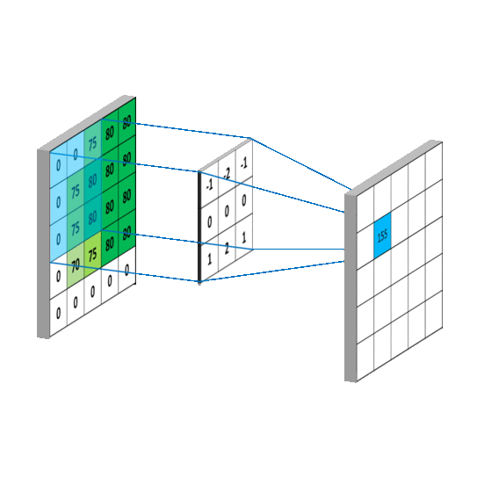
2d Cross-correlation
We’re given an image $I$ of size $h×w$
And a kernel $K$ of size $k×l$, both odd
The center of the kernel is $c={\left(\left\lceil \frac{k}{2}\right\rceil ,\left\lceil \frac{l}{2}\right\rceil \right)}^{T}$
$$I⨂K\left(i,j\right)=\sum_{m=−\left\lfloor k/2\right\rfloor }^{\left\lfloor k/2\right\rfloor }{\sum_{n=\left\lfloor l/2\right\rfloor }^{\left\lfloor l/2\right\rfloor }{I\left(i+m, j+n\right)⋅K(c_{x}+m,c_{y}+n)}}$$
Credits: https://mlnotebook.github.io/img/CNN/convSobel.gif

Slide 11
2d convolution
Image frame
Kernel
$$⋆$$
$$I⋆K\left(i,j\right)=\sum_{m=−\left\lfloor k/2\right\rfloor }^{\left\lfloor k/2\right\rfloor }{\sum_{n=\left\lfloor l/2\right\rfloor }^{\left\lfloor l/2\right\rfloor }{I\left(i+m, j+n\right)⋅K(c_{x}−m,c_{y}−n)}=\sum_{m=−\left\lfloor k/2\right\rfloor }^{\left\lfloor k/2\right\rfloor }{\sum_{n=\left\lfloor l/2\right\rfloor }^{\left\lfloor l/2\right\rfloor }{I\left(i−m, j−n\right)⋅K(c_{x}+m,c_{y}+n)}}}$$
Note: for symmetric kernels ($K\left(c_{x}+i, c_{y}+j\right)=K(c_{x}−i, c_{y}−j)$), convolution $≡$ cross-correlation

Slide 12
Border effects (padding)
$$I∈{\left(ℕ∩\left[0,255\right]\right)}^{4×4}$$
35 | 142 | 125 | 10
37 | 100 | 38 | 154
220 | 200 | 122 | 0
0 | 22 | 44 | 123
$J= f(I)$ ${∈\left(ℕ∩\left[0,255\right]\right)}^{2×2}$
1/9 | 1/9 | 1/9
1/9 | 1/9 | 1/9
1/9 | 1/9 | 1/9
113 | 99
87 | 89
$$⨂$$
$$=$$
Question
Is there a way to keep the resulting $f(I)$ of the same dimension of $I$?
? | ? | ? | ? | ? | ?
? | 35 | 142 | 125 | 10 | ?
? | 37 | 100 | 38 | 154 | ?
? | 220 | 200 | 122 | 0 | ?
? | 0 | 22 | 44 | 123 | ?
? | ? | ? | ? | ? | ?
$$\overline{I}{∈\left(ℕ∩\left[0,255\right]\right)}^{6×6}$$
Answer
? | ? | ? | ?
? | 113 | 99 | ?
? | 87 | 89 | ?
? | ? | ? | ?
1/9 | 1/9 | 1/9
1/9 | 1/9 | 1/9
1/9 | 1/9 | 1/9
Padding.
$$⨂$$
$$=$$
$$J= f\left(\overline{I}\right)∈{\left(ℕ∩\left[0,255\right]\right)}^{4×4}$$

Slide 13
Types of padding
mirroring
warping
zero-padding
(constant padding)
clamping

Slide 14
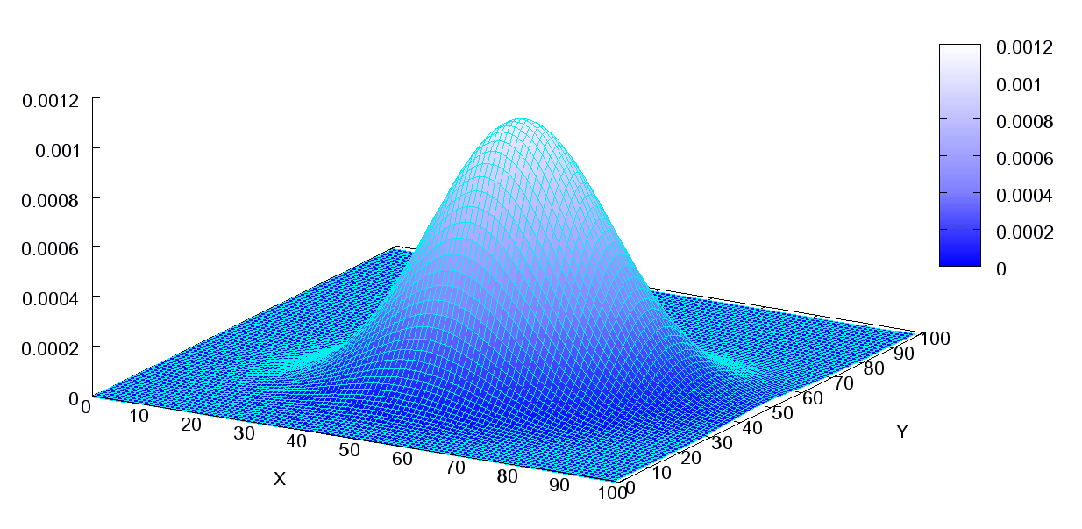
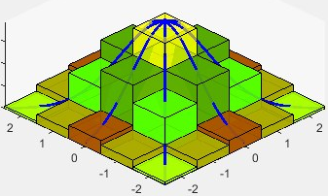
Usage of correlation/convolution
Correlation/Convolution have historically been used to recognize some specific low-level features and to execute given tasks
Sobel filter
(oriented edges)
-1 | 0 | 1
-2 | 0 | 2
-1 | 0 | 1
-1 | -2 | -1
0 | 0 | 0
1 | 2 | 1
$$⋆$$
$$↝$$
$$⋆$$
$$↝$$
Gaussian filter
(blurring)
discretize
Credits: reelaboration of https://en.wikipedia.org/wiki/Multivariate_normal_distribution#/media/File:Multivariate_Gaussian.png and
https://www.mathworks.com/matlabcentral/mlc-downloads/downloads/e573acb5-4a80-11e4-9553-005056977bd0/fecbef1b-a5bd-4937-b4df-c166a7442b2b/images/1597241565.jpg

Slide 15
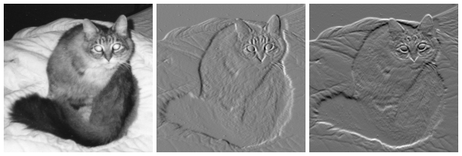
Image gradient
«Directional change in the intensity of color of an image» (wiki)
$$∇I={\left(\frac{∂I}{∂x},\frac{∂I}{∂y}\right)}^{T}$$
Can be approximated in various ways from the original image, e.g. using the Sobel filter from the previous slide.
By Njw000 - Own work, Public Domain, https://commons.wikimedia.org/w/index.php?curid=10588443

Slide 16
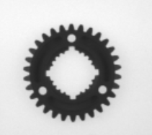
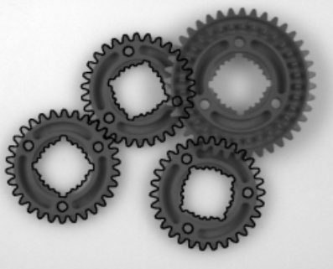
Shape recognition
One of the most successful algorithm for shape recognition used in industrial settings (e.g. HALCON) is the shape-based matching applied to image gradients.
Template
$$T$$
Scene
$$I$$
“(Normalized) cross-correlation” between image and template gradients
$$∇I={\left(\frac{∂I}{∂x},\frac{∂I}{∂y}\right)}^{T}∈ℝ^{2×h×w}$$
$$G_{I}∈ℝ^{h×wx2}$$
$$s=\frac{1}{n}\sum_{x, y∈R}{\frac{\left\langle G_{I}\left(x,y\right), G_{T}(x,y)\right\rangle }{\left\|G_{I}\left(x,y\right)\right\|⋅\left\|G_{T}(x,y)\right\|}}$$
$s→1⇒$ match
$s→0⇒$ no match
reshape
Region of interest
Images from Steger, Carsten. "Similarity measures for occlusion, clutter, and illumination invariant object recognition." Joint Pattern Recognition Symposium. Springer, Berlin, Heidelberg, 2001.

Slide 17
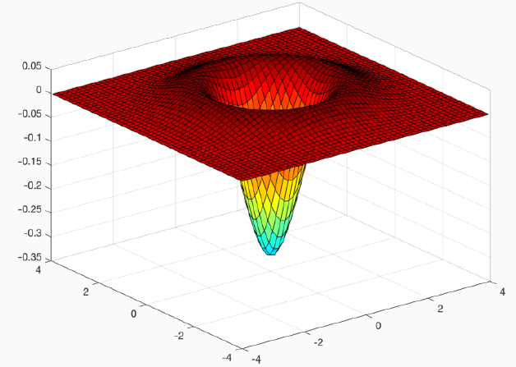
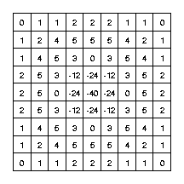
Keypoint detection using sift – blob detection
SIFT (Scale Invariant Feature Transform) is built upon the concept of detection of blobs at different scales.
Blobs can be detected by means of the second derivatives $\frac{∂^{2}I}{∂x^{2}},\frac{∂^{2}I}{∂y^{2}}$ and then obtaining the Laplacian:
$$L\left(x,y\right)=\frac{∂^{2}I}{∂x^{2}}+\frac{∂^{2}I}{∂y^{2}}$$
And then convolving it with a 2D homoschedastic Gaussian to obtain the Laplacian of Gaussian (LoG) operator.
The LoG can be directly obtained by convolving the original image with a specific filter (example with $σ=1.4$)
Last image from https://homepages.inf.ed.ac.uk/rbf/HIPR2/log.htm

Slide 18
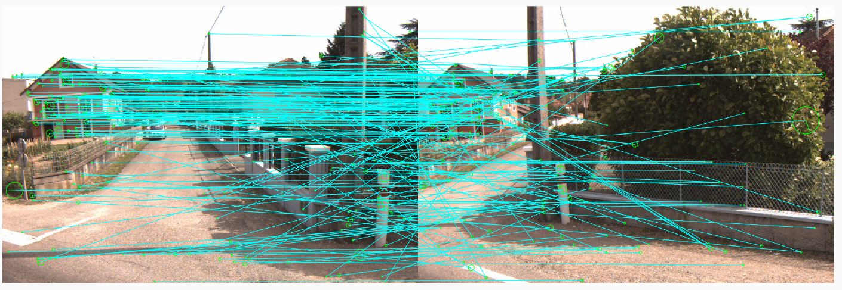
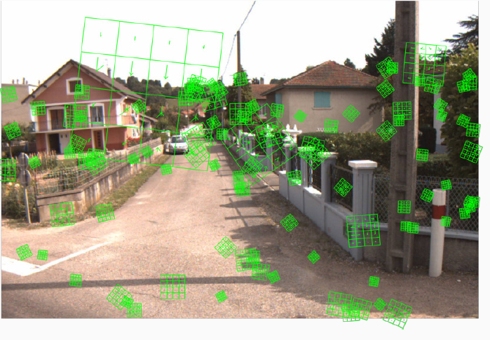
Sift – keypoint detection
The construction of SIFT is much more complicated than that and involves several passages to gain both robustness and efficiency
The process concludes with the definition of a descriptor $d_{k}∈ℝ^{128}$ for each keypoint $k$
The descriptor defines the image gradient in the neighborhood of the keypoint

Slide 19
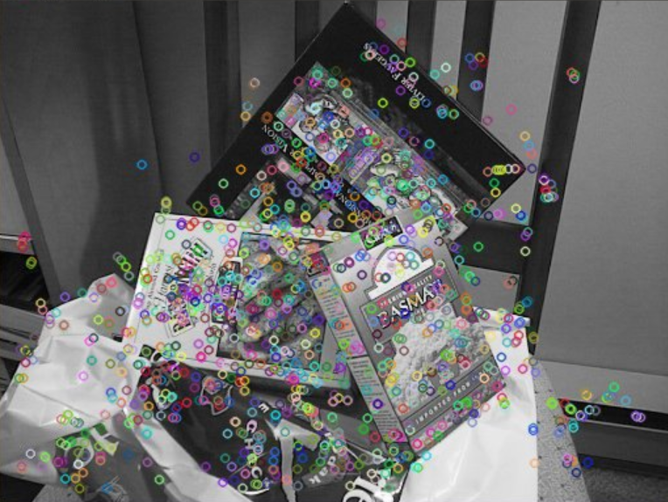
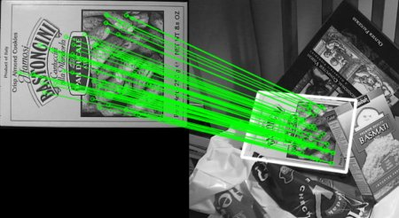
Using keypoints for recognition
Identify and describe keypoints in template
Identify and describe keypoints in scene
Match keypoints
Build homography with subset of matching keypoints
RanSaC
Stop when reconstruction is “sufficiently good” from a geometrical viewpoint

Slide 20
More on convolution/correlation
Convolution is translation-invariant: given its “moving window” approach, the response to a given object is the same if it is translated.
…
…
“Convolution was designed by hand as a heuristic solution to the problem of capturing translation-invariant features at different levels of hierarchy”
Stanley, Kenneth O., et al. "Designing neural networks through neuroevolution."

Slide 21
The next step – deep learning
Nowadays, we have the tools to do more than that
Artificial Neural Networks (ANNs) have achieved a huge success because of their ability to iteratively learn their weights in order to adapt to a given task
There’s no need anymore for hand-crafted features
Let the machine learn the weights of a convolutional kernel rather than designing them heuristically

Slide 22
Convolutional neural networks
Convolutional Neural Networks (CNNs) are essentially a cascade of sequential cross-correlations* grouped in layers.
Each layer learns higher level features starting from the features learned by the previous layer.
Fully-connected layer
$Q$^{th} convolutional layer
Original image $I$
$K_{1}$ kernels of size $3×3$
$$w$$
$$w^{(1)}$$
$w^{(Q)}$
$$⊗$$
$$=$$
$$h^{(Q)}$$
$$flat(⋅)$$
$$h^{(1)}$$
$$⊗$$
$$=$$
Classification
…..
$$h$$
…
$$⊗$$
$$=$$
$$K_{Q}⋅h^{(Q)}⋅w^{Q}$$
$$⊗$$
$$=$$
$$I_{1}∈ℝ^{K_{1}×h^{(1)}×w^{(1)}}$$
$$I_{Q}∈ℝ^{K_{Q}×h^{(Q)}×w^{(Q)}}$$
1st convolutional layer
* we have seen before that convolution and correlation are similar in concept. Correlation is slightly more efficient.

Slide 23
Where can I learn more?
CNNs (a bit more rigorously)
Next lectures…
Classical Computer Vision, specific models for instance recognition, object detection…
“Computer Vision and Pattern Recognition”, 3rd semester DSSC course by prof. Pellegrino
References?
See next slide…

Slide 24
references
Classical Computer Vision:
Szeliski, R. (2010). Computer vision: algorithms and applications, 1st edition.
Forsyth, D. and Ponce, J. (2012). Computer vision: a modern approach, 2nd edition.
Shape recognition
Steger, C. (2001). Similarity measures for occlusion, clutter, and illumination invariant object recognition.
Convolutional Neural Networks
Bengio, Y., Goodfellow, I., & Courville, A. (2017). Deep learning.
Nielsen, M. (2019) Neural Networks and Deep Learning.

Slide 25
Thanks for the attention!
marco.zullich@phd.units.it
contact me on Teams as well!

